Slide 1

Testing and Validation of the Bedload Package
July 2024

Slide 2
Introduction to the Bedload Package
Developer: Brett Eaton
This package includes functions to calculate various hydraulic properties and sediment transport parameters essential for river channel analysis.
File Path:
C:\Users\nnematollahi\OneDrive - BGC Engineering Inc\Project02_bedloadpackage\bedload_r_package\bedload\R\bedload_functions
Notes:
On the slide, you can see that the file path for this package is located at: C:\Users\nnematollahi\OneDrive - BGC Engineering Inc\Project02_bedloadpackage\bedload_r_package\bedload\R\bedload_functions.
Let me give you a bit more context. This package contains all the necessary equations for calculating bedload in rivers. What's great about it is that it clearly defines all the variables and their associated units, making it user-friendly for all of us.
Now, I'd like to quickly walk you through how we tested each function within this package and discuss their outputs in R. If you have any questions along the way, please feel free to ask!

Slide 3

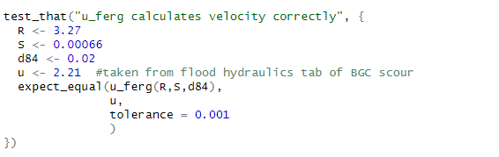
Testing Approach
Test_that is a testing framework for R that allows you to write unit tests for functions. Unit tests check that individual parts of our defined functions work as expected.
Test_that(description, code)
Expected_equal(actual, expected)
Examples:
Test File Path: C:\Users\nnematollahi\OneDrive - BGC Engineering Inc\Project02_bedloadpackage\bedload_r_package\bedload\tests\testthat\ test-my_test_file
Notes:
Moving on to our testing approach, we used the test_that framework, which is a testing framework for R. actually It allows us to write tests for our functions. Essentially, tests help us ensure that individual parts of our defined functions work exactly as expected.
Let me break it down a bit:
test_that(description, code): This function is used to define a test. The First argument describes what the test is checking, and the second argument is the R code that performs the test.
expect_equal(actual, expected is a function that compare the actual result of a function to the expected result. If they are not equal, the test will fail.
For instance, in the examples shown on the slide:
The first test checks if multiplication works correctly by comparing the result of 2 * 2 to 4.
The second example tests the u_ferg function to ensure it calculates velocity correctly. We set specific values for R, S, and d84, and compare the result of u_ferg with a known expected value using expect_equal.
The file path for our test scripts is provided at the bottom of the slide: C:\Users\nnematollahi\OneDrive - BGC Engineering Inc\Project02_bedloadpackage\bedload_r_package\bedload\tests\testthat\test-my_test_file
if you click on this link you will be directed to the R environment and there if you click on that you will see that scripit will be run with no failure. Which is great. However . This file doesn not contains all the functions that are defined in bed load package.
There are some functions in bed load packages that their out put is a plot.
Or functions that their input is not single variables like u freg that we see here. For those function our testing approach was using excel to calculate variables and creating plot and futher comparing the excel out put with our functions out put in R. Let me explain as ab example.

Slide 4
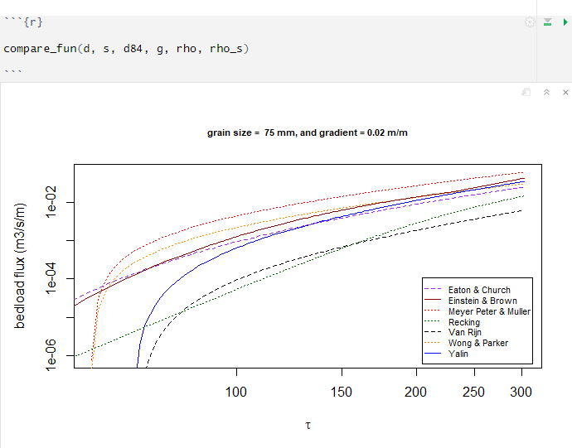
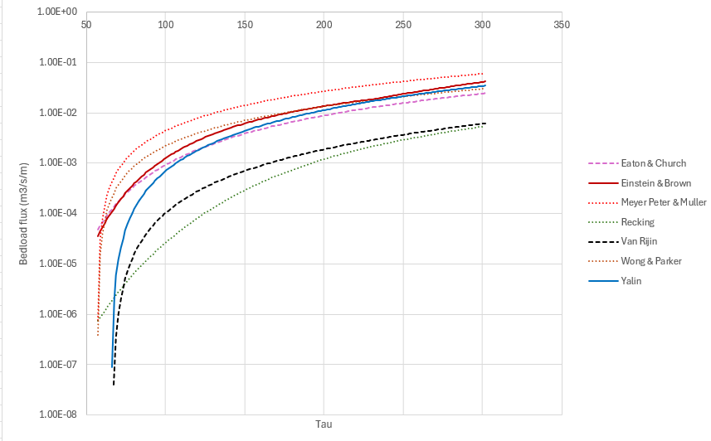
Compare_fun
This function compares the transport functions for a specified grain size and channel gradient over a reasonable range of shear stress values
Path to test file: C:\Users\nnematollahi\OneDrive - BGC Engineering Inc\Project02_bedloadpackage\bedload_r_package\bedload\tests\BedLoad_package_test
Notes:
As you know there are several equations and intermediate variables that has been calculated within thin function so that this plot is generated. To test all that intermediate variable and inial plot we created a comprehensive excel sheet

Slide 5
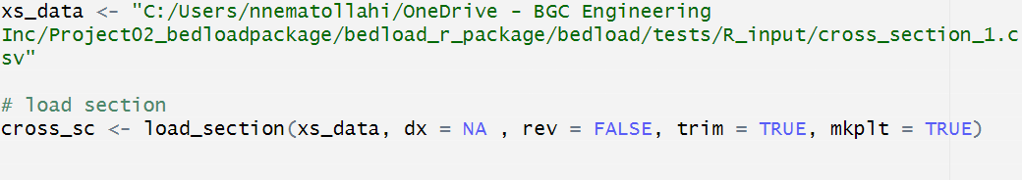
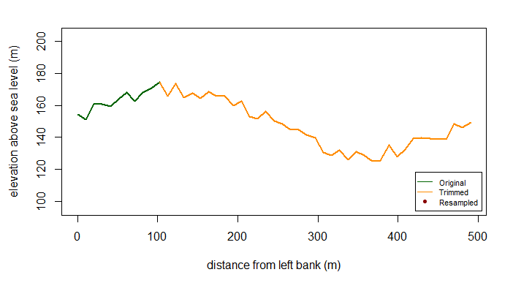
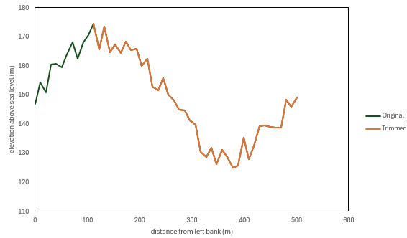
Load_section
This function loads profile data that is saved in a text file (XYZ format) and calculates the distance along the profile from the first data point in the file.
Notes:
As you know there are several equations and intermediate variables that has been calculated within thi function so that this plot is generated. To test all that intermediate variable and inial plot we created a comprehensive excel sheet

Slide 6
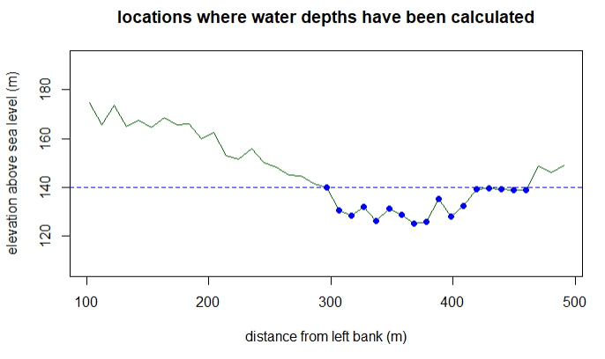
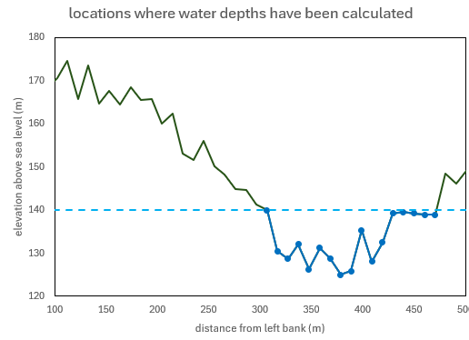
Calc_depths
this function uses a water surface elevation (WSE) and the location index for the channel thalweg to calculate the depths in the main channel.

Slide 7
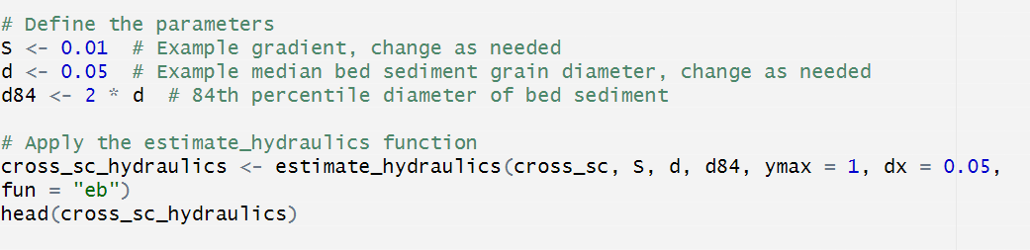
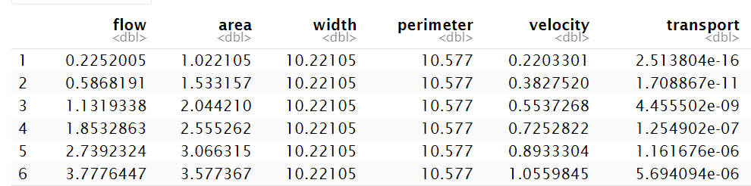
Estimate_hydralics
this function estimates hydraulic properties at regular WSE elevation intervals these data can be used to interpolate values for target flow values

Slide 8
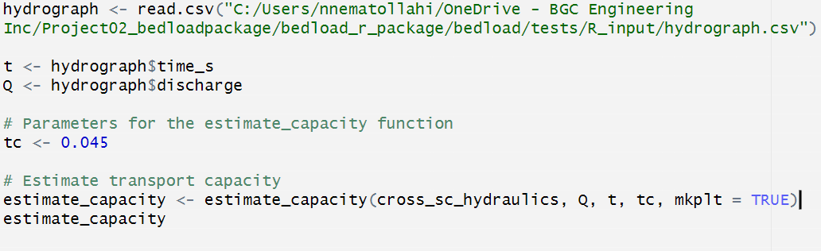
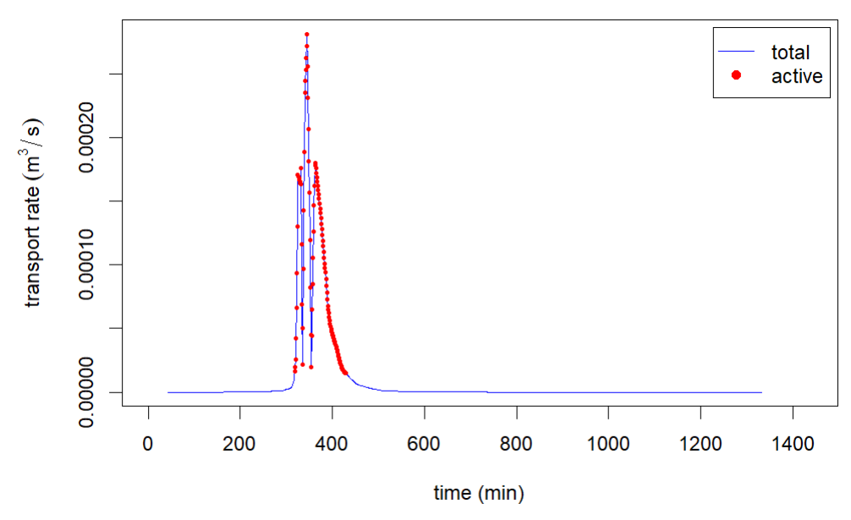
Estimate_capacity
this function uses a data frame created by the estimate_hydraulics() function to approximate the volume of bed material that could be transported during a hydrograph. It also estimates the geomorphically active volume of transport based on a threshold dimensionless shear stress.

