Slide 1


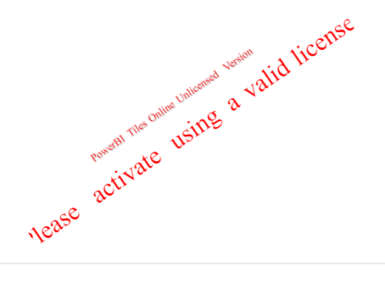
sample_financial_Desafio1_Page3

