Slide 1
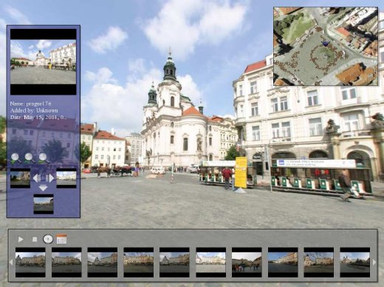
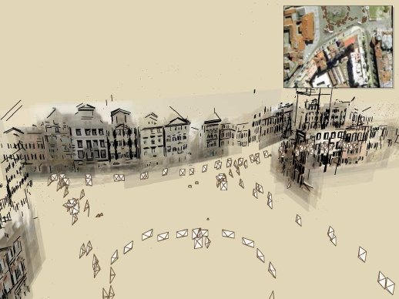
Feature points extraction
A low level building block in many applications:
Structure from motion
Object identification:
Video Google
Objects recognition.
Many slides are courtesy of Darya Frolova, Denis Simakov

Slide 2









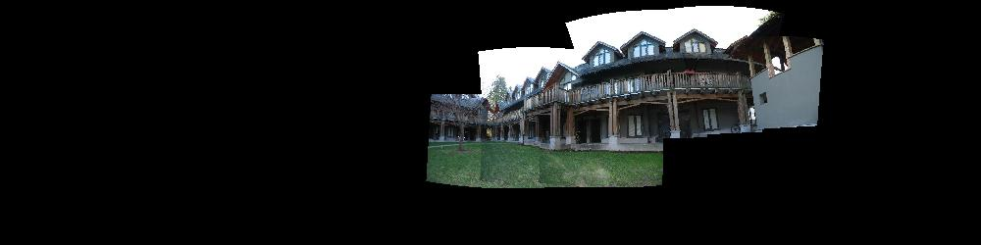
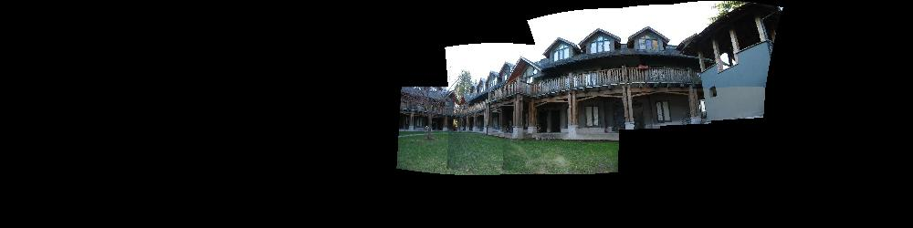
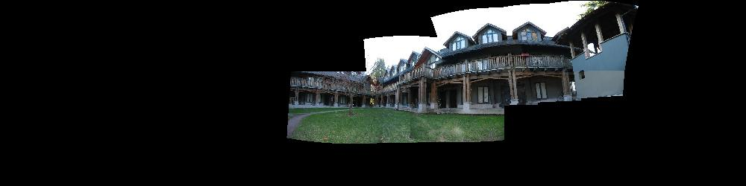
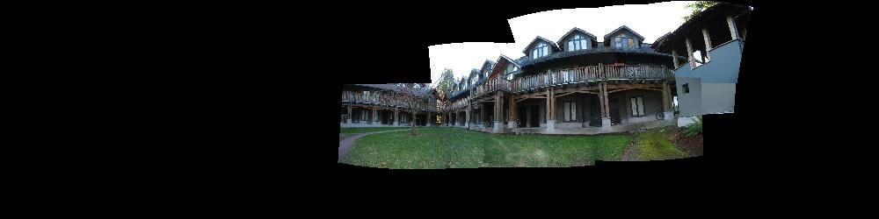
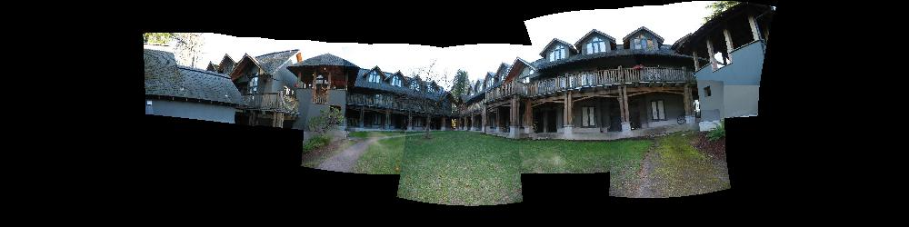
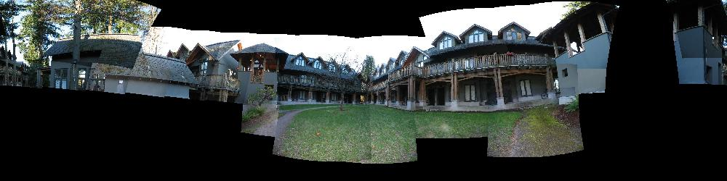
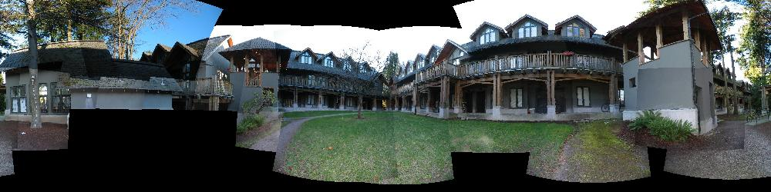
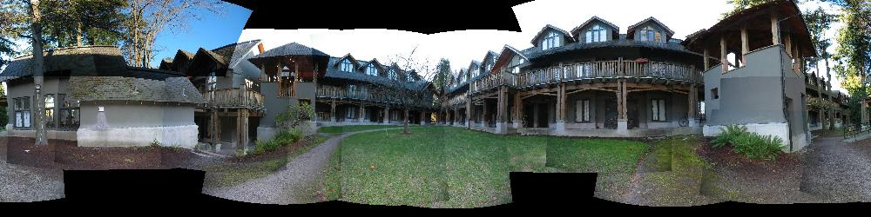
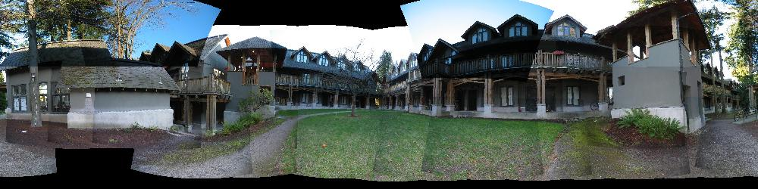
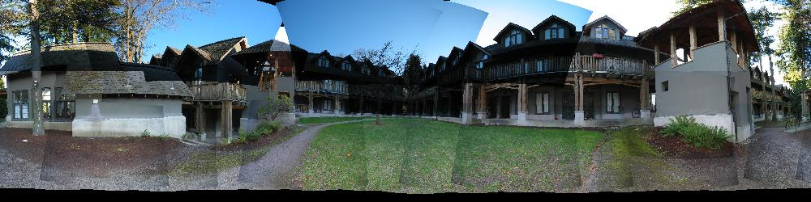
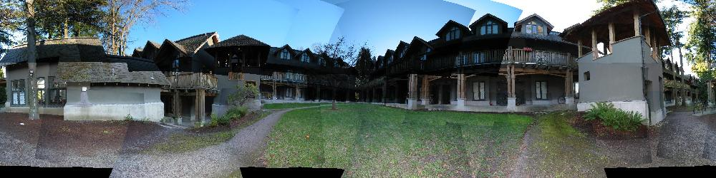
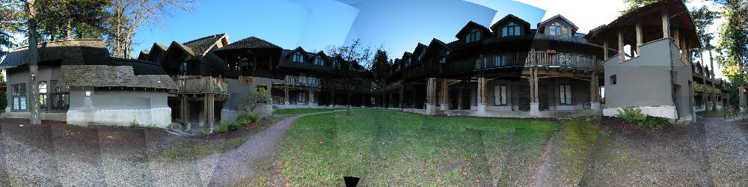

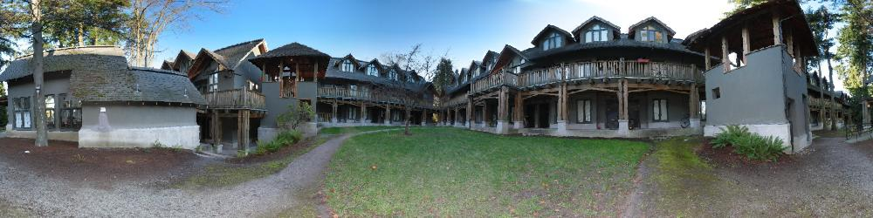
Example: Build a Panorama
M. Brown and D. G. Lowe. Recognising Panoramas. ICCV 2003

Slide 3
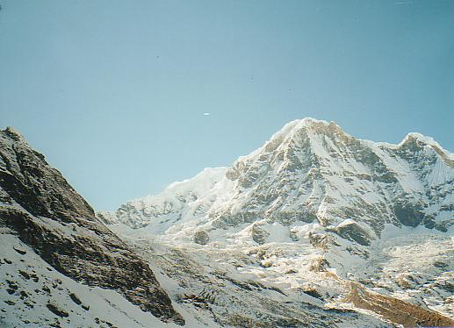
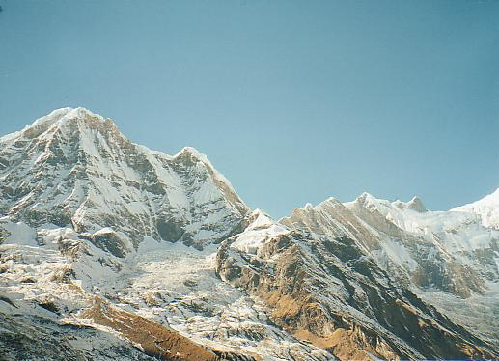
A motivating application
Building a panorama
We need to match/align/register images

Slide 4
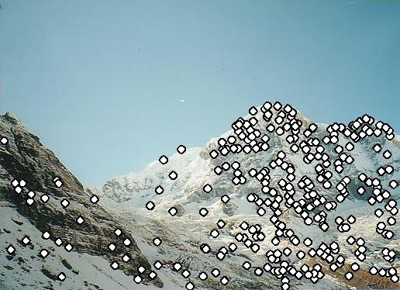
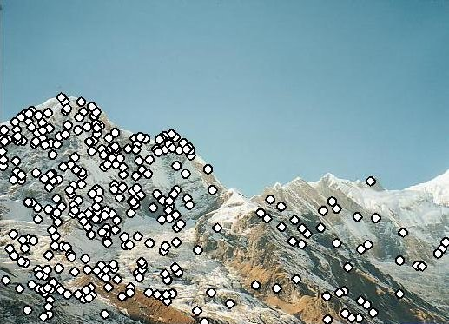
Building a panorama
1) Detect feature points in both images

Slide 5
Building a panorama
Detect feature points in both images
Find corresponding pairs

Slide 6
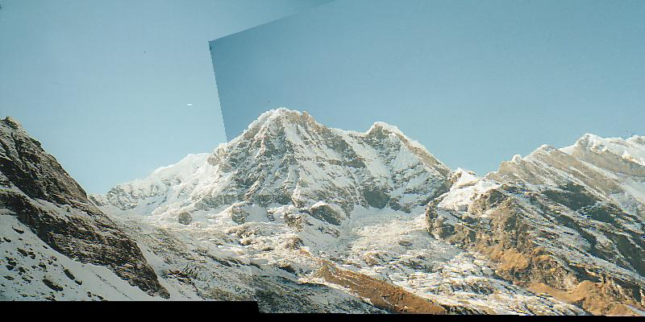
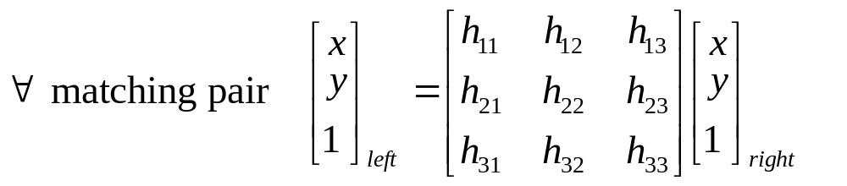
Building a panorama
Detect feature points in both images
Find corresponding pairs
Find a parametric transformation (e.g. homography)
Warp (right image to left image)

Slide 7
Matching with Features
Detect feature points in both images
Find corresponding pairs
Find a parametric transformation
Today's
talk
2 (n) views geometry

Slide 8

Criteria for good Features
Repeatable detector
Distinctive descriptor
Accurate 2D position

Slide 9
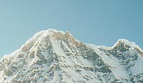

Repeatable detector
Property 1:
  Detect the same point independently in both images
no chance to match!

Slide 10
Distinctive descriptor
Property 2:
  Reliable matching of a corresponding point
?

Slide 11
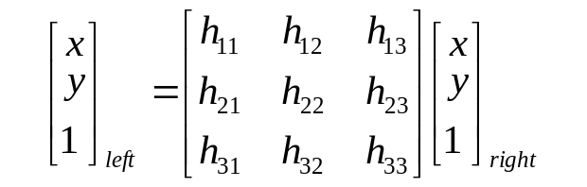
Accurate 2D position
Property 3: Localization
  Where exactly is the point
?
Sub-pixel accurate 2D position

Slide 12
3 Criteria for good Features
Redetection rate
Descriptor discrimination
Localization (accuracy)

Slide 13
Examples of commonly used features
Harris, Corner Detector (1988)
KLT Kanade-Lucas-Tomasi (80’s 90’s)
Lowe, SIFT (Scale Invariant Features Transform)
Mikolajczyk &Schmid, “Harris Laplacian” (2000)
Tuytelaars &V.Gool. Affinely Invariant Regions
Matas et.al. “Distinguished Regions”
Bay et.al. “SURF” (Speeded Up Robust Features) (2006)

Slide 14
Corner detectors
Harris & KLT
Detection: points with high “Cornerness” (next slide)
Descriptor: a small window around it (i.e., matching by SSD, SAD)
Localization: peak of a fitted parabola that approximates the “cornerness” surface
C.Harris, M.Stephens. “A Combined Corner and Edge Detector”. 1988
Lucas Kanade. An Iterative Image Registration Technique 1981.
Tomasi Kanade. Detection and Tracking of Point Features. 1991.
Shi Tomasi. Good Features to Track 1994.

Slide 15
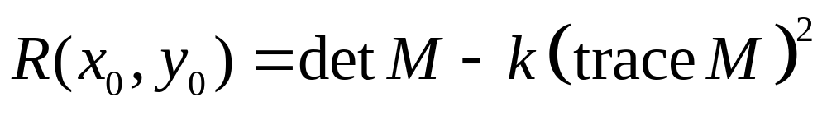
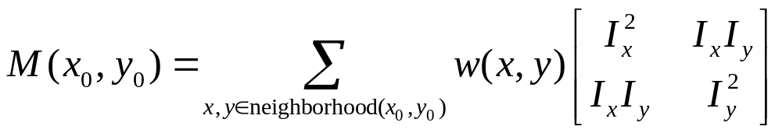
Cornerness (formally)
“Cornerness” R (x₀, y₀) of a point is defined as:
where M is a 2×2 “structure matrix”
computed from image derivatives:
And k – is a scale constant, and w(x,y) is a weight function

Slide 16
Descriptors & Matching
  Descriptors ROI around the point (rectangle / Gaussian ) typical sizes 8X8 up to 16X16.
  Matching: (representative options)
  Sum Absolute Difference
  Sum Square Difference
  Correlation (Normalized Correlation)

Slide 17
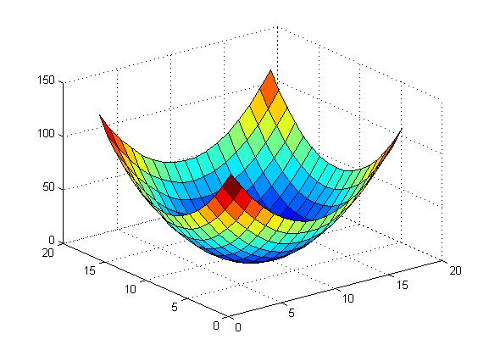
Naming conventions
Feature “point” (small window)
Search window
“correlation” surface

Slide 18
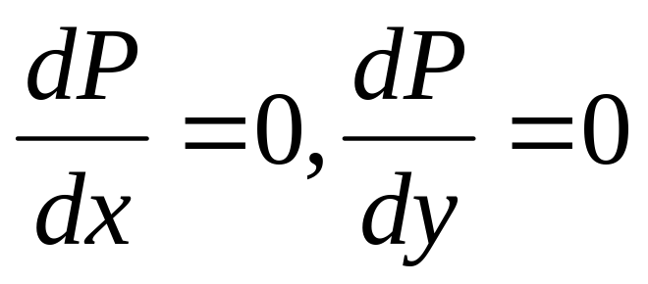
Localization
Fit a surface / parabola P(x,y)
(using 3x3 R values)
Compute its maxima
➔ Yields a non integer position.

Slide 19
Harris corner detector is motivated by accurate localization
Find points such that:
small shift → high intensity change
Hidden assumption:
Good localization in one image ➔ good localization in another image

Slide 20
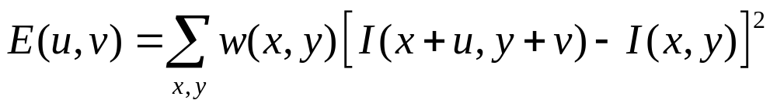
Harris Detector Cont.
Cornerness ≈
High change of intensity for every shift
Change of intensity for the shift [u,v]:
Window function
Shifted intensity
Intensity
E
Window function w(x,y) =
or
1 in window, 0 outside
Gaussian
u
v

Slide 21
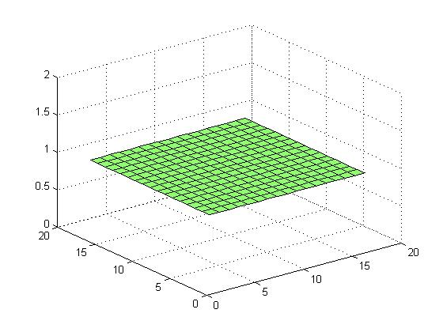
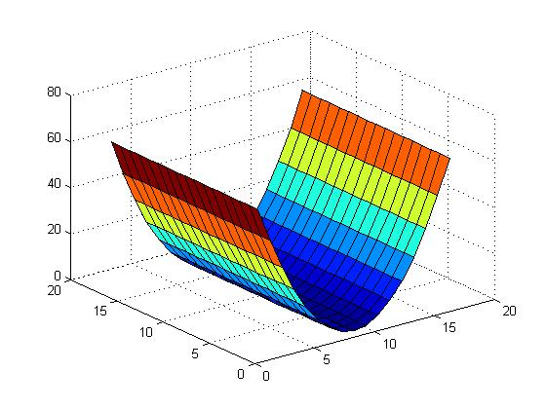
Harris Detector: Basic Idea
“flat” region:
“edge”:
“corner”:

Slide 22
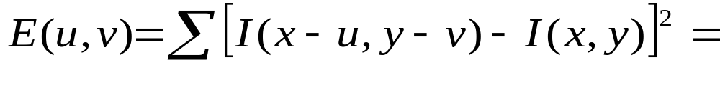
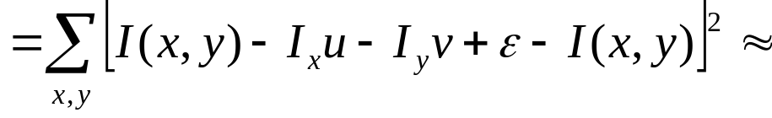
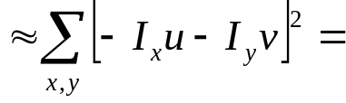
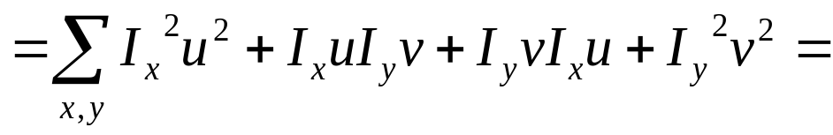
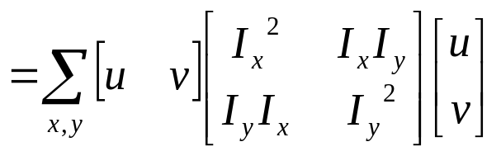
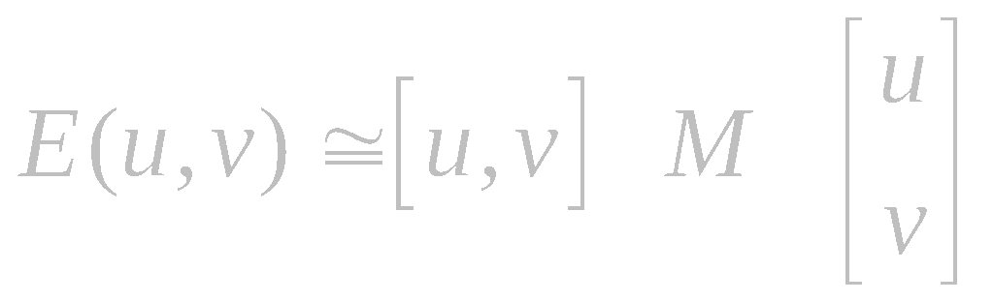
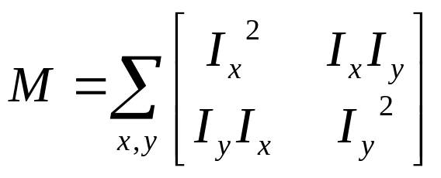
Measuring the “properties” of E()
M depends on image properties

Slide 23
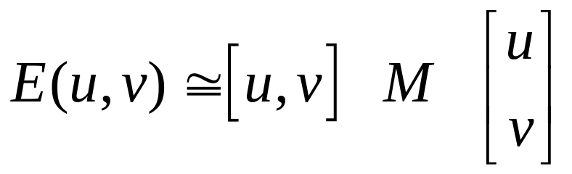
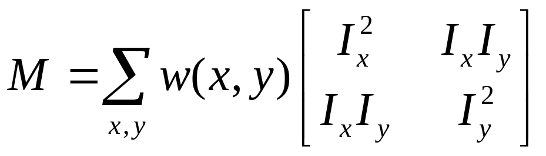
Harris Detector Cont.
“properties” of E() ↔ “properties” of M
For small shifts [u,v] we have a bilinear approximation:
where M is a 2×2 matrix computed from image derivatives:

Slide 24
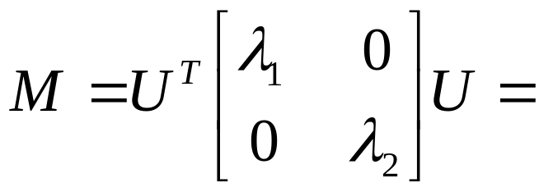
Bilinear form and its eigenvalue
λ₁, λ₂ – eigenvalues of M
Ellipse E(u,v) = const
direction of the slowest change
direction of the fastest change
(λ_{min})^{-1/2}
(λ_{max})^{-1/2}

Slide 25
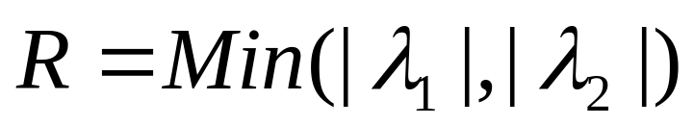
KLT
“Cornerness” of a point R(x₀, y₀) is defined as:
And k – is a scale constant, and w(x,y) is a weight function

Slide 26
Classification of image points using eigenvalues of M:
λ₂
“Edge”
λ₂ >> λ₁
“Corner”
λ₁ and λ₂ are large,
λ₁ ~ λ₂;
E increases in all directions
λ₁ and λ₂ are small;
E is almost constant in all directions
“Flat” region
“Edge”
λ₁ >> λ₂
λ₁

Slide 27
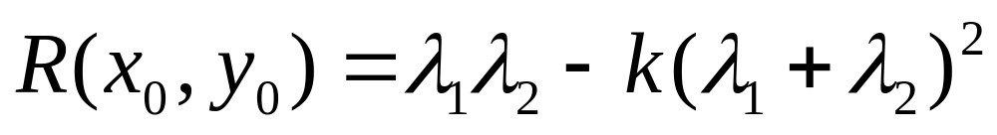
Harris corner detector
“Cornerness” of a point R(x₀, y₀) > threshold >0:
And 0<k<0.25 (~0.05) is a scale constant,
Computed using 2 tricks:
C.Harris, M.Stephens. “A Combined Corner and Edge Detector”. 1988

Slide 28
Harris Detector
λ₂
“Edge”
“Corner”
R depends only on eigenvalues of M
R is large for a corner
R is negative with large magnitude for an edge
|R| is small for a flat region
R < 0
R > 0
“Flat”
“Edge”
|R| small
R < 0
λ₁

Slide 29
Descriptors & Matching
  Descriptors ROI around (rectangle Gaussian ) the point Typical sizes 8X8 up to 16X16.
  Matching: (representative options)
  Sum Absolute Difference
  Sum Square Difference
  Correlation (Normalized Correlation)

Slide 30
Harris Detector (summary)
The Algorithm:
  Detection: Find points with large corner response function R (R > threshold)
  Localization:
  Approximate (parabola) local maxima of R
  Descriptors ROI around (rectangle) the point.
  Matching : SSD, SAD, NC.

Slide 31
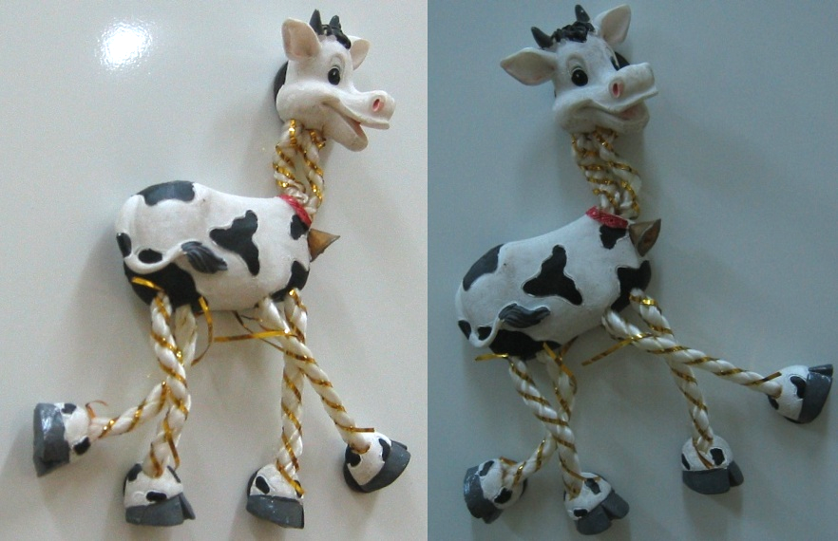
Harris Detector: Workflow

Slide 32
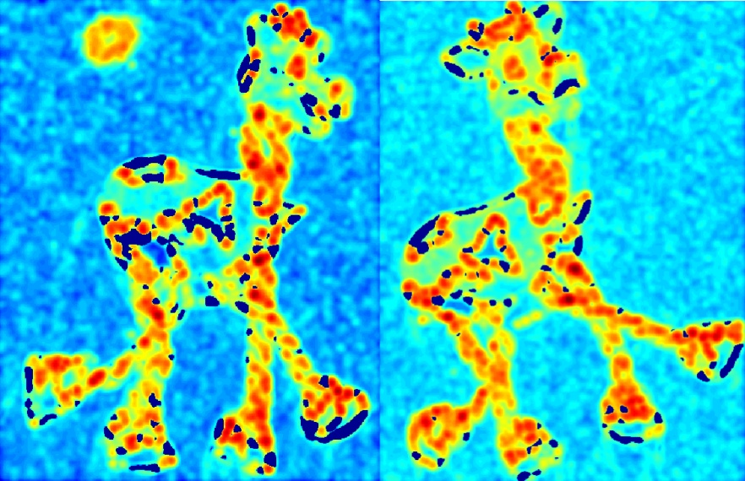
Harris Detector: Workflow
Compute corner response R

Slide 33
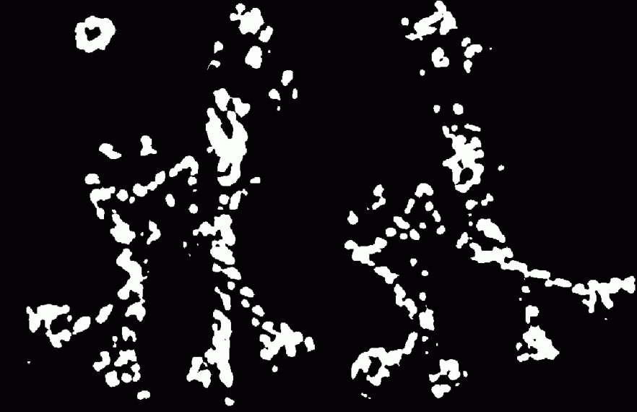
Harris Detector: Workflow
Find points with large corner response: R>threshold

Slide 34
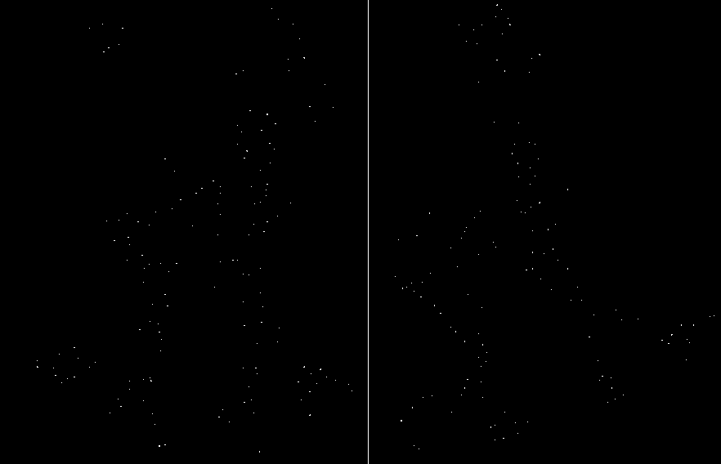
Harris Detector: Workflow
Take only the points of local maxima of R

Slide 35
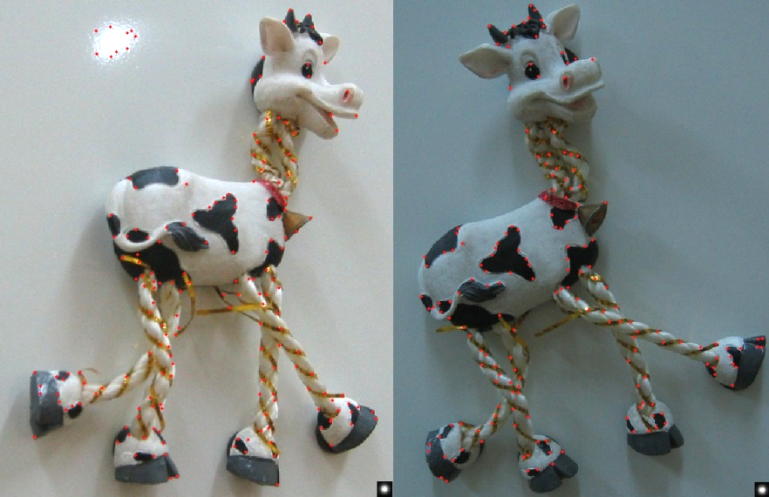
Harris Detector: Workflow

Slide 36
Matching Demo
Zhang demo at Inria:
http://www-sop.inria.fr/robotvis/personnel/zzhang/CalibEnv/CalibEnv-ima.html

Slide 37
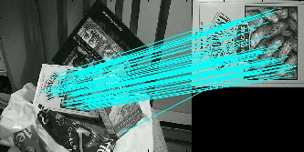
Detector Properties
Properties to be “Invariant” to
2D rotations
Illumination
Scale
Surface orientation
Viewpoint (base line between 2 cameras)
If I detected this point
Will I detect this point
If I detected this point
Will I detect this point
If I detected this point
Will I detect this point

Slide 38
Harris Detector: Properties
Rotation invariance
Ellipse rotates but its shape (i.e. eigenvalues) remains the same
Corner response R is invariant to image rotation

Slide 39
Harris Detector: Properties
Partial invariance to intensity change
Only derivatives are used to build M => invariance to intensity shift I → I + b
R
R
threshold
x (image coordinate)
x (image coordinate)

Slide 40
Harris Detector: Properties
Non-invariant to image scale!
points “classified” as edges
Corner !

Slide 41
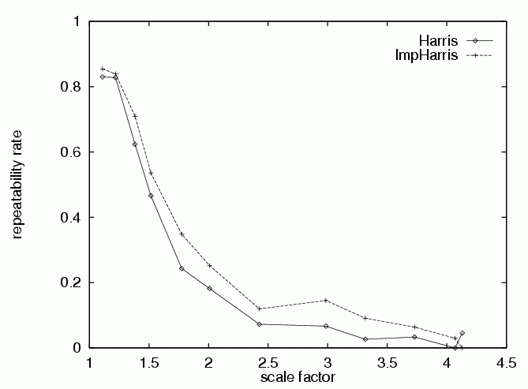
Harris Detector: Properties
Non-invariant for scale changes
Repeatability rate is:
# correspondences
# possible correspondences
“Correspondences” in controlled setting (i.e., take an image and scale it) is trivial
C.Schmid et.al. “Evaluation of Interest Point Detectors”. IJCV 2000

Slide 42
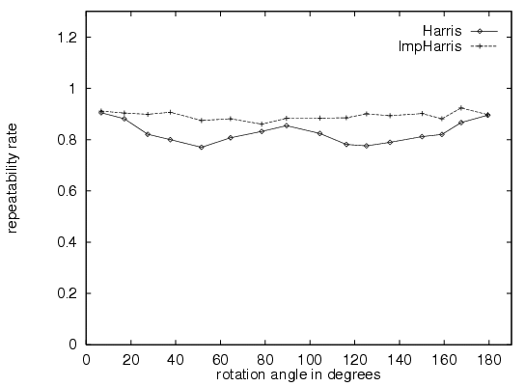
Rotation Invariant Detection
Harris Corner Detector
C.Schmid et.al. “Evaluation of Interest Point Detectors”. IJCV 2000

Slide 43
Examples of commonly used features
Harris, Corner Detector (1988)
KTL Kanade-Lucas-Tomasi
Lowe, SIFT (Scale Invariant Features Transform)
Mikolajczyk &Schmid, “Harris Laplacian” (2000)
Tuytelaars &V.Gool. Affinely Invariant Regions
Matas et.al. “Distinguished Regions”
Bay et.al. “SURF” (Speeded Up Robust Features) (2006)

Slide 44
Contents
Harris Corner Detector (1988)
K.Mikolajczyk, C.Schmid. “Harris Laplacian”
D.Lowe. SIFT (2003)
T.Tuytelaars, L.V.Gool. Affinely Invariant Regions
J.Matas et.al. “Distinguished Regions”

Slide 45
Scale Invariant problem illustration
Consider regions (e.g. circles) of different sizes around a point

Slide 46
Scale invariance approach
Find a “native” scale.
The same native scale should redetected
(at images of different scale).

Slide 47
Scale Invariant Detection
  Design a scale invariant” function on regions (circle), (the same for corresponding regions, even if they are at different scales)
Example: average intensity. For corresponding regions (even of different sizes) it will be the same.
  For a point in one image, we can consider it as a function of region size (circle radius)
f
Image 1
region size

Slide 48
Scale Invariant Detection
Approach:
Take a local maximum of this function
Observation: region size, for which the maximum is achieved, should be invariant to image scale.
f
Image 1
f
Image 2
scale change
s₁
region size
s₂
region size

Slide 49
Scale Invariant Detection
A “good” function for scale detection:
has one stable sharp peak
f
f
f
Good !
bad
bad
region size
region size
region size
For usual images: a good function would be a one which responds to contrast (sharp local intensity change)

Slide 50
Scale Invariant Detection
  For practical reasons we used discrete sampling of f
f
Image property
1:1
1:2
1:5
Scale ratio
f
Image property
region size

Slide 51
Scale Invariant Detectors
Harris-Laplacian
Find local maximum of: Harris corner detector for set of Laplacian images
scale
← Laplacian →
y
← Harris →
x
¹ K.Mikolajczyk, C.Schmid. “Indexing Based on Scale Invariant Interest Points”. ICCV 2001

Slide 52




Laplacian images
Kernel:
(Laplacian)
where Gaussian

Slide 53


SIFT (Lowe)
Find local maximum of Difference of Gaussians
scale
← DoG →
y
← DoG →
x
D.Lowe. “Distinctive Image Features from Scale-Invariant Keypoints”. IJCV 2004

Slide 54


Difference of Gaussians images
Functions for determining scale
Kernels:
(Difference of Gaussians)
where Gaussian
Note: both kernels are invariant to scale and rotation

Slide 55
SIFT Localization
Fit a 3D quadric D(x,y,s)
(using 3x3X3 DoG values)
Compute its maxima
➔ Yields a non integer position (in x,y) .
Brown and Lowe, 2002

Slide 56

D(x,y,s) is also used for pruning non-stable maxima
D.Lowe. “Distinctive Image Features from Scale-Invariant Keypoints”. IJCV 2004

Slide 57

Scale Invariant Detectors
Experimental evaluation of detectors
w.r.t. scale change
Repeatability rate:
# correspondences
# possible correspondences
K.Mikolajczyk, C.Schmid. “Indexing Based on Scale Invariant Interest Points”. ICCV 2001

Slide 58
Scale Invariant, Summary:
Given: two images of the same scene with a large scale difference between them
Goal: find the same interest points independently in each image
Solution: search for maxima of suitable functions in scale and in space (over the image)
Methods:
Harris-Laplacian [Mikolajczyk, Schmid]: maximize Laplacian over scale, Harris’ measure of corner response over the image
SIFT [Lowe]: maximize Difference of Gaussians over scale and space

Slide 59
SIFT Descriptors

Slide 60
SIFT – Descriptor
A vector of 128 values each between [0 -1]
  We also computed
  location
  scale
  “native” orientation
D.Lowe. “Distinctive Image Features from Scale-Invariant Keypoints”. IJCV 2004

Slide 61
“native” orientation
Peaks in a gradient orientation histogram
  Gradient is computed at the selected scale
  36 bins (resolution of 10 degrees).
  Many times (15%) more than 1 peak !?
  The “weak chain” in SIFT descriptor.
D.Lowe. “Distinctive Image Features from Scale-Invariant Keypoints”. IJCV 2004

Slide 62

Computing a SIFT descriptor
  Determine scale (by maximizing DoG in scale and in space),
  Determine local orientation (direction dominant gradient).
  → define a native coordinate system.
  Compute gradient orientation histograms (of a 16x16 window)
  16 windows ➔128 values for each point/ (4x4 histograms of 8 bins)
  Normalize the descriptor to make it invariant to intensity change
D.Lowe. “Distinctive Image Features from Scale-Invariant Keypoints”. IJCV 2004

Slide 63
Matching SIFT Descriptors
vectors of 128 values
  Using L2 norm.
  A search for NN (or KNN) cannot be commuted trivially , and is implemented using a KD-tree
D.Lowe. “Distinctive Image Features from Scale-Invariant Keypoints”. IJCV 2004

Slide 64

SIFT - empirically found² to show good performance,
SIFT Empirically found² to show good performance,
Scale = 2.5
Rotation = 45⁰
² K.Mikolajczyk, C.Schmid. “A Performance Evaluation of Local Descriptors”. CVPR 2003

Slide 65

Descriptors Invariant to Scale/Orientation
Use the scale/orientation to determined by detector to in a normalized frame.
compute a descriptor in this frame.
Scale example:
  moments integrated over an adapted window
  derivatives adapted to scale: sI_{x}
Scale & orientation example:
Resample all points/regions to 11X11 pixels
  PCA coefficients
  Principle components of all points.

Slide 66
Other invariant features
(not part of this class)
K.Mikolajczyk, C.Schmid. “Harris Laplacian”
T.Tuytelaars, L.V.Gool. Affinely Invariant Regions
J.Matas et.al. “Distinguished Regions”
Kadir & Brady Max entropy
Bay et.al. “SURF” (Speeded Up Robust Features)

Slide 67
Thank You
Note, home assignment 2.

Slide 68

Affine Invariant Detection (Tuytelaars)
Take a local intensity extremum as initial point
Go along every ray starting from this point and stop when extremum of function f is reached
f
points along the ray
We will obtain approximately corresponding regions
Remark: we search for scale in every direction
T.Tuytelaars, L.V.Gool. “Wide Baseline Stereo Matching Based on Local, Affinely Invariant Regions”. BMVC 2000.

Slide 69

Affine Invariant Detection
The regions found may not exactly correspond, so we approximate them with ellipses
Geometric Moments:
Fact: moments m_{pq} uniquely determine the function f
Taking f to be the characteristic function of a region (1 inside, 0 outside), moments of orders up to 2 allow to approximate the region by an ellipse
This ellipse will have the same moments of orders up to 2 as the original region

Slide 70
Affine Invariant Detection
Algorithm summary (detection of affine invariant region):
  Start from a local intensity extremum point
  Go in every direction until the point of extremum of some function f
  Curve connecting the points is the region boundary
  Compute geometric moments of orders up to 2 for this region
  Replace the region with ellipse
T.Tuytelaars, L.V.Gool. “Wide Baseline Stereo Matching Based on Local, Affinely Invariant Regions”. BMVC 2000.

Slide 71












Affine Invariant Detection (Matas)
Maximally Stable Extremal Regions
  Threshold image intensities: I > I₀
  Extract connected components
  (“Extremal Regions”)
  Find a threshold when an extremal
  region is “Maximally Stable”,
  i.e. local minimum of the relative
  growth of its square
  Approximate a region with
  an ellipse
J.Matas et.al. “Distinguished Regions for Wide-baseline Stereo”. Research Report of CMP, 2001.

Slide 72
Affine Invariant Detection
Kadir & Brady
Algorithm summary
Entropy(x,r) = entropy of circle of radiuses r around x
Look for local maxima (in r). ➔ scale
At each peak find change in pdf function of scale (r).
Replace the circle with ellipse ( a greedy search)
Kadir et. Al, Affine invariant salient region detector ECCV 04

