Slide 1
Scale & Affine Invariant Interest Point Detectors
Mikolajczyk & Schmid
presented by Dustin Lennon

Slide 2
Paper Goal
Combine Harris detector with Laplacian
  Generate multi-scale Harris interest points
  Maximize Laplacian measure over scale
  Yields scale invariant detector
Extend to affine invariant
  Estimate affine shape of a point neighborhood via iterative algorithm

Slide 3
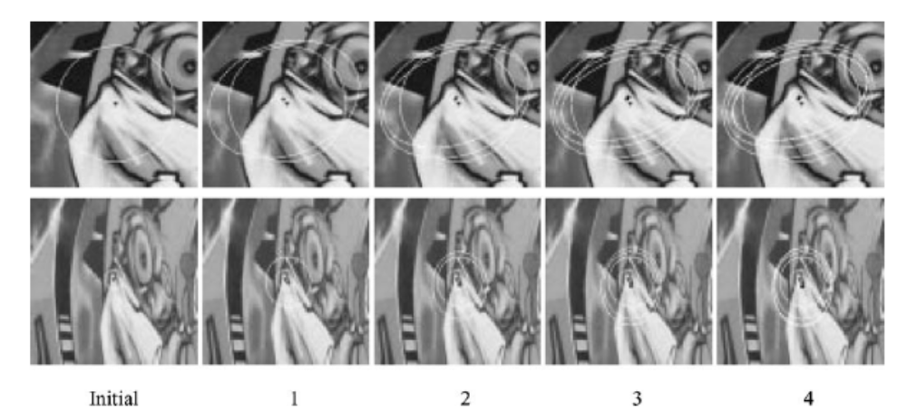
Visual Goal

Slide 4
Background/Introduction
Basic idea #1:
  scale invariance is equivalent to selecting points at characteristic scales
    Laplacian measure is maximized over scale parameter
Basic idea #2:
  Affine shape comes from second moment matrix (Hessian)
    Describes the curvature in the principle components

Slide 5
Background/Introduction
Laplacian of Gaussian
  Smoothing before differentiating
  Both linear filters, order of application doesn’t matter
  Kernel looks like a 3D mexican hat filter
  Detects blob like structures
  Why LoG: A second derivative is zero when the first derivative is maximized
Difference of Gaussian
  Subtract two successive smoothed images
  Approximates the LoG

Slide 6
Background/Introduction
But drawbacks because of detections along edges
  unstable
More sophisticated approach using penalized LoG and Hessian
  Det, Tr are similarity invariant
  Reduces to a consideration of the eigenvalues

Slide 7
Background/Introduction
Affine Invariance
  We allow a linear transform that scales along each principle direction
  Earlier approaches (Alvarez & Morales) weren’t so general
    Connect the edge points, construct the perpendicular bisector
      Assumes qualities about the corners
  Claim is that previous affine invariant detectors are fundamentally flawed or generate spurious detected points

Slide 8
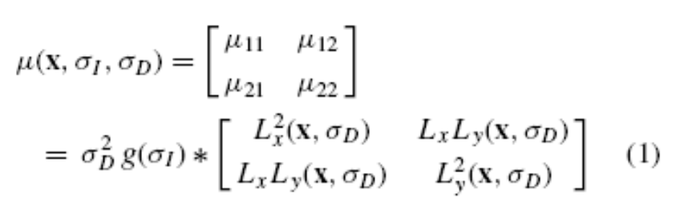
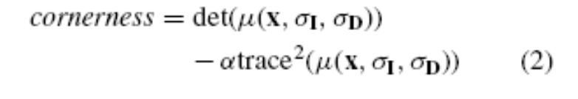
Scale Invariant Interest Points
Scale Adapted Harris Detector
Harris Measure

Slide 9
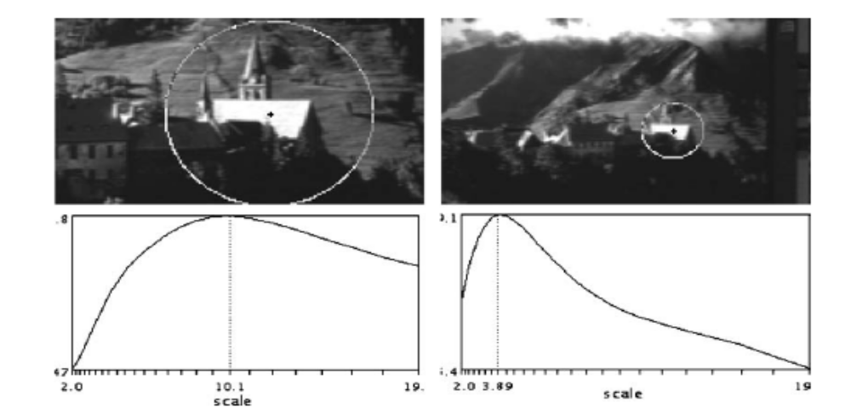
Characteristic Scale
Sigma parameters
  Associated with width of smoothing windows
  At each spatial location, maximize LoG measure over scale
    Characteristic scale
  Ratio of scales corresponds to a scale factor between two images

Slide 10
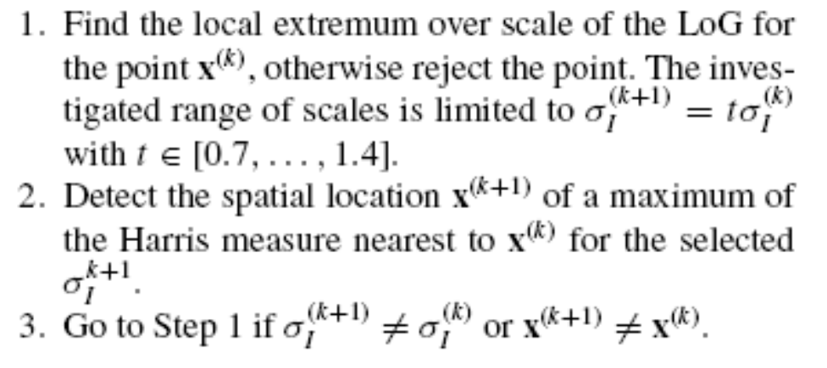
Harris-Laplace Detector
Algorithm
  Pre-select scales, sigma_n
  Calculate (Harris) maxima about the point
    threshold for small cornerness
  Compute the matrix mu, for sigma_I = sigma_n
  Iterate

Slide 11
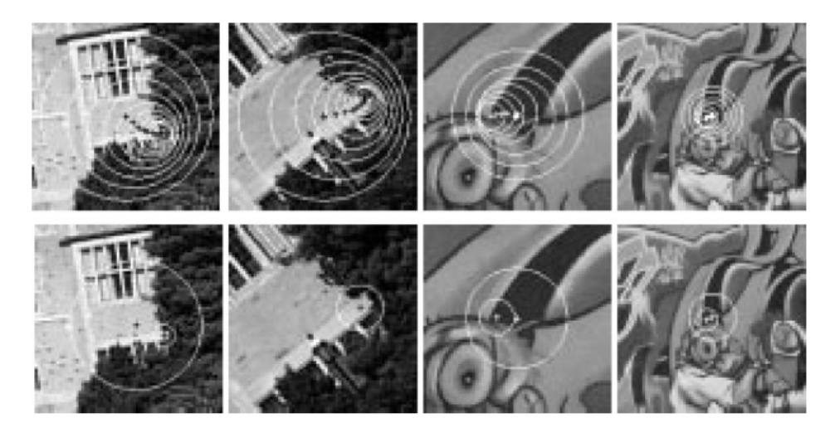
Harris-Laplace Detector
The authors claim that both scale and location converge. An example is shown below.

Slide 12
Harris Laplace
A faster, but less accurate algorithm is also available.
Questions about Harris Laplace
  What about textured/fractal areas?
    Kadir’s entropy based method
  Local structures over a wide range of scales?
    In contrast to Kadir?

Slide 13
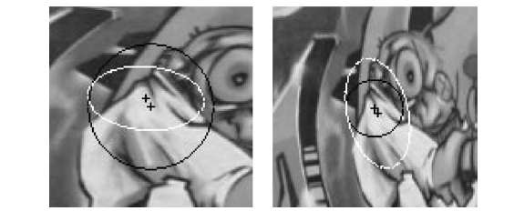
Affine Invariance
Need to generalize uniform scale changes
Fig 3 exhibits this problem

Slide 14
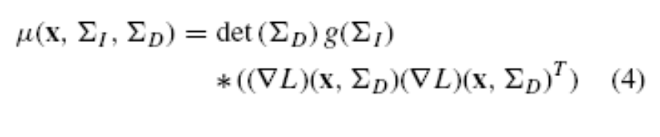
Affine Invariance
The authors develop an affine invariant version of mu:
Here Sigma represents covariance matrix for integration/differentiation Gaussian kernels
The matrix is a Hermitian operator.
To restrict search space, let Sigma_I, Sigma_D be proportional.

Slide 15
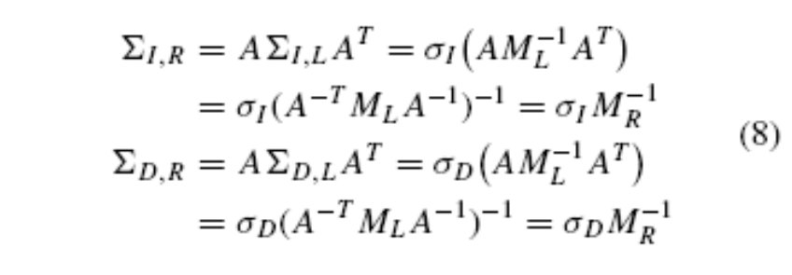

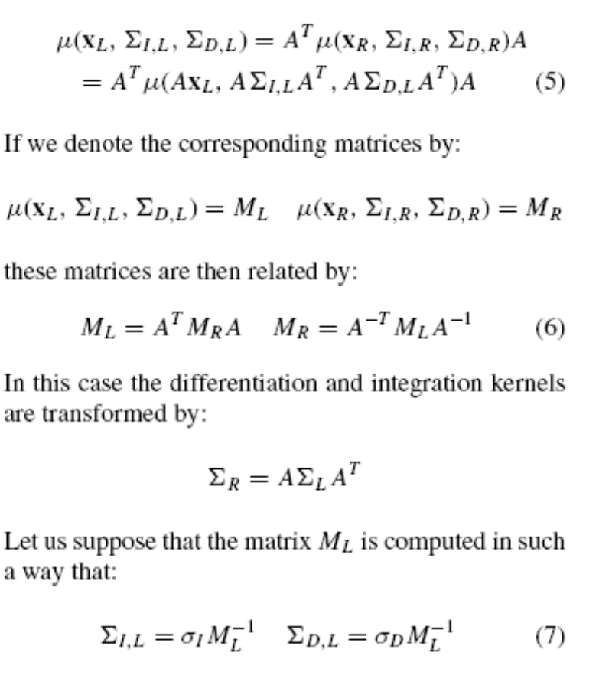
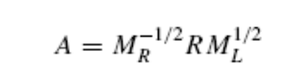
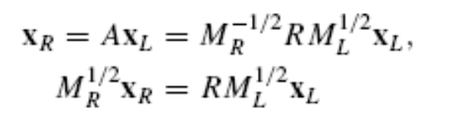
Affine Transformation
Mu is transformed by an affine transformation of x:

Slide 16
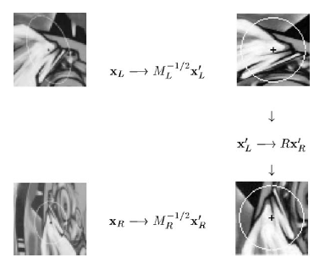
Affine Invariance
Lots of math, simple idea
We just estimate the Sigma covariance matrices, and the problem reduces to a rotation only
  Recovered by gradient orientation

Slide 17
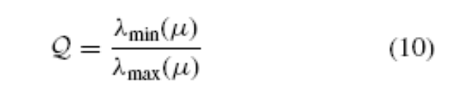
Isotropy
If we consider mu as a Hessian, its eigenvalues are related to the curvature
We choose sigma_D to maximize this isotropy measure.
Iteratively approach a situation where Harris-Laplace (not affine) will work

Slide 18
Harris Affine Detector
Spatial Localization
  Local maximum of the Harris function
Integration scale
  Selected at extremum over scale of Laplacian
Differentiation scale
  Selected at maximum of isotropy measure
Shape Adaptation Matrix
  Estimated by the second moment matrix

Slide 19
Shape Adaptation Matrix
Iteratively update the mu matrix by successive square roots
  Keep max eigenvalue = 1
  Square root operation forces min eigenvalue to converge to 1
  Image is enlarged in direction corresponding to minimum eigenvalue at each iteration

Slide 20
Integration/Differentiation Scale
Shape Adaptation means
  only need sigmas corresponding to the Harris-Laplace (non affine) case.
    Use LoG and Isotropy measure
Well defined convergence criterion in terms of eigenvalues

Slide 21
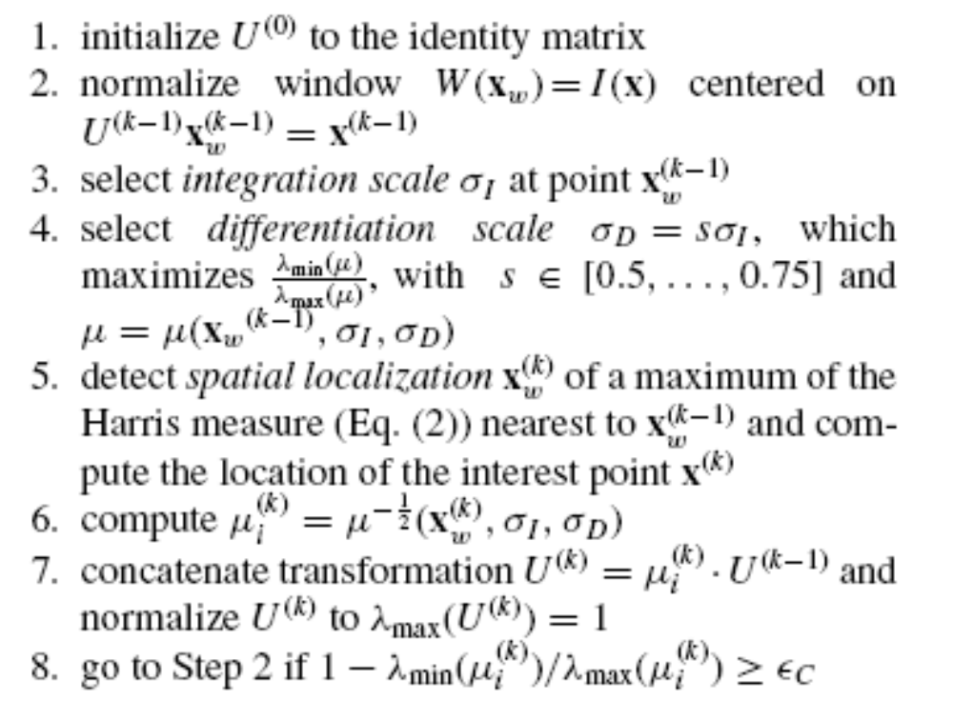
Detection Algorithm

Slide 22
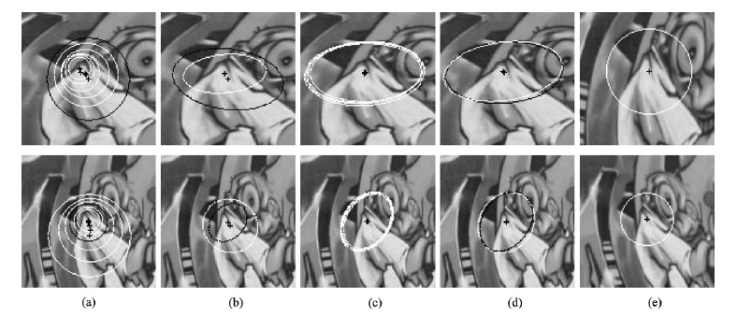
Detection of Affine Invariant Points

Slide 23
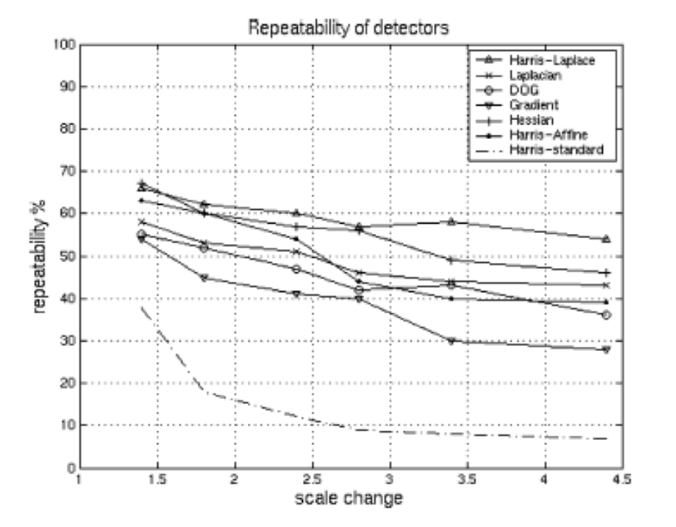
Results/Repeatability

Slide 24
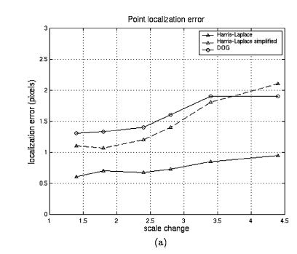
Results/Point Localization Error

Slide 25
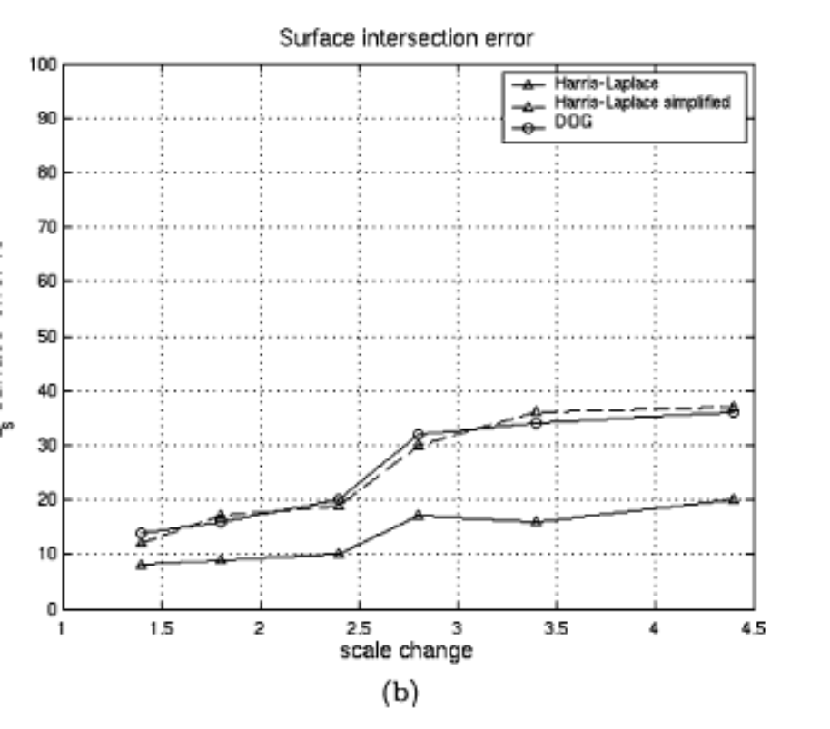
Results/Surface Intersection Error

Slide 26
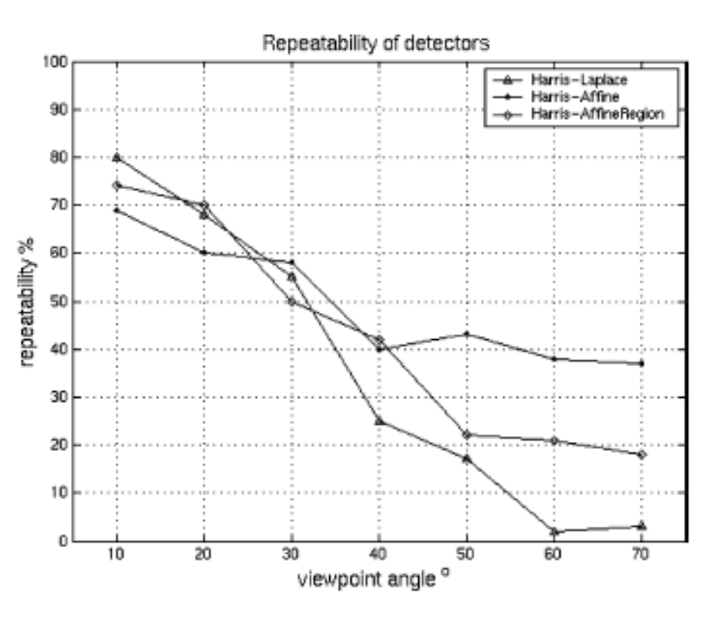
Results/Repeatability

Slide 27
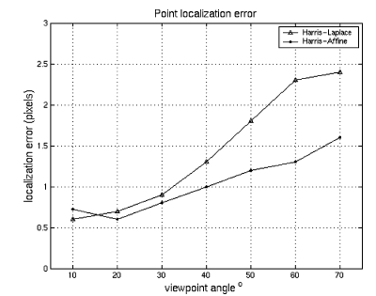
Point Localization Error

Slide 28
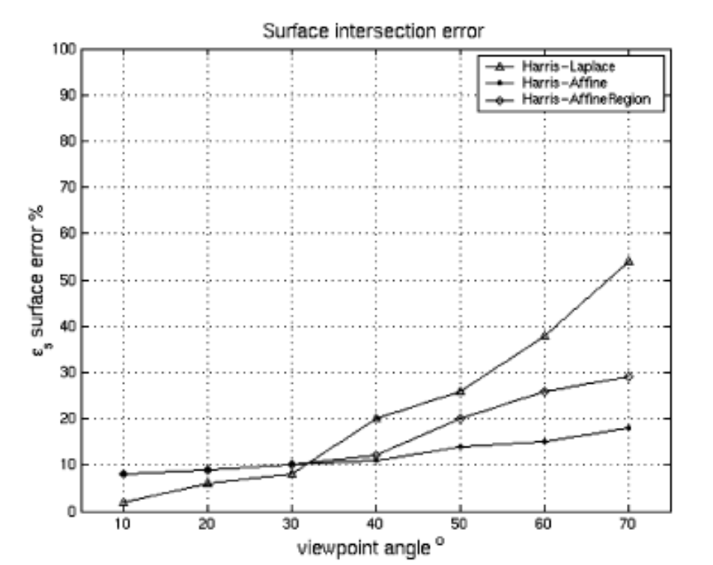
Surface Intersection Error

Slide 29
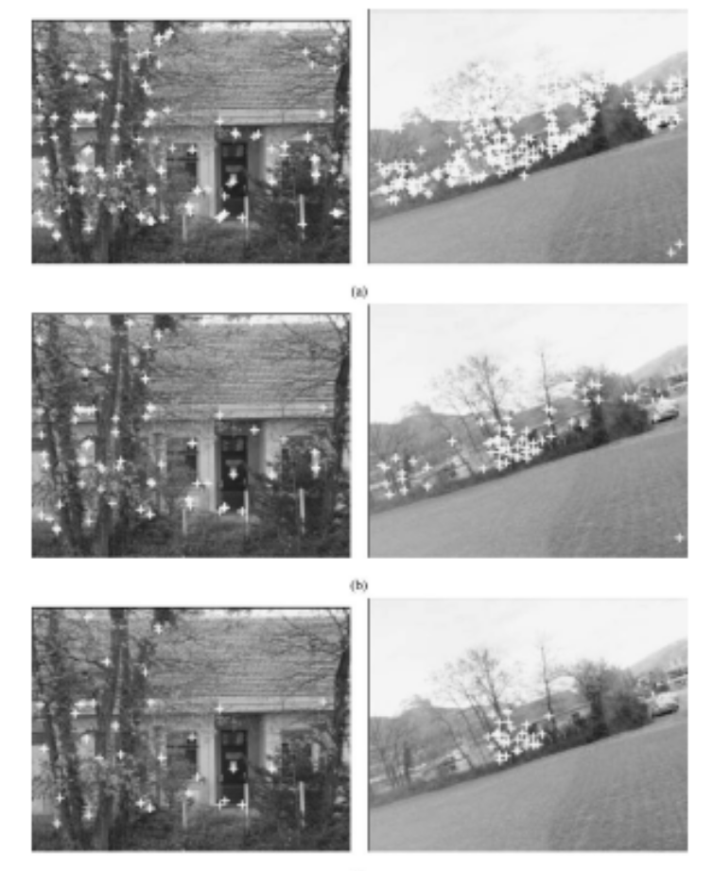
Applications

Slide 30
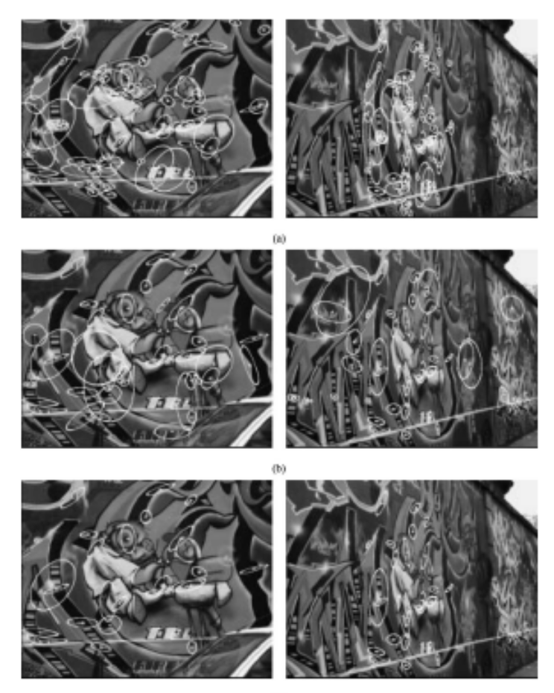
Applications

Slide 31
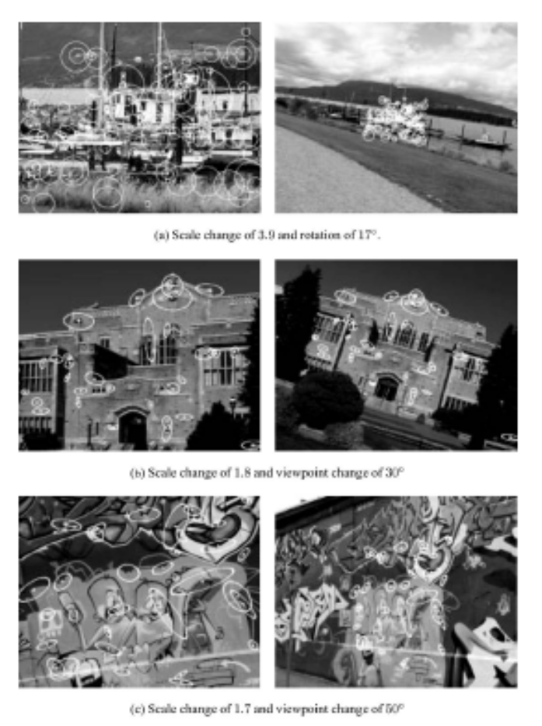
Applications

Slide 32
Conclusions
Results – impressive
Methodology – reasonably well-justified
Possible drawbacks?

