Slide 1
2024 FLL Submerged
OMMS Team 2
Robot & Attachment Design and
Missions to Task Assignments
Rev 13
21 January 2024

Slide 2
Missions, Requirements, and Tasks
In FLL, there are missions
  Submerged has 15 missions
  Some missions have multiple requirements that need to be completed to get the maximum number of points
Tasks are a combination of 1 or more missions
  Some tasks may only include some of the mission’s requirements
    For example, M09 Unexpected Encounter is has two requirements which have been split between between Tasks 1 & 2
  If we split a mission across multiple tasks use Part # (P#) notation to indicate which part(s) of the mission this task is doing.

Slide 3
Folder and File Structure
On the laptop there are the following folders (directories) for Team 2 Submerged
  Team2_Base_Code
    Core libraries shared by all tasks
    Robot Menu code
  Team2_SM_Combined
    A directory containing all the current code we are loading on a fully configured robots
  Team2_SM_Documents
    The various documents (including this one) and the innovation project files used by the team
  Team2_SM_Tasks
    Contains a folder for each task
    Team2_SM_T# - where # is the number of the Task
    This where you store the python source code for your tasks

Slide 4


Creating and Updating Tasks
When working on tasks, save new revisions into the folder for that task
When saving a file to make a new revision:
  Increase the revision number (“rev”) in the comment at the top of the file
  Increase the “_rev#” on the filename (in the Pybrick Apps, use the “pencil” icon to rename the file
  Then press the save icon to save the file to the selected folder
  Never reuse the number for the same task, always increase the number by 1

Slide 5
Overview of the Robot & Attachments

Slide 6
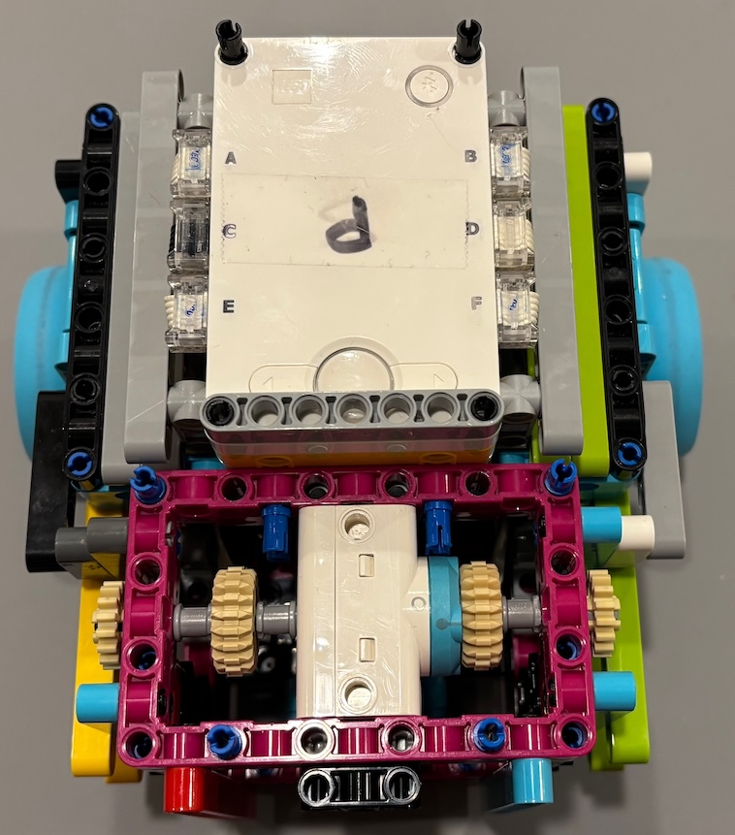
Robot: Top View of Robot
Front End of the Robot
Back End of the Robot

Slide 7
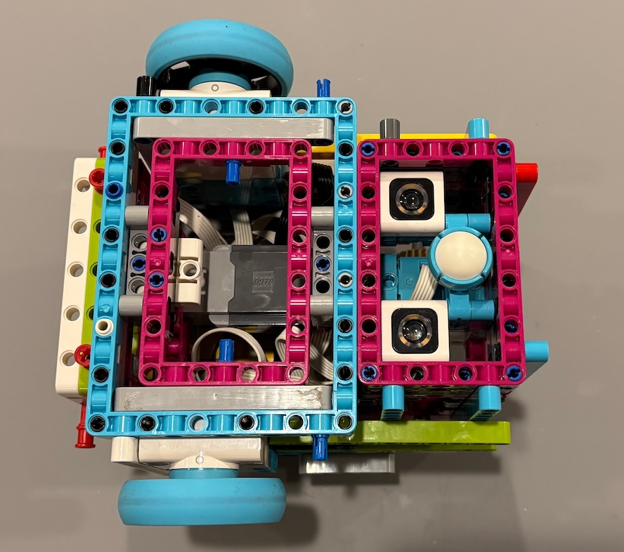
Robot: Bottom View of Robot
This is the Ball & Socket that supports the back of the robot
It does not roll perfectly
See Best Practices section for details about movements
Front End of the Robot
Back End of the Robot

Slide 8
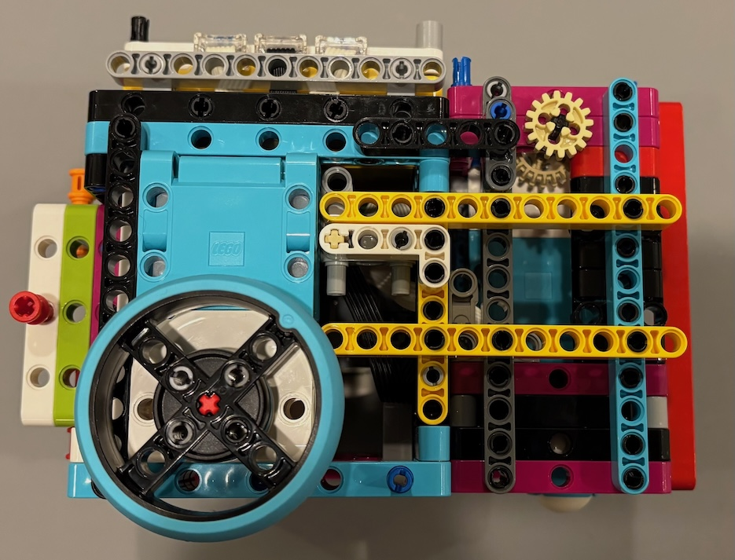
Robot: Side View of Robot
Knob for manually turning the top motor
Back End of
the Robot
Front End of
the Robot

Slide 9
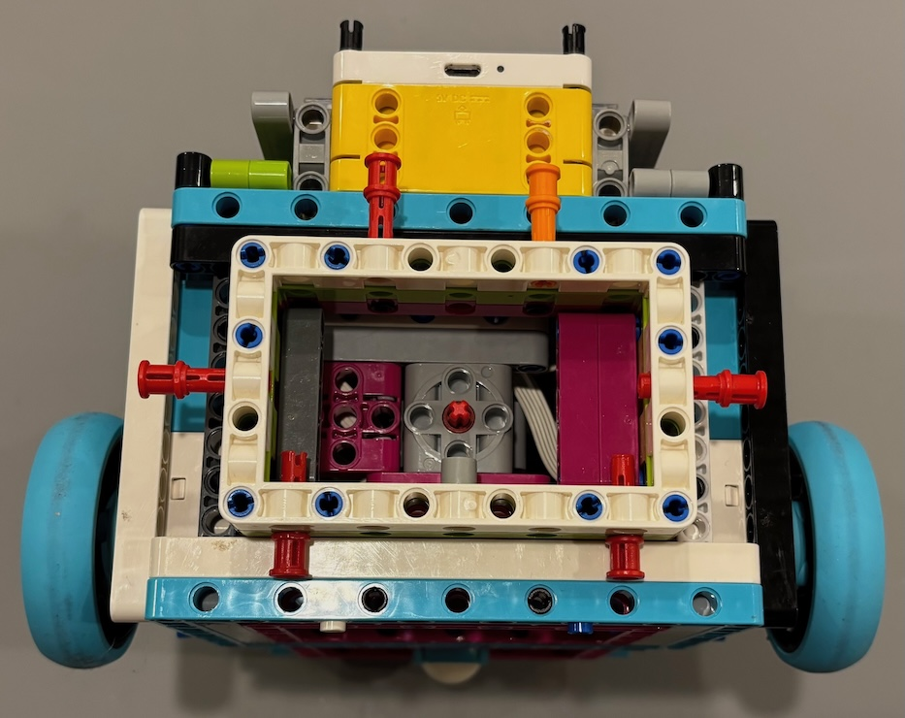
Robot: Front Attachment Mount
Front End of Robot showing the Front Attachment Point
Push pins for securing attachments to the front mount. Colors may vary between robots.

Slide 10
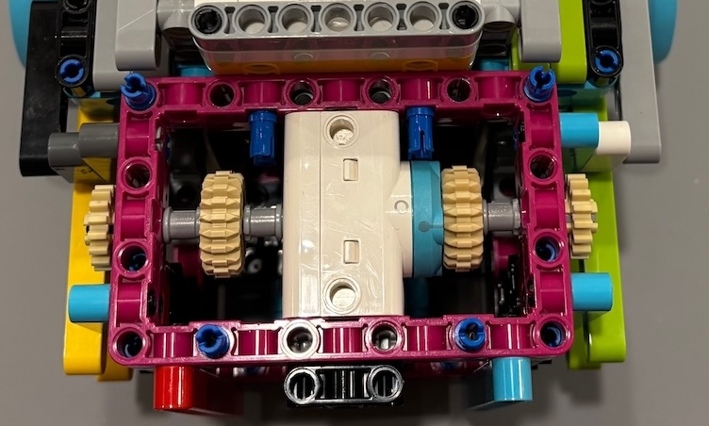
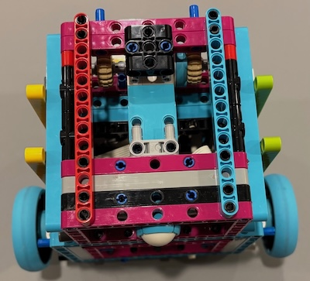
Robot: Top Attachment Mount
Back End of Robot showing the motor for the top attachment mount
Pins for aligning and securing the attachment to the mount

Slide 11
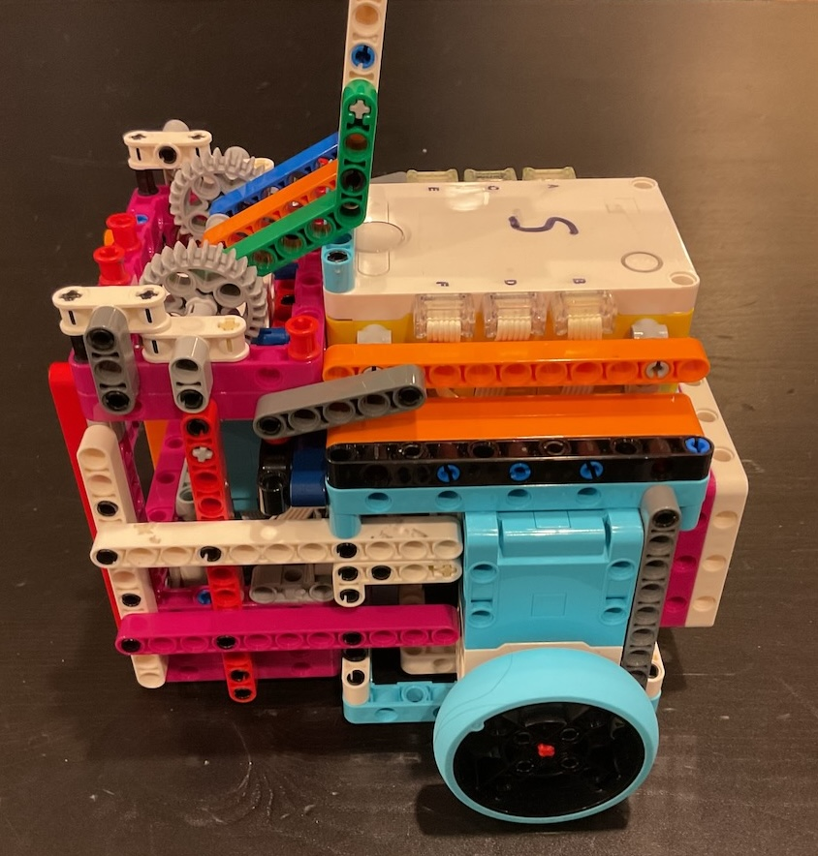
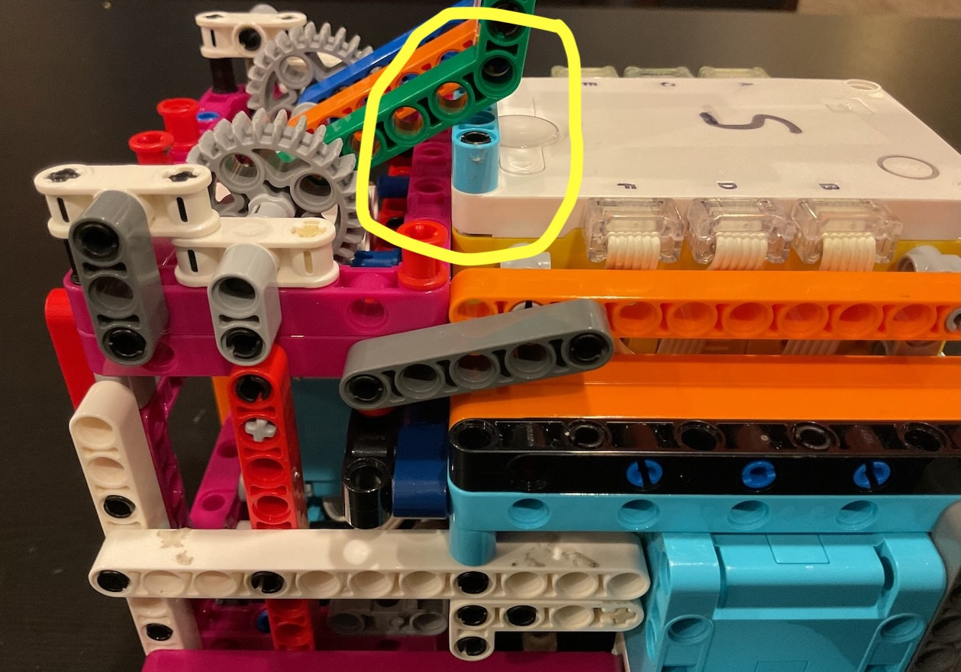
Robot: Top Attachment Zero (Reset) Point
The zero (reset) point for the top attachment is highlighted in the yellow oval.
The top attachment must be in this position PRIOR to the start of every mission that has the top attachment installed. Otherwise all movements of the attachment will be off. See the Best Practices slides.

Slide 12
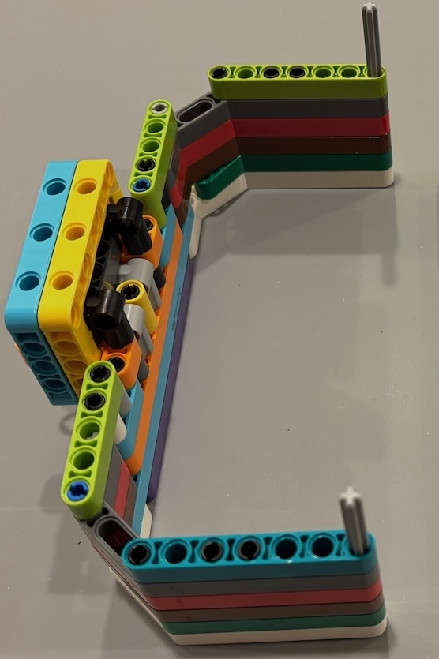
Front Attachment: Plow
Start Side:
  Left Home Base for Plow
Tasks Used:
  Plow T0, T1, T2, T3

Slide 13
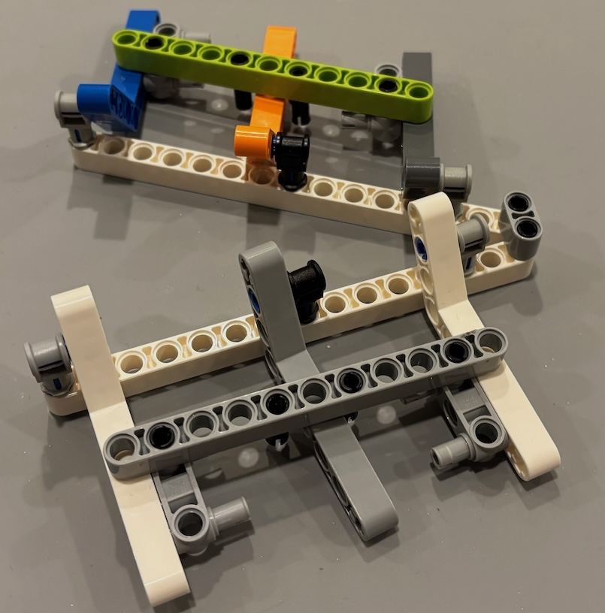
Top (of hub) Attachment: Octopus Basket
Start Side: Left Home Base
Tasks Used: T1

Slide 14
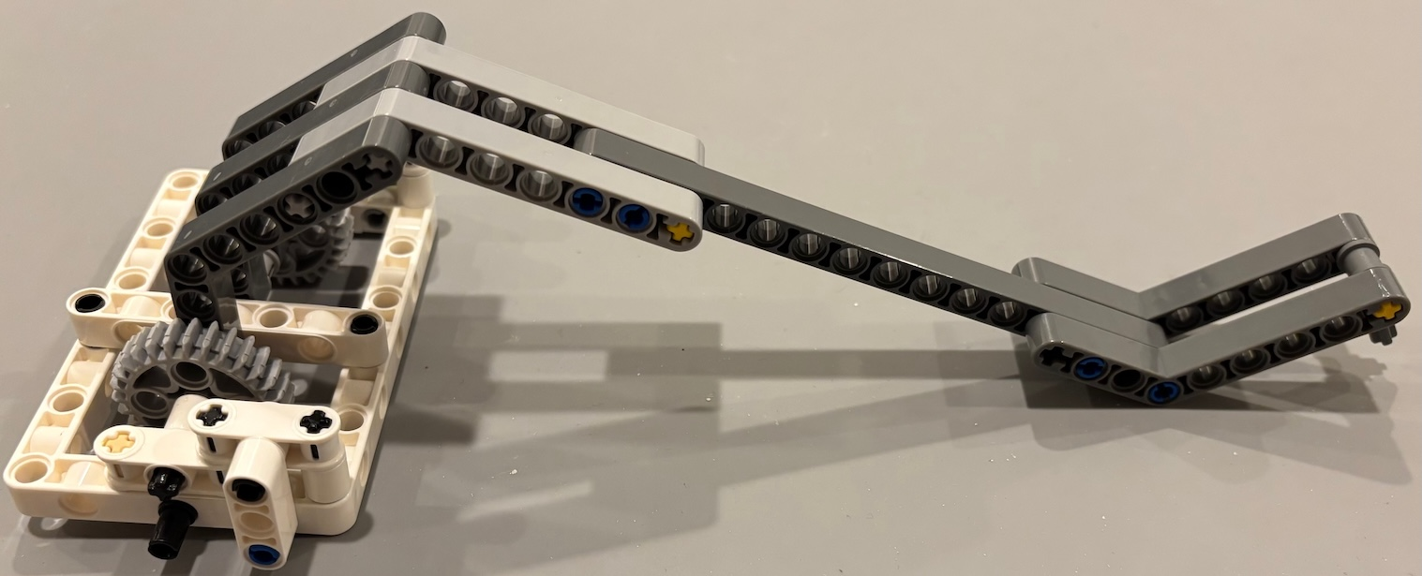
Top Motor Attachment: Downward Spike Lift Arm
Start Side: Right Home Base
Tasks Used: T2

Slide 15
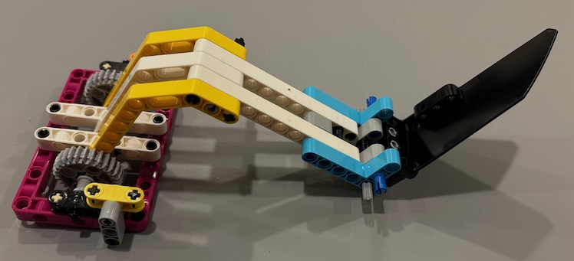
Top Motor Attachment: Wing Lift Arm
Start Side: Right Home Base
Tasks Used: T4

Slide 16
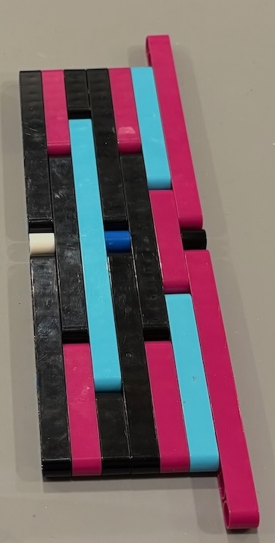
Front Attachment: Plow Door
Start Side: Right Home Base
Tasks Used: T1

Slide 17
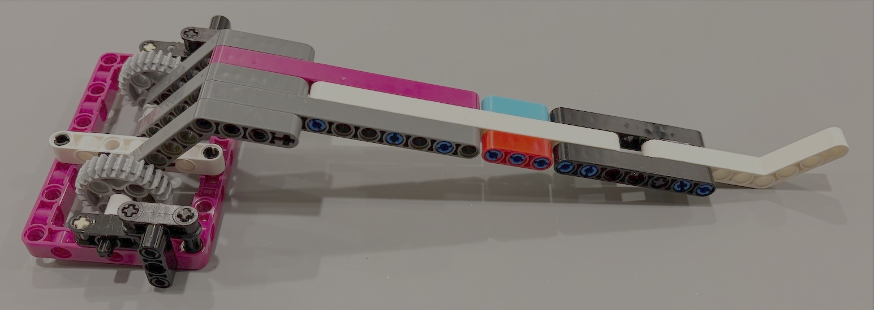
Top Motor Attachment: Single Beam Lift Arm
Start Side: Left Home Base
Tasks Used: Not used at this time

Slide 18
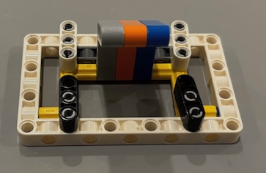
Front Attachment: Pusher
Start Side: Left Home Base
Tasks Used: T5

Slide 19
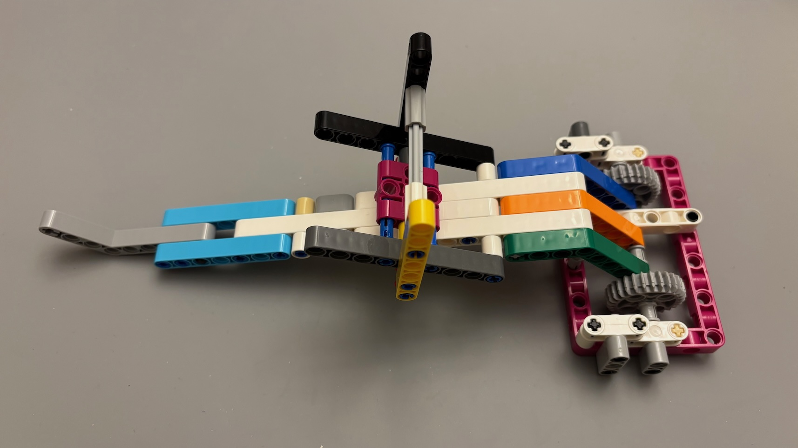
Front Attachment: Lift Arm with Single Beam and Shark Holder
Start Side: Left Home Base
Tasks Used: T5
Shark Holder

Slide 20
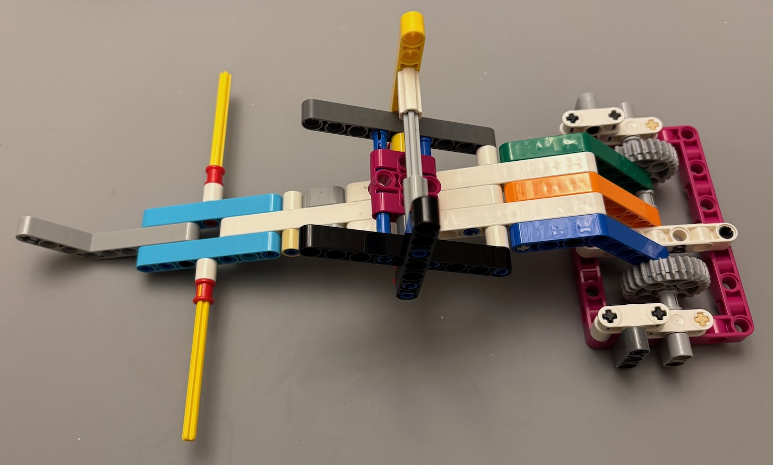
Front Attachment: Lift Arm with Single Beam and
Sample and Shark Holders
Start Side: Left Home Base
Tasks Used: T6 & T7
Sample Holder
These are added in T6
Shark Holder

Slide 21
Attachment Overview
The following slides show all the attachments, which tasks they are used, and if they located on the left or right home base.
The order and groups of the attachments are:
Starting/First Group (T0)
  Adds Plow, Octopus Basket
Second Group (T1)
  Adds Plow Door
  Adds Downward Spike Lift Arm
  No removes
Third Group (T2)
  Removes Plow Door
Fourth Group (T3)
  No Removes
Fifth Group (T4)
  Removes Plow
  Removes Downward Spike Lift Arm
  Adds Wing Lift Arm
Sixth Group (T5)
  Removes Wing Lift Arm
  Remove Octopus Basket
  Adds Lift Arm with Single Beam and Shark Holder
  Adds Pusher
Seventh Group (T6 & T7)
  Removes Pusher
  Adds Sample “Yellow/Red” Arms

Slide 22
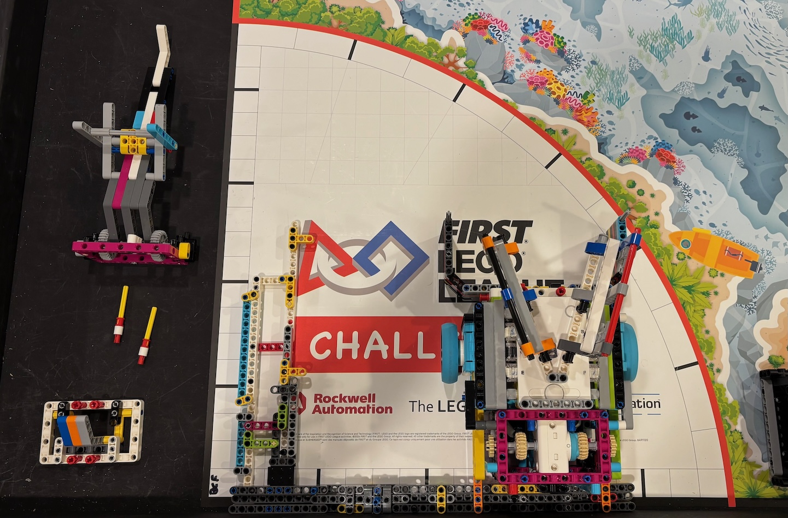
Left Side Start Position for T0

Slide 23
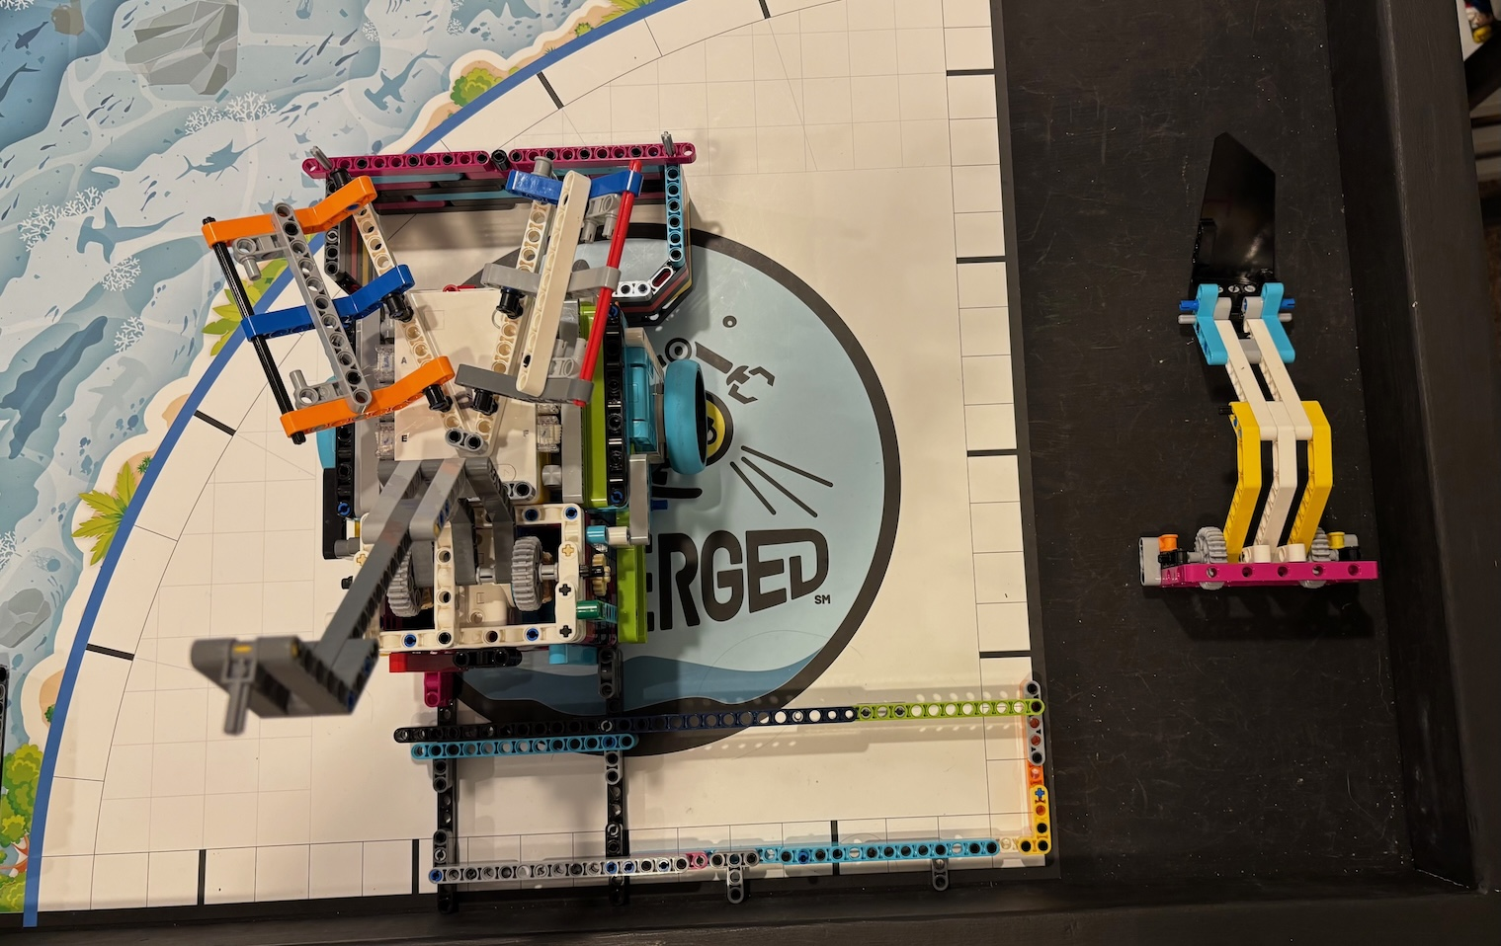
Right Side Start Position for T1

Slide 24
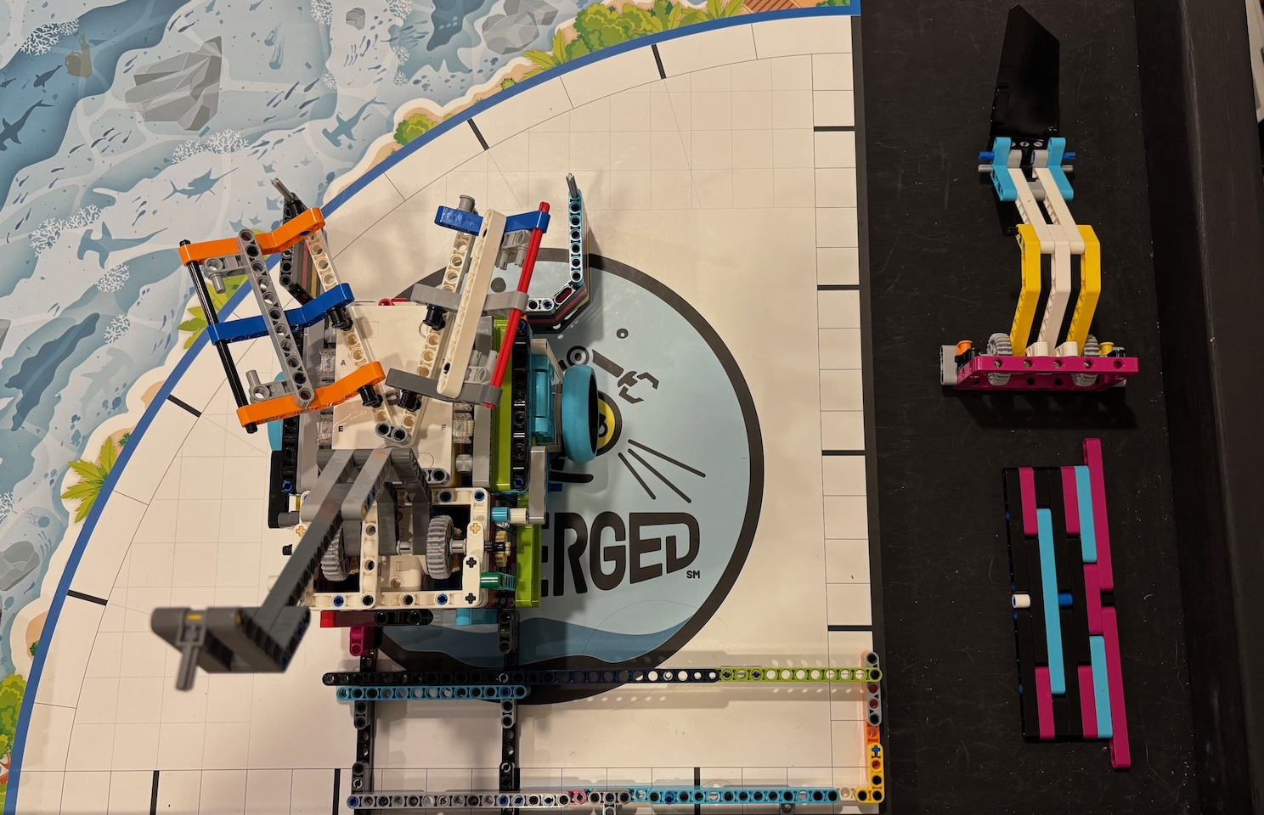
Right Side Start Position for T2
Make sure Octopus is in the Plow on the right side!

Slide 25
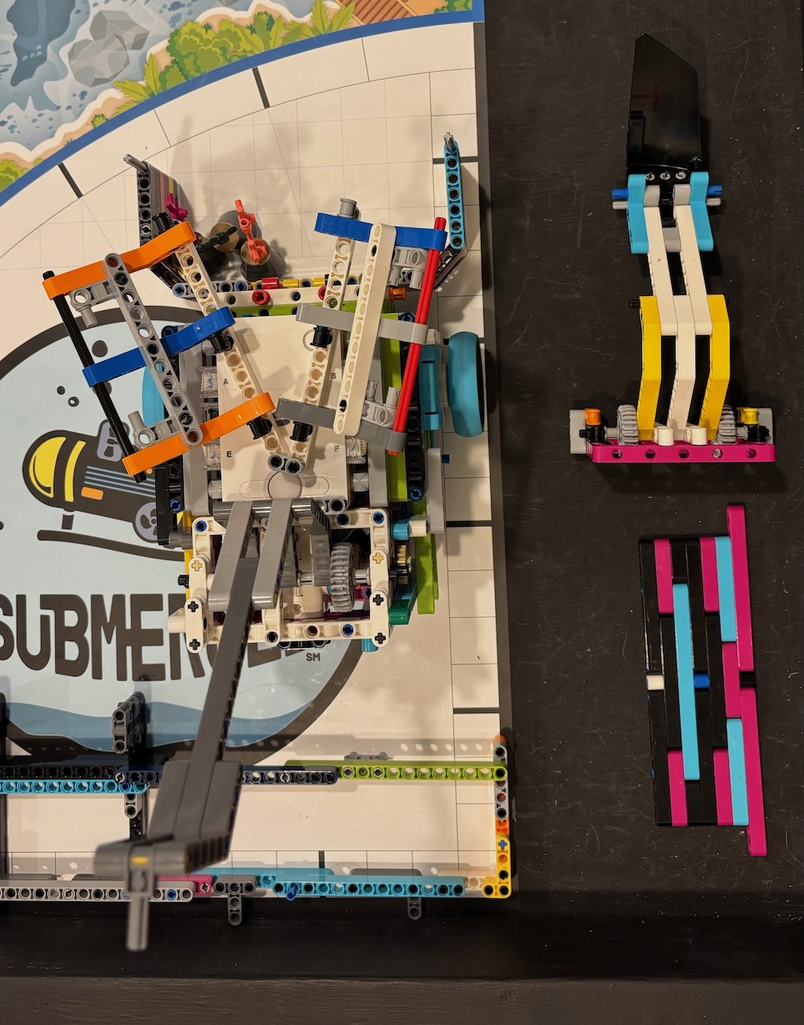
Right Side Start Position for T3

Slide 26
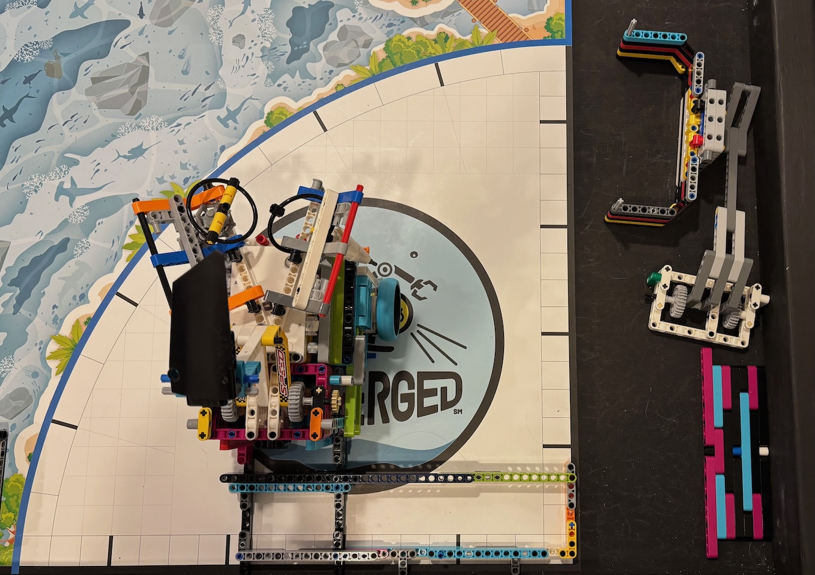
Right Side Start Position for T4

Slide 27
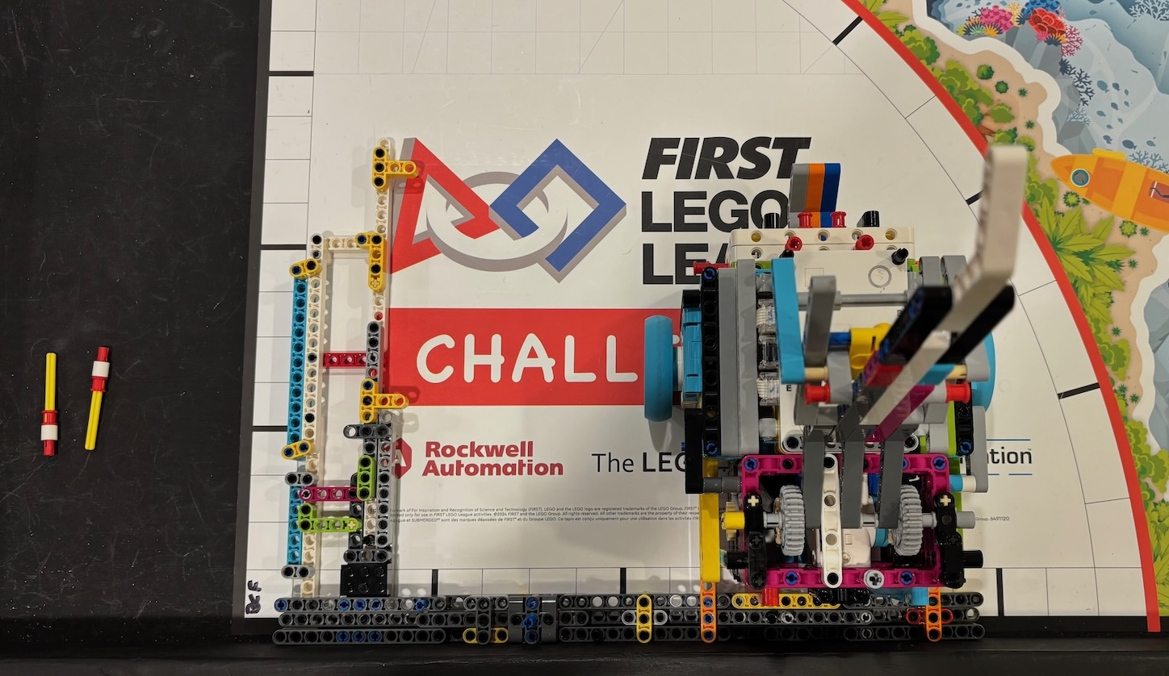
Right Side Start Position for T5

Slide 28
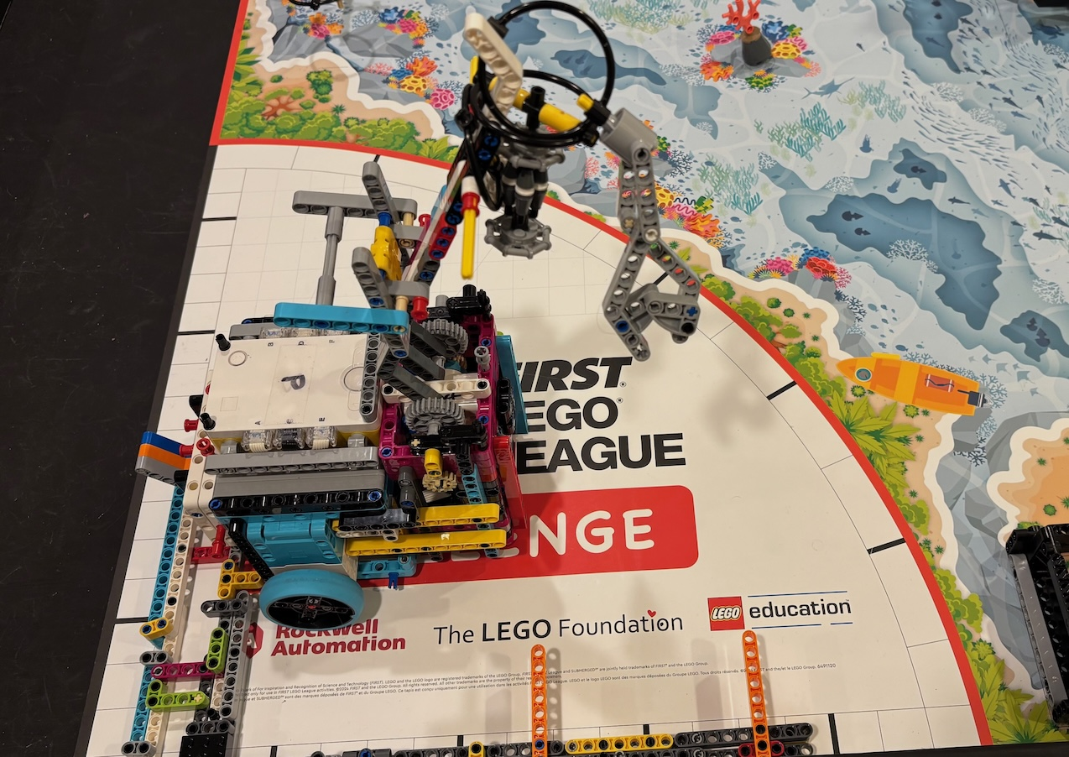
Right Side Start Position for T6

Slide 29
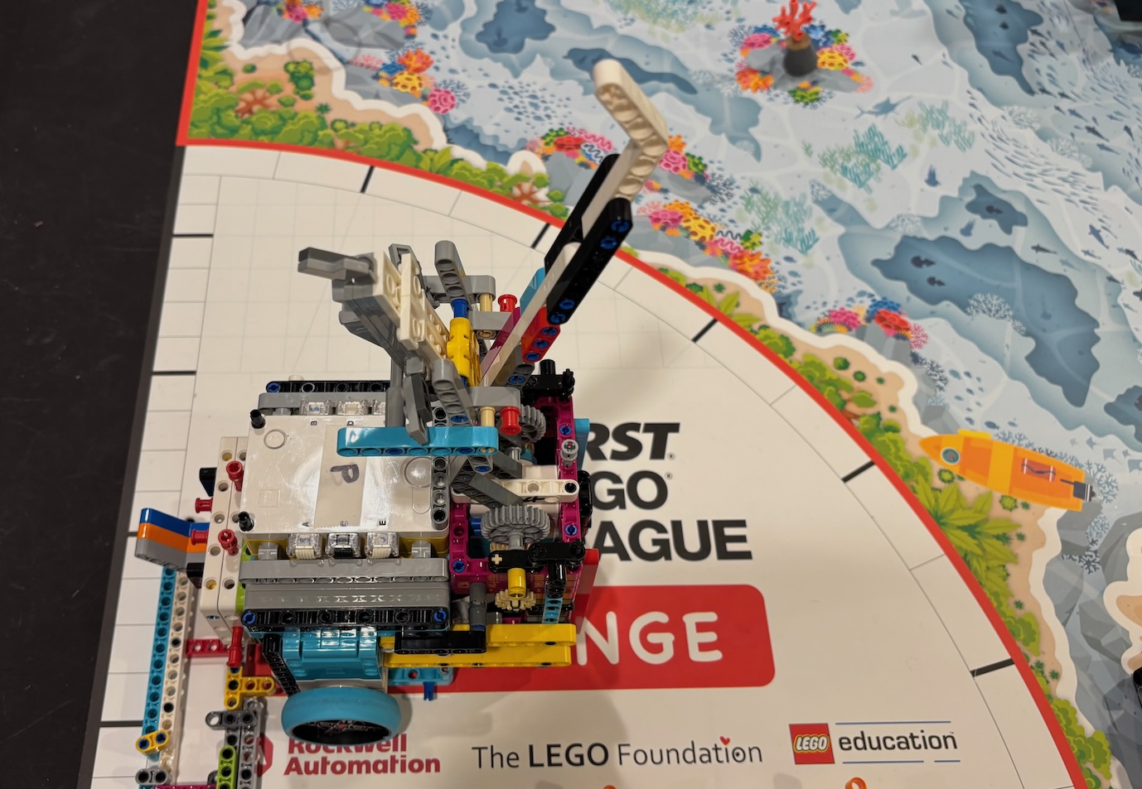
Right Side Start Position for T7

Slide 30
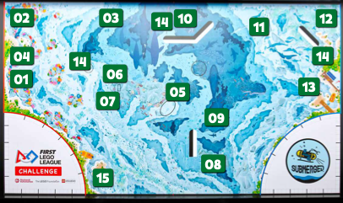
Submerged Missions
Missions
M01: CORAL NURSERY
M02: SHARK
M03: CORAL REEF
M04: SCUBA DIVER
M05: ANGLER FISH
M06: RAISE THE MAST
M07: KRAKEN'S TREASURE
M08: ARTIFICIAL HABITAT
M09: UNEXPECTED ENCOUNTER
M10: SEND OVER THE SUBMERSIBLE
M11: SONAR DISCOVERY
M12: FEED THE WHALE
M13: CHANGING SHIPPING LANES
M14: SAMPLE COLLECTION
M15: RESEARCH VESSEL
All robot game wording means precisely and only what it says. Don’t overthink it!
If a detail is not mentioned, it does not matter.
At an event, your head referee makes the final decision. Text always has authority over pictures.

Slide 31
Task 0 – Clean Up Mat and move robot to right side home,
M09 (“Octopus”) Part 1
Requirements:
M14 – (collect only, still have to put back on board)
  If the water sample is completely outside the water sample area = 5
M03 – (collect only, still have to put back on board)
  If a reef segment is standing upright, outside of home, and touching the mat = 5 each
M09 part 1
  If the unknown creature is released = 20
Start Position: Left Side Home Base
Attachments on Robots:
  Plow
  Octopus Basket

Slide 32
Task 1 – M09 (“Octopus”) Part 1
Merged with Task 0

Slide 33
Task 2 – M09 (“Octopus”) Part 2, M05 (“Angler Fish),
M10 Send over the Submersible,
M11 – Sonar Discovery, M14 - Plankton Sample Part
Requirements:
M09 part 2
  If the unknown creature is at least partly in the cold seep = 10
M05
  If the angler fish is latched within the shipwreck = 30
M10
  If your team’s yellow flag is down = 30
  If the submersible is clearly closer to the opposing Field = 10
  Teams may not block the opposing team. It is not possible to earn the bonus in remote competitions or if there is no opposing team
M11
  If one whale is revealed = 20
  Bonus: If both whales are revealed = 10 added
M14
  If the plankton sample is no longer touching the kelp forest = 10
Start Position: Right Side Home Base
Attachments on Robots:
  Plow
  Octopus Basket
  Downward Spike Lift Arm

Slide 34
Task 3 – M03 Part 3 – Reef Segments (drop off)
Requirements:
M03 Part 2
  If a reef segment is standing upright, outside of home, and touching the mat = 5 each, 15 total
Start Position: Right Side Home Base
Attachments on Robots:
  Plow and Plow Door
  Octopus Basket
  Wing Lift Arm

Slide 35
Task 4 – M13 – Changing Shipping Lanes (“sailboat”), M08 Artificial Habitat (crabs), Drive to Left Home with Samples
Requirements:
M13
  If the ship is in the new shipping lane, touching the mat = 20
M08
  If an artificial habitat stack segment is completely flat and upright = 10 each
Start Position: Right Side Home Base
Attachments on Robots:
  Plow
  Octopus Basket
    NOTE: Water Sample and Plankton are in the basket!
  Wing Lift Arm

Slide 36
Task 5 – M06 – Raise the Mask, M01 – Coral Nursery (p1), M02 Shark (p1), M03 – Scuba Diver, M14 – Seabed Sample
Requirements:
M06
  If the shipwreck’s mast is completely raised = 30
  The shipwreck’s mast is considered raised when the latch prevents it from returning to its starting position
M01 part 1
  If the coral buds are flipped up = 20
M02 part 1
  If the shark is no longer touching the cave = 20
M03 – Part 1 & 2
  If the scuba diver is no longer touching the coral nursery = 20
  If the scuba diver is hanging on the coral reef support = 20
  The “coral nursery” includes any part of the Mission 1 mission model.
M14
  If the seabed sample is no longer touching the seabed = 10
Start Position: Left Side Home Base, right side of rig
Attachments on Robots:
  Lift Arm with Single Beam and Shark Holder
  Pusher

Slide 37
Task 6 - M15 Research Vessel – Part 1
Requirements:
M15 part 1
  If any of the following are at least partly in the research vessel’s cargo area:
    Sample(s) = 5 each
    Trident Part(s) = 5 each
    Treasure Chest = 5
Start Position: Left Side Home Base, left side of rig
Attachments on Robots:
  Lift Arm with Single Beam, Sample, & Shark Holders
  Pusher

Slide 38
Task 7 - M02 – Shark (p2), M14 – Trident
Requirements:
M02
  If the shark is touching the mat and is at least partly in the shark = 10
M14
  If a piece of the trident is no longer touching the shipwreck = 20
  Bonus: If both pieces are no longer touching the shipwreck = 10 added
Start Position: Left Side Home Base, left side of rig
Attachments on Robots:
  Lift Arm with Single Beam, Sample, & Shark Holders
  Pusher

Slide 39
Unassigned Tasks & Missions

Slide 40
Task # - M15 Research Vessel – Part 2
Requirements:
M15 part 2
  If the port’s latch is at least partly in the research vessel’s loop = 20
Start Position: Left Side Home Base, left side of rig
Attachments on Robots:
  Lift Arm with Sample & Shark Holders
  Pusher

Slide 41
Task # - M07 Kraken’s Treasure
Requirements:
M07
  If the treasure chest is completely outside the kraken’s nest = 20
Revision #: X
Status of Implementation: Not started
Position Rig Completed:
Rig #: X
Known Issues: Issues if any

Slide 42
Task # - M12 Feed the Whale
Requirements:
M12
  Krill at least partly in the whale’s mouth = 10 each
Revision #: X
Status of Implementation: Not started
Position Rig Completed:
Rig #: X
Known Issues: Issues if any

Slide 43
Task # - M01 – Coral Nursery Part 2
Requirements:
If the coral tree is hanging on the coral tree support = 20
Bonus: and the bottom of the coral tree is in its holder = 10
Revision #: X
Status of Implementation: Working, Not started, Designed, Partial,etc.., In progress
Position Rig Completed:
Rig #: X
Known Issues: Issues if any

