Slide 1



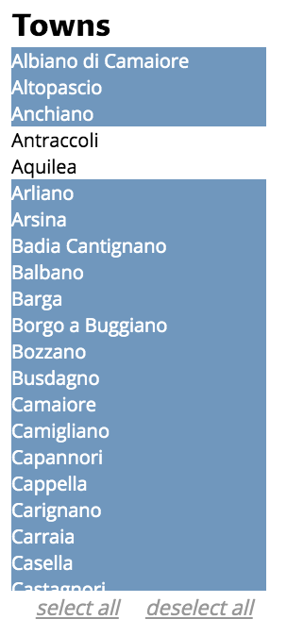
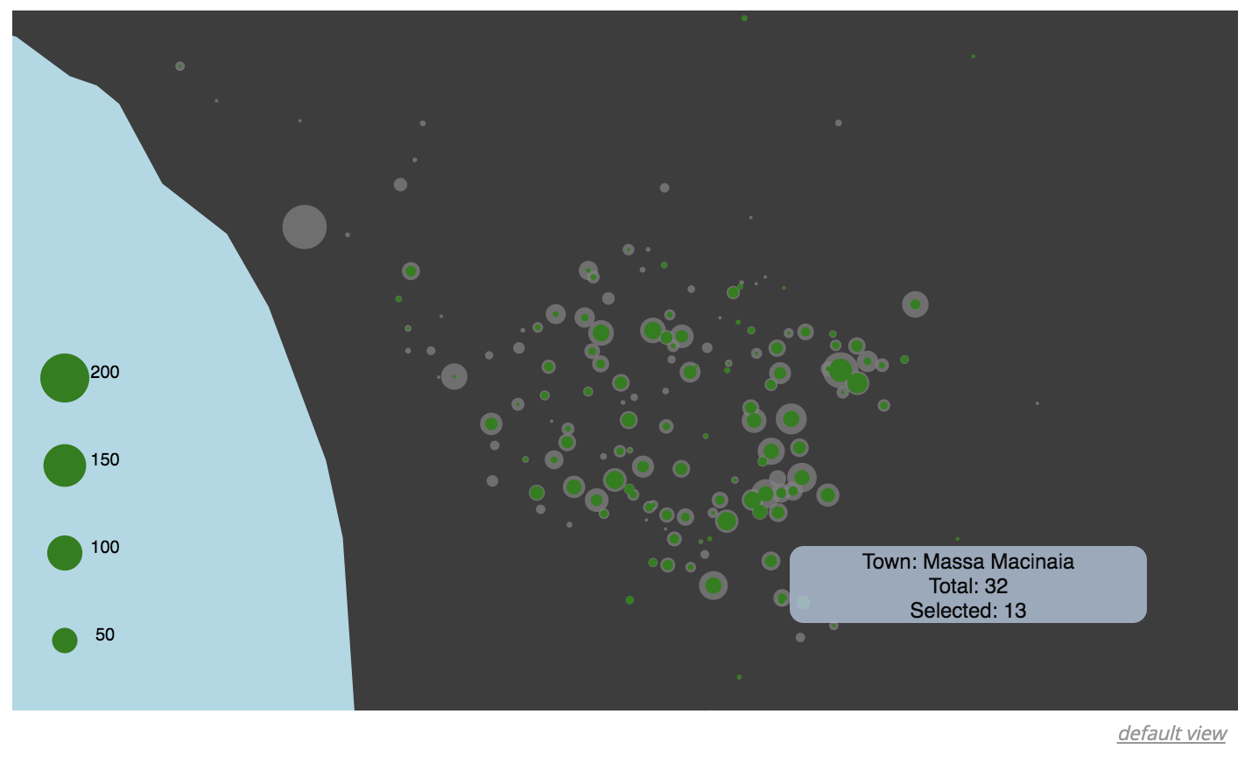
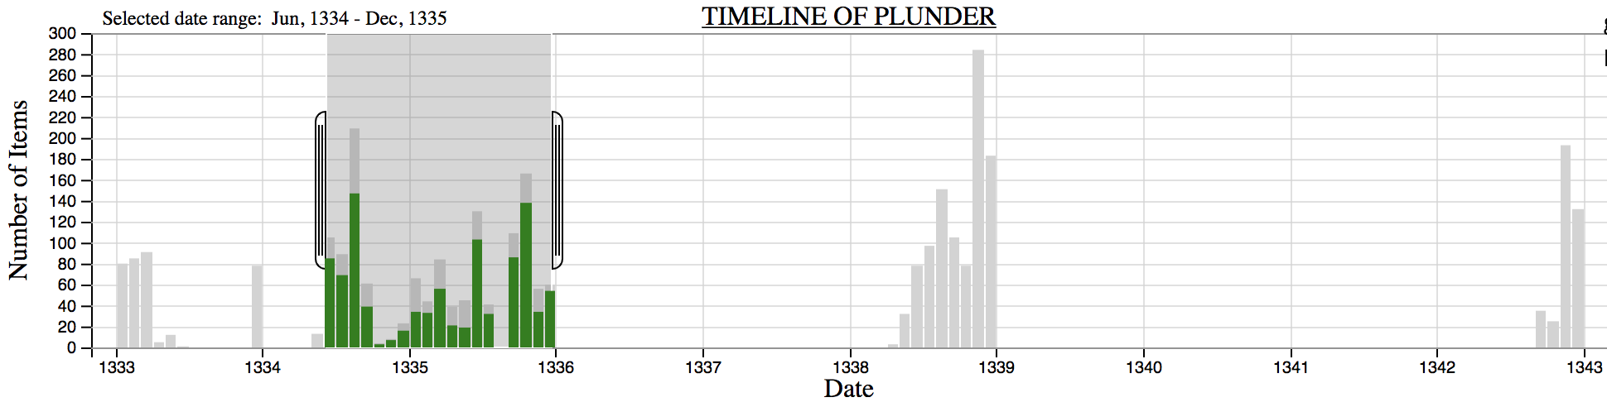
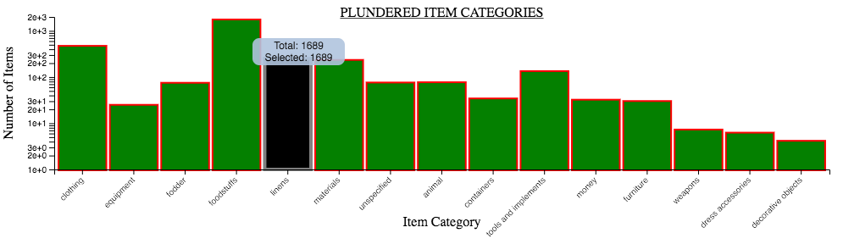
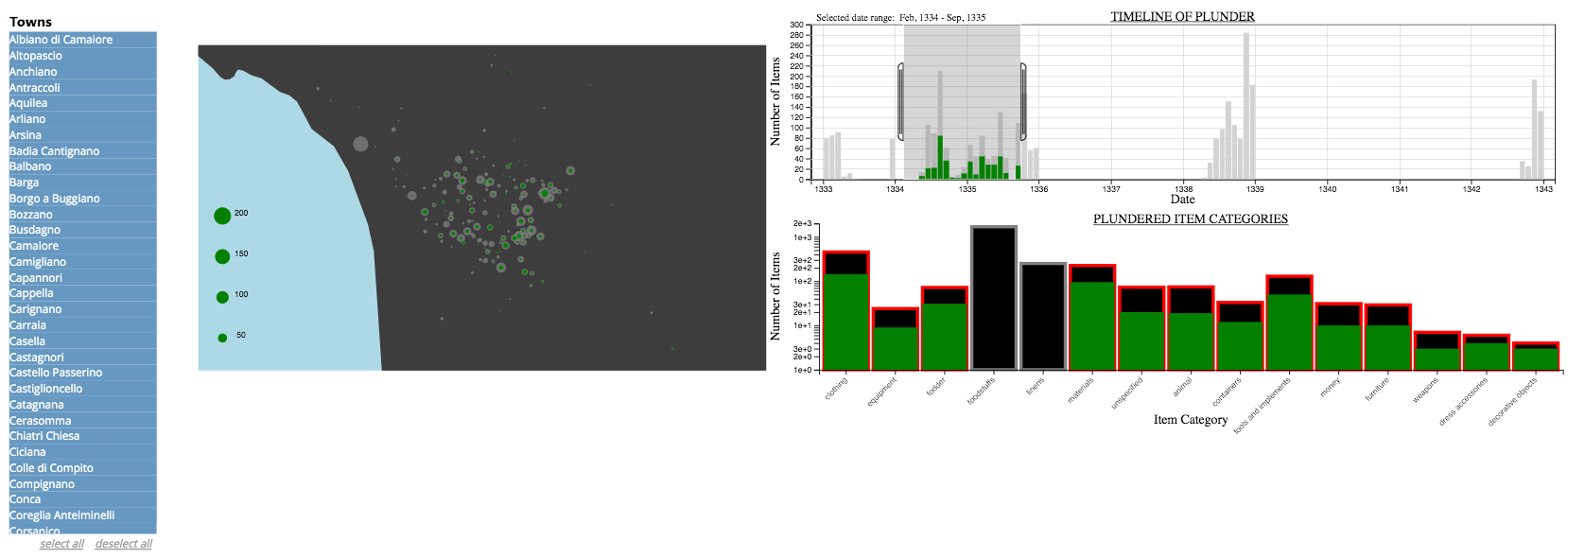
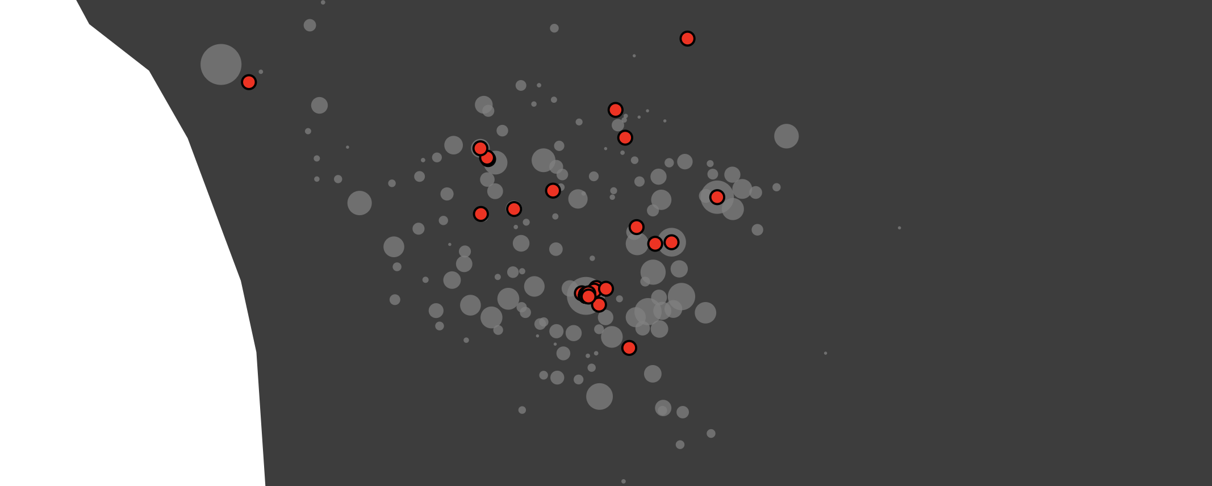

By integrating a set of interactive filters for exploratory data analysis with a cartographic visualization, we create a tool for documentary archaeologists to understand a large corpus of household inventories from late medieval Italy.
Mapping Legal Plunder in Late Medieval Italy
Timothy Akintilo¹, Ashrujit Ghoshal¹, Joseph Janizek¹, Benjamin Lee¹, Gabriel Pizzorno² ¹ Paul G. Allen School of Computer Science & Engineering, ² Documentary Archaeology of Late Medieval Europe, Harvard University
Problem: A clear statement of the problem your project addresses.
Motivation: An explanation of why the problem is interesting and important.
Approach: A description of the techniques or algorithms you used to solve the problem.
Results: Screenshots and a working demo, and an indication of how they effectively address your problem.
Documentary Archaeology of Late Medieval Europe (DALME)
Online database focused on a corpus of household inventories – lists of objects identified during legal proceedings
No specialized standards exist for documentary archaeologies – documents often published without tools necessary for their systematic study
Our particular dataset focuses on records of legal plunder in late medieval Lucca, Italy
Filtering by town
List of names of all towns in database
Highlighted (blue) when selected
No highlighting when deselecting
Upon selection, only records in the active set will be highlighted in the other data views (i.e. colored green on the two histograms and on the map)
Map visualization
Since each record in the database contains geographical coordinates, we wanted to mark all of the records on a map of the region
Each town is marked first as a grey circle, where the radius is proportional to the square root of the total number of records collected from that town in the entire dataset
Each town is then marked again as a green circle, where the radius of the green circle is proportional to the square root of the number of records present in the current filtered selection (see interactive cross-filtering and filtering subsections)
Tool tip provides town name, number of total records, and number of actively selected records
Filtering by timeline
Histogram displays number of records per month over time range of data
Brushing on timeline highlights only records from relevant time range on this sub-visualization, as well as on map and object category histogram
Filtering by object category
Interactive cross-filtering
Working with our collaborator, identified three separate ways we would want to be able to filter records: (1) by town, (2) by data, (3) by item category
Importantly, might want to filter in multiple ways simultaneously
Thus, we implemented interactive cross-filtering
When we change the selection according to one field, we want to interactively display how this changes the selection in other fields
Brushing and clicking to select on multiple sub-plots
Specific object categories can be selected/deselected by clicking directly on the bars in the object category histogram
Selected bars outlined in red, deselected outlined in gray
We see that the vast majority of plundered objects were food
Animating flow of wealth
Every 50 ms we pull a new legal plunder record sequentially from the dataset, create a circle at the geographic location of the former owner, linearly interpolate the circle between this location and the location of the new owner, then remove the circle
Large directed graphs tend to be hard to visualize statically
By animating, we can easily see that plundered wealth tends to flow into Lucca from the surrounding towns
QR Code links to our project page:
https://cse512-19s.github.io/FP-Mapping-Legal-Plunder
Code repository:
https://github.com/cse512-19s/FP-Mapping-Legal-Plunder

