Slide 1

Callbacks, Scopes & Maybe Transactions
Neil Thawani
@neilthawani

Slide 2



Professionally
Currently
Previously

Slide 3


Academically

Slide 4


College Gigs

Slide 5

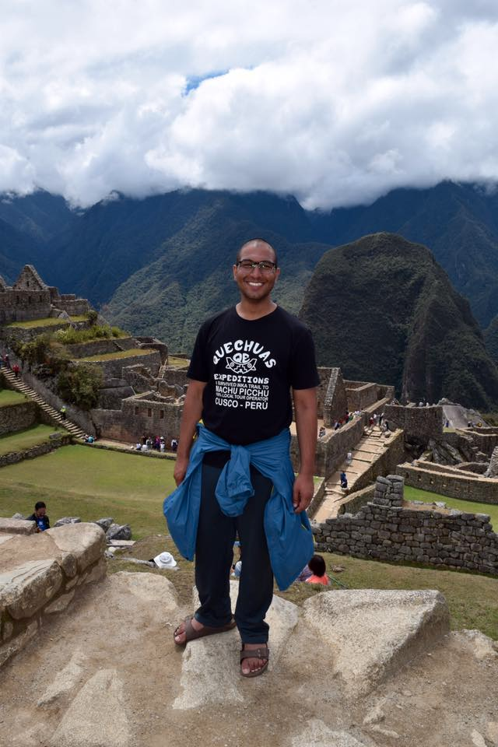

Personally

