Slide 1
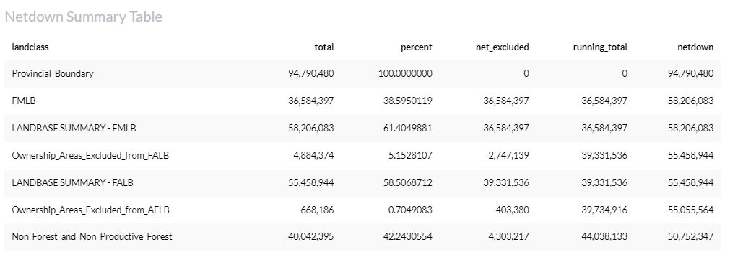
For Non_Forest_and_Non_Productive_Forest netdown inclusion factor:
The total area is 40,042,395 ha which is 42.2% of the Provincial_Boundary area (40042395/94790480*100 = 42.2)
Of the 40,042,395 ha , 4,303,217 ha are excluded. (Other areas have already been excluded from previous netdown area exclusions).
The running total of excluded area is 44,038,133 (39,734,916 ha from previous step plus 4,303,217 from Non_Forest_and_Non_Productive_Forest).
The netdown is the remaining area after excluded areas from current and previous steps are removed (running total + netdown = Provincial Boundary Area)

