Slide 1
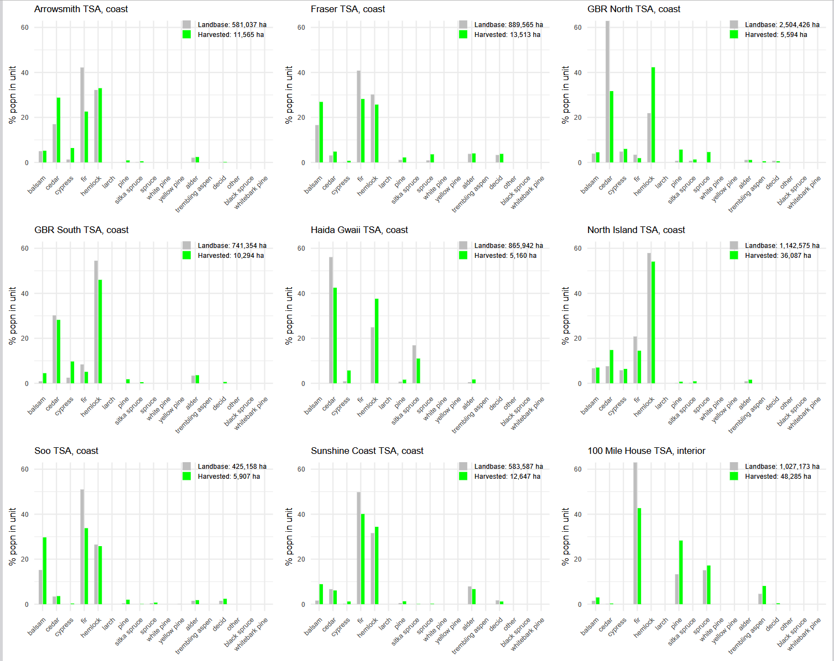
COAST
Suggested non-commercial groupings:
+ Other
+ Black spruce
+ Whitebark pine
+ Trembling aspen
+ spruce
+ larch
+ yellow pine
+ Decid
+ white pine

