Slide 1


Assets Team
Stakeholder Engagement Approach 2020
Notes:
The Corp Plan serves as an excellent tool to help satisfy employees’ desire (2016 Work Environment Survey) for clarity on our vision and mission.
But not if it’s published and sits on a shelf.
It’s by keeping the story alive that we make it real, and get an even stronger commitment to achieve the goals.
This strategy works to make this happen – and I’m here to seek your approval to move forward.

Slide 2

What We’re Focused On
Modernize the PPR System
Enable Private Sector Value Addition

Slide 3
What We’re Working Towards
Discourage Fraud & Misuse
Data Integrity
Being More Accountable & Continuous Improvement Oriented

Slide 4
Stakeholder Overview
Internal Stakeholders: Operations, Help Desk
External Stakeholders:
New Private Partners

Slide 5
Working Group Structures
Working Group 1: Internal Stakeholders
Registries staff, Service BC staff
Working Group 2: External Stakeholders
Registries staff, Service BC staff
Working Group 3: Pro-Data / B2G
To be formed after the official introduction to the target B2G stakeholders
Working Group 3
Working Group 2
Working Group 3

Slide 6
FY 19/20 Q4 Engagement Activities

Slide 7
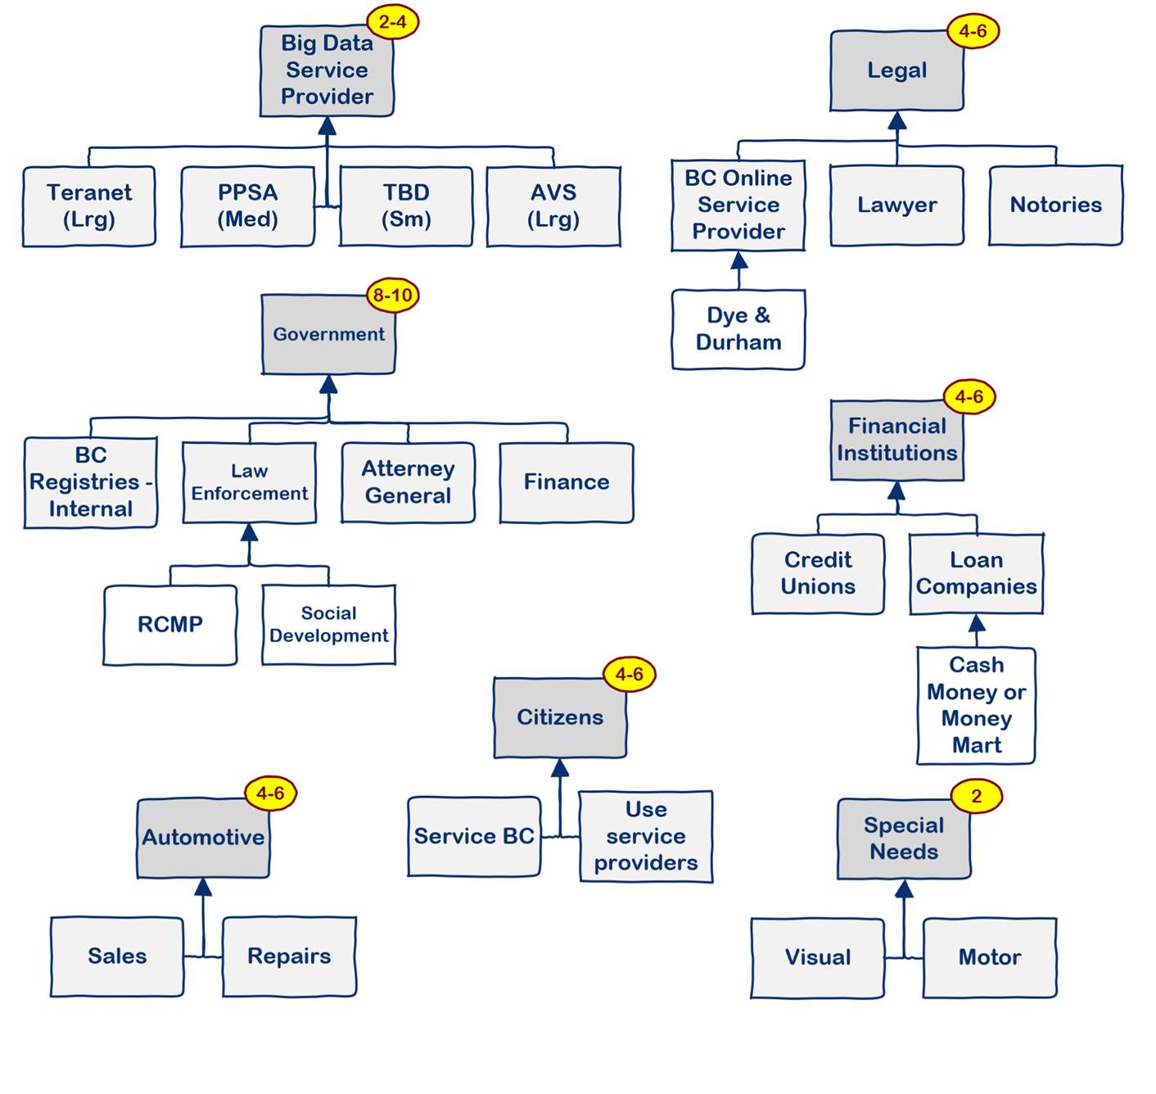
Assets Q4 User Research
Call out for study participants - Feb 21st - Feb 28th
Collect Survey Information & - Feb 21st - Feb 28th Screen Respondents
Conduct Virtual Interviews - Mar 2nd - Mar 13th
Finalize & Present Report Out - Mar 16th - Mar 25th

