Slide 1

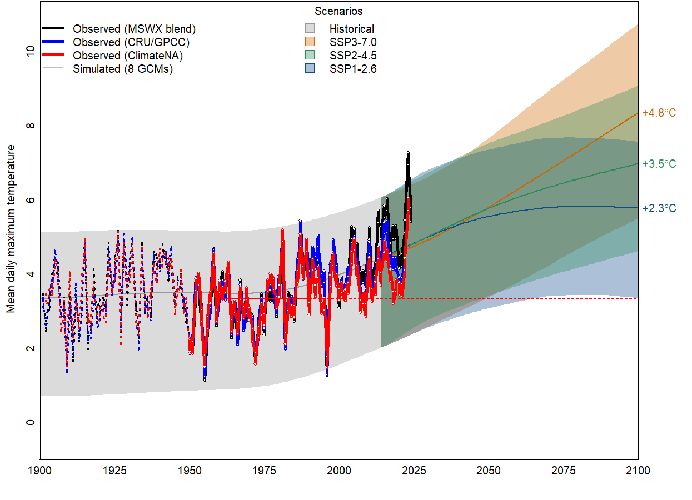







Time Series Plot for Mackenzie FLP Area
Year 1901-2100 on the x-axis
User-selected climate variable on the y-axis
Observed historic climate data by dataset (black, red and blue lines), from 1901-2024
Generalized range (min to max) of simulated historical year-to-year variability in the ensemble of 8 global climate models (GCMs), from 1901-2014 (gray shading)
Generalized range (min to max) of year-to-year variability the GCM ensemble for each SSP emissions scenario (blue, green, and orange shading), from 2015-2100
Generalized ensemble mean, by SSP (blue, green, and orange lines), from 2015-2100
Change in the ensemble mean for each SSP at year 2100 relative to the 1961-1990 baseline
1961-1990 baseline
Notes:
Time series plots of 20th and 21st century climate change for user-selected locations and climate variables.
Purposes of the plot:
View differences in interannual variability and climate change trends among global climate models (GCMs)
View the differences between multiple simulations of each model
Compare simulated and observed climate change from 1901 to present
Compare time series of two different variables
All global climate model anomalies are bias-corrected to the 1961-1990 reference period normals.

Slide 2
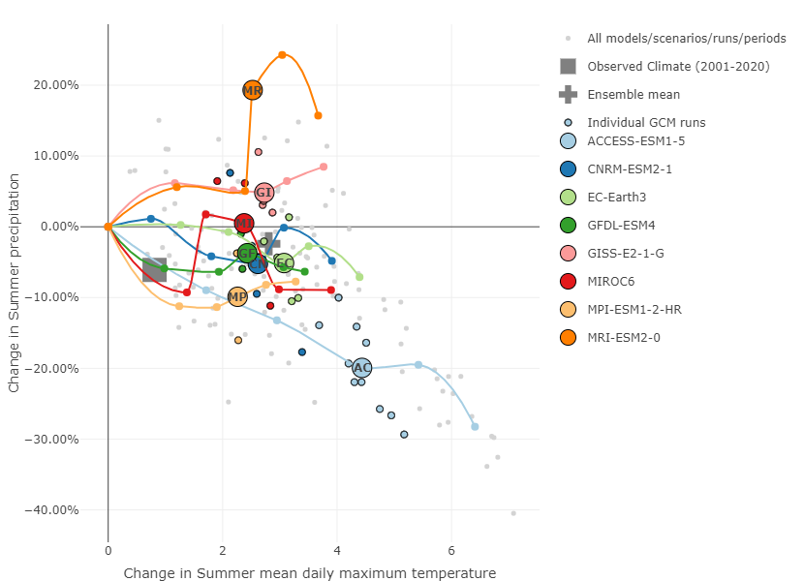
Bivariate Plot for 100 Mile House FLP Area; 2041-2060
All changes in climate are measured relative to the 1961-1990 mean climate.
Small coloured dots are the 20-year average change for one simulation of a global climate model (GCM) in the user-specified time period (2041-2060 in this case) for the SSP2-4.5 scenario.
Larger colored and labelled dots are the GCM’s mean change for the user-specified time period (i.e., the mean of the smaller dots of the same color).
Other points along the line are the GCM mean change for other time periods (i.e., 2061-2080).
The line connects the GCM mean changes for the five 20-year periods, indicating the trajectory of climate change projected by the GCM.
The ensemble mean (grey cross) is the average of the GCM mean change (larger colored dots).
Notes:
Bivariate climate change plot
The bivariate plots show projections of 21st century climate change for user-selected climate variables. The main purposes of the plot are to:
- Show differences in climate change trends among global climate models (GCMs);
- Show the differences between multiple simulations of each model; and
Compare simulated climate change to observed climate change in the 2001-2020 period.
We recommend using temperature variables as the x-axis. This provides a representation of how the y-axis variable is projected to change in proportion to regional climate heating.
Details
- All climate changes are relative to the mean climate of the 1961-1990 period.
The observed climate change in the 2001-2020 period is obtained from the MSWX-blend dataset.
Change values are for the SSP2-4.5 emissions scenario only. We have not provided other scenarios as they tend to differ only in magnitude rather than trends and variation, which are the focus of this plot.

Slide 3
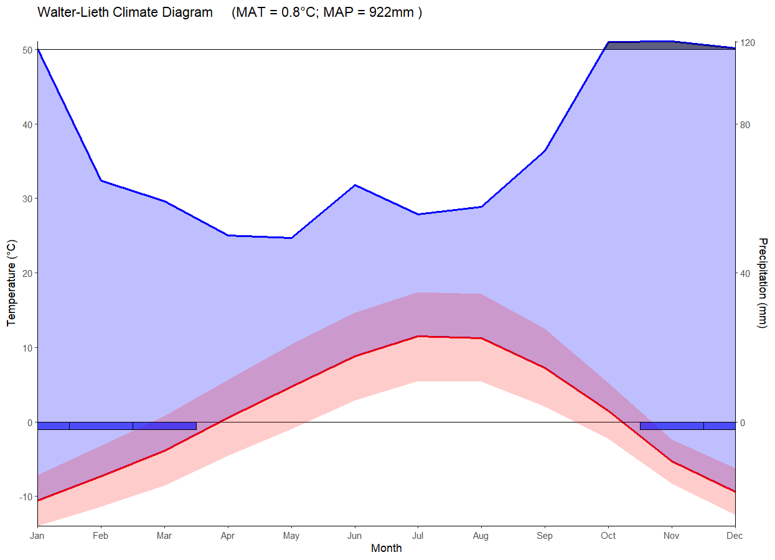
Bulkley-Morice FLP Area; 1961-1990
Average annual temperature & precipitation
Temperature axis
Precipitation axis
Months of the year
Months with likely frost (blue bars)
Average monthly temperature curve
Average monthly precipitation curve
Diurnal range (difference between the highest and lowest temperature recorded in a 24-hr period – red shading)
Notes:
The Walter-Lieth climate diagram was developed by German climatologists Heinrich Walter and Helmut Lieth in the 1950s–60s as part of their efforts to standardize the visualization of climate data for ecological zoning and global vegetation classification. The diagrams are a simple way to graphically represent seasonal patterns of temperature and precipitation at a given location, and to compare the climates of different regions.
The diagram provides an overview of climate seasonality using a dual-axis plot.
- Temperature (°C) is plotted on the left vertical axis.
- Precipitation (mm) is plotted on the right, typically at a scale where 2 mm of precipitation corresponds to 1°C (the 1:2 ratio).
The 1:2 scaling allows for a simplified identification of arid periods. However, this is only a rough proxy for climatic moisture deficit and does not directly integrate potential evapotranspiration and relevant factors like wind, humidity, or radiation. Therefore, the diagram should not be interpreted as a quantitative water balance diagram.

Slide 4
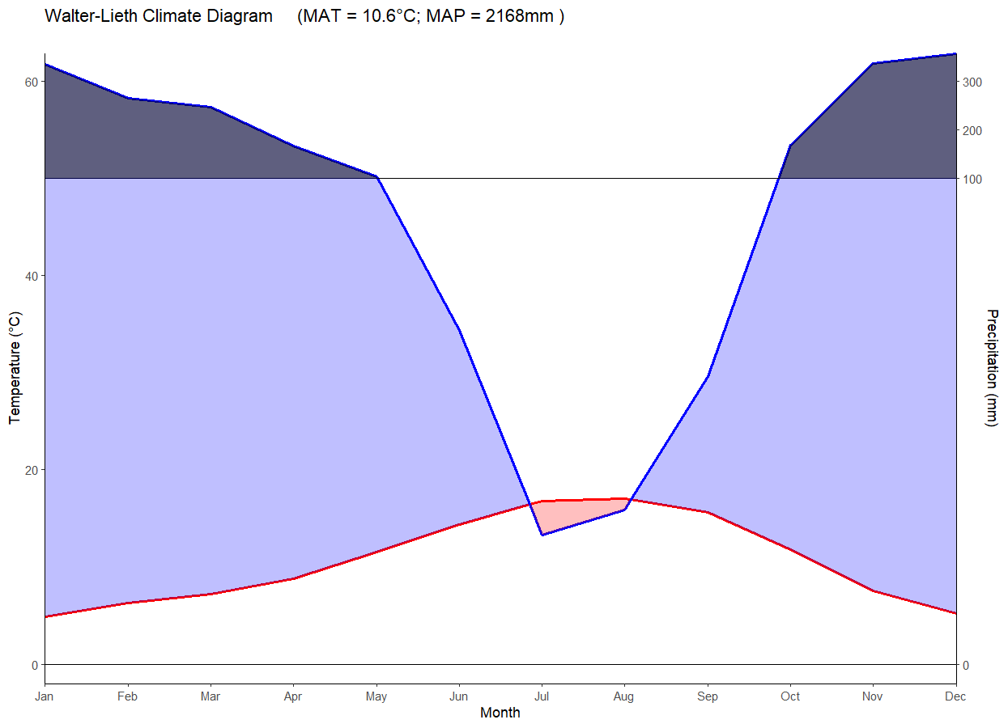
Coast Range Ecoregion; 1961-1990
Wet period:
When the blue line is above 100m, conditions are wet
Dry period:
When the red line is above the blue line, conditions are dry
Humid period:
When the blue line is above the red line, conditions are humid
Notes:
How to interpret climatic trends:

