Slide 1

Introduction to
Data science
with Python
1
2
3
4
Welcome!
Please find a seat and get settled
Start your laptop and check internet
We will start at 9.00am!

Slide 2
Welcome!
Presenter introduction
Lindsay Forestell
Stuart Hemerling
Acknowledgement
Indigenous Peoples and Lands (cirnac.gc.ca)
The First Nations Principles of OCAP® - The First Nations Information Governance Centre (fnigc.ca)
Native-Land.ca | Our home on native land
1
2
3
4

Slide 3
The Learning Environment
1
2
3
Content is new, developed by the DSP team
Geared to the practice of data science
Course is interactive – no textbook - you will be coding and saving your work for future reference
We will aim to start/end sessions on time
4

Slide 4
Day 1
9:00-9:30 - Course Introduction (20 min) (Stuart)
9:30-10:30 - Getting Up and Running (60 min) (Lindsay)
10:30-10:45 BREAK ☕
10:45-Noon Working with Code (90 min) (Stuart)
Noon-I:00 LUNCH 🍍
1:00-2:30 Core Data Structure Concepts (90 min) (Lindsay)
2:30-2:45 BREAK 🍩
2:45-4:30 Getting Data (90 min) (Lindsay)
Day 2
9:00-10:30 - Data Cleaning (90 min) (Stuart)
10:30-10:45 BREAK ☕
10:45-Noon Exploring Data with Pandas (90 min) (Stuart)
Noon-1:00 LUNCH 🍍
1:00-2:30 Graphical Depictions of Data (90 min) (Lindsay)
2:30-2:45 BREAK 🍩
2:45-4:30 Bonus Content: TBD (90 min) (TBD – Learners vote on topic end of Day 1!)
1
This is a general guide of what will be covered – some sections may start or end earlier or later than outlined!
2
3
4

Slide 5
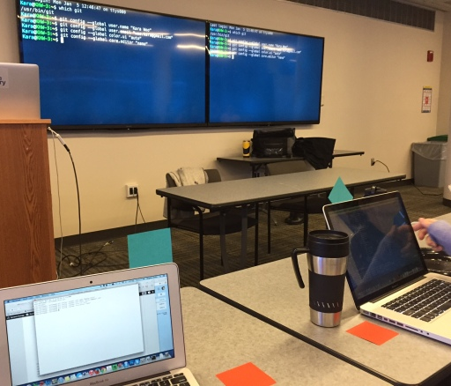
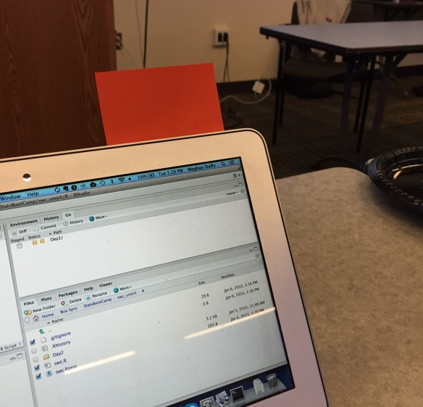
Sticky Notes
1
As Status Flags
Green is "I'm done!"
Red is "I need help!"
No flag means "Working on it"
Please put your name on both so we can get to know each other properly!
2
3
4
Notes:
Gauge progress in the class
Can keep working while flag is raised (hard to type one-handed)
More discreet than hand-raising
At lunch and/or at end of day, learners can write one thing that’s going well on note, and one thing that they’re struggling with on the other. Can help change track or address common misunderstandings early.

Slide 6
Collaborative Note Taking: Etherpad
1
https://etherpad.wikimedia.org/p/bcgov-intro-python-jan23
Where we can share challenges and solutions throughout course
Let's start by going there!
2
3
4
Notes:
It allows people to compare what they think they’re hearing with what other people are hearing, which helps them fill in gaps and correct misconceptions right away.
It gives the more advanced learners in the class something useful to do. Rather than getting bored and checking Instagram during class, they can take the lead in recording what’s being said, which keeps them engaged and allows less advanced learners to focus more of their attention on new material.
The notes the learners take are usually more helpful to them than those the teacher would prepare in advance, since the learners are more likely to write down what they actually found new rather than what the teacher predicted would be new.
Glancing at recent notes while learners are working on an exercise helps the teacher discover that the class missed or misunderstood something.

Slide 7
Getting up and running
1
2
3
4
Introduction to Python
Get And Clean Data
Understand and Analyze Data
Advanced Topics

Slide 8
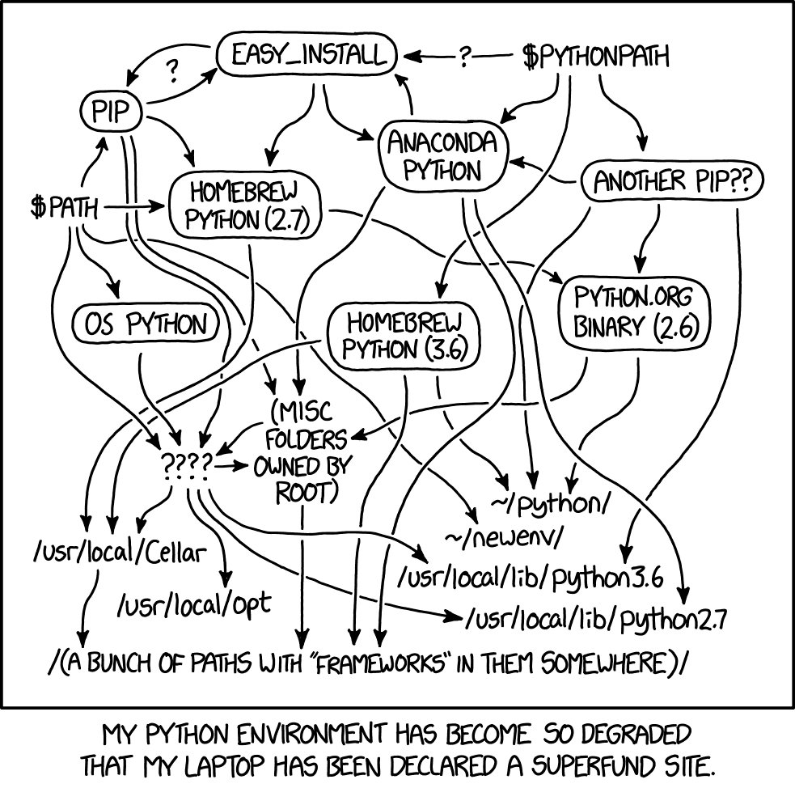
Why use conda?
1
2
3
4

Slide 9
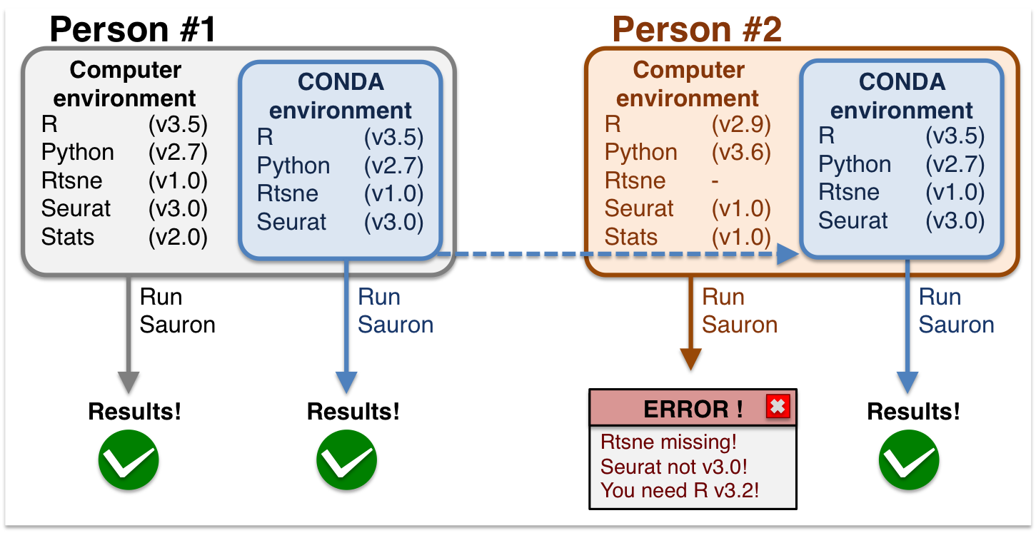
Why use conda?
1
2
3
4

Slide 10
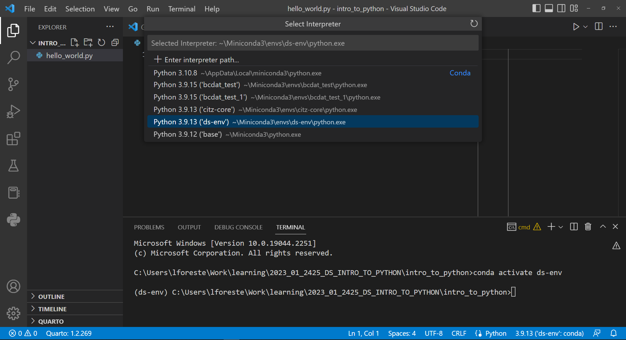
Remember to double check:
1
Does my command line start with the right environment name?
Is VS Code using the right environment?
2
3
4

Slide 11
Different Environments for Different Purposes
1
Jupyter Lab
VS Code
Barebones IDE
Useful for exploratory and documented analysis done in notebooks
.ipynb files
Displays plots inline, between cells of code
More wholistic IDE (integrated developing environment)
Useful for running, testing, debugging scripts
.py files
Displays plots externally
No notion of code cells
2
3
4

Slide 12
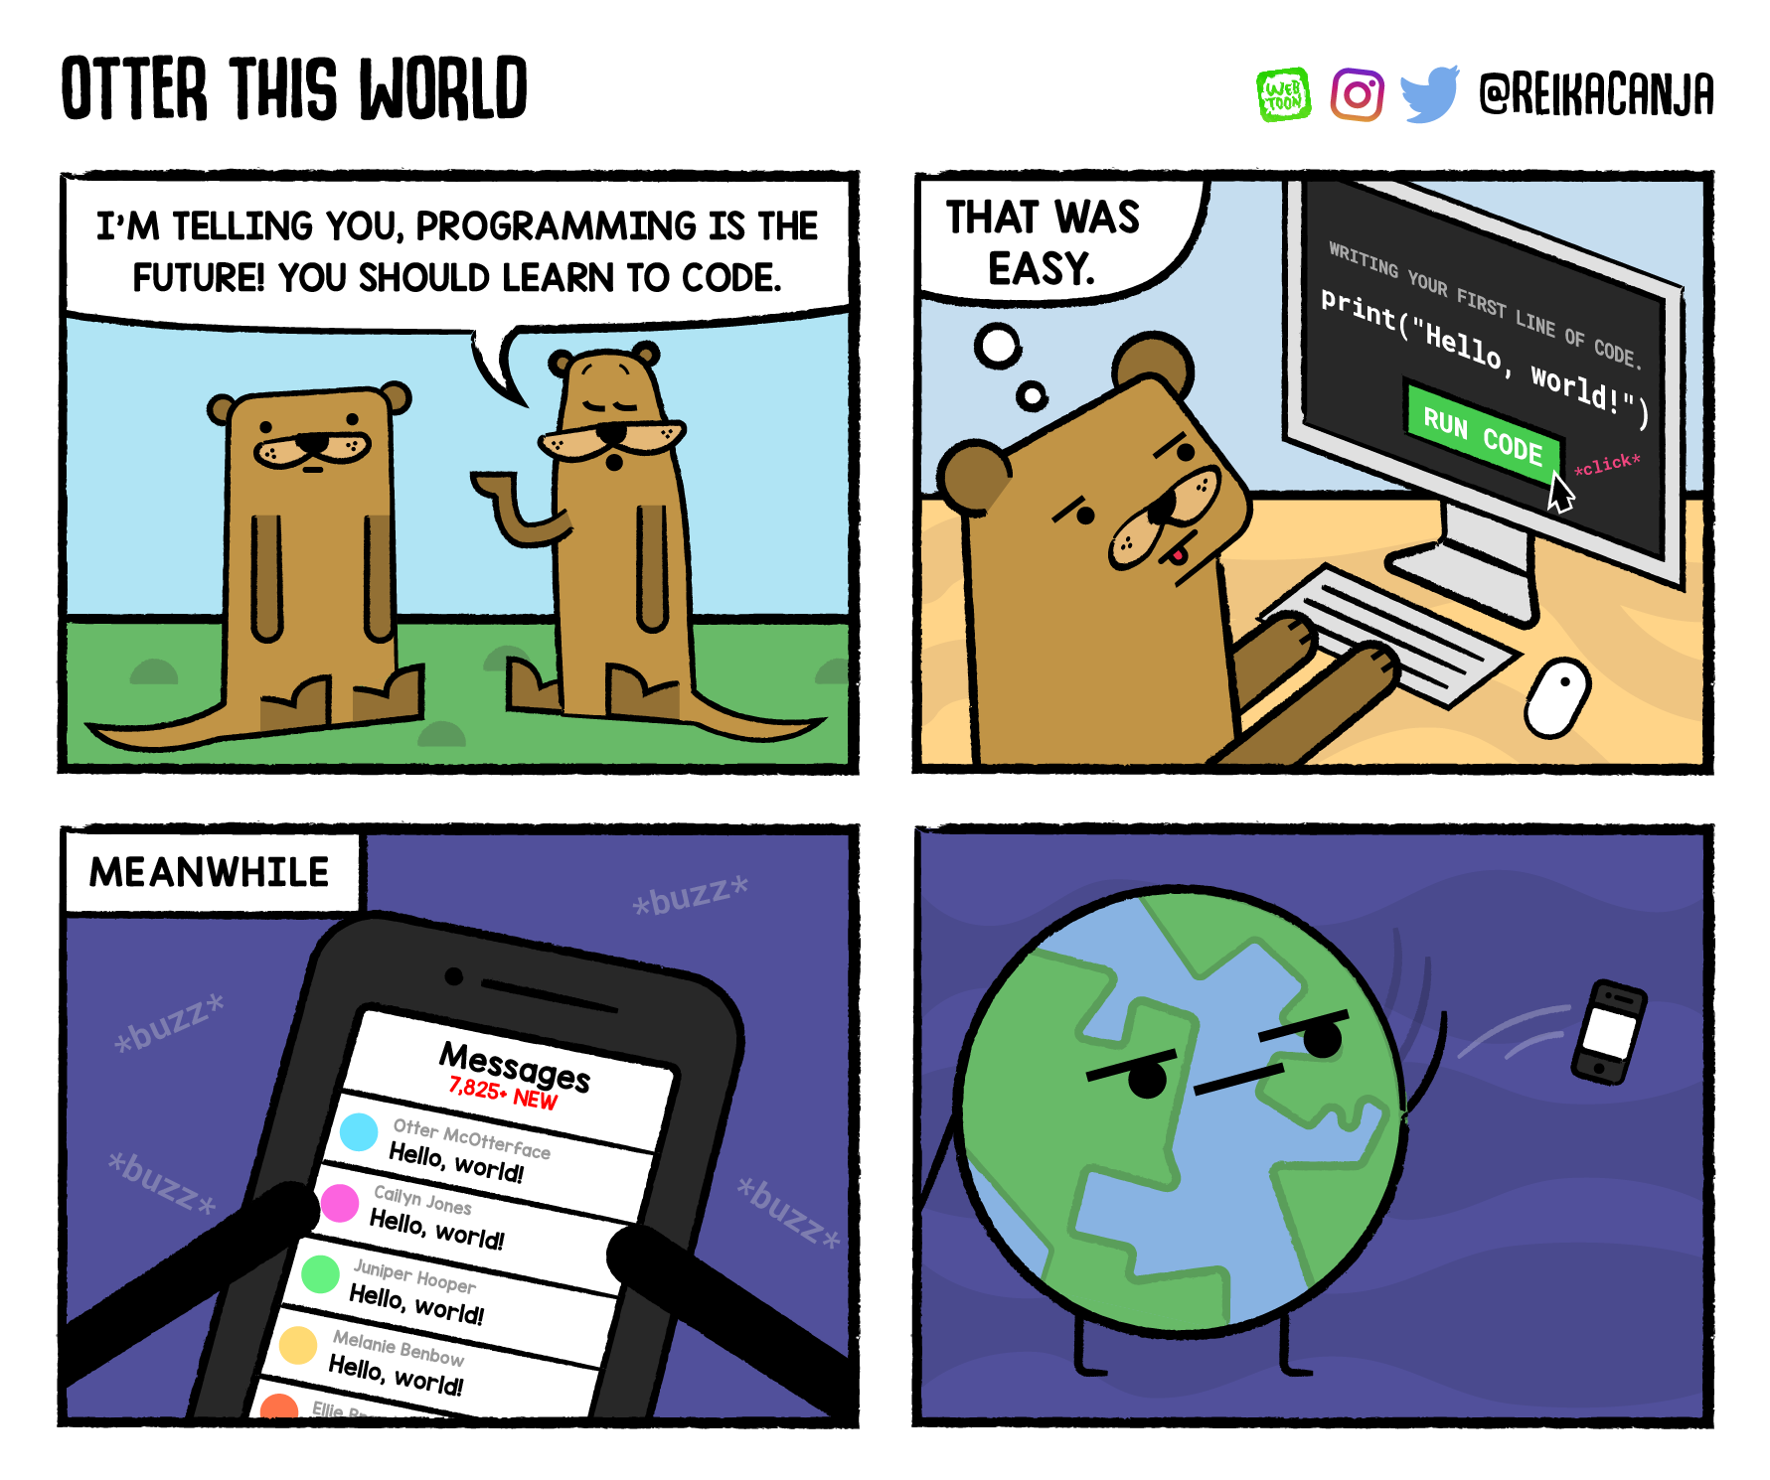
Hello, world!
1
2
3
4

Slide 13
Challenge 1
1
In the hello_world.py file, run the second line of code.
Add a third line of code that prints your favourite TV show, and print this line.
2
3
4

Slide 14
Challenge 2
1
Try clicking the play button again.
What happens here? Can you explain why?
2
3
4

Slide 15
Challenge 3
1
Rename the notebook to hello_world.ipynb
2
3
4

Slide 16
Challenge 4
1
Print ‘Hello World’ inside the Jupyter Notebook.
2
3
4

Slide 17
WORKING WITH CODE
1
2
3
3
Introduction to Python
Get And Clean Data
Understand and Analyze Data
Advanced Topics

Slide 18
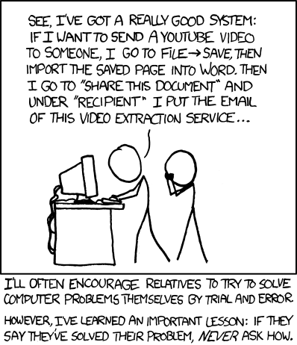
Organizing Matters
1
2
3
4

Slide 19
Organizing Principles
Treat data as read only
2. Clean and analyze your data with code
3. Treat generated output as disposable
4. Organize your files
1
2
3
4

Slide 20
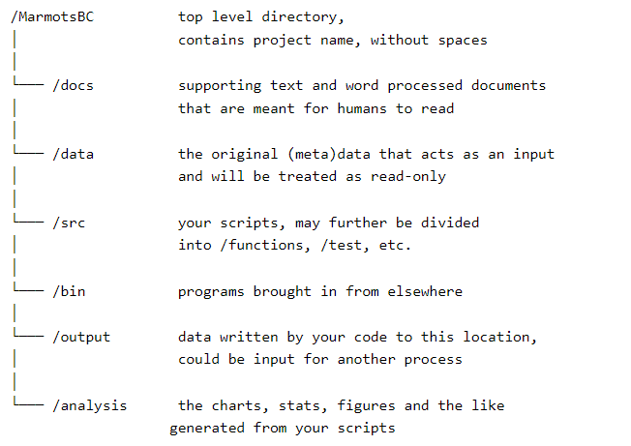
File Organization "Template"
1
2
3
4

Slide 21
Challenge 1
1
What are three activities associated with a project that are made more difficult and put at risk if project files are not kept well organized? Who is likely to be affected?
2
3
4
Notes:
Activities that will be affected include:
interpreting outputs
fixing errors that arise
extending the project.
Existing or future team members will be most directly affected. Ultimately downstream users of the data may also be impacted.

Slide 22
Challenge 2
1
If output is generally considered the most usable thing for end-users of data, why should it be considered as disposable?
2
3
4
Notes:
Output can always be reproduced if the data itself and details about how the data is transformed (cleaned, munged, analyzed, etc.) is available. The loss of things that can be generated from data and code is not a serious risk to the project.

Slide 23
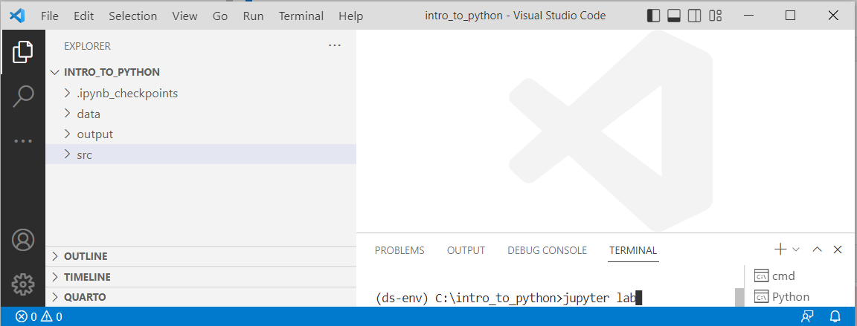
Getting Help
1
Let's get coding!
2
3
4

Slide 24
Challenge 3
1
You want to find out what the print() function does. How would you look to answer this question? What does it do, does it send a print job to a printer?
2
3
4
Notes:
Use one of the two most efficient ways to obtain information
help(print) # One way to get the info
Help on built-in function print in module builtins: print(...) print(value, ..., sep=' ', end='\n', file=sys.stdout, flush=False) Prints the values to a stream, or to sys.stdout by default. Optional keyword arguments: file: a file-like object (stream); defaults to the current sys.stdout. sep: string inserted between values, default a space. end: string appended after the last value, default a newline. flush: whether to forcibly flush the stream.
print() # Shift-tab another way to get the info
Does not send to a physical printer! Prints the values passed into it to a stream or to an output (usually to output shown on a monitor).

Slide 25
Challenge 4
1
Someone asks you want the term “iterable” means in the context of a python function? How would you go about finding an answer? What does it mean?
2
3
4
Notes:
You could use help off of the menu. Might be quicker to do a Google search.
Iterable is an object which can be looped over or iterated over with the help of a for loop. Objects like lists, tuples, sets, dictionaries, strings, etc. are called iterables. In short and simpler terms, iterable is anything that you can loop over.
You may or may not know what “loops” are, but perhaps have heard of lists and such. Particularly at the beginning of your Python journey, there will be terms that you will not yet be familiar with that will show up in explanations of other things. Don’t worry! As with anything, this will occur less and less often over time.

Slide 26
Coding in Style
1
Let's get coding!
2
3
4

Slide 27
Challenge 5
1
Based on what we have covered, what, if any are the style code issues.
# Example 1 print (last_name) # Example 2 celcius = (fahrenheit - 32) / 1.8 # Example 3 index = ['snail', 'pig', 'elephant', 'rabbit', 'giraffe', 'coyote', 'horse', 'giraffe', 'ping pong']
2
3
4
Notes:
Example 1: there should be no space between the function call and the “(”
Example 2: there should be no space between “fahrenheit”, the “-” operator, and “32”
Example 3: line exceeds 79 characters so should be spaced over two lines

Slide 28
CORE CONCEPTS
1
2
3
4
Introduction to Python
Get And Clean Data
Understand and Analyze Data
Advanced Topics

Slide 29
Challenge 1
1
So far in the notebook we should have:
variable_name = 'variable_value’
first_name = 'Loki’
age = 1054
In the next cell, run the following command:
print(last_name)
What happens?
Why?
How can we fix it?
2
3
4

Slide 30
Challenge 2
1
Fill in the table below, showing the values of each variable in this program after each statement is executed.
2
Command | Value of x | Value of y | Value of swap
x = 1.0 | 1.0 | Undefined | Undefined
y = 3.0 | 1.0 | 3.0 | Undefined
swap = x | 1.0 | 3.0 | 1.0
x = y | 3.0 | 3.0 | 1.0
y = swap | 3.0 | 1.0 | 1.0
3
4

Slide 31
Challenge 3
1
Given the following string:
full_name = 'Peregrin Fool of a Took Pippin'
What would these expressions return?
full_name[2:8]
full_name[11:] (without a value after the colon)
full_name[:4] (without a value before the colon)
full_name[:] (just a colon)
full_name[11:-3]
full_name[-5:-3]
What happens when you choose a stop value which is out of range? (i.e. try full_name[0:42] or full_name[:103]
2
3
4

Slide 32
Lists vs Dictionaries
1
Lists: use an ordered index, starting at 0
Error!
list[2]
list[‘color’]
2
0 1 2 3 4
apple | banana | orange | potato | otter
orange
3
A ‘key’ ‘color’ 99 ‘cute’
4
Dictionary: uses an unordered index, using values supplied by you, the coder
dictionary[2]
dictionary[‘color’]
Error!

Slide 33
Data Types
1
Integers (int)
positive or negative whole numbers
42, -7, 90_210, 0, …
Floats (float)
real fractional numbers
3.14159, -87.6, 0.0, …
Strings (str)
text written either in ‘single’ or “double” quotes
‘Hello, World!’, “42”, ‘zero’
Booleans (bool)
the logical values of True and False
2
3
4

Slide 34
Challenge 4
1
Use the help() and round() functions to print out the value of:
2.71828182845904523536
to 0 and 2 decimal places
2
3
4

Slide 35
Challenge 5
1
What will be the output of the following block of code?
num = 42
animal = 'otter’
if num==42 and animal=='mouse’:
print('Correct, that is the animal that found the answer’)
elif num==42 and animal!='mouse’:
print('Almost, the number is correct but not the animal.’)
animal = 'dolphin’
elif num!=42 or animal=='mouse’:
print('Almost, the animal is correct but not the number.’)
num = 5
elif (1>3) or (4>3):
print('This has nothing to do with it, we just needed an or statement’)
else:
print('Not even close, those pesky mice need to work harder.’)
num = 19
animal = 'kangaroo’
print('The end result is the number', num, 'and animal', animal)
2
3
4

Slide 36

Objects in Python
1
Class:
Cat
Attributes
Methods
weight: 19 lbs
number_of_legs: 4
predatory_instinct: True
meow()
eat()
sleep()
enter_room()
exit_room()
name: Coco
play()
type: calico
2
3
4

Slide 37
Challenge 6
1
We currently have the string:
my_string = 'Peter Piper Picked a Peck of Pickled Peppers’
What happens if we try to run the following block of code:
print(my_string.isnumeric().upper())
2
3
4

Slide 38
Challenge 7
A common data string you see across government are various personal IDs. One example is the Personal Education Number (PEN), which is a nine-digit number assigned to you when you enter the K-12 School System. Oftentimes when looking at such an ID, any leading zeros that are an actual part of the PEN get stripped away, leading to unevenly sized strings of IDs across the dataset.
Write a piece of code for PEN IDs that does the following:
Checks to make sure that the ID is entirely numeric. If it is not, print out a warning that this is an invalid PEN.
If the PEN is numeric, make sure that it is less than or equal to 9 digits long. If it is longer, print out a warning that this is an invalid PEN.
If the PEN is too short, make sure to pad it with the appropriate number of 0’s to the left. Print out the correct PEN.
1
Try your code out with the following PENs:
pen_1 = '12345678x’
pen_2 = '123456789’
pen_3 = '1234567890’
pen_4 = 123456789
pen_5 = '123456'
2
3
4

Slide 39
Common Package Aliases:
1
Package | Alias
pandas | pd
matplotlib.pyplot | plt
seaborn | sns
numpy | np
2
3
4
import PACKAGE as ALIAS

Slide 40
Getting data with Pandas
1
2
3
3
Introduction to Python
Get And Clean Data
Understand and Analyze Data
Advanced Topics

Slide 41
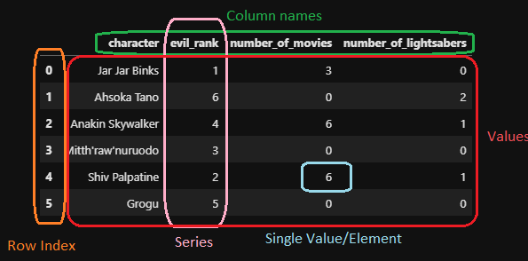
Pandas Dataframes
1
2
3
4

Slide 42
Challenge 1
1
Bring the gapfinder dataset back into pandas.
This time:
Use the country as the index
Only include the year, continent and population columns
Hint: ?pd.read_csv
Hint 2: What do the arguments index_col and usecols do?
2
3
4

Slide 43
Challenge 2
1
We have the gapfinder dataset loaded into an object called df
What will happen if we run the following code:
df.sample(42).describe()
Do we expect the results to be the same as df.describe()? Why or why not?
Run the code again. Are the results the same or different than before? Can you explain?
2
3
4

Slide 44
Beginning of a Reproducible Pipeline
1
stat_results
histogram_1
scatter_plot_1
Python
my_data
my_clean_data
2
3
Project Folder
analysis/stat_results.csv
analysis/histogram_1.png
analysis/scatter_plot_1.png
data/my_data.csv
output/clean_data.csv
4
src/clean_data.py
src/analyze_data.py

Slide 45
Challenge 3
1
Save a copy of all the summary statistics for the gapfinder dataset.
Only include the statistics for the pop and lifeExp columns.
What happens when we include or exclude the index?
Hint: columns, index
2
3
4

Slide 46
CLEANING DATA
1
2
3
3
Introduction to Python
Get And Clean Data
Understand and Analyze Data
Advanced Topics

Slide 47
Challenge 1
1
You are given a dataset for several days time frame in Feb/March 2021 of the average daily temperature in celcius for three Canadian cities. You would like to ultimately create a plot of the temperatures but don’t want to have gaps in the data. Run the code below to get the data and see what it looks like.
import pandas as pd temps = "https://raw.githubusercontent.com/bcgov/" \ "ds-intro-to-python/main/data/citytemps.csv" city_temps = pd.read_csv(temps) city_temps.head(10)
Unfortunately you notice that several of the days have data missing. Write code that leverages the interpolate() function to fill in the missing data. Run the code. Is this an appropriate solution for the problem? What are the pros and cons to this approach.
2
3
4
Notes:
Here we can see how the values “smooth” out the data. Were we to go ahead and plot the data, it would make more sense.

Slide 48
Challenge 2
1
You would like to clean up the scale used in the question about whether one’s mental illness affects one’s work.
Find the column (pandas series) that needs to be transformed and transform its values using replace() with numerical values that make sense.
Display the modified dataframe showing the replaced values.
2
3
4
Notes:
See web page

Slide 49
Exploring data structures
1
2
3
3
Introduction to Python
Get And Clean Data
Understand and Analyze Data
Advanced Topics

Slide 50
Challenge 1
1
Let’s say you want to narrow down the dataset to include only the country and the year. How would you do it? Don’t forget to run your code so it also shows a view of the result so you can confirm the code worked as you wanted it to.
2
3
4
Notes:
First you would like to create a new object to hold this narrowed down version of the dataset, then use the .head() to see some of the resulting data.
challenge1_df = country_metrics[['country', 'year']] challenge1_df.head(2)

Slide 51
Challenge 2
1
Your director has come to you and asked if you know what the life expectancy has been in Canada since 1992. How would you use pandas code to get the data you need? And after having run the code, what’s the answer?
2
3
4
Notes:
First you would like to create a new object to hold this narrowed down version of the dataset, then use some method like .print() or .head() to see some of the resulting data.
challenge2_df = country_metrics[ (country_metrics['year'] >= 1992) & (country_metrics['country'] == 'Canada') ] challenge2_df.head()

Slide 52
Challenge 3
1
Your director has come back to you and wondered about whether the life expectancy of people changed during the 1970s in Cambodia. Use what you know about selecting rows and sorting data to get the data you need to answer the question, sorted from most recent at the top.
2
3
4
Notes:
Using code to select the country Cambodia, then call sort_values() method and chain them together and sorting by year in descending fashion. Looking at the data we see that in the 1920s there was a sharp decline in life expectancy in Cambodia. We also see, thankfully, that it has recovered strongly since then.
challenge3_df = country_metrics[ (country_metrics['country'] == 'Cambodia') ].sort_values('year', ascending = False) challenge3_df.head(10)

Slide 53
Challenge 4
1
You would like to summarize population as well as life expectancy by year, grouped by continent. Pick some aggregations that would make sense to look at for this task. Don’t worry about re-setting the index or about creating new labels for the result.
2
3
4
Notes:
Using what we learned about how to select rows, we should limit the dataframe to rows where the year is greater than or equal to 1992. Next we should create a multi-column call to the .groupby() function. Finally we should select some aggregations such as mean and max among others could make sense here.
challenge4_df = country_metrics.groupby( ['continent', 'year']).agg({'pop' : ['mean', 'max'], 'lifeExp' : ['mean', 'max']} ) challenge4_df

Slide 54
Graphical depictions of data
1
2
3
4
Introduction to Python
Get And Clean Data
Understand and Analyze Data
Advanced Topics

Slide 55
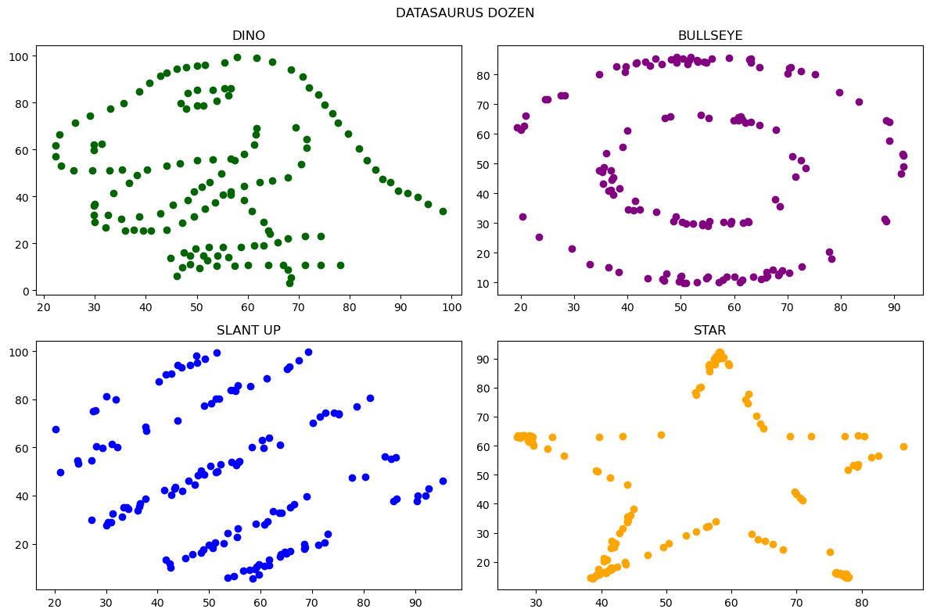
Matplotlib Figures
Figure
1
Axes
2
3
4
Axis

Slide 56
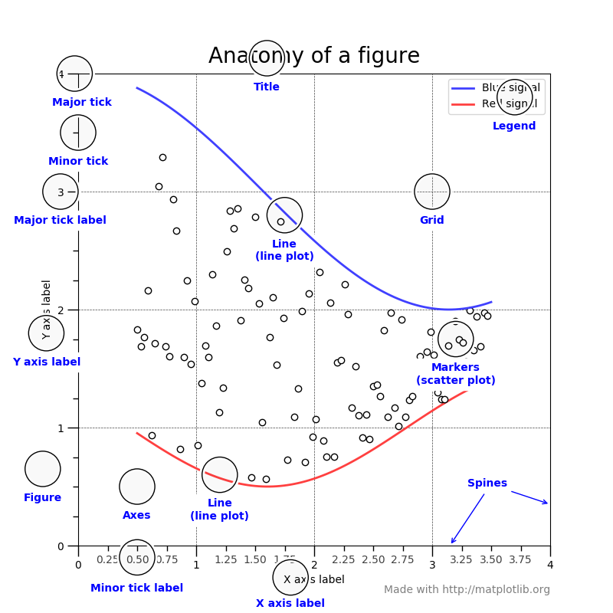
Matplotlib Figures
Entire figure and axes is initialized when we create the first plot. These are assigned to the current figure/axes.
Add secondary/tertiary plots to the same axes line by line.
Individual plot characteristics are defined on each of these lines (label, plot type, color used, etc.)
Label each axes as required
Titles, legend names, legend values, etc.
Save the plot
Display the plot
1
2
3
4

Slide 57
Challenge 1
1
Using what we have learned so far about pandas filtering and matplotlib functionality, produce a plot of bill lengths vs. depths for the penguins dataset.
Colour the three penguin species (Adelie, Chinstrap, Gentoo) different colours.
Include a legend that identifies which species is which colour!
HINT: use what we learned with Stu to filter the dataframe to a single species (create three new dataframes…)
2
3
4

Slide 58
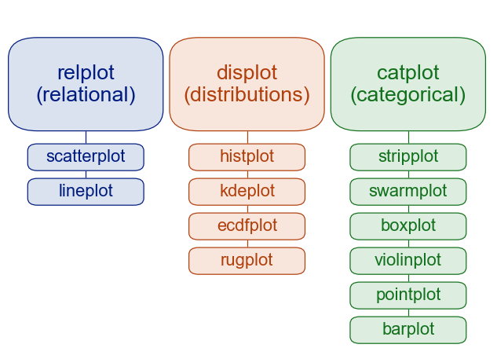
Seaborn Plots
Figure Level:
Simple, single command for multiple different plot types
Returns a ‘fully formed’ final figure
Cannot easily access the underlying matplotlib components
1
2
Axes Level:
Individualized for specific plot types
Returns a single axes that can be added to other matplotlib figures
Easier to customize, but more ‘fidgety’
3
4

Slide 59
Relational Plots
Usage
Let us look for patterns in a dataset between two or more numerical features
Can be used to identify trends over time
Can be used to display uncertainty in a model
Types
Scatter plots
Line plots
Conditional Options
style, hue, size
row, col
1
2
3
(For regressions):
lmplot
4

Slide 60
Challenge 2
1
Using the Seaborn load_dataset method, import a dataset called ‘dowjones’.
What does this dataset include/represent?
On what date does the data represented here reach its highest price?
Create a line plot to depict the data. Does the plot agree with the answer you came up with in part 2?
2
3
4

Slide 61
Challenge 3
1
Choose any two numerical features in the penguins dataset.
Produce a scatter plot that highlights the differences between species.
Separate the results into two plots – one for male and one for female penguins.
2
3
4

Slide 62
Distribution Plots
Usage
Analyze the data to see how features are distributed
Identify outliers
Compare subsets
Types
Histograms
KDE (Kernel Density Estimation)
ECDF (Empirical Cumulative Distribution Function)
Conditional Options
hue
row/col
1
2
3
4

Slide 63
Challenge 4
1
Create a KDE plot of body mass from the penguins dataset. (body_mass_g)
Does it appear to be bi-modal (2 peaks)?
If so, create another plot (or more) to identify what may be the cause. Are male penguins heavier? Is it a specific species? Does the island matter?
2
3
4

Slide 64
Challenge 5
1
Which penguin species was most frequently included in this dataset?
Display your result visually!
2
3
4

Slide 65
Categorical Plots
Usage
Let us look for patterns in a dataset using at least one categorical feature
Default is to display aggregations of the data for most types!
Types
Categorical scatterplots: swarm, strip
Categorical distribution plots: box, violin, boxen
Categorical estimate plots: point, bar, count
Conditional Options
hue
row/col
1
2
3
4

