Slide 1

Agenda
Welcome and Introductions
RSI Solution Principles
RSI Solution Concept Overview
Assumption Review
Open Discussion

Slide 2
RSI Solution Principles
Start Small and Grow In Time
Decouple eTicketing and Payments
Minimize Impact on ESRs
Design for Disconnection
Build the minimum required interface to the hub required to support eTicketing. Use standard integration patterns to allow the hub to expand in the future.
Separate out the concept of eTicketing and ePayment to allow each to proceed independently: An eTicket can be paid with cash. An ePayment can be made against a paper ticket.
Do not force sweeping changes on existing Enforcement Systems of Record. Find a way to work with the existing systems in order to meet the business outcomes.
Assume that the flow of information in and out of the hub will be done in a reliable way to ensure message delivery regardless of network stability of connectivity

Slide 3
RSI Hub Overview (Phase 1)
Creation of Electronic Tickets
Online payment of moneys owed to the Province
Receipt of electronic ticket information for payment collection
Reconciliation and Reporting of documents
Notes:
Note: responsibility colors the same as on the 2013 concept diagrams

Slide 4
Implications for Enforcement (phase 1)
PrimeCorp: the Enforcement solution subsystem will implement an interface to the Hub that will publish eDocs representing Enforcement activities.

Slide 5
Implications for ESR (phase 1)
ICBC: ESR subdomain will implement an interface to Hub to consume eDocs representing enforcement activities, which are then routed and applied to existing ESRs.

Slide 6
Implications for Online Payment (phase 1)
PayBC and ICBC: the Online Payments subdomain to be encapsulated within ICBC's current payment solution space; no new payment interactions with other subdomains; reusing existing solution interactions;

Slide 7
Implications for Hub
Implement interfaces and route documents between Enforcement and ESR
receive of batch document state information from all parties

Slide 8
RSI Solution – future phases enabled

Slide 9





RSI Hub Capabilities (phase 1)
Enforcement System
Adapter
ESR System Adapter
Document
(eTicket)
Validation
Document
(eTicket)
Routing
Document
(eTicket)
Repository
Ability for Versaterm to send violation ticket information to the Hub
Ability for the Hub to send Enforcement System of Records violation ticket information
Ability for the Hub to validate information submitted by Versaterm
Ability for the Hub to decide what to do with information it has been given.
Ability for the Hub to store information it is sent and to expose a way for stakeholders to gain insight into it

Slide 10
Assumptions Requiring Validation
Document Content Submitted to the Hub
Assumption: Enforcement will print a ticket at roadside and the data contained in that ticket will be sent to the hub as an electronic document. A physical image of the ticket is not sent nor required. Messages sent to the hub will be digitally signed: This signature can be verified both upon receipt and on demand (Court Challenge)
Document Content Sent from the Hub
Assumption: ESR (ICBC) does not require a digital image of the eTicket: The data contained in the electronic document is sufficient to be loaded into existing ESR applications.
Integration with Ticketee
Assumption: Ticketees will not interact with the Hub. They will interact with:
Enforcement – when they are issued a ticket;
ICBC – if they pay over the counter; and
PayBC – if they pay online.

Slide 11

Open Discussion

Slide 12
Solution alternative – Phase 1 - No Hub
Summary: decrease in subproject decoupling, increased impact on legacy ESR systems, loss of future phase enablement, loss of Government visibility into all RSI-related activities

Slide 13
Solution Alternative – No Hub – Implication for Future Phases
Summary: dramatic increase in complexity and decrease in likelihood of realizing RSI business outcomes

Slide 14
Conclusion: Hub-based architecture best, both for phase 1 and future

Slide 15
RSI Architecture Principles - working
The following is a start some potential principles:
Balance Discipline and Agility to enable us to respond to evolution over time of the opportunity landscape, readiness of different stakeholders, and availability of solution components
Start development of any new capability with a minimum-viable-product subset solution
Always develop a proof-of-concept (PoC) when introducing a new solution building block (technology) or substantive architecture change, at least one phase before committing to build and delivery of concrete business functionality
Always stay well within the intended functionality of COTS products
Separate user interface (service design) features from everything else, using interfaces and APIs
Design resilient solutions by decomposing the problem space, through separation-of-concerns, information hiding and minimizing interactions, and then build resilience into the remain interactions between decoupled subdomains
CAVEAT: While there is a number of artifacts, such as concept diagrams, an RSI solution architecture has not yet been developed; that would include definition of principles and associated rational .

Slide 16
Target State: full interoperability between partner domains
Notes:
This logical view represents the desired state, for an integrated road safety system, capable of delivering systemic road safety improvements with the Citizen as the Centre of government services. The goal of a future RSI IM/IT solution is to enable this business need.

Slide 17
Target Solution: HUB to enable interoperation between stakeholder domains
Notes:
An RSI solution architecture includes use of a common Hub infrastructure subsystem, key to enabling the delivery the desired business capabilities. This RoadSafety Hub represents application of a standard enterprise integration architecture pattern that is commonly seen in distributed IT systems, and also in industries such Air Transportation and Telecommunications.
The Hub component of the RSI solution architecture provides a number of enabling functions required by all parties, including:
A function to hold the data model shared by RSI partners, enable each partner to hold a different data model in the systems they’ve implemented that are focused on their unique business needs; e.g. the information needs of Police are different than those of Driver improvement programs.
Common document management functions, available to and consumed by all of the business subdomains
Network and message protocol adaptation, such as translating between the interfaces offered by different COTS products and custom applications
Overall system resilience in the face of multiple separate systems, operated by different organizations, with different maintenance schedules and service levels; e.g. Police operate 23/7/365 versus administrative programs tend to operate only during day-time business hours. Also, the reality of any concrete distributed system is that at any point in time, some component, such as server, will not be functioning, either due to failure or being subject to some form of maintenance.
Some of the general qualities provided by the Hub and the associated architecture include:
Minimizing overall system complexity
Minimizing complexity associated with integrating each partners’ systems
Maximizing ability to incrementally develop, evolve, and support the total system over time
Maximizing the visibility of shared business events to all partners
Maximizing the ability to govern and ensure business outcomes

Slide 18
Target Phase 1 Solution: eTicketing and Online Ticket Payment
Notes:
The phase 1 solution implements the minimum-viable-product solution for two aspects of the larger RSI solution:
Creation of electronic Ticket documents by Enforcement
Online Payment of traffic Tickets
There is also development of proof-of-concept analytics function based on processing of eTicket documents.

Slide 19
Point-to-point, No-Hub approach is not a solution
- Extra point-to-point integration
Notes:
Some people might view the Hub subsystem as an unnecessary additional to the solution; they might ask why can’t the core stakeholder domains directly interact without use of a Hub?
There are multiple reasons why direct interaction, or point-to-point integration, won’t work.
Logically, the Hub represents a key difference between a view of the desired capability, for rich interoperability between stakeholder systems, and a actual functioning IM/IT solution that delivers that capability. As an analogy, the Internet enables message-level connectivity between any set of Internet-connected devices or systems; it could be logically viewed as fully-meshed interconnection between every network-connected device: the solution that delivers that capability is not a dedicated wire or network circuit between every possible pair of devices, which would require an astronomical number of links -- order N**2. Rather, the Internet is implemented as a layered architecture of physical links, switches, network protocols, and Hub routers.
The RSI solution space involves multiple existing custom, existing COTS, and future custom and COTS IT systems. These systems must interact in some fashion in order to realize larger RSI business outcomes. Each such end system has its own software solution with its own data model and capability to exchange data. And each of those end-systems is undergoing constant evolution, such as COTS security patching and upgrades. Any form of point-to-point integrations would quickly become buried in project management difficulties, and then even if a small number of integration could be completed, would then succumb to operational challenges.
Pragmatically, it is probably not possible to implement an RSI solution without a Hub.

Slide 20
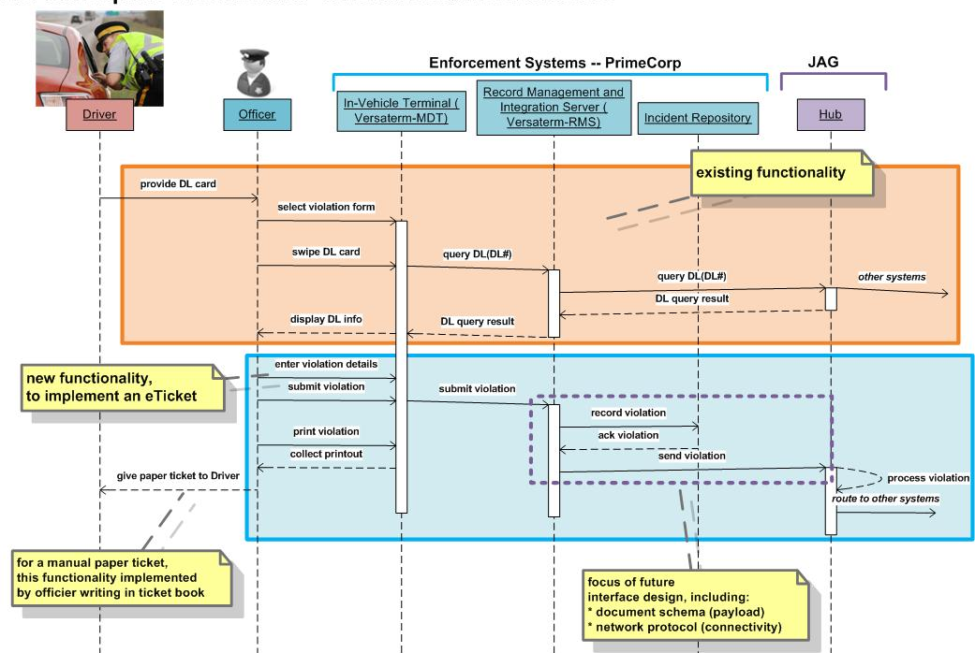
Conceptual Solution – eTicket generation
Bulk of new functionality delivered by standard extensions to COTS Versaterm product
Hub to consume out-of-the-box representation of new enforcement documents.

Slide 21
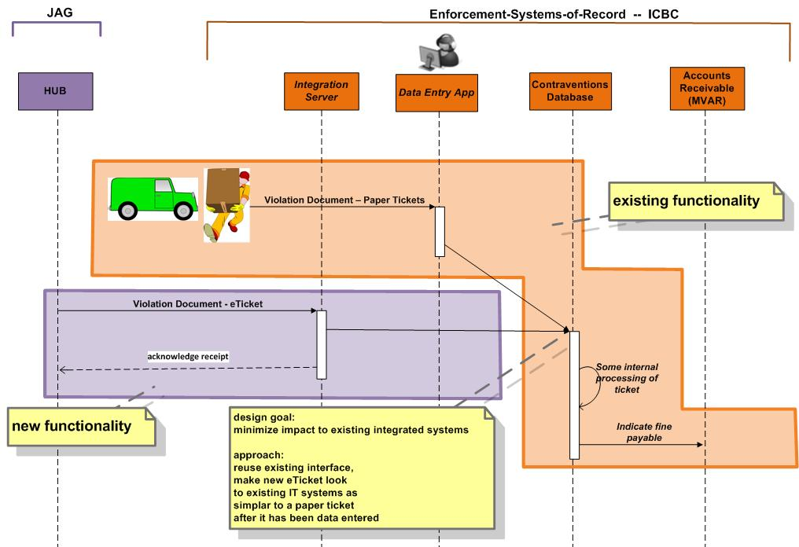
Conceptual Solution – eTicket backend processing
Design goal to integrate new eTicket into existing ticket processing backend.
Hub to send eTicket documents to ICBC in best format to achieve this design goal.

Slide 22
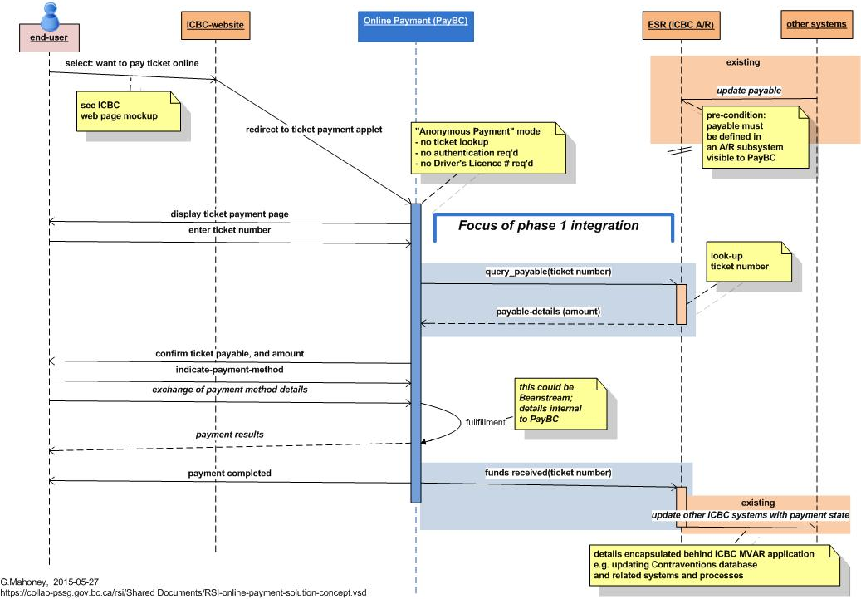
Conceptual Solution – Online Ticket Payment
Bulk of Online Payment functionality delivered by new PayBC components, such as web-user interface and credit card processing (fulfillment).
RSI Phase 1 focus is to integrate the PayBC backend with ICBC’s A/R system, via PayBC’s integration architecture.
Future phases to consider alternative approaches to integration of financial services and events.

Slide 23
Future Concept: separate Financial Services from Road Safety program area activities
Administrative Justice
RoadSafetyBC: DIIP
Courts: JUSTIN
ICBC: Contraventions, Drivers, …
ESR: ICBC’s system of systems
Courts:
ARC
ICBC: MVAR
MoF:
GARMS?

Slide 24
Conceptual View of Phase 1 Development Activities
Different parties will have different levels of involvement over time.
The architecture has been developed to enable the Online Payment work to be done independent of the eTicket work.
Apr,2017
June,17
July,17
Oct,17
BI
PILOT 1
PILOT 2
$
PILOT 1 :
PILOT 2: Remaining agencies will have e-ticketing implemented and pilot programs will run across the agencies
HUB
Oct,2015
Mar,2017
Responsibility Legend
Enforcement - PRIMECorp -
HUB - JAG
Enforcement Systems Of Record - ICBC
Online Payment - PayBC-
Business Intelligence - JAG
18 months

