Slide 1
Binary Search Trees
CS 580U Fall 17

Slide 2
A Better ADT
Vectors make working with arrays easier, but no real performance improvements
Linked list improves the array, but slow on random access
using nodes gives us memory flexibility
How can we improve?
What if we add additional node pointers to each node
we can divide the problem in half

Slide 3
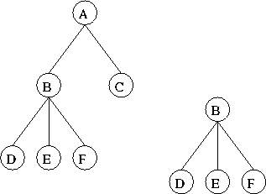
The Tree ADT
Definition:
A finite set of nodes such that one node is designated as the root. All other nodes are partitioned into sets, each of which is a tree.

Slide 4
Terminology
Root node
The ‘top’-most node in the tree
Branch
the connection to a child node that may or may not contain a subtree
Subtree
subnode that contains subnodes

Slide 5
Properties of a Tree
max # of leaves
all nodes that do not have branches
max # of nodes
all nodes in the tree
Height for a tree
path depth
The number of branches between the current node and the farthest leaf
max depth
The number of branches between the root node and and the farthest leaf
A Binary Node
Data
left node pointer
right node pointer

Slide 6
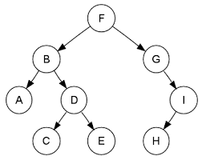
Parents and Children
Parent Node
The immediate predecessor node in the tree structure
Child Node
the immediate following node in the tree structure
Parent Node to A
Child Node to I

Slide 7
Height
A tree’s depth is the number of ‘steps’ to get to a leaf
Only count branches, not nodes
What is the depth of A? H?
A tree’s height is based on its maximum depth
What is the tree’s height?

Slide 8
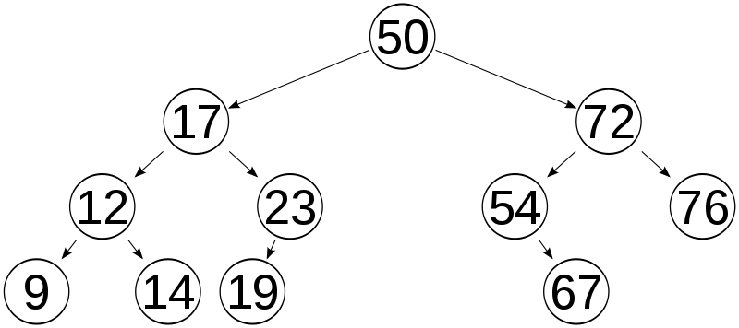
Binary Search Tree

Slide 9
Binary Search Tree
Common Tree Data Structure
Each node has two branches
Branches may point to another node, or NULL
all data in every node of the left subtree are less than the data in the node
all data in every node of the right subtree are greater than the data in the node
All data in a BST is unique

Slide 10
Implementation
Array
You can use an array to implement your tree
left child index = 2*(Parent Index)+1
right child index = 2*(Parent Index)+2
parent index = (Child Index-1)/2 (truncate)
Pros:
Constant time Access
Cons:
Complexity
Array Max Size must be known
Linked
a linked list using structs and pointers
a data field
a left child field with a pointer to a node
a right child field with a pointer to a node
a parent field with a pointer to the parent node
Pros:
Dynamic Memory size
Cons:
Complexity
Linked Traversal

Slide 11
The BST ADT
Made up of two structs:
Tree
Node * root
Node
Node * left
Node * right
Data * data
Node * parent (optional, but recommended)

Slide 12
BST’s use recursion
Recursion is the process of a function calling itself to perform iteration
Basically, using the stack as your loop
Why use recursion
Simplifies code greatly
Why not use recursion?
Uses more memory
Can be very slow

Slide 13
Formal Def. of Recursion
Recursion is an iterative procedure that defines the value of a function, argument n, by using the value of the previous argument n − 1
0 if n=0 or n=1
pd(n) =
pd(n−1) otherwise

Slide 14
Recursion has two parts
Recursion requires two parts within the recursive function:
A base case that defines an atomic object
an end to the recursion.
A recursive step that defines how objects can be modified, reduced, or combined to produce another object closer to the atomic object
Recursion Rules
Every recursive method must have a base case -- a condition under which no recursive call is made -- to prevent infinite recursion.
Every recursive method must make progress toward the base case to prevent infinite recursions

Slide 15
Classwork
int toZero(int num){
printf(“%d\n”, num);
if(num == 0)
return;
else
(num > 0) ? toZero(num-1) : toZero(num+1);
}
Recursion

Slide 16
Tree Traversal
Traversal, whether for insertion, deletion, or read, uses recursion
each can be completed iteratively as well, but it is slightly more complex
A method is recursive if it can call itself directly or indirectly
A function, foo(), is indirectly recursive if it calls, bar(), which in turn calls foo()

Slide 17
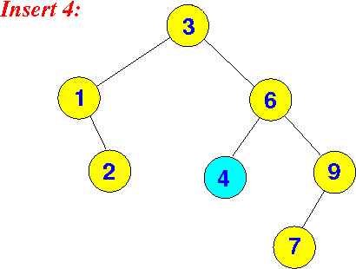
Recursive Insert
Recursive insert
Check if value is greater than or less than the value in the current node
If greater, go right, check again
If less, go left, check again
If null, add a leaf to the tree
if equal, NOOP
All values in a tree should be unique

Slide 18
Inserting a node into an existing tree
Operations:
Use recursion to traverse through the tree
Insert node as a leaf
What information do you need?
Data inserted
current node visited
with access to child nodes

Slide 19
Insert (pseudocode)
insert(node, data){
if (data < node.data)
if(node.left == NULL)
addLeaf(node, data);
else
insert(node.left, data)
else if (data > node.data)
if(node.right == NULL)
addLeaf(node, data);
else
insert (node.right, data)
*must handle special case where tree is empty

Slide 20
Problems
How to choose the root node?
What happens if you choose a bad root node?
Becomes a linked list
Insertion (with a well chosen root)
Best Case?
constant time
Worst Case?
size of the list
Notes:
Constant time best case is property of heap

Slide 21
Recursive Read
Almost identical to insert
Requires a return statement
Reference or pointer
Check if value is greater than or less than the value in the current node
If greater, go right, check again
If less, go left, check again
If equal, return data
If null, error message

Slide 22
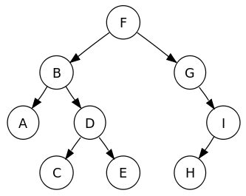
Read (pseudocode)
read(node, data){
if(data == node.data) return node.data
else if (data < node.data)
if(node.left == NULL)
print(“value not found”);
else
return read(node.left, data)
else if (data > node.data)
if(node.right == NULL)
print(“value not found”);
else
return read (node.right, data)
*must handle special case where tree is empty

Slide 23
Delete
Basic Deletion process
Remove the pointer to the node
delete node
Operations required
Tree Traversal to find the node
Must always keep track of the parent node
This is where maintaining a parent pointer in the node is helpful

Slide 24
Delete - 3 Scenarios
What are the primary cases for deleting a node?
Delete a leaf node - easy
set parent node pointer to null
delete node
Delete a 1 branch parent node
Can’t just delete the node, because then our tree would "fall apart."
Delete a 2 branch parent node
We must promote one of the children to become the new parent.

Slide 25
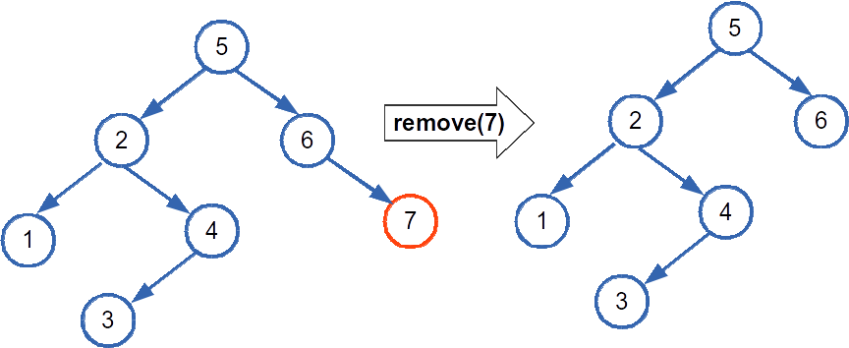
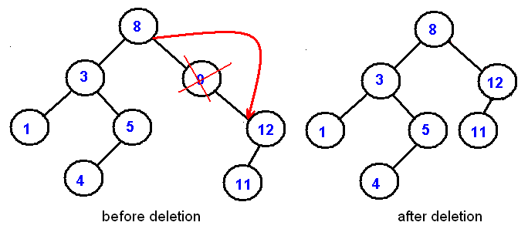
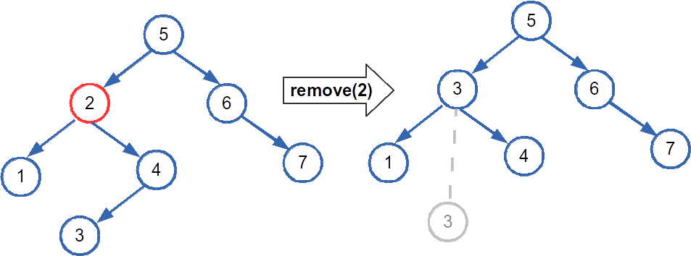
Delete Algorithm
node = findNode(data);
if ( node not in BST )
return;
else if ( node has no subtrees ){
deleteLeaf(node);
}else if ( node has 1 tree ) {
shortCircuit(node);
}else if(node has 2 subtrees){
promotion(node);
}

Slide 26
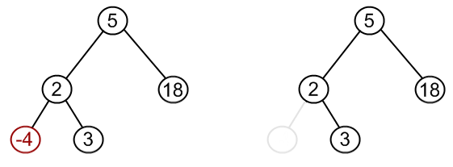
Deleting Leaf Nodes

Slide 27
DeleteLeaf Pseudocode
void removeLeaf(Node * leaf)
if leaf->parent->right == leaf
leaf->parent->right = NULL
else
leaf->parent->left = NULL
delete leaf
What if the leaf is the root?
Delete root
Set root to null to signify an empty tree

Slide 28
Short Circuit Algorithm
The Short Circuit Algorithm sets the child node’s child to be the child of the parent, then deletes the extra leaf node
When deleting a parent node in a BST, you must ensure that the new parent is:
bigger than all the other children in the left tree
smaller than all the other children in the right tree
You must maintain the BST structure

Slide 29
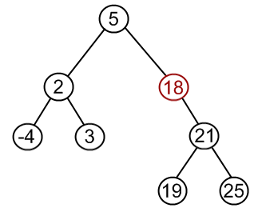
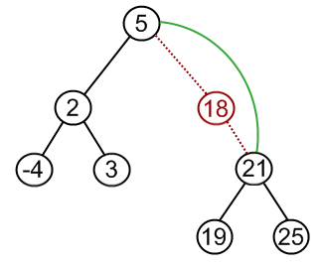
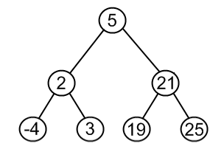
Deleting Single Branch Nodes
Short Circuit Method

Slide 30
Short Circuit Pseudocode
void shortCircuit(Node * node)
if( node->parent->right == node)
if node->right == NULL
parent->right = node->left
node->left->parent = node->parent
else
parent->right = node->right
node->right>parent = node->parent
else
...
delete node
What if the node to be delete is the root?
We have to promote the child node to become the root

Slide 31
Classwork: Max Or Min
Node* searchMin(Node * node){
if(node->left != NULL)
return searchMin(node->left);
else
return node;
}
Node* searchMax(Node * node){
while(node->right != NULL)
node = node->right;
return node;
}

Slide 32
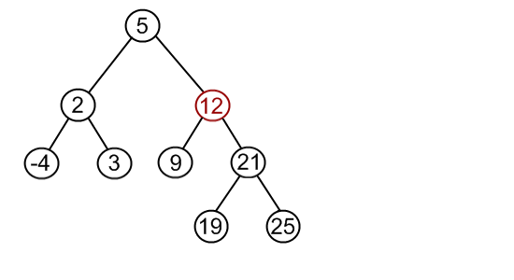
Deleting 2 Child Nodes

Slide 33
Promotion
We must promote a node to a higher space in the tree
There are at most two possible candidates:
the rightmost child of the left subtree
Traverse left once, then right as far as possible
the leftmost child of the right subtree
Traverse right once, then left as far as possible
It doesn't matter which one we pick,
both choices will maintain the BST structure
Successor node
the node in the right subtree that is min value -or-
the node in the left subtree that is max value

Slide 34
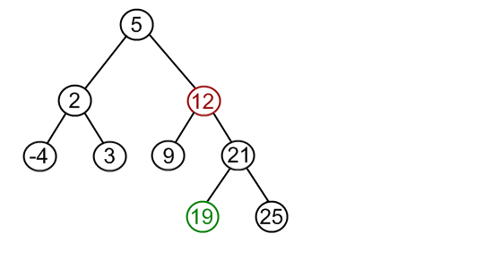
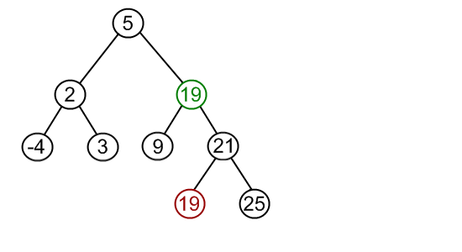
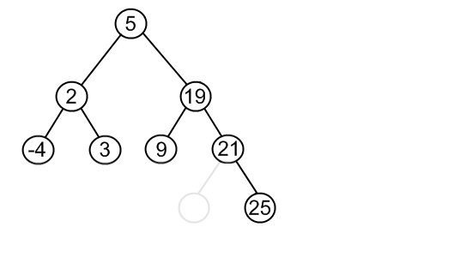
Promote Successor
Find node to delete
2) Find successor
3) Replace value
4) Delete Successor

Slide 35
Promotion Selection
functions needed
Node * getMaxNode(Node * node)
Node * getMinNode(Node * node)
What if the min or max is not a leaf node?
We call our short circuit algorithm
min value has right subtree?
Run single subtree (short-circuit) algorithm
What if the delete node is the root node?
Special case: must promote leftmost max or rightmost min to root node

Slide 36
Promotion Algorithm
void promotion(Node * n){
Node * d_node = searchMin(n->right);
n->data = d_node->data;
//Leaf
if(d_node->left==NULL && d_node->right==NULL){
removeLeaf(d_node);
//one branch
}else{
shortCircuit(d_node);
}
}

Slide 37
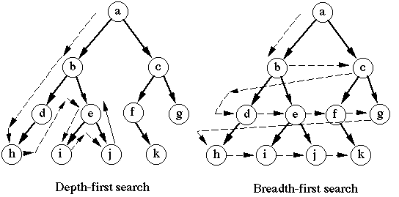
Searching a Tree

Slide 38
Depth First Traverse
Depth First travels down the tree structure to find a value
Basic Algorithm:
Start at the root node,
traverse down the left until finding a leaf
traverse back up until finding a right branch
repeat until no right branch

Slide 39
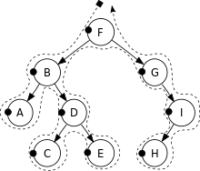
PreOrder
Process each node as you reach it in traversal order
Algorithm:
preorderTraversal(node): process(node) preorderTraversal(node->left) preorderTraversal(node->right)

Slide 40
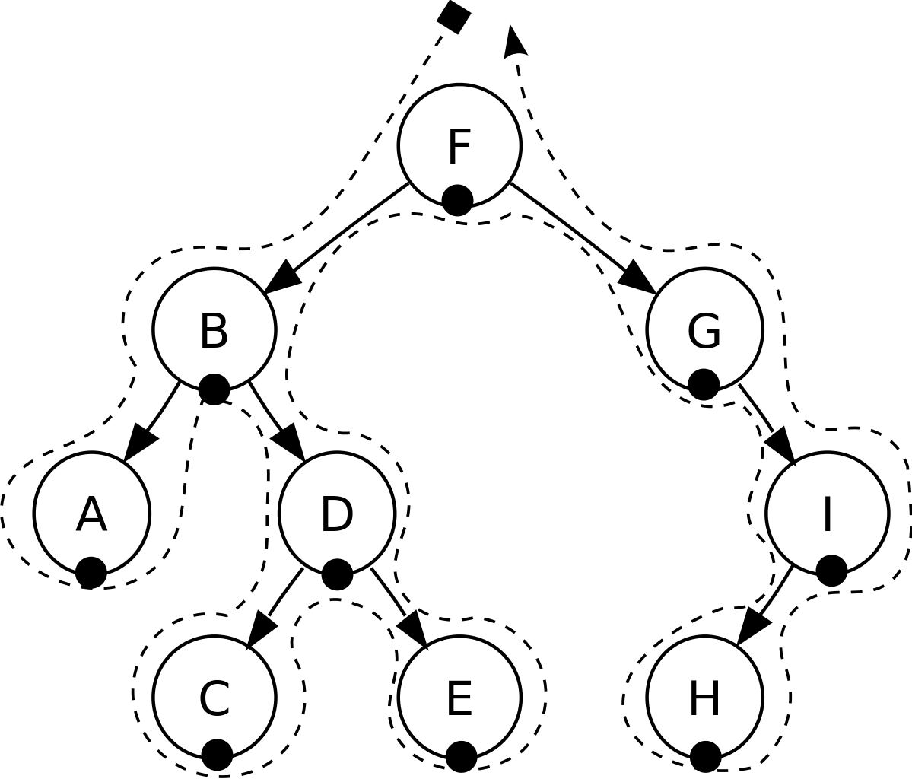
InOrder
Visit each node in ascending order
Algorithm:
inorderTraversal(node): inorderTraversal(node->left) process(node) inorderTraversal(node->right)

Slide 41

PostOrder
Visit each node as you reach it in traversal order
Algorithm:
postorderTraversal(node): postorderTraversal(node->left) postorderTraversal(node->right) process(node)

Slide 42
Classwork
5,3,2,1,4,8,6,7,9
1,2,3,4,5,6,7,8,9
1,2,4,3,7,6,9,8,5
Post Order - delete
In Order - sort
Pre Order - copy
Tree Traversal

Slide 43
Use Cases
Basic required Tree operations:
Deep Copy Tree
Delete Tree
Sorted Print
Depth First Search
Traverse as far as possible down a single path
Determine use case for each DFS Operation
PreOrder: copy of the tree
InOrder: gives nodes in non-decreasing order
PostOrder: used to delete the tree

Slide 44
Breadth First Search
Visit every node on a particular level before going to the next level
Also called Level order
How to Implement?
Not really a recursive algorithm
Can still implement recursively, but not traditionally done with recursion
With a helper Data Structure to store the next level
need to store each node in order, and ensure they are accessed in the same order
Which data structure would work best?

Slide 45
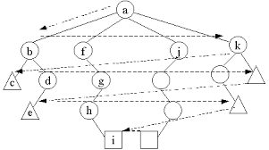
Breadth First Helper ADT
A Queue
Enforces first in first out
Assume we have a Tree ADT
Child nodes are stored in an array within the Node class

Slide 46
Breadth First Search Algorithm
Assume a tree where each node has an unknown number of children
breadthFirstSearch(){ Queue q; q.enqueue(root); while(!q.empty()){ node = q.dequeue(); processNode(node); for child in node.children //where children is a vector of nodes q.enqueue(child); } }

