Slide 1
Graphs
CS580U - Fall 2016

Slide 2
A New ADT
Trees represent a hierarchy of data. What if we have relational data, similar to a tree, but no hierarchy.
For example, we go the circus, and there’s lots of equally great stuff to do (ferris wheel, talk to carnie folk, fried twinkies)
We need to store each activity as a data point, and it’s relation to the other data points.
What are all the properties we need to consider for this kind of data set?

Slide 3
Considerations
Are all vertices connected to every other vertices or are there gaps?
Is there a path of finite length between the Slingshot ride and the cotton candy booth?
Are the edges equally weighted or different weights?
Are all neighboring rides equidistant from each other?
Are the edges directional?
Are paths between rides one way? (They should be)
How many vertices are 1 stop away?

Slide 4
What is a Graph?
A data structure that consists of a set of nodes (vertices) and a set of edges that relate the nodes to each other
The set of edges describes relationships among the vertices
Graphs are essential in:
GPS
Efficient Database Design
Building Webcrawlers
Representing computational models

Slide 5
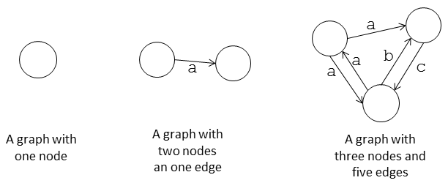
Formal Definition
A graph G is defined as follows:
G=(V,E)
A Graph is a set of vertices and edges
V(G): a finite, nonempty set of vertices
E(G): a set of edges (pairs of vertices)
Any subset of a graph’s vertices and edges is a subgraph

Slide 6
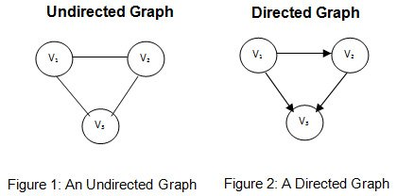
Directed vs. Undirected graphs
When the edges in a graph have no direction, the graph is called undirected
Country roads with no traffic laws
When the edges in a graph have a direction, the graph is called directed (or digraph)
One way streets in downtown Binghamton

Slide 7
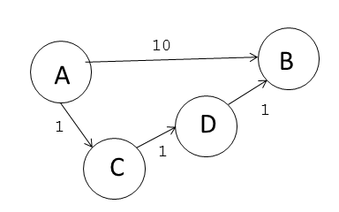
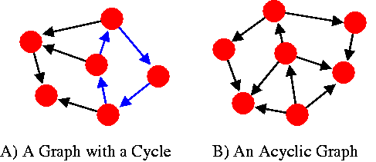
Adjacent Vertices
Connected by a single edge
Degree (of a vertex)
# of adjacent vertices
Out-Degree vs In-Degree
Path
sequence of vertices v1. . .vk such that consecutive vertices are adjacent.
Simple Path means no repeated v
Cycle
The start and end vertices are the same

Slide 8
Kinds of Graphs
Trees
Special cases of graphs
connected graphs without cycles
Simple Graphs
There is only one edge between any two vertices and no self loops
Formal Definition: A simple graph G = (V,E ) consists of a non-empty set V of vertices (or nodes) and a set E (possibly empty) of edges where each edge is a subset of V with cardinality 2 (an unordered pair).
We are only considering simple graphs for this class

Slide 9
Connected vs Disconnected vs Complete
Disconnected
Parts of the Graph are inaccessible from other parts of the graph through any path
Connected
It is possible to get to any other part of the graph from any point in the graph
Complete
It is possible to get to any other part of the graph from any point in the graph in 1 ‘hop’

Slide 10
Sparse vs Dense
A graph is sparse if | E | | V |.
If most V have a cardinality <= 2
A graph is dense if | E | | V |2.
If most V have a cardinality = V-1

Slide 11
ADT Graph Operations
Test whether graph is empty.
Get number of vertices in a graph.
Get number of edges in a graph.
See whether edge exists between two given vertices.
Insert
Insert a new distinct vertex in graph
Must ensure the new vertex is distinct with different value from previous vertices
Insert edge between two given vertices in graph.
Remove
Remove specified vertex from graph and any edges between the vertex and other vertices.
Remove edge between two vertices in graph.
Retrieve from graph vertex that contains given value.

Slide 12
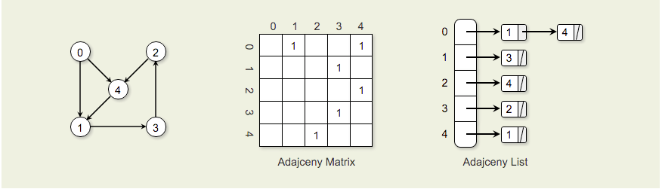
Representing Graphs in Memory
Adjacency Matrix
2 dimensional array contains entries for Vertex v_{i}.
Column j in row i is marked with weight if there is an edge from v_{i} to v_{j}.
Space requirements for the adjacency matrix are V².
Adjacency List
Array of linked lists. The array is |V| items long, with position i storing a pointer to the linked list of edges for Vertex v_{i}.

Slide 13
Classwork:
Implementing Graphs

Slide 14
Pros and Cons of Adjacency List
Advantages:
Saves space for sparse graphs. Most graphs are sparse.
“Visit” edges that start at v
Only need to traverse linked list of v
Size of linked list of v is degree(v)
T(n) = (degree(v))
Disadvantages:
Check for existence of an edge (v, u)
Must traverse linked list of v
Size of linked list of v is degree(v)
T(n) = (degree(v))

Slide 15
Pros and Cons of Adjacency Matrix
Advantage:
Save space on pointers for dense graphs.
Check for existence of an edge (i, j)
Just check if A[i, j] = 1?
So T(n) = c.
Disadvantage:
“Visit” all the edges that start at v
Row v of the matrix must be traversed.
So T(n) = (|V |)

Slide 16
Graph Traversal
Breadth First Traversal
Depth First Traversal
Minimum Spanning Tree
Kruskal
Prim
Shortest Path
You don’t need anything past here for the final

Slide 17
s-t Connectivity
2 algorithmic questions
Given two nodes s and t, is there a path between s and t?
Called the s-t connectivity problem
Can be modified to ask: is there a path between all nodes?
Given two nodes s and t, what is the length of the shortest path between s and t?
Called the s-t shortest path problem
Can be modified to ask: what is the shortest path between all nodes?

Slide 18
Search

Slide 19
Traversing a Graph
Given an graph G = (V, E) and a source vertex, s, how can we systematically traverse the edges of G to “discover” (visit) nodes of G reachable from s?

Slide 20
Frontiers
Discovers all vertices ‘k’ vertices away from s before discovering any vertices k + 1 vertices from s
We expand the frontier between already discovered and undiscovered vertices one step at a time.
Works similar to breadth first search of a tree
Use a First-In-First-Out (FIFO) queue to implement the Frontier.
Need T(n) = c time to update
It also produces a breadth first tree with s as a root that contains all the reachable vertices from s.

Slide 21
Breadth First
On an unweighted graph, the algorithm also computes the shortest distance (dist) from s to any reachable node.
To get |V| + |E| running time, we use an adjacency list representation.
If we used an adjacency matrix, the running time would be O(|V|2). Why?
For each node, we have to ‘check’ every other node to see if there is a connection
BFS may fail to reach all nodes for directed or unconnected graphs.

Slide 22
Going in Cycles
How can we ensure we don’t go over the same path we already visited?
We tag the nodes to keep track of where we are in the process
We can use colors to tag nodes
Nodes change color in order: White -> Gray -> Black
White are undiscovered nodes
Grey are ‘frontier’ nodes
Black are fully explored nodes
Why do we need to keep track?
How will cycles affect our search?

Slide 23
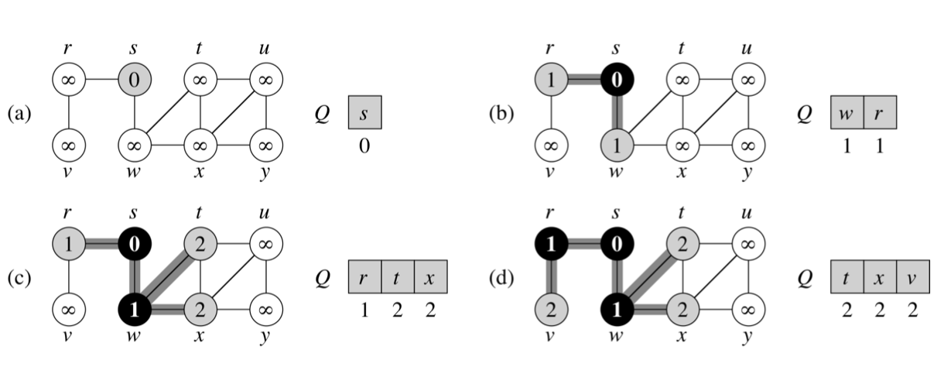
BFS: Example

Slide 24
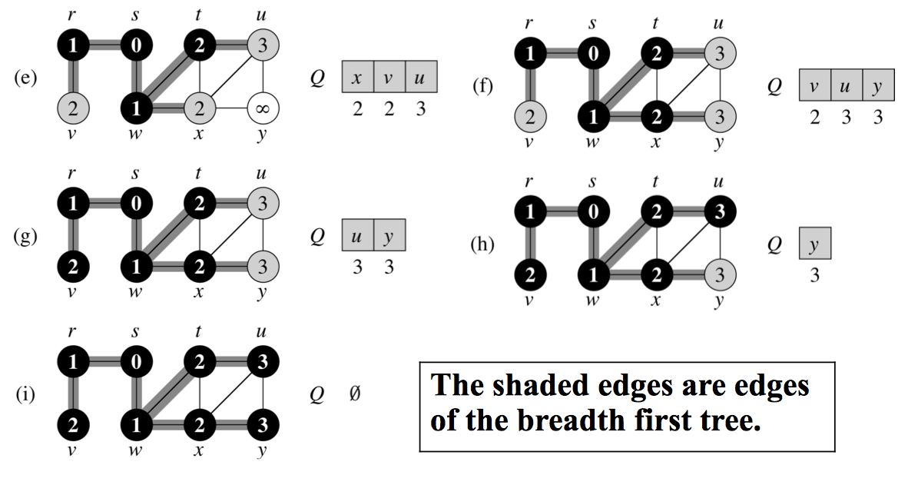
BFS: Example (continued)

Slide 25
Implementing the BFS
BFS(G, root) //start the search from node s in graph G
for each vertex u in G.V
u.color = white
u.distance = infinity // holds distance from s to u
u.pre = NIL // u.pre denotes the predecessor of u root.color = gray
root.distance = 0 // distance to itself is 0
root.pre = NIL
Q = // Q is an FIFO queue and it is initially empty Q.enqueue(root)

Slide 26
Implementing the BFS - Part 2
while Q is not empty:
current = Q.dequeue()
for each node n that is adjacent to current:
if n.color == white:
n.color = gray
n.distance = current.distance + n.edge(u)
n.parent = current
Q.enqueue(n)
u.color = black
Notes:
n.edge(w) gets the edge weight between the two vertices

Slide 27
Depth First
Go “deeper” whenever possible.
Traverse down the graph as far as possible before check adjacent vertices
Basic Algorithm
Start a depth first search from node s by selecting 1 adjacent node.
The search proceeds from the most recently discovered node to the next adjacent node.
When you get to the last discovered node v, backtrack to the previous node used to discover v, and check adjacent.
Eventually, the start node is fully explored.

Slide 28
Node Tagging
We can use the same tagging method as the BFS
We still need to guard against cycles
White: Undiscovered Nodes
Gray: Encountered, but not fully explored
Black: fully explored nodes
A node is considered fully explored if all of its adjacent nodes have been examined (discovered or fully explored).

Slide 29
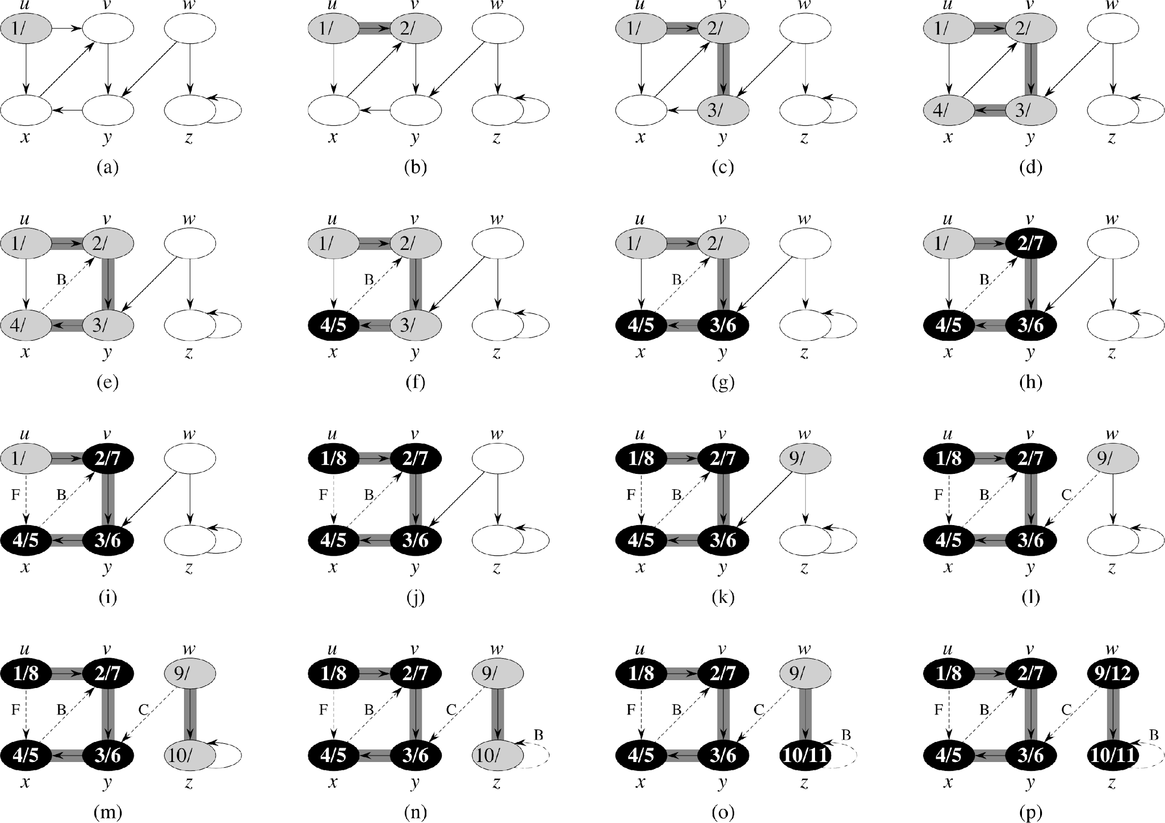
DFS: Example (1)

Slide 30
DFS: Example (2)

Slide 31
DFS: Example (3)

Slide 32
DFS Implementation
DFS(G, v):
for each u in G.V
u.color = white
u.pre = null
DFSVisit(G, v)
DFSVisit(v)
v.color = gray
for each a in v.adjacent() do
if a.color != gray a.distance = v.distance + v.edge(a)
recursively call DFSVisit(a)
v.color = black

Slide 33
Shortest Path

Slide 34
Solutions to Shortest path
BFS finds shortest path on unweighted tree
Why would we want to find the shortest path from a single source within a graph?
GPS, networking, etc.
Why is finding the shortest path between two vertices on a graph hard?
Shortest path may require traversal through intermediate points

Slide 35
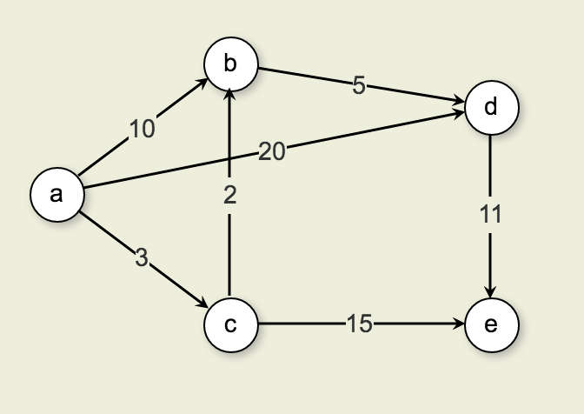
Finding the Shortest Path
Paths from A to D
The cost of the edge directly from A to D is 20.
The cost from A to C to B to D is 10.
Thus, the shortest path from A to D is 10 (rather than along the edge connecting A to D).
On weighted graphs, the brute force solution is to find all possible paths, then select the shortest.
How can we find the shortest path without traversing every edge of the graph?

Slide 36
Single source shortest-paths
Given
Weighted digraph, single source s.
Goal:
Find distance (and shortest path) from s to every other vertex.
If just looking for a single destination, just stop once the destination is found
Note: Shortest paths form a tree
Meaning no cycles

Slide 37
Implementing a faster Shortest Path
Observe: The shortest path from Start (S) to any Destination (D) is the shortest path that goes from S to any Adjacent (A) to D + the shortest path between A to D
Given the graph to the right, if I have the shortest path between a and d’s adjacents then I only need to find the shortest path between adj and d to find the shortest path between a and d

Slide 38
Tracking our Path
What variables do we need to keep track of?
G
The graph which contains V and E
dist[]
vertex-indexed array containing distance from start
pred[]
Vertex index array containing the optimal previous node

Slide 39
Edge Relaxation
For all vertices, dist[v] is the length of some path from start to v
Initially all are set to infinity
Relaxation along edge e from v to w.
dist[v] is length of some path from s to v
dist[w] is length of some path from s to w
if v-w gives a shorter path to w through v, update dist[w] and pred[w]
Relaxation sets dist[w] to the length of a shorter path from s to w (if v-w gives one)
if (dist[w] > dist[v] + w.weight(v)){ dist[w] = dist[v] + w.weight(v)); pred[w] = v; }

Slide 40
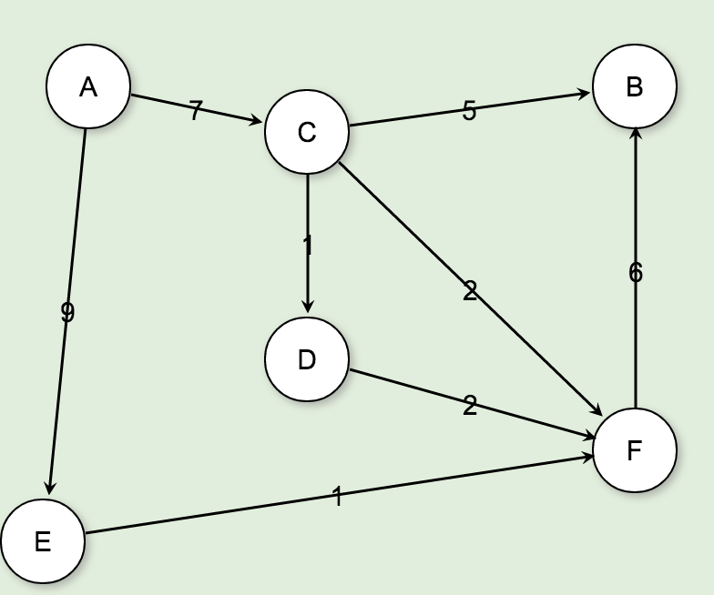
Dijkstra’s Solution
Initialize an array of visited nodes
Initialize all vertices dist[] to infinity
Initialize all optimal previous to NULL
A
B
C
D
E
F
∞
∞
∞
∞
∞
∞
ø
ø
ø
ø
ø
ø
Vertices
Dist
OptimalPrev

Slide 41
Dijkstra’s Solution
Start at A, mark distance as 0
Leave Optimal Previous Vertex at NULL
Mark distance of each adjacent node to A and optimal previous node
Mark A as a fully explored vertices
A
B
C
D
E
F
0
∞
7
∞
9
∞
ø
ø
A
ø
A
ø
Vertices
Dist
OptimalPrev

Slide 42
Dijkstra’s Solution
Advance to the next unexplored Node with the least distance from A
This would be C
Check all C’s unexplored adjacent nodes
if less than C’s current distance from A and weight from C, update distance and set optimal previous node
A
B
C
D
E
F
0
12
7
8
9
9
ø
C
A
D
A
C
Vertices
Dist
OptimalPrev

Slide 43
Dijkstra’s Solution
Mark C as Explored
A
B
C
D
E
F
0
12
7
8
9
9
ø
C
A
D
A
C
Vertices
Dist
OptimalPrev

Slide 44
Dijkstra’s Solution
Advance to the next unexplored Node with the least distance from A
This would be D
Check it’s unexplored nodes to see if less distance
F would be 10, which is greater than 9, so ignore the path
Mark D as Explored
A
B
C
D
E
F
0
12
7
8
9
9
ø
C
A
D
A
C
Vertices
Dist
OptimalPrev

Slide 45
Dijkstra’s Solution
Repeat until all nodes are fully explored
We can now find the shortest path from any node back to a single source by following the optimal previous backward to the source
A
B
C
D
E
F
0
12
7
8
9
9
ø
C
A
D
A
C
Vertices
Dist
OptimalPrev

Slide 46
Classwork:
Dijkstra’s

Slide 47
Dijkstra’s Algorithm
// Compute shortest path distances from s, store them in D
void Dijkstra(Graph G, int s, int[] D) {
for (int i=0; i<G.nodeCount(); i++) // Initialize
D[i] = INFINITY; OP[i] = NULL
D[s] = 0;
for (int i=0; i<G.nodeCount(); i++) { // Process the vertices
int v = minVertex(G, D); // find next-closest unexplored vertex
G.setValue(v, VISITED); //set visited
if (D[v] == INFINITY) return; // Unreachable
int[] nList = G.neighbors(v);
for (int j=0; j<nList.length; j++) {
int w = nList[j];
if (D[w] > (D[v] + G.weight(v, w)))
D[w] = D[v] + G.weight(v, w); OP[w] = v;
}
}
}
}

Slide 48
Improving Dijkstra’s Algorithm
We can improve our shortest path implementation with a priority queue
Using a heap, we can produce the minimum unvisited edge in logn time rather than n
This gives Dijkstra’s shortest path algorithm an nlogn complexity

Slide 49
Minimum Spanning Tree

Slide 50
Problem
You are asked to write software that gives the most efficient path layout to laying fiber optic cable between a set of cities.

Slide 51
Reaching all the Vertices
The minimal-cost spanning tree (MCST) problem takes as input a connected, undirected graph G, where each edge has a distance or weight measure attached.
Minimum Spanning Tree
has minimum total cost as measured by summing the values for all of the edges in the subset, and
keeps the vertices connected.
contains no cycles

Slide 52
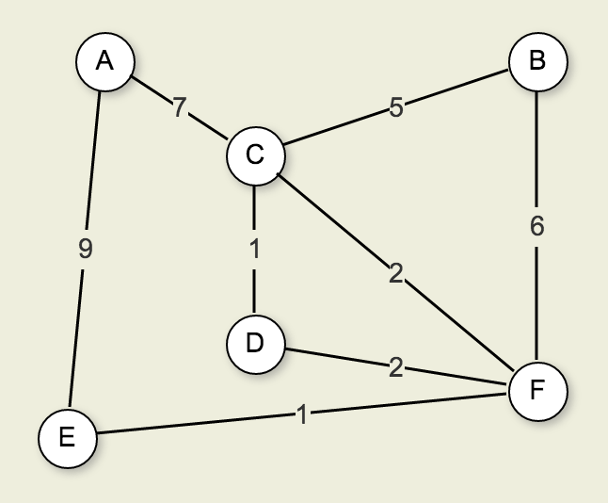
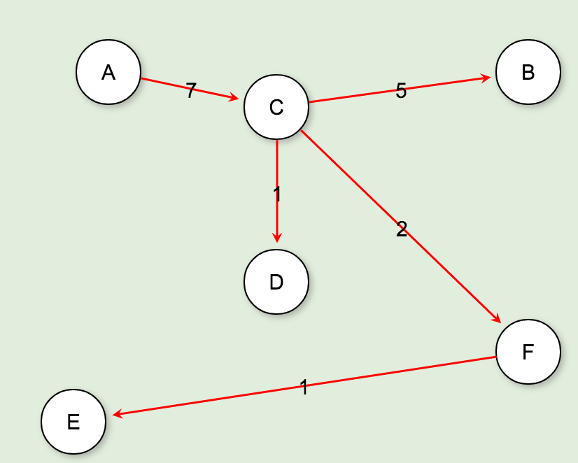
Minimum Cost Spanning Tree
MCST is a free tree with |V|−1 edges.

Slide 53
Two Implementations
Greedy Algorithm
Build up sub-optimal solutions to find the optimal solution
Kruskal
Depth first search
Prim
Breadth first search

Slide 54
Kruskal’s Algorithm
TBD

Slide 55
Kruskal’s Implementation
// Kruskal's MST algorithm
void Kruskal(Graph G) { ParPtrTree A = new ParPtrTree(G.nodeCount()); // Equivalence array KVPair[] E = new KVPair[G.edgeCount()]; // Minheap array int edgecnt = 0; // Count of edges
for (int i=0; i<G.nodeCount(); i++) { // Put edges in the array
int[] nList = G.neighbors(i);
for (int w=0; w<nList.length; w++)
E[edgecnt++] = new KVPair(G.weight(i, nList[w]), new int[]{i,nList[w]});
}
MinHeap H = new MinHeap(E, edgecnt, edgecnt);
int numMST = G.nodeCount(); // Initially n disjoint classes
for (int i=0; numMST>1; i++) { // Combine equivalence classes
KVPair temp = H.removemin(); // Next cheapest edge
if (temp == null) return; // Must have disconnected vertices
int v = ((int[])temp.value())[0];
int u = ((int[])temp.value())[1];
if (A.differ(v, u)) { // If in different classes
A.UNION(v, u); // Combine equiv classes
AddEdgetoMST(v, u); // Add this edge to MST
numMST--; // One less MST
}
}
}

Slide 56
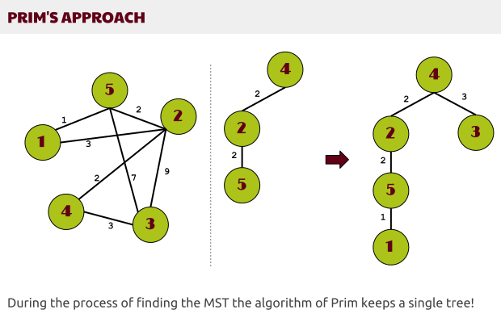
Prim’s Algorithm
Create an array of each vertices and a distance
initialize each distance to infinity
Start with any vertex
For each adjacent vertex, check the distance
Add distance to the distance array
Add the smallest, unvisited edge to the MCST
Advance to the adjacent node for the smallest edge
repeat

Slide 57
Prim Implementation
void Prim(Graph G, int s, int[] D, int[] V) { for (int i=0; i<G.nodeCount(); i++) // Initialize D[i] = INFINITY; D[s] = 0; for (int i=0; i<G.nodeCount(); i++) { // Process the vertices int v = minVertex(G, D); // Find next-closest vertex and set distances G.setValue(v, VISITED); if (D[v] == INFINITY) return; // Unreachable if (v != s) AddEdgetoMST(V[v], v); int[] nList = G.neighbors(v); for (int j=0; j<nList.length; j++) { int w = nList[j]; if (D[w] > G.weight(v, w)) { D[w] = G.weight(v, w); V[w] = v;
} }
} }

