Slide 1
I/O
CS580U - Fall 2018

Slide 2
What is input?
Kinds of input?
Sources of input?

Slide 3
This is Input
Any data coming into an executing program from an outside source
Sources
Device (user)
Keyboard, mouse
File
Binary or text
Memory/Network
another program?

Slide 4
Input is a String
All input comes in as a string
some functions do conversion for you
scanf() converts based on type
This means the data type of all input is what?
Char
<enter>, <space>, <tab> are all whitespace characters
represented by an escape, “\<character>”
“\n” = new line (enter or return)
“\t” = tab
printing escape characters
Use an extra “\” to escape escape characters
“\\n” prints “\n”

Slide 5
Important fact that will save you hours of debugging if you remember it
Input is always only read one character at a time at the lowest level
When you press enter, you are submitting a character for the computer to process, represented in C as ‘\n’
The following is equivalent for the computer:
“Hello there”
“Hello\nthere\0”

Slide 6
FILE *
Library object that holds information about a memory location
for C programs, all input and output goes through FILE *
Not necessarily a file, can be
File
Device
Volatile Memory

Slide 7
Streams
Streams are library macros for FILE *
Allows redirection of I/O to or from devices
Treats devices as if they were files
Streams are one way
Data enters stream one end, exits the other
Some streams are instant, some have delays (buffered
Door (non buffered) vs Tunnel (buffered)

Slide 8
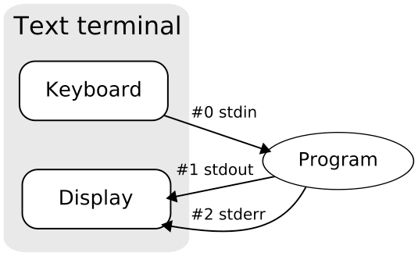
Stream usage example
3 standard streams available in C
stdin (0)
stdout (1)
stderr (2)
redirectable

Slide 9
Example of stdin, stdout, stderr
char buff[255];
//library function scanf uses stdin stream
scanf(“\n%s\n”, buff);
//printf uses stdout stream
printf(“\n%s\n”, buff);
//fprintf uses chosen stream
fprintf(stderr, “\n%s\n”, buff);

Slide 10
User Input
Take input from a user during program execution:
scanf();
from stdin to a specified format
getchar();
from stdin 1 byte at a time
char * gets ( char * str );
don't use gets(), no bounds checking. Continues reading until newline or end of file
Terminal input always come from stdin

Slide 11
scanf()
interface: int scanf ( const char * format, ... )
… means any number of variables matching the number of format specifiers
Format specifiers, just like printf
%d requires a pointer (why?)
example: scanf(“%d”, &x)
All scanf parameters are pointers
We need the address to store the data, not the data itself

Slide 12
scanf - %s
%s works differently in scanf()
scans up to next whitespace character, adds a null byte
example
scanf(“%s”, buff)
“hello there”
buff contains “hello”

Slide 13
The Scan Check
like gets, scanf does not automatically do bounds checking
Buffer overrun
ALWAYS limit how much you scan to the size of your buffer
char str[50]; scanf(“%50s”, &str);

Slide 14
Takeaways so far
All I/O is via a FILE *
I/O can be wrapped in streams to get I/O to or from devices
Use scanf() for structured user input
Always limit strings in scanf() to the buffer size or less

Slide 15

Buffering

Slide 16
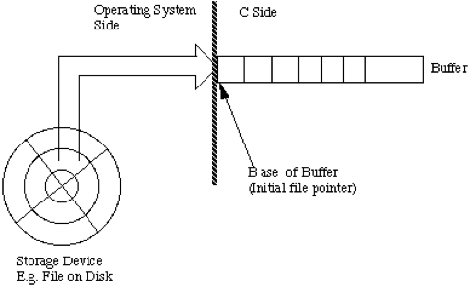
Buffered Output
Buffered : stored in a memory ‘bucket’ for later use
Usually to increase performance
Most output is buffered
stdin, stdout streams are buffered
stderr is not

Slide 17
Buffering complications
double n, m; double pi = 3.14159; char buffer[256]; printf("Enter degrees: "); fgets(buffer, 256, stdin); n = atof(buffer); m = sin(n * pi / 180);
Which executes first?
Which ‘outputs’ first?

Slide 18
Buffering complications
double n, m; double pi = 3.1415926535; char buffer[256]; printf("Enter degrees: ");
fflush(stdout); fgets(buffer, 256, stdin); n = atof(buffer); m = sin(n * pi / 180);
Flushes output stream

Slide 19
Debugging
When debugging, it is often better to use fprintf()
int fprintf ( FILE * stream, const char * format, ... );
Allows you to define a stream
stderr is non-buffered
bad for performance, good for debugging
Always use fprintf(stderr, “my debug statement”) for debugging
this ensures output isn’t buffered

Slide 20
Always flush
Flushing the output
use fflush(FILE *)
example: fflush(stdin)
Flushing the input
There is no easy way to flush input
You must know your input format
Input Flushing technique
while ( getchar() != '\n' ); //why does this work?

Slide 21
Buffered Input
All input must be buffered
You are too slow for the computer, so it has to buffer
Input is read into memory, and sent to the executing program as it requests it
Every character you press on the keyboard is sent to the input buffer
Including the enter key

Slide 22
Fix Me
void foo(int x){ printf(“DEBUG : %d”, x); char buff[255]; if(x < 100){ scanf(“%d %s”, x, buff ); } … }

Slide 23
//Corrected
void foo(int x){ fprintf(stderr, “DEBUG : %d”, x); char buff[255]; if(x < 100){ scanf(“%d %255s”, &x, buff ); } … }

Slide 24
int main(){
fprintf(stdout, “first”);
fprintf(stderr, “second”);
char let = ' ';
while(let != 'n' and let != 'N'){
fprintf(stdout, "Would you like to continue?");
let = getchar();
while(getchar() != '\n');
}
}
Classwork: Streams

Slide 25
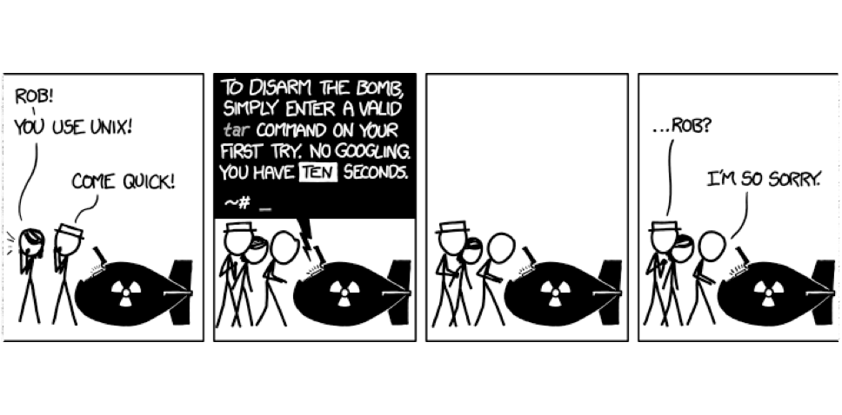
Command Line Arguments

Slide 26
Command Line Arguments
Strings sent in as parameters to main
Optional parameters to main, argc and argv
int main(int argc, char * argv[])
argc : argument count, i.e. number of parameters including program name
argv: array of strings containing the parameters
$> ./prog hello there
The above command runs the executable file prog, passing the command line arguments “hello” and “there”
Passed arguments are separated by spaces in the command
There is no limit to the number of arguments you can send

Slide 27
Using CLA
Remember: All arguments come in as strings
argc: allows you to loop through arguments and index into the argv array
Use argc for error checking
if(argc < 3){ printf(“usage: ./prog arg1 arg2\n”); } else{ printf(“\n %s %s \n”, argv[1], argv[2]); }
The name of the executable is always the first argument
argv: a two dimensional character array

Slide 28
What size argv array does this produce?
$ >./foo hello world config.txt 123 vars.exe
Notes:
6

Slide 29
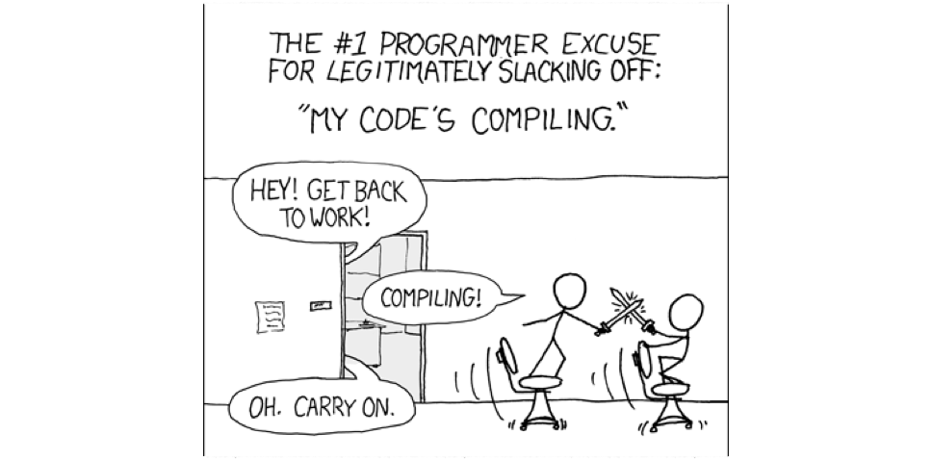
File IO

Slide 30
File I/O
File input works the same as stdin/stdout, except for the file position indicator
The File Position Indicator (sometimes also called file pointer) is a bookmark for where you are in the file when reading or writing
EOF - library macro indicating end of file

Slide 31
File Open
fopen opens a file stream and returns a FILE * to it
FILE * fopen ( const char * filename, const char * mode );
Because streams are one way, you must define the kind of stream or mode
r
read from file, starting from beginning
w
write to file, truncate if it already exists
a
write to file, append if it already exists
*+
read and write, according to *

Slide 32
fopen() Usage
FILE * fptr = fopen(“myfile.txt”, “r”);
opens myfile.txt in the same directory as the executable for reading
fopen(“config/myconfig.txt”, “w”);
opens myconfig.txt in the config directory for writing, clearing its contents
fopen(“binary.exe”, “a+”);
opens the binary.exe file for read/write to preserving its contents

Slide 33
File Close
fclose(FILE *)
ALWAYS close files when done
Remember that output is buffered
if the program exits before the buffer completes writing, data is lost
usage: fclose(fp)
guarantees all buffered output will be written

Slide 34
File Write
fprintf(FILE*, const char * format , …)
write to a file using format specifiers at the current position
usage
fprintf(fp, “%s”, buff);

Slide 35
File Read
Read from a file, and store in a variable
For structure format:
fscanf(FILE *, const char *, …)
Does automatic type conversion
For unstructured format:
fgets(char *, int , FILE *)
fgets reads a specified number of bytes, and saves it int a char buffer

Slide 36
File Position Indicator
Set the position with fseek()
works with bytes, not lines
Usage: fseek(FILE *, int offset, int origin)
origin = SEEK_SET | SEEK_CUR | SEEK_END
SEEK_SET : Beginning of file
SEEK_CUR : current position
SEEK_END : end of file

Slide 37
int main(){
fprintf(stdout, “first”);
fprintf(stderr, “second”);
fprintf(stdout, “first\n”);
fprintf(stderr, “second\n”);
char c = ‘ ‘;
while(c != ‘n’){
c = getchar();
while(getchar() != ‘\n’);
} printf(“Please enter a number and a username: ”);
fflush(stdout); char buff[255] = {0};
int num = 0;
scanf(“%d %255s”, &num, buff); FILE * fptr = fopen(“username.key”, w); for(char * ptr = buff; ptr != NULL; ptr++) fprintf(fptr, “%c”, (((*ptr)+num) % 62) + 65);
fclose(fptr);
}
Classwork: Passkey

