Slide 1
Pointers
CS 580U Fall 2018

Slide 2
Array Addresses
The memory address of the first element of an array is given the name of the array.
for example, given: int list[] = {5,6,7,8} list is the memory address of ‘5’
When memory is allocated for the array cells, the starting address is fixed
To ensure that this address is not changed array names may not be used as variables on the left of an assignment statement

Slide 3
Classwork
#include <stdio.h>
int main(){
char str[1];
printf("%p\n", str);
printf("%p\n", str+1);
int num[1];
printf("%p\n", num);
printf("%p\n", num+1);
double db[1];
printf("%p\n", db);
printf("%p\n", db+1);
}
Printing Addresses

Slide 4
Pointers
A variable that has the memory address of another variable
Sometimes called references or alias
One of the most powerful features of C
Allows you to write very efficient code
Pointers do not hold data
Pointers hold a number that corresponds to an address in memory of some data

Slide 5
Why Pointers?
They allow you to refer to large data structures in a compact way
They make memory usage and management easier
They make it possible to get new memory dynamically as your program is running

Slide 6
Managing Memory
Recall, C is pass by value
What if we want to change a value in different scope?
Example
We write a function to keep track of various info since we have been castaway on a deserted island
We have an int num_days = 0, food_left = 50;
We want to increment the num_days in the function.
We could return the new number of days, but then food_left does not get decremented
We need to access the original value, not a copy

Slide 7
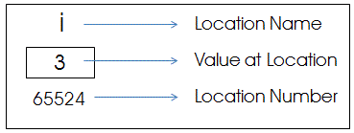
Defining a Pointer
Uses the * operator
Definition: <type> * <var>;
Example: int * num_ptr
What does a pointer contain?
just a number
You can treat it just like an integer

Slide 8
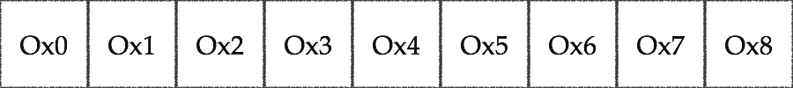
A Pointer in Memory
Computer memory is just a very large array
Memory is addressed in bytes
byte 1 address = 0, byte 2 address = 1...
Every byte has an address
Byte addressable

Slide 9
Pointer’s Flexible Syntax
The ‘*’ that designates the pointer type may have a space between the data type (int, char, etc) and the variable name
It does not have to
Example: char * x == char* x == char *x;
IMPORTANT: The pointer is a type
char != char * <—these are different types

Slide 10
Best practice
What does the following declare?
int * x, y;
For clarity, best practice is to keep the pointer symbol next to the variable
int *x, *y;

Slide 11
NULL
NULL is essentially 0
NULL is the universal value for ‘this variable has not been initialized yet’
Pointer variables should ALWAYS be initialized to NULL if not initialized to a value
Why? What do they contain if you don’t?
Don’t confuse a void pointer and a NULL pointer
void is a type, NULL is a value

Slide 12
Classwork: MySizeOf

Slide 13
Pointer Parameters
Declare pointer parameters like other types
Example: int foo(char * string, int * list);
functionally the same as: int foo(char string[], int list[]);
All arrays are passed as pointers

Slide 14
Pass By Value
C only has pass by value
But you can pass the value of a memory address *tricky*
We say all types passed by value except pointers and arrays
even though they are too
Pointer passes by value, but values pointed to are always referenced

Slide 15
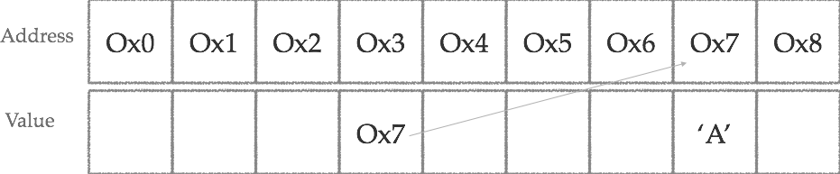
Dereferencing
“Any problem in computer science can be solved by more indirection”
A pointer is a memory address with a restricted type, also known as a reference

Slide 16
Dereference Pointers
Dereference the pointer with *
int x = *ptr
Same symbol as pointer declaration, not the same operation
When you follow GPS directions to an address, you are dereferencing the address
Dereferencing jumps from the address in the pointer to the data stored at that address

Slide 17
Dereference
char some_string[] = “string”;
char *letter_ptr = some_string;
//to access some_string[0] char letter_1 = *letter_ptr; //to access some_string[1] char letter_2 = letter_ptr[1];
We can treat pointers just like arrays
But they aren’t the same thing (more on this later…)
Notes:
to the code

Slide 18
Order of Operations
Dereference example: int num = *num_ptr;
Used in an expression
int num = *num_ptr+2; //this may not give the expected results
Dereference has the higher priority
int num = *(num_ptr + 2); //must use parenthesis

Slide 19

Reference Operator
Get the memory address of data with the reference operator: &
Example:
char c = ‘c’; char * c_ptr = &c;
Type should match
You can assign the address of an int to a char pointer, but what happens?

Slide 20
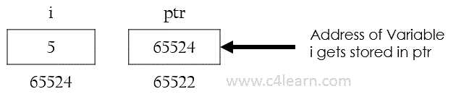
& - memory address
Grab the memory address of any variable with the reference operator - &
The value must be stored in memory, not a literal
&var gives me the memory address of var
&10 not possible, 10 is not 'stored', it is a literal

Slide 21
Pass By Reference
Pass the memory address of the data
Pass by reference using & and *
Example: int x = 1; passByReference(&x); /…/ int passByReference(int * x) { (*x) = (*x) + 2; }

Slide 22
Classwork
4, 4
3, 4
void swap(int *p1, int *p2){
int temp = *p1;
*p1 = * p2;
*p2 = temp;
}
Pointers

Slide 23
Pointer Arithmetic
Because pointer’s are basically just numbers, you can do basic arithmetic with them
add and subtract only
Math works different with pointers
int * ptr = 2; int * new_ptr = ptr + 2;
What do you think new_ptr would equal?

Slide 24
Math with Pointers
Pointer math always takes into account the type
Formula: <address> + (<val> * <type size>)
type size is implicit/automatic
Example
int * ptr = 2; new_ptr = ptr + (2 * sizeof(int))
if int is 4 bytes, new_ptr == 10
Notes:
to the code

Slide 25
Unary Operator
Preoperations
++i or --i
(Inc/Dec)rements first, then performs operation
Postoperations
i++ or i- -
performs operation, then (Inc/Dec)rements

Slide 26
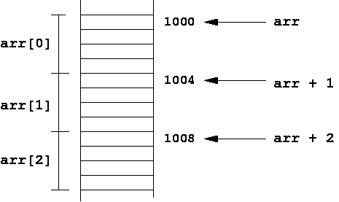
Pointer Increment
Remember, pointers have types to support pointer arithmetic
Pointers add according to their types
Example:
++int_ptr: adds by sizeof(int)
char_ptr++: adds by sizeof(char)

Slide 27
Classwork
#include <stdio.h>
void prints(char * str){
char * c;
for(c = str; *(c+1) != '\0'; c++)
printf("%c -", *c);
printf("%c", *c);
}
void reverse(int * arr, int size){
int * end;
for(end = arr+size-1; arr < end; arr++, end--){
int temp = *arr;
*arr = *end;
*end = temp;
}
}
int main(){
int nums[] = {1,2,3,4,5,6,7};
char string[] = "Hello";
prints(string);
printf("\n");
reverse(nums, sizeof(nums)/sizeof(int));
int * arr = nums;
for(; arr < nums+sizeof(nums)/sizeof(int); arr++){
printf("%d", *arr);
}
printf("\n");
return 0;
}
Pointer Arithmetic

Slide 28
Pointers to Pointers
Since we can have pointers to int, and in fact pointers to any type in C, it shouldn't come as too much of a surprise that we can have pointers to other pointers.
We'll now have to distinguish between the pointer, what it points to, and what the pointer that it points to points to.
And, of course, we might also end up with pointers to pointers to pointers, or pointers to pointers to pointers to pointers...

Slide 29
Double Pointers
So, what if I want to keep any array of 5 strings?
Since strings are just pointers to an array of characters
char * strings[5]
But arrays are just pointers to a starting memory address
char ** strings;
where the two asterisks indicate that two levels of pointers are involved.

Slide 30


Double Pointers
Suppose we have:
int ** ipp; int i = 5, j = 6; k = 7; int *ip1 = &i, *ip2 = &j;
Now we can set:
ipp = &ip1;
If we say:
*ipp = ip2;

Slide 31
Using Pointers to Manage Memory

Slide 32
Segmentation
When your executable runs, the Operating System reserves a segment of memory available for the program’s execution
When your program tries to access memory outside of this allotted segment, you create a ‘segmentation fault’
All resources used by this segment are released when the segment is released

Slide 33
How to Build a Segment
Your segment is further divided into different kinds of memory
Why? Because some information is known at compile time and some won’t be known until runtime
The memory-segment is divided into sub-segments
We need space for our program to run
We also need free memory to allocate and deallocate

Slide 34
Memory Organization
3 Primary Memory Sub-Segments
Stack - running program
Heap - free space
Static - compile time memory
Stack and Heap are Dynamic Memory
They are allocated during runtime
The Stack
Free Space
The Heap
Static Memory

Slide 35
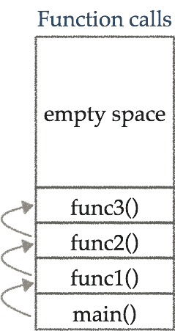
The Stack
The stack grows as functions allocate local variables
Automatically allocated and freed
The stack has size limits
OS Dependant
Local variables only exist while the function that created them is running
scope

Slide 36
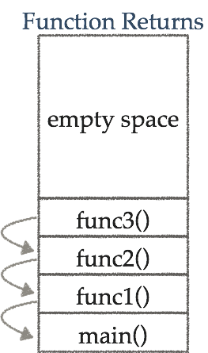
Stack Movement
Function calls add a frame to the stack
Function returns remove frames from the stack
Once a frame is unwound, the data is lost
or is it?

Slide 37
The Heap
Writable memory can be allocated and deallocated by the programmer (dynamically)
Memory does not automatically free from the heap for the life of the program
Pointers are essential
The Stack
Free Space
The Heap
Static Memory

Slide 38
Stack vs Heap vs Global
 | Stack | Heap | Static
Memory Type | Runtime | Runtime | Compile Time
How is it created? | Automatically Allocated | Explicitly Allocated | Statically Allocated
How is it freed? | Automatically Freed | Explicitly Freed | Life of the Program

Slide 39
void *
typeless or universal pointer
cannot be dereferenced
must be cast into a type before dereferencing
why?
cannot be used in pointer arithmetic
why?
How to know what to cast it?
This is the programmer’s responsibility

Slide 40
void * examples
As variables
void * v_ptr = &foo;
remember, pointer addresses are just integers
On most compilers, void * automatically become the pointer type assign
Example: int * x = returnVoidPtr();
This automatically becomes an int *

Slide 41
malloc()
malloc dynamically allocates memory that lives outside the life of stack
void* malloc (size_t size);
size_t is a library typedef for an unsigned int
size_t is always in bytes
Examples
int * int_ptr = malloc(4);
int * int_ptr = malloc(sizeof(int));
int * my_ptr = malloc(sizeof(MyStruct));

Slide 42
Allocating space for arrays
Allocate space for arrays by multiplying the number of items by the size of the type
Example
int * int_list = malloc(sizeof(int) * 5);
sizeof(int) = 4
4*5 = 20
MyStruct * mystruct_list = malloc(sizeof(MyStruct) * 20);
IMPORTANT: malloc doesn’t know you are allocating an array. It’s just allocating a chunk of memory.
int_list
4 bytes | 4 bytes | 4 bytes | 4 bytes | 4 bytes

Slide 43
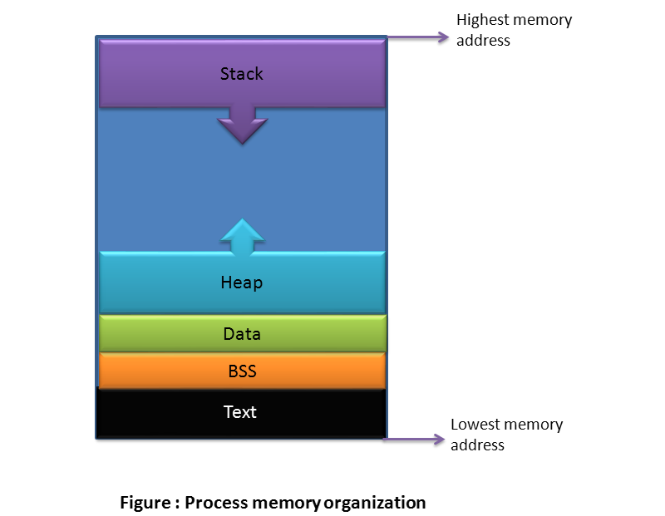
Where is this memory?
Dynamically allocated memory is put on the heap
The heap grows as more memory is allocated
The amount of room for heap memory is finite
Though you’ll probably never run into this limit unless you have a bad memory leak

Slide 44
malloc() Only Allocates
malloc allocates and marks a chunk of memory in the heap as ‘in use’
malloc does not
clear or zero out memory (some OS’s do)
whatever was there previously is still there (junk)
do any bounds checking to make sure you are only using that memory
You can write and read past the end of your allocated memory
guarantee the memory is secure
another pointer can point to the same memory and overwrite it

Slide 45
malloc() isn’t the boss of you...
What’s wrong with this code?
int * ptr = malloc(sizeof (int));
*ptr = 8;
*(ptr + 1) = 5;
printf("\n%d\n", ptr[1]);

Slide 46
...but malloc() will take your stuff
int * ptr = malloc(sizeof (int));
*ptr = 8;
*(ptr + 1) = 5;
printf("\n%d\n", ptr[1]);
Allocated by malloc()
Not allocated, but (probably) still accessible
000000000 | 00000000 | 00000000 | 00001000 | 00000000 | 00000000 | 00000000 | 00000101

Slide 47
Buffer Overrun
malloc finds and allocates free space,
it doesn’t limit what you can access within your segment
As long as the memory is in your dynamic segment, you can access it with a pointer
No guarantee that the OS won’t overwrite memory not allocated by malloc

Slide 48
Verify Successful Allocation
malloc returns NULL if there is not enough memory to allocate
You can check malloc’s return value for NULL
Example:
if((ptr = malloc(num_bytes)) == NULL){ exit(-1); }
Is this necessary?
Depends on the system and who relies on your code.

Slide 49
Additional Allocation calls
calloc()
void* calloc (size_t num, size_t size);
Allocates a block of memory for an array of num elements, each of them size bytes long, and initializes all its bits to zero.
realloc()
void* realloc (void* ptr, size_t size);
Changes the size of the memory block pointed to by ptr. The function may move the memory block to a new location (whose address is returned by the function).

Slide 50
free()
free releases memory marked as allocated by malloc
requires the address of memory allocated by malloc
memory is reclaimed for later use
Syntax: void free (void* ptr);
Example:
char * str = malloc(sizeof(char)*6); … free(str);

Slide 51
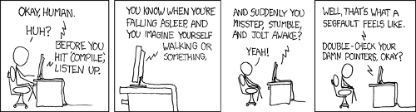
Always NULL Freed Pointers
Free does not change the pointer
Free does not ‘clear’ memory
The freed pointer still has the memory address of the freed memory
Dangling Pointer
Always NULL freed pointers
free(ptr); ptr = NULL;
Calling free() on NULL is a no-op, not an error

Slide 52
Space
classwork

