Slide 1
Structs
CS580U - Fall 2018

Slide 2

Problem
Define a Person in code:
char person_name[] = “Hannibal Lecter”; int person_age = 57; char person_hobbies[3][50] = { “Long Talks”, “Problem Solving”, “Foodie”};
How do we organize this information?
This is the fundamental problem data structures tries to solve

Slide 3

Structs
User defined type
treated just like int, double, etc
Complex Type
Compound data structure
Two ways to think about it
A container for stuff
A multi-type array

Slide 4
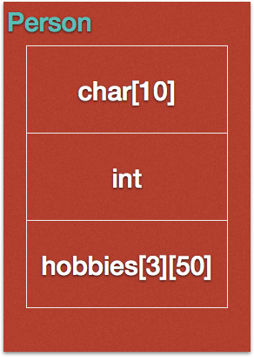
Declaring Structs
syntax
struct <name>{ <data> };
Example
struct Person{ char name[10]; int age; char hobbies[3][50]; };

Slide 5
Initializing Structs
Multiple ways to initialize a struct
struct Person hannibal; hannibal.name = “Hannibal”; hannibal.age = 57; hannibal.hobbies = hobby_list;
struct Person hannibal = { .age = 57, .name = “Hannibal”, .hobbies = hobby_list };
struct Person hannibal = {“Hannibal”, 57, hobby_list};
this form should be considered deprecated

Slide 6
Inline Initialization
Can initialize a struct inline (as needed)
struct { int i; char c; } my_struct; //declaration
struct { int i; char c; } my_struct = {6, ‘a’}; //definition

Slide 7
Uninitialized Structs
When you define a struct, if you do not give it any values, it is contains junk values
Once upon a time this was useful, less so today
You can zero out a struct on definition by assigning a blank struct
struct Person hannibal = {}
This makes sure that all values are zeroed out

Slide 8
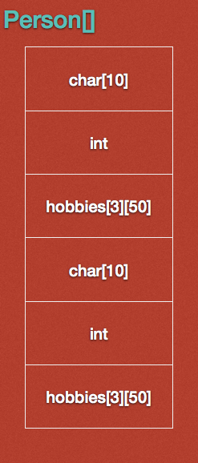
Structs in Memory
{
A struct is a single data type, regardless of how many elements make it up
Structs are basically a hash
.name
.age
.hobbies
people[0]
{
people[1]
.name
.age
.hobbies

Slide 9
Structs as Parameters
Must use the ‘struct’ keyword
int escape(struct Person var);
the keyword is part of the type
the type is ‘struct Person’
You can create a struct on the fly, a.k.a. a Compound Literal
When passing a compound literal, must typecast
escape((struct Person){.age = 57, .name = “Hannibal”, .hobbies = hobby_list});

Slide 10
Direct Definition of Struct Arrays
Direct Definition:
struct Person people[2] = { {“Hannibal”, 57, hannibal_hobbies}, {“Forrest”, 45, forrest_hobbies} };
-or-
struct Person people[2] = {“Hannibal”, 57, hannibal_hobbies,“Forrest”, 45, forrest_hobbies};
Why does this work?

Slide 11
Classwork
padding
8, 8
16, 16
9, 16
12, 16

Slide 12

sizeof Struct
You cannot count on the size of a struct
struct Stuff{ int i; char c; }
What size should this be?
Word Alignment
This is a way to simplify hardware
Pads out to the next CPU word according to the largest internal data type
it’s bigger on the inside

Slide 13

Structs-ception
Structs can contain other structs
Example:
struct Food{ struct Person people[2]; };
Structs cannot contain themselves
Why not?
Infinite structs-ception
Workaround? Structs can contain pointers to themselves
Why does this work?

Slide 14
Struct Assignment
Can assign structs to other structs
Performs shallow copy
Example:
struct Person forrest = hannibal;
Copies all values over, why?
Structs are a single unit of data, like any other data type
variable names are just keys into the ‘hash’

Slide 15
Typedef
What is the declaration if I need an unsigned long integer value
unsigned long int num;
Can I shorten that?
Use typedef
Allows you to give a additional name for an existing type.
new names are just an alias for some other type
Improves clarity of the program with additional benefits

Slide 16
Using Typedef
Syntax
typedef <type> <alias>;
To shorten a type name
typedef unsigned long int uint64;

Slide 17
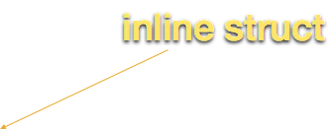
Dropping the struct Keyword
Let’s get rid of the ‘struct’ keyword
structs are just user defined types, right?
use typedef to create an alias
Example:
typedef struct { int i; char c; } MyType;
usage: MyType var;

Slide 18
Struct-ception 2: Typedef
Example:
typedef struct mytype{ int i; struct mytype * var;
char c;
} MyType;
//Have to refer to the struct the old way inside the typedef

Slide 19
Freeing Structs
Given: int = 4 bytes, char = 1 byte, * = 4 bytes
struct foo{ int x; char * str; }; … foo * f = malloc(sizeof(foo)); f.str = malloc(sizeof(char) * 6); … free(f);
What is the size of foo?
What get deallocated?

Slide 20
Free Secondary Types
Foo
Char array
int | 4 bytes
1 byte | 1 byte | 1 byte | 1 byte | 1 byte | 1 byte
char * | 4 bytes

Slide 21
Free Secondary Types
Foo
Char array
int | 4 bytes
1 byte | 1 byte | 1 byte | 1 byte | 1 byte | 1 byte
char * | 4 bytes
…
free(f);
...

Slide 22
Free Secondary Types
Foo
Char array
int | 4 bytes
1 byte | 1 byte | 1 byte | 1 byte | 1 byte | 1 byte
char * | 4 bytes
…
free(f);
...
This still exists in memory. How can we access it?

Slide 23
Free Secondary Types
Foo
Char array
int | 4 bytes
1 byte | 1 byte | 1 byte | 1 byte | 1 byte | 1 byte
char * | 4 bytes
…
free(f);
...
We can’t. It is lost for the life of the program.

Slide 24

memory leaks
A Memory Leak is when you free memory that contains the only address of dynamically allocated memory
You must free the ‘deepest’ pointer to dynamically allocated memory first, then work your way ‘up’ the chain
NULL pointers (if you nullify them properly) mean the memory has been freed
Remember, you can call free on NULL and it is a no-op (doesn’t do anything)

Slide 25
Structs as Classes
Structs are not classes, they are compound data types.
However, we can easily modify how we use them to make them work more like classes.
Every struct should have 3 accompanying functions:
new_<structname>
Takes no paramaters
Returns a pointer to the initialized struct
copy_<structname>
Takes a pointer to another struct of the same type as a parameter
Returns a pointer to the copied struct
free_<structname>
Takes a pointer to a struct
Returns void

Slide 26
Person Example
typedef struct Person{
char * name;
int age;
} Person;
Person * new_person(){
Person * p = malloc(sizeof(Person));
p->age = 0;
p->name = NULL;
return p;
}
void delete_person(Person * p){
free(p->name);
free(p);
}
Person * copy_person(Person * p){
Person * copy = new_person();
copy->name = malloc(strlen(p->name)+1); //Deep copy
copy->age = p->age;
strcpy(copy->name, p->name);
return copy;
}

Slide 27
Function Pointers
So far, we created some functions and a struct, but these aren’t methods.
We need to have the functions belong to the struct
We need function pointers
A function pointer is the address in memory of a function
A function’s interface is also the functions type
whenever we use an address in memory, we also need the type of the data stored at that address
we declare function pointers with the following syntax:
return (*name)(<parameters>)
We declares the function’s ‘type’ when we declare the function pointer
For example, if we wanted to get the address of a function: int foo(char *)
int (*fp)(char *) = foo;

Slide 28
Struct Methods
If we define function pointers within our struct for each function that ‘belongs’ to the struct, we can treat them as methods.
The exception to that is the new_ method. That becomes a bootstrapping problem and must stay outside the struct.
We have now created a kind of namespacing, where we can use uniform names for copy, delete, and other functions belonging to the struct
We still have to use unique names for the functions, we just don’t have to remember them.

Slide 29
Person w/ Methods Example
typedef struct Person{
char * name;
int age;
struct Person * (*copy)(struct Person *);
void (*delete)(struct Person *);
} Person;
Person * new_person(){
Person * p = malloc(sizeof(Person));
p->age = 0;
p->name = NULL;
p->copy = copy_person;
p->delete = delete_person;
}

Slide 30
Classwork: structs

