Slide 1

PROJECT BASED LEARNING
A MACHINE LEARNING MODEL FOR PRODUCT RISK MANAGEMENT
NAME | ROLL NUMBER
B.CHAKRADHAR | 21951A1220
B.DATTA SAI | 21951A1222
K.JAYA KRISHNA | 21951A1233

Slide 2
ABSTRACT
A machine learning model is a program that can find patterns or make decisions from a previously unseen dataset. For example, in natural language processing, machine learning models can parse and correctly recognize the intent behind previously unheard sentences or combinations of words.
This model helps to identify the risk of product manufacturing and marketing.

Slide 3
PROBLEM DEFINITION
Developing a machine learning model for product risk management involves addressing various challenges related to identifying and mitigating risks associated with products.
Risk Identification
Integration with Existing Systems
Scalability
Toxic comment identification

Slide 4
INTRODUCTION
PROBLEM DEFINITION
INTRODUCTION
Machine learning has the ability to identify risks more efficiently. By analyzing large volumes of data from various sources, including historical data, social media, and news feeds, AI algorithms can identify potential risks that may have been overlooked by humans.
Machine learning algorithms can also learn from previous risk events and identify similar patterns that could indicate a new risk.
By automating the risk management process, machine learning can help businesses improve efficiency.

Slide 5
LITERATURE SURVEY
Literature Survey
Deep Learning Based Sentiment Analysis Using Convolution Neural Network:
Deep Learning Based Sentiment Analysis Using Convolution Neural Network
Deep learning:
Deep learning discovers intricate structure in large data sets by using the backpropagation algorithm to indicate how a machine should change its internal parameters used to compute the representation in each layer from the representation in the previous layer.
NLP techniques are recognized for their effectiveness in extracting valuable insights from unstructured textual data, enabling a more comprehensive understanding of potential risks.
Techniques such as sentiment analysis, topic modeling, and named entity recognition are employed to identify and categorize risks within user reviews, feedback, and other textual sources.

Slide 6
METHODOLOGY
NLP Methods:
Data Collection:
Obtain a dataset of product reviews.
Data Preprocessing:
Perform data cleaning by removing duplicates, handling missing values, and addressing any specific issues in the dataset.
Feature Engineering:
Create relevant features, such as word counts, TF-IDF vectors, or word embeddings

Slide 7
METHODOLOGY
Data Splitting:
Split the dataset into training, validation, and test sets to train and evaluate the sentiment analysis model.
Model Selection and Development:
Logistic Regression
Naive Bayes
Support Vector Machines
Model Training
Model Evaluation

Slide 8
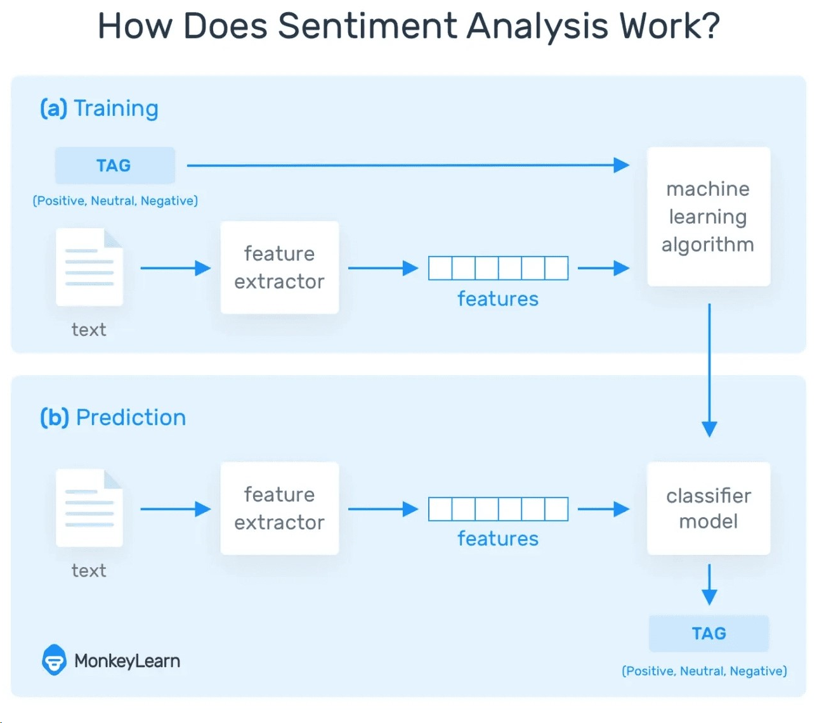
SYSTEM DESIGN

Slide 9
SYSTEM DESIGN
The system is trained using the CNN model which consists of four layers, i.e.,
1.Input layer: The input layer is where the network receives the initial data, and for image data, it is typically a multi-dimensional array representing the pixel values of the image.
2.Convolution layer: Fundamental building block responsible for extracting features from input data
3.Global max pool layer: Global Max Pooling is a pooling layer that takes the maximum value from each feature map.
4.Fully connected layer: The fully connected layer processes the features extracted by the convolutional layers and makes predictions.

Slide 10
IMPLEMENTATION
1. Data Collection:
Gather a labeled dataset that includes comments labeled for toxicity and information about user behavior.
Annotate the dataset with labels indicating harmful users.
2. Data Preprocessing:
Clean and preprocess the text data using NLP techniques (tokenization, lemmatization, etc.).
Extract relevant features from user behaviors and comments.
3. Feature Extraction:
Use techniques like TF-IDF, word embeddings, or pre-trained language models to represent textual data as numerical features.
Consider additional features such as user engagement history, frequency of toxic comments, etc.

Slide 11
IMPLEMENTATION
4. Model Selection:
Choose a suitable machine learning model or ensemble of models for toxic comment identification and harmful user detection.
Consider using models like Convolutional Neural Networks (CNNs), Recurrent Neural Networks (RNNs), or transformer-based models.
5. Model Training:
Split the dataset into training and testing sets.
Train the chosen models on the training set, using labeled data for toxic comments and harmful user behaviors.
Optimize hyperparameters and conduct cross-validation for better generalization.
6. Evaluation Metrics:
Define appropriate evaluation metrics for both toxic comment identification and harmful user detection.
Metrics may include accuracy, precision, recall, F1 score, and area under the ROC curve for toxic comment identification, and similar metrics for harmful user detection.

Slide 12
IMPLEMENTATION
7. Blocking Mechanism:
Implement a blocking mechanism that prevents identified harmful users from interacting with the platform.
Define specific thresholds or rules for user blocking based on the severity or frequency of toxic behavior.
8. Testing:
Conduct thorough testing of the system in various scenarios.
Test for robustness against adversarial examples and edge cases.
9. Deployment:
Deploy the toxic comment identification and user blocking system into a production environment.
Use containerization (e.g., Docker) for easy deployment and scalability.

Slide 13
CONCLUSION
Machine learning have the potential to transform product risk management in industrial services. By analyzing large volumes of data and identifying patterns, these technologies can help businesses to identify potential risks and take proactive measures to mitigate those risks.
The future of machine learning for product risk management is dynamic, with continuous advancements in technology, increased data availability, and growing awareness of the benefits of AI in enhancing safety, quality, and compliance across various industries. As organizations adapt to these developments, they will be better equipped to identify and mitigate risks, ultimately improving product safety and consumer satisfaction.

