Slide 1
Applying Compliance Frameworks using InSpec
Translating CIS and DoD Specifications into InSpec Tests

Slide 2
Objectives
After completing this module, you should be able to:
Translate CIS (Center for Internet Security) specifications into InSpec tests.
Translate DoD (Department of Defense) specifications into InSpec tests.
Notes:
TBD Delete later: https://chefio.atlassian.net/wiki/pages/viewpage.action?spaceKey=SE&title=Week+2+-+Use+Cases#Week2-UseCases-Exercises-CIS

Slide 3
Compliance Frameworks
The CIS Security Benchmarks program provides well-defined, un-biased and consensus-based industry best practices to help organizations assess and improve their security.
Resources include secure configuration benchmarks, automated configuration assessment tools and content, security metrics and security software product certifications.
https://benchmarks.cisecurity.org/

Slide 4
GE: Compliance Frameworks
Translating a CIS benchmark into an InSpec control and Compliance profile.
In this exercise you will download the latest CIS benchmarks, interpret one of the benchmarks and write an InSpec control and Compliance profile based on CIS benchmark.

Slide 5
GE: Compliance Frameworks
Translating a CIS benchmark into an InSpec control and Compliance profile.
Download the benchmark PDF for the Linux platform of your scanning target
Implement Section 3 - Specialty Purpose Services as InSpec controls.
Use `inspec exec` to run the tests against your Linux target.
Package the profile and upload it to your Compliance server.

Slide 6

GE: Downloading the CIS Benchmarks
1. Go to: https://benchmarks.cisecurity.org/
Click the Products & Services tab.
Click Benchmarks.

Slide 7
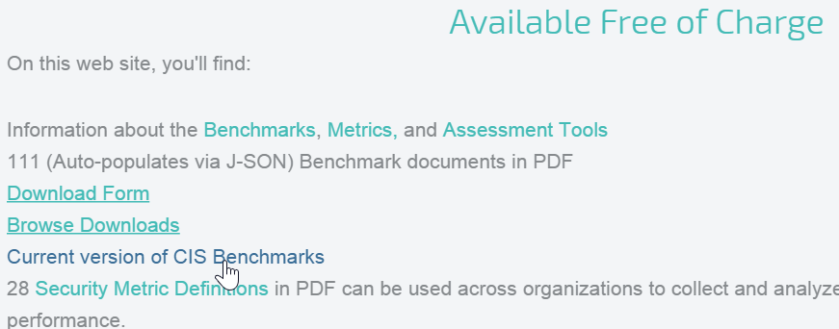
GE: Downloading the CIS Benchmarks
Scroll down to the Available Free of Charge section and then click Current version of CIS Benchmarks.

Slide 8
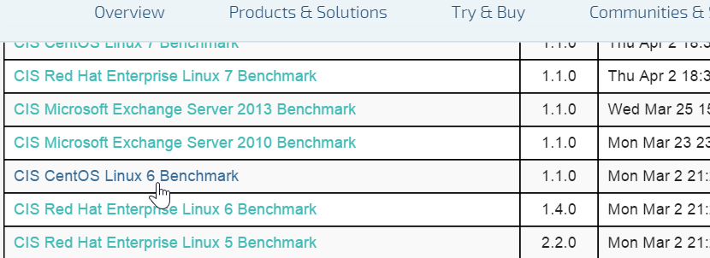
GE: Downloading the CIS Benchmarks
Scroll down to the benchmark for the system you're running. In our case, click the CIS CentOS Linux 6 Benchmark link.

Slide 9
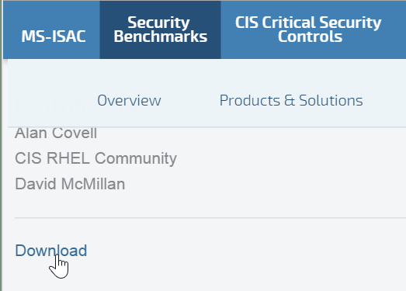
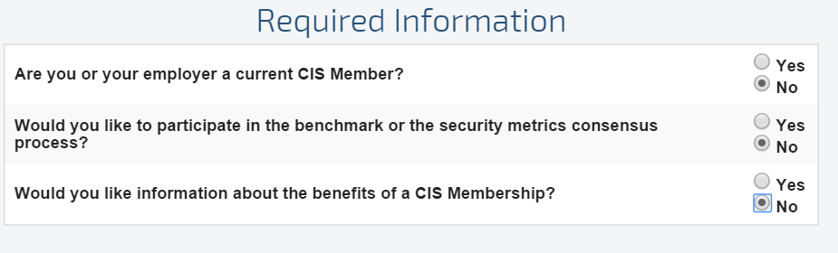
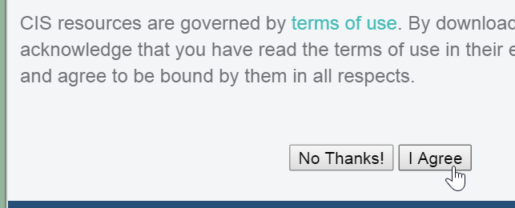
GE: Downloading the PDF
Scroll down to the bottom of the page and click Download.
On the resulting page, click the Required Information radio buttons.
Then scroll down and click the I Agree button.

Slide 10
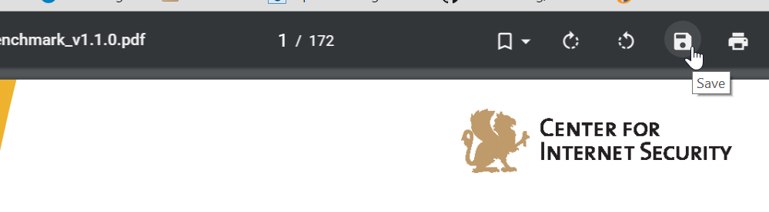
GE: Downloading the CIS Benchmarks
Save the PDF to your laptop. If a Save icon is not obvious, you should be able to save the PDF by right-clicking it.

Slide 11
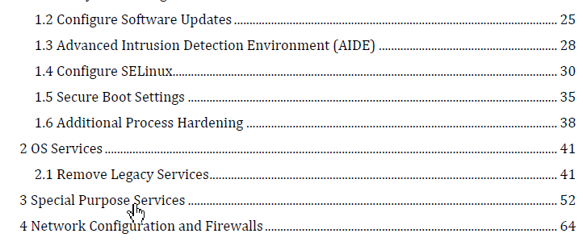
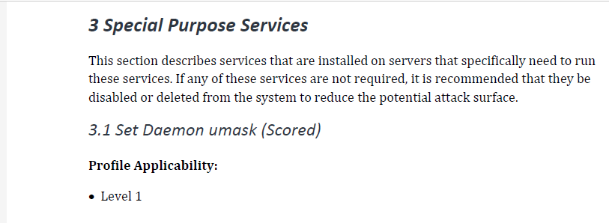
GE: CIS Benchmarks
From the Table of Contents, click the Special Purpose Services bookmark or otherwise go to that section.
Notes:
As you can see on that page the 3.1 Set Daemon umask (Scored) section says:
Description:
Set the default umask for all processes started at boot time. The settings in umask selectively turn off default permission when a file is created by a daemon process.
Rationale:
Setting the umask to 027 will make sure that files created by daemons will not be readable, writable or executable by any other than the group and owner of the daemon process and will not be writable by the group of the daemon process. The daemon process can manually override these settings if these files need additional permission.
Audit:
Perform the following to determine if the daemon umask is set.
# grep umask /etc/sysconfig/init umask 027

Slide 12
Downloading The Latest Benchmarks
The latest CIS benchmarks in PDF format can be downloaded from here:
https://benchmarks.cisecurity.org/downloads/latest/
From that link, scroll down to and download the
CIS CentOS Linux 6 Benchmark PDF.

Slide 13
GE: Create a Set Daemon umask Control
$ cd ~
Notes:
On your target node, ensure you are in your home directory.
$ `mkdir -p ~/compliance_profiles/profile_01`
$ `cd ~/compliance_profiles/profile_01'
Reminder: In the workplace you would likely perform this task TBD

Slide 14
GE: Create a Set Daemon umask Control
~/cis31.rb
control 'cis-3.1' do
impact 0.7
title 'Set Daemon umask'
describe file('/etc/sysconfig/init') do
its('content') {should match 'umask 027'}
end
end
Notes:
TBD: Need to provide explanation on how to write this.
For anything scored by CIS we'll score it 0.7. For anything not scored you should score it 0.0.

Slide 15
GE: Test the Control with `inspec exec`
$ inspec exec cis31.rb
F
Failures:
1) File /etc/sysconfig/init content should match "umask 027"
Failure/Error: its('content') {should match 'umask 027'}
expected "# color => new RH6.0 bootup\n# verbose => old-style bootup\n# anything else => new style bootup without ANSI colors or positioning\nBOOTUP=color\n# column to start \"[ OK ]\" label in \nRES_COL=60\n# terminal sequence to move to that column. ...
Finished in 0.03128 seconds (files took 0.46609 seconds to load)
1 example, 1 failure
Failed examples:
rspec # File /etc/sysconfig/init content should match "umask 027"
Notes:
This is the kind of failure we should see because the umask of the etc/sysconfig/init is not 027.
F
Failures:
1) File /etc/sysconfig/init content should match "umask 027"
Failure/Error: its('content') {should match 'umask 027'}
Note: Sat the end of the output you will see a reference to rspec. This is because inspec is based on rspec.
expected "# color => new RH6.0 bootup\n# verbose => old-style bootup\n# anything else => new style bootup without ANSI colors or positioning\nBOOTUP=color\n# column to start \"[ OK ]\" label in \nRES_COL=60\n# terminal sequence to move to that column. You could change this\n# to something like \"tput hpa ${RES_COL}\" if your terminal supports it\nMOVE_TO_COL=\"echo -en \\\\033[${RES_COL}G\"\n# terminal sequence to set color to a 'success' color (currently: green)\nSETCOLOR_SUCCESS=\"echo -en \\\\033[0;32m\"\n# terminal sequence to set color to a 'failure' color (currently: red)\nSETCOLOR_FAILURE=\"echo -en \\\\033[0;31m\"\n# terminal sequence to set color to a 'warning' color (currently: yellow)\nSETCOLOR_WARNING=\"echo -en \\\\033[0;33m\"\n# terminal sequence to reset to the default color.\nSETCOLOR_NORMAL=\"echo -en \\\\033[0;39m\"\n# Set to anything other than 'no' to allow hotkey interactive startup...\nPROMPT=yes\n# Set to 'yes' to allow probing for devices with swap signatures\nAUTOSWAP=no\n# What ttys should gettys be started on?\nACTIVE_CONSOLES=/dev/tty1\n# Set to '/sbin/sulogin' to prompt for password on single-user mode\n# Set to '/sbin/sushell' otherwise\nSINGLE=/sbin/sushell\n" to match "umask 027"
Diff:
@@ -1,2 +1,27 @@
-umask 027
+# color => new RH6.0 bootup
+# verbose => old-style bootup
+# anything else => new style bootup without ANSI colors or positioning
+BOOTUP=color
+# column to start "[ OK ]" label in
+RES_COL=60
+# terminal sequence to move to that column. You could change this
+# to something like "tput hpa ${RES_COL}" if your terminal supports it
+MOVE_TO_COL="echo -en \\033[${RES_COL}G"
+# terminal sequence to set color to a 'success' color (currently: green)
+SETCOLOR_SUCCESS="echo -en \\033[0;32m"
+# terminal sequence to set color to a 'failure' color (currently: red)
+SETCOLOR_FAILURE="echo -en \\033[0;31m"
+# terminal sequence to set color to a 'warning' color (currently: yellow)
+SETCOLOR_WARNING="echo -en \\033[0;33m"
+# terminal sequence to reset to the default color.
+SETCOLOR_NORMAL="echo -en \\033[0;39m"
+# Set to anything other than 'no' to allow hotkey interactive startup...
+PROMPT=yes
+# Set to 'yes' to allow probing for devices with swap signatures
+AUTOSWAP=no
+# What ttys should gettys be started on?
+ACTIVE_CONSOLES=/dev/tty1
+# Set to '/sbin/sulogin' to prompt for password on single-user mode
+# Set to '/sbin/sushell' otherwise
+SINGLE=/sbin/sushell
# cis31.rb:5:in `block (3 levels) in load'
Finished in 0.03515 seconds (files took 0.50435 seconds to load)
1 example, 1 failure
Failed examples:
rspec # File /etc/sysconfig/init content should match "umask 027"

Slide 16
Objectives
stat -L -c "%a %u %g" /etc/crontab | egrep ".00 0 0"
sudo chmod og-rwx /etc/cron.hourly
stat /etc/cron.hourly

Slide 17
Compliance Frameworks

Slide 18
Running Reports
mmm
IMPORTING NODES
andrew: you can add nodes using the API, e.g. in bulkhttps://github.com/chef/chef-compliance/blob/master/docs/api_compliance.rst#post-bulk

Slide 19
GE: Creating a Custom Profile
Creating custom profiles to fit your business needs.
Create a custom profile.
Test your profile with InSpec
Notes:
The custom profile you will create will scan nodes to ensure they have a '/tmp' directory and that directory should be owned by the root user.
Note: In the workplace you would likely perform these custom profile tasks on your local workstation and upload them to the Compliance Server. In this class we'll use our target nodes as a workstation to create the profile on since they already have Chef installed on them. Then we'll ultimately upload the customer profile to your Compliance Server.

Slide 20
GE: Create a Directory for your Profile
$ mkdir -p ~/compliance_profiles/profile_01
$ cd ~/compliance_profiles/profile_01
Notes:
On your target node, create a directory for your profiles and the move into that new directory.
$ `mkdir -p ~/compliance_profiles/profile_01`
$ `cd ~/compliance_profiles/profile_01'
Reminder: In the workplace you would likely perform this task TBD

Slide 21
GE: Uploading the Custom Profile to the Compliance Server
Uploading it so it can be used in scans..
Zip up the new profile.
Upload it to your laptop and then to the Compliance Server.
Notes:
In addition to the uploading procedure we'll do in the exercise, in the workplace you could also upload such custom profiles using an API.

Slide 22
Review Questions
What is ...? ______________________________
Which is the correct answer?
answer
answer
answer
answer
Capable of carrying on a conversation
Explain

Slide 23
©2016 Chef Software Inc.

