Slide 1
Creating Custom Profiles
Defining and Uploading Compliance Profiles to the Compliance Server

Slide 2
Objectives
After completing this module, you should be able to:
Write a custom compliance profile.
Use InSpec to test your code and your custom profile.
Upload a custom compliance profile to your Chef Compliance server.
Test your custom profile.

Slide 3
Creating a Custom Profile
In this section we will create a custom compliance profile.
Custom profiles are created using InSpec, just like the existing profiles were created.
After you have created a custom profile, you'll learn how to upload it to a Compliance Server and then use it to check for compliance issues.

Slide 4
InSpec Command Line Interface
In this section we will use the InSpec command line interface (CLI) to run audit tests against targets.
The InSpec CLI can run audit tests against targets using SSH, WinRM, locally, or on Docker containers.
We'll be using `inspec check` and `inspec exec`.
`inspec check` just verifies the code--it doesn't actually test a system.
`inspec exec' will run the tests against a system.

Slide 5
Group Lab: Creating a Custom Profile
Creating custom profiles to fit your business needs.
Create a custom profile.
Test your profile with InSpec
Notes:
The custom profile you will create will scan nodes to ensure they have a '/tmp' directory and that directory should be owned by the root user.
Note: In the workplace you would likely perform these custom profile tasks on your local workstation and upload them to the Compliance Server. In this class we'll use our target nodes as a workstation to create the profile on since they already have Chef installed on them. Then we'll ultimately upload the customer profile to your Compliance Server.

Slide 6
GL: Create and Change to a Directory for your Profile
$ mkdir -p ~/compliance_profiles/profile_01
$ cd ~/compliance_profiles/profile_01
Notes:
On your target Linux node, create a directory for your profiles and the move into that new directory.
$ `mkdir -p ~/compliance_profiles/profile_01`
$ `cd ~/compliance_profiles/profile_01'

Slide 7
GL: Run `inspec check` to Verify Tests
$ inspec check ~/compliance_profiles/profile_01
E, [2015-12-11T20:14:28.196462 #15754] ERROR -- : Can't find metadata file /home/chef/compliance_profiles/profile_01/metadata.rb
/opt/chefdk/embedded/lib/ruby/gems/2.1.0/gems/inspec-0.9.2/lib/inspec/targets/folder.rb:23:in `resolve': Don't know how to handle folder /home/chef/compliance_profiles/profile_01 (RuntimeError)
Notes:
`inspec check` is used to verify all tests at the specified path. (https://docs.chef.io/ctl_inspec.html)
Run 'inspec check' against the new directory.
$ `inspec check /home/chef/compliance_profiles/profile_01'
Notice that InSpec can't find the metadata.rb that it expects to find.

Slide 8
GL: Create a metadata.rb via `touch`
$ touch ~/compliance_profiles/profile_01/metadata.rb
$ ls
metadata.rb
Notes:
So let's fix the missing metadata.rb issue.
From within ~/compliance_profiles/profile_01, let's create a metadata.rb by using the `touch` command.
$ `touch metadata.rb` or you can use the full path as shown in this slide.
You can also `ls` to see that the metadata.rb is now there.

Slide 9
GL: Run `inspec check` Against the New File
$ inspec check ~/compliance_profiles/profile_01
I, [2015-12-11T20:18:18.145021 #15801] INFO -- : Checking profile in /home/chef/compliance_profiles/profile_01
E, [2015-12-11T20:18:18.145182 #15801] ERROR -- : No profile name defined
W, [2015-12-11T20:18:18.145238 #15801] WARN -- : No version defined
W, [2015-12-11T20:18:18.145283 #15801] WARN -- : No title defined
W, [2015-12-11T20:18:18.145326 #15801] WARN -- : No maintainer defined
/opt/chefdk/embedded/lib/ruby/gems/2.1.0/gems/inspec-0.9.2/lib/inspec/profile.rb:104:in `check': undefined method `empty?' for nil:NilClass (NoMethodError)
Notes:
Run `inspec check /home/chef/compliance_profiles/profile_01'.
Now `inspec check` can find the expected metadata.rb.
But notice how 'inspec check' can't find the expected profile name, version, title, or maintainer values it expected to find in a metadata.rb.

Slide 10
GL: Add Values to the metadata.rb
~/compliance_profiles/profile_01/metadata.rb
name 'myname/profile'
version '0.1.0'
title 'MyName Profile'
maintainer 'My Name'
Notes:
So let's fix the missing profile name, version, title, and maintainer values that the `inspec check` expected to find in a metadata.rb.
Ensure that you define the 'name' line exactly as shown in the example above so you can later see how it is used by the Compliance Server.
You can use your own name in the `title` line and the `maintainer` line of you like.
Note: In the workplace you may want to make the name 'myname/profile' value more descriptive so it will be unique. For example:
name 'myname/XYZprofile'. This is because the 'myname" portion will be substituted by the user name you are using when you upload such a profile to the Compliance Server. For example, if you log in to the Compliance Server as `admin`, then all profiles uploaded using the `myname` namespace will have `admin` in place of 'myname'.

Slide 11
GL: Run `inspec check` Again
$ inspec check ~/compliance_profiles/profile_01
/home/chef/compliance_profiles/profile_01/metadata.rb:1:in `load': undefined method `name' for #<#<Class:0x00000002b177e8>:0x00000002b175e0> (NoMethodError)
from /opt/chefdk/embedded/lib/ruby/gems/2.1.0/gems/inspec-0.9.2/lib/inspec/profile_context.rb:31:in `instance_eval'
from /opt/chefdk/embedded/lib/ruby/gems/2.1.0/gems/inspec-0.9.2/lib/inspec/profile_context.rb:31:in `load'
Notes:
Now run `$ inspec check ~/compliance_profiles/profile_01'.
Why are we getting an error?
tbd- the error is not explicit of what's wrong.

Slide 12
GL: InSpec Directory Structure Expectation
As you write controls, InSpec v0.9.2 expects a specific directory structure. In our case, we need a `test` directory to be in our profile as follows:
├── README.md ├── metadata.rb └── test ├── foo_spec.rb └── bar_spec.rb
https://chefio.atlassian.net/wiki/pages/viewpage.action?spaceKey=SE&title=Week+1#Week1-Addingprofiles
Notes:
The answer is, as you write controls, InSpec expects a `test` directory at the same level as the metadata.rb.
├── README.md ├── metadata.rb └── test ├── foo_spec.rb └── bar_spec.rb

Slide 13
GL: Create the Missing `test` Directory
$ mkdir -p ~/compliance_profiles/profile_01/test
$ ls -l
total 8
-rw-rw-r-- 1 chef chef 82 Dec 11 20:25 metadata.rb
drwxrwxr-x 2 chef chef 4096 Dec 11 20:36 test
Notes:
Create the missing `test` directory by running `mkdir -p ~/compliance_profiles/profile_01/test'
Then use `ls -l` to confirm its creation.

Slide 14
GL: Run `inspec check` Again
$ inspec check ~/compliance_profiles/profile_01
I, [2015-12-11T20:40:32.950800 #15852] INFO -- : Checking profile in /home/chef/compliance_profiles/profile_01
I, [2015-12-11T20:40:32.951063 #15852] INFO -- : Metadata OK.
D, [2015-12-11T20:40:32.951155 #15852] DEBUG -- : Found 14 rules.
I, [2015-12-11T20:40:32.951234 #15852] INFO -- : Rule definitions OK.
Notes:
Now run `$ inspec check ~/compliance_profiles/profile_01' again. You should no longer see the errors you saw previously.
tbd Let's find out where the 14 rules are found on 5-14.

Slide 15
GL: Write the Control Called tmp.rb
~/compliance_profiles/profile_01/test/tmp.rb
title '/tmp profile'
control "tmp-1.0" do
impact 0.3
title "Create /tmp directory"
desc "A /tmp directory must exist"
describe file('/tmp') do
it { should be_directory }
end
end
control "tmp-1.1" do
impact 0.3
title "/tmp directory is owned by the root user"
desc "The /tmp directory must be owned by the root user"
describe file('/tmp') do
it { should be_owned_by 'root' }
end
end
Notes:
tbd - Note: It's generally correct to use single quotes unless string interpolation is used, in which doubles are correct. Check with inspec team about describe statement correctness
Create the ~/compliance_profiles/profile_01/test/tmp.rb file with the control shown here. We've pasted the code below so you can see it better.
title '/tmp profile'
control "tmp-1.0" do
impact 0.3
title "Create /tmp directory"
desc "A /tmp directory must exist"
describe file('/tmp') do
it { should be_directory }
end
end
control "tmp-1.1" do
impact 0.3
title "/tmp directory is owned by the root user"
desc "The /tmp directory must be owned by the root user"
describe file('/tmp') do
it { should be_owned_by 'root' }
end
end

Slide 16
GL: Run `inspec check` Again
$ inspec check ~/compliance_profiles/profile_01
I, [2015-12-11T22:53:24.912307 #16092] INFO -- : Checking profile in /home/chef/compliance_profiles/profile_01/
I, [2015-12-11T22:53:24.912498 #16092] INFO -- : Metadata OK.
D, [2015-12-11T22:53:24.912570 #16092] DEBUG -- : Found 14 rules.
D, [2015-12-11T22:53:24.912617 #16092] DEBUG -- : Verify all rules in /home/chef/compliance_profiles/profile_01/test/tmp.rb
Notes:
Now run `inspec check ~/compliance_profiles/profile_01' again. You should see the new tmp/rb files was verified.
Instructor Note: In a recent test (1/28 inspec 0.9.2) the output was a little different: [chef@ip-172-31-2-116 profile_01]$ inspec check ~/compliance_profiles/profile_01
I, [2016-01-28T22:14:01.897589 #6154] INFO -- : Checking profile in /home/chef/compliance_profiles/profile_01
I, [2016-01-28T22:14:01.897815 #6154] INFO -- : Metadata OK.
D, [2016-01-28T22:14:01.897878 #6154] DEBUG -- : Found 15 rules.
D, [2016-01-28T22:14:01.897926 #6154] DEBUG -- : Verify all rules in /home/chef/compliance_profiles/profile_01/test/tmp.rb
I, [2016-01-28T22:14:01.897980 #6154] INFO -- : Rule definitions OK.

Slide 17
GL: Use `inspec exec` to Run Tests
$ inspec exec ~/compliance_profiles/profile_01
..
Finished in 0.03994 seconds (files took 0.4762 seconds to load)
2 examples, 0 failures
Notes:
`inspec exec` is used to run all tests at the specified path.
run `inspec exec ~/compliance_profiles/profile_01'. The test should be successful, showing no failures.

Slide 18
Group Lab: Uploading the Custom Profile to the Compliance Server
Uploading it so it can be used in scans..
Zip up the new profile.
Download it to your laptop.
Upload it to the Compliance Server.
Notes:
In addition to the uploading procedure we'll do in the exercise, in the workplace you could also upload such custom profiles using an API.

Slide 19
GL: Install the zip Package
$ sudo chef-apply -e "package 'zip'"
Recipe: (chef-apply cookbook)::(chef-apply recipe)
* yum_package[zip] action install
- install version 3.0-1.el6_7.1 of package zip
Notes:
Your node may not have the zip package installed so let's use Chef to do that now.

Slide 20
GL: Zip up your New Profile
$ cd ~/compliance_profiles
$ zip -r profile_01.zip profile_01
adding: profile_01/ (stored 0%)
adding: profile_01/metadata.rb (deflated 17%)
adding: profile_01/test/ (stored 0%)
adding: profile_01/test/tmp.rb (deflated 54%)
Notes:
Move to ~/compliance_profiles and then run `zip -r profile_01.zip profile_01`.

Slide 21
GL: Verify the zip File's Creation
$ ls -l
total 8
drwxrwxr-x 3 chef chef 4096 Dec 14 16:45 profile_01
-rw-rw-r-- 1 chef chef 937 Dec 14 16:50 profile_01.zip
Notes:
Type `ls -l` to verify the new zip file's creation.

Slide 22
GL: From Your Laptop Run the scp Command
C:\tmp>scp chef@52.90.148.31:~/compliance_profiles/profile_01.zip .
The authenticity of host '52.90.148.31 (52.90.148.31)' can't be established.
RSA key fingerprint is a5:c3:31:5a:ce:4d:a8:17:46:ac:47:17:60:fc:26:17.
Are you sure you want to continue connecting (yes/no)? yes
Warning: Permanently added '52.90.148.31' (RSA) to the list of known hosts.
chef@52.90.148.31's password:
profile_01.zip 100% 937 0.9KB/s 00:00
Notes:
Important: Be sure to run this command from your laptop. You can first move to whatever directory on your laptop that you like.
In this Windows example, the user created and moved to the C:\tmp location and then ran the above command. The IP address after the `chef@` is the IP address of the target node where the profile_01.zip was created.
Instructor Note: Not sure if it was my laptop settings, but I could not see the zip file when I scp'd it directly to my C: drive. I had to create the C:\tmp dir first then download to there.

Slide 23
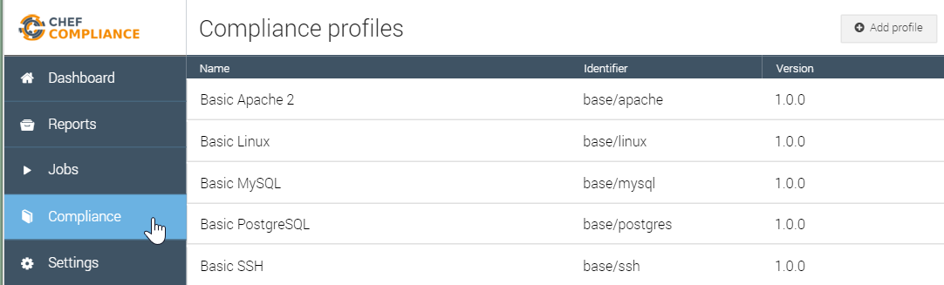
GL: Upload the Profile to Chef Compliance
From your Compliance Server Dashboard, click the Compliance button and then click the Add Profile button.
Notes:
The Compliance Server checks uploaded profiles using the same `inspec check ` mechanism that we used when running inspec via the CLI.
Note that if you upload a Compliance profile to Compliance Server and the profile is written incorrectly, we currently don't get an error in the web UI. We would only be notified by the error when the new profile doesn't appear in the list of Compliance profiles or by looking at the logs.
In the near future, the status of the uploaded profile will reported by the web UI.

Slide 24
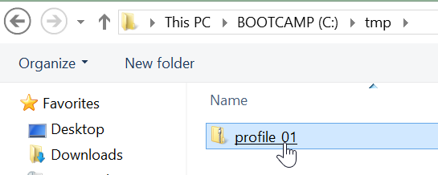
GL: Upload the Profile to Chef Compliance
Select the zip file from your laptop.

Slide 25
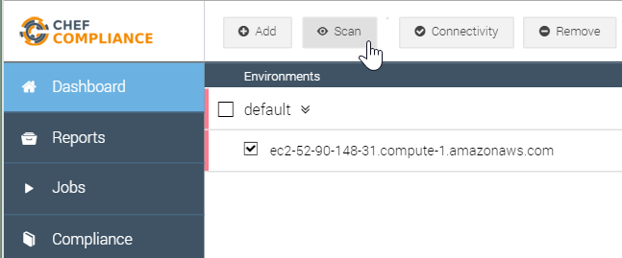

GL: Scan Your Node
From the Dashboard, select your Linux node and then click the Scan button.

Slide 26
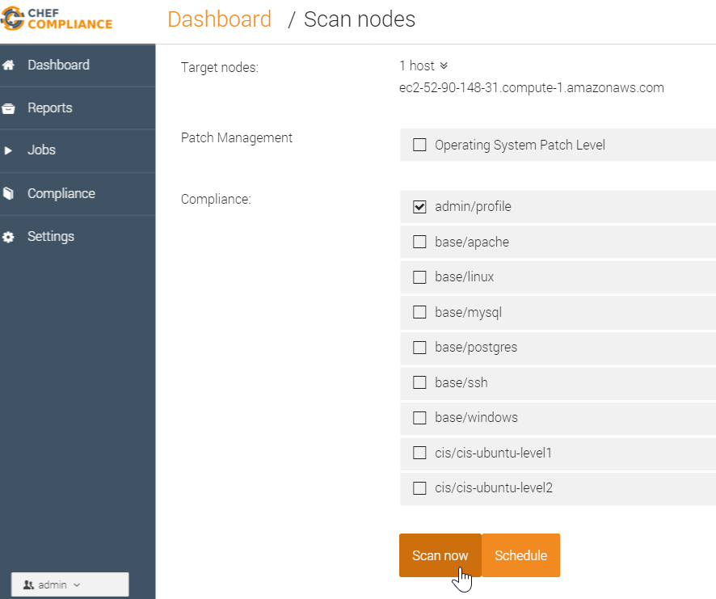
GL: Scan Using the New Profile
From the resulting page, select only the new profile (admin/profile) and then click Scan now.
Note: The profile name in this view is based on the name space in your metadata.rb.
For example: 'myname/profile'
Notes:
Since you are logged in to the Chef Compliance UI as 'admin', your profile is called 'admin/profile' on the 'Scan nodes' page.
Instructor Note: Regarding this note above--`Note: The profile name in this view is based on the name space in your metadata.rb.`--the compliance team may have improved that Compliance profile name field on the "Scan nodes" page by now to include whatever is the `title` value from the metadata.rb. Therefore it would match the name as displayed in the Compliance profiles page.

Slide 27
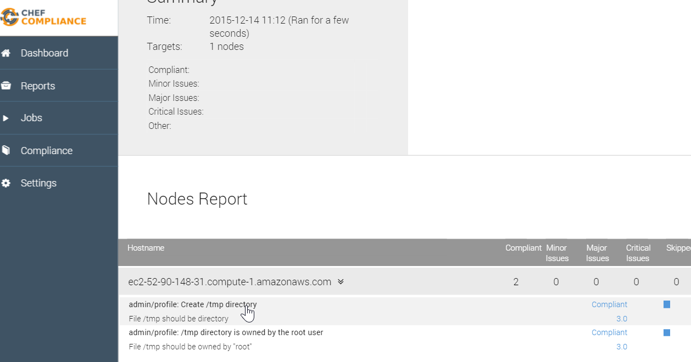
GL: Results of the Custom Profile Scan
The results of your scan should look like this example.
The scan should show compliance as well.

Slide 28
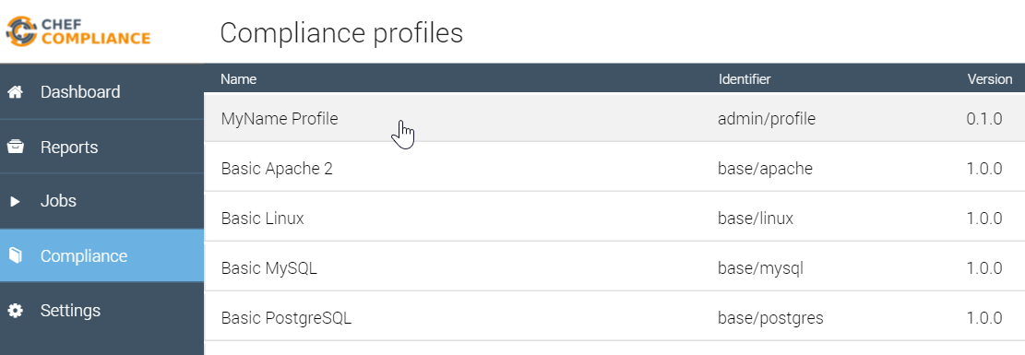
GL: Results of the Custom Profile Scan
You should also be able to see your custom profile from your Compliance page.

Slide 29
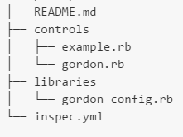
InSpec Directory Structure Roadmap
As mentioned previously, InSpec v0.9.2 expects the directory structure on the left. In the future, the InSpec version that will ship with the next version of ChefDK will expect the directory structure on the right.
├── README.md ├── metadata.rb └── test ├── foo_spec.rb └── bar_spec.rb
Notes:
Instructor Note: The AMIs for this class have InSpec v0.9.2. We did not want to use the latest version of InSpec in this course since upgrading a part of ChefDk would not be an awesome message to tell. Here is a link to where the image on the right was derived: https://github.com/chef/inspec/blob/1f325b1cfd02391fab14a996693a034da37aadd8/docs/profiles.rst

Slide 30
GL: TBD from here to end
Show how this is populated by /rb file - see next slide
TBD- Show side by side metadata and Compl UI profile name to illustrate how the name field is populated.
Notes:
TBD: now do lab for windows too. Also add inspec reference link that gives writing profile examples.

Slide 31
Create /tmp directoryMinor (score: 3.0)
/tmp directory is owned by the root userMinor (score: 3.0)
The /tmp directory must be owned by the root user
control "tmp-1.1" do impact 0.3 title "/tmp directory is owned by the root user"
desc "The /tmp directory must be owned by the root user"
describe file('/tmp') do it { should be_owned_by 'root' }

Slide 32
GL: Save this
https://github.com/chef/inspec/blob/7f555b902d6860ffe236ff23e4b52f20bac28adc/lib/inspec/profile.rb#L81-L129
and Check uses the above from here: https://github.com/chef/inspec/blob/b1ec95e343aac75ee1a21e3d1a09a32a5a8c1dd2/bin/inspec#L70-L78
https://chefio.atlassian.net/wiki/pages/viewpage.action?spaceKey=SE&title=Week+1#Week1-Addingprofiles
Notes:
https://github.com/chef/inspec/blob/7f555b902d6860ffe236ff23e4b52f20bac28adc/lib/inspec/profile.rb#L81-L129
So your cookbooks will have a metadata.rb.
And your
Adding profiles
Compliance profiles must be packaged in to a .tar.gz or .zip file to be uploaded to the Compliance Server.
The directory structure is as follows (note, this is subject to change. TODO: link to official docs when avaialble):
xyz.zip:
. ├── README.md ├── metadata.rb └── test ├── foo_spec.rb └── bar_spec.rb
As you write controls, InSpec requires a `test` directory since it InSpec expect this structure.

Slide 33
TBD delete later.
As you write controls, InSpec expects a specific directory structure. In our case, we need a `test` directory to be in our profile as follows:
├── README.md ├── metadata.rb └── test ├── foo_spec.rb └── bar_spec.rb
https://chefio.atlassian.net/wiki/pages/viewpage.action?spaceKey=SE&title=Week+1#Week1-Addingprofiles
Notes:
The answer is, as you write controls, InSpec expects a `test` directory at the same level as the metadata.rb.
├── README.md ├── metadata.rb └── test ├── foo_spec.rb └── bar_spec.rb
https://github.com/chef/inspec/blob/7f555b902d6860ffe236ff23e4b52f20bac28adc/lib/inspec/profile.rb#L81-L129
Adding profiles
Compliance profiles must be packaged in to a .tar.gz or .zip file to be uploaded to the Compliance Server.
The directory structure is as follows (note, this is subject to change. TODO: link to official docs when availalble):
xyz.zip:
. ├── README.md ├── metadata.rb └── test ├── foo_spec.rb └── bar_spec.rb
As you write controls, InSpec requires a `test` directory since it InSpec expect this structure.

Slide 34
Review Questions
What is ...? ______________________________
Which is the correct answer?
answer
answer
answer
answer
Capable of carrying on a conversation
Explain

Slide 35
©2016 Chef Software Inc.

