Slide 1
Running Scans, Remediation, and Testing on Windows Nodes
Configuring the Chef Compliance Server to Run Scans and Writing Remediation Recipes
Notes:
Instructor Note: In this section we'll cover scanning a Windows node. However we will not repeat the remediation process since this course is focusing on Chef Compliance, not how to write Chef recipes.

Slide 2
Objectives
After completing this module, you should be able to:
Add a Windows node to test for compliance.
Run a Compliance scan.
Test for compliance with InSpec from the CLI.
Remediate a compliance issue.
Use Test Kitchen to test your remediation.
Rescan the node and ensure compliance.
Notes:
tbd:
USE Name field.

Slide 3
Group Lab: Adding a Node to Scan
Add a Windows Node to Scan
Test connectivity

Slide 4
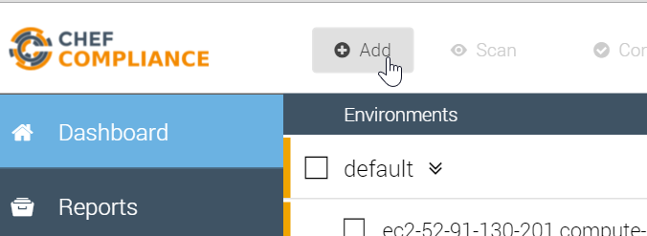
GL: Adding a Node to Scan
From your Chef Compliance Dashboard, click Add Node.

Slide 5
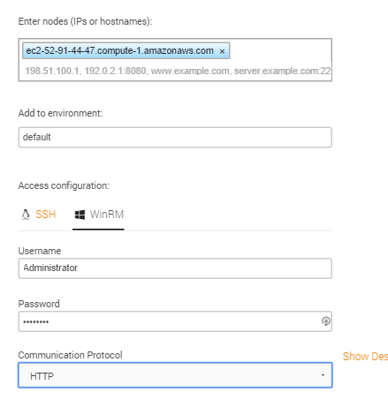
GL: Adding a Node
From the resulting page, enter the Windows node's FQDN or IP address.
Select the default environment.
Click the WinRM Access configuration.
Type Administrator in the Username field.
Type the password (Cod3Can!) in the password field.
Notes:
Be sure you are using the hostname of the Windows target node that you noted previously in class.
In the workplace, the target node's username and password will likely be different than shown in this example.

Slide 6
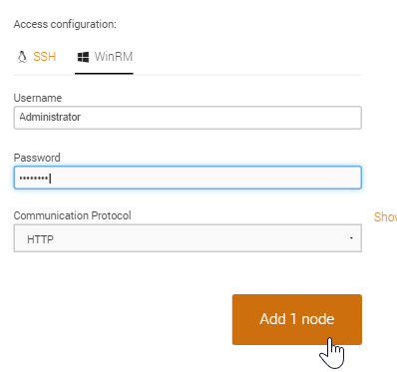
GL: Adding a Node to Scan
Ensure the HTTP Communication Protocol is set.
Click the Add 1 node button.

Slide 7
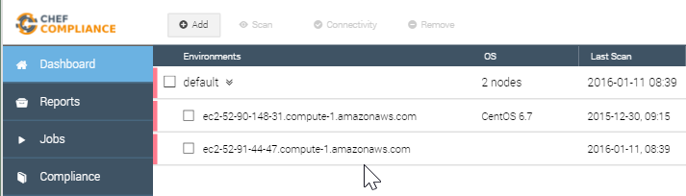
GL: Adding a Node to Scan
At this point your Compliance Dashboard should list the node you just added. In the next step we'll modify the Windows node name to make it easier to differentiate it from your Linux node.

Slide 8
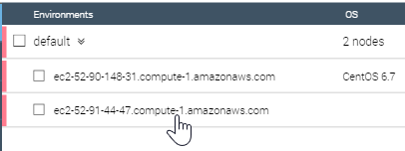
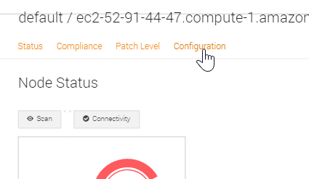
GL: Modify the Node Name
Click the Windows node.
From the resulting page, click Configuration.

Slide 9
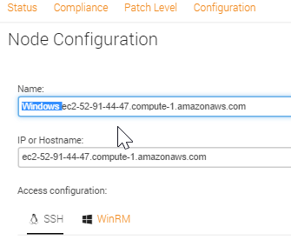
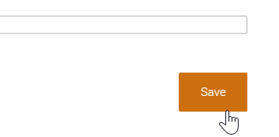
GL: Modify the Node Name
Type Windows at the beginning of the Name: field. Important: Do not change the value in the IP or Hostname field because that field is used to connect to your node.
Click Save.

Slide 10
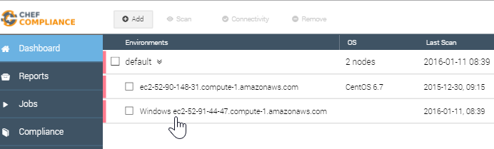
GL: Modify the Node Name
Now you can more easily differentiate your Windows node from your Linux node.

Slide 11
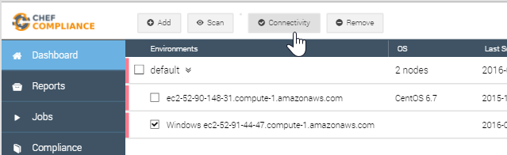
GL: Testing Connectivity to your Node
Click the check box next to your Windows node and then click the Connectivity button.

Slide 12
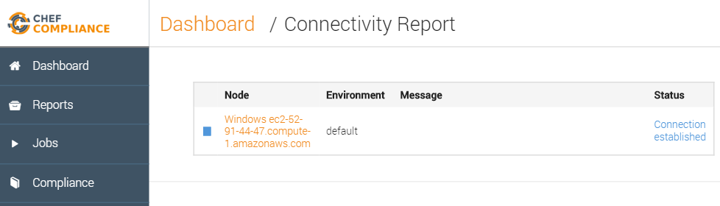
GL: Testing Connectivity to your Node
The Status column of your node should now indicate Connection established.
Notes:
If your Status column does not indicate `Connection established`, please notify the instructor.
Instructor Note: In at least Compliance Server v 0.9.11, I have seen where a Connectivity test will fail, but then a scan will work. After the scan is successful, the Connectivity test will start working. Almost like the Windows target was sleepy. Usually happens after the windows node sits idle overnight.

Slide 13
Group Lab: Running a Scan
Run a Compliance scan.
View the output of a scan.

Slide 14
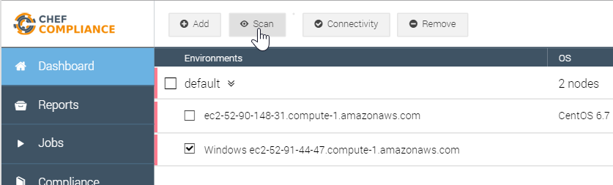
GL: Running a Scan
Click the check box next to your node and then click the Scan button.

Slide 15
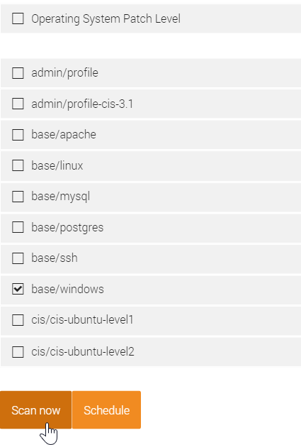
GL: Running a Scan
From the resulting page, check the base/windows profile and uncheck any other check boxes.
Click the Scan now button.

Slide 16
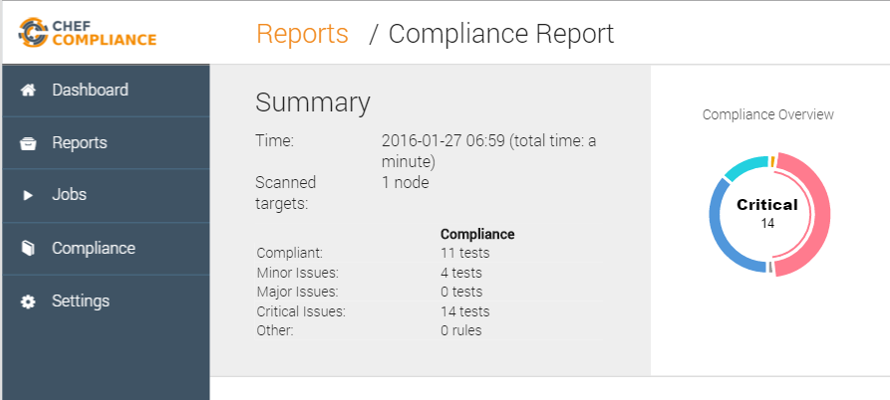
Scan Results
A Compliance Report should now display and your scan results should be similar to that shown here.
Notice how in the upper Summary section in this example, 11 tests were compliant and 14 tests show critical issues with ssh.
Notes:
There are also 6 critical issues related to ssh on the target node.
Instructor Note: This and the following slide should be used for a discussion of the scan results. The Group Lab continues after that.

Slide 17
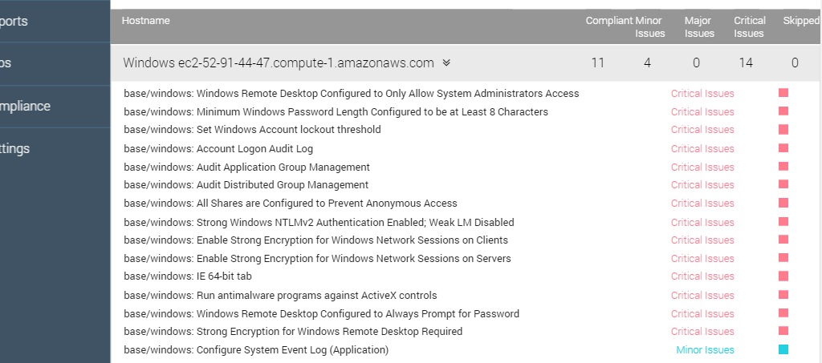
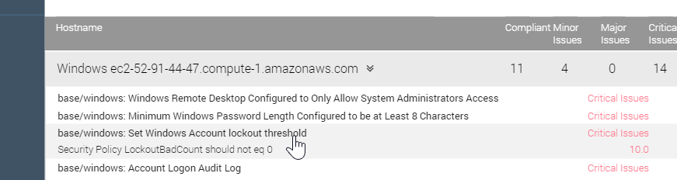
Scan Results
The bottom half of the Compliance Report shown here has a table of details of the scan, similar to what you saw in the Linux example.
Notice how one of the critical issues regards Windows Account lockout threshold.
Notes:
The bottom half of the Compliance Report has a table of details of test results.
These are sorted by severity so the critical issues are listed at the top and the compliant items are at the bottom of the list.
If you click an issue as shown here, a bit more information about the issue displays, but that's not really telling us much.

Slide 18
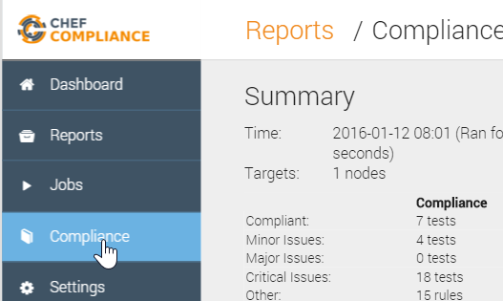
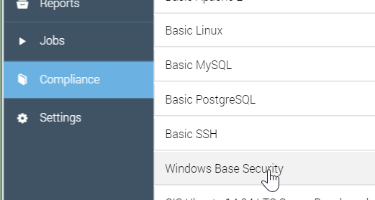
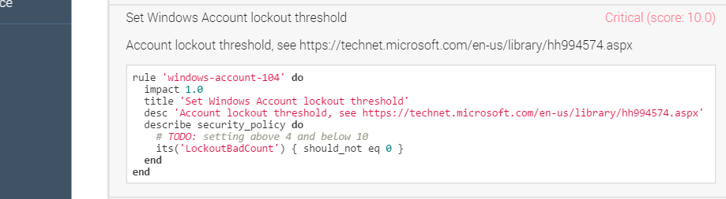
GL: Profile
To view the InSpec code that comprises this profile, do the following:
Click the Compliance button.
Click the relevant profile category (Windows Base ...).
Scroll down and click the Set Windows Account lockout... profile.
Notes:
Instructor Note: Now we continue the Group Lab but you should stop as needed to explain what this code means.
tbd: No todo and control vs rule?

Slide 19
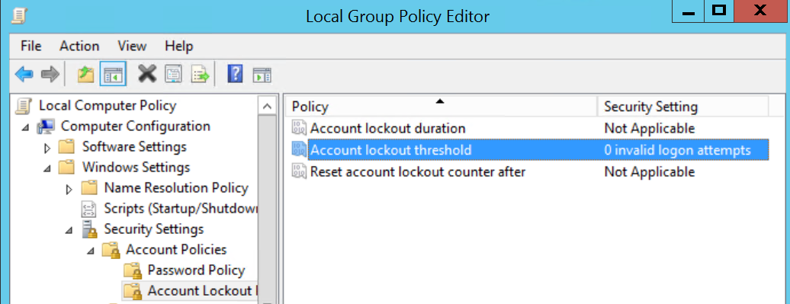
Discussion: InSpec Profile Code
You can see in the bottom image where the Account lockout threshold is set in Windows.
In a production environment you'd want to write a Chef recipe to remediate the Account lockout threshold issue.

Slide 20
Review Questions
What is ...? ______________________________
Which is the correct answer?
answer
answer
answer
answer
Capable of carrying on a conversation
Explain

Slide 21
©2016 Chef Software Inc.

