Slide 1
Running Scans, Remediation, and Testing
Configuring the Chef Compliance Server to Run Scans and Writing Remediation Recipes
Notes:
Instructor Note: Answers to quizzes are contained in Instructor Notes found below each quiz slide so participants won't see the answers.

Slide 2
Objectives
After completing this module, you should be able to:
Add a node to test for compliance.
Run a Compliance scan.
Test for compliance with InSpec from the command line interface.
Remediate a compliance issue.
Use Test Kitchen to test your remediation.
Test for compliance with InSpec from the CLI
Rescan the node and ensure compliance.

Slide 3
Adding a Node to Scan
To add a node you'll need:
The IP address or FQDN of the nodes to be tested.
Access configuration (ssh or WinRM).
The node's username and password OR
The node's username plus security key pair.

Slide 4
Group Lab: Adding a Node to Scan
Add a Linux Node to Scan
Test connectivity
Note: In the next module you will perform the same exercises as in this module but using a Windows node as your target node.

Slide 5
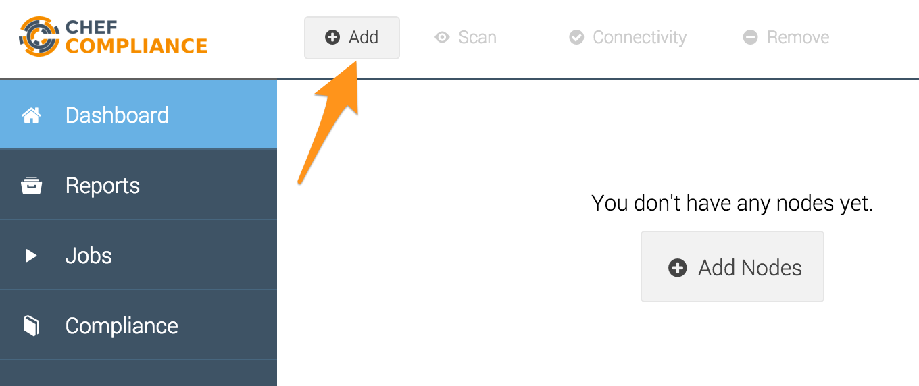
GL: Adding a Node to Scan
From your Chef Compliance Dashboard, click Add Node.

Slide 6
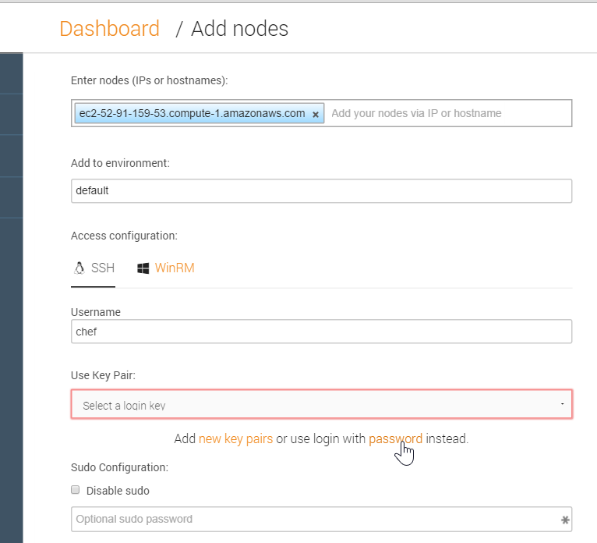
GL: Adding a Node
From the resulting page, enter the node's FQDN or IP address.
Leave environment blank. A ‘default’ environment will be used
Accept the default SSH Access configuration
Type chef in the username field.
Click the password link as shown in this illustration.
Notes:
Be sure you are using the hostname of the target node that you noted previously in class.
In the workplace, the target node's username and password will likely be different than shown in this example.
We'll discuss using key pair access later in the module.

Slide 7
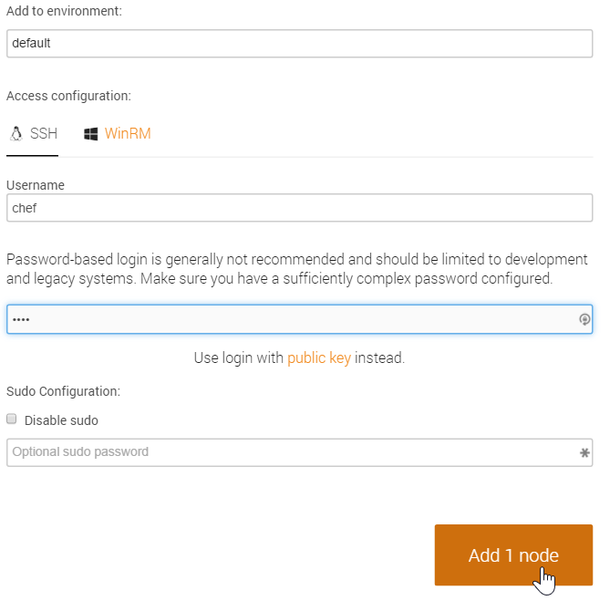
GL: Adding a Node to Scan
Type the password (chef) in the password field.
Click the Add 1 node button as shown in this illustration.
Notes:
Instructor Note: If a Linux target node's image has /etc/sudoers `Defaults requiretty` uncommented, then the Compliance server won't be able to connect to the target node unless we disable sudo on this page. Once the issue is fixed it should not matter if the target node /etc/sudoers `Defaults requiretty` is uncommented. The Linux AMI used in this course has /etc/sudoers `Defaults requiretty` commented so no worries."

Slide 8
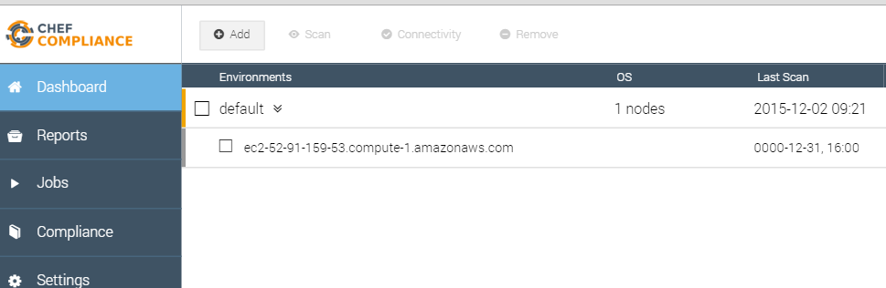
GL: Adding a Node to Scan
At this point your Compliance Dashboard should list the node you just added.

Slide 9
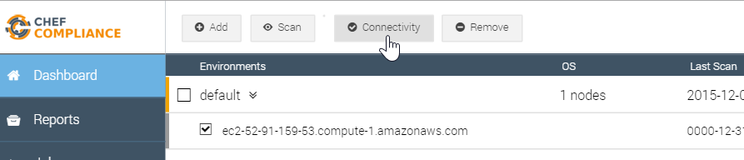
GL: Testing Connectivity to Your Node
Click the check box next to your node and then click the Connectivity button.

Slide 10
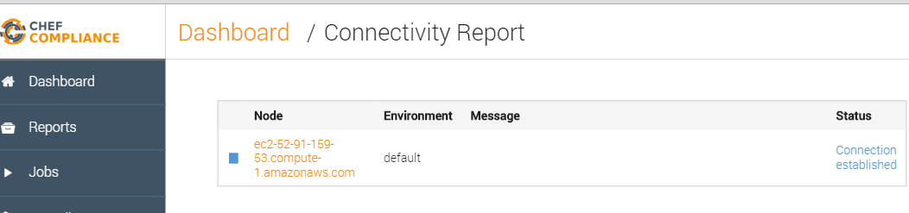
GL: Testing Connectivity to Your Node
The Status column of you node should now indicate Connection established.
Notes:
If your Status column does not indicate `Connection established`, please notify the instructor.

Slide 11
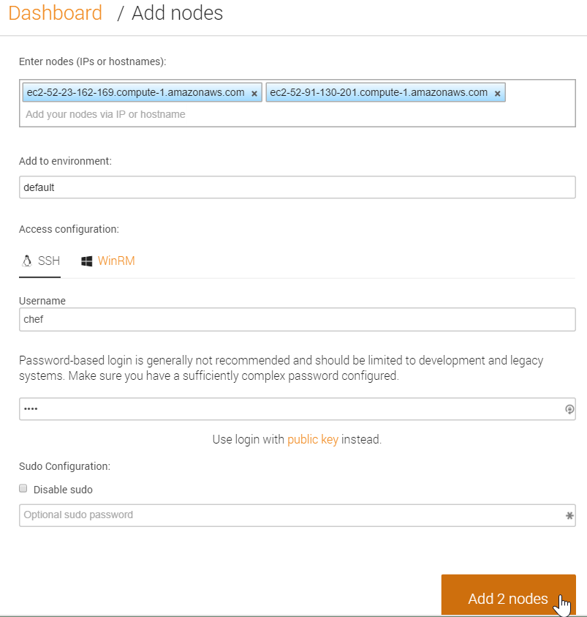
Adding Nodes in Bulk
You could add additional nodes by simply repeating the previous steps.
You could also add a number of nodes at once by separating each hostname or IP address with a comma or a space, as shown in this illustration.
Chef Compliance also supports bulk loading of nodes via API.
Notes:
As you may have noticed, you could add additional nodes by simply repeating the previous steps.
You could also add a number of nodes at once by separating each hostname or IP address with a comma or a space, as shown in this illustration.
Chef Compliance also supports bulk loading of nodes via API.

Slide 12
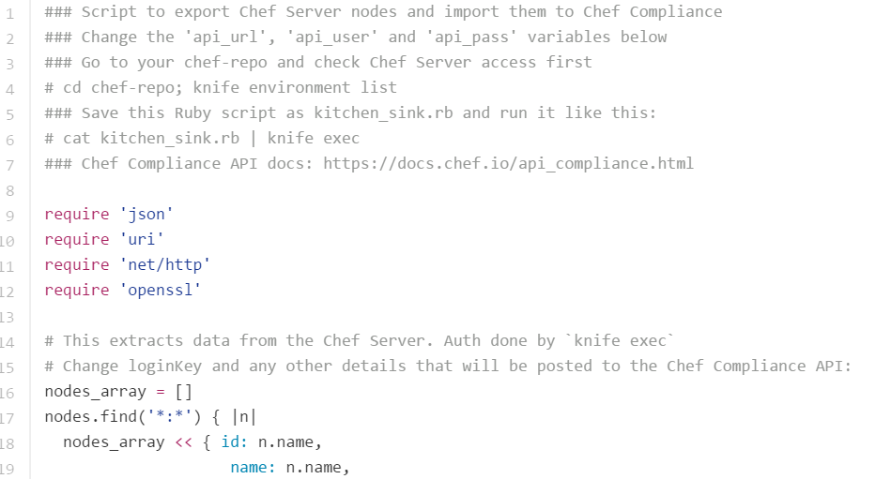
Adding Nodes in Bulk via API
After class you can go to the following link.
The resulting kitchen_sink.rb will step you through how to upload nodes in bulk.
https://gist.github.com/alexpop/01b0bba8d259adeee320
Notes:
Instructor Note: If you have extra time, you can walk the participants through this file.

Slide 13
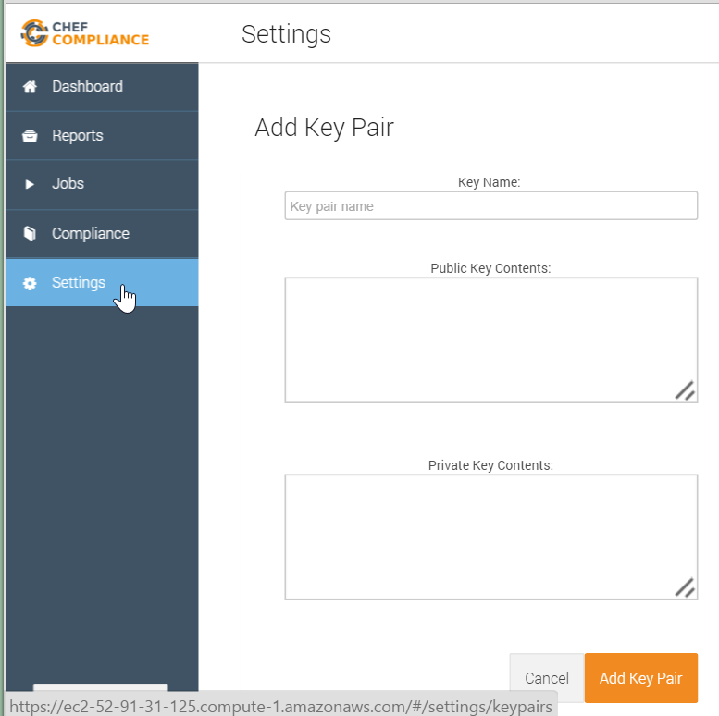
Key Pairs
In the workplace, using security key pairs would be a more secure method for connecting to nodes than using the password method.
By clicking Settings > Add New Key Pair you will see where to paste your private and public keys.
Notes:
In the workplace, using security key pairs would be a more secure method for connecting to nodes than using the password method we are using in class.
By clicking `Settings > Add New Key Pair` you will see where to paste your private and public keys.

Slide 14
Running Compliance Scans
You can run Compliance scans on demand or schedule them to run at a later time.
Chef Compliance maintains profiles as a collection of individual controls that comprise a complete audit.
As mentioned previously, Chef Compliance comes with a few reference profiles of various compliance policies that you can leverage or use as examples to create your own.

Slide 15
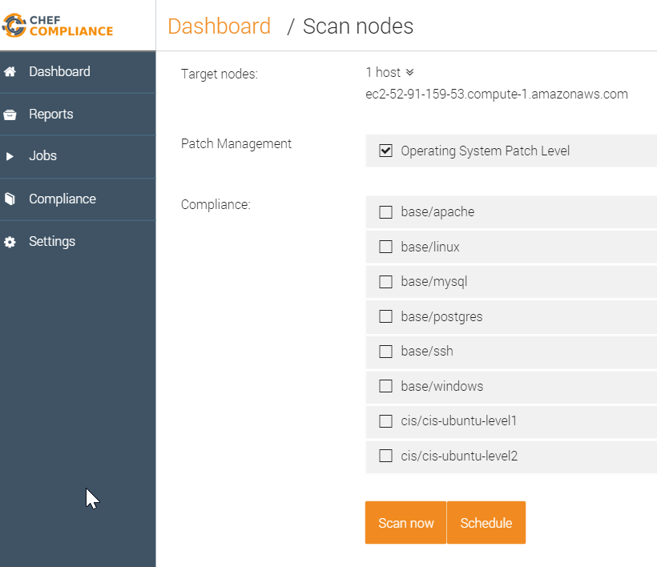
Compliance Profiles Used in Scans
This image shows the default Compliance Profiles as accessed from the Scan Nodes page.
You should be thoughtful with which profiles choose.
Notice how you can also choose to run a scan on demand or schedule a scan.
Notes:
This image shows the default Compliance Profiles as accessed from the Scan Nodes page. This page displays when you select nodes to scan and then click the Scan button.
You'll access the profiles in a moment. These profiles determine what will be scanned on your nodes.
You should be thoughtful with which profiles choose since the more you choose to run, the longer it will take to execute the scan.
Notice how you can also choose to run a scan on demand (Scan now) or schedule a scan to run at a later time.

Slide 16
Group Lab: Running a Scan
Run a Compliance scan.
View the output of a scan.

Slide 17
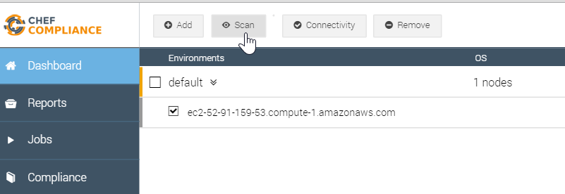
GL: Running a Scan
Click the check box next to your node and then click the Scan button.

Slide 18
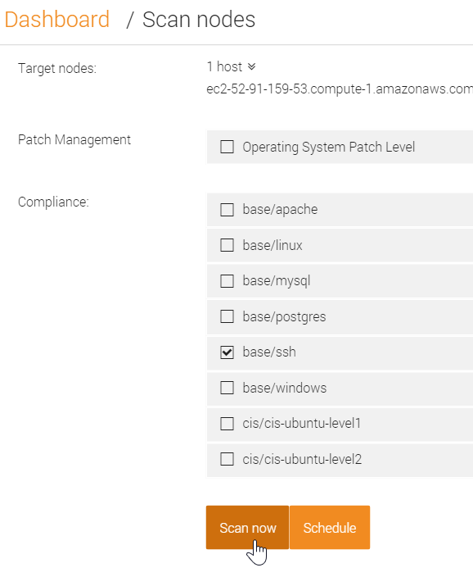
GL: Running a Scan
From the resulting page, check the base/ssh profile and uncheck any other check boxes.
Click the Scan now button.

Slide 19
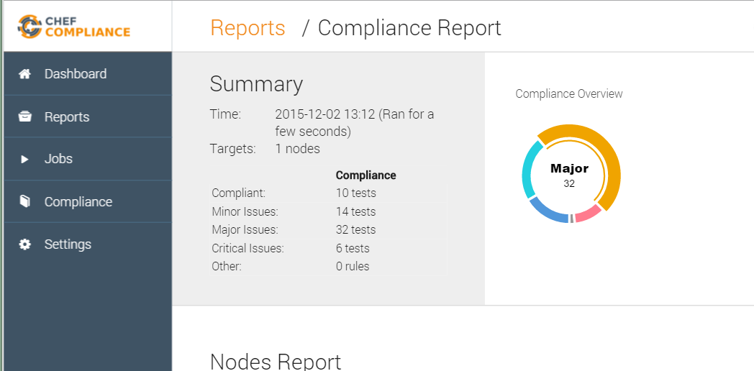
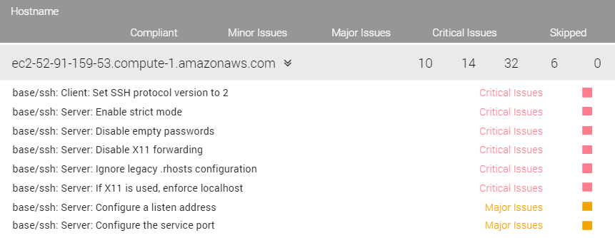
Scan Results
A Compliance Report should now display and your scan results should be similar to that shown here.
Notice how in the upper Summary section in this example, 10 tests were compliant and 6 tests show critical issues with ssh.
Notes:
There are also 6 critical issues related to ssh on the target node. Your results may be slightly different than this example.
Instructor Note: This and the following slide should be used for a discussion of the scan results. The group exercise continues after that.

Slide 20
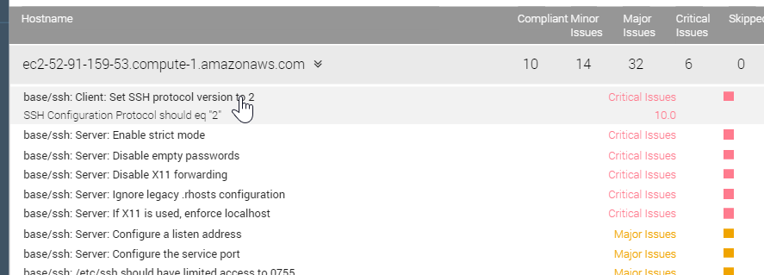
Scan Results
The bottom half of the Compliance Report shown here has a table of details of test results.
These are sorted by severity.
If you click an issue as shown here, a bit more information about the issue displays.
Notes:
The bottom half of the Compliance Report has a table of details of test results.
These are sorted by severity so the critical issues are listed at the top and the compliant items are at the bottom of the list.
If you click an issue as shown here, a bit more information about the issue displays, but that's not really telling us much.

Slide 21
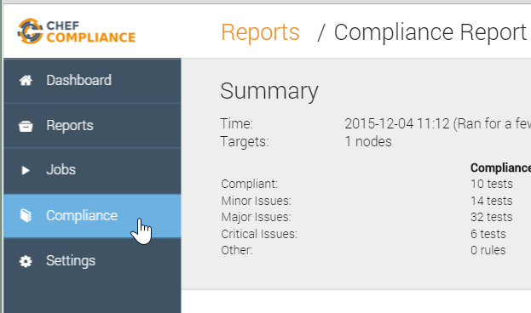
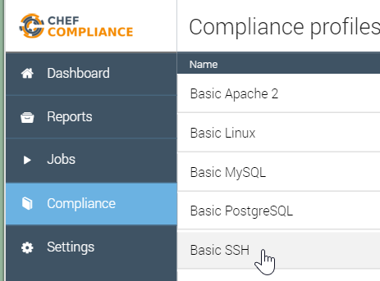
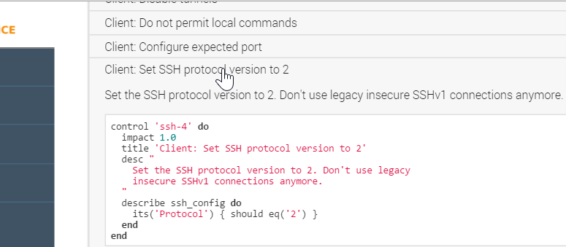
GL: Profile
To view the InSpec code that comprises this profile, do the following:
Click the Compliance button.
Click the relevant profile (Basic SSH).
Scroll down and click the `Set SSH protocol version to 2` profile.
Notes:
Instructor Note: Now we continue the group Lab but you should stop as needed to explain what this code means.

Slide 22
Discussion: InSpec Profile Code
Let's discuss what this profile is doing.
The `impact` of 1.0 indicates this is a Critical issue.
The `title` is what populates the Compliance Report issue title.
Notes:
Let's discuss what this profile is doing.
The impact of 1.0 indicates this is a critical issue if it the scanned node violates what is in this code. We'll discuss severity mapping in a moment.

Slide 23
Discussion: InSpec Profile Code
The desc is typically human-readable description sourced from the CIS or source doc.
The `describe` section is the actual test that is executed.
Notes:
The desc is typically human-readable description sourced from the CIS or source doc.
The describe value is the actual test. In this case, this is saying the protocol for `ssh_config` Protocol should be `2`. If the actual value from the node is not Protocol 2, the Critical issue is reported as in this case.
So when you run a scan, the Compliance Server connects to the node using the configuration we specified, in this case ssh, and then it will run this set of code, this InSpec control, on that node. The Compliance Server translates the InSpec code into ssh commands when it transmits across the wire.
No agent or client is required to be running on the target node for this work.

Slide 24
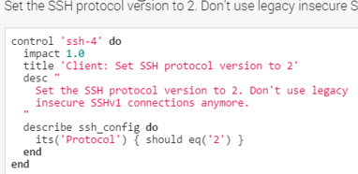
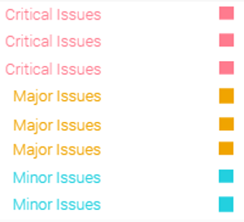
Compliance Profile Severity Mapping
The table below shows the current mapping of Compliance Profile impact numbering to severity.
Impact Numbering | Severity Designation
0.7 - 1.0 | Critical Issues
0.4 - <0.7 | Major Issues
0 - <0.4 | Minor Issues
https://nvd.nist.gov/cvss.cfm
Notes:
Here is the current mapping of Compliance Profile impact numbering to severity.
The image at the top-right shows a Compliance Profile's impact numbering.
The table at the bottom-left shows the current mapping of Compliance Profile impact numbering to severity.
The image at the bottom-right is an example of the severities listed in the reports in the Compliance web UI.
The mapping is currently analogous to the Common Vulnerability Scoring System (CVSS) framework, which can be viewed via the link at the bottom of this slide.
This mapping will be made configurable in the future.

Slide 25
Example: Node's ssh config
$ more /etc/ssh/ssh_config
# IdentityFile ~/.ssh/identity
# IdentityFile ~/.ssh/id_rsa
# IdentityFile ~/.ssh/id_dsa
# Port 22
# Protocol 2,1
# Cipher 3des

Slide 26
Let's Remediate the Issue
Now that we've identified the ssh version issue, let's write a recipe on the target node to remediate the issue.
Then we'll run the compliance scan again to see if we successfully remediated the issue.
Note: In this course we will write a recipe directly on the node that we're running scans on. Of course in a production environment you will likely write such recipes locally and upload them to Chef Server. Then the nodes would convergence the recipes on their next chef-client run.

Slide 27
GL: Remediating the Issue
Start writing a remediation recipe on that node.
Test the recipe with Test Kitchen.
Test for compliance with InSpec from the command line interface (CLI)
Converge the recipe.
Rescan the node and ensure compliance.

Slide 28
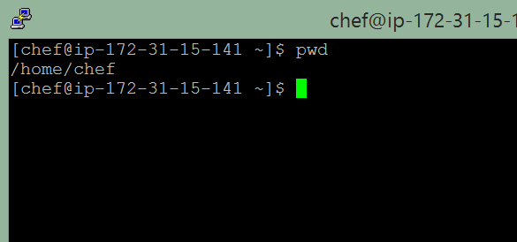
GL: Remediating the Issue
Log in to your target node (not your compliance server node) using ssh and ensure you are in the home directory.
Note: emacs, nano, and vim/vi are installed on your Linux nodes. Some tips for using them can be found below in your participant guide.
Notes:
Emacs: (Emacs is fairly straightforward for editing files.)
OPEN FILE $ emacs FILENAME
WRITE FILE ctrl+x, ctrl+w
EXIT ctrl+x, ctrl+c
Nano: (Nano is usually touted as the easiest editor to get started with editing through the command-line.)
OPEN FILE $ nano FILENAME
WRITE (When exiting) ctrl+x, y, ENTER
EXIT ctrl+x
VIM: (Vim, like vi, is more complex because of its different modes. )
OPEN FILE $ vim FILENAME
START EDITING i
WRITE FILE ESC, :w
EXIT ESC, :q
EXIT (don't write) ESC, :q!

Slide 29
GL: Create and Change to a ‘cookbooks’ Directory
$ mkdir -p cookbooks
$ cd cookbooks
From the home directory, create a `cookbooks` directory and navigate into it.

Slide 30
GL: Create an SSH Cookbook
$ chef generate cookbook ssh
Compiling Cookbooks...
Recipe: code_generator::cookbook
* directory[/home/chef/cookbooks/ssh] action create
- create new directory /home/chef/cookbooks/ssh
...
- create new file /home/chef/cookbooks/ssh/recipes/default.rb
- update content in file /home/chef/cookbooks/ssh/recipes/default.rb from none to b702c7
(diff output suppressed by config)

Slide 31
GL: Create an SSH Client Recipe
$ chef generate recipe ssh client
Compiling Cookbooks...
Recipe: code_generator::recipe
* directory[./ssh/spec/unit/recipes] action create (up to date)
* cookbook_file[./ssh/spec/spec_helper.rb] action create_if_missing (up to date)
...
- create new file ./ssh/recipes/client.rb
- update content in file ./ssh/recipes/client.rb from none to 9c833a
(diff output suppressed by config)
Notes:
In this step, instead of modifying the default recipe, we will create a new `ssh client` recipe.
This is because a default ssh cookbook probably affects an ssh server config and ssh client config and we only want to affect an ssh client.

Slide 32
GL: Create an SSH Config Template
$ chef generate template ssh ssh_config.erb -s /etc/ssh/ssh_config
Compiling Cookbooks...
Recipe: code_generator::template
* directory[./ssh/templates/default] action create
- create new directory ./ssh/templates/default
* file[./ssh/templates/default/ssh_config.erb] action create
- create new file ./ssh/templates/default/ssh_config.erb
- update content in file ./ssh/templates/default/ssh_config.erb from none to 86eb9b
(diff output suppressed by config)
Notes:
In this step, we want to create a template file to manage our `ssh_config` file.
The `-s` option in this command takes the contents of the current `/etc/ssh/ssh_config` file and places it in the `ssh_config.erb` file.
Instructor Note: At this time you might want to show the class the contents of `/home/chef/cookbooks/ssh/templates/default/ssh_config.erb` to illustrate how the contents of the current `/etc/ssh/ssh_config` file is now in the `ssh_config.erb` file.

Slide 33
GL: Write the Client Recipe
$ ~/cookbooks/ssh/recipes/client.rb
# Cookbook Name:: ssh
# Recipe:: client
# Copyright (c) 2035 The Authors, All Rights Reserved.
template '/etc/ssh/ssh_config' do
source 'ssh_config.erb'
owner 'root'
group 'root'
mode '0644'
end
Notes:
Edit the `~/cookbooks/ssh/recipes/client.rb` file and add the contents shown here.

Slide 34
GL: Testing the Recipe
Write a remediation recipe on that node.
Test the recipe with Test Kitchen.
Test for compliance with InSpec from the command line interface (CLI)
Converge the recipe.
Rescan the node and ensure compliance.

Slide 35
GL: Navigate to your SSH Cookbook
$ cd ~/cookbooks/ssh/
Notes:
To test your recipe, first navigate to where the recipe lives

Slide 36
GL: Edit your .kitchen.yml -- Part 1
~/cookbooks/ssh/.kitchen.yml
---
driver:
name: docker
provisioner:
name: chef_zero
Notes:
Edit your `.kitchen.yml` as shown here and on the following slide.
Because our node is an EC2 AWS instance, we need to change the driver from vagrant to docker. docker should already be installed on the EC2 AWS training instances.

Slide 37
GL: Edit your .kitchen.yml -- Part 2
~/cookbooks/ssh/.kitchen.yml
platforms:
# - name: ubuntu-14.04
- name: centos-6.7
suites:
- name: default
run_list:
- recipe[ssh::default]
attributes:
Notes:
Also comment the ubuntu platform line and change the centos platform to `centos-6.7', which should be the version running on the training instance.
To confirm the centos release, you could execute `more /etc/*-release`
::::::::::::::
/etc/centos-release
::::::::::::::
CentOS release 6.7 (Final)

Slide 38
GL: Edit your .kitchen.yml -- Part 3
~/cookbooks/ssh/.kitchen.yml
platforms:
# - name: ubuntu-14.04
- name: centos-6.7
suites:
- name: client
run_list:
- recipe[ssh::client]
attributes:
+
Notes:
Finally, change the suites name to `client' and the run_list recipe name to `ssh:client`.
run_list:
- recipe[ssh::client]

Slide 39
GL: Run `kitchen list` from ~/cookbooks/ssh/
$ kitchen list
Instance Driver Provisioner Verifier Transport Last Action
client-centos-67 Docker ChefZero Busser Ssh <Not Created> :
Notes:
Now run `kitchen list` from the ~/cookbooks/ssh directory. This command will tell you if you have a typo in your `.kitchen.yml`.

Slide 40
GL: Run `kitchen converge`
$ kitchen converge
-----> Starting Kitchen (v3.4.2)
-----> Creating <client-centos-67>...
Sending build context to Docker daemon 32.26 kB
Sending build context to Docker daemon
Step 0 : FROM centos:centos6
---> 3bbbf0aca359
...
Chef Client finished, 0/3 resources updated in 03 seconds
Finished converging <client-centos-67> (0m28.27s).
-----> Kitchen is finished. (0m30.32s)
zlib(finalizer): the stream was freed prematurely.
Notes:
Now run `kitchen converge` from the ~/cookbooks/ssh directory.
`kitchen converge` will:
Launch a docker container.
Place the cookbook into the docker container.
Install chef-client in the docker container.
Run chef zero (i.e., chef-client in local mode) across the client recipe.
The end result will be that it should write out the ssh_conf to the appropriate location (i.e., /etc/ssh/ssh_config).
It could take a couple minutes or so for this command to complete.

Slide 41
What We've Done So Far
In the preceding exercises, we began writing a remediation recipe on our target node.
We also tested the recipe with Test Kitchen.
But have we even addressed the "Set the SSH protocol version to 2" issue?
Notes:
In the preceding exercises we began writing a remediation recipe on our target node.
We also tested the recipe with Test Kitchen.
But have we even addressed the "Set the SSH protocol version to 2" issue?
If you answered "no", you are correct. In a little while we will modify our recipe to address the "Set the SSH protocol version to 2" issue.

Slide 42
GL: Using InSpec for Verification
Write a remediation recipe on that node.
Test the recipe with Test Kitchen.
Test for compliance with InSpec from the command line interface (CLI)
Converge the recipe .
Rescan the node and ensure compliance.

Slide 43
GL: Create the `inspec` Directory
$ mkdir -p ~/cookbooks/ssh/test/integration/client/inspec

Slide 44
GL: Create the `client_spec.rb' file
~/cookbooks/ssh/test/integration/client/inspec/client_spec.rb
control 'ssh-4' do
impact 1.0
title 'Client: Set SSH protocol version to 2'
desc "
Set the SSH protocol version to 2. Don't use legacy
insecure SSHv3 connections anymore.
"
describe ssh_config do
its('Protocol') { should eq('2') }
end
end
Notes:
See the following slide for an example of a handy way to populate this file.

Slide 45
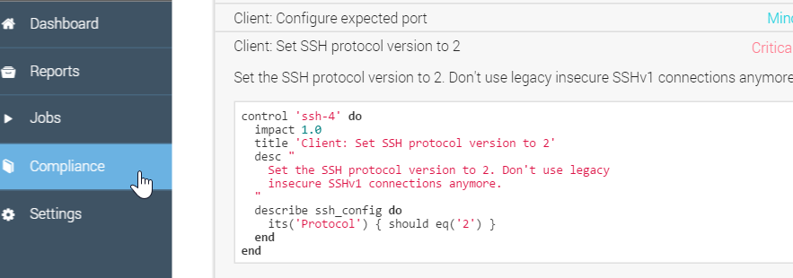
Example of Creating the `client_spec.rb' file
One handy way to populate the preceding `client_spec.rb' is to use the Compliance Web UI and copy the InSpec code found in the relevant Compliance profile: Compliance > Base SSH > Set the SSH protocol version to 2
Notes:
One handy way to populate the preceding `client_spec.rb' is to use the Compliance Web UI and copy the InSpec control code found in the relevant Compliance profile.
Then you can paste it into the `client_spec.rb' file to save yourself some typing.
Instructor Note: It could also be good for the instructor to demonstrate using the InSpec verifier in test kitchen locally with Vagrant to show the students that it can be done.

Slide 46
Running InSpec from the Command Line Interface (CLI)
InSpec is an executable application.
InSpec can execute on remote hosts, including docker
containers.
You can use 'inspec exec' to run tests at a specified path.

Slide 47
GL: Change Owner of `/var/run/docker.sock`
$ sudo chown root:dockerroot /var/run/docker.sock
Notes:
First, we need to run this command because we are using Docker solely for testing and placing it in this configuration is not secure. We are doing it here because it is necessary if we do not want to prefix `sudo` in front of the commands we execute.
So it’s done here namely for speed and ease of training so you can focus on Compliance. On your local system you may use vagrant, ec2, or the azure driver and those will not have the same concern that we are experiencing here.
Instructor Note: This command is done in order to put the chef user in the dockerroot group and make /var/run/docker.sock's group dockerroot. This change would not persist when making part of the AMI so we run the command here.

Slide 48
GL: What is your Docker ID?
$ sudo docker ps
CONTAINER ID IMAGE COMMAND CREATED STATUS PORTS NAMES
5b51a4237437 d5b8fd3299b4 "/usr/sbin/sshd -D - 41 minutes ago Up 41 minutes 0.0.0.0:32768->22/tcp grave_davinci
Notes:
Below is an example of the details of the `sudo docker ps` command. This shows one docker container running.
You should only have only one docker container running too.
You'll need the Container ID for the next step so copy your Container ID, which is the first value that is not a header.
CONTAINER ID IMAGE COMMAND CREATED STATUS PORTS NAMES
5b51a4237437 d5b8fd3299b4 "/usr/sbin/sshd -D - 41 minutes ago Up 41 minutes 0.0.0.0:32768->22/tcp grave_davinci

Slide 49
GL: Running InSpec from the CLI
$ inspec exec ~/cookbooks/ssh/test/integration/client/inspec/client_spec.rb -t docker://CONTAINER_ID
Failures:
1) SSH Configuration Protocol should eq "2"
Failure/Error: its('Protocol') { should eq('2') }
expected: "2"
got: nil
(compared using ==)
# ./test/integration/client/inspec/client_spec.rb:9:in `block (3 levels) in load'
Finished in 0.79369 seconds (files took 0.7207 seconds to load)
1 example, 1 failure
Failed examples:
rspec # SSH Configuration Protocol should eq "2"
Notes:
Run this inspec command using the container ID you just copied, replacing CONTAINER_ID in the example.
`inspec exec ~/cookbooks/ssh/test/integration/client/inspec/client_spec.rb -t docker://CONTAINER_ID`
Running InSpec in this way can uncover more complex issues than the basic issue we are remediating in this module.
While the image of the output may be hard to see, key parts of the output is also pasted below. Notice how inspec from the command line also found the "SSH Configuration Protocol should eq "2" non compliance issue.
Key parts of the output is here:
Failures:
1) SSH Configuration Protocol should eq "2"
Failure/Error: its('Protocol') { should eq('2') }
expected: "2"
got: nil
...
Failed examples:
rspec # SSH Configuration Protocol should eq "2"

Slide 50
GL: Update the Template
~/cookbooks/ssh/templates/default/ssh_config.erb
# IdentityFile ~/.ssh/id_rsa
# IdentityFile ~/.ssh/id_dsa
# Port 22
# Protocol 2,1
Notes:
Edit the ~/cookbooks/ssh/templates/default/ssh_config.erb file.
Uncomment the `# Protocol 2,1` line.
Change the protocol version to `2` only.

Slide 51
GL: Update the Template
~/cookbooks/ssh/templates/default/ssh_config.erb
# IdentityFile ~/.ssh/id_rsa
# IdentityFile ~/.ssh/id_dsa
# Port 22
Protocol 2
Notes:
Results: Your ~/cookbooks/ssh/templates/default/ssh_config.erb file's Protocol line should now look like this example.

Slide 52
GL: Ensure you are in ~/cookbooks/ssh
$ cd ~/cookbooks/ssh
Notes:
Change to ~/cookbooks/ssh if not there already.

Slide 53
GL: Run `kitchen converge`
$ kitchen converge
...
+++ /etc/ssh/.ssh_config20151209-412-cf7gd7 2015-12-09 20:35:29.734689138 +0000
@@ -37,7 +37,7 @@
# IdentityFile ~/.ssh/id_rsa
# IdentityFile ~/.ssh/id_dsa
# Port 22
-# Protocol 2,1
+Protocol 2
# Cipher 3des
Notes:
You should now see that only Protocol version 2 is currently set in test kitchen.
- update content in file /etc/ssh/ssh_config from 86eb9b to 065f90
--- /etc/ssh/ssh_config 2015-08-13 09:58:26.000000000 +0000
+++ /etc/ssh/.ssh_config20151209-412-cf7gd7 2015-12-09 20:35:29.734689138 +0000
@@ -37,7 +37,7 @@
# IdentityFile ~/.ssh/id_rsa
# IdentityFile ~/.ssh/id_dsa
# Port 22
-# Protocol 2,1
+Protocol 2
# Cipher 3des
# Ciphers aes128-ctr,aes192-ctr,aes256-ctr,arcfour256,arcfour128,aes128-cbc,3des-cbc
Running handlers:
Chef Client finished, 3/3 resources updated in 03 seconds
Finished converging <client-centos-67> (0m8.22s).

Slide 54
GL: Running InSpec from the CLI
$ inspec exec ~/cookbooks/ssh/test/integration/client/inspec/client_spec.rb -t docker://CONTAINER_ID
.
Finished in 0.21546 seconds (files took 0.3575 seconds to load)
1 example, 0 failures
Notes:
Run this inspec command again using the container ID you copied previously, replacing CONTAINER_ID in the example.
`inspec exec ~/cookbooks/ssh/test/integration/client/inspec/client_spec.rb -t docker://CONTAINER_ID`
You should now see that the test has passed. In addition to the output text that says there were 0 failures, the single dot at the top-left of the output means there was one test made and that it passed.

Slide 55
GL: Apply the New SSH Recipe
$ sudo chef-client --local-mode -r 'recipe[ssh::client]'
...
+++ /etc/ssh/.ssh_config20151209-10413-hlk9ow 2015-12-09 20:37:07.621689137 +0000
@@ -37,7 +37,7 @@
# IdentityFile ~/.ssh/id_rsa
# IdentityFile ~/.ssh/id_dsa
# Port 22
-# Protocol 2,1
+Protocol 2
# Cipher 3desesources updated in 3.29477735 seconds
Notes:
Now we need to actually apply the change to the node. We'll do this using chef-client in local mode. You should then see that only Protocol version 2 is currently set on the node.
Of course in a production environment chef-client would most likely be set to run automatically to download and converge these changes from Chef Server.

Slide 56
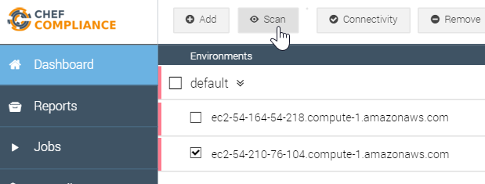

GL: Re-run the Compliance Scan
Return to the Compliance Web UI and re-run the scan on your target node.
Be sure to run only the base/ssh scan as shown on the next slide.

Slide 57
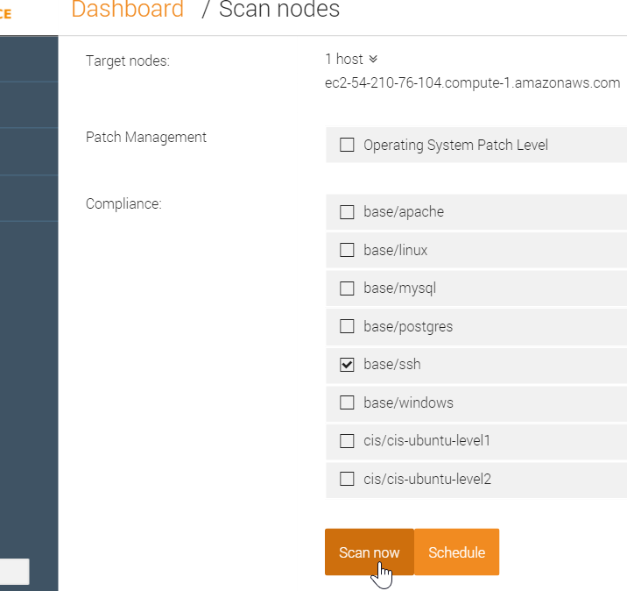
GL: Re-run the Compliance Scan
Run only the base/ssh scan.

Slide 58
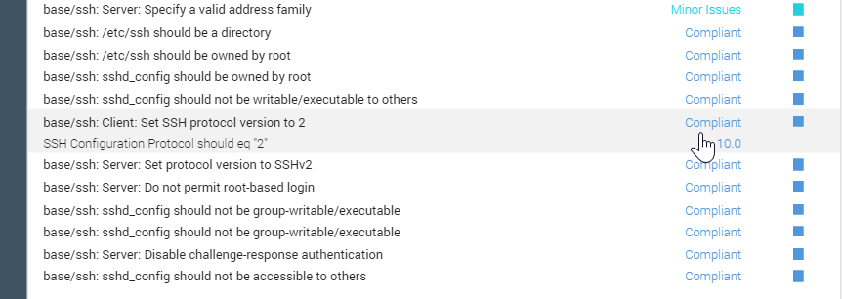
GL: Results of this Exercise
Your scan should show that the ssh protocol issue is now complaint.

Slide 59
Conclusion
Log in to your target node.
Write a remediation recipe on that node.
Test the recipe with Test Kitchen.
Test for compliance with InSpec from the CLI
Converge the recipe.
Rescan the node and ensure compliance.
Notes:
In this module we scanned a node for compliance issues. We identified an issue and then wrote a remediation recipe directly on the node scanned. We also tested our recipe with test kitchen.
As mentioned previously, in a production environment, you will likely write such recipes locally, add them to the node's run list, and then upload them to Chef Server.
Then the nodes would download the recipes from Chef Server on their next chef-client run and also convergence the recipes.

Slide 60
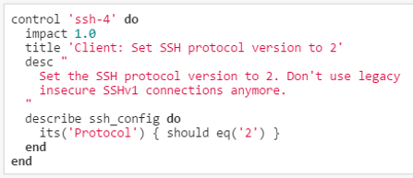
Review Questions
When adding a node to the Compliance server's dashboard, should you use the node's FQDN or just its IP address?
What can `inspec exec` be used for?
How are compliance severities defined?
Using the image on the right, what section is the actual test?
Notes:
Instructor Note Answers:
1. It doesn't matter...you could use the node's FQDN or just its IP address.
2. `inspec exec` can be used to test a compliance profile against remote hosts, including docker containers.
3. The `impact` value in a Compliance Profile/control defines severity. See slide 3-22 through slide 3-24 for examples.
4. The `describe` section is the actual test.

Slide 61
Review Questions
If a compliance scan tells you that a node is unreachable, what might you use to troubleshoot the connection?
What language is used to define controls?
Notes:
Instructor Note Answers:
5. You could use the Dashboard's "check the connectivity" test, ssh into the target, and/or check the node's configuration in the Web UI (IP address, login credentials.)
6. InSpec.

Slide 62
©2016 Chef Software Inc.

