Slide 1
Scheduling Scans and Running Reports
Scheduling Scans for Future Reporting

Slide 2
Objectives
After completing this module, you should be able to:
Schedule scans.
View pending jobs.
View and export reports.

Slide 3
Scheduling Scans
You can schedule scans to run at a later time.
Running a scheduled compliance scan on your infrastructure, say every night, could give you up-to-date compliance information on a daily basis.
In this way, any changes to your infrastructure that may have put some nodes out of compliance can be routinely identified.

Slide 4
Scheduling Scans
The time zone for "Date" scheduling in the Compliance web UI is based on your local workstation's browser time zone.
The time zone for "Recurring" scheduling in the Compliance web UI is based on UTC. (Coordinated Universal Time, which equals GMT.)
The Compliance logs, should you view them, are also based on UTC.
Notes:
This time distinction is important when scheduling scans or if viewing the compliance logs.
Instructor Note: As of this writing this slide is correct but it could be subject to change. Also, here is the `tail` command in case you want to demonstrate the logs as you set a scheduled scan: `sudo tail -f /var/log/chef-compliance/core/current`/
TBD: Demo this via a slide.

Slide 5
GE: Scheduling Scans
Schedule a scan.
View the scan output.
TBD tail the log file when the scheduled scan runs.

Slide 6
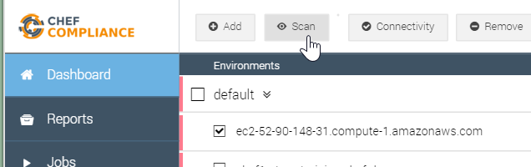
GE: Scheduling Scans
1. Open the Compliance web UI's Dashboard page.
2. Select one of your target nodes.
3. Click Scan.

Slide 7
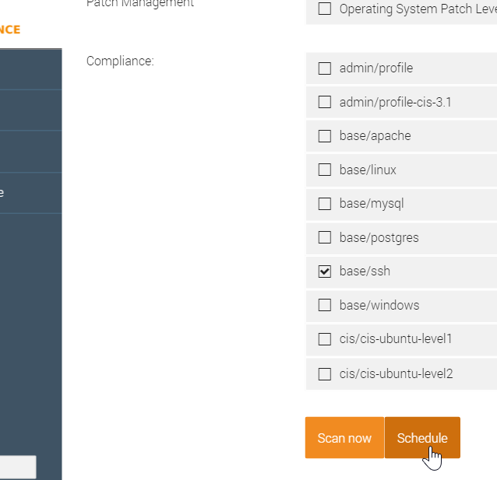
GE: Scheduling Scans
4. Deselect all profiles.
5. Select the base/ssh profile for a Linux node or the base/windows profile for a Windows node
6. Click the Schedule button.

Slide 8
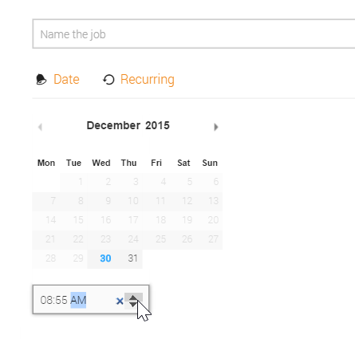
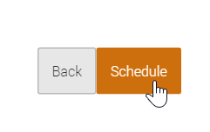
GE: Scheduling Scans
7. Type a name for this scan in the Name the job field.
8. Click the up arrow and set the scheduled time to 5 minutes from now and then click Schedule.
Note: The up/down arrows are also used to set the AM and PM value.

Slide 9
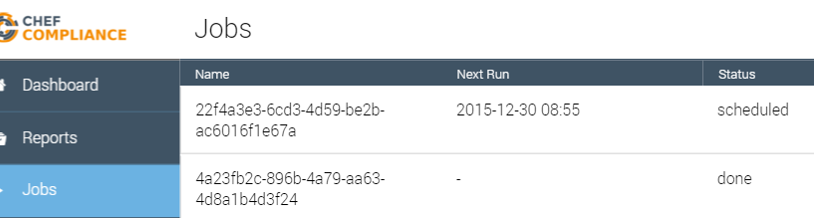
GE: Scheduling Scans
Click the Jobs tab and you should see your scheduled scan's details such as its Next Run time and its "scheduled" status.

Slide 10
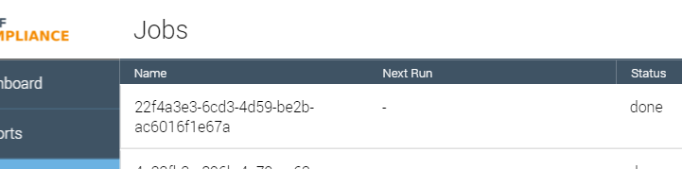
GE: Scheduling Scans
When 5 minutes have elapsed, refresh your browser and you should see that your Job's status is now "done".
Note: If you like you could click that job to see its original details that you set when you scheduled it.
Notes:
TBD Delete button after click.

Slide 11
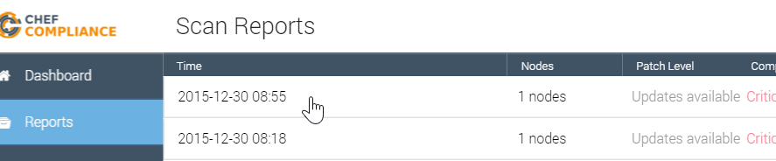
GE: Scheduling Scans
Click the Reports tab and then click the report from your scheduled scan.

Slide 12
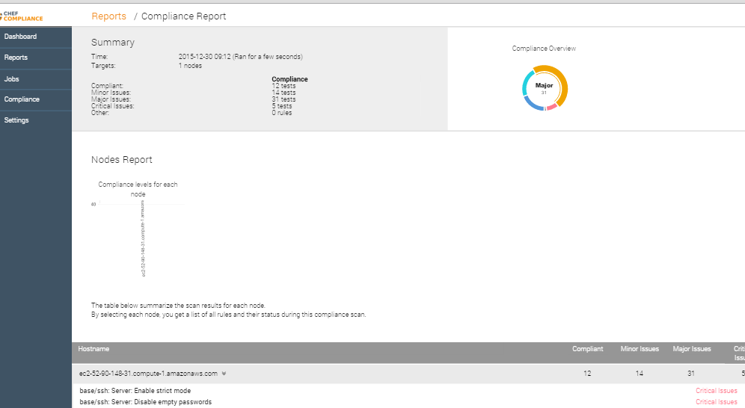
GE: Scheduling Scans
At this point you should be able to view the report from your scheduled scan.

Slide 13
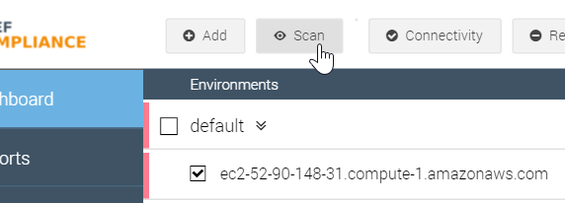
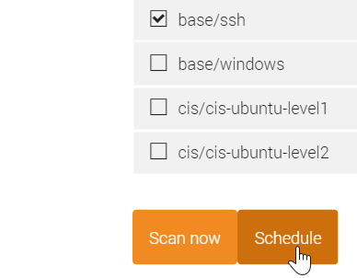
Demonstration: Recurring Scans
You can schedule recurring scans as well.
To do so, set up a scheduled scan like you just did...

Slide 14
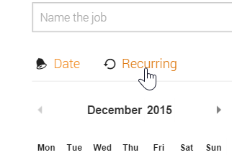
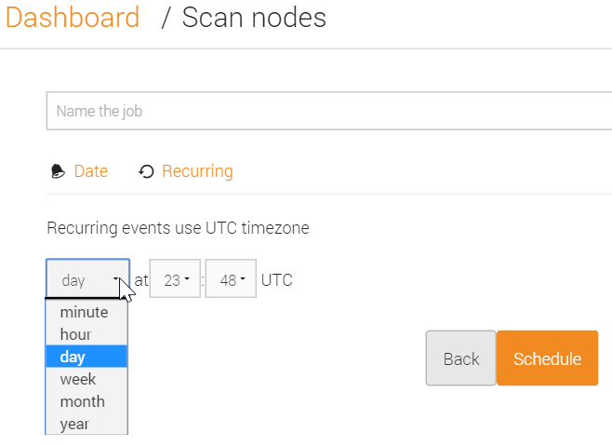
Demonstration: Recurring Scans
...but when you get to the page with the calendar (Scan nodes page), click the Recurring link and you'll be able to set the recurrence.
In this example the user is scheduling a scan to run every day at 23:48 UTC.

Slide 15
Demonstration: Scheduled Scan Logs
While not necessary, if you ever want to view the Compliance log files while you are scheduling or running a scan, keep in mind that log files use UTC time instead of your local browser time.
To tail those logs, from your Compliance Server you can run: `sudo tail -f /var/log/chef-compliance/core/current`
Notes:
Instructor Note: As this slide indicates, tailing the log files is not required but can be of interest to some users. In one scenario where it came in handy, a browser session to the Compliance Server got stale and would not schedule a scan. After tailing the log files and realizing the scan was not even being scheduled, the user refreshed the Compliance Server web UI, logged in again, and the scan would properly schedule and run.
Instructor Note: If you find yourself ahead of schedule, you can spend some time demonstration the output of this log file as you perform a number of procedures via the Web UI.

Slide 16
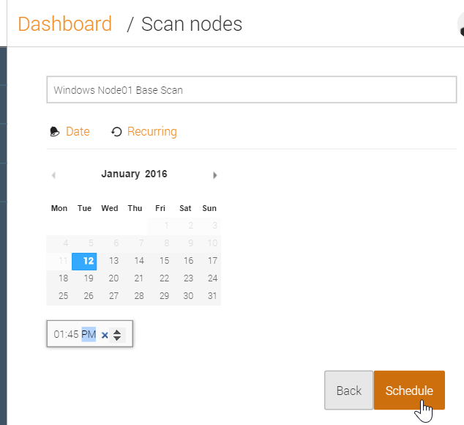
Demonstration: Scheduled Scan Logs
2016-01-12_21:41:16.82603 21:41:16.825 DEB => Add job: admin/2e48b32c-bd3b-4024-9d15-f3fc82537290 2016-01-12 21:45:00 +0000 UTC next: 2016-01-12 21:45:00 +0000 UTC
2016-01-12_21:41:16.83327 [GIN] 2016/01/12 - 21:41:16 | 200 | 9.475356ms | 50.170.125.99 | POST /owners/admin/jobs
2016-01-12_21:41:16.94064 [GIN] 2016/01/12 - 21:41:16 | 200 | 3.283171ms | 50.170.125.99 | GET /owners/admin/jobs
Notes:
The image on the left shows the user setting the next scheduled scan for 1:45 P.M. local browser time.
The image on the right shows the output of `sudo tail -f /var/log/chef-compliance/core/current` taken at the very same time that the scan was scheduled. Notice the log file timestamps are in UTC and the next schedule scan is set for UTC: 2016-01-12 21:45:00 +0000 UTC instead of the local browser time.

Slide 17
Deleting Old Jobs
The list of old scheduled jobs can grow so you can delete them if you no longer need them.

Slide 18
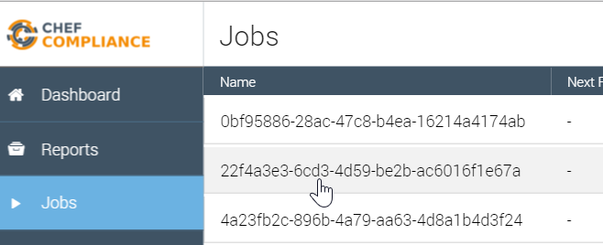
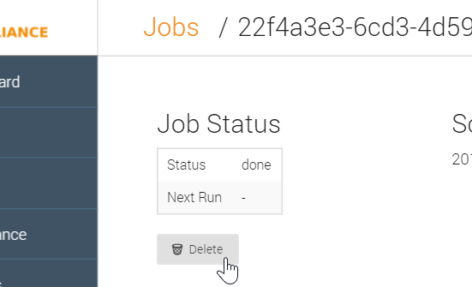
Demonstration: Deleting Jobs
To delete an old job, from the Jobs tab, click a job...
...and from the resulting page, click the Delete button.

Slide 19
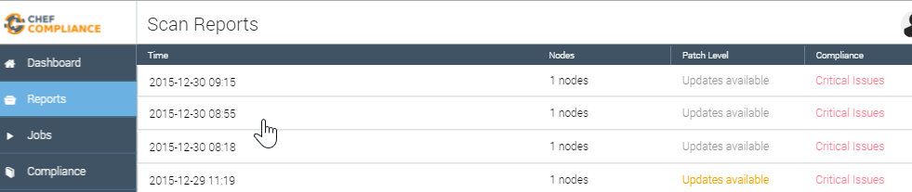
Compliance Reports
The results of all of your scans are available via the Reports tab.
As of this writing, JSON-based exporting of reports is supported.
Notes:
TBD explain json exporting?

Slide 20
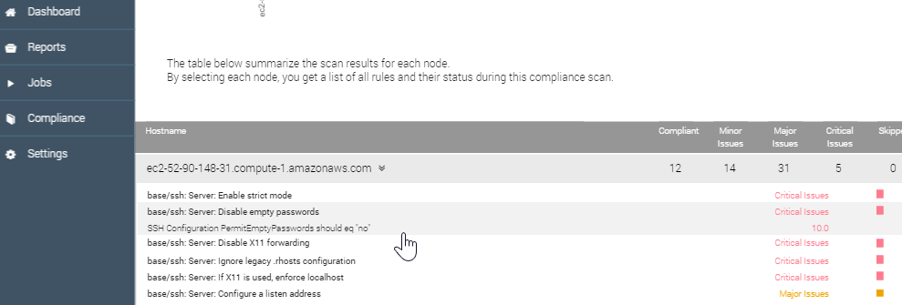
Compliance Reports
You can also export a compliance report as a PDF.
In the near future, Chef Compliance will also support exporting reports to Excel and sending to an email recipient.
Notes:
Instructor Note: This section is more of a placeholder for exporting Compliance reports after the email and Excel methods are ready for release.

Slide 21
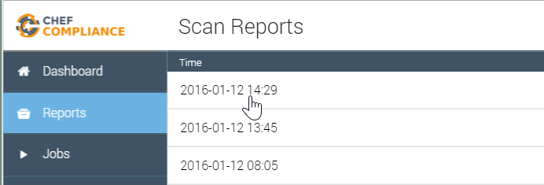
GE: Exporting Reports
From the left column of the web UI, click Reports and then click any report that may exist.

Slide 22
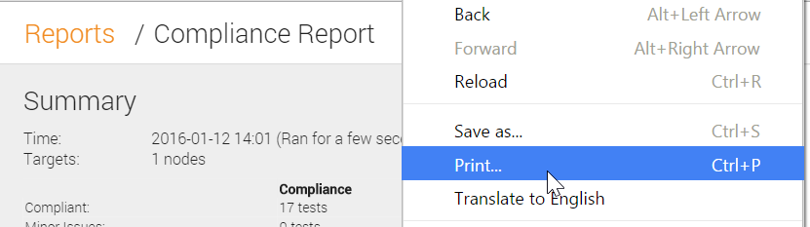
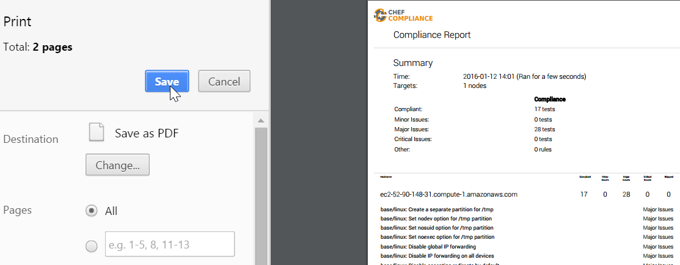
GE: Exporting Reports
Right-click on the report page and then click Print.
Ensure your print option is set to PDF and save and then click Save, thus saving to you local laptop.

Slide 23
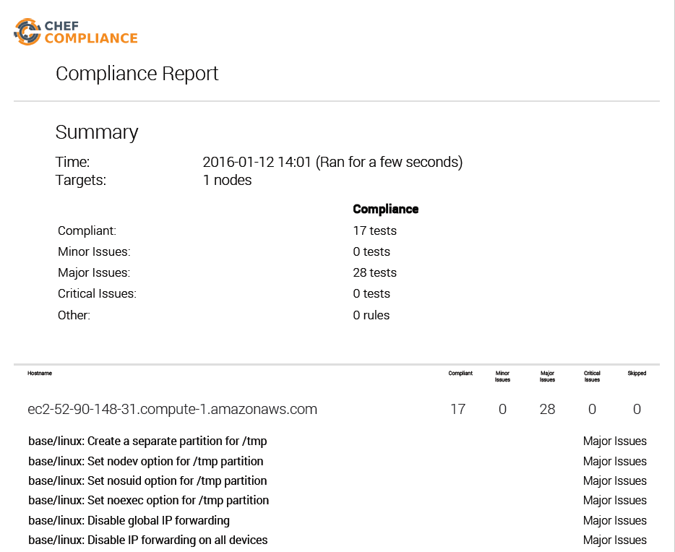
GE: Exporting Reports
Your saved report should look similar to this example with the text properly aligned and formatted.

Slide 24
Scheduling Scans
SD: My internal notes below to be deleted.
TBD: Need to test PDF export on Mac.
Notes:
Hi Dominik....Is there a document that explains a use case for running scheduled scans?
​[9:31 AM]
dominik Not really right now :simple_smile: We have them included, but their functionality is still a bit limited in the UI. what are you interested in ?
​[9:32 AM]
steve_delfante I wrote a short lab on how to schedule scans and read the results but I gave no reason why someone would want to schedule a scan rather than do one on the fly.(edited)
​[9:33 AM]
dominik For example: Run a compliance scan every night on your whole infrastructure. Instead of pushing it off manually, you could ask chef compliance to do it for yoou
​[9:33 AM]
This would give you up to date information on a daily basis without interruptions in reporting.
​[9:33 AM]
steve_delfante OK, because nodes cold fall out of compliance due to updates others may have made throught the day?
​[9:34 AM]
dominik for example; or if you had changed your chef automation and something went wrong (because you didn’t use delivery to verify compiance of your changes)
​[9:35 AM]
or if any component was changed, that you didn’t yet explicitly manage through chef; for example: have telnet listen on tcp for some reason you didn’t expect; apart from uninstalling telnet through chef, we don’t tend to write cookbooks for negative cases :wink: so that’s a great example for compliance
​[9:36 AM]
steve_delfante Cool. thanks!
​[9:36 AM]
One more question for now please....
​[9:37 AM]
Is there going to be a way to export reports or do we only have people view results live?
​[9:37 AM]
dominik Yes there is; We are looking into exporting reports to PDF and (some type of) Excel format
​[9:38 AM]
There is also the alternative to retrieve reports via JSON api
​[9:38 AM]
we will have the PDF and Excel options in UI
​[9:38 AM]
steve_delfante Sounds good. Do you have an ETA for exporting?(edited)
​[9:39 AM]
dominik It has not been explicitly planned yet. My expectation is for end of Q1, but it could just as easily move into early Q2
​[9:39 AM]
steve_delfante Ok. Thanks!
​[9:39 AM]
dominik JSON-based exporting however is already supported
new messages
​[9:39 AM]
and we are rewriting the API to be much better at generating large reports
​[9:39 AM]
let me know if customers have different priorities

Slide 25
Review Questions
What is ...? ______________________________
Which is the correct answer?
answer
answer
answer
answer
Capable of carrying on a conversation
Explain

Slide 26
©2016 Chef Software Inc.

