Slide 1
Scheduling Scans and Running Reports
Scheduling scans for future reporting

Slide 2
Objectives
After completing this module, you should be able to:
Schedule scans.
View pending jobs.
Run Reports.

Slide 3
Scheduling Scans
You can schedule scans to run at a later time.
Running a scheduled compliance scan on your infrastructure, say every night, could give you up to date compliance information on a daily basis without interruptions in reporting.
In this way, any changes to your infrastructure that may have put some nodes out of compliance can be routinely identified.

Slide 4
Scheduling Scans
The time zone for scan scheduling in the Compliance web UI is based on your local workstation's browser time zone.
The Compliance logs are based on UTC.
Notes:
This time distinction could be important if you need to view the Compliance logs.

Slide 5
GE: Scheduling Scans
Schedule a scan.
View the scan output.
tail the log file when the scheduled scan runs.

Slide 6
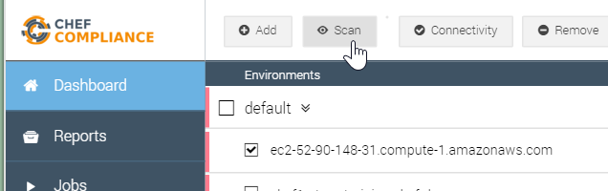
GE: Scheduling Scans
1. Open the Compliance web UI's Dashboard page.
2. Select your Linux target node.
3. Click Scan.

Slide 7
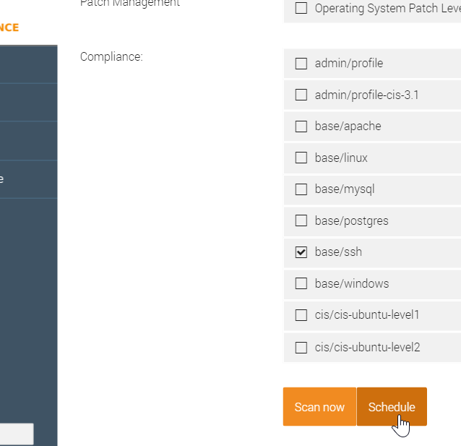
GE: Scheduling Scans
4.Deselect all profiles.
5. Select the base/ssh profile
6. Click the Schedule button.

Slide 8
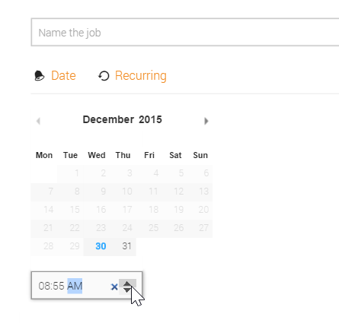
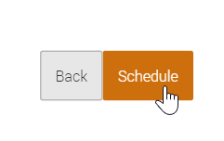
GE: Scheduling Scans
7. If you like, type a name for this scan in the Name the job field.
8. Click the up arrows and set the scheduled time to 5 minutes from now and then click Schedule.
Note: The up/down arrows are also used to set the AM and PM value.

Slide 9
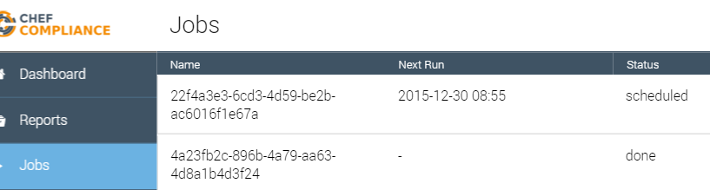
GE: Scheduling Scans
Click the Jobs tab and you should see your scheduled scan's details such as its Next Run time and its "scheduled" status.

Slide 10
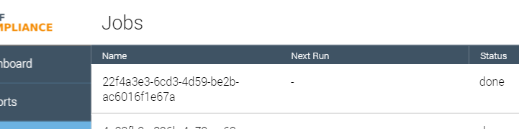
GE: Scheduling Scans
When 5 minutes have elapsed, refresh your browser and you should see that your Job's status is now "done".
Note: If you like you could click that job to see its original details that you set when you scheduled it.
Notes:
TBD Delete button after click.

Slide 11
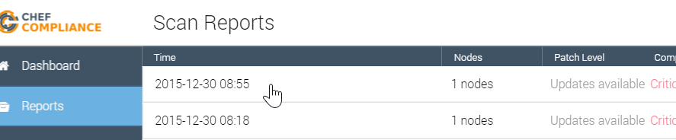
GE: Scheduling Scans
Click the Reports tab and then click the report from your scheduled scan.

Slide 12
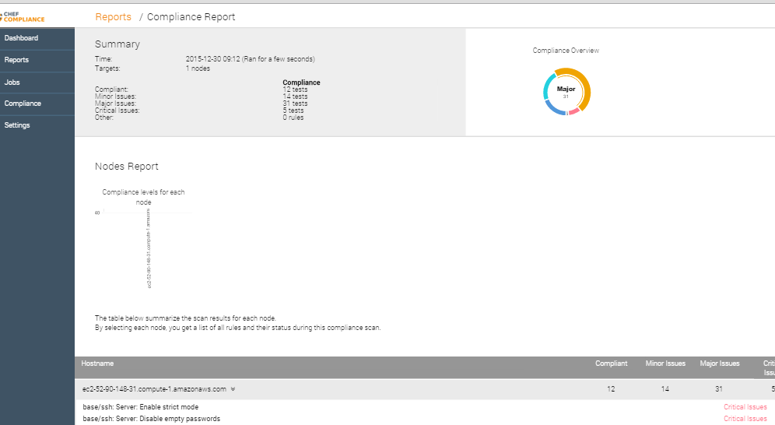
GE: Scheduling Scans
At this point you should be able to view the report from your scheduled scan.

Slide 13
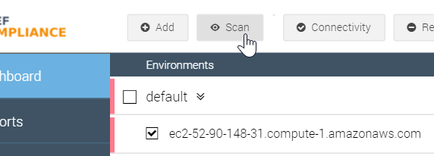
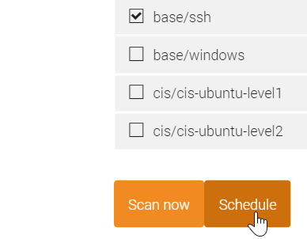
Demonstration: Recurring Scans
You can schedule recurring scans as well.
To do so, set up a scheduled scan as you just did...

Slide 14
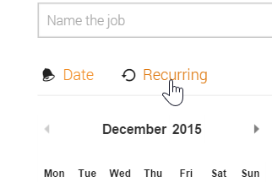
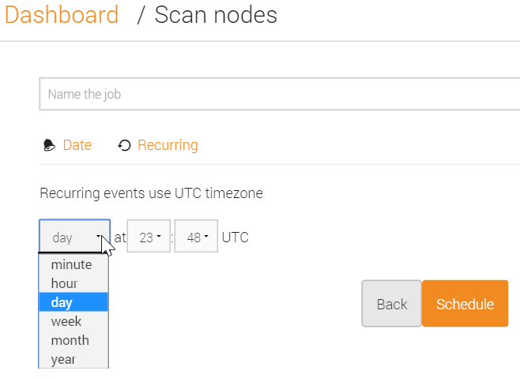
Demonstration: Recurring Scans
...but when you get to the page with the calendar, click the Recurring link and you'll be able to set the recurrence.
In this example the user is scheduling a scan to run every day at 23:48 UTC.
Notes:
Instructor Note: We recommend you demonstrate the available recurrence values in the UI at this time.

Slide 15
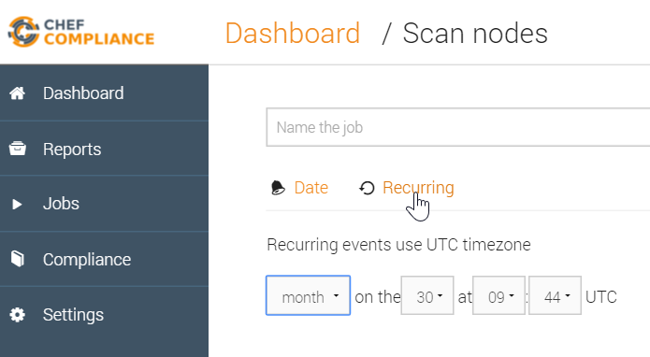
Deleting Old Jobs
The list of old scheduled jobs can grow so you should delete them after you are done with them.

Slide 16
Recurring Jobs
The list of old scheduled jobs can grow so you should delete them after you are done with them.

Slide 17
Demonstration: Deleting Jobs
At this point you should be able to view the report from your scheduled scan.

Slide 18
Deleting Old Jobs
mmm
IMPORTING NODES
andrew: you can add nodes using the API, e.g. in bulkhttps://github.com/chef/chef-compliance/blob/master/docs/api_compliance.rst#post-bulk

Slide 19
GE: Creating a Custom Profile
Creating custom profiles to fit your business needs.
Create a custom profile.
Test your profile with InSpec
Notes:
The custom profile you will create will scan nodes to ensure they have a '/tmp' directory and that directory should be owned by the root user.
Note: In the workplace you would likely perform these custom profile tasks on your local workstation and upload them to the Compliance Server. In this class we'll use our target nodes as a workstation to create the profile on since they already have Chef installed on them. Then we'll ultimately upload the customer profile to your Compliance Server.

Slide 20
GE: Create a Directory for your Profile
$ mkdir -p ~/compliance_profiles/profile_01
$ cd ~/compliance_profiles/profile_01
Notes:
On your target node, create a directory for your profiles and the move into that new directory.
$ `mkdir -p ~/compliance_profiles/profile_01`
$ `cd ~/compliance_profiles/profile_01'
Reminder: In the workplace you would likely perform this task TBD

Slide 21
Scheduling Scans
READ NOTES
Notes:
Hi Dominik....Is there a document that explains a use case for running scheduled scans?
​[9:31 AM]
dominik Not really right now :simple_smile: We have them included, but their functionality is still a bit limited in the UI. what are you interested in ?
​[9:32 AM]
steve_delfante I wrote a short lab on how to schedule scans and read the results but I gave no reason why someone would want to schedule a scan rather than do one on the fly.(edited)
​[9:33 AM]
dominik For example: Run a compliance scan every night on your whole infrastructure. Instead of pushing it off manually, you could ask chef compliance to do it for yoou
​[9:33 AM]
This would give you up to date information on a daily basis without interruptions in reporting.
​[9:33 AM]
steve_delfante OK, because nodes cold fall out of compliance due to updates others may have made throught the day?
​[9:34 AM]
dominik for example; or if you had changed your chef automation and something went wrong (because you didn’t use delivery to verify compiance of your changes)
​[9:35 AM]
or if any component was changed, that you didn’t yet explicitly manage through chef; for example: have telnet listen on tcp for some reason you didn’t expect; apart from uninstalling telnet through chef, we don’t tend to write cookbooks for negative cases :wink: so that’s a great example for compliance
​[9:36 AM]
steve_delfante Cool. thanks!
​[9:36 AM]
One more question for now please....
​[9:37 AM]
Is there going to be a way to export reports or do we only have people view results live?
​[9:37 AM]
dominik Yes there is; We are looking into exporting reports to PDF and (some type of) Excel format
​[9:38 AM]
There is also the alternative to retrieve reports via JSON api
​[9:38 AM]
we will have the PDF and Excel options in UI
​[9:38 AM]
steve_delfante Sounds good. Do you have an ETA for exporting?(edited)
​[9:39 AM]
dominik It has not been explicitly planned yet. My expectation is for end of Q1, but it could just as easily move into early Q2
​[9:39 AM]
steve_delfante Ok. Thanks!
​[9:39 AM]
dominik JSON-based exporting however is already supported
new messages
​[9:39 AM]
and we are rewriting the API to be much better at generating large reports
​[9:39 AM]
let me know if customers have different priorities

Slide 22
Scheduling Scans
sudo tail -f /var/log/chef-compliance/core/current
srenatus commented 9 minutes ago
@SteveDelFante Hehe, I might hope so, but I wouldn't hold my breath. We have not found the real issue at play here yet. But tomorrows release is much more explicit about errors, and rejects "old jobs", so we can hopefully tackle this bug better with it. ;)
Scheduled times are still a rather split: recurring jobs uses UTC, one-off jobs local time. Nothing has changed there (yet -- #237).

Slide 23
GE: Uploading the Custom Profile to the Compliance Server
Uploading it so it can be used in scans..
Zip up the new profile.
Upload it to your laptop and then to the Compliance Server.
Notes:
In addition to the uploading procedure we'll do in the exercise, in the workplace you could also upload such custom profiles using an API.

Slide 24
Review Questions
What is ...? ______________________________
Which is the correct answer?
answer
answer
answer
answer
Capable of carrying on a conversation
Explain

Slide 25
©2016 Chef Software Inc.

