Slide 1
Users, Organizations, Teams and Permissions
Specifying Views and Actions Users Have Access To
Notes:
Instructor Note: While managing users and organizations via a web UI may seem like a trivial topic, in Chef Compliance there is some complexity in how nodes are shared via Organizations. So this hands-on module allows the students to manage users, organizations, and teams so they can see the resulting behavior first hand.
Instructor Note: LDAP integration is scheduled for Q2 2016. As of this writing, users have two options for managing manage users, organizations, and teams--The web UI or via API: https://docs.chef.io/release/compliance_1-0/api_compliance.html#users

Slide 2
Objectives
After completing this module, you should be able to:
Create users.
Set user permissions.
Create and apply organizations.
Create Teams.
Set Team permissions.

Slide 3
Managing Users
You can create and edit Compliance Server users.
You can also modify their permission to allow or prevent certain actions.
Notes:
Permissions are used to control what users and organizations can do in the context of Chef Compliance. You can effectively enable or disable permissions to scan systems, update packages, or manage various aspects of Chef Compliance including users and organizations.

Slide 4
Group Lab: Creating Users
Let's learn by doing. We'll stop along the way to explain details.
Create a new Compliance User.
Modify a User's Permissions.

Slide 5
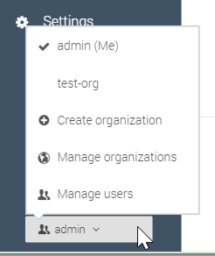
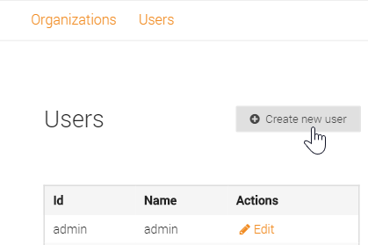
GL: Creating Users
From the bottom-left, click the menu button and then click Manage users.
Click Manage users.
From the resulting screen, click Create new user.

Slide 6
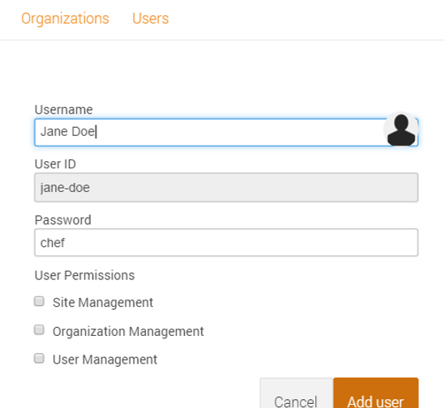
Discussion: Creating Users
The Users/Create screen displays.
A user can have the following permissions:
Site Management users can do everything.
Organization Management users can create, edit or delete Organizations.
User Management users can create, edit or delete users.
Notes:
The Site Management permission can be thought of as Administrator-level permissions. It is like a superset of the Organization Management and the User Management permissions.
We will discuss Organizations and their purpose later in this module.

Slide 7
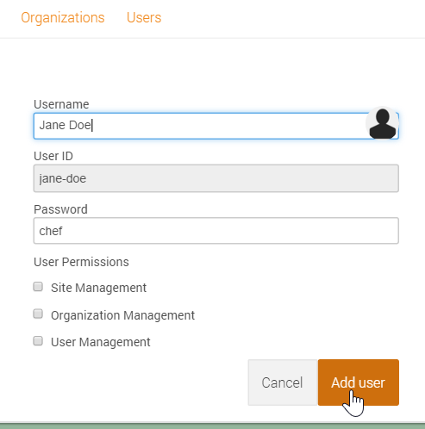
GL: Creating Users
From the current Users/Create screen, type a user name of your choice and a password you'll remember, like chef.
Note: Leave the new user's permissions unchecked for now.
5. Click the Add user button.

Slide 8
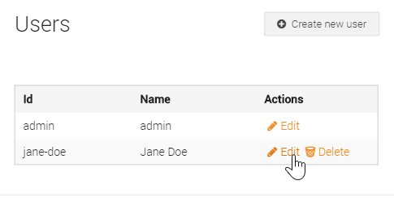
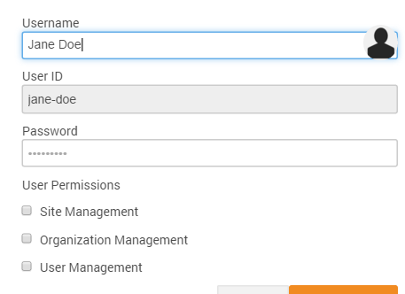
Discussion: Creating Users
Notice from the current Users screen you could edit or delete users.
The bottom image shows the permissions that you can edit for a user.
You could also edit the Username and/or Password but not the user ID.
Reminder: Leave the new user's permissions unchecked for now.
Notes:
Notice that you can't delete the original admin user, however, since you always need at least an admin user.
We will use this new user in the up coming lab exercises.

Slide 9
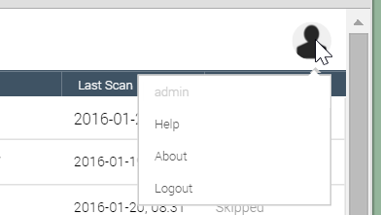
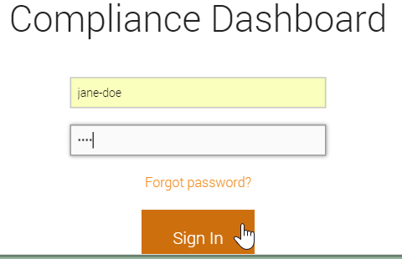
GL: Managing Users
From the top-right of the Compliance web UI, click the User icon and log out.
From the resulting login screen, log in with your new user ID.

Slide 10
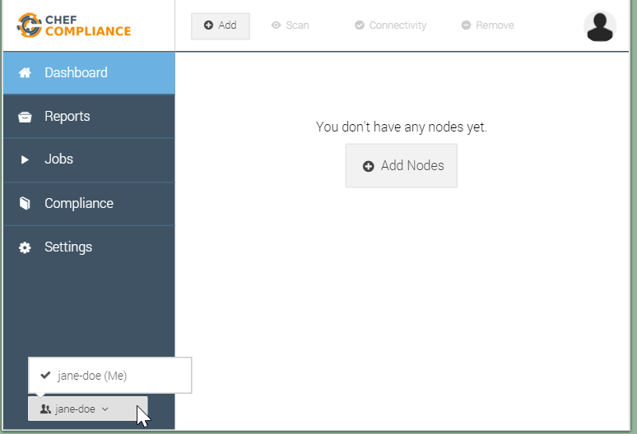
GL: Managing Users
Notice that you cannot access any nodes that were added previously.
Also notice that your current permissions don't allow you to manage users or organizations.
8. Log out and then log back in as the admin user.

Slide 11
Organizations in Chef Compliance
Organizations are objects that enable you to segregate target nodes and make them accessible to users other than just the admin user.
Before you add nodes that you may want to share with other users, you should first create at least one Compliance organization and a corresponding Compliance team to which those nodes will be associated.
In such a scenario, you'll need to switch to the new organization and then add nodes while you are working under that organization.
Notes:
As of this writing, the only way to share access to nodes between different user accounts via a combination of an Organization object and its Team object.

Slide 12
Group Lab: Using Organizations and Teams
Let's keep learning by doing. We'll stop along the way to explain details again.
Create an Organization.
Create a Team.
Add a Member to a Team.
Add a Node to an Organization.
Test a Team Member's Access to a Node.

Slide 13
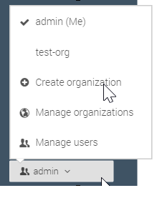
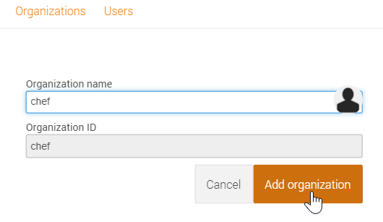
GL: Creating an Organization
From the bottom-left of the Dashboard, click admin > Create Organization.
Type a new organization name (chef) in the Organization name field and then click the Add organization button.

Slide 14
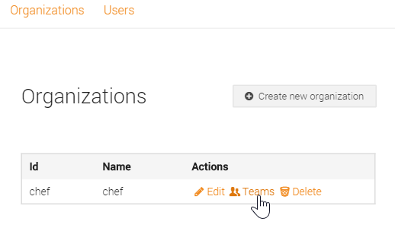
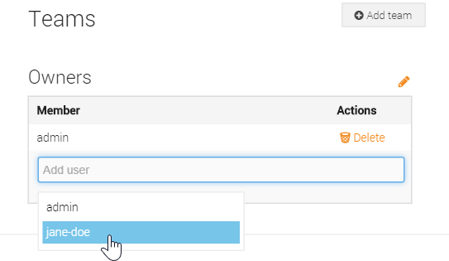
GL: Creating an Organization
From the resulting screen, click the Teams link to add team member to your new organization.
Click the Add user field and then select your new user name to add it to this team.
Notice that the original admin user us already part of this and any new organization teams.

Slide 15
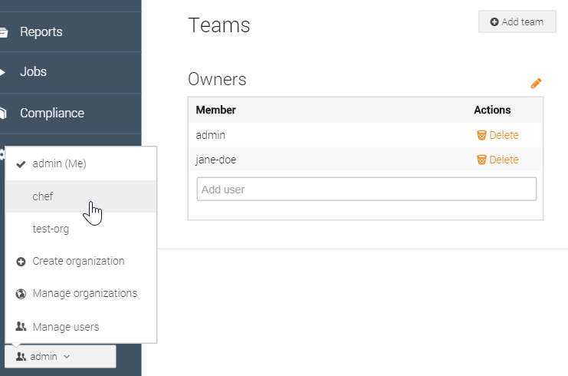
GL: Using Your New Organization
You should now see that your new user name is part of the chef organization's team.
In the next step we'll switch to the new organization so we can add a node to it.
5. From the bottom-left of the web UI, click admin and then click your new organization (chef) to switch to it.

Slide 16
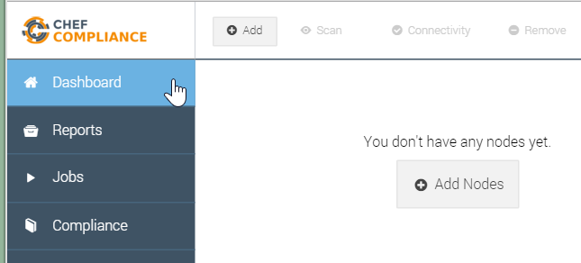
GL: Using Your New Organization
6. Click the Dashboard link and notice that you can no longer see any nodes.
Question: Where have your previous nodes gone?
Click the Add button to add a node to your organization.
Notes:
Instructor Note: Answer--The nodes have not gone anywhere. They are only accessible under the admin user's default organization, not under this new `chef` organization. In the next steps we'll add a node to our new organization.

Slide 17
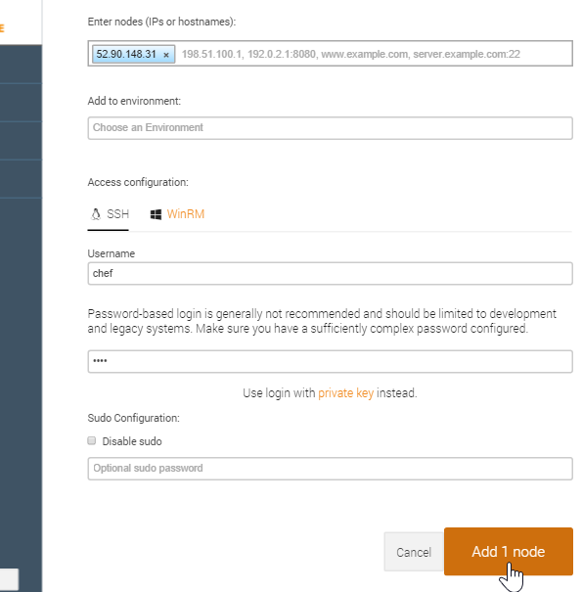
GL: Using Your New Organization
Add one of the target nodes you were assigned at the beginning of this course and then click the Add 1 node button.
Note: Use the same password authentication method as done previously in the course.

Slide 18
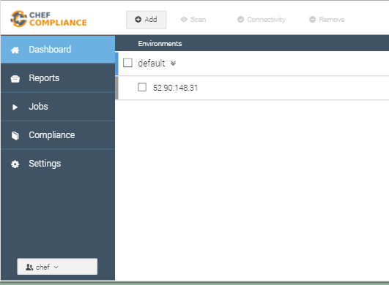
GL: Using Your New Organization
You should now see the node you added to your new chef organization.
You can also determine which organization you are switched to by looking at the bottom-left of the Chef Compliance Dashboard.

Slide 19
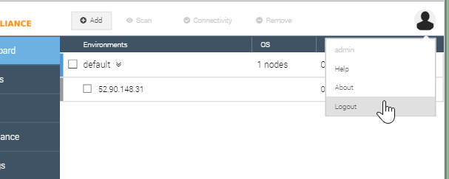
GL: Using Your New Organization
As you may recall, the last time you tried to view nodes while logged in to the Compliance Dashboard with your new user name, you could not see any nodes.
8. Log out of the Compliance Dashboard and log back in with your new user name.

Slide 20
GL: Using Your New Organization
While logged in with your new user name, you should now be able to access the node that was created under your new organization.
Question: Do you remember why this is possible?
Notes:
Instructor Note: Answer--Because your new user name is part of the Team object that is resides under the new (chef) organization.

Slide 21
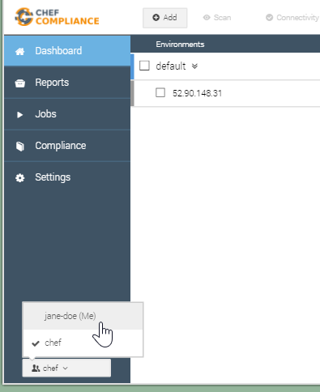
GL: Using Your New Organization
9. From the bottom-left of the Compliance Dashboard, switch back and forth between you new organization and your user name's default organization.
You should only be able to access the node that was created under your new organization.

Slide 22
Managing Team Permissions
Teams have their own set of permissions.
Team permissions are completely separate and independent of user permissions.

Slide 23
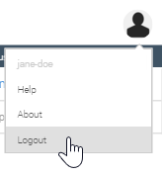
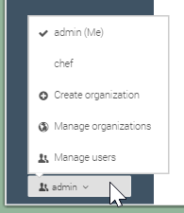
GL: Managing Team Permissions
Log out of the Compliance Web UI and log back in as admin.
If you like you can switch back to the admin organization although it really doesn't matter for the next task.

Slide 24
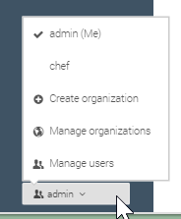
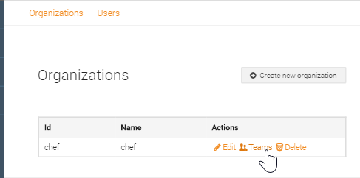
GL: Managing Team Permissions
Click Manage Organizations from the menu.
From the resulting Organizations screen, click the chef organization's Teams link.

Slide 25
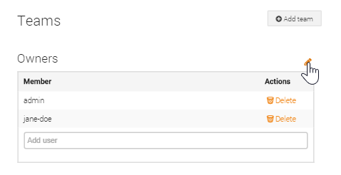
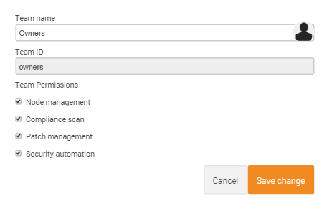
GL: Managing Team Permissions
From the resulting Teams screen, click the pencil icon.
The team permissions screen should display.

Slide 26
Discussion: Managing Team Permissions
The Node Management permissions, when checked, enable the team members to add, edit or delete nodes from the dashboard.
The Compliance Scans permissions, when checked, enable the team members to execute scans.
Notes:
When you create a new team, all these permissions are enabled (checked) so if you want to limit team members' permissions listed here, you will need to disable them.

Slide 27
Discussion: Managing Team Permissions
Note: As of this writing, the Patch Management and Security Automation permissions are not fully functional.
Notes:
Instructor Note: This is what a Compliance SME wrote about the last two permissions listed above: "patch management - execute patch execution (deactivated by default). Security automation - use cookbooks for remediation (not available yet)

Slide 28
Review Questions
How can you share nodes between different user names?
Of the following permissions found on the Users/Create screen, which has the highest levels of permissions when enabled?
Organization Management.
User Management.
Site Management.
Notes:
Instructor Note Answers: 1. By using a combination of an Organization object and its Team object. Teams belong to Organizations so members of teams can then view or manage nodes that have been added to their team's organization.
2. Site Management.
A user can have the following permissions:
Organization Management users can create, edit or delete Organizations.
User Management users can create, edit or delete users.
Site Management users can do everything.

Slide 29
Review Questions
Regarding team permissions, what can the Node management permission allow?
Notes:
Instructor Note Answers: 1. The Node Management permissions, when checked, enable the team members to add, edit, or delete nodes from the dashboard.

Slide 30
©2016 Chef Software Inc.

