Slide 1
Applying Compliance Frameworks Using InSpec
Translating CIS and DoD Specifications into InSpec Tests
Notes:
Useful references for this module:
https://docs.chef.io/release/compliance_1-0/dsl_compliance.html
https://docs.chef.io/inspec_reference.html

Slide 2
Objectives
After completing this module, you should be able to:
Translate CIS (Center for Internet Security) specifications into InSpec tests.
Translate DoD (Department of Defense) specifications into InSpec tests.

Slide 3
CIS Compliance Frameworks
The CIS Security Benchmarks program provides well-defined, un-biased and consensus-based industry best practices to help organizations assess and improve their security.
Resources include secure configuration benchmarks, automated configuration assessment tools and content, security metrics and security software product certifications.
https://benchmarks.cisecurity.org/

Slide 4
Group Lab: Compliance Frameworks - CIS Linux
Translating a CIS benchmark into an InSpec control and Compliance profile.
Download the benchmark PDF for the platform of your scanning target
Implement Section 3 - Specialty Purpose Services as InSpec controls.

Slide 5
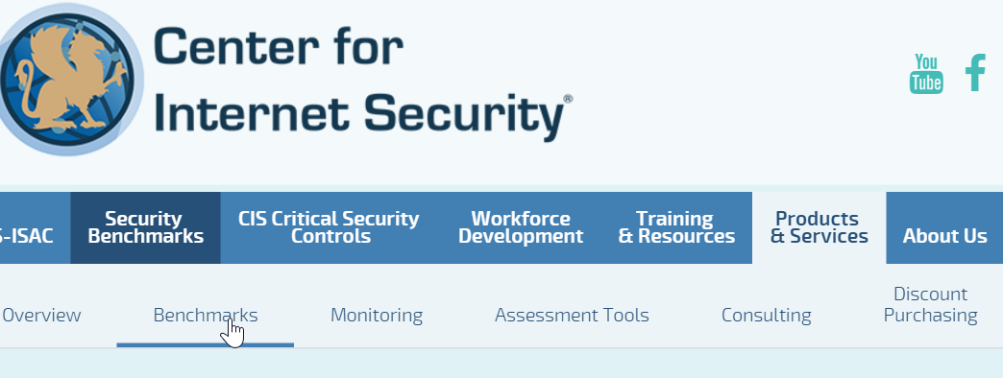
GL: Downloading the CIS Benchmarks for Linux
1. Go to: https://benchmarks.cisecurity.org/
Click the Products & Services tab.
Click Benchmarks.

Slide 6
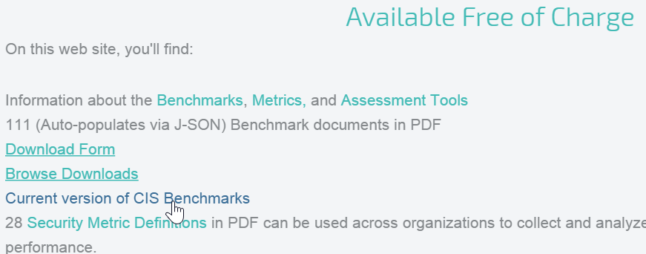
GL: Downloading the CIS Benchmarks
Scroll down to the Available Free of Charge section and then click Current version of CIS Benchmarks.

Slide 7
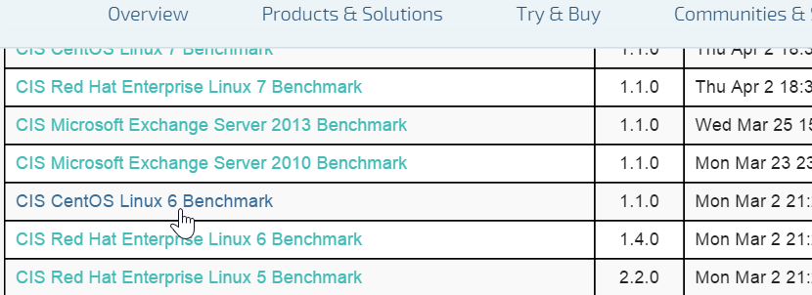
GL: Downloading the CIS Linux Benchmarks
Scroll down to the benchmark for the system you're running. In our case, click the CIS CentOS Linux 6 Benchmark link.

Slide 8
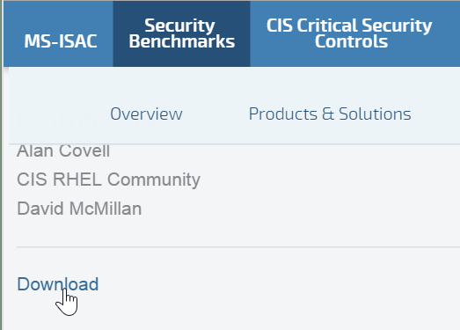
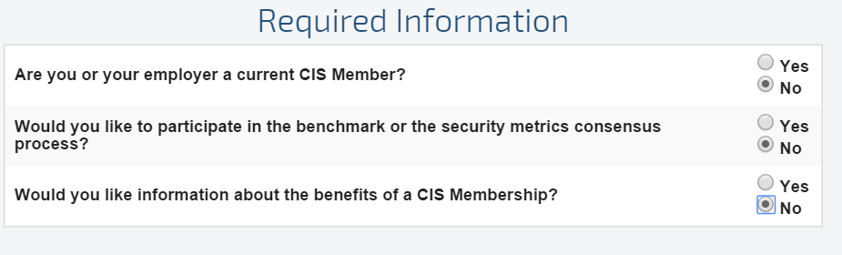
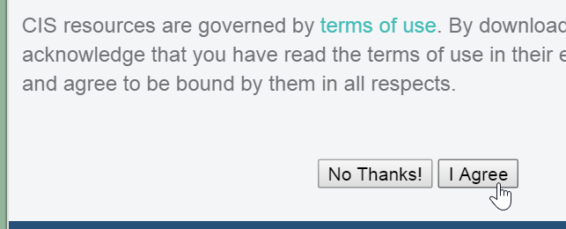
GL: Downloading the PDF
Scroll down to the bottom of the page and click Download.
On the resulting page, click the Required Information radio buttons.
Then scroll down and click the I Agree button.

Slide 9
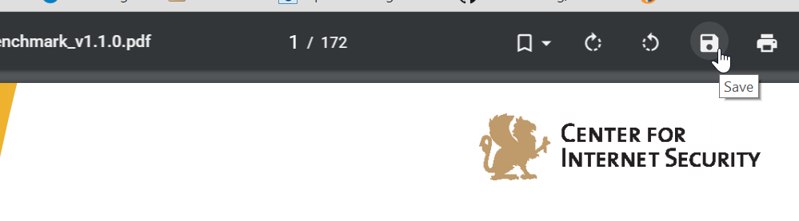
GL: Downloading the CIS Benchmarks
Save the PDF to your laptop. If a Save icon is not obvious, you should be able to save the PDF by right-clicking it.

Slide 10
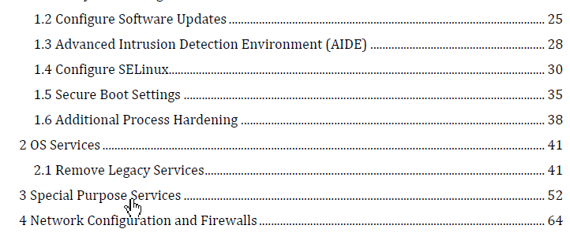
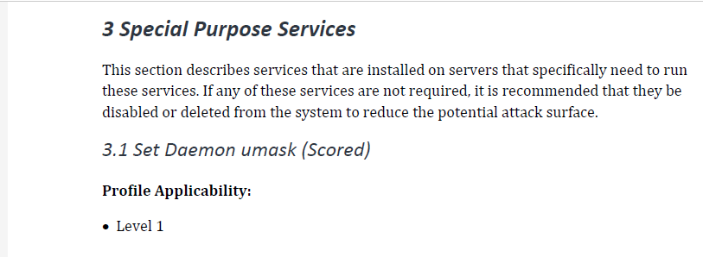
GL: CIS Benchmarks
Open the PDF and then from the Table of Contents, click the Special Purpose Services bookmark or otherwise go to that section.
Go to Section 3.1.

Slide 11
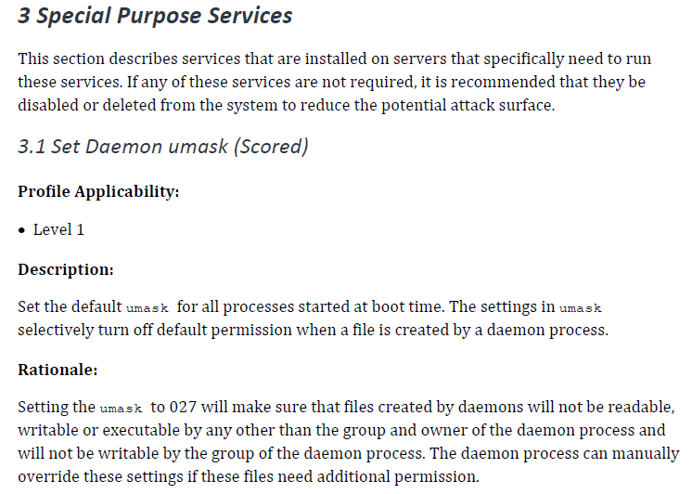
Demonstration: Writing an InSpec Test for CIS Benchmark (1 of 3)
control 'cis-3.1' do
impact 0.7
title 'Set Daemon umask'
desc '
Set the default umask for all processes started at boot time.
'
describe file('/etc/sysconfig/init') do
its('content') {should match 'umask 027'}
end
end
Notes:
The text in the example on the left can be used to create a Compliance Profile control (on the right). In this example, you can name the control the same as the section in the CIS document: control 'cis-3.1'
The Description text from the CIS document can be used to write the `desc` section.
As you can see on that page, the 3.1 Set Daemon umask (Scored) section says:
Description:
Set the default umask for all processes started at boot time. The settings in umask selectively turn off default permission when a file is created by a daemon process.
Rationale:
Setting the umask to 027 will make sure that files created by daemons will not be readable, writable or executable by any other than the group and owner of the daemon process and will not be writable by the group of the daemon process. The daemon process can manually override these settings if these files need additional permission.

Slide 12
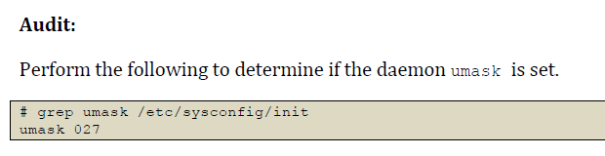
Demonstration: Writing an InSpec Test for CIS Benchmark (2 of 3)
control 'cis-3.1' do
impact 0.7
title 'Set Daemon umask'
desc '
Set the default umask for all processes started at boot time.
'
describe file('/etc/sysconfig/init') do
its('content') {should match 'umask 027'}
end
end
Notes:
If you scrolled down in that section, you will see an Audit example. So based on the Audit example on the left, you could write an InSpec test as shown on the right. In this way you can subsequently use this custom profile to scan nodes for umask compliance.
https://docs.chef.io/release/compliance_1-0/dsl_compliance.html
https://docs.chef.io/inspec_reference.html

Slide 13
Demonstration: Writing an InSpec Test for CIS Benchmark (3 of 3)
control 'cis-3.1' do
impact 0.7
title 'Set Daemon umask'
desc '
Set the default umask for all processes started at boot time.
'
describe file('/etc/sysconfig/init') do
its('content') {should match 'umask 027'}
end
end
After writing the test, in the workplace you should:
Use 'inspec exec' to test the control.
Package the custom compliance profile and upload it to your Compliance server.
Notes:
After writing the test, in the workplace you should:
Use 'inspec exec' to test the control.
Package the custom compliance profile and upload it to your Compliance server.

Slide 14
Lab: Write a Linux InSpec Test for CIS Linux - TBD Really?
Use the CIS document to write your own Compliance Inspec control for CIS.
You can use the Compliance DSL link below as a guide to write your own Compliance Inspec test if you like.
Compare your results with the class.
https://docs.chef.io/release/compliance_1-0/dsl_compliance.html

Slide 15
Group Lab: Compliance Frameworks - CIS Windows
Translating a CIS benchmark into an InSpec control and Compliance profile.
Download the benchmark PDF for the platform of your scanning target
Implement Section 3 - Specialty Purpose Services as InSpec controls.

Slide 16
GL: Downloading the CIS Benchmarks for Windows
1. Go to: https://benchmarks.cisecurity.org/
Click the Products & Services tab.
Click Benchmarks.

Slide 17
GL: Downloading the CIS Benchmarks for Windows
Scroll down to the Available Free of Charge section and then click Current version of CIS Benchmarks.

Slide 18
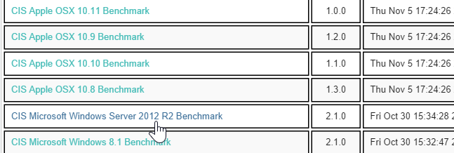
GL: Downloading the CIS Benchmarks for Windows
Scroll down to the benchmark for the system you're running. In our case, click the CIS Microsoft Windows Server 2012 R2 Benchmark link.

Slide 19
GL: Downloading the PDF
Scroll down to the bottom of the page and click Download.
On the resulting page, click the Required Information radio buttons.
Then scroll down and click the I Agree button.

Slide 20
GL: Downloading the CIS Benchmarks for Windows
Save the PDF to your laptop. If a Save icon is not obvious, you should be able to save the PDF by right-clicking it.

Slide 21
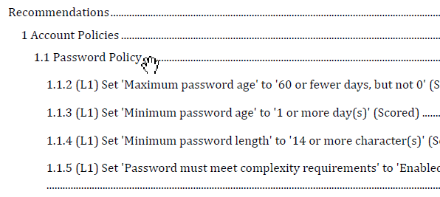
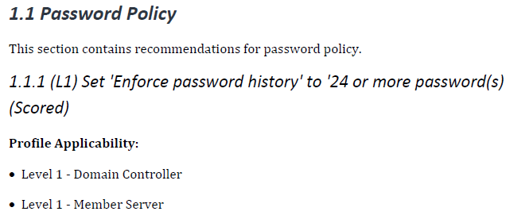
GL: CIS Benchmarks for Windows
Implement Section 1.1 - Password Policy as InSpec controls with the profile of Level 1 - Member Server.
Use 'inspec exec' to test the control.
Package profile and upload to your Compliance server.

Slide 22
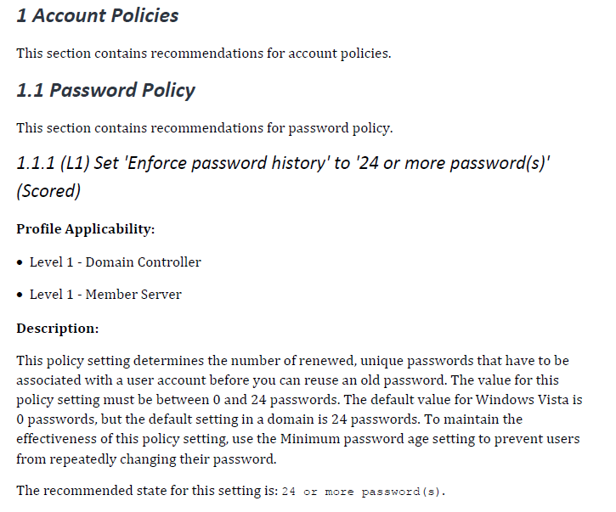
GL: Writing an InSpec Test for a Windows CIS Benchmark (1 of 3)
control 'cis-enforce-password-history-1.1.1' do
impact 0.7
title '1.1.1 Set Enforce password history to 24 or more passwords'
desc 'Set Enforce password history to 24 or more passwords'
describe security_policy do
its('PasswordHistorySize') { should be >= 24 }
end
end
Notes:
Scroll down to the 1.1 Password Policy section,
The text in the example on the left can be used to create a Compliance Profile control (on the right). In this example, you can name the control the same as the section in the CIS document: cis-enforce-password-history-1.1.1
The Description text from the CIS document can be used to write the `desc` section.

Slide 23
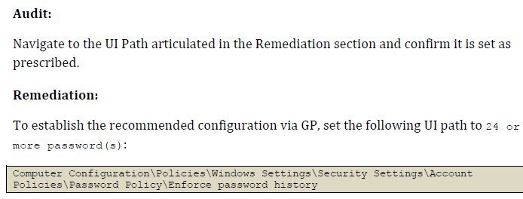
GL: Writing an InSpec Test for a Windows CIS Benchmark (2 of 3)
control 'cis-enforce-password-history-1.1.1' do
impact 0.7
title '1.1.1 Set Enforce password history to 24 or more passwords'
desc 'Set Enforce password history to 24 or more passwords'
describe security_policy do
its('PasswordHistorySize') { should be >= 24 }
end
end
Notes:
If you scrolled down in that section, you will see an Audit example. So based on the Audit example on the left, you could write an InSpec test as shown on the right. In this way you can subsequently use this custom profile to scan nodes for umask compliance.
The path shown in this example could be used if you wanted to manually navigate on the Windows node to see how password history parameter is set. However, when the Compliance Server scans the node, the Compliance server's inspec will use cmd = inspec.command('secedit /export /cfg win_secpol.cfg') to locate the parameter.
https://github.com/chef/inspec/blob/master/lib/resources/security_policy.rb

Slide 24
GL: Writing an InSpec Test for a Windows CIS Benchmark (3 of 3)
This inspec code below shows how inspec can scan for security policy compliance by parsing secedit /export /cfg win_secpol.cfg.
# load security content
def load
# export the security policy
cmd = inspec.command('secedit /export /cfg win_secpol.cfg')
return nil if cmd.exit_status.to_i != 0
control 'cis-enforce-password-history-1.1.1' do
impact 0.7
title '1.1.1 Set Enforce password history to 24 or more passwords'
desc 'Set Enforce password history to 24 or more passwords'
describe security_policy do
its('PasswordHistorySize') { should be >= 24 }
end
end
https://github.com/chef/inspec/blob/master/lib/resources/security_policy.rb
Notes:
The Compliance server's inspec will parse cmd = inspec.command('secedit /export /cfg win_secpol.cfg') to locate the parameter.
The following URL shows the full inspec/lib/resources/security_policy.rb code.
https://github.com/chef/inspec/blob/master/lib/resources/security_policy.rb

Slide 25
GL: CIS Benchmarks for Windows
control 'cis-enforce-password-history-1.1.1' do
impact 0.7
title '1.1.1 Set Enforce password history to 24 or more passwords'
desc 'Set Enforce password history to 24 or more passwords'
describe security_policy do
its('PasswordHistorySize') { should be >= 24 }
end
end
After writing such a Compliance policy, in a production environment you would use 'inspec exec' to test the control.
Then you could package the profile and upload it to your Compliance server.

Slide 26
DoD Compliance Frameworks
Department of Defense (DoD) STIGs
The Security Technical Implementation Guides (STIGs) and the NSA Guides are the configuration standards for DOD IA and IA-enabled devices/systems.

Slide 27
DoD Compliance Frameworks
Department of Defense (DoD) STIGs
Since 1998, DISA has played a critical role enhancing the security posture of DoD's security systems by providing the Security Technical Implementation Guides (STIGs).
The STIGs contain technical guidance to "lock down" information systems/software that might otherwise be vulnerable to a malicious computer attack.
http://iase.disa.mil/stigs/Pages/index.aspx

Slide 28
GL: Compliance Frameworks - DoD
Translating a CIS benchmark into an InSpec control and Compliance profile.
Download STIGViewer2.
Download DoD Security Rules for RHEL 6 and Windows 2012 MS (Member Server).
Explain how to translate the DoD Security Rule into a Chaf Compliance profile control.

Slide 29
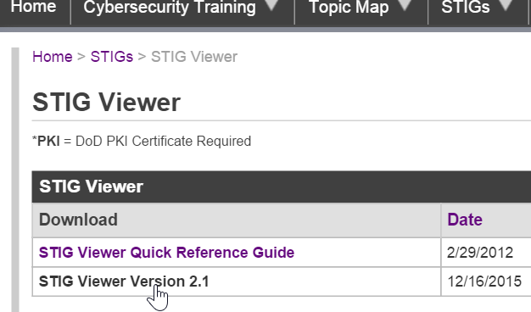
GL: Download STIGViewer2.x
From your local laptop, go to this site...
http://iase.disa.mil/stigs/Pages/stig-viewing-guidance.aspx
...and download the latest version of the STIG Viewer
Notes:
Go to this site...
http://iase.disa.mil/stigs/Pages/stig-viewing-guidance.aspx
...and download the latest version of the STIG Viewer. In this example we are downloading Version 2.1.

Slide 30
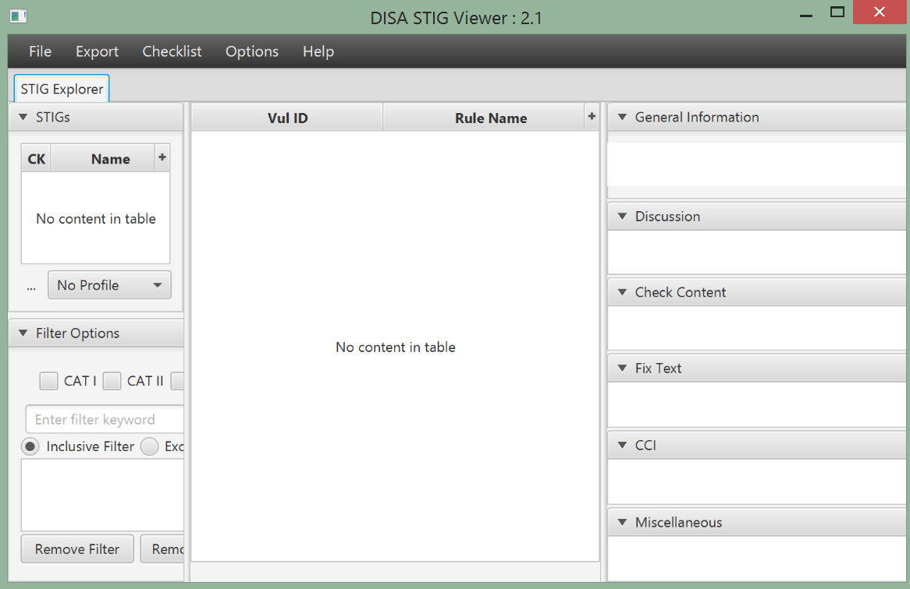
GL: Launch STIGViewer2.x
Click the STIGViewer_2.1 shortcut or otherwise launch the STIGViewer_2.1 viewer.
If it doesn't launch, you may need to install the latest Java Runtime Environment (JRE) as indicated on the next slide.
Notes:
Try to run the STIG Viewer. If it fails due to a Java error, you may need to install the latest Java Runtime Environment (JRE) as indicated on the next slide.

Slide 31
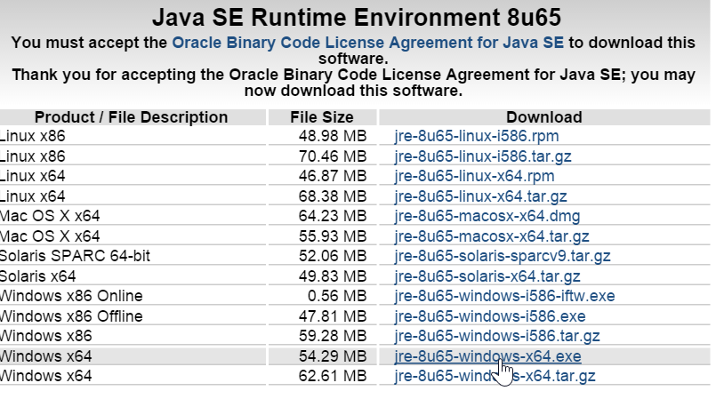
GL: Download Java JRE if Necessary
You may need to install the latest Java Runtime Environment (JRE) if your STIG Viewer doesn't launch when clicked.
http://www.oracle.com/technetwork/java/javase/downloads/jre8-downloads-2133155.html

Slide 32
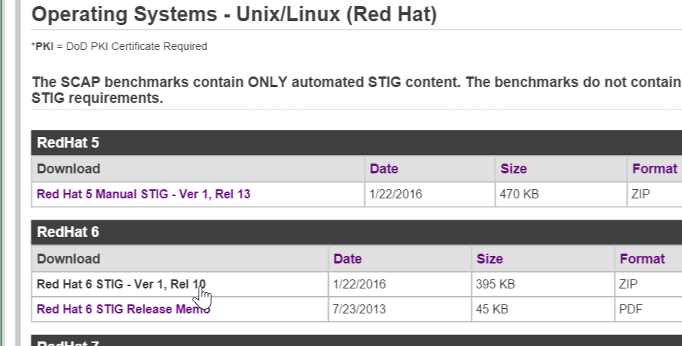
GL: Download STIG Profiles for Red Hat 6
Download the STIG profiles for RHEL 6 from this site and remember the location to where you downloaded onto your laptop.
http://iase.disa.mil/stigs/os/unix-linux/Pages/red-hat.aspx

Slide 33
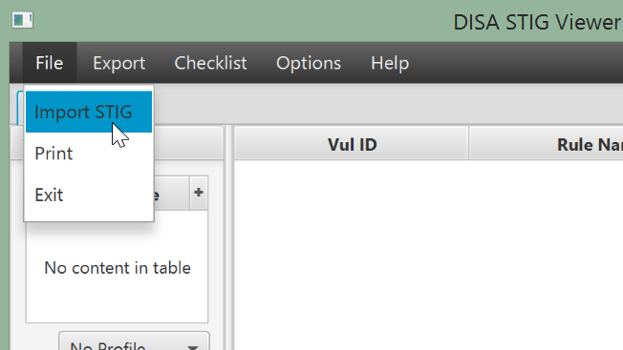
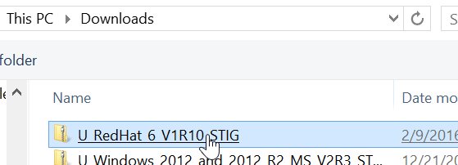
GL: Import STIG Profiles for Red Hat 6
Click File > Import STIG.
Navigate to the STIG profiles file you just downloaded and click the file.

Slide 34
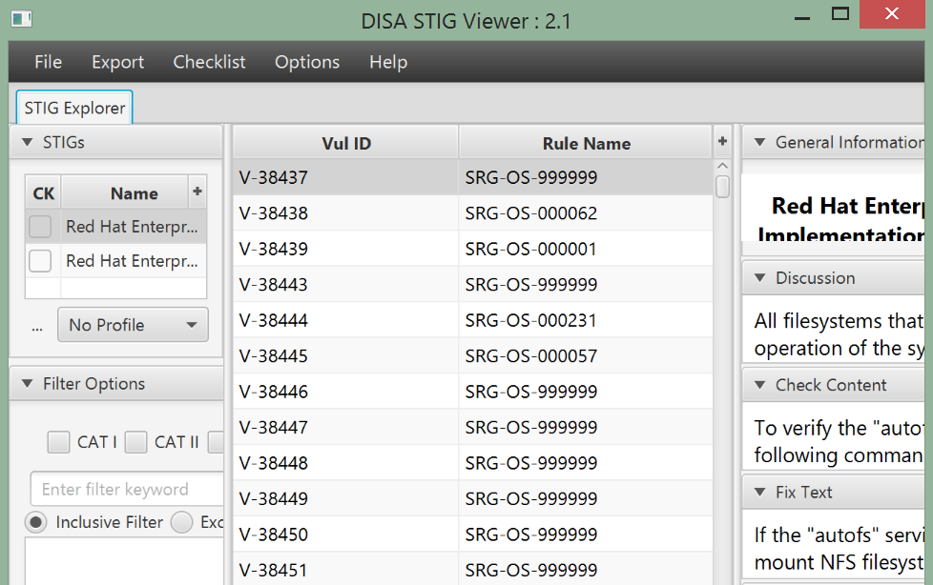
GL: STIG Profiles for Red Hat 6
Your STIG viewer should now be populated with DoD Security Rule profiles.

Slide 35
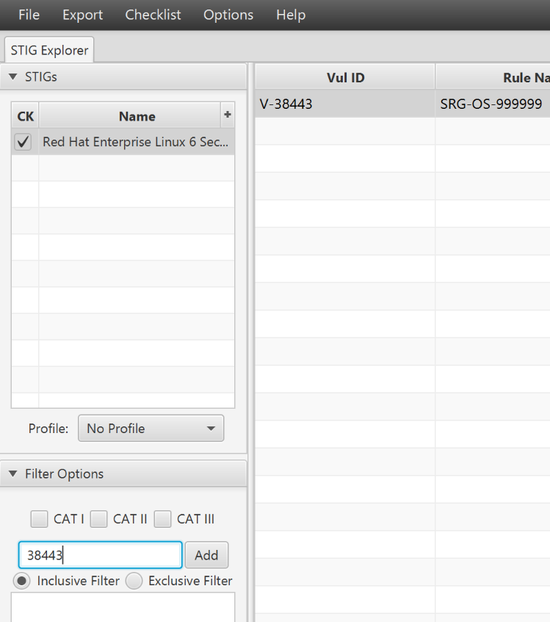
GL: Filter STIG Profiles
Type 38443 in the filter field.
Notice how the center pane now lists only one DoD Security Rule.
Notes:
TBD SCAP Roadmap.

Slide 36
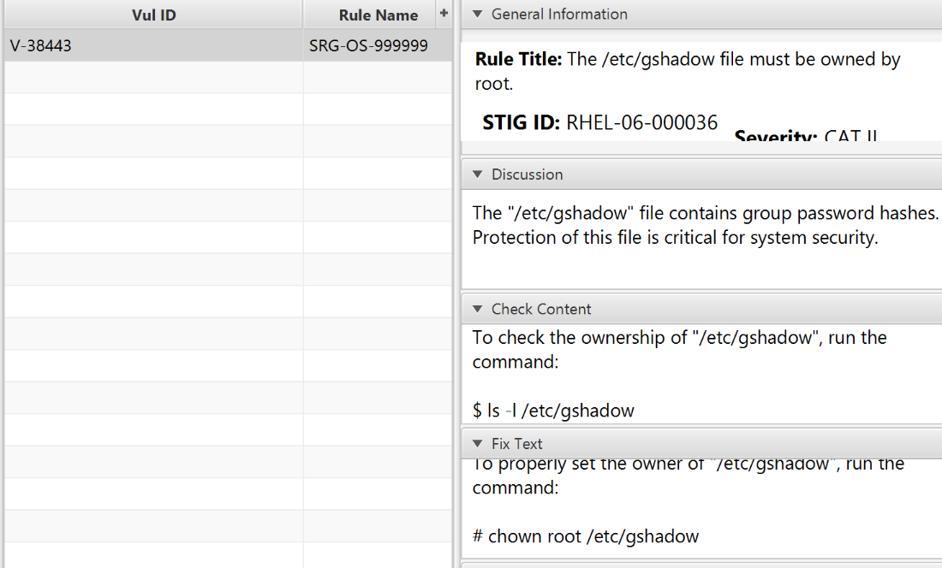
GL: Writing Compliance Profiles from DoD Rules
#The /etc/gshadow file must be owned by root.
#Severity: Medium
#The "/etc/gshadow" file contains group password hashes. Protection of this
#file is critical for system security.
control 'v-38443-gshadow' do
impact 0.5
title 'v-38443: verify gshadow is owned by root'
describe file('/etc/gshadow') do
it { should be_owned_by 'root' }
end
end
Notes:
The image on the right shows the right-side pane of the STIG viewer including the details of this DoD Security rule. This rule states that /etc/gshadow must be owned by root.
The image on the left shows a Chef Compliance Profile that was written based on the details of this DoD Security rule. Notice how the Chef Compliance Profile control name reflects the DoD Security rule name. This is a best practice that you should follow when writing Chef Compliance Profiles for DoD Security rules.

Slide 37
GL: Writing Compliance Profiles from DoD Rules
#The /etc/gshadow file must be owned by root.
#Severity: Medium
#The "/etc/gshadow" file contains group password hashes. Protection of this
#file is critical for system security.
control 'v-38443-gshadow' do
impact 0.5
title 'v-38443: verify gshadow is owned by root'
describe file('/etc/gshadow') do
it { should be_owned_by 'root' }
end
end
If you have permissions you can access a list of predefined DoD controls at this link:
https://github.com/chef/compliance-profiles/tree/DOD-STIG/stig/rhel6/test

Slide 38
DoD STIG References
Windows 2012 - http://iase.disa.mil/stigs/os/windows/Pages/2012.aspx
Unix/Linux (Red Hat) - http://iase.disa.mil/stigs/os/unix-linux/Pages/red-hat.aspx
All Operating Systems - http://iase.disa.mil/stigs/os/Pages/index.aspx

Slide 39
GL: TBD SCAP Roadmap.
Notes:
TBD SCAP Roadmap.

Slide 40
Review Questions
What is ...? ______________________________
Which is the correct answer?
answer
answer
answer
answer
Capable of carrying on a conversation
Explain

Slide 41
GL: Download Java JRE if Necessary
Download STIG profiles for RHEL 6 and Windows 2012 MS (Member Server).
RHEL 6 - http://iase.disa.mil/stigs/os/unix-linux/Pages/red-hat.aspx
Windows 2012 - http://iase.disa.mil/stigs/os/windows/Pages/2012.aspx
Write a compliance profile for RHEL 6 Category 1 benchmarks.
Implement the following Windows 2012 controls: V-1073, V-2374
Notes:
https://chefio.atlassian.net/wiki/pages/viewpage.action?spaceKey=SE&title=Week+1#Week1-Exercises.1
https://chefio.atlassian.net/wiki/display/SE/Week+2+-+Use+Cases#Week2-UseCases-Exercises-CIS

Slide 42
©2016 Chef Software Inc.

