Slide 1
Users, Organizations, Teams and Permissions
Specifying Views and Actions Various Users Have Access To

Slide 2
Objectives
After completing this module, you should be able to:
Create users.
Set user permissions.
Create and apply organizations.
Create Teams.
Set Team permissions.

Slide 3
Managing Users
You can create and edit Compliance Server users.
You can also modify their permission in or to allow or prevent certain actions.
Notes:
As of this writing, the only way to share access to nodes is via teams/organizations.
Permissions / RBAC is used to control what users and organizations can do in the context of chef compliance. You can effectively enable or disable permissions to scan systems, update packages, or manage various aspects of Chef Compliance including users and organizations. see ChefComplianceSalesEngFAQ

Slide 4
Group Lab: Creating Users
Let's learn by doing. We'll stop along the way to explain details.
Create a new Compliance User.
Modify a user's permissions.

Slide 5
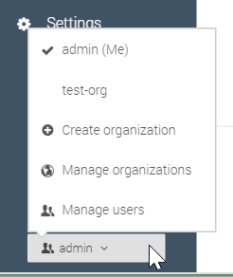
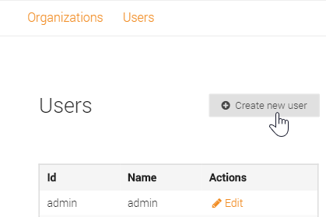
GL: Creating Users
From the bottom-left, click the menu button and then click Manage users.
Click Manage users.
From the resulting screen, click Create new user.

Slide 6
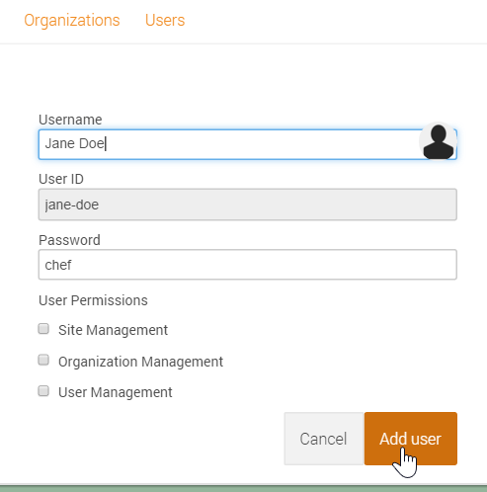
GL: Creating Users
From the resulting screen, type a user name of your choice and a password you'll remember, like chef.
Note: Leave the new user's permissions unchecked for now.
5. Click the Add user button.

Slide 7
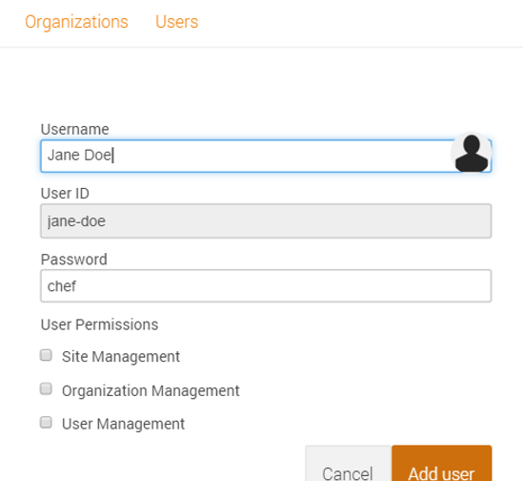
Discussion: Creating Users
A user can have the following permissions:
Site Management users can do everything.
Organization Management users can create, edit or delete Organizations.
User Management users can create, edit or delete users.
Notes:
The Site Management permission can be thought of as Administrator-level permissions. It is like a superset of the Organization Management and the User Management permissions.
We will discuss Organizations and their purpose later in this module.

Slide 8
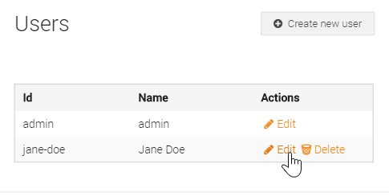
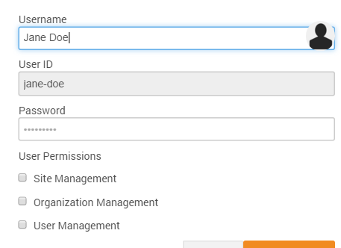
Discussion: Creating Users
Notice from the current Users screen you could edit or delete users.
The bottom image shows the permissions that you can edit for a user.
You could also edit the Username and/or Password but not the user ID.
Reminder: Leave the new user's permissions unchecked for now.
Notes:
Notice that you can't delete the original admin user, however, since you always need at least an admin user.
We will use this new user in the up coming lab exercises.

Slide 9
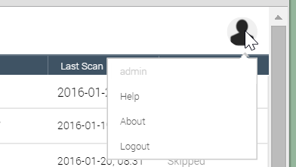
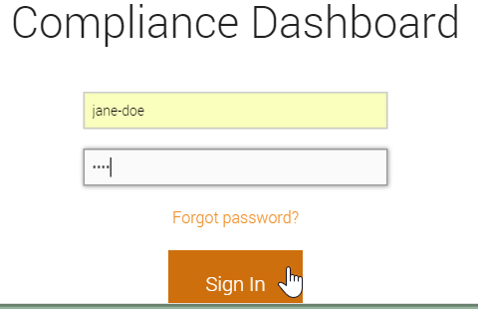
GL: Managing Users
From the top-right of the Compliance web UI, click the User icon and log out.
From the resulting login screen, log in with your new user name.

Slide 10
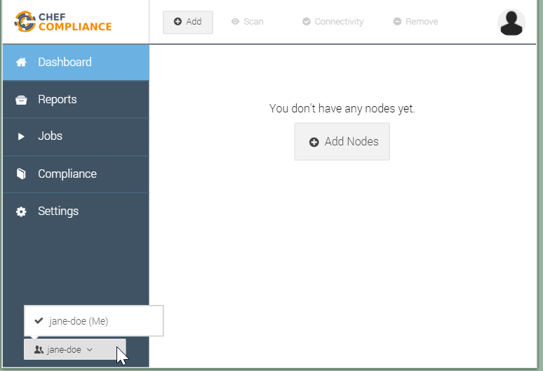
GL: Managing Users
Notice that you cannot access any nodes.
Also notice that your current permissions don't allow you to manage anything.
8. Log out and then log back in as the admin user.

Slide 11
Organizations in Chef Compliance
Organizations are objects that enable you to segregate target nodes and make them accessible to users other than just the admin user.
Before you add nodes that you may want to share with other users, you should first create at least one Compliance Organization and a corresponding Compliance Team to which those nodes will be associated.
Notes:
As of this writing, the only way to share access to nodes from one user's account is via a combination of an Organizations object and its Team object.

Slide 12
Group Lab: Using Organizations and Teams
Let's keep learning by doing. We'll stop along the way to explain details again.
Create an Organization.
Create a Team.
Add a Member to a Team.
Add a Node to an Organization.
Test a Team Member's Access to a Node.

Slide 13
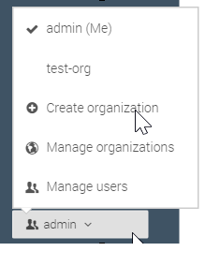
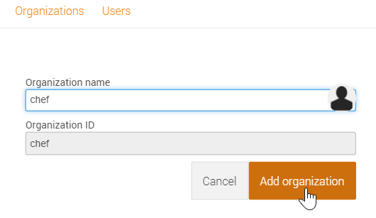
GL: Creating an Organization
From the bottom-left of the Dashboard, click admin > Create Organization.
Type a new organization name (chef) in the Organization name field and then click the Add organization button.

Slide 14
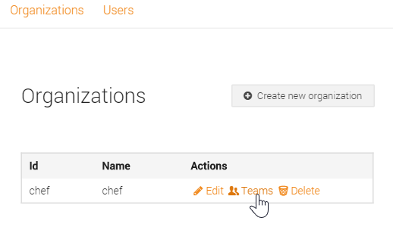
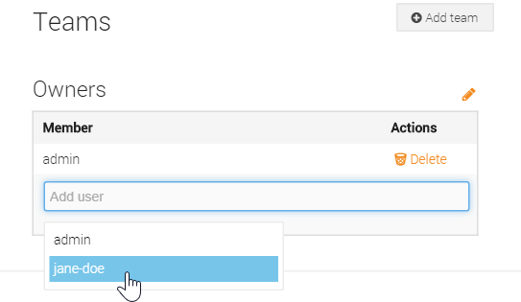
GL: Creating an Organization
From the resulting screen, click the Teams link to add team member to your new organization.
Click the Add user filed and then select your new user name to this team.

Slide 15
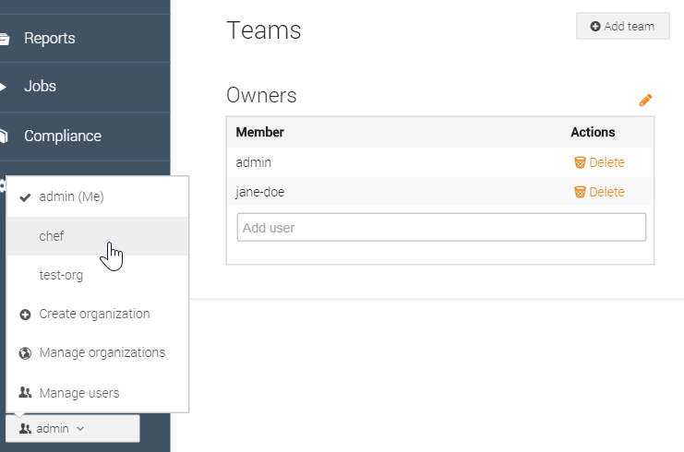
GL: Using Your New Organization
You should now see that your new user name is part of the chef organization's team.
In the next step we'll switch to the new organization so we can add a node to it.
5. From the bottom-left of the web UI, click admin and then click your new organization (chef) to switch to it.

Slide 16
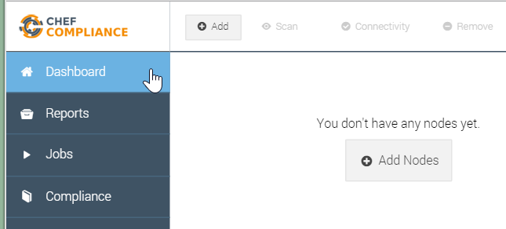
GL: Using Your New Organization
6. Click the Dashboard link and notice that you can no longer see any nodes.
Questions: Where have your previous nodes gone?
Click the Add button to add a node to your organization.
Notes:
Instructor Note: Answer--The nodes have not gone anywhere. They are only accessible under the admin user's default organization, not under this new `chef` organization. In the next steps we'll add a node to our new organization.

Slide 17
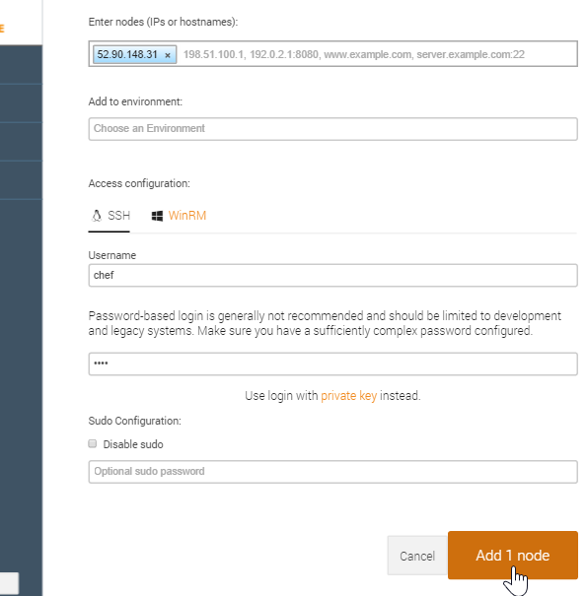
GL: Using Your New Organization
Add one of the target nodes you were assigned at the beginning of this course and then click the Add 1 node button.
Note: Use the same password authentication method as done previously in the course.

Slide 18
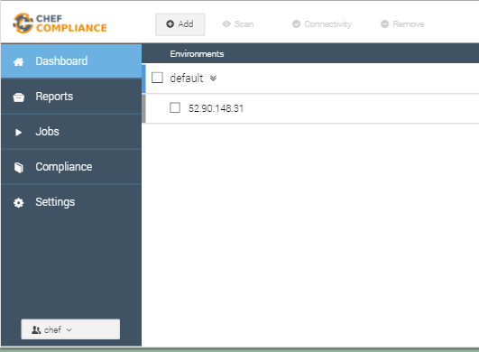
GL: Using Your New Organization
You should now see the node you added to your new chef organization.
You can also determine which organization you are switched to by looking at the bottom-left of the Chef Compliance Dashboard.

Slide 19
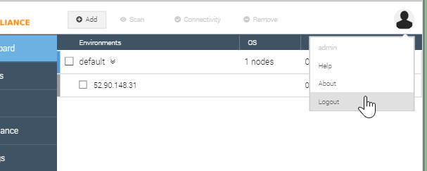
GL: Using Your New Organization
As you may recall, the last time you tried to view nodes while logged into the Compliance Dashboard with your new user name, you could not see any nodes.
8. Log out of the Compliance Dashboard and log back in with your new user name.

Slide 20
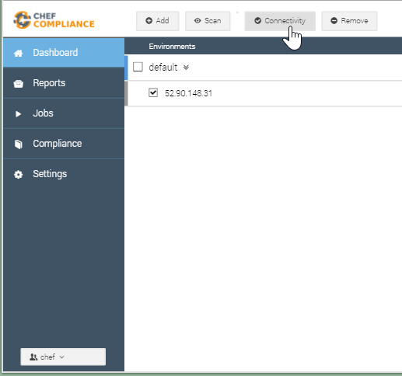
GL: Using Your New Organization
While logged in with your new user name, you should now be able to access the node that was created under your new organization.
Do you remember why this is possible?
Notes:
Instructor Note: Answer--Because your new user name is part of the Team object that is resides under the new (chef) organization.

Slide 21
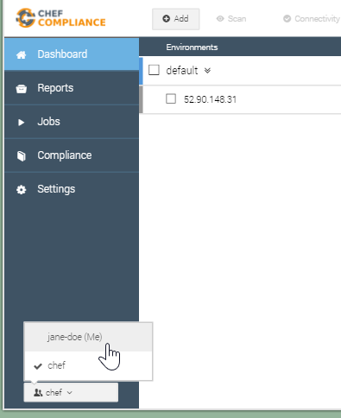
GL: Using Your New Organization
9. From the bottom-left of the Compliance Dashboard, switch back and forth between you new organization and your user name's default organization.
You should only be able to access the nodes that was created under your new organization.

Slide 22
GL: Using Your New Organization
While logged in with your new user name, you should now be able to access the node that was created under your new organization.
Do you remember why this is possible?
Notes:
Instructor Note: Answer--Because your new user name is part of the Team object that is under the new (chef) organization.

Slide 23
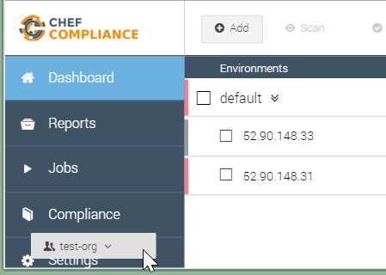
Organizations and Teams
When an organization is created and nodes are created under it, you can then allow users other than just the admin user to access those nodes.
This is done by associating users to a Team object that lives under an Organization object.
Notes:
So to share nodes between different users, they are shared by virtue of a combination of an Organization and a team...because a Team object is a child object of an Organization, correct?1
[8:56]
Therefore, Nodes need to be created under an Organization, and then any team members associate to that Org can see and or manage nodes created under that Org, right?

Slide 24
TODO - permissions.
Everything past this slide is under heavy construction.
Notes:
So to share nodes between different users, they are shared by virtue of a combination of an Organization and a team...because a Team object is a child object of an Organization, correct?1
[8:56]
Therefore, Nodes need to be created under an Organization, and then any team members associate to that Org can see and or manage nodes created under that Org, right?

Slide 25
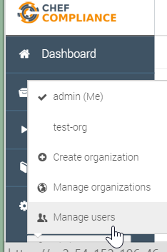
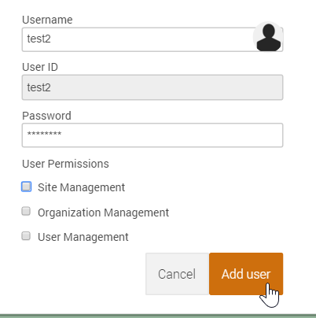
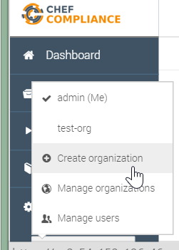
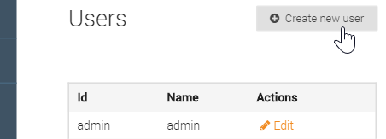
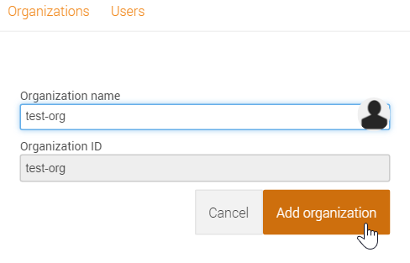
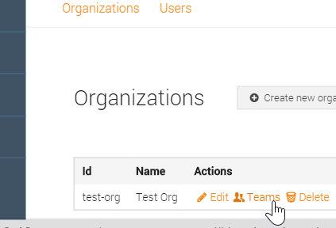
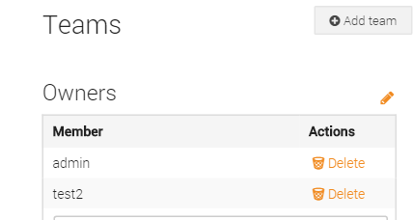
Sharing Nodes via Organizations and Teams
Notes:
Nodes are created under `test-org`.
This is done by associating users a Team object that lives under an Organization object.

Slide 26
Organizations in Chef Compliance
You can also limit other users' ability to manage nodes by setting permissions at the user level, or at the organization's team level.
Team objects reside under the Organization object and will be discussed later in this module.

Slide 27
Nodes and Organizations
You asked about permission management in Chef Compliance: - we distinguish between users and teams - multiple users can be part of a team - if you want to share nodes with multiple users, the nodes need to be part of a team (we do not have a transfer nodes from user to team yet) A user can have the following permissions: - site management - aka administrator, can do everything - organization management - can create, edit or delete orgs - user management - can create, edit or delete users Team: - node management - add, edit or delete nodes - compliance scans - execute scans - patch management - execute patch execution (deactivated by default) - security automation - use cookbooks for remediation (not available yet) I think we need to remove the latest to points until we have finalized the features.(edited)

Slide 28
Group Lab: Managing Users and Permissions
Uploading it so it can be used in scans..
Zip up the new profile.
Upload it to your laptop and then to the Compliance Server.
Notes:
In addition to the uploading procedure we'll do in the exercise, in the workplace you could also upload such custom profiles using an API.

Slide 29
GL: Managing Permissions
OUTLINE
Creating a user
Creating an org - must create nodes while in org.
Teams - have special privleges--orgs seem to own team and in orgs is where you create teams.

Slide 30
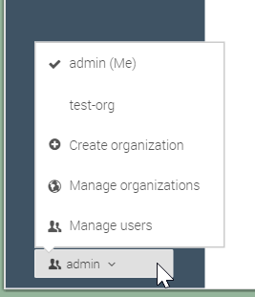
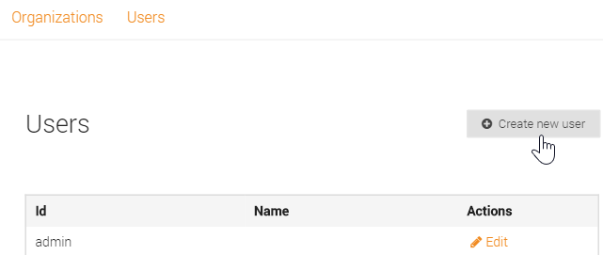
GL: Managing Permissions

Slide 31
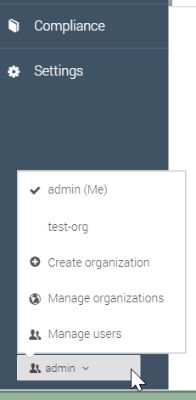
GL: Managing Permissions

Slide 32
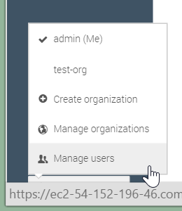
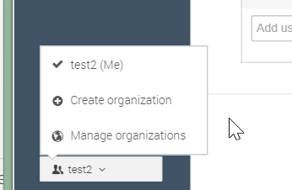
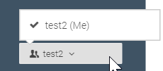
GL: Managing Permissions
1. full perms can mange users, orgs and perms.
2. if i set test2 user perms to only org management
3. if i remove all perms..you can do nothing but view profiles and add keys..

Slide 33
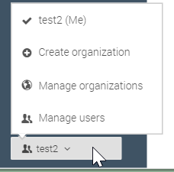
GL: Managing Permissions
1. If i set to site management only can do all?
2. if i set test2 user perms to only org management
3. if i remove all perms..you can do nothing but view profiles and add keys..

Slide 34
GL: Managing Permissions
I got it to work now. Seem that after I switch to a different org, I then need to create/add nodes while in that org.

Slide 35
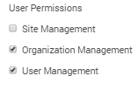
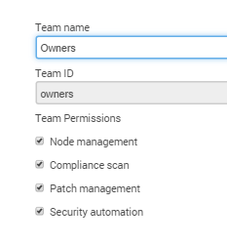
GL: Managing Permissions
can edit or create a node.
HARD refresh
Teams seem to have their own set of permissions. Couple questions please: 1. How does a user's Site Management permissions relate to a Team's Node Management and Compliance Scan permissions?
steve_delfante [11:06 AM] uploaded an image: Pasted image at 2016-01-22, 11:06 AM

Slide 36
Running Reports
mmm
IMPORTING NODES
andrew: you can add nodes using the API, e.g. in bulkhttps://github.com/chef/chef-compliance/blob/master/docs/api_compliance.rst#post-bulk

Slide 37
GE: Creating a Custom Profile
Creating custom profiles to fit your business needs.
Create a custom profile.
Test your profile with InSpec
Notes:
The custom profile you will create will scan nodes to ensure they have a '/tmp' directory and that directory should be owned by the root user.
Note: In the workplace you would likely perform these custom profile tasks on your local workstation and upload them to the Compliance Server. In this class we'll use our target nodes as a workstation to create the profile on since they already have Chef installed on them. Then we'll ultimately upload the customer profile to your Compliance Server.

Slide 38
GE: Create a Directory for your Profile
$ mkdir -p ~/compliance_profiles/profile_01
$ cd ~/compliance_profiles/profile_01
Notes:
On your target node, create a directory for your profiles and the move into that new directory.
$ `mkdir -p ~/compliance_profiles/profile_01`
$ `cd ~/compliance_profiles/profile_01'
Reminder: In the workplace you would likely perform this task TBD

Slide 39
GE: Uploading the Custom Profile to the Compliance Server
Uploading it so it can be used in scans..
Zip up the new profile.
Upload it to your laptop and then to the Compliance Server.
Notes:
In addition to the uploading procedure we'll do in the exercise, in the workplace you could also upload such custom profiles using an API.

Slide 40
Review Questions
What is ...? ______________________________
Which is the correct answer?
answer
answer
answer
answer
Capable of carrying on a conversation
Explain

Slide 41
©2016 Chef Software Inc.

