Slide 1
Initial Configuration and Running Scans
Configuring the Chef Compliance Server to Run Scans

Slide 2
Objectives
After completing this module, you should be able to:
Add a node to test for compliance.
Use the password connection option.
Run a Connectivity test
Run a Compliance scan.
Interpret scan results.
Explain where to set up security key pairs.

Slide 3
Adding a Node to Test
Adding a node is a fairly straightforward process. You'll need:
The IP address or FQDN of the nodes to be tested.
Access configuration (ssh or WinRM).
The node's username and password OR
The node's username plus security key pair.

Slide 4
Group Exercise: Adding a Node to Scan
Add a Node to Scan
Test connectivity
Run an initial scan

Slide 5
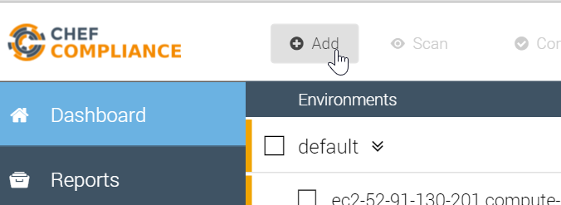
GE: Adding a Node to Scan
From your Chef Compliance Dashboard, click Add Node.

Slide 6
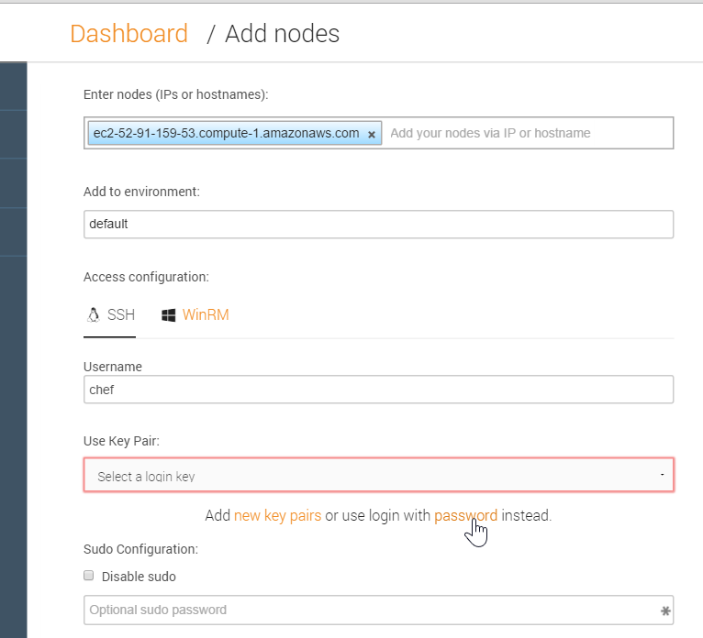
GE: Adding a Node
From the resulting page, enter the node's FQDN or IP address.
Select the default environment.
Accept the default SSH Access configuration
Type chef in the username field.
Click the password link as shown in this illustration.
Notes:
In the workplace, the node's username and password will likely be different than shown in this example.
We'll discuss using key pair access later in the module.

Slide 7
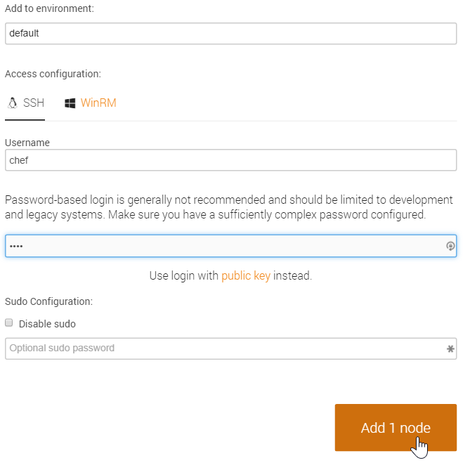
GE: Adding a Node to Scan
Type the password (chef) in the password field.
Click the Add 1 node button as shown in this illustration.

Slide 8
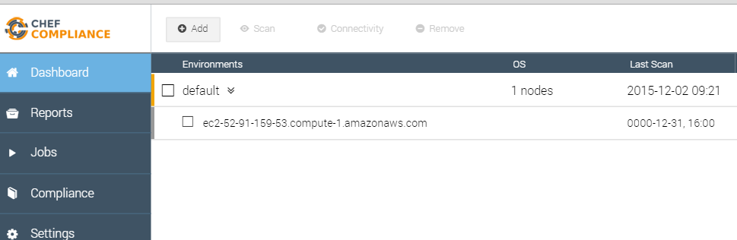
GE: Adding a Node to Scan
At this point your Compliance Dashboard should list the node you just added.

Slide 9
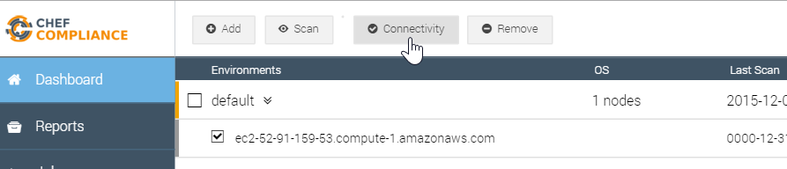
GE: Testing Connectivity to your Node
Click the check box next to your node and then click the Connectivity button.

Slide 10
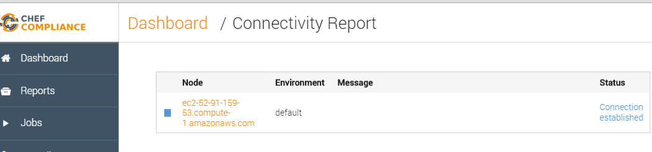
GE: Testing Connectivity to your Node
The Status column of you node should now indicate Connection established.
Notes:
If your Status column does not indicate Connection established, please notify the instructor.

Slide 11
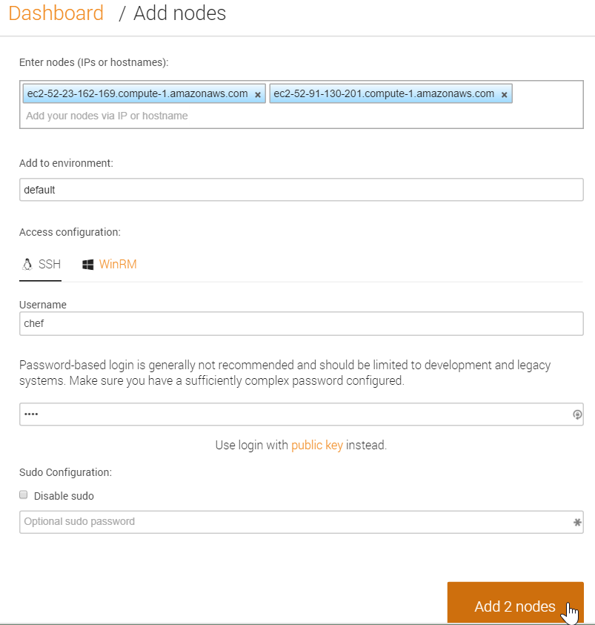
Adding Nodes in Bulk
As you may have noticed, you could add additional nodes by simply repeating the previous steps.
You could also add nodes in bulk by separating each hostname or IP address with a comma or a space, as shown in this illustration.
Notes:
As you may have noticed, you could add additional nodes by simply repeating the previous steps and entering the new nodes' IP addresses or FQDNs.
You could also add nodes in bulk by separating each hostname or IP address with a comma or a space as shown in this illustration.

Slide 12
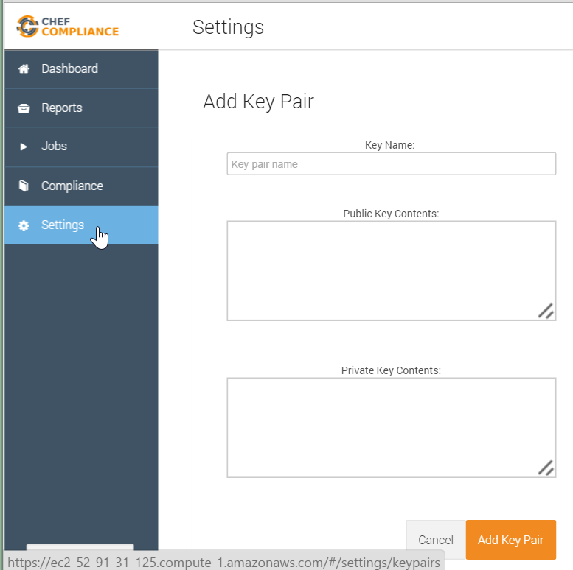
Key Pairs
In the workplace, using security key pairs would be a more secure method for connecting to nodes than using the password method.
By clicking Settings > Add New Key Pair you will see where to paste your private and public keys.
Notes:
In the workplace, using security key pairs would be a more secure method for connecting to nodes than using the password method we are using in class.
By clicking Settings > Add New Key Pair you will see where to past your private and public keys.

Slide 13
Running Compliance Scans
You can run Compliance scans on demand or schedule them to run at a later time.
Chef Compliance maintains profiles as a collection of individual controls that comprise a complete audit.
As mentioned previously, Compliance profiles exist for many scenarios, such as those created by the Center for Internet Security (CIS).

Slide 14
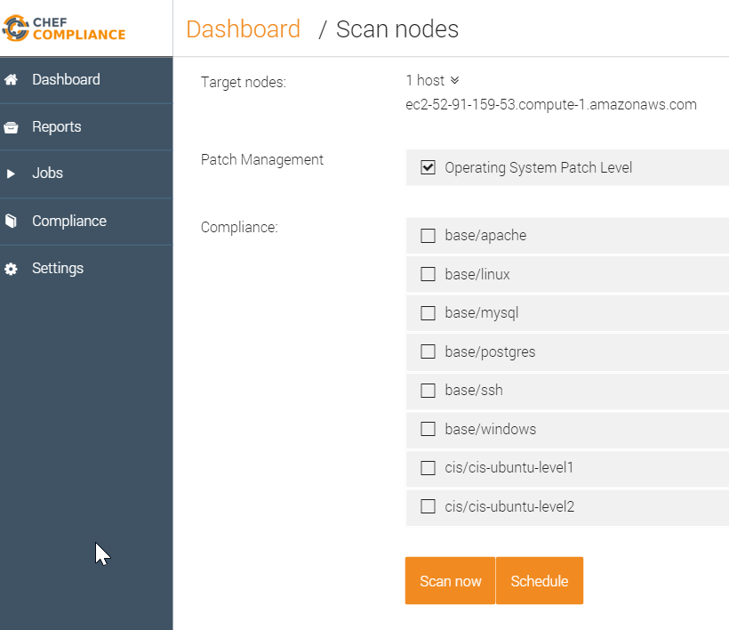
Compliance Profiles Used in Scans
This image shows the default Compliance Profiles as accessed from the Scan Nodes page.
You should be thoughtful with which profiles choose.
Notice how you can also choose to run a scan on demand or schedule a scan.
Notes:
This image shows the default Compliance Profiles as accessed from the Scan Nodes page. This page displays when you select nodes to scan and then click the Scan button.
You'll access the profiles in a moment. These profiles determine what will be scanned on your nodes.
You should be thoughtful with which profiles choose since the more you choose to run, the longer it will take to execute the scan.
Notice how you can also choose to run a scan on demand (Scan now) or schedule a scan to run at a later time.

Slide 15
Group Exercise: Running a Scan
Run a Compliance scan.
View the output of a scan.

Slide 16
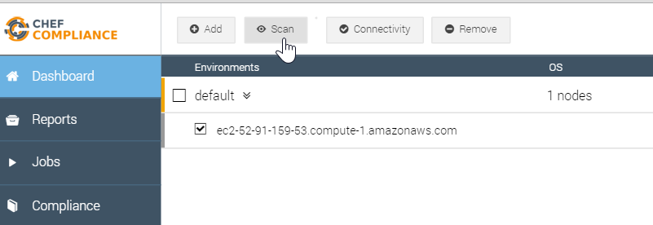
GE: Running a Scan
Click the check box next to your node and then click the Scan button.

Slide 17
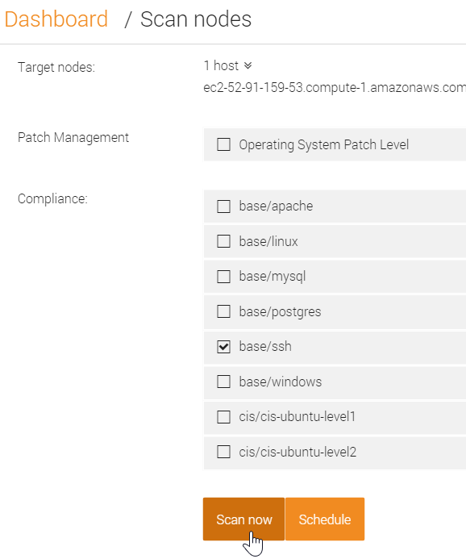
GE: Running a Scan
From the resulting page, check the base/ssh profile and uncheck any other check boxes.
Click the Scan now button.

Slide 18
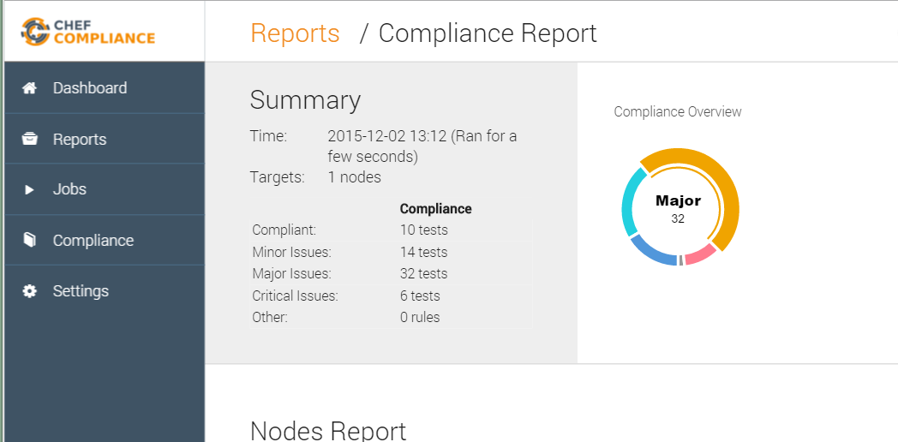
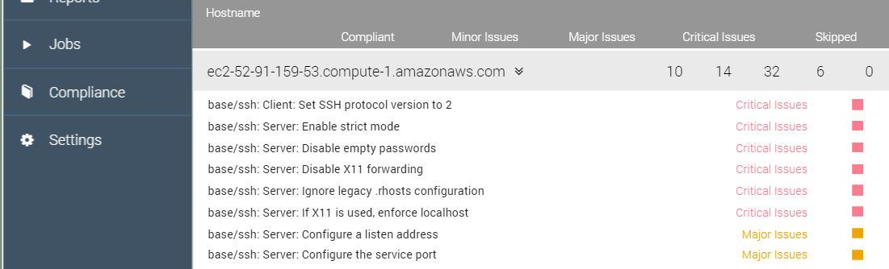
Scan Results
A Compliance Report should now display and your scan results should be similar to that shown here.
Notice how in the upper Summary section in this example, 10 tests were compliant and 6 tests show critical issues with ssh.
Notes:
There are also 6 critical issues related to ssh on the target node.
Instructor Note: This and the following slide should be used for a discussion of the scan results. The group exercise continues after that.

Slide 19
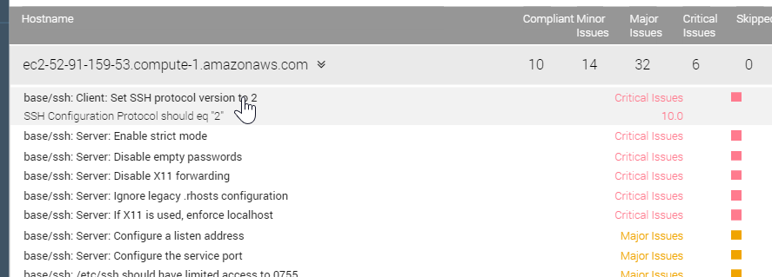
Scan Results
The bottom half of the Compliance Report shown here has a table of details of test results.
These are sorted by severity.
If you click an issue as shown here, a bit more information about the issue displays.
Notes:
The bottom half of the Compliance Report has a table of details of test results.
These are sorted by severity so the critical issues are listed at the top and the compliant items are at the bottom of the list.
If you click an issue as shown here, a bit more information about the issue displays, but that's not really telling us much.

Slide 20
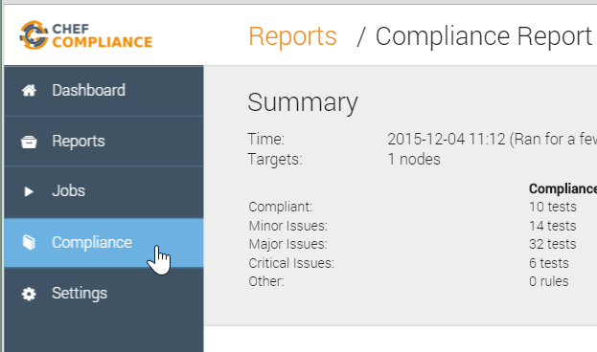
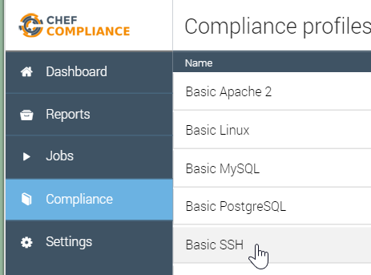
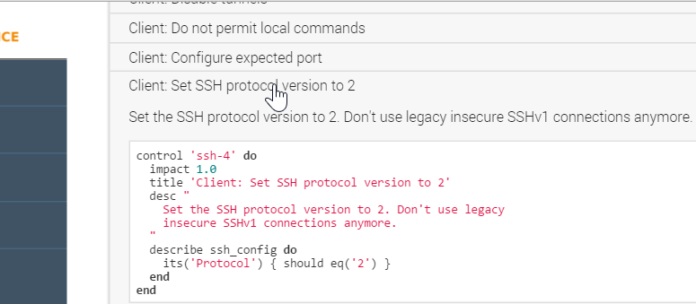
GE: Scan Results
To view the InfoSpec code that comprises this profile, do the following:
Click the Compliance button.
Click the relevant profile (Basic SSH).
Scroll down and click the `Set SSH protocol version to 2` profile.
Notes:
Instructor Note: Now we continue the group exercise but you should stop as needed to explain what this code means.

Slide 21
GE: Scan Results
Let's discuss what this profile is doing.
The impact of 1.0 indicates this is a Major issue.
The title is what populates the Compliance Report issue title.
The describe section is the actual test.
Notes:
Let's discuss what this profile is doing.
The impact of 1.0 indicates this is a Major issue.
The title is what populates the Compliance Report issue title.
The describe value is the actual test. In this case, this is saying the protocol for ssh_config should be 2. If the actual value from the node is not Protocol 2, the Major issue is reported as in this case.

Slide 22
Adding a

Slide 23
Need explanation of scan results here.

Slide 27
i believe so. that's how i have it running, i've also been running a reconfigure and restart after i upgrade the package
​[9:04 AM]
steve_delfante `sudo chef-compliance-ctl reconfigure` will reconfigure it but s=does that also restart it?
new messages
​[9:04 AM]
kennon not always, you should also run `sudo chef-compliance-ctl restart

Slide 28
Review Questions
What is ...? ______________________________
Which is the correct answer?
answer
answer
answer
answer
Capable of carrying on a conversation
Explain

Slide 29
©2016 Chef Software Inc.

