Slide 1
Chef Compliance Installation, Configuration, and Operation
Introduction
Notes:
Instructor Note: Be sure to read Appendix Z at the end of this instructor guide for training lab set up notes and additional instructor notes. This course requires ChefDK 0.10.0 on or higher on the AMIs.
TBD IMPORTANT: We need to build the shell init stuff for chef dk in to the AMI images.
echo 'eval "$(chef shell-init bash)"' >> ~/.bash_profile then log out and in.
https://docs.chef.io/install_dk.html
Kennon thinks we need to put the chef user in the dockerroot group and make /var/run/docker.sock's group dockerroot in the future training images.
my TEMP fix: chef@ip-172-31-7-193 run]$ sudo chmod 777 docker.sock
Nathan: The images I’ve used were built with a chef provisioning script
The issue is this: inspec exec ~/cookbooks/ssh/test/integration/client/inspec/client_spec.rb -t docker://CONTAINER_ID wont run witrhout permissions error nor ps docker without sudo.
See module 3 "GE: Running InSpec from the CLI" slide and notes.

Slide 2
Introduce Yourselves
Name
Current job role
Previous job roles/background
Experience with Chef and/or config management

Slide 3
Objectives
After completing this course, you should be able to:
Describe the capabilities of Chef Compliance.
Install and initially configure the Chef Compliance server.
Perform scans with Chef Compliance.
Remediate compliance issues.
Schedule and run compliance reports.
Use InSpec to create, modify, and test Chef Compliance profiles.
Manage users, organizations, teams and permissions
Note: You should have attended at least Chef Essentials, Chef Fundamentals or have equivalent Chef experience prior to attending this course.
Notes:
Instructor Note: You can tell the students that this course covers scanning and remediating both Linux and Windows nodes. For example, module 03 covers scanning and remediating Linux nodes and module 04 covers scanning and remediating Windows nodes. However, the Compliance server runs only on Linux.

Slide 4
Chef Compliance Value Proposition
You are probably aware of how Chef automates the configuration and management of your infrastructure. But what about risks and compliance?
Regulatory compliance is a fact of life for every enterprise.
With Chef Compliance you can scan for risks and compliance issues with easy-to-understand, customizable reports and visualization.
Notes:
By now you are probably aware of how Chef automates the configuration and management of your infrastructure. But what about risks and compliance issues of your infrastructure?
Regulatory compliance is a fact of life for every enterprise. With Chef Compliance you can scan for risks and compliance issues with easy-to-understand, customizable reports and visualization.
You can then use Chef to automate the remediation of issues and use Chef Compliance to implement a continuous audit of applications and infrastructure.

Slide 5
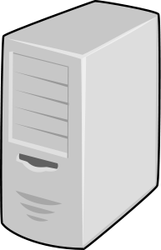
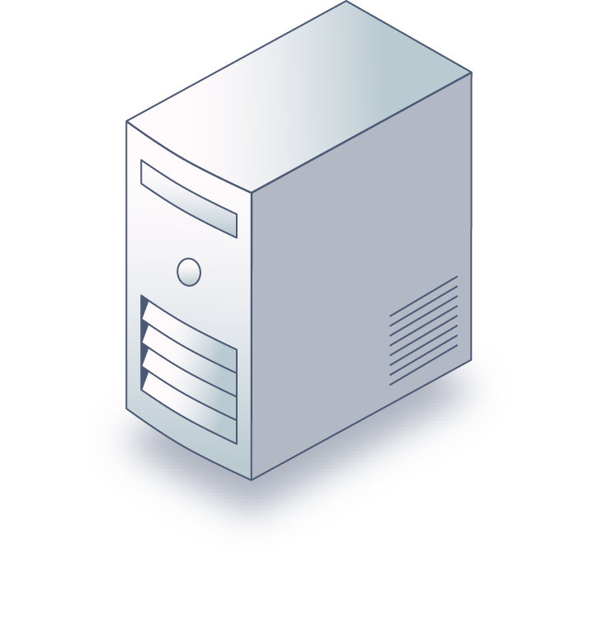
Chef Compliance
LAN/WAN
Chef Compliance Server
Your Infrastructure
Notes:
The Chef Compliance server is a centralized location from which all aspects of the state or your infrastructure’s compliance can be managed.
With Chef Compliance you can test any node in your infrastructure, including all of the common UNIX and Linux platforms and most versions of Microsoft Windows.
Chef Compliance can continuously test any node against the goals of your organization’s security management lifecycle for risks and compliance issues.

Slide 6
Chef Compliance
Chef Compliance can run without any other Chef software installed.
The nodes you scan don't even need Chef software on them if you are merely scanning them for compliance.
However, you would need Chef software to create and implement remediation recipes.
Notes:
Chef Compliance can run without any other Chef software installed on the Chef Compliance server machine.
The nodes you scan don't even need Chef software on them if you are merely scanning them for compliance.
However, you would need Chef software to create and implement remediation recipes if you choose to use recipes to remediate compliance issues.

Slide 7
Chef Compliance
Reports: Chef Compliance can produce reports that indicate risks and issues classified by severity and impact levels.
Compliance Profiles: You can get started quickly with pre-built profiles for CIS, Linux, and Windows.

Slide 8
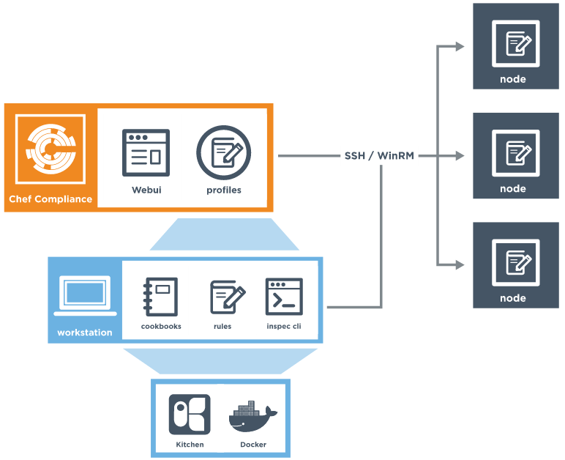
Chef Compliance and InSpec
Chef Compliance leverages InSpec.
InSpec is an open-source run-time framework and rule language used to specify compliance, security, and policy requirements for testing any node in your infrastructure.
Notes:
Chef Compliance leverages InSpec.
InSpec is an open-source run-time framework and rule language used to specify compliance, security, and policy requirements for testing any node in your infrastructure. The InSpec name refers to “infrastructure specification
InSpec includes a collection of resources to help you write auditing rules quickly and easily using the Compliance DSL.
Use InSpec to examine any node in your infrastructure; run the tests locally or remotely.
Any detected security, compliance, or policy issues are flagged in a log and displayed in reports.
The InSpec audit resource framework is fully compatible with Chef Compliance.
Instructor note: InSpec is similar to ServerSpec but learners who have no experience with Serverspec may be confused by the reference.

Slide 9
InSpec DSL
InSpec includes a collection of resources to help you write auditing rules quickly and easily using the Compliance DSL
Use InSpec to examine any node in your infrastructure; run the tests locally or remotely.
Any detected security, compliance, or policy issues are flagged in a log and in Chef Compliance, displayed in a GUI.
describe port(80) do
it { should_not be_listening }
end
describe port(443) do
it { should be_listening }
its('protocols') {should include 'tcp'}
end

Slide 10
InSpec DSL
The InSpec audit resource framework is fully compatible with Chef Compliance.
The Compliance DSL is a Ruby DSL for writing audit rules, which includes audit resources that you can invoke.
describe port(80) do
it { should_not be_listening }
end
describe port(443) do
it { should be_listening }
its('protocols') {should include 'tcp'}
end

Slide 11
Compliance Profiles
Compliance profiles exist for many scenarios, such as those created by the Center for Internet Security (CIS)
Chef Compliance maintains profiles as a collection of individual controls that comprise a complete audit.
You can also create your own custom Compliance profiles.
Notes:
Compliance profiles exist for many scenarios, such as those created by the Center for Internet Security (CIS), a non-profit organization that is focused on enhancing the cyber security readiness and response of public and private sector entities.
Chef Compliance maintains profiles as a collection of individual controls that comprise a complete audit. For example, CIS benchmark 8.1.1.1 recommends testing for the maximum size of the audit log.
You can also create your own custom Compliance profiles.

Slide 12
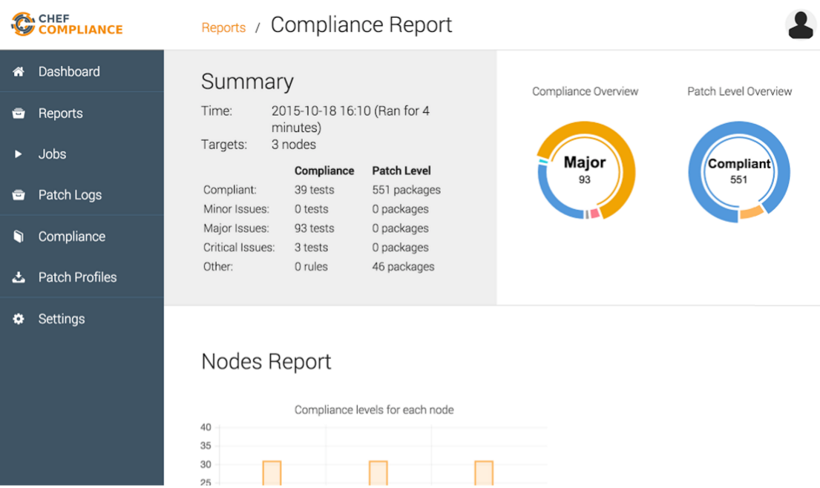
Compliance Web UI
The Chef Compliance web UI provides views into compliance scan results as well as views of Chef Compliance profiles.
You execute scans via the Compliance web UI.

Slide 13
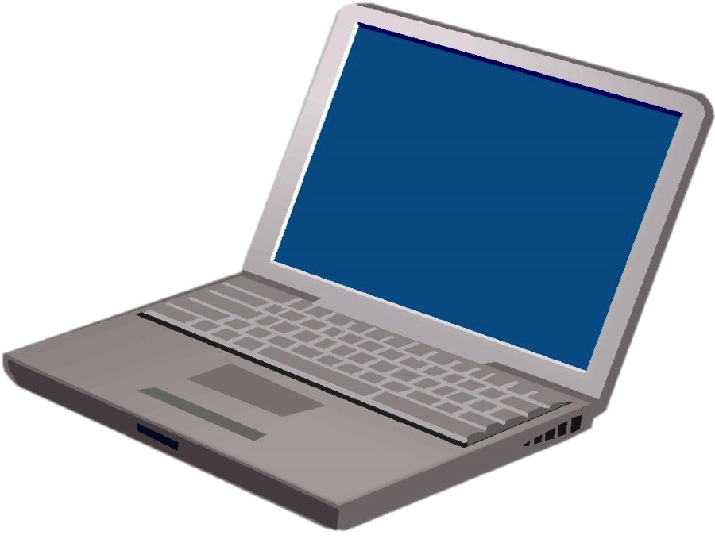
Your Lab Environment for Scanning
We will provide three machines for you to use while performing lab exercises in this course:
One Linux server to install and run Chef Compliance on.
One Windows node and one Linux node to perform Chef Compliance scans against.
Compliance Scans
ssh and HTTP
Server on which to install Chef Compliance
Nodes to run Compliance tests against
Your Laptop
Notes:
These are basic AWS AMIs that we use for Chef training. They have ChefDK installed on them although Chef does not actually need to be installed on these instances in order to run scans.
Instructor Note: Now would be a good time to distribute the hostnames of the three nodes you will assign to each student. You should ask the students to note which one they will use as their Compliance Server and which ones they will use as the target nodes for scans.
For example: ec2-52-91-31-125.compute-1.amazonaws.com = Compliance server.
ec2-54-164-54-218.compute-1.amazonaws.com = Linux Target node.
ec2-54-164-54-210.compute-1.amazonaws.com = Windows Target node.
The login credentials for the Linux nodes is chef/TBD.
The login credentials for the Windows nodes is Administrator/TBD.

Slide 14
Your Lab Environment for Remediation
Compliance
Server
You will also log in to your Windows and Linux nodes in order to write remediation and run chef-client in local mode.
This is so you can use those nodes as virtual workstations while writing remediation.
Linux
Win
ssh
Nodes to run Compliance tests against AND use as workstations for writing remediation
Windows Remote Desktop
Your Laptop
Notes:
The dotted lines indicate that those sessions will only be used to write and test remediation. In this scenario, your target nodes will act as virtual workstations.
But all scans will only be run via the Compliance server as indicated in the previous slide.

Slide 15
Logging in to the Compliance Server and Linux Node
$ ssh ADDRESS -l chef
Notes:
This is just an explanation. You don't need to log in to these machines at this time.
You should use an ssh client like PuTTY or a local command prompt to connect to the remote workstation that we assign to you.
Instead of the command shown in this slide, you could also use this command:
ssh chef@IPADDRESS
For example: ssh chef@52.90.140.22

Slide 16
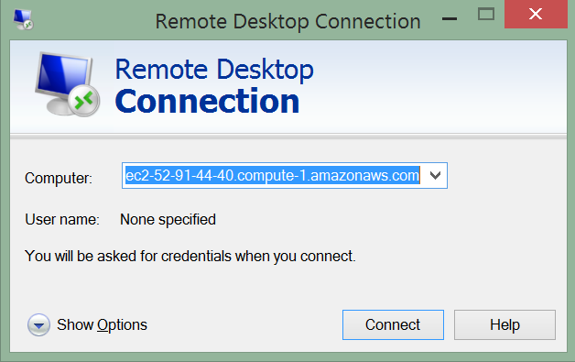
Logging in to the Remote Windows Node
Notes:
This is just an explanation. You don't need to log in to these machines at this time.
You should have installed on your laptop a Windows Remote Desktop Connection which you'll only use to write remediation later in this course.

Slide 17

Hands-on Legend
GL or Group Lab: All participants and the instructor do this task together with the instructor often leading the way and explaining things as we proceed.
Lab: You perform this task on your own.

Slide 18
©2016 Chef Software Inc.

