Slide 1
Initial Configuration and Running Scans
Configuring the Chef Compliance Server to Run Scans

Slide 2
Objectives
After completing this module, you should be able to:
Add a node to test for compliance.
Use the password connection option.
Run a Connectivity test
Run a Compliance scan.
Set up Compliance key pairs.

Slide 3
Adding a Node to Test
Adding a node is a fairly straightforward process. You'll need:
The IP address or FQDN of the nodes to be tested.
Access configuration (ssh or WinRM).
The node's username and password OR
The node's username plus security key pair.

Slide 4
Group Exercise: Adding a Node to Scan
Add a Node to Scan
Test connectivity
Run an initial scan

Slide 5
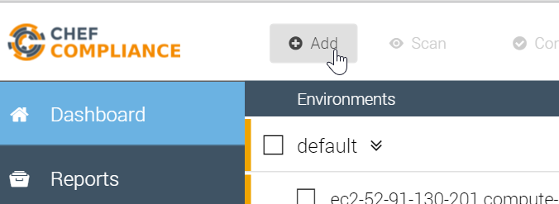
GE: Adding a Node to Scan
From your Chef Compliance Dashboard, click Add Node.

Slide 6
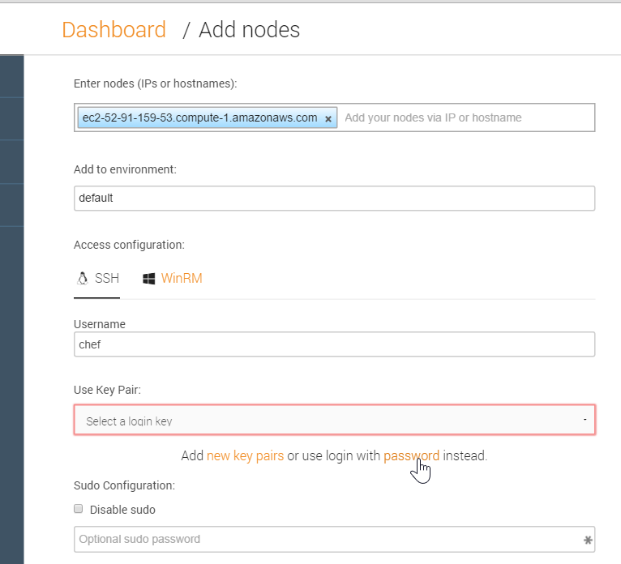
GE: Adding a Node
From the resulting page, enter the node's FQDN or IP address.
Select the default environment.
Accept the default SSH Access configuration
Type chef in the username field.
Click the password link as shown in this illustration.
Notes:
In the workplace, the node's username and password will likely different than shown in this example.

Slide 7
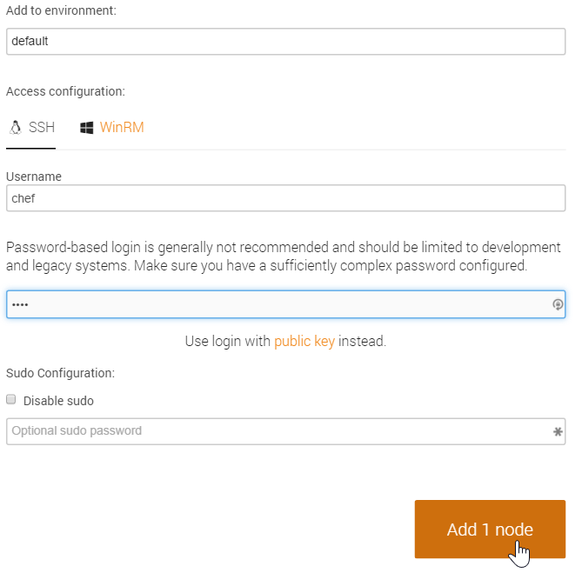
GE: Adding a Node to Scan
Type the password (chef) in the password field.
Click the Add 1 node button as shown in this illustration.

Slide 8
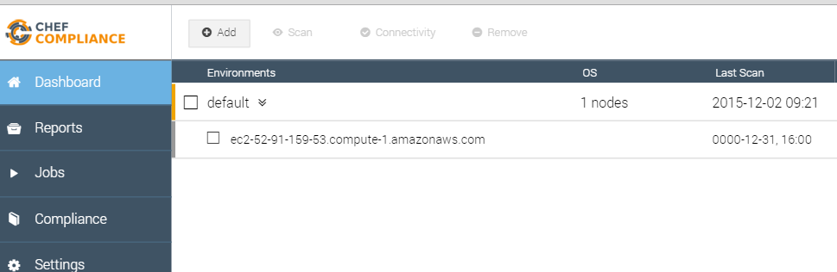
GE: Adding a Node to Scan
At this point your Compliance Dashboard should list the node you just added.

Slide 9
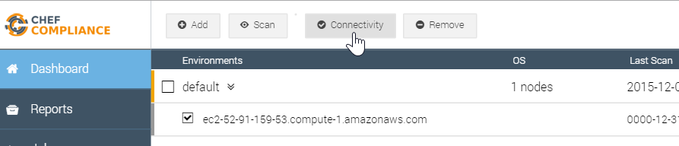
GE: Testing Connectivity to your Node
Click the check box next to your node and then click the Connectivity button.

Slide 10
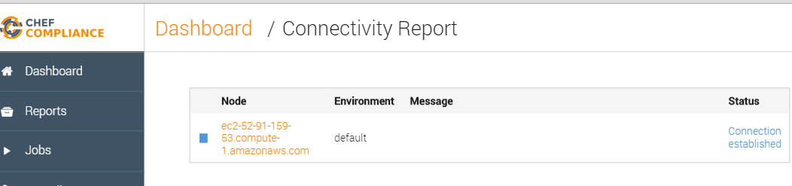
GE: Testing Connectivity to your Node
The Status column of you node should now indicate Connection established.
Notes:
If your Status column does not indicate Connection established, please notify your instructor.

Slide 11
As you may have noticed, you could add additional nodes by simply repeating the previous steps and entering the new nodes' IP addresses or FQDNs.

Slide 12
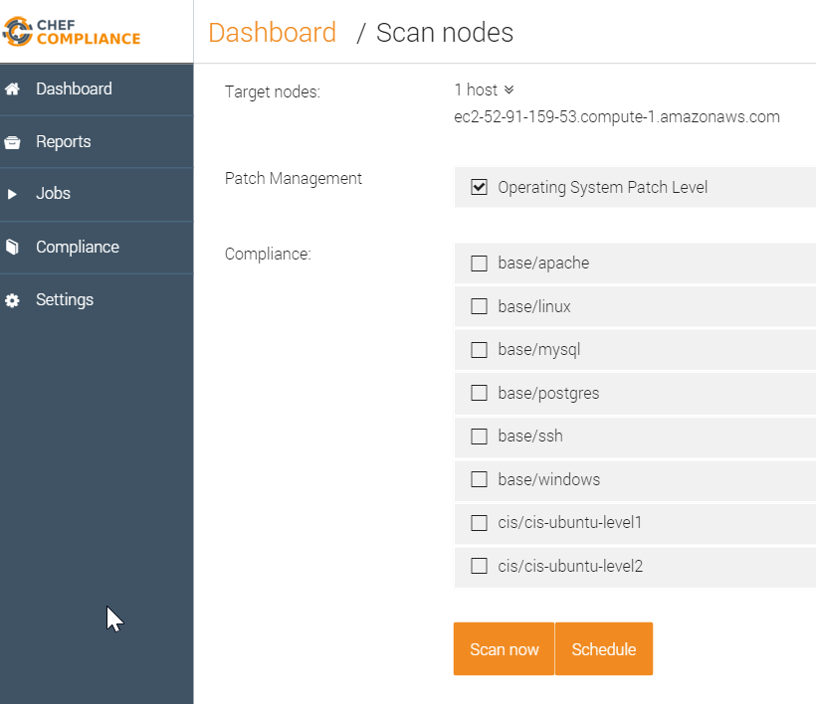
Compliance Profiles Used in Scans
This image shows the default Compliance Profiles.
You should be thoughtful with which profiles choose.
Notice how you can also choose to run a scan on demand or schedule a scan.
Notes:
This image shows the default Compliance Profiles that are included with the Chef Compliance server. You'll access the profiles in a moment. These profiles determine what will be scanned on your nodes.
You should be thoughtful with which profiles choose since the more you choose to run, the longer it will take to execute the scan.
Notice how you can also choose to run a scan on demand (Scan now) or schedule a scan to run at a later time.

Slide 13
Group Exercise: Running a Scan
Run a Compliance scan.
View the output of a scan.

Slide 14
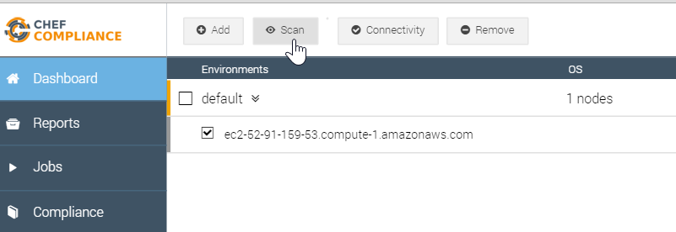
GE: Running a Scan
Click the check box next to your node and then click the Scan button.

Slide 15
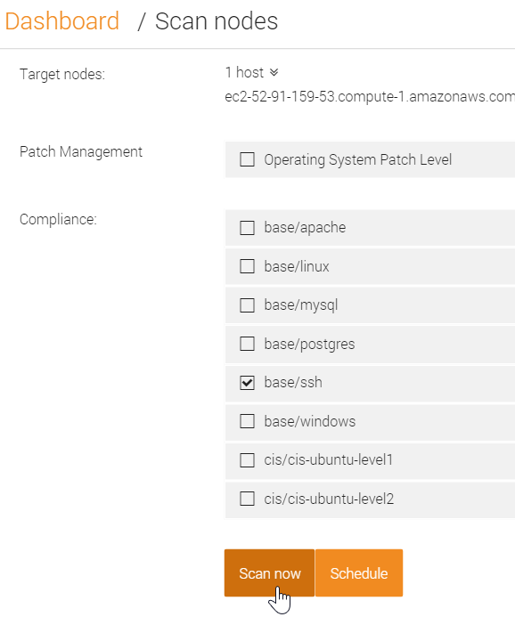
GE: Running a Scan
From the resulting page, check the base/ssh profile and uncheck any other check boxes.
Click the Scan now button.

Slide 16
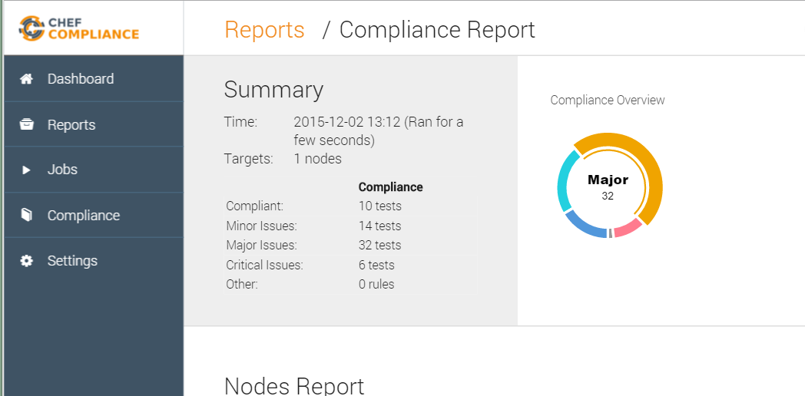
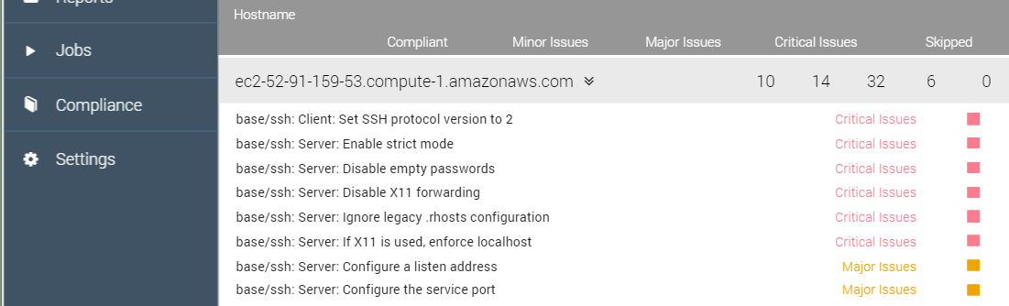
Scan Results
A Compliance Report should now display and your scan results should be similar to that shown here.
TBD- Show how to view this Compliance Report at a later time.

Slide 17
Need explanation of scan results here.

Slide 21
i believe so. that's how i have it running, i've also been running a reconfigure and restart after i upgrade the package
​[9:04 AM]
steve_delfante `sudo chef-compliance-ctl reconfigure` will reconfigure it but s=does that also restart it?
new messages
​[9:04 AM]
kennon not always, you should also run `sudo chef-compliance-ctl restart

Slide 22
Review Questions
What is ...? ______________________________
Which is the correct answer?
answer
answer
answer
answer
Capable of carrying on a conversation
Explain

Slide 23
©2016 Chef Software Inc.

