Slide 1
Chef Compliance Installation, Configuration, and Operation
Introduction
Notes:
Instructor Note: Be sure to read Appendix Z at the end of this instructor guide for training lab set up notes and additional instructor notes.

Slide 2
Introduce Yourselves
Name
Current job role
Previous job roles/background
Experience with Chef and/or config management

Slide 3
Objectives
After completing this course, you should be able to:
Explain the Chef Compliance workflow
Install the Chef Compliance server
Configure the Chef Compliance server
Create and modify Chef Compliance profiles
Perform tests with Chef Compliance
View compliance statistics for a node

Slide 4
Chef Compliance
The Chef Compliance server is a centralized location from which all aspects of the state or your infrastructure’s compliance can be managed.
With Chef Compliance you can test any node in your infrastructure, including all of the common UNIX and Linux platforms and most versions of Microsoft Windows.
Chef Compliance can continuously test any node against the goals of your organization’s security management lifecycle.

Slide 5
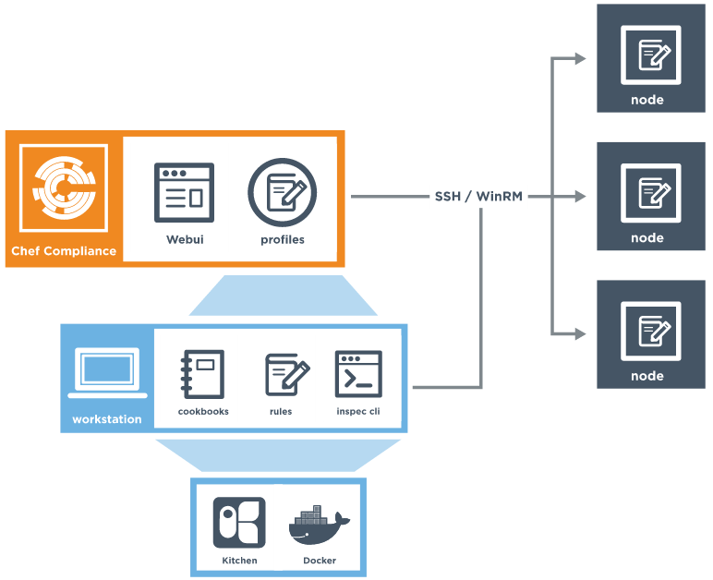
Chef Compliance and InSpec
Chef Compliance is built over InSpec
InSpec is an open-source run-time framework and rule language used to specify compliance, security, and policy requirements for testing any node in your infrastructure.
Notes:
InSpec is an open-source run-time framework and rule language used to specify compliance, security, and policy requirements for testing any node in your infrastructure. The InSpec name refers to “infrastructure specification
InSpec includes a collection of resources to help you write auditing rules quickly and easily using the Compliance DSL.
Use InSpec to examine any node in your infrastructure; run the tests locally or remotely.
Any detected security, compliance, or policy issues are flagged in a log.
The InSpec audit resource framework is fully compatible with Chef Compliance.

Slide 6
Compliance Profiles
Compliance profiles exist for many scenarios, such as those created by the Center for Internet Security (CIS)
Chef Compliance maintains profiles as a collection of individual controls that comprise a complete audit.
You can also create your own custom Compliance profiles.
Notes:
Compliance profiles exist for many scenarios, such as those created by the Center for Internet Security (CIS), a non-profit organization that is focused on enhancing the cyber security readiness and response of public and private sector entities.
Chef Compliance maintains profiles as a collection of individual controls that comprise a complete audit. For example, CIS benchmark 8.1.1.1 recommends testing for the maximum size of the audit log.
You can also create your own custom Compliance profiles.

Slide 7
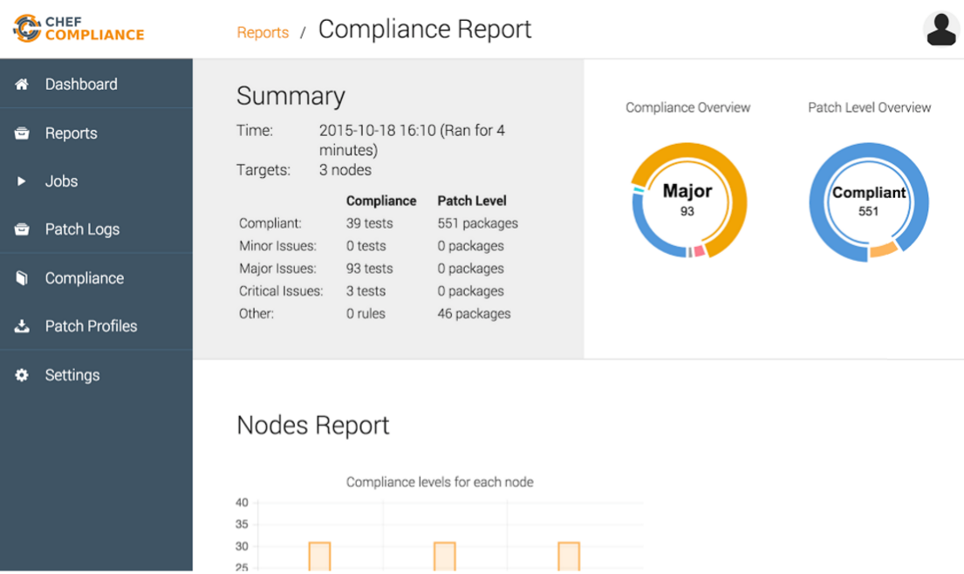
Compliance Web UI
TBD

Slide 8
Your Lab Environment
We have provided two servers for you to use while performing lab exercises in this course:
One node to install and run Chef Compliance on.
One node to perform Chef Compliance tests against.

Slide 9
SSH Into the Remote Workstation
$ ssh ADDRESS -l chef
Notes:
You should use an ssh client like PuTTY to connect to the remote workstation that we assign to you. You'll need to ssh into your assigned workstation in order to issue Chef commands.
Instructor Note: You should assign the participants their nodes at this time. The login credentials for them is chef/chef.

Slide 10

Hands-on Legend
GE or Group Exercise: All participants and the instructor do this task together with the instructor often leading the way and explaining things as we proceed.
Lab: You perform this task on your own.

Slide 11
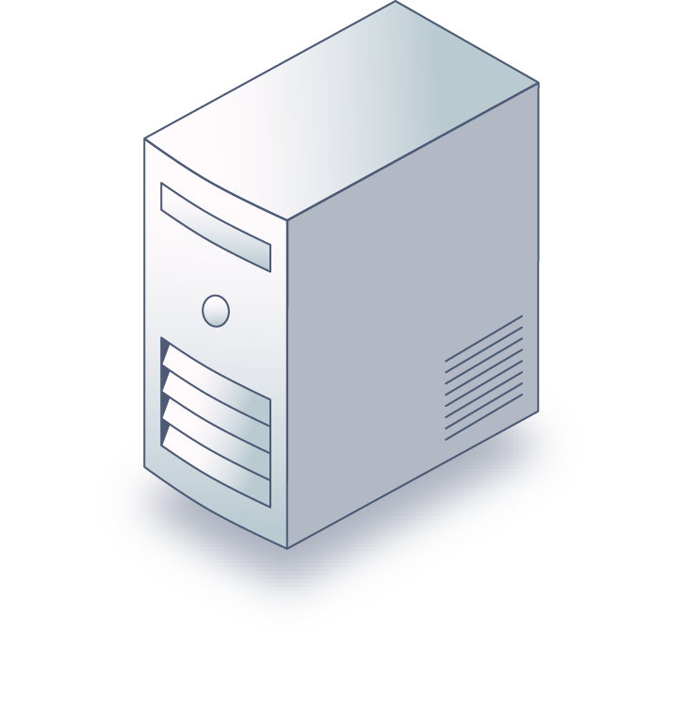
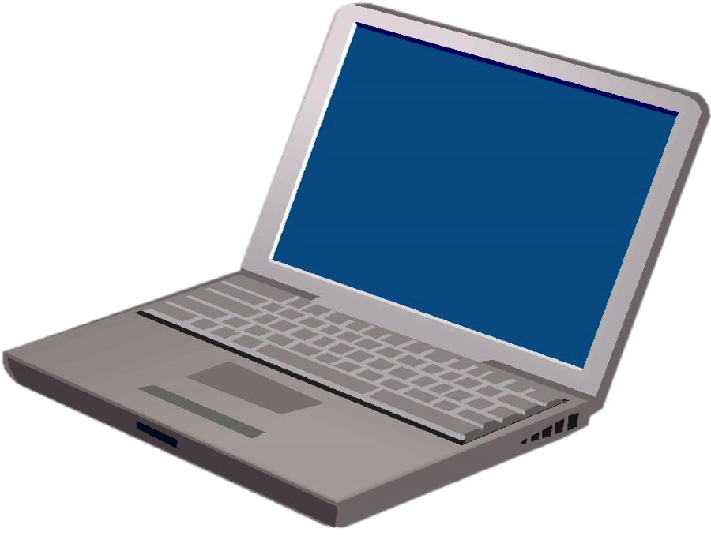
Boilerplate
Architecture 1
Virtual Workstation
Preconfigured with Chef tools
Your Laptop
Notes:
This is the architecture you'll start using in a few minutes. To ensure the smoothest setup experience, you'll be using a virtual workstation with all the necessary tools installed so you can start using Chef right away.

Slide 12
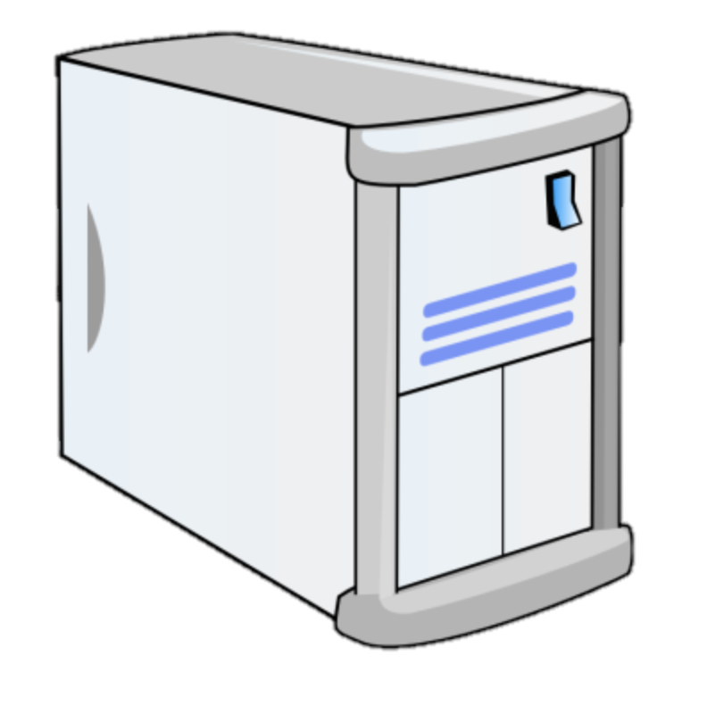
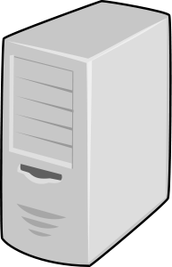
Boilerplate
Architecture 2
Chef Server
Your Local Workstation
Nodes
Notes:
This is the architecture you'll be using later in this course. When using this architecture, the Chef tools will be installed on your laptop and you'll perform your configurations locally before pushing them to the Chef server and ultimately to the nodes you will be managing.
In this way, when you complete this course you will have a code repository on your laptop that can be used and modified to solve real business problems.
We'll discuss the items in this architecture in more detail later in this class.

Slide 14
Review Questions
What is ...? ______________________________
Which is the correct answer?
answer
answer
answer
answer
Capable of carrying on a conversation
Explain

Slide 15
©2016 Chef Software Inc.

