Slide 1
Installing Chef Compliance
Installing a Standalone Chef Compliance Server

Slide 2
Objectives
After completing this module, you should be able to:
Install the Chef Compliance server.
Perform initial configuration of the Compliance server.
Set up Compliance key pairs.

Slide 3
Compliance Installation Options
You can install the Chef Compliance server as a an Amazon Machine Images (AMI) instance or as a Standalone installation.
The standalone installation of Chef Compliance server creates a working installation on a single server.
In this course we will use the most common method--the Standalone method.
Notes:
You can install the Chef Compliance server as a an Amazon Machine Images (AMI) instance or as a Standalone installation.
The standalone installation of Chef Compliance server creates a working installation on a single server.
This installation is also useful when you are installing Chef Compliance in a virtual machine, for proof-of-concept deployments, or as a part of a development or testing loop

Slide 4
Group Exercise Standalone Installation
Standalone Installation
ssh into your node
Install wget on your node
Use wget to download the chef-compliance-x package on your node
Use chef-compliance-ctl to initially configure Chef Compliance server
Run the Compliance Web UI

Slide 5
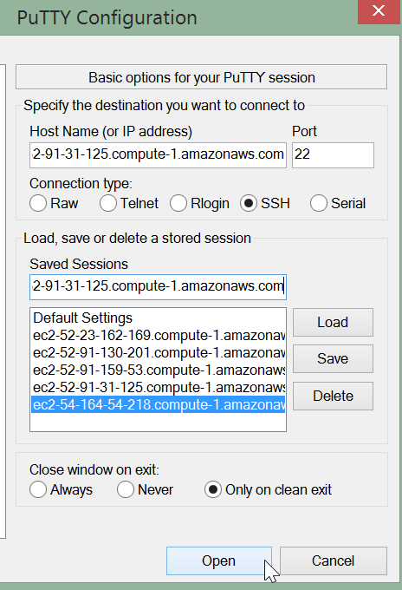
GE: Standalone Installation
ssh into the node you want to install the Compliance server on.
Here is an example of using Putty to do so.

Slide 6
GE: Install wget
$ sudo yum install wget -y
Loaded plugins: fastestmirror, presto
Setting up Install Process
Determining fastest mirrors
epel/metalink | 15 kB 00:00
* base: mirror.us.leaseweb.net
* epel: mirror.symnds.com
...
Running Transaction
Installing : wget-1.12-5.el6_6.1.x86_64 1/1
Notes:
From the current home directory (/home/chef) install the wget package so you can properly download the Compliance server package.

Slide 7
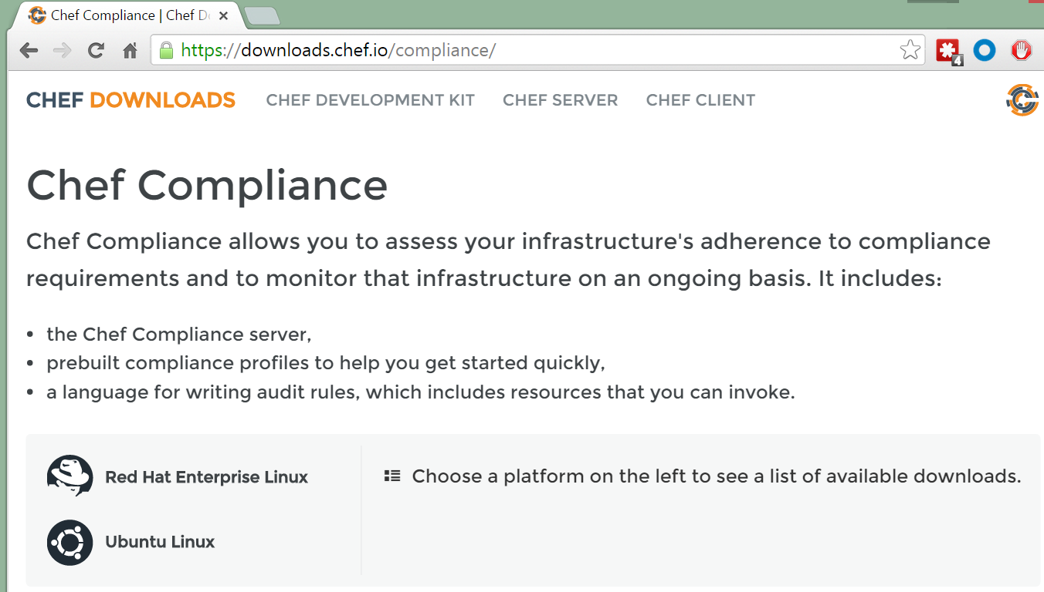
GE: Standalone Installation
From your local laptop, use a web browser to navigate to https://downloads.chef.io/compliance/

Slide 8
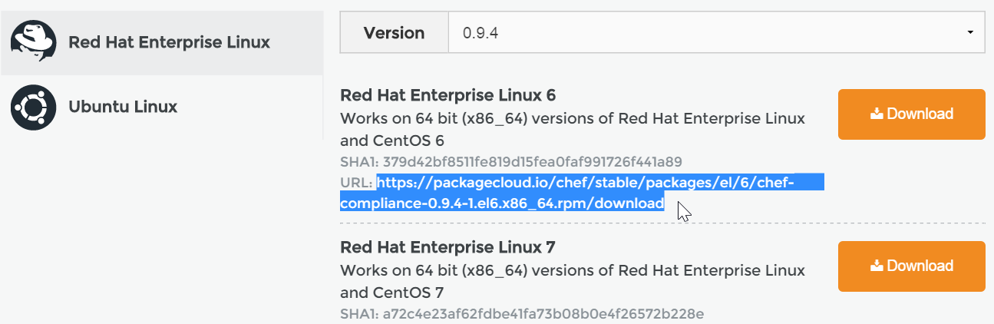
GE: Standalone Installation
From the resulting web page, click the Red Had Linux link and then highlight and copy the URL for the Red Hat Enterprise Linux 6 version. Do not click the Download button.
Notes:
From the resulting web page, highlight and copy the URL for the latest Red Hat Enterprise Linux 6 version. Do not click the Download button. We don't want to download this directly to your laptop but instead we will download it directly to our node.

Slide 9
GE: Download the Install package
wget https://packagecloud.io/chef/stable/packages/el/6/chef-compliance-0.9.1-1.el6.x86_64.rpm/download
--2016-11-13 19:54:02-- https://packagecloud.io/chef/stable/packages/el/6/chef-compliance-0.9.1-1.el6.x86_64.rpm/download
Resolving packagecloud.io... 50.23.79.58
Connecting to packagecloud.io|50.23.79.58|:443... connected.
HTTP request sent, awaiting response... 302 Found
...HTTP request sent, awaiting response... 200 OK
Length: 142162851 (136M) [application/x-rpm]
Saving to: “download”
100%[======================================>] 142,162,851 8.13M/s in 21s
Notes:
Use the wget command to install the Chef Compliance package.
For example, type wget and then paste the URL you copied in the preceding step:
wget https://packagecloud.io/chef/stable/packages/el/6/chef-compliance-0.9.1-1.el6.x86_64.rpm/download
Note: The compliance package will be named download at this point.

Slide 10
GE: Install the Compliance Package
sudo rpm -Uvh download
warning: download: Header V4 DSA/SHA1 Signature, key ID 83ef826a: NOKEY
Preparing... ########################################### [100%]
You're about to install chef-compliance!
1:chef-compliance ########################################### [100%]
Notes:
Execute sudo rpm -Uvh download to install the Compliance package. This could take some time.

Slide 11
GE: Initial Configuration of Compliance
sudo chef-compliance-ctl reconfigure
...
- change mode from '' to '0644'
Recipe: sysctl::service
* service[procps] action start
- start service service[procps]
Running handlers:
Running handlers complete
Chef Client finished, 118/124 resources updated in 259.512030572 seconds
chef-compliance Reconfigured!
Notes:
This reconfiguration process could take 10 to 15 minutes to complete.
Important: Do not use Ctrl c while this is running.
TBD- i believe so. that's how i have it running, i've also been running a reconfigure and restart after i upgrade the package
​[9:04 AM]
steve_delfante `sudo chef-compliance-ctl reconfigure` will reconfigure it but s=does that also restart it?
new messages
​[9:04 AM]
kennon not always, you should also run `sudo chef-compliance-ctl restart

Slide 12
GE: Create Administrator Credentials
sudo chef-compliance-ctl user-create admin admin
20:11:10.388 DEB ▶ Use PostgreSQL backend chef_compliance@127.0.0.1:5432
20:11:10.573 DEB ▶ Save user admin
Notes:
Execute sudo chef-compliance-ctl user-create admin admin .
This will create a user named admin with a password of admin.
Important: In the workplace you should of course create a more secure password.

Slide 13
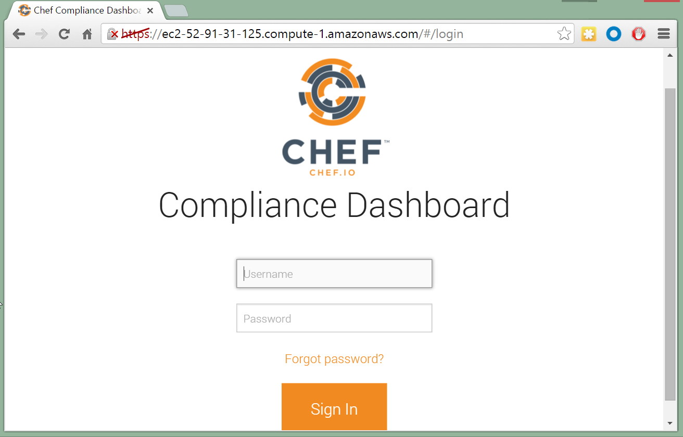
GE: Connect to your Compliance Web UI
From your laptop, point a web browser to the FQDN of your Compliance server.
For example ec2-52-91-31-125.compute-1.amazonaws.com
Note: We have not set up SSL so the https strikethrough is fine for now.
Notes:
We have not set up SSL so the https strikethrough is fine for now. In the workplace you would want to use SSL for connections to your Compliance Web UI.

Slide 14
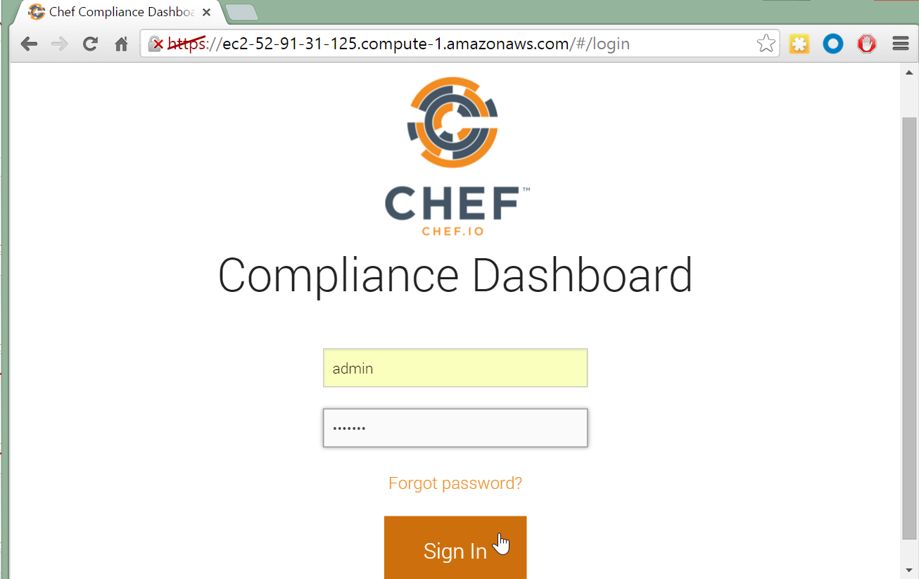
GE: Log into your Compliance Web UI
Log into your Compliance Dashboard using the admin credentials you created previously.
Notes:
We have not set up SSL so the https strikethrough is fine for now. In the workplace you would want to use SSL for connections to your Compliance Web UI.

Slide 15
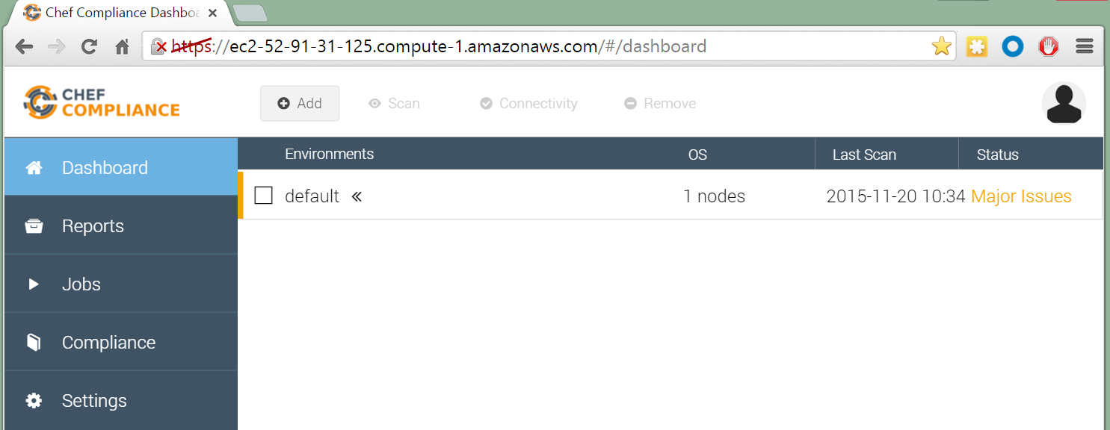

GE: Test your Compliance Web UI
You should now see an empty Compliance Dashboard.
Notes:
We have not set up SSL so the https strikethrough is fine for now. In the workplace you would want to use SSL for connections to your Compliance Web UI.

Slide 19
i believe so. that's how i have it running, i've also been running a reconfigure and restart after i upgrade the package
​[9:04 AM]
steve_delfante `sudo chef-compliance-ctl reconfigure` will reconfigure it but s=does that also restart it?
new messages
​[9:04 AM]
kennon not always, you should also run `sudo chef-compliance-ctl restart

Slide 20
Review Questions
What is ...? ______________________________
Which is the correct answer?
answer
answer
answer
answer
Capable of carrying on a conversation
Explain

Slide 21
©2016 Chef Software Inc.

