Slide 1
Applying Compliance Frameworks using InSpec
Translating CIS and DoD Specifications into InSpec Tests

Slide 2
Objectives
After completing this module, you should be able to:
Translate CIS (Center for Internet Security) specifications into InSpec tests.
Translate DoD (Department of Defense) specifications into InSpec tests.
Notes:
TBD Delete later: https://chefio.atlassian.net/wiki/pages/viewpage.action?spaceKey=SE&title=Week+2+-+Use+Cases#Week2-UseCases-Exercises-CIS

Slide 3
Compliance Frameworks
The CIS Security Benchmarks program provides well-defined, un-biased and consensus-based industry best practices to help organizations assess and improve their security.
Resources include secure configuration benchmarks, automated configuration assessment tools and content, security metrics and security software product certifications.
https://benchmarks.cisecurity.org/

Slide 4
GE: Compliance Frameworks
Translating a CIS benchmark into an InSpec control and Compliance profile.
In this exercise you will download the latest CIS benchmarks, interpret one of the benchmarks and write an InSpec control and Compliance profile based on CIS benchmark.

Slide 5
GE: Compliance Frameworks - CIS
Translating a CIS benchmark into an InSpec control and Compliance profile.
Download the benchmark PDF for the Linux platform of your scanning target
Implement Section 3 - Specialty Purpose Services as InSpec controls.
Use `inspec exec` to run the tests against your Linux target.
Package the profile and upload it to your Compliance server.

Slide 6

GE: Downloading the CIS Benchmarks
1. Go to: https://benchmarks.cisecurity.org/
Click the Products & Services tab.
Click Benchmarks.

Slide 7
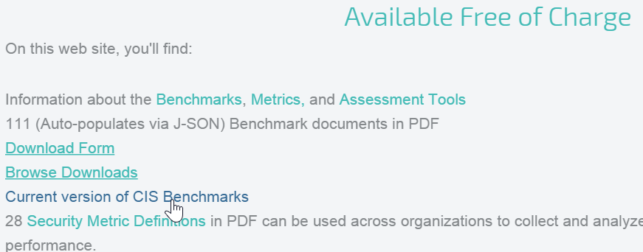
GE: Downloading the CIS Benchmarks
Scroll down to the Available Free of Charge section and then click Current version of CIS Benchmarks.

Slide 8
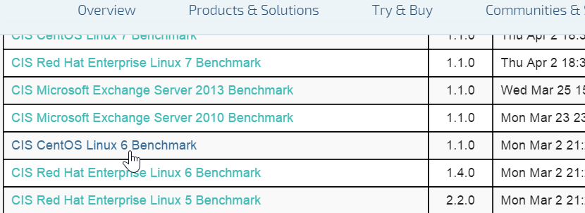
GE: Downloading the CIS Benchmarks
Scroll down to the benchmark for the system you're running. In our case, click the CIS CentOS Linux 6 Benchmark link.

Slide 9
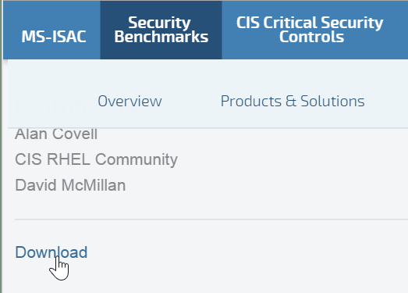
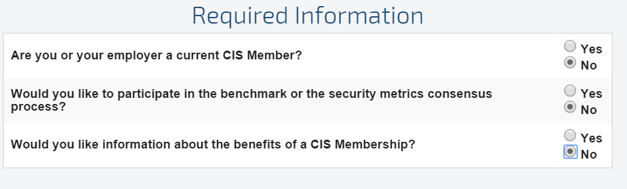
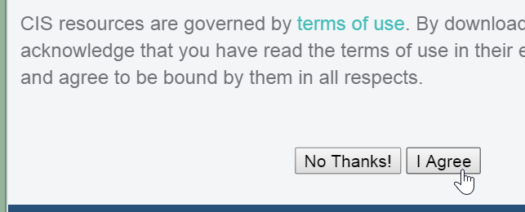
GE: Downloading the PDF
Scroll down to the bottom of the page and click Download.
On the resulting page, click the Required Information radio buttons.
Then scroll down and click the I Agree button.

Slide 10
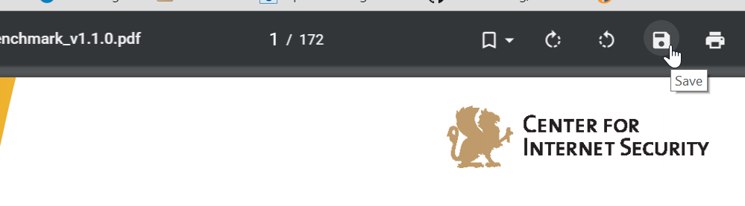
GE: Downloading the CIS Benchmarks
Save the PDF to your laptop. If a Save icon is not obvious, you should be able to save the PDF by right-clicking it.

Slide 11
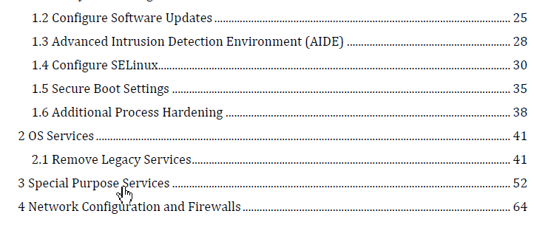
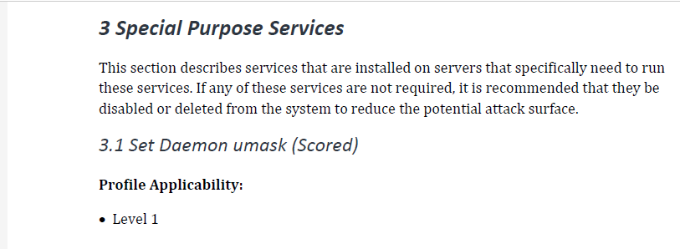
GE: CIS Benchmarks
From the Table of Contents, click the Special Purpose Services bookmark or otherwise go to that section.
Notes:
As you can see on that page the 3.1 Set Daemon umask (Scored) section says:
Description:
Set the default umask for all processes started at boot time. The settings in umask selectively turn off default permission when a file is created by a daemon process.
Rationale:
Setting the umask to 027 will make sure that files created by daemons will not be readable, writable or executable by any other than the group and owner of the daemon process and will not be writable by the group of the daemon process. The daemon process can manually override these settings if these files need additional permission.
Audit:
Perform the following to determine if the daemon umask is set.
# grep umask /etc/sysconfig/init umask 027

Slide 12
GE: CIS Benchmarks
TBD: Show how to create this... control 'cis-3.1' do
impact 0.7
title 'Set Daemon umask'
describe file('/etc/sysconfig/init') do
its('content') {should match 'umask 027'}
end
end
...from the CIS page.
Notes:
As you can see on that page the 3.1 Set Daemon umask (Scored) section says:
Description:
Set the default umask for all processes started at boot time. The settings in umask selectively turn off default permission when a file is created by a daemon process.
Rationale:
Setting the umask to 027 will make sure that files created by daemons will not be readable, writable or executable by any other than the group and owner of the daemon process and will not be writable by the group of the daemon process. The daemon process can manually override these settings if these files need additional permission.
Audit:
Perform the following to determine if the daemon umask is set.
# grep umask /etc/sysconfig/init umask 027

Slide 13
GE: Move to ~/compliance_profiles
$ cd ~/compliance_profiles
Ensure you are on your target node for this part of this exercise.
Notes:
On your target node, create the directory for your new profile and then move into it.

Slide 14
GE: Create the Directory for your new Profile
$ mkdir profile_02
$ cd profile_02
Create and move into the profile_02 directory.
Notes:
On your target node, create the directory for your new profile and then move into it.

Slide 15
GE: Create the metadata.rb
~/compliance_profiles/profile_02/metadata.rb
name 'myname/profile-cis-3.1'
version '0.1.0'
title 'cis-3.1 Profile'
maintainer 'My Name'
Notes:
TBD: Naming conventions for `name` line?
Instructor Note: It seems that in the `name` line in metadata.rb, the Compliance code treats anything before the first `/` as the username variable. For example, name 'fooooo/profile-cis-3.1' will appear as `admin/profile-cis-3.1` in the UI if the user who uploaded that profile was the `admin` user.

Slide 16
GE: Create and Move into the `test` Directory
$ mkdir test
$ cd test

Slide 17
GE: Create a `Set Daemon umask' Control
~/compliance_profiles/profile_02/test/cis31.rb
control 'cis-3.1' do
impact 0.7
title 'Set Daemon umask'
describe file('/etc/sysconfig/init') do
its('content') {should match 'umask 027'}
end
end
Notes:
TBD: Need to provide explanation on how to write this.
For anything scored by CIS we'll score it 0.7. For anything not scored you should score it 0.0.

Slide 18
GE: Test the Control with `inspec exec`
$ inspec exec ~/compliance_profiles/profile_02/test/cis31.rb
F
Failures:
1) File /etc/sysconfig/init content should match "umask 027"
Failure/Error: its('content') {should match 'umask 027'}
expected "# color => new RH6.0 bootup\n# verbose => old-style bootup\n# anything else => new style bootup without ANSI colors or positioning\nBOOTUP=color\n# column to start \"[ OK ]\" label in \nRES_COL=60\n# terminal sequence to move to that column. ...
Finished in 0.03128 seconds (files took 0.46609 seconds to load)
1 example, 1 failure
Failed examples:
rspec # File /etc/sysconfig/init content should match "umask 027"
Notes:
This is the kind of failure we should see because the umask of the etc/sysconfig/init is not 027.
F
Failures:
1) File /etc/sysconfig/init content should match "umask 027"
Failure/Error: its('content') {should match 'umask 027'}
Note: At the end of the output you will see a reference to rspec. This is because inspec is based on rspec.
expected "# color => new RH6.0 bootup\n# verbose => old-style bootup\n# anything else => new style bootup without ANSI colors or positioning\nBOOTUP=color\n# column to start \"[ OK ]\" label in \nRES_COL=60\n# terminal sequence to move to that column. You could change this\n# to something like \"tput hpa ${RES_COL}\" if your terminal supports it\nMOVE_TO_COL=\"echo -en \\\\033[${RES_COL}G\"\n# terminal sequence to set color to a 'success' color (currently: green)\nSETCOLOR_SUCCESS=\"echo -en \\\\033[0;32m\"\n# terminal sequence to set color to a 'failure' color (currently: red)\nSETCOLOR_FAILURE=\"echo -en \\\\033[0;31m\"\n# terminal sequence to set color to a 'warning' color (currently: yellow)\nSETCOLOR_WARNING=\"echo -en \\\\033[0;33m\"\n# terminal sequence to reset to the default color.\nSETCOLOR_NORMAL=\"echo -en \\\\033[0;39m\"\n# Set to anything other than 'no' to allow hotkey interactive startup...\nPROMPT=yes\n# Set to 'yes' to allow probing for devices with swap signatures\nAUTOSWAP=no\n# What ttys should gettys be started on?\nACTIVE_CONSOLES=/dev/tty1\n# Set to '/sbin/sulogin' to prompt for password on single-user mode\n# Set to '/sbin/sushell' otherwise\nSINGLE=/sbin/sushell\n" to match "umask 027"
Diff:
@@ -1,2 +1,27 @@
-umask 027
+# color => new RH6.0 bootup
+# verbose => old-style bootup
+# anything else => new style bootup without ANSI colors or positioning
+BOOTUP=color
+# column to start "[ OK ]" label in
+RES_COL=60
+# terminal sequence to move to that column. You could change this
+# to something like "tput hpa ${RES_COL}" if your terminal supports it
+MOVE_TO_COL="echo -en \\033[${RES_COL}G"
+# terminal sequence to set color to a 'success' color (currently: green)
+SETCOLOR_SUCCESS="echo -en \\033[0;32m"
+# terminal sequence to set color to a 'failure' color (currently: red)
+SETCOLOR_FAILURE="echo -en \\033[0;31m"
+# terminal sequence to set color to a 'warning' color (currently: yellow)
+SETCOLOR_WARNING="echo -en \\033[0;33m"
+# terminal sequence to reset to the default color.
+SETCOLOR_NORMAL="echo -en \\033[0;39m"
+# Set to anything other than 'no' to allow hotkey interactive startup...
+PROMPT=yes
+# Set to 'yes' to allow probing for devices with swap signatures
+AUTOSWAP=no
+# What ttys should gettys be started on?
+ACTIVE_CONSOLES=/dev/tty1
+# Set to '/sbin/sulogin' to prompt for password on single-user mode
+# Set to '/sbin/sushell' otherwise
+SINGLE=/sbin/sushell
# cis31.rb:5:in `block (3 levels) in load'
Finished in 0.03515 seconds (files took 0.50435 seconds to load)
1 example, 1 failure
Failed examples:
rspec # File /etc/sysconfig/init content should match "umask 027"
Note: The references to color is just inspec reading the contents of the file you are checking, even though you aren't testing for color.

Slide 19
GE: Zip up your New Profile
$ cd ~/compliance_profiles
$ zip -r profile_02.zip profile_02
adding: profile_02/ (stored 0%)
adding: profile_02/metadata.rb (deflated 13%)
adding: profile_02/test/ (stored 0%)
adding: profile_02/test/cis31.rb (deflated 20%)
Notes:
Because `inspec exec` proved that the new profile is working correctly, let's prepare to upload our new profile to the Compliance server.
Move to ~/compliance_profiles and then run `zip -r profile_01.zip profile_01`.

Slide 20
GE: Verify the zip File's Creation
$ ls -l
total 12
drwxrwxr-x 3 chef chef 4096 Dec 14 16:45 profile_01
drwxrwxr-x 3 chef chef 4096 Dec 22 17:38 profile_02
-rw-rw-r-- 1 chef chef 886 Dec 22 17:46 profile_02.zip
Notes:
Type `ls -l` to verify the new zip file's creation.

Slide 21
GE: From your Laptop Run the scp Command
C:\tmp>scp chef@52.90.148.31:~/compliance_profiles/profile_02.zip .
chef@52.90.148.31's password:
profile_02.zip 100% 886 0.9KB/s 00:00
Notes:
Important: Be sure to run this command from your laptop. You can first move to whatever directory on your laptop that you like.
In this Windows example, the user created and moved to the C:\tmp location and then ran the above command. The IP address after the `chef@` is the IP address of the target node where the profile_01.zip was created.

Slide 22
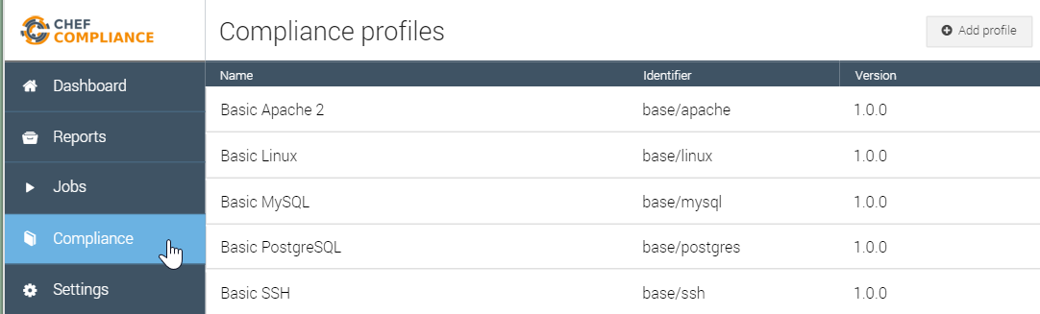
GE: Upload the Profile to Chef Compliance
From your Compliance Server Dashboard: Click the Compliance button and then click the Add Profile button.

Slide 23
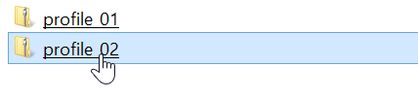
GE: Upload the Profile to Chef Compliance
Select the new zip file (profile_02) from your laptop.

Slide 24
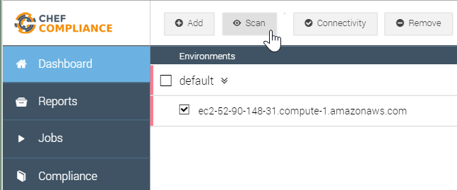
GE: Upload the Profile to Chef Compliance
From the Dashboard, select your node and then click the Scan button.

Slide 25
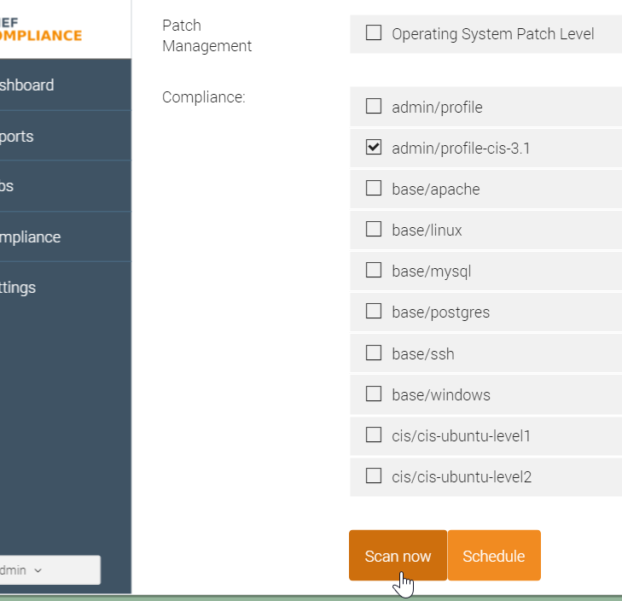
GE: Scan Using the New Profile
From the resulting page, select only the new profile (admin/profile-cis-3.1) and then click Scan now.
Notes:
Since you are logged into the Chef Compliance UI as 'admin', your profile is called 'admin/profile' on the 'Scan nodes' page.
Instructor Note: Regarding this note above--`Note: The profile name in this view is based on the name space in your metadata.rb.`--the compliance team may have improved that Compliance profile name field on the "Scan nodes" page by now to include whatever is the `title` value from the metadata.rb. Therefore it would match the name as displayed in the Compliance profiles page.

Slide 26
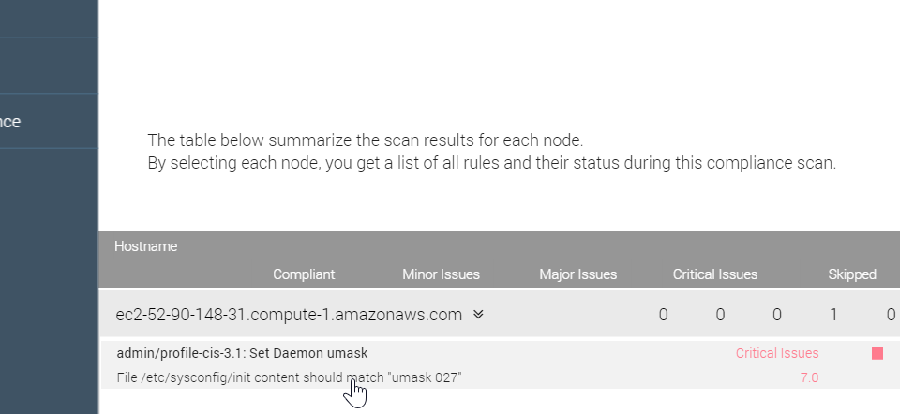
GE: Results of the Custom Profile Scan
The results of your scan should look like this example.
Notes:
The results of your scan should look like this example.
In this case, the scan should show a critical issue because /etc/sysconfig/init does not set umask to 027.
In the workplace you would want to write a recipe to remediate the /etc/sysconfig/init umask issue and then you could run the scan again to ensure you have corrected the issue.
For example, your remediation recipe should add this line to /etc/sysconfig/init: umask 027

Slide 27
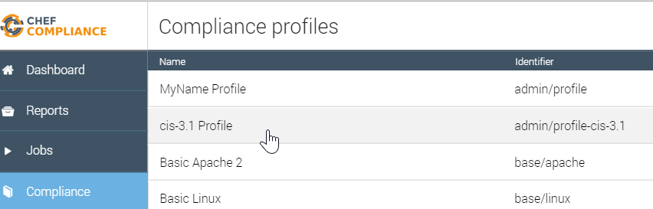
GE: Results of the Custom Profile Scan
You should also be able to see your custom profile from your Compliance page.

Slide 28
DoD

Slide 29
Review Questions
What is ...? ______________________________
Which is the correct answer?
answer
answer
answer
answer
Capable of carrying on a conversation
Explain

Slide 30
Delete tbd
The latest CIS benchmarks in PDF format can be downloaded from here:
https://benchmarks.cisecurity.org/downloads/latest/
From that link, scroll down to and download the
CIS CentOS Linux 6 Benchmark PDF.

Slide 31
©2016 Chef Software Inc.

