Slide 1
Installing Chef Compliance
Installing a Standalone Chef Compliance Server

Slide 2
Objectives
After completing this module, you should be able to:
Install the Chef Compliance server.
Perform initial configuration of the Compliance server.
Launch the Compliance Web UI.

Slide 3
Compliance Installation Options
You can install the Chef Compliance server as a an Amazon Machine Images (AMI) instance or as a Standalone installation.
The standalone installation of Chef Compliance server creates a working installation on a single server.
In this course we will use the most common method--the Standalone method.
Notes:
You can install the Chef Compliance server as a an Amazon Machine Images (AMI) instance or as a Standalone installation.
The standalone installation of Chef Compliance server creates a working installation on a single server.
This installation is also useful when you are installing Chef Compliance in a virtual machine, for proof-of-concept deployments, or as a part of a development or testing loop

Slide 4
Group Lab: Standalone Installation
Standalone Installation
ssh in to your Compliance Server node
Download and install the chef-compliance-x package on your node
Use chef-compliance-ctl to initially configure Chef Compliance server
Run the Compliance Web UI
Notes:
In this group lab you will perform the installation and initial configuration tasks listed in this slide.

Slide 5
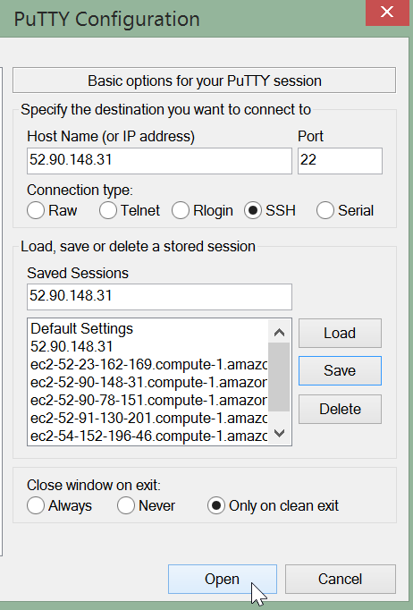
GL: Standalone Installation
ssh in to the node you want to install the Compliance server on.
Here is an example of using Putty to do so.

Slide 6
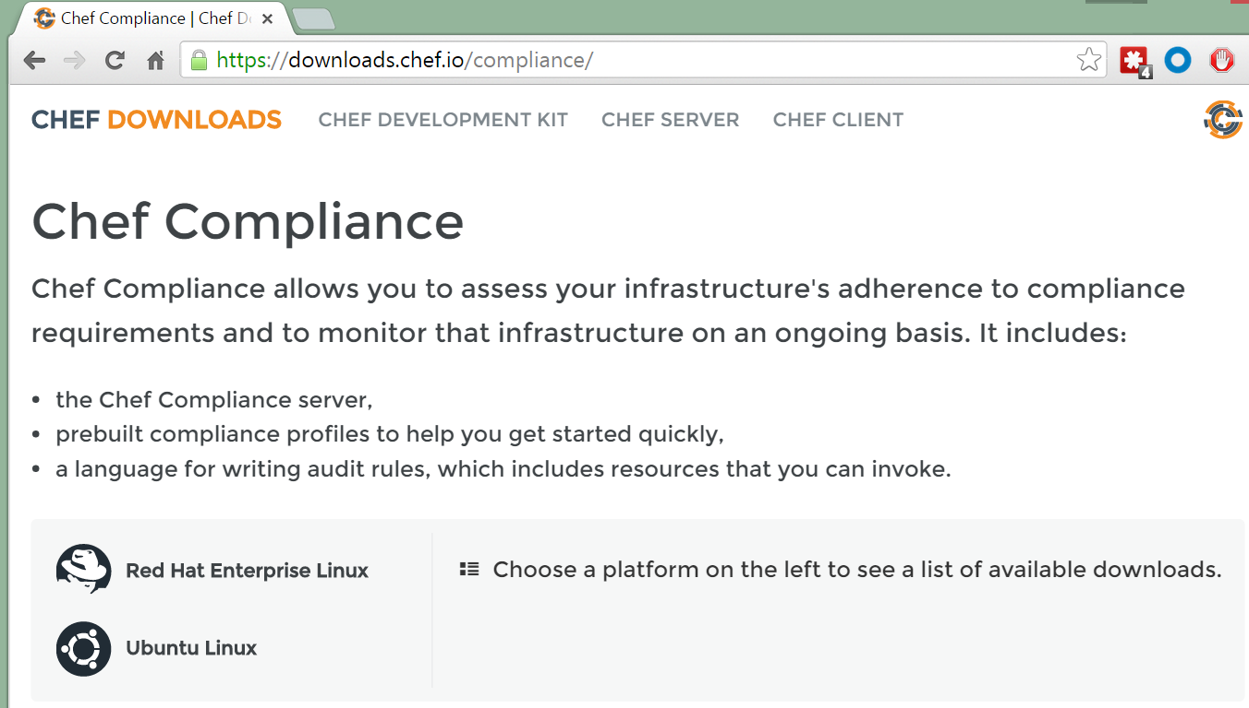
GL: Standalone Installation
From your local laptop, use a web browser to navigate to https://downloads.chef.io/compliance/

Slide 7
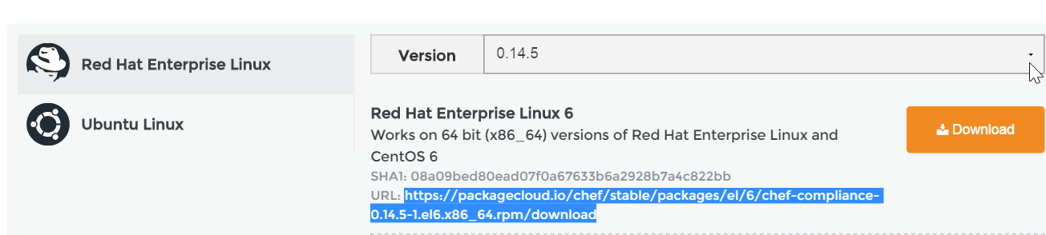
GL: Standalone Installation
From the resulting web page, click the Red Had Linux link and then click the Version button.
Select the version from the Version pull-down as indicated by the instructor.
Notes:
Instructor Note: This course has been tested on Compliance Server v0.14.5.

Slide 8
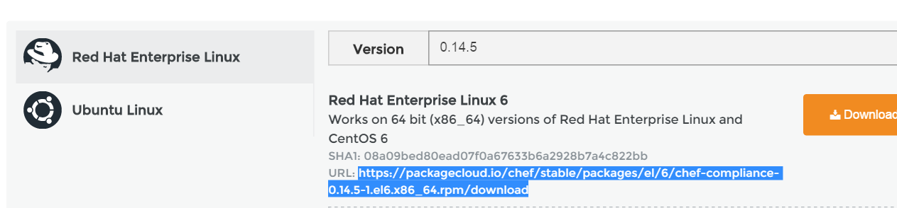
GL: Standalone Installation
Highlight and copy the URL for the Red Hat Enterprise Linux 6 version the instructor indicated. Do not click the Download button.
Notes:
From the resulting web page, highlight and copy the URL for the Red Hat Enterprise Linux 6 version Do not click the Download button. We don't want to download this directly to your laptop but instead we will download it directly to our node.
Instructor Note: This course has been tested on Compliance Server v0.14.5.

Slide 9
GL: Install and Install Compliance Package
$ sudo rpm -Uvh https://packagecloud.io/chef/stable/packages/el/6/chef-compliance-0.9.5-2.elX.x86_64.rpm/download
Retrieving https://packagecloud.io/chef/stable/packages/el/6/chef-compliance-0.9.5-2.el6.x86_64.rpm/download
warning: /var/tmp/rpm-tmp.4Mgmgw: Header V4 DSA/SHA2 Signature, key ID 83ef826a: NOKEY
Preparing... ########################################### [200%]
You're about to install chef-compliance!
2:chef-compliance ########################################### [200%]
Notes:
Execute sudo rpm -Uvh https://packagecloud.io/chef/stable/packages/el/6/chef-compliance-0.9.5-2.elX.x86_64.rpm/download but using the URL you just copied to download and install the Compliance package. This could take some time.
Note: The compliance package will be named download at this point.
Instructor Note: The X in this part of the file name - 0.9.2-2.elX - was added so students will paste the latest version and not try to copy/paste the above command verbatim. It could take about a minute to download Compliance server.

Slide 10
GL: Initial Configuration of Compliance
$ sudo chef-compliance-ctl reconfigure
...
- change mode from '' to '0644'
Recipe: sysctl::service
* service[procps] action start
- start service service[procps]
Running handlers:
Running handlers complete
Chef Client finished, 228/224 resources updated in 259.522030572 seconds
chef-compliance Reconfigured!
Notes:
This reconfiguration process could take 5 or more minutes to complete.
Important: Do not use Ctrl c while this is running.

Slide 11
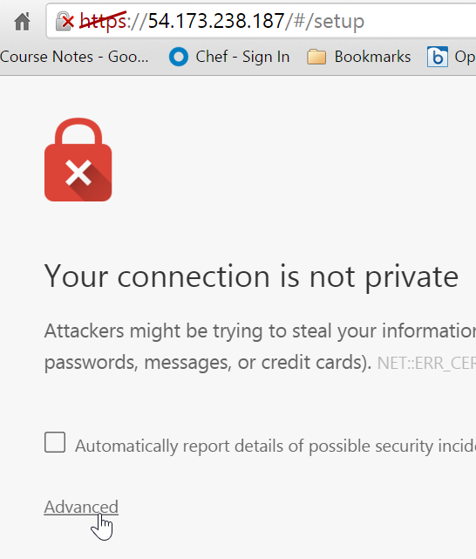
GL: Configure the Compliance Server
From your laptop, open a web browser and point it to: https://IPADDRESS/#/setup where IPADDRESS is the IP addressed you are using for your Compliance Server.
For example https://54.173.238.187/#/setup
Click Advanced from the warning page.

Slide 12
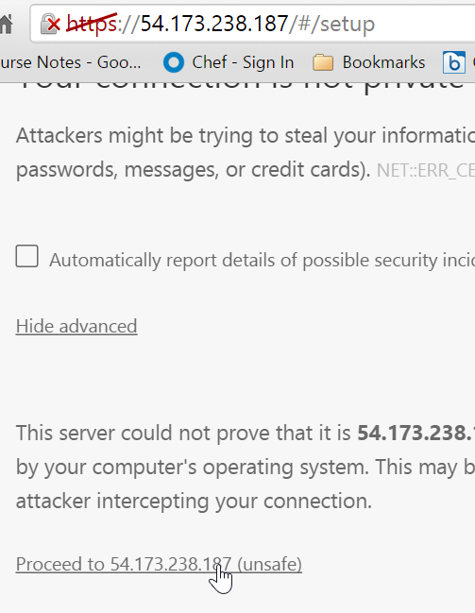
GL: Configure the Compliance Server
Click the Proceed to 54.173.238.xxx ... link.
Note: We have not set up SSL so the https strikethrough and warning is fine for now.
Notes:
We have not set up SSL so the https strikethrough is fine for now. In the workplace you would want to use SSL for connections to your Compliance Web UI.

Slide 13

GL: Configure the Compliance Server
From the resulting page, click the Setup Chef Compliance button.

Slide 14
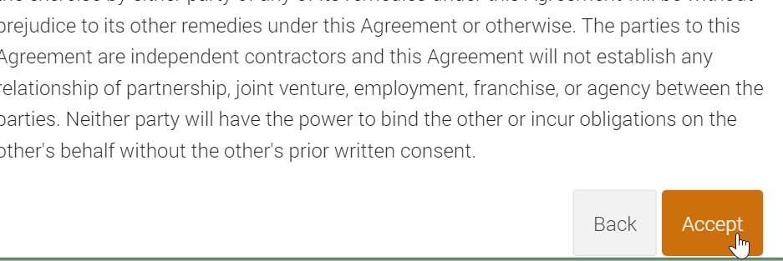
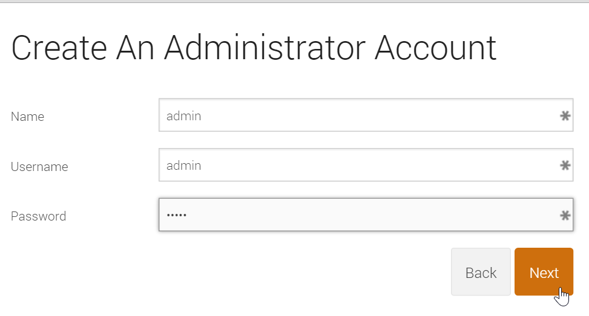
GL: Configure the Compliance Server
Accept the Online Master License and Services Agreement.
Create an Administrator Account using admin/admin for credentials.
Notes:
In the workplace you should of course create a more secure password.

Slide 15
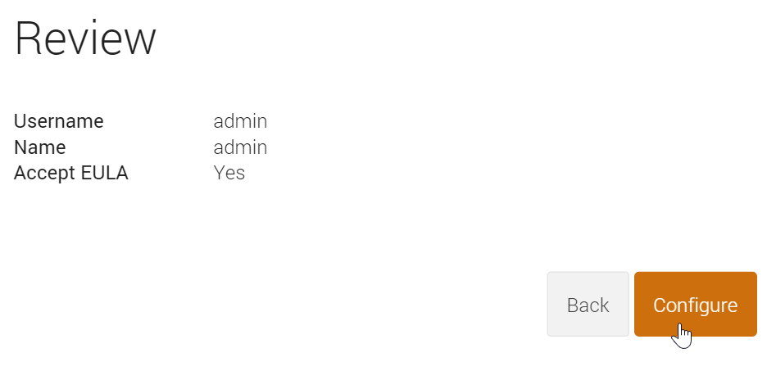
GL: Configure the Compliance Server
On the resulting page click the Configure button.

Slide 16
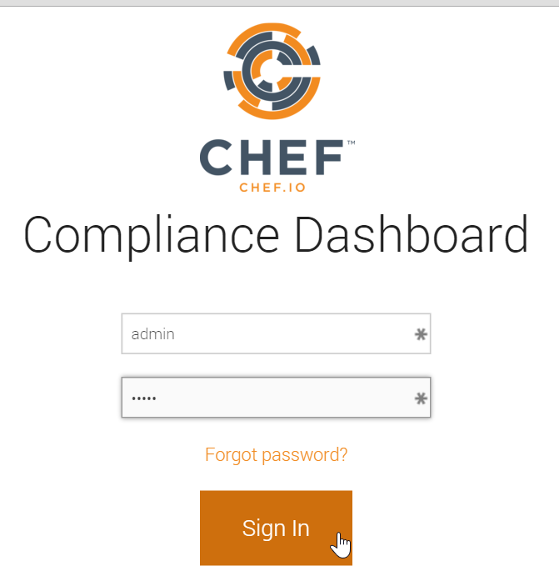
GL: Configure the Compliance Server
On the resulting page sign in using admin/admin.

Slide 17
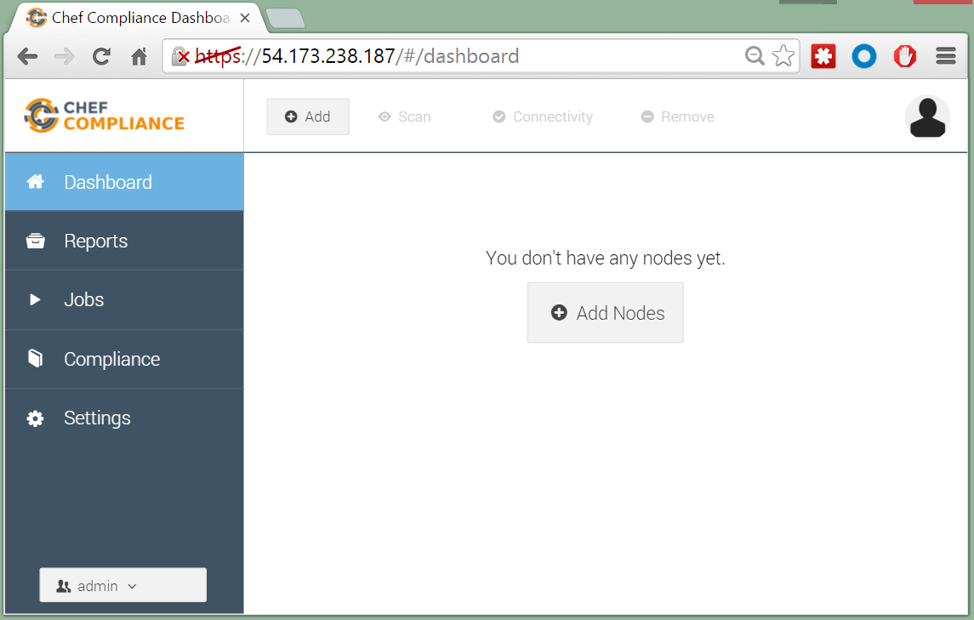
GL: Configure the Compliance Server
You should now see an empty Compliance Dashboard.
Notes:
In the workplace you would want to use SSL for connections to your Compliance Web UI.
https://docs.chef.io/install_compliance.html > Configure SSL

Slide 18
Compliance Upgrades
If at some point you want to install a newer version of Chef Compliance, you can simply install the new version over the old version as follows:
sudo rpm -Uvh https://packagecloud.io/chef/stable/packages/<rest of filename>
sudo chef-compliance-ctl reconfigure
sudo chef-compliance-ctl restart
Relaunch the Compliance Web UI
Notes:
If you needed to downgrade Compliance to a previous version, the `--oldpackage' option will do that for you. In the following example, the `https://package...` would be the version of the old package that you want to downgrade to:
sudo rpm -Uvh --oldpackage https://packagecloud.io/chef/stable/packages/el/6/chef-compliance-0.9.6-1.el6.x86_64.rpm/download
...and the run these commands:
sudo chef-compliance-ctl reconfigure
sudo chef-compliance-ctl restart

Slide 19
Review Questions
What can this command be used for? `sudo chef-compliance-ctl reconfigure`
What does this command do? `sudo rpm -Uvh https://packagecloud.io/chef/stable/packages/<rest of filename>'
Notes:
Instructor note answers:
It can be used to initially configure a new installation or to reconfigure an upgrade or downgrade of the Compliance Server software.
It downloads AND installs the Compliance Server software.

Slide 20
©2016 Chef Software Inc.

