Slide 1
Applying Compliance Frameworks using InSpec
Translating CIS and DoD Specifications into InSpec Tests

Slide 2
Objectives
After completing this module, you should be able to:
Translate CIS (Center for Internet Security) specifications into InSpec tests.
Translate DoD (Department of Defense) specifications into InSpec tests.
Notes:
TBD Delete later: https://chefio.atlassian.net/wiki/pages/viewpage.action?spaceKey=SE&title=Week+2+-+Use+Cases#Week2-UseCases-Exercises-CIS

Slide 3
CIS Compliance Frameworks
The CIS Security Benchmarks program provides well-defined, un-biased and consensus-based industry best practices to help organizations assess and improve their security.
Resources include secure configuration benchmarks, automated configuration assessment tools and content, security metrics and security software product certifications.
https://benchmarks.cisecurity.org/

Slide 4
Group Lab: Compliance Frameworks - CIS
Translating a CIS benchmark into an InSpec control and Compliance profile.
Download the benchmark PDF for the platform of your scanning target
Implement Section 3 - Specialty Purpose Services as InSpec controls.
Use `inspec exec` to run the tests against your Linux target.
Package the profile and upload it to your Compliance server.

Slide 5

GL: Downloading the CIS Benchmarks for Linux
1. Go to: https://benchmarks.cisecurity.org/
Click the Products & Services tab.
Click Benchmarks.

Slide 6
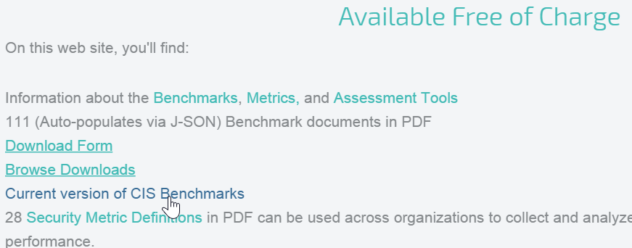
GL: Downloading the CIS Benchmarks
Scroll down to the Available Free of Charge section and then click Current version of CIS Benchmarks.

Slide 7
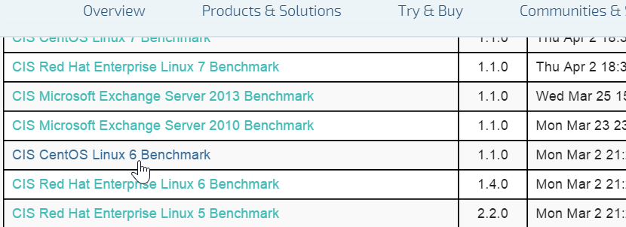
GL: Downloading the CIS Linux Benchmarks
Scroll down to the benchmark for the system you're running. In our case, click the CIS CentOS Linux 6 Benchmark link.

Slide 8
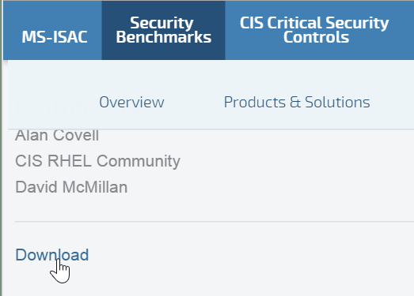
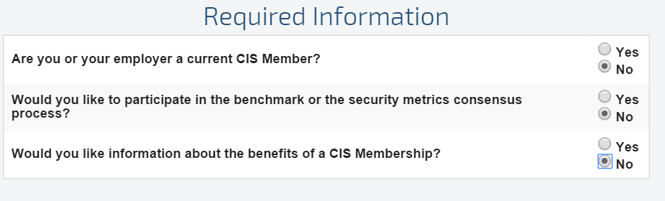
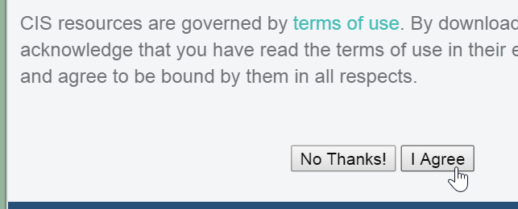
GL: Downloading the PDF
Scroll down to the bottom of the page and click Download.
On the resulting page, click the Required Information radio buttons.
Then scroll down and click the I Agree button.

Slide 9
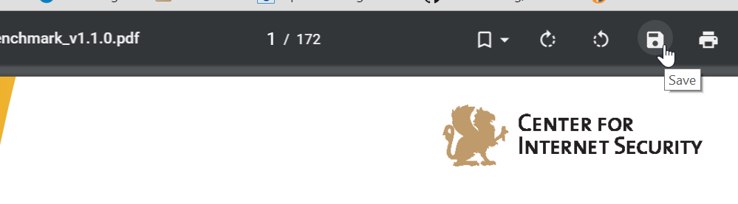
GL: Downloading the CIS Benchmarks
Save the PDF to your laptop. If a Save icon is not obvious, you should be able to save the PDF by right-clicking it.

Slide 10
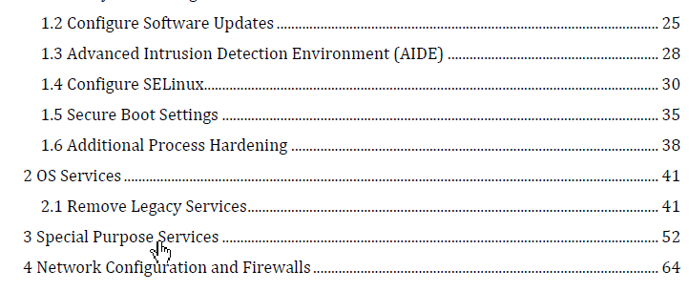
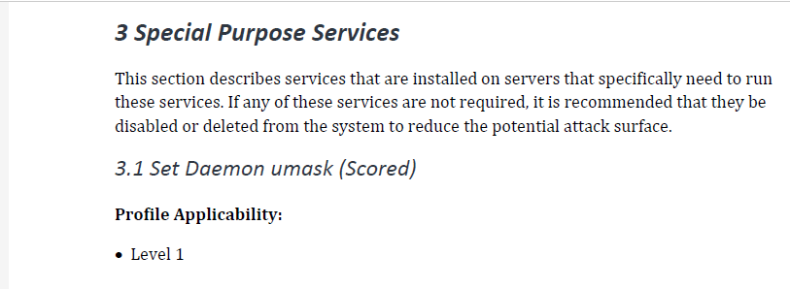
GL: CIS Benchmarks
Open the PDF and then from the Table of Contents, click the Special Purpose Services bookmark or otherwise go to that section.

Slide 11
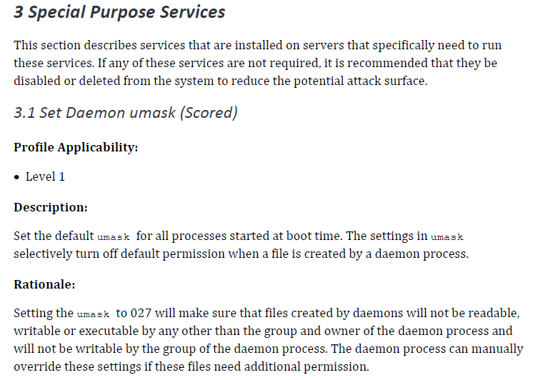
Demonstration: Writing an InSpec Test for CIS Benchmark (1 of 3)
Notes:
As you can see on that page, the 3.1 Set Daemon umask (Scored) section says:
Description:
Set the default umask for all processes started at boot time. The settings in umask selectively turn off default permission when a file is created by a daemon process.
Rationale:
Setting the umask to 027 will make sure that files created by daemons will not be readable, writable or executable by any other than the group and owner of the daemon process and will not be writable by the group of the daemon process. The daemon process can manually override these settings if these files need additional permission.

Slide 12
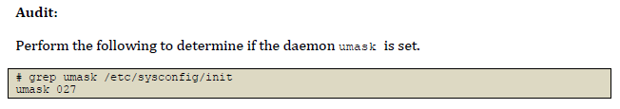
Demonstration: Writing an InSpec Test for CIS Benchmark (2 of 3)
control 'cis-3.1' do
impact 0.7
title 'Set Daemon umask'
describe file('/etc/sysconfig/init') do
its('content') {should match 'umask 027'}
end
end
Notes:
If you scrolled down in that section, you will see a CIS Audit example. So based on this audit example on the left, you could write an InSpec test as shown on the right and add it to a Chef Compliance custom profile. In this way you can subsequently use the custom profiles to scan nodes for umask compliance.

Slide 13
Demonstration: Writing an InSpec Test for CIS Benchmark (3 of 3)
After writing the test, in the workplace you should:
Use 'inspec exec' to run the tests against your Linux target node.
Package the custom compliance profile and upload it to your Compliance server.
control 'cis-3.1' do
impact 0.7
title 'Set Daemon umask'
describe file('/etc/sysconfig/init') do
its('content') {should match 'umask 027'}
end
end
Notes:
After writing the test, in the workplace you should:
Use 'inspec exec' to run the tests against your Linux target node.
Package the custom profile and upload it to your Compliance server.

Slide 14
GL: Downloading the CIS Benchmarks for Windows
1. Go to: https://benchmarks.cisecurity.org/
Click the Products & Services tab.
Click Benchmarks.

Slide 15
GL: Downloading the CIS Benchmarks for Windows
Scroll down to the Available Free of Charge section and then click Current version of CIS Benchmarks.

Slide 16
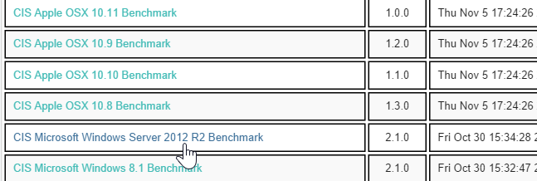
GL: Downloading the CIS Benchmarks for Windows
Scroll down to the benchmark for the system you're running. In our case, click the CIS Microsoft Windows Server 2012 R2 Benchmarklink.

Slide 17
GL: Downloading the PDF
Scroll down to the bottom of the page and click Download.
On the resulting page, click the Required Information radio buttons.
Then scroll down and click the I Agree button.

Slide 18
GL: Downloading the CIS Benchmarks for Windows
Save the PDF to your laptop. If a Save icon is not obvious, you should be able to save the PDF by right-clicking it.

Slide 19
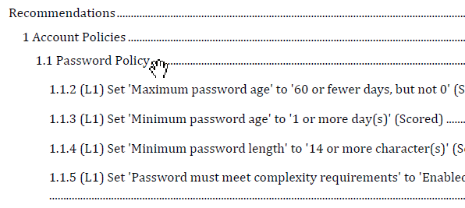
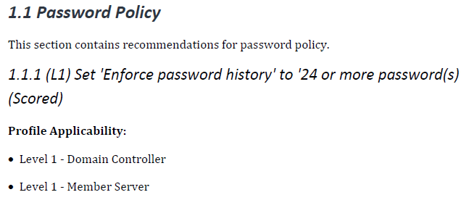
GL: CIS Benchmarks for Windows
Implement Section 1.1 - Password Policy as InSpec controls with the profile of Level 1 - Member Server.
Use 'inspec exec' to run the tests against your Windows target.
Package profile and upload to your Compliance server.
Notes:
https://chefio.atlassian.net/wiki/pages/viewpage.action?spaceKey=SE&title=Week+2+-+Use+Cases#Week2-UseCases-Exercises-CIS
Implement Section 1.1 - Password Policy as InSpec controls with the profile of Level 1 - Member Server.

Slide 20
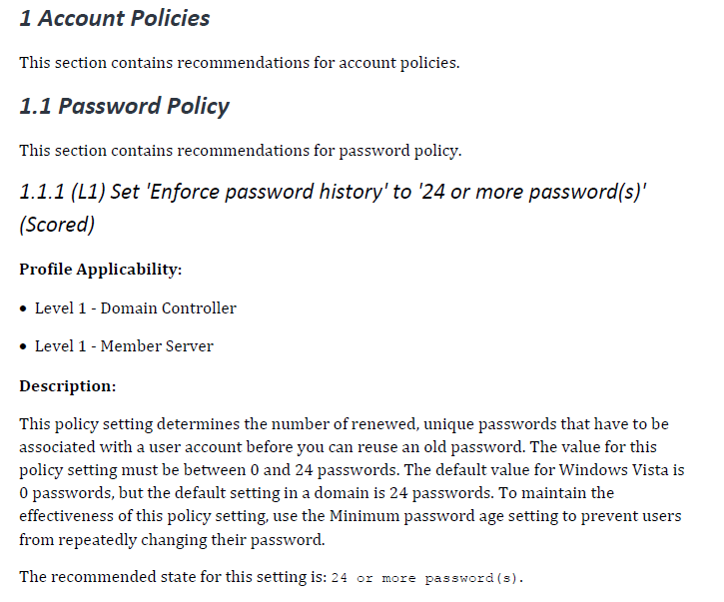
GL: Writing an InSpec Test for a Windows CIS Benchmark (1 of 3)
Notes:
As you can see on that page the 1.1 Password Ploicy section says:
Description:
This policy setting determines the number of renewed, unique passwords that have to be associated with a user account before you can reuse an old password. The value for this policy setting must be between 0 and 24 passwords. The default value for Windows Vista is 0 passwords, but the default setting in a domain is 24 passwords. To maintain the effectiveness of this policy setting, use the Minimum password age setting to prevent users from repeatedly changing their password.
The recommended state for this setting is: 24 or more password(s).

Slide 21
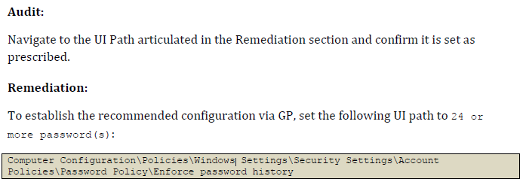
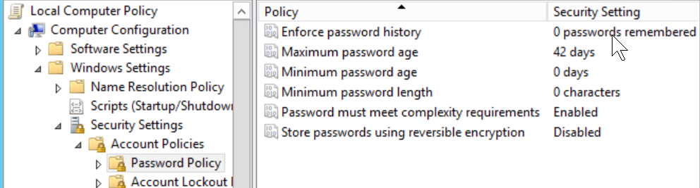
GL: Writing an InSpec Test for a Windows CIS Benchmark (2 of 3)
Notes:
If you scroll down in that section, you will see a CIS Audit example. The image at the bottom shows that the Windows node's `Enforce password history' setting is out of compliance.

Slide 22
GL: Writing an InSpec Test for a Windows CIS Benchmark (2 of 3)
control 'cis-enforce-password-history-1.1.1' do
impact 0.7
title '1.1.1 Set Enforce password history to 24 or more passwords'
desc 'Set Enforce password history to 24 or more passwords'
describe security_policy do
its('PasswordHistorySize') { should be >= 24 }
end
end
Notes:
So based on the audit example on the left (and the path to that configuration below that), you could write an InSpec test, as shown on the right, and add it to a Chef Compliance custom profile. In this way you can subsequently use the custom profiles to scan nodes for password history compliance.

Slide 23
TBD GL: Move to ~/compliance_profiles
$ cd ~/compliance_profiles
Ensure you are on your target node for this part of this exercise.
Notes:
On your target node, create the directory for your new profile and then move into it.

Slide 24
GL: Create the Directory for your New Profile
$ mkdir profile_02
$ cd profile_02
Create and move into the profile_02 directory.
Notes:
On your target node, create the directory for your new profile and then move into it.

Slide 25
GL: Create the metadata.rb
~/compliance_profiles/profile_02/metadata.rb
name 'myname/profile-cis-3.1'
version '0.1.0'
title 'cis-3.1 Profile'
maintainer 'My Name'
Notes:
TBD: Naming conventions for `name` line? TBD check metadata name.
Instructor Note: It seems that in the `name` line in metadata.rb, the Compliance code treats anything before the first `/` as the username variable. For example, name 'fooooo/profile-cis-3.1' will appear as `admin/profile-cis-3.1` in the UI if the user who uploaded that profile was the `admin` user.

Slide 26
GL: Create and Move into the `test` Directory
$ mkdir test
$ cd test

Slide 27
GL: Create a `Set Daemon umask' Control
~/compliance_profiles/profile_02/test/cis31.rb
control 'cis-3.1' do
impact 0.7
title 'Set Daemon umask'
describe file('/etc/sysconfig/init') do
its('content') {should match 'umask 027'}
end
end
Notes:
TBD: Need to provide explanation on how to write this.
For anything scored by CIS we'll score it 0.7. For anything not scored you should score it 0.0.

Slide 28
GL: Test the Control with `inspec exec`
$ inspec exec ~/compliance_profiles/profile_02/test/cis31.rb
F
Failures:
1) File /etc/sysconfig/init content should match "umask 027"
Failure/Error: its('content') {should match 'umask 027'}
expected "# color => new RH6.0 bootup\n# verbose => old-style bootup\n# anything else => new style bootup without ANSI colors or positioning\nBOOTUP=color\n# column to start \"[ OK ]\" label in \nRES_COL=60\n# terminal sequence to move to that column. ...
Finished in 0.03128 seconds (files took 0.46609 seconds to load)
1 example, 1 failure
Failed examples:
rspec # File /etc/sysconfig/init content should match "umask 027"
Notes:
This is the kind of failure we should see because the umask of the etc/sysconfig/init is not 027.
F
Failures:
1) File /etc/sysconfig/init content should match "umask 027"
Failure/Error: its('content') {should match 'umask 027'}
Note: At the end of the output you will see a reference to rspec. This is because inspec is based on rspec.
expected "# color => new RH6.0 bootup\n# verbose => old-style bootup\n# anything else => new style bootup without ANSI colors or positioning\nBOOTUP=color\n# column to start \"[ OK ]\" label in \nRES_COL=60\n# terminal sequence to move to that column. You could change this\n# to something like \"tput hpa ${RES_COL}\" if your terminal supports it\nMOVE_TO_COL=\"echo -en \\\\033[${RES_COL}G\"\n# terminal sequence to set color to a 'success' color (currently: green)\nSETCOLOR_SUCCESS=\"echo -en \\\\033[0;32m\"\n# terminal sequence to set color to a 'failure' color (currently: red)\nSETCOLOR_FAILURE=\"echo -en \\\\033[0;31m\"\n# terminal sequence to set color to a 'warning' color (currently: yellow)\nSETCOLOR_WARNING=\"echo -en \\\\033[0;33m\"\n# terminal sequence to reset to the default color.\nSETCOLOR_NORMAL=\"echo -en \\\\033[0;39m\"\n# Set to anything other than 'no' to allow hotkey interactive startup...\nPROMPT=yes\n# Set to 'yes' to allow probing for devices with swap signatures\nAUTOSWAP=no\n# What ttys should gettys be started on?\nACTIVE_CONSOLES=/dev/tty1\n# Set to '/sbin/sulogin' to prompt for password on single-user mode\n# Set to '/sbin/sushell' otherwise\nSINGLE=/sbin/sushell\n" to match "umask 027"
Diff:
@@ -1,2 +1,27 @@
-umask 027
+# color => new RH6.0 bootup
+# verbose => old-style bootup
+# anything else => new style bootup without ANSI colors or positioning
+BOOTUP=color
+# column to start "[ OK ]" label in
+RES_COL=60
+# terminal sequence to move to that column. You could change this
+# to something like "tput hpa ${RES_COL}" if your terminal supports it
+MOVE_TO_COL="echo -en \\033[${RES_COL}G"
+# terminal sequence to set color to a 'success' color (currently: green)
+SETCOLOR_SUCCESS="echo -en \\033[0;32m"
+# terminal sequence to set color to a 'failure' color (currently: red)
+SETCOLOR_FAILURE="echo -en \\033[0;31m"
+# terminal sequence to set color to a 'warning' color (currently: yellow)
+SETCOLOR_WARNING="echo -en \\033[0;33m"
+# terminal sequence to reset to the default color.
+SETCOLOR_NORMAL="echo -en \\033[0;39m"
+# Set to anything other than 'no' to allow hotkey interactive startup...
+PROMPT=yes
+# Set to 'yes' to allow probing for devices with swap signatures
+AUTOSWAP=no
+# What ttys should gettys be started on?
+ACTIVE_CONSOLES=/dev/tty1
+# Set to '/sbin/sulogin' to prompt for password on single-user mode
+# Set to '/sbin/sushell' otherwise
+SINGLE=/sbin/sushell
# cis31.rb:5:in `block (3 levels) in load'
Finished in 0.03515 seconds (files took 0.50435 seconds to load)
1 example, 1 failure
Failed examples:
rspec # File /etc/sysconfig/init content should match "umask 027"
Note: The references to color is just inspec reading the contents of the file you are checking, even though you aren't testing for color.

Slide 29
GL: Zip up your New Profile
$ cd ~/compliance_profiles
$ zip -r profile_02.zip profile_02
adding: profile_02/ (stored 0%)
adding: profile_02/metadata.rb (deflated 13%)
adding: profile_02/test/ (stored 0%)
adding: profile_02/test/cis31.rb (deflated 20%)
Notes:
Because `inspec exec` proved that the new profile is working correctly, let's prepare to upload our new profile to the Compliance server.
Move to ~/compliance_profiles and then run `zip -r profile_01.zip profile_01`.

Slide 30
GL: Verify the zip File's Creation
$ ls -l
total 12
drwxrwxr-x 3 chef chef 4096 Dec 14 16:45 profile_01
drwxrwxr-x 3 chef chef 4096 Dec 22 17:38 profile_02
-rw-rw-r-- 1 chef chef 886 Dec 22 17:46 profile_02.zip
Notes:
Type `ls -l` to verify the new zip file's creation.

Slide 31
GL: From your Laptop Run the scp Command
C:\tmp>scp chef@52.90.148.31:~/compliance_profiles/profile_02.zip .
chef@52.90.148.31's password:
profile_02.zip 100% 886 0.9KB/s 00:00
Notes:
Important: Be sure to run this command from your laptop. You can first move to whatever directory on your laptop that you like.
In this Windows example, the user created and moved to the C:\tmp location and then ran the above command. The IP address after the `chef@` is the IP address of the target node where the profile_01.zip was created.

Slide 32
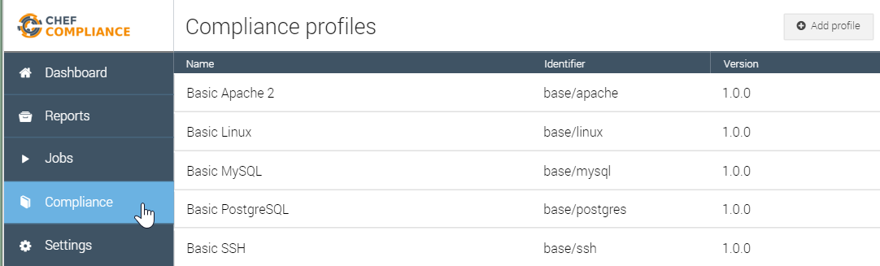
GL: Upload the Profile to Chef Compliance
From your Compliance Server Dashboard: Click the Compliance button and then click the Add Profile button.

Slide 33
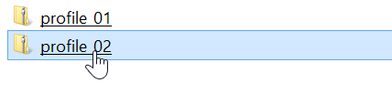
GL: Upload the Profile to Chef Compliance
Select the new zip file (profile_02) from your laptop.

Slide 34
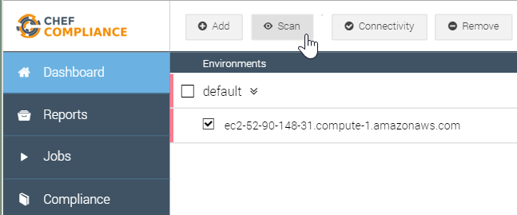
GL: Upload the Profile to Chef Compliance
From the Dashboard, select your node and then click the Scan button.

Slide 35
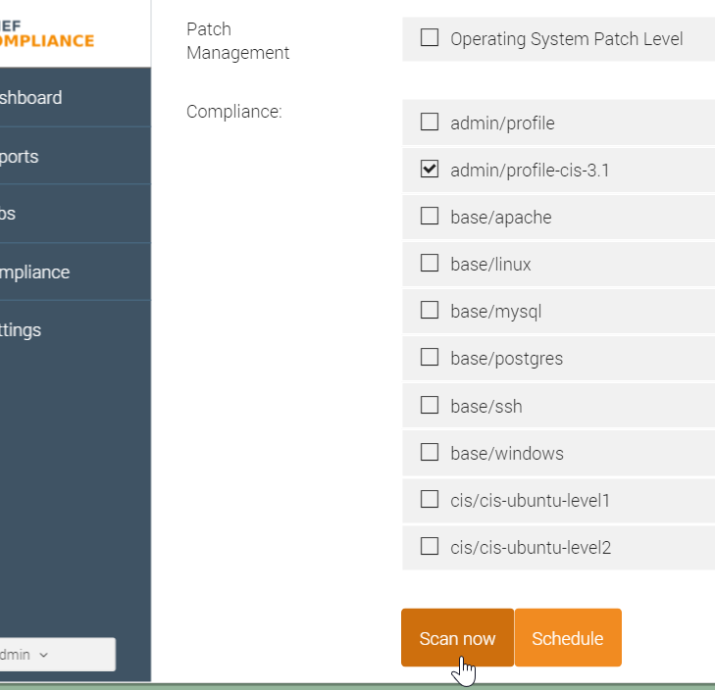
GL: Scan Using the New Profile
From the resulting page, select only the new profile (admin/profile-cis-3.1) and then click Scan now.
Notes:
Since you are logged into the Chef Compliance UI as 'admin', your profile is called 'admin/profile' on the 'Scan nodes' page.
Instructor Note: Regarding this note above--`Note: The profile name in this view is based on the name space in your metadata.rb.`--the compliance team may have improved that Compliance profile name field on the "Scan nodes" page by now to include whatever is the `title` value from the metadata.rb. Therefore it would match the name as displayed in the Compliance profiles page.

Slide 36
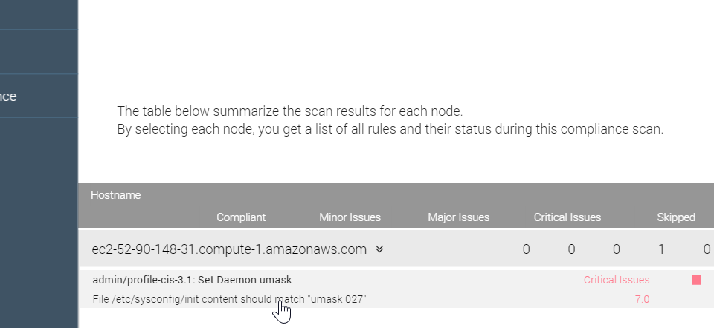
GL: Results of the Custom Profile Scan
The results of your scan should look like this example.
Notes:
The results of your scan should look like this example.
In this case, the scan should show a critical issue because /etc/sysconfig/init does not set umask to 027.
In the workplace you would want to write a recipe to remediate the /etc/sysconfig/init umask issue and then you could run the scan again to ensure you have corrected the issue.
For example, your remediation recipe should add this line to /etc/sysconfig/init: umask 027

Slide 37
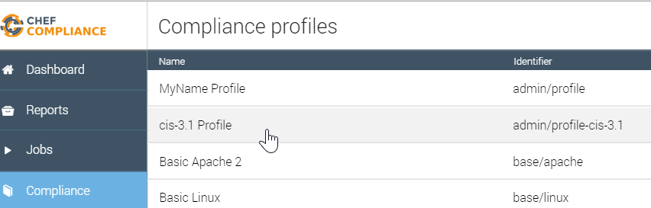
GL: Results of the Custom Profile Scan
You should also be able to see your custom profile from your Compliance page.

Slide 38
DoD Compliance Frameworks
Department of Defense (DoD) STIGs
The Security Technical Implementation Guides (STIGs) and the NSA Guides are the configuration standards for DOD IA and IA-enabled devices/systems.
Notes:
TBD: Do this lab as windows.

Slide 39
DoD Compliance Frameworks
Department of Defense (DoD) STIGs
Since 1998, DISA has played a critical role enhancing the security posture of DoD's security systems by providing the Security Technical Implementation Guides (STIGs).
The STIGs contain technical guidance to "lock down" information systems/software that might otherwise be vulnerable to a malicious computer attack.
http://iase.disa.mil/stigs/Pages/index.aspx

Slide 40
GL: Compliance Frameworks - DoD
Translating a CIS benchmark into an InSpec control and Compliance profile.
Download STIGViewer2.
Download STIG profiles for RHEL 6 and Windows 2012 MS (Member Server).
Write a compliance profile for RHEL 6 Category 1 benchmarks.
Implement the following Windows 2012 controls: V-1073, V-2374.
Package the profile and upload it to your Compliance server.

Slide 41
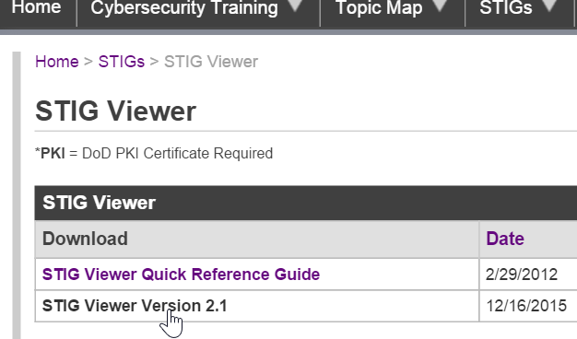
GL: Download STIGViewer2.x
From your local laptop, go to this site...
http://iase.disa.mil/stigs/Pages/stig-viewing-guidance.aspx
...and download the latest version of the STIG Viewer
Notes:
Go to this site...
http://iase.disa.mil/stigs/Pages/stig-viewing-guidance.aspx
...and download the latest version of the STIG Viewer. In this example we are downloading Version 2.1.
Try to run the STIG Viewer.

Slide 42
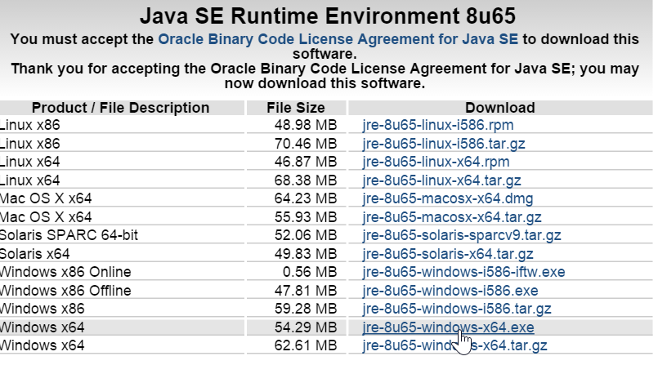
GL: Download Java JRE if Necessary
You may need to install the latest Java Runtime Environment (JRE) if your STIG Viewer doesn't launch when clicked.
http://www.oracle.com/technetwork/java/javase/downloads/jre8-downloads-2133155.html
Notes:
TBD: ask sean about setting path to inspec.

Slide 43
Review Questions
What is ...? ______________________________
Which is the correct answer?
answer
answer
answer
answer
Capable of carrying on a conversation
Explain

Slide 44
Delete tbd
The latest CIS benchmarks in PDF format can be downloaded from here:
https://benchmarks.cisecurity.org/downloads/latest/
From that link, scroll down to and download the
CIS CentOS Linux 6 Benchmark PDF.

Slide 45
©2016 Chef Software Inc.

