Slide 1
Todays Agenda
Introduction to Node Js.
Introduction To express Js.
Introduction to MongoDB.

Slide 2
What is Node JS
Node.js is an open-source and cross-platform JavaScript runtime environment.
Node.js runs the V8 JavaScript engine, the core of Google Chrome, outside of the browser.
A Node.js app runs in a single process, without creating a new thread for every request.
When Node.js performs an I/O operation, like reading from the network, accessing a database or the filesystem, instead of blocking the thread and wasting CPU cycles waiting, Node.js will resume the operations when the response comes back.
This allows Node.js to handle thousands of concurrent connections with a single server without introducing the burden of managing thread concurrency

Slide 3
V8 JS Engine
V8 is the JavaScript engine i.e. it parses and executes JavaScript code.
V8 is written in C++, and it's continuously improved. It is portable and runs on Mac, Windows, Linux and several other systems.
Other JS Engines :
  Firefox has SpiderMonkey
  Safari has JavaScriptCore (also called Nitro)
  Edge was originally based on Chakra but has more recently been rebuilt using Chromium and the V8 engine.

Slide 4
NPM & package.json
npm is the standard package manager for Node.js.
All package (dependencies) get added to package.json file.
Basic npm commands :
  npm instasll
  npm install <package-name>
  npm run <task-name>
  Npm install –g <package-name>

Slide 5
Blocking VS Non-Blocking
Blocking refers to the blocking of further operation until the current operation finishes. Blocking methods are executed synchronously. Synchronously means that the program is executed line by line. The program waits until the called function or the operation returns.
Non-Blocking refers to the program that does not block the execution of further operations. Non-Blocking methods are executed asynchronously. Asynchronously means that the program may not necessarily execute line by line. The program calls the function and move to the next operation and does not wait for it to return.

Slide 6
What is Express JS
Express is a minimal and flexible Node.js web application framework that provides a robust set of features for web and mobile applications.
Express JS is a small framework that works on top of Node web server functionality to simplify its APIs and add helpful new features. It makes it easier to organize your application’s functionality with middleware and routing. It adds helpful utilities to Node HTTP objects and facilitates the rendering of dynamic HTTP objects
npm install –save express .
Advantages :
  Simplicity and Minimalism
  Flexibility and Customization
  Middleware Ecosystem
  Scalability

Slide 7
MongoDB
MongoDB is an open-source document-oriented database that is designed to store a large scale of data and also allows you to work with that data very efficiently. It is categorized under the NoSQL (Not only SQL) database because the storage and retrieval of data in the MongoDB are not in the form of tables.
The MongoDB database contains collections just like the MYSQL database contains tables.
Now inside of the collection we have documents
The documents are created using the fields. Fields are key-value pairs in the documents, it is just like columns in the relation database.
The data stored in the MongoDB is in the format of BSON documents. Here, BSON stands for Binary representation of JSON documents.
In MongoDB documents, you are allowed to store nested data. This nesting of data allows you to create complex relations between data and store them in the same document which makes the working and fetching of data extremely efficient as compared to SQL

Slide 8
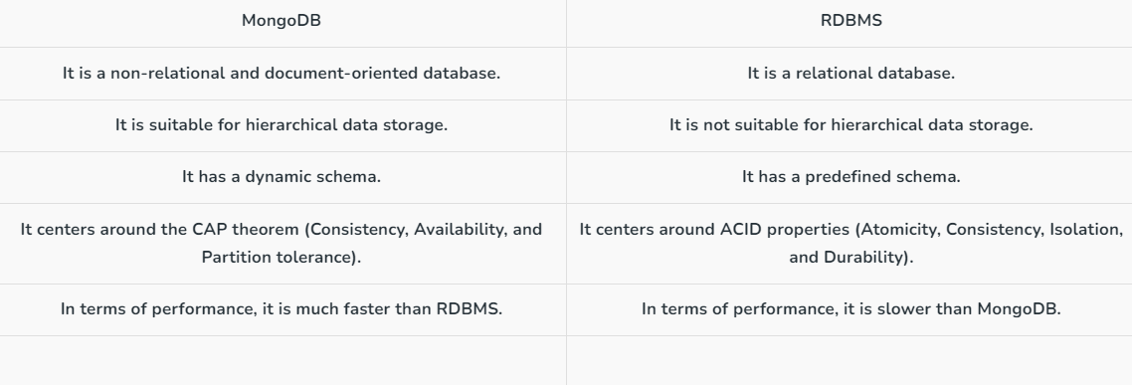
MongoDB VS RDBMS

