Slide 1
MCP Training

Slide 2
Limitation of Pre-trained Models
Pretrained up to say May 2024
Observations
User Query
LLM/SLM
Knowledge only upto May 2024
Answers are limited to its pretrained ability
Not open to live or real time information
For real time info, we need to connect to a tool/agent that can fetch needed information in real time
User
Answer with knowledge up to 2024

Slide 3
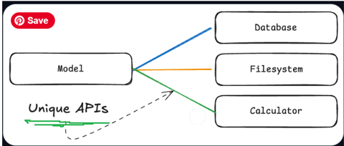
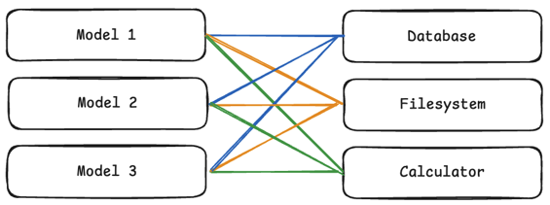
What could be the possible approach ?
Single user Interaction
Multiple user/Model Interaction
MXN Problem

Slide 4
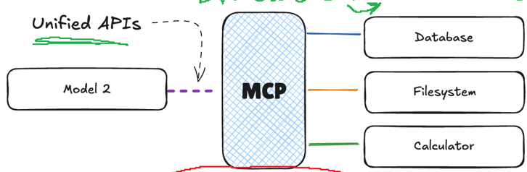
MCP (Model Context Protocol)
M1
M3
3 x 3 = 9
3 + 3

Slide 7
Process Outline – Tech stack
Equipment #1 (equip name, mapped icon image, equipment's dimensions, A list of other equipment to be connected to this equipment)
Equipment #2 ……. Equipment #N
Inputs
RFQ
BOM from CPR
Standard Syst Architecture
Step 1:
Take RFQ and BOM as input
Step 2:
Extract list of equipment & their connectivity
Step 3:
Refer standard Topology/ Architecture
Step 4:
Generate altered architecture
Step 5:
Provide in downloadable/editable format (svg, vsdx)
Proposed Algorithm
Use LLM
Z3 SMT solver
Graphviz
Input can be in the form of a list of Components with their metadata
Creates Nodes and edges list for Graph
Apply Constraints, remove the nodes and edges that are not part of the extracted list
Example: "The web server connects to the database through an API" can be converted to ⟶ WebServer ⟶ API ⟶ Database
where ⟶ is the connectivity (edge) while webserver, API, Database are the equipment (nodes)
Technology Stack:
LLM
Microsoft Z3 SMT (Satisfiability Modulo Theories) Solver
Graphviz

