Slide 1
Open Source & Open Data

Slide 2
Ben Chartoff
@benchartoff
benchartoff.com
github.com/bchartoff

Slide 3
Open Source

Slide 4
What is it?
Notes:
Also known as FOSS (Free and Open Source Software), in general pertains to software/ code. The source code of a project is a.) publicly available and b.) licensed to be freely and openly distributed c.) (not a technical but a functional def) hosted in a context that is easy to access (github vs. viewing source on a website)

Slide 5
Why?
Notes:
In many newsrooms or other orgs, this is the question you’re going to encounter.

Slide 6
Collaboration
Notes:
It’s a two way street!!
Working in the open
Collaborative workflows

Slide 7



Notes:
Firefox – totally open source browser, shepards of internet tech (MDN - https://developer.mozilla.org/en-US/)
D3.js – javascript library (data driven documents) written by Mike Bostock, currently of the NYT
Linux – FOSS operation system, widely used to a degree on person computers, but much more so on servers, devices (cars, microwaves, etc), the infrastructure of the web and tech. Used bc it is stable and fast
Git – version control system written by Linus Torvalds (creator of linux) in order to handle linux code

Slide 8
Git and Github
Notes:
For many, git (and github) are semi-synonymous w/ FOSS.
Private github also exists (plus bitbucket etc) and is used in many newsrooms/ by most devs
Examples: https://github.com/django/django contrib
https://github.com/unitedstates/congress-legislators/ issues

Slide 9
#you
Notes:
Personal brand (ugh)
Even if you’re not a dev, open source contributions look great to employers. Data heavy newsrooms or teams (Propublica, CIR, NPR, NYT) big into open source community
Can help w/ internal office reputation and politics

Slide 10
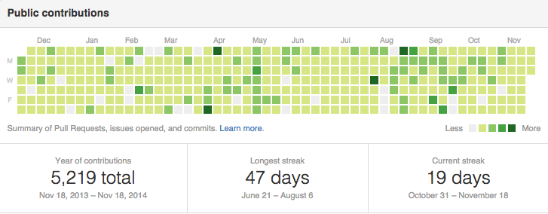
Notes:
My friend is crazy

Slide 11
What about Data?
Notes:
http://www.data.gov/
http://data.worldbank.org/

Slide 12
Data as a Public Good
Notes:
In many newsrooms or other orgs, this is the question you’re going to encounter.
http://theunitedstates.io/licensing/
http://openelections.net/

Slide 13
Journalism?

Slide 14
What’s next?
Notes:
Dat: http://dat-data.com/#content

