Slide 1
Open Source & Open Data

Slide 2
Ben Chartoff
@benchartoff
benchartoff.com
github.com/bchartoff

Slide 3
Open Source

Slide 4
What is it?
Notes:
Also known as FOSS (Free and Open Source Software), in general pertains to software/ code. The source code of a project is a.) publicly available and b.) licensed to be freely and openly distributed c.) (not a technical but a functional def) hosted in a context that is easy to access (github vs. viewing source on a website)

Slide 5
Why?
Notes:
In many newsrooms or other orgs, this is the question you’re going to encounter.

Slide 6
Collaboration
Notes:
It’s a two way street!!
Working in the open
Collaborative workflows

Slide 7



Notes:
Firefox – totally open source browser, shepards of internet tech (MDN - https://developer.mozilla.org/en-US/)
D3.js – javascript library (data driven documents) written by Mike Bostock, currently of the NYT
Linux – FOSS operation system, widely used to a degree on person computers, but much more so on servers, devices (cars, microwaves, etc), the infrastructure of the web and tech. Used bc it is stable and fast
Git – version control system written by Linus Torvalds (creator of linux) in order to handle linux code

Slide 8
Git and Github

Slide 9
#you

Slide 10
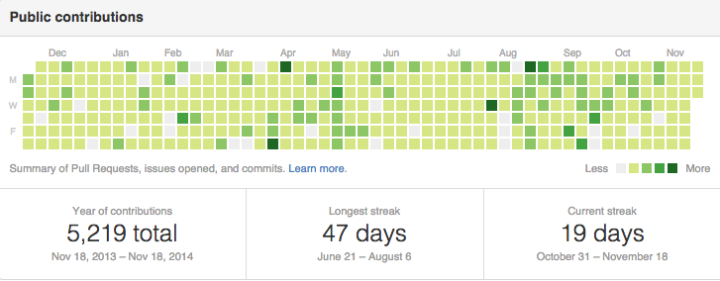

Slide 11
What about Data?

