Slide 1
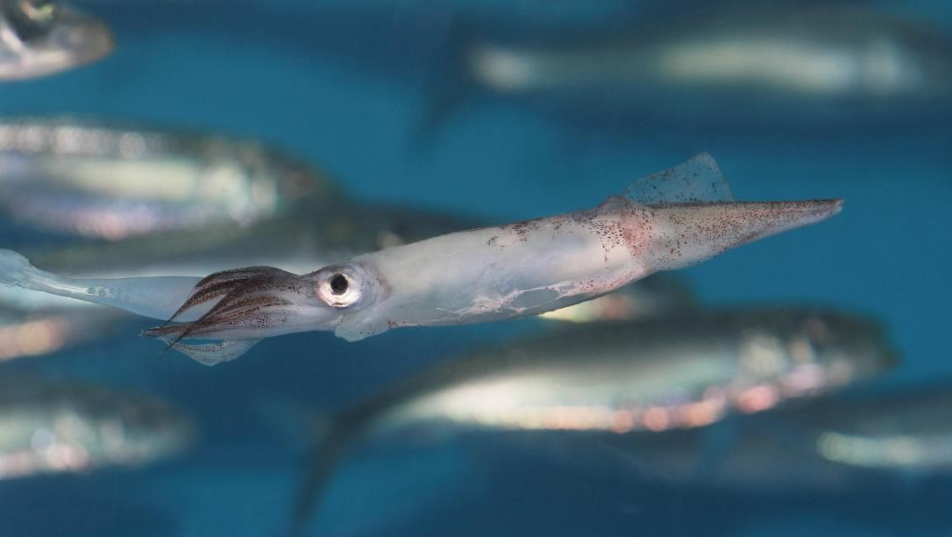
Evidence of temperature driven shifts in market squid
(Doryteuthis opalescens)
densities and distribution in the California Current Ecosystem
Brandon Chasco¹ , Mary Hunsicker ^{1,2} , Kym Jacobson¹ , Owen Welch⁴ ,
Cheryl Morgan¹ , Barbara A. Muhling³, Jeff Harding³
¹ NWFSC, Ocean Ecology
² NWFSC, FATE
³ SWFSC
⁴ OSU
https://aquarium.org/market-squid-eggs/
Notes:
https://aquarium.org/market-squid-eggs/
PC: Monterey Bay Aquarium, Loligo opalescens, or the market squid
Evidence of temperature driven shifts in market squid (Doryteuthis opalescens) densities
and distribution in the California Current Ecosystem

Slide 2
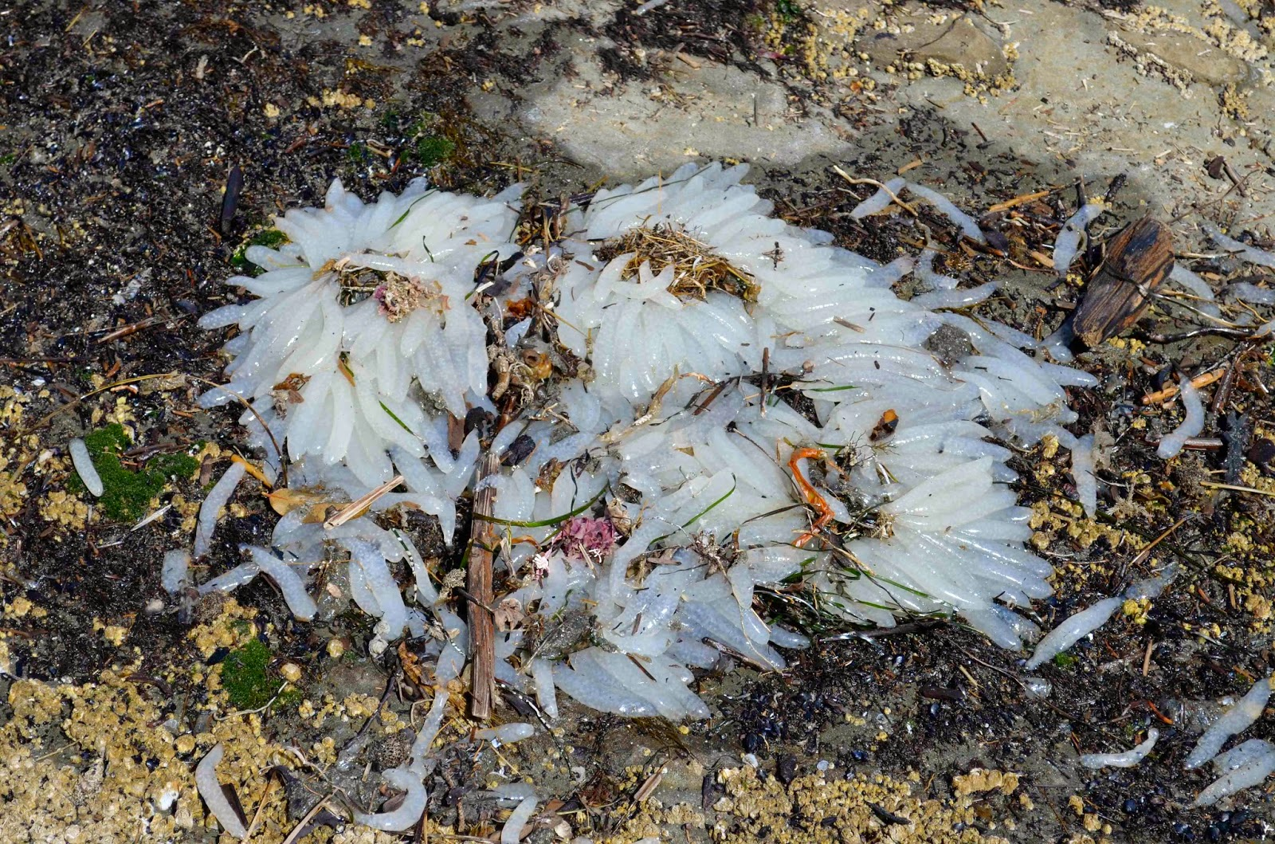
http://byui-mbfe.blogspot.com/2015/04/mbfe-day-7-sun-and-sand.html
Notes:
Market squid are fast-growing animals with a short natural life span. They reach up to 1 foot in total length, including their arms.
They semelaparous and spawn at less an 1 year.
They spawn year-round. Spawning occurs April through October in central California and October through the end of April or May in southern California.
Spawning squid congregate in large schools near their spawning grounds, usually over sandy habitats.
Males deposit spermatophores into females, and the eggs are fertilized as females release them. Females produce about 20 egg cases, with each case containing about 200 individual eggs.
Females deposit eggs on sandy habitats, building large mounds of egg cases. Eggs take several days to months to hatch, depending on temperature.
Newly hatched eggs are called “paralarvae” and resemble miniature adults.
Juvenile market squid feed on small crustaceans. As they grow, they feed on krill, small crustaceans, small fish, and other squid.
Market squid are a critical food source for a variety of fish (salmon, lingcod, and rockfish), seabirds, and marine mammals.

Slide 3
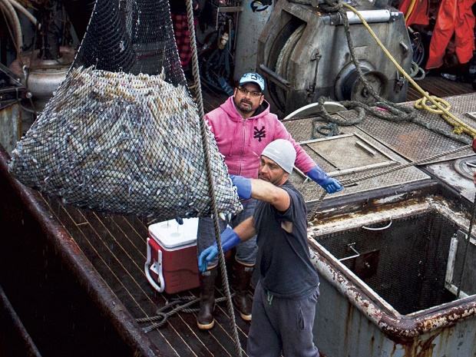
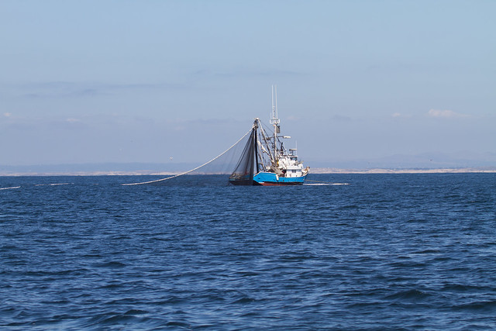
Commercial catches
Largest west coast fishery
~70,000 mt yr⁻¹
~$47,000,000 yr⁻¹
https://www.earthisland.org/journal
Notes:
Squid in Oregon is not new, but it’s seen a large uptick in recent years. The CA fishery is a lot more established and in fact most of the squid are shipped to CA for processing.
Oregon squid catches - https://www.dfw.state.or.us/MRP/regulations/commercial_fishing/docs/MrktSquidPubMtg_2020_Final.pdf
CA data - https://wildlife.ca.gov/Conservation/Marine/Pelagic#52132543-commercial-catch
yc <- c(2000,2001,2002,2003,2004,2005,2006,2007,2008,2009,2010,2011,2012,2013,2014,2015,2016,2017,2018,2019,2020)
cc <- c(10,10,10,10,10000,10,10000,10,10,5000,10,10,10,10,10,3000000,10,7000000,5500000,7300000,NA)
Df <- cbind(yc,cc)
plot(Df)

Slide 4
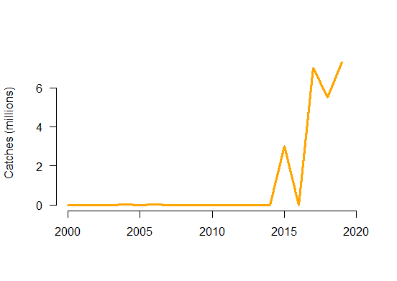
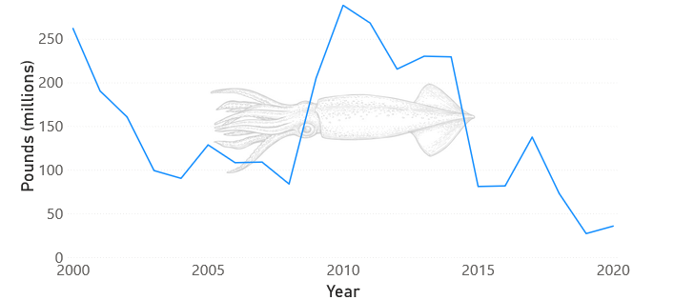
Commercial catches
ODFW - Buell
5%
95%
CDFW
Notes:
I think it’s important to note that we are modeling the squid population from an spatial domain that accounts for only about 5% of the squid catches. I should also note that another goal of the project is to start publishing some of the historical data from the JSOES project.

Slide 5
Survey data
Year JSOES SWFSC
1998 40 0
1999 50 0
2000 28 0
2001 48 0
2002 53 0
2003 65 0
2004 56 0
2005 43 0
2006 68 0
2007 52 0
2008 52 0
2009 50 0
2010 55 61
2011 54 68
2012 69 52
2013 50 55
2014 48 68
2015 45 66
2016 45 35
2017 52 0
2018 64 0
2019 51 0
Notes:
We wanted to look at the squid catches in the juvenile fish surveys from the NWFSC and SWFSC and see if we could infer anything about changes in densities and in their relationship to climate conditions

Slide 6
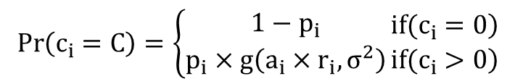
VAST model
Encounter rate
$$\operatorname{Pr}\left(c_{i}=C\right)=\left\{\begin{matrix}1−p_{i} \\ p_{i}×g\left(a_{i}×r_{i},σ^{2}\right)\end{matrix}\right.\begin{matrix}\left.if(c_{i}=0\right) \\ \left.if(c_{i}>0\right)\end{matrix}$$
Density
$$\operatorname{logit}\left(p_{i}\right)=\begin{matrix}intercept \\ \overbrace{β_{p}\left(t_{i}\right)}\end{matrix}+\begin{matrix}spatial \\ \overbrace{L_{ω_{p}}(f_{i})ω_{p}\left(s_{i},f_{i}\right)}\end{matrix}+\begin{matrix}spatiotemporal \\ \overbrace{L_{ε_{p}}(f_{i})ε_{p}\left(s_{i},t_{i},f_{i}\right)}\end{matrix}+\begin{matrix}catchability covariates \\ \overbrace{λ_{p}\left(k\right)Q\left(i,k\right)}\end{matrix}$$
$$\log\left(r_{i}\right)=\begin{matrix}intercept \\ \overbrace{β_{r}\left(t_{i}\right)}\end{matrix}+\begin{matrix}spatial \\ \overbrace{L_{ω_{r}}(f_{i})ω_{r}\left(s_{i}\right)}\end{matrix}+\begin{matrix}spatiotemporal \\ \overbrace{L_{ε_{r}}{\left(f_{i})ε\right.}_{r}\left(s_{i},t_{i},f_{i}\right)}\end{matrix}+\begin{matrix}catchability covariates \\ \overbrace{λ_{i_{r}}\left(k\right)Q\left(i,k\right)}\end{matrix}$$
Notes:
To do this we built a VAST model, which is meant to account for biases that might arise from temporal and spatial biases that might arise from the data collection process. The VAST model contains two parts to the probability that squid occur in the survey area and the probability of the number/density of squid captured.

Slide 7
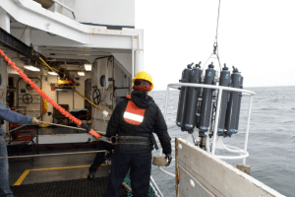
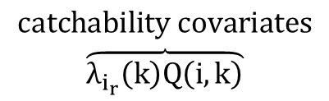
$$\begin{matrix}catchability covariates \\ \overbrace{λ_{i_{r}}\left(k\right)Q\left(i,k\right)}\end{matrix}$$
Salinity
Temperature
Notes:
The VAST model can do a lot of things but we only included covariates for the catchability of squid, and then we will make a heuristic comparison to warm pool events associated with the MHW.

Slide 8
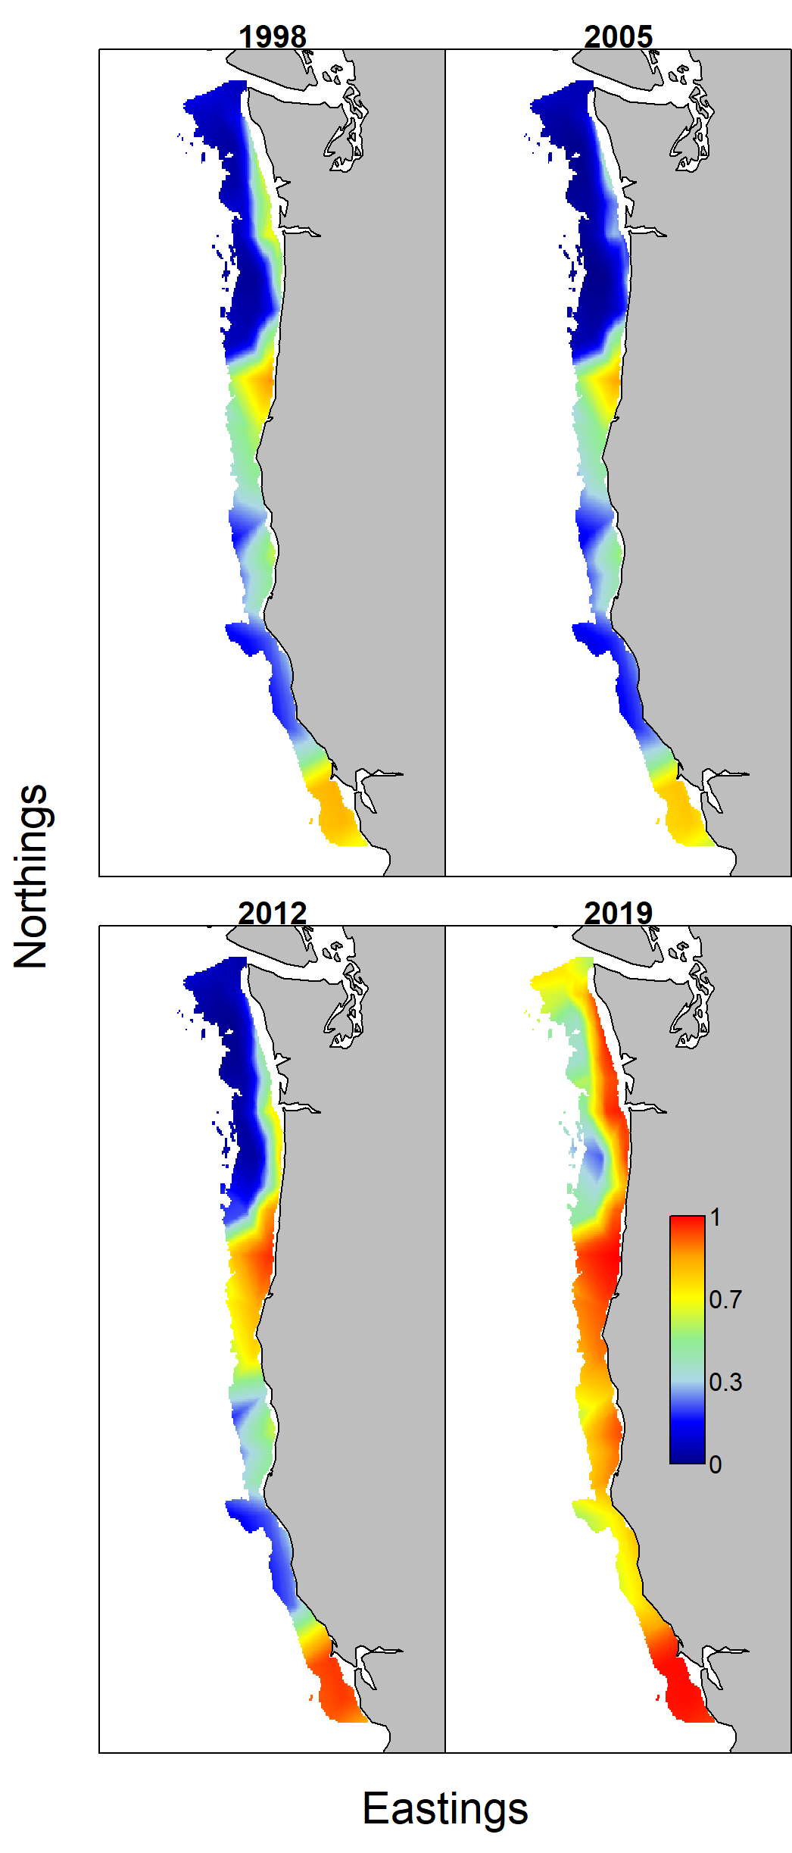
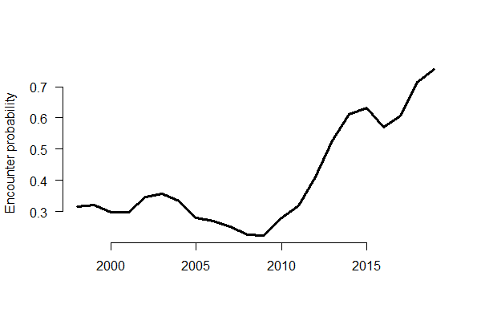
VAST results
$$\operatorname{logit}\left(p_{i}\right)=\begin{matrix}intercept \\ \overbrace{β_{p}\left(t_{i}\right)}\end{matrix}+\begin{matrix}spatial \\ \overbrace{L_{ω_{p}}(f_{i})ω_{p}\left(s_{i},f_{i}\right)}\end{matrix}+\begin{matrix}spatiotemporal \\ \overbrace{L_{ε_{p}}(f_{i})ε_{p}\left(s_{i},t_{i},f_{i}\right)}\end{matrix}+\begin{matrix}catchability covariates \\ \overbrace{λ_{p}\left(k\right)Q\left(i,k\right)}\end{matrix}$$
Notes:
Let’s just jump right into the results. Here is a comparison of the spatiotemporal changes in squid encounter rates between 1998 and 2019. There are two things to notice: 1) there are hotspots of encounters, and I think that is to be expected since squid need very specific conditions for laying there eggs, 2) the increase in encounter rates occurs across the entire spatial domain.
plot(1998:2019,plogis(All_fit$Report$beta1_tc), las=1, type="l", col="black", bty="n", ylab="Encounter probability", xlab="", lwd=3)

Slide 9
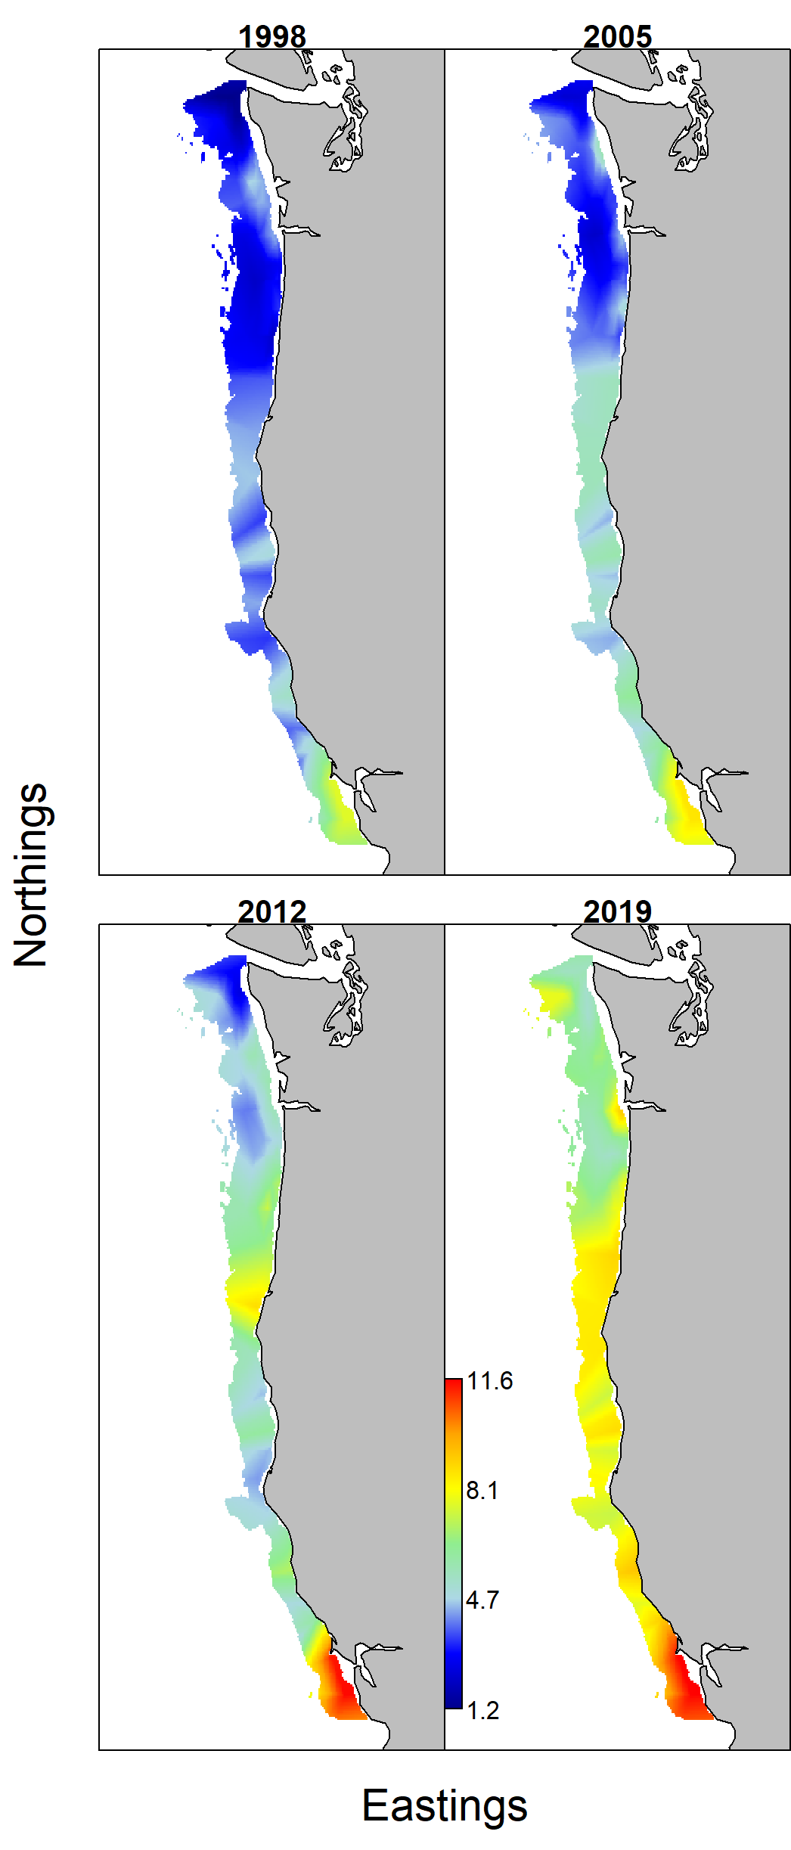
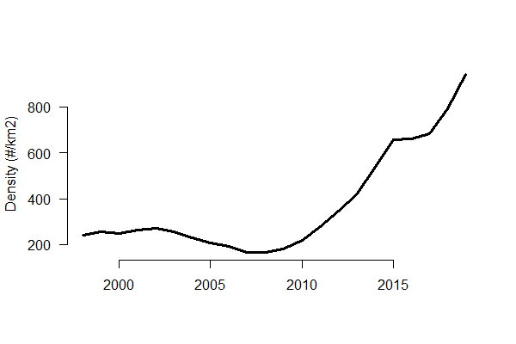
VAST results
$$\log\left(r_{i}\right)=\begin{matrix}intercept \\ \overbrace{β_{r}\left(t_{i}\right)}\end{matrix}+\begin{matrix}spatial \\ \overbrace{L_{ω_{r}}(f_{i})ω_{r}\left(s_{i}\right)}\end{matrix}+\begin{matrix}spatiotemporal \\ \overbrace{L_{ε_{r}}{\left(f_{i})ε\right.}_{r}\left(s_{i},t_{i},f_{i}\right)}\end{matrix}+\begin{matrix}catchability covariates \\ \overbrace{λ_{i_{r}}\left(k\right)Q\left(i,k\right)}\end{matrix}$$
Notes:
If we look at squid densities we see a similar pattern. Hotspots of high density in 1998 and 2019 (this is a log-scale), and a general increase across all regions.
plot(1998:2019,plogis(All_fit$Report$beta1_tc), las=1, type="l", col="black", bty="n", ylab="Encounter probability", xlab="", lwd=3)

Slide 10
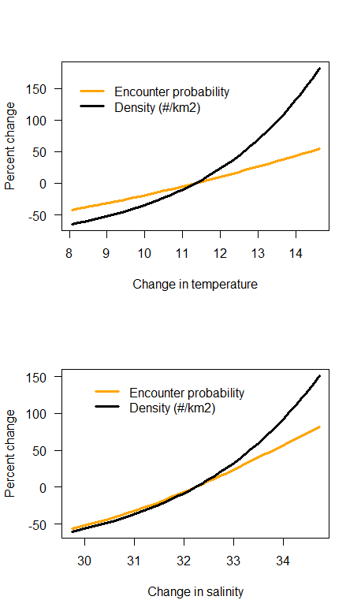
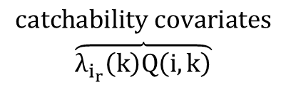
VAST results
Temperature
$$\begin{matrix}catchability covariates \\ \overbrace{λ_{i_{r}}\left(k\right)Q\left(i,k\right)}\end{matrix}$$
Salinity
Notes:
If we look at the squid response to environmental factors, temperature and salinity results in higher encounter rates and density, although I should say this pattern breaks down when we disaggregate the data, suggesting that there are are likely other regional forces are play.

Slide 11
How do shifts in the distribution coincide
with large basin-scale drivers?
Notes:
Once of the things we can do with spatiotemporal models is integrate across the spatial domain and look for shifts in the species distributions. This a plot of the center of gravity for the squid population north of Monterey Bay. What we see is that, despite and coast wide increase, the center of gravity of the population remains relatively stable, except in a couple of years, xx, xx, and xx.

Slide 12
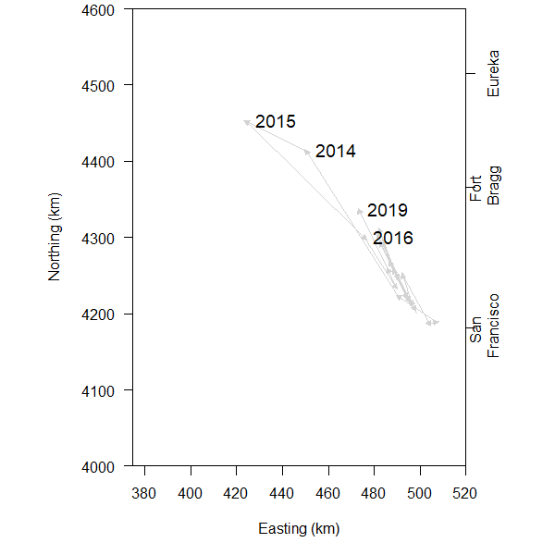
VAST derived variables
How much has the center of gravity shifted
during the last 20 years?
Notes:
Once of the things we can do with spatiotemporal models is integrate across the spatial domain and look for shifts in the species distributions. This a plot of the center of gravity for the squid population north of Monterey Bay. What we see is that, despite and coast wide increase, the center of gravity of the population remains relatively stable, except in a couple of years, xx, xx, and xx.

Slide 13
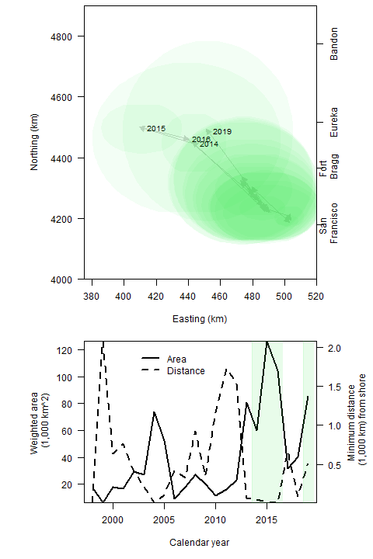
We compared estimates of total area and distance from shore for MHW to shifts in the COG.
Notes:
Many of you may be thinking what does these dramatic shifts have to do with the marine heatwave. There are two statistics that I downloaded from the NOAA website: the size and distance from shore.
The year when the MHW was large and close to shore, are the same year we see large shifts in the squid distribution.

Slide 14
Actionable Advice
Research and Monitoring
Fill critical ocean ecology data gaps
Marine heatwaves may be driving large shifts in squid distribution
Experimental Studies
Justification for future JSOES studies
Integrate all west coast studies into a squid assessment
Actively manage other marine species
Need to find out who’s eating squid (everyone). Work with I. Kaplan to see if shifts are important in EBFM.
Incorporate Early Warning Indicators
‘wetfish’ fisheries along the central coast of California, identified fleet diversification and early warning systems to shifts in species distribution caused by climate forces as a key goal (Aguilera et al. 2018)
CDFG and SWFSC has seen the paper. Next step is to build a forecast model with fishermen and economists in mind.
Crozier et al. 2021

