Slide 1
Computational motor control and learning:
a game theoretic approach
Ben Chasnov, Behnoosh Parsa Dr. Sam Burden, Dr. Lillian Ratliff

Slide 2
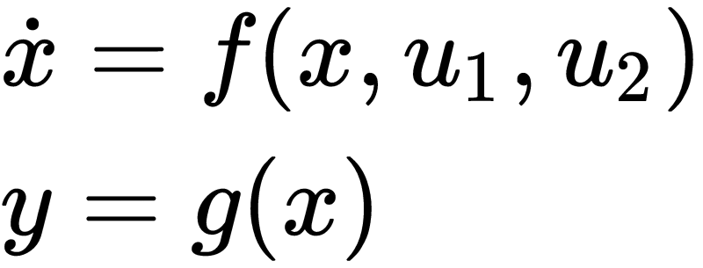

Motivation: Multi-agent Dynamics
Dynamical system
Player 1’s optimal trajectory
Player 2’s optimal trajectory
Coupled dynamics?
?

Slide 3
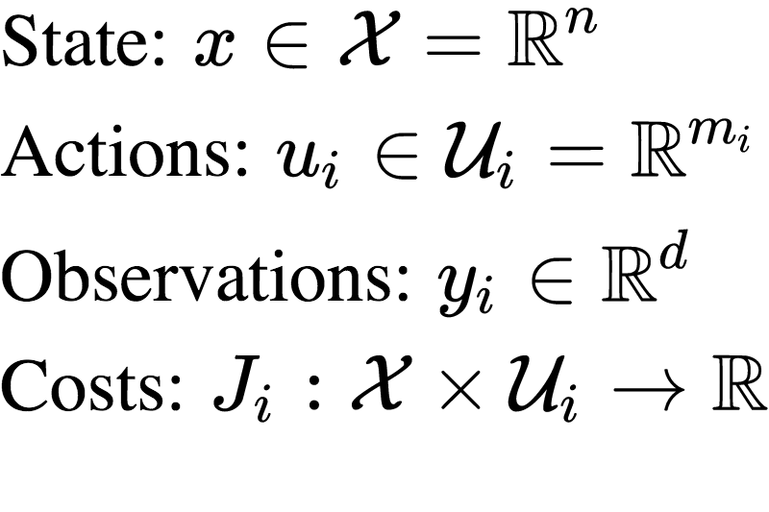

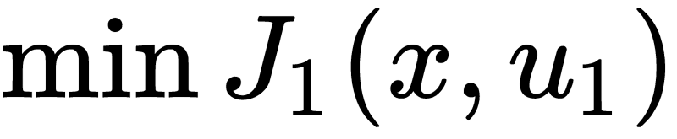


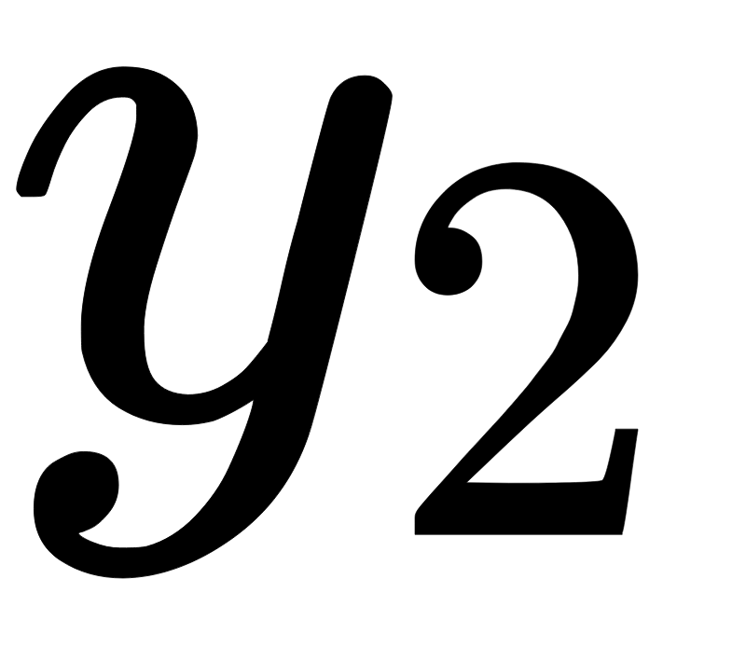
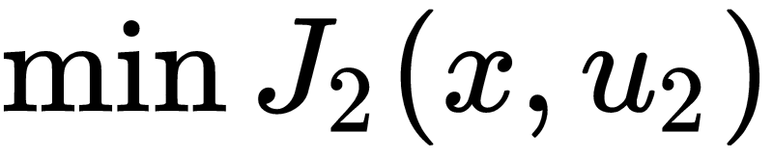
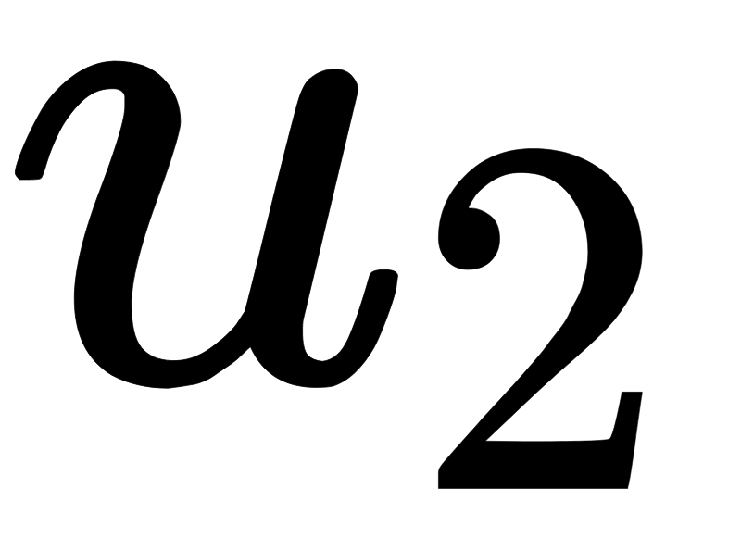
Mathematical Model
Agent 1
Environment
Agent 2 …...

Slide 4
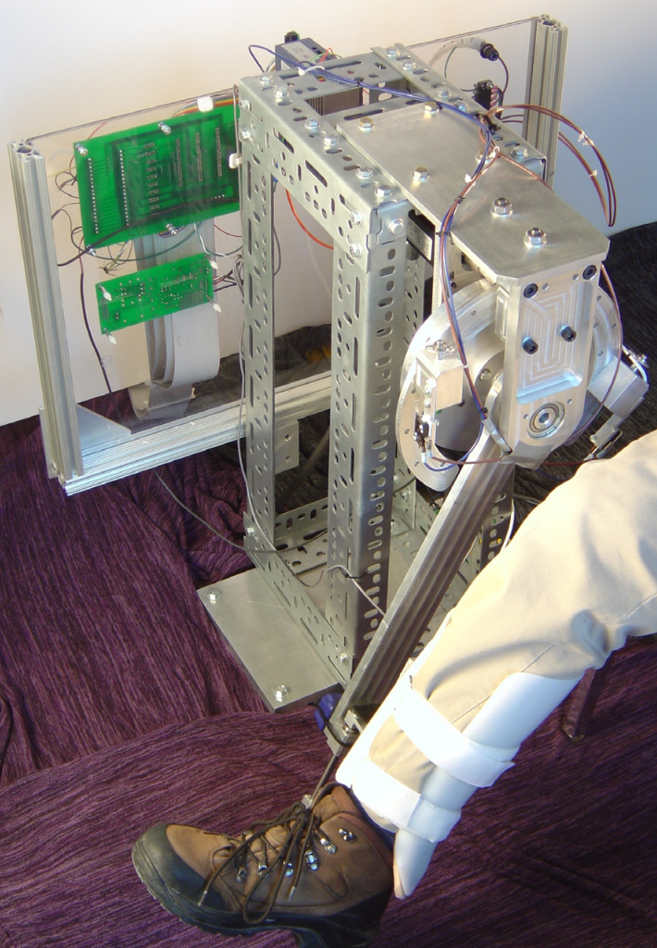
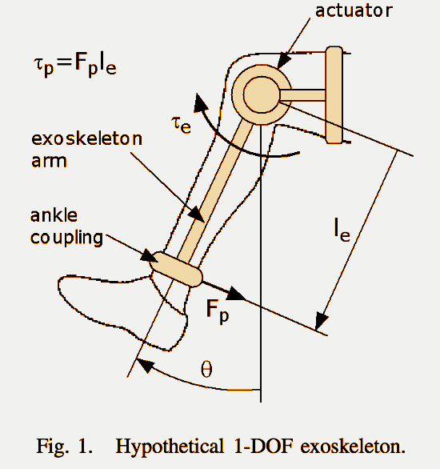
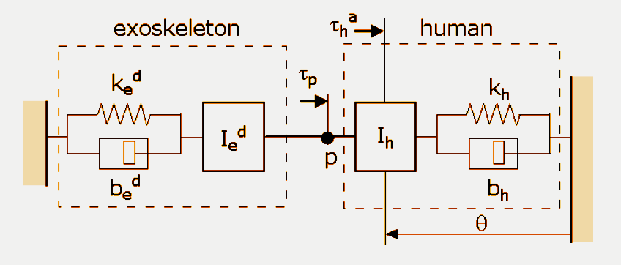
Mechanical Human/Agent Example
Reed, Peshkin (2008)

Slide 5
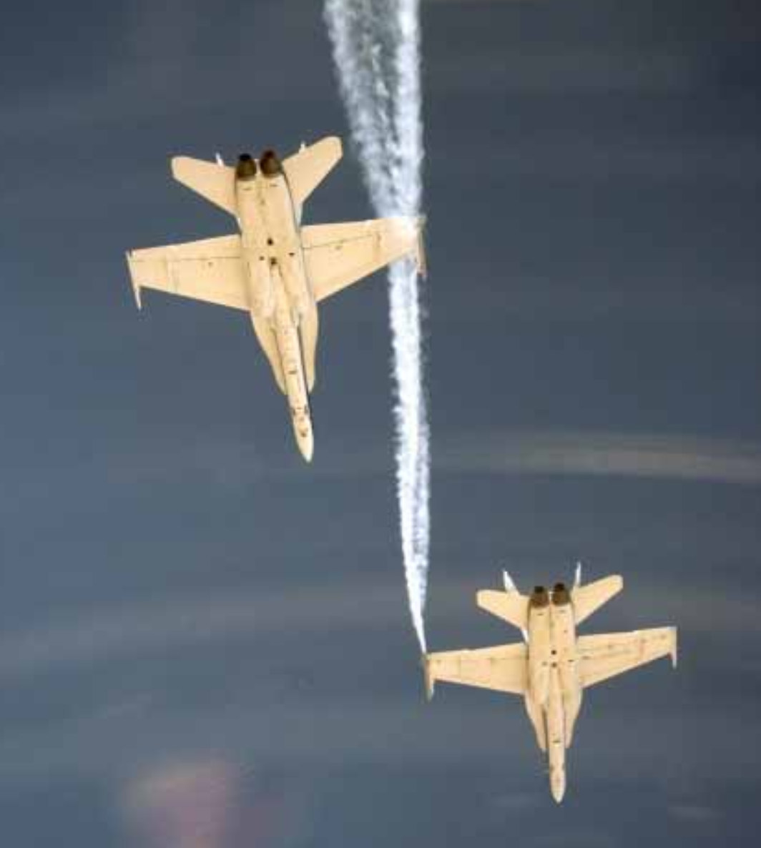
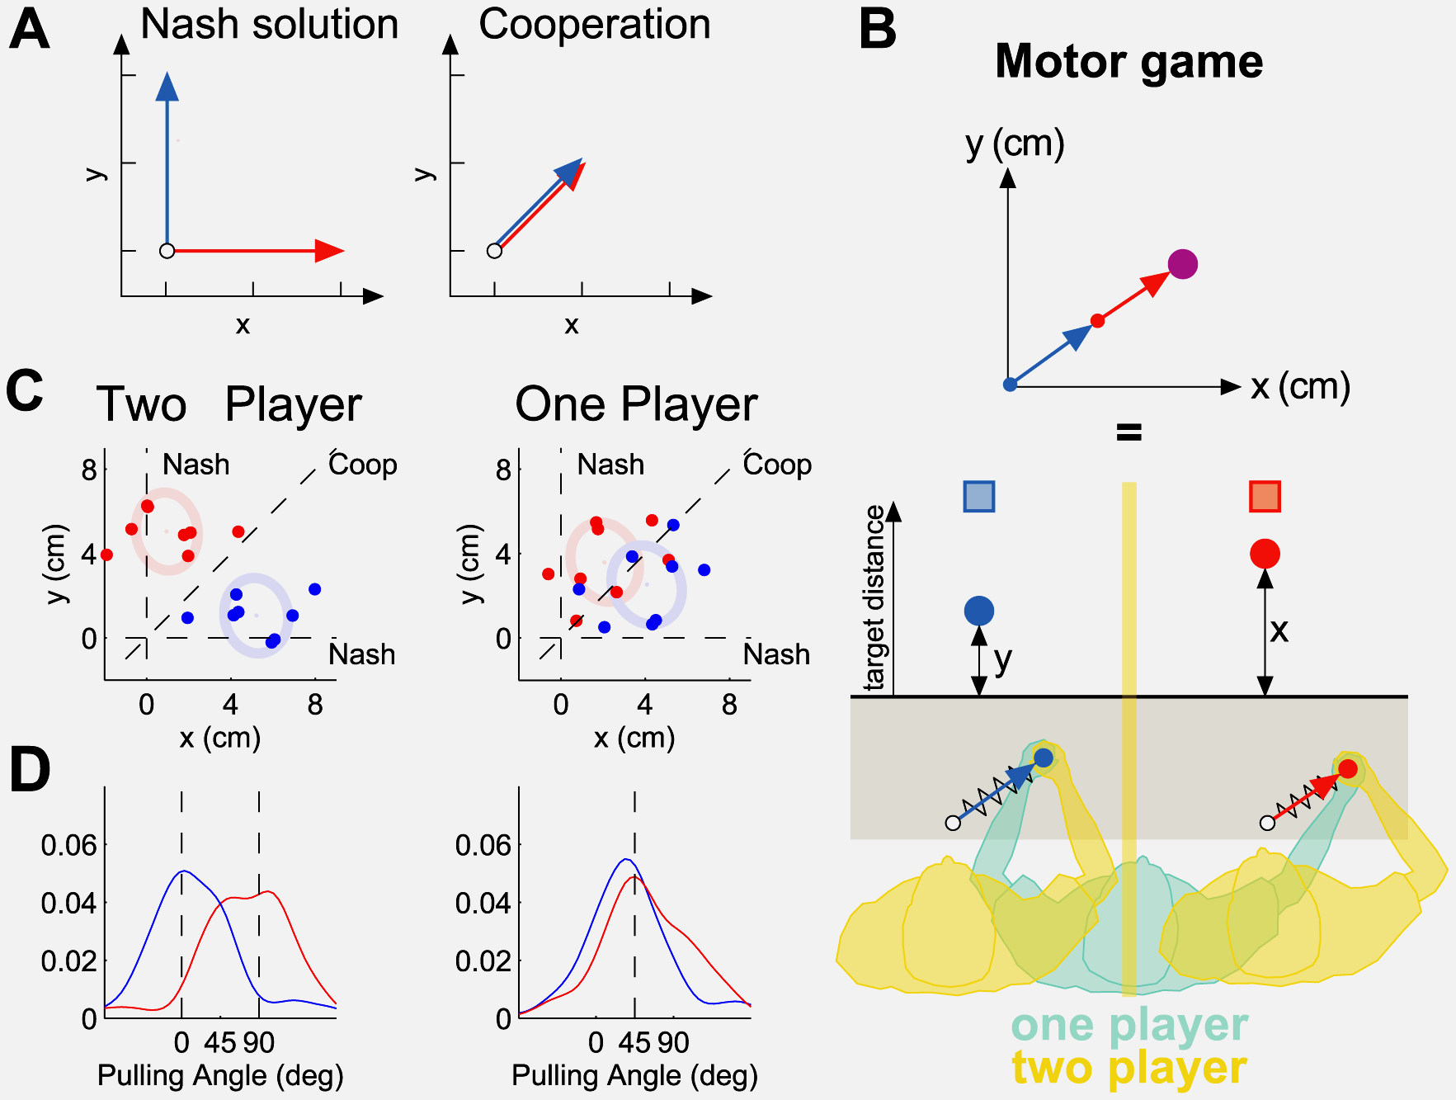
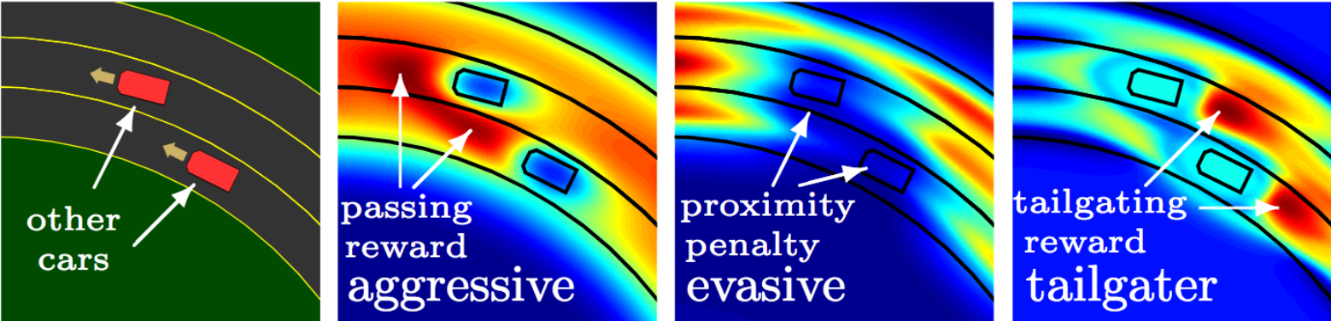
Prior work
Adaptive Control (Slotine, 1980s …) Learns unknown system parameters
Inverse optimal control (Levine, Abbeel, Ng, etc, 2000s …) Learns control law from trajectory
Dynamic noncooperative games (Başar, Olser, 1999 … ) Theoretical framework for analyzing dynamic games
Motor games (Wolpert, 2009 … ) Cooperation vs nash equilibrium in motor games
Lavretsky et. al (2003)
Levine, Vladlen (2012)
Braun, Pedro, Wolpert (2009)

Slide 6
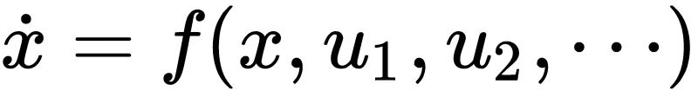

Our contribution
Dynamical system
Non-cooperative agents
Online adaptive controllers Learns unknown parameters/control law of other agents
Game theoretic insights Nash equilibria, stackelberg equilibria, information patterns…
Experimental validation of theory

Slide 7
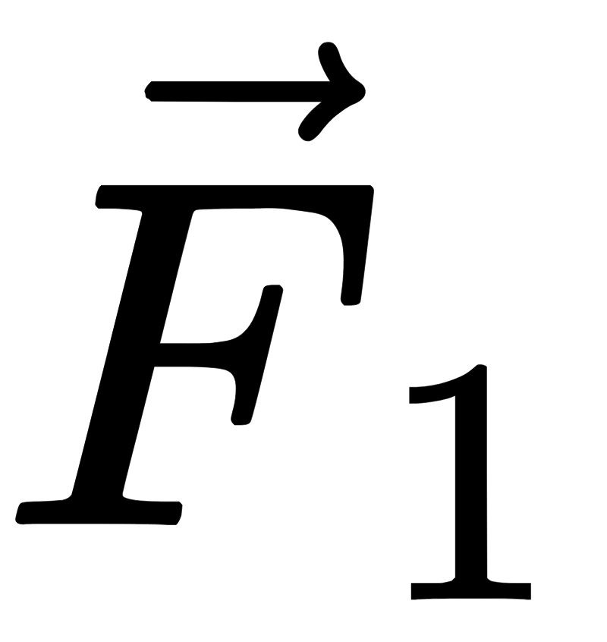

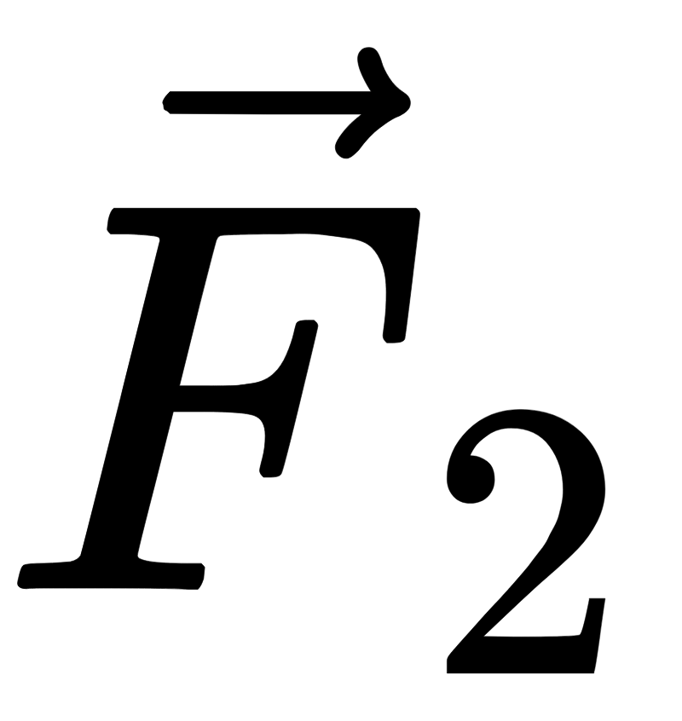
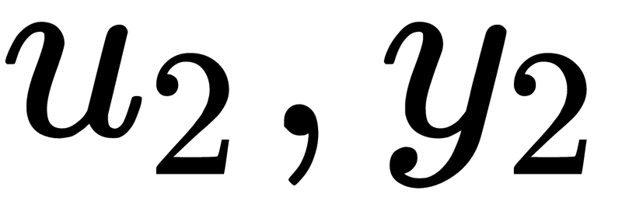
Experimental setup
Motion capture
Dynamics simulator
( )
Haptic paddles

Slide 8
Questions?
References
Basar, Tamer, and Geert Jan Olsder. Dynamic noncooperative game theory. Vol. 23. Siam, 1999.
Braun, Daniel A., Pedro A. Ortega, and Daniel M. Wolpert. "Nash equilibria in multi-agent motor interactions." PLoS computational biology 5, no. 8 (2009): e1000468.
Lavretsky, E., Hovakimyan, N., Calise, A., Stepanyan, V. “Adaptive Vortex Seeking Formation Flight Neurocontrol”, AIAA-2002-4757, AIAA GN&C Conference,St. Antonio, TX, 2003.
Levine, Sergey, and Vladlen Koltun. "Continuous inverse optimal control with locally optimal examples." arXiv preprint arXiv:1206.4617 (2012).
Reed, Kyle B., and Michael A. Peshkin. "Physical collaboration of human-human and human-robot teams." IEEE Transactions on Haptics 1, no. 2 (2008): 108-120.
Slotine, Jean-Jacques E., and Weiping Li. Applied nonlinear control. Vol. 199, no. 1. Englewood Cliffs, NJ: Prentice hall, 1991.

Slide 9
Project Timeline
April May June
Lit review
Develop novel models and theory:
...
(Method 1) LQR games via gradient play
July Aug Sept
Summer Spring
(Method 2) MDP minimax games via LPs
(Method 3) Adaptive control for multi-agents
Hardware testbench:
Source parts
Manufacture first prototype
Prelim. data collection and verification
Iterate second prototype

Slide 10
Summer deliverables
✓ Completed ⌾ In progress
Theory
LQR games via gradient play
Convergence guarantees ✓
Prelim simulations ✓
MDP minimax games
Problem formulation with constraints ✓
Prelim. simulations ⌾
Adaptive control with multi-agent SI
Novel multi-agent approach ⌾
Inverse optimal control
Shift nash of cost minimizing agents
Prelim. simulations
Experimental
Modular testbench: series-elastic haptic paddle
Design first prototype ✓
Source parts ✓
Print and assemble ⌾
Simple PID controller ⌾
Validation experiments:
Adaptive controller detects sys. params. ⌾
Reproduce Wolpert motor games
(Stretch goal) Novel experiments
Characterize nash of two-player dynamic games
Inverse reinforcement learning via adaptive control
(Stretch goal) Extend modular hardware setup
Hopper games
Balance games

