Slide 1
Creating Feeds for News, Events, and More
Vinit Varghese
Implementation Manager

Slide 2
Agenda
Understanding RSS
Overview of page templating
Understanding RSS items
Configuring the TCF
Displaying the feed items

Slide 3
RSS
Rich Site Summary; AKA Really Simple Syndication
Displays real-time updated bursts of information
Often used for:
News
Events
Announcements
Feeds are configured by administrators
Items are added by end users and administrators
OU Campus uses feeds and aggregates of feeds
Maintain the item in one place and update multiple feeds

Slide 4
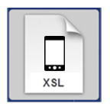


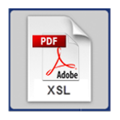

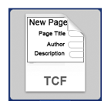

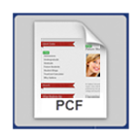
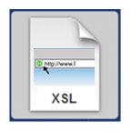
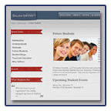
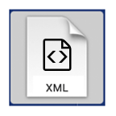

Template Structure
PRODUCTION
STAGING

Slide 5
Terminology
TCF = Template Control File
Can contain 4 lists:
Variable List
Directory List
Template List
Navigation List
May use multiple TMPLs
May be used to pass RSS variables
May utilize auto navigation

Slide 6
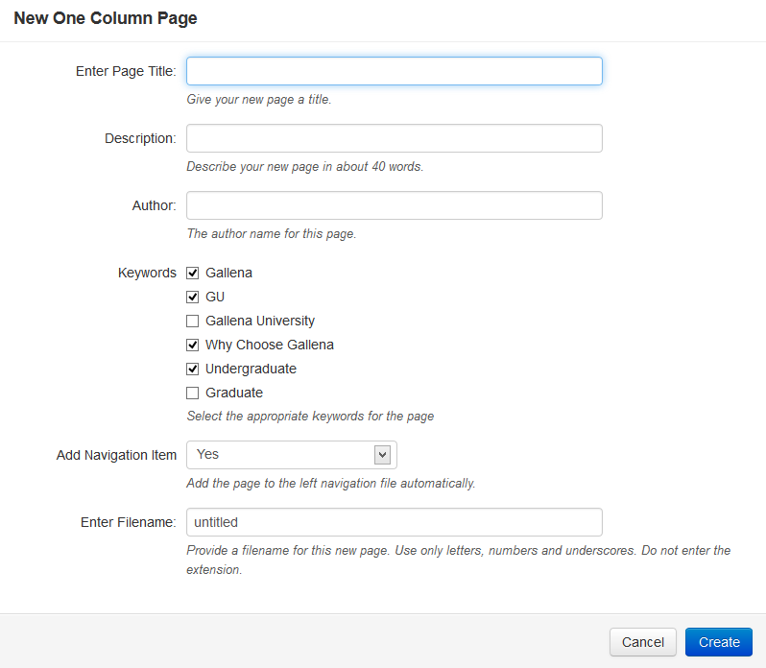
Template Control File (TCF)

Slide 7
RSS Items
Pass components from variables through templates
Variables can include:
Feed
Title
Description
Author
Link
Media
Extra XML elements
Publish date
Item is posted when page is published

Slide 8
Let’s Do It!

Slide 9
Q&A

Slide 10
Don’t forget to take our survey
outc15.com/surveys

Slide 11
Thank you!

