Slide 1
Ternary Content Addressable Memory
Ben Chavet
James Dicke

Slide 2
Background
Ternary
  Uses key/mask input pair
  Three states: 0, 1, and x (don’t care)
CAM: Content Addressable Memory
  Hardware version of associative array

Slide 3
Memory Retrieval using Mask
Input: 00010011
Mask: 00000101
Retrieves contents of first occurrence with address:
  00010010,
  00010011,
  00010110, or
  00010111

Slide 4
Inputs / Outputs
Inputs
  8-bit key
  8-bit mask
  16-bit input word
  memwrite
  delete
  reset
Outputs
  16-bit output word
  memfull
  notfound

Slide 5
Features
Power conservation
  When match found, subsequent words disabled using
Chaining multiple CAMs in series
  Additional inputs & outputs: fullPrev, notFoundPrev, pass

Slide 6
Modes of Operation
Read
  always active
  out = mem[key/mask pair]
  if key/mask pair is absent:
    out = 0
    notfound = 1

Slide 7
Modes of Operation
Write
  active when write = 1
  if CAM is full:
    memfull = 1
  else:
    if address key is present:
      mem[key] = input
    else
      mem[unused memory space] = input

Slide 8
Modes of Operation
Delete
  active when delete = 1
  if key is present:
    mem[key] occupied flag set to 0
  else
    Do nothing

Slide 9
Modes of Operation
Reset
  active when reset = 1
  all occupied flags = 0
  Note: Reset required for CAM initialization

Slide 10
Modes of Operation
Pass
  active when pass = 1
  out = input
  Note: Used only for chaining

Slide 11
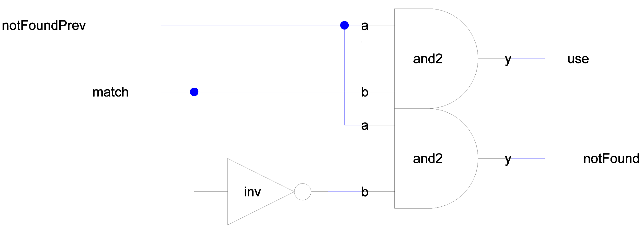
Schematics: found{sch}

Slide 12
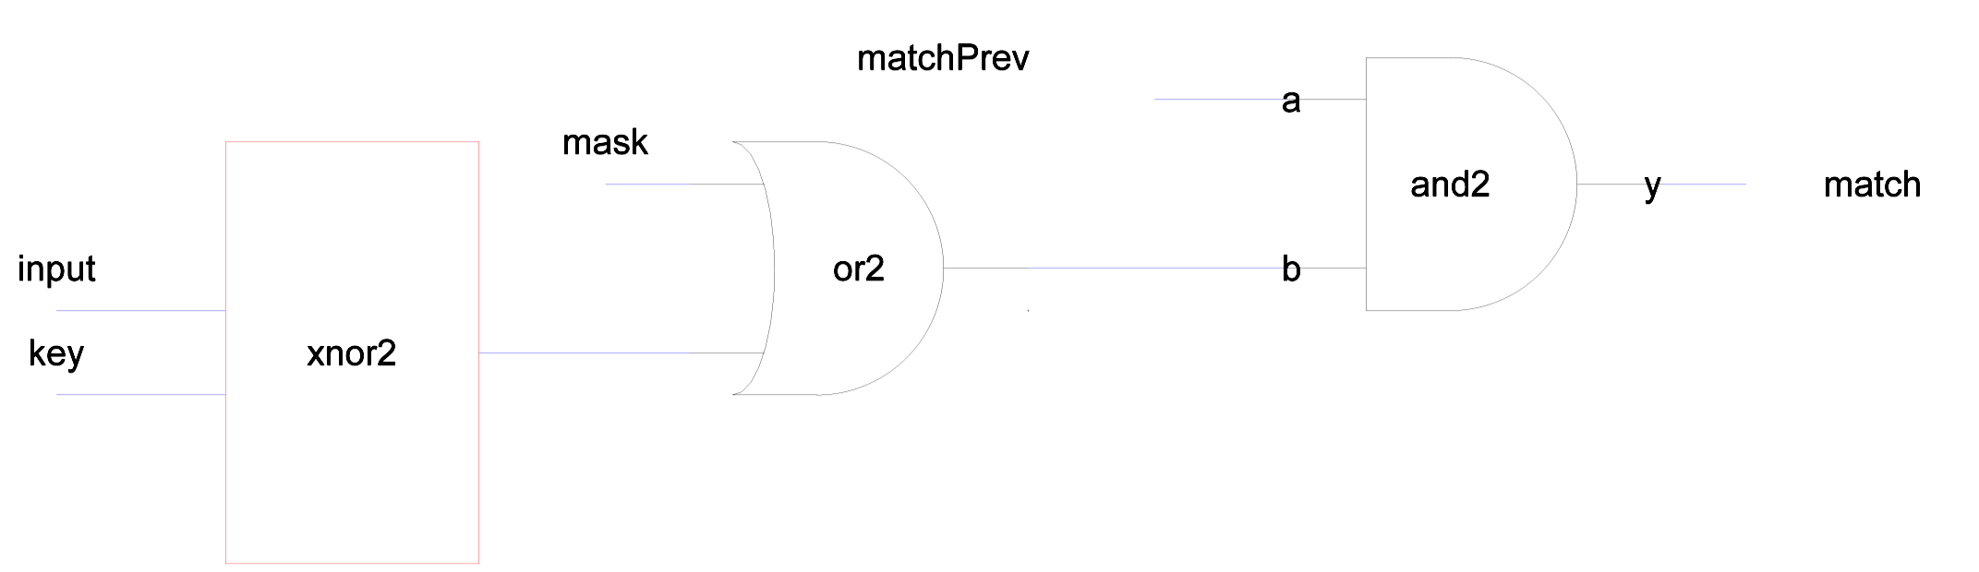
Schematics: match{sch}

Slide 13
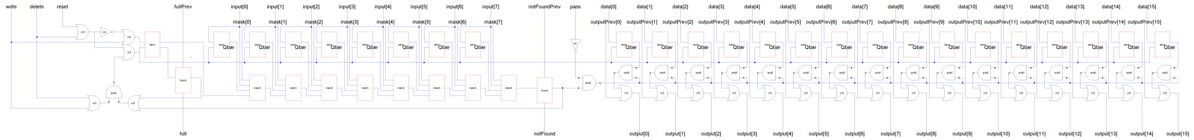
Schematics: slice{sch}

Slide 14
Layout: slice{lay}

Slide 15
Design Size
Slice: 3300λ x 200λ
Plan to stack 16 slices in each chip

Slide 16
Tasks To Be Completed
Reduce word or address length for less pins
  Currently 53 pins used.
Stacking and interconnections
Preparation for fabrication
Final Testing

Slide 17
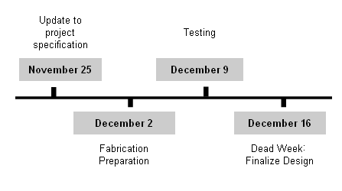
Timeline

Slide 18

Questions

