Slide 1
Ternary Content Addressable Memory
Ben Chavet
James Dicke

Slide 2
Background
Ternary
  Uses key/mask input pair
  Three states: 0, 1, and x (don’t care)
CAM: Content Addressable Memory
  Hardware version of associative array

Slide 3
Inputs / Outputs
Inputs
  8-bit key
  8-bit mask
  16-bit input word
  write
  delete
  reset
Outputs
  16-bit output word
  full
  notfound

Slide 4
Modes of Operation
Read
  Output the first entry that matches key/mask input
Write
  Most complicated operation
  Overwrite first entry that matches key/mask input
  If no match, write to the first empty location
  If no empty spaces, set Full output to high
Delete
  Delete first entry that matches key/mask input
Reset
  Set all locations to empty state

Slide 5
Additional Features
Low Power Consumption
  Much of the logic remains disabled
  Only one set of output logic enabled at a time
Chaining
  CAMs can be chained to act as a single CAM
  Useful if more space is needed
  Time penalty is linear

Slide 6
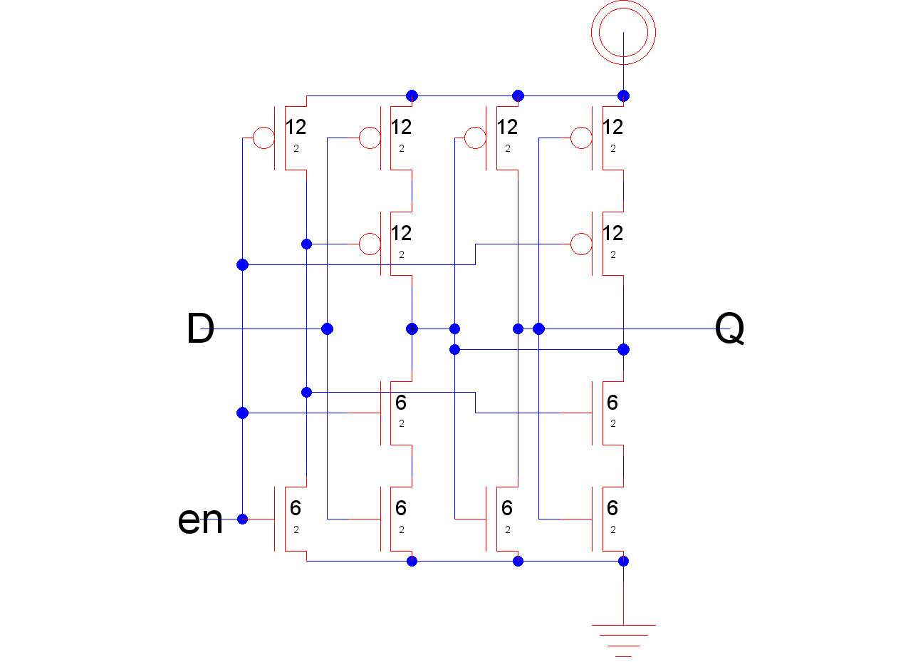
Leaf Cell: D-Latch Schematic
12 transistors
  6 P-MOS
  6 N-MOS

Slide 7

Leaf Cell: D-Latch Timing
Propagation delay= 300 ps

Slide 8
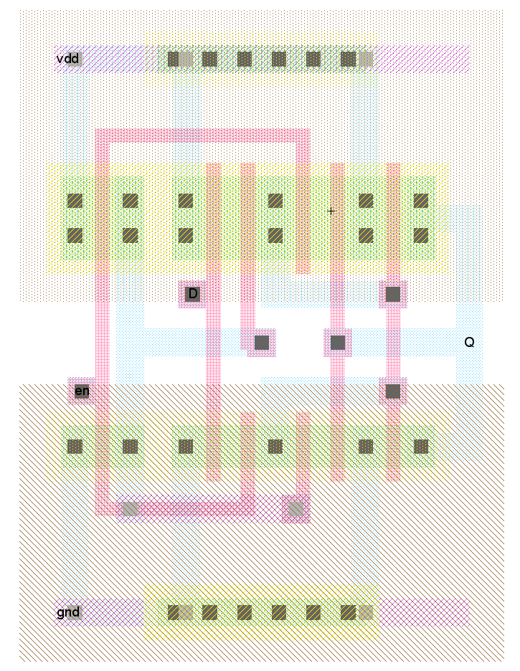
Leaf Cell: D-Latch Layout
70.5λ x 97λ
80λ rail spacing

Slide 9
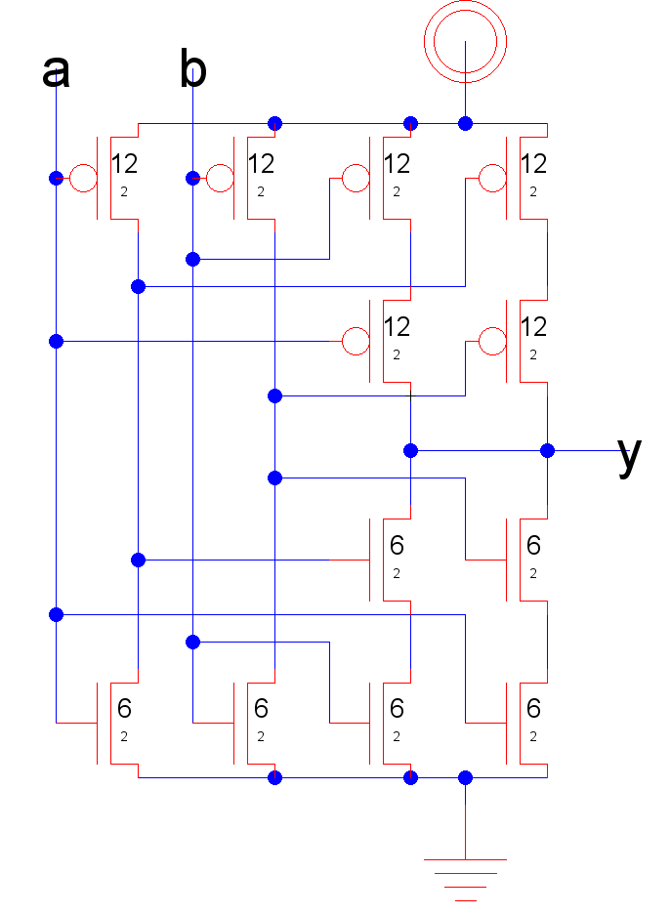
Leaf Cell: XNOR2 Schematic
12 transistors
  6 P-MOS
  6 N-MOS

Slide 10

Leaf Cell: XNOR2 Timings
High → Low = 100ps
Low → High = 130ps

Slide 11
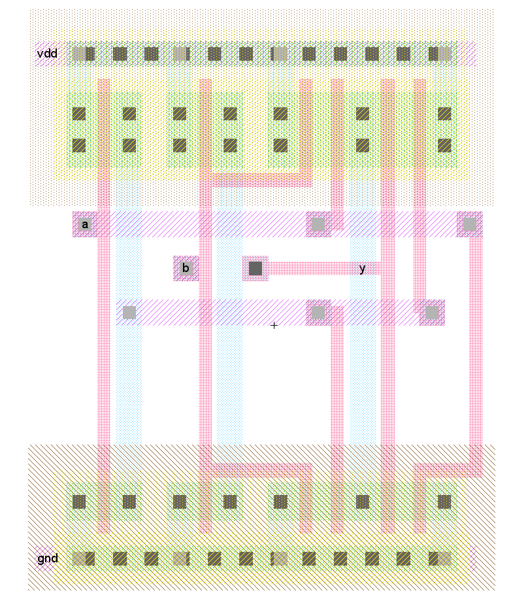
Leaf Cell: XNOR2 Layout
75λ x 97λ
80λ rail spacing

Slide 12
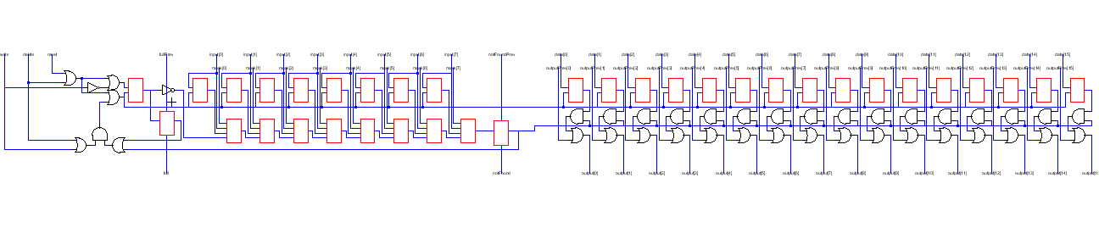
Slice - Schematic
Heart of the CAM
Holds one key/value pair

Slide 13
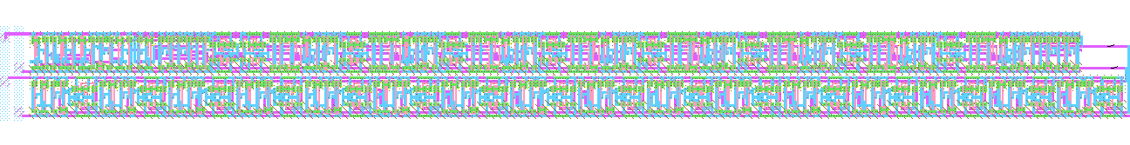
Slice - Layout
2369λ x 200λ
Top layer is control logic and key storage
Bottom layer is data storage

Slide 14
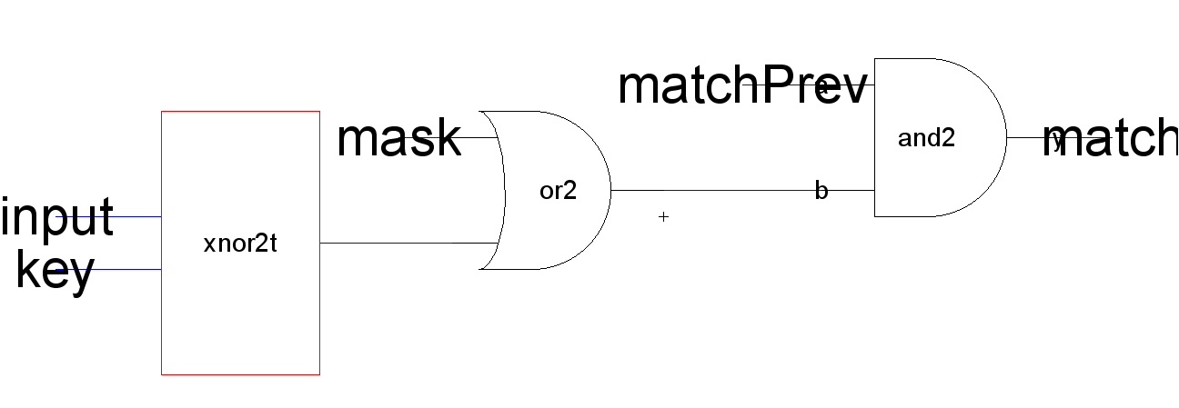
Key Logic: Match
Logic attached to every bit of the key
Power saving: if one bit does not match, all remaining bits remain turned off

Slide 15
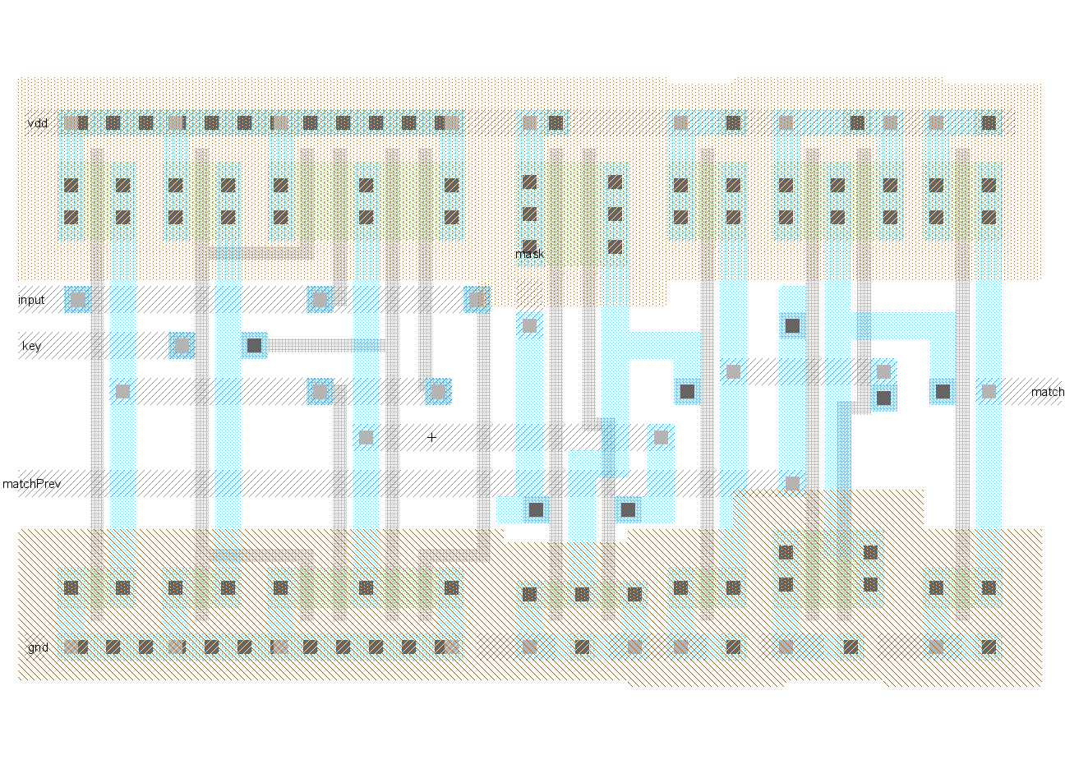
Key Logic: Match Layout

Slide 16
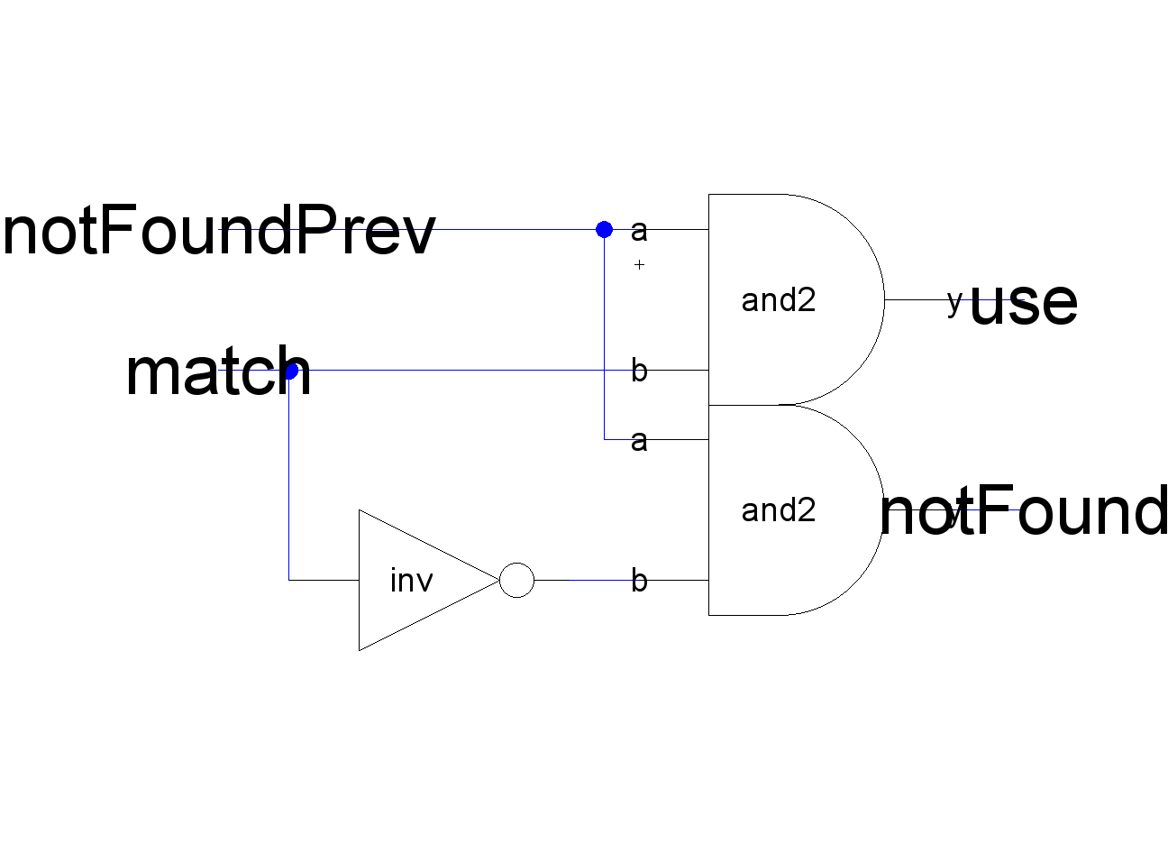
Key Logic: Found/NotFound
Logic on each slice to find the first match
Power saving: if use is zero, data portion of this slice remains disabled

Slide 17
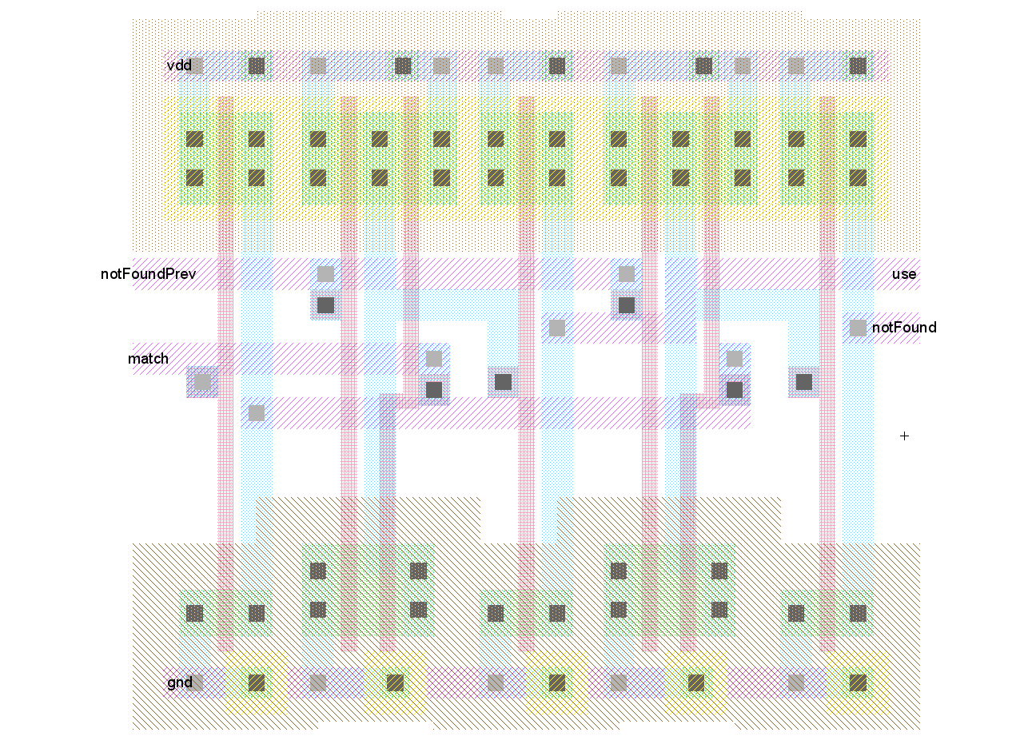
Key Logic: Found/NotFound Layout

Slide 18
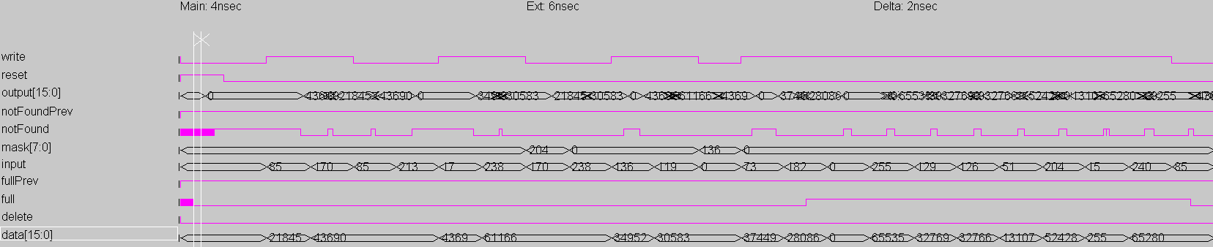
Full 16-bit CAM - Timings
13ns delay on all operations

Slide 19
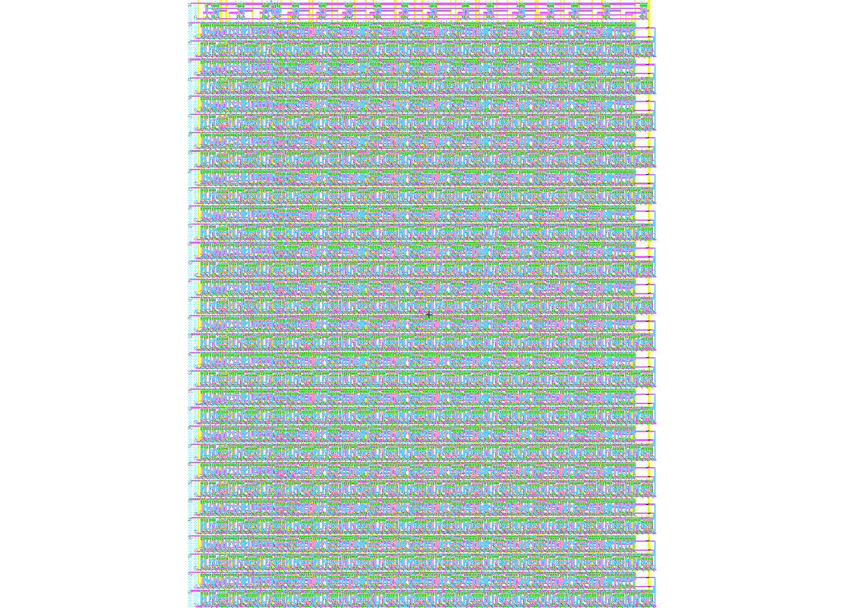
Full 16-bit CAM - Layout
16 slices plus control logic
2396.75λ x 3119λ
Speed: 13 ns memory fetch

Slide 20
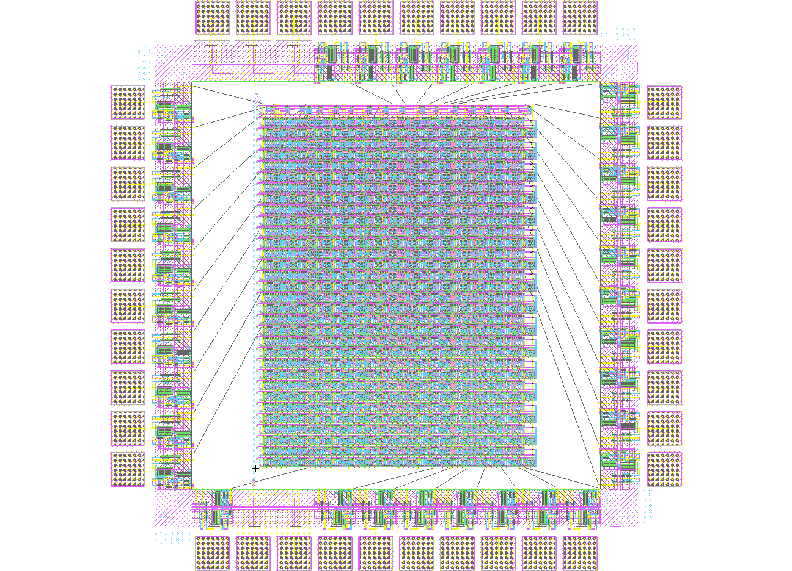
Reduced 6-bit CAM
16-bit cam has too many pins
Disabled the last 10 data bits
4888.8λ x 4888.5λ
Ready for fabrication

Slide 21
References
http://tams-www.informatik.uni-hamburg.de/applets/cmos/cmosdemo.html
http://tech-www.informatik.uni-hamburg.de/applets/hades/webdemos/05-switched/40-cmos/latch.html
http://java.icmc.usp.br/dilvan/thesis.phd/result.html
http://en.wikipedia.org/wiki/Content-addressable memory
http://www.pagiamtzis.com/cam/camintro.html
K. Pagiamtzis and A. Sheikholeslami, \Content-addressable memory (CAM) circuits and architectures: A tutorial and survey," IEEE Journal of Solid-State Circuits, vol. 41, no. 3, pp. 712727, March 2006.

Slide 22
Questions?

