Slide 1
A Distributed Approach for Coordination of Traffic Signal Agents
Written By: Ana L. C. Bazzan
Panel By: Team Win
Ben Chavet, Steve Mott, Justin McKinstry

Slide 2
Based On
Bazzan, A. L. C. (2005). A Distributed Approach for Coordination of Traffic Signal Agents, Journal of Autonomous Agents and Multiagent Systems, 10:131-164. (bazzan2005.pdf)

Slide 3
Contents
Introduction
The Basics
Why A Multiagent Solution?
How It All Works
Results
Conclusion

Slide 4
Introduction
Traffic systems use a centralized approach, which may be inefficient
Let’s use a practical application of multiagent systems to solve existing problems
But what is there to fix?

Slide 5
The Basics 1
Traffic control has several basic elements
  Intersections
  Arterials
  Capacity and Traffic Density
  Signal Plans (SP)
  “The Green Wave”

Slide 6
The Basics 2
Current traffic control strategies
  Fixed-Time Control
    Cheap, but fixed
  Traffic-Responsive SP Selection
    Many plans, uses sensors to choose one
  Traffic-Responsive SP Modification
    Modify an existing SP to fit current needs
  Traffic-Responsive SP Generation
    Make new signal plans on the fly

Slide 7
Why A Multiagent Solution? 1
Using a central point of failure means that if the central point drops, so does the entire system
Specific pre-computations are needed to determine an efficient signal plan for each crossing
Traffic changes over time, and the systems should be built to match

Slide 8
Why A Multiagent Solution? 2
Centralized systems usually have odd requirements like matching hardware.
Traffic may come in indeterminate bursts (such as during football game days)

Slide 9
How It All Works
Continue to use existing hardware and input/output devices
An agent at each intersection
Agents will select partial signal plans based on inputs
Agents will maximize rewards by maximizing traffic throughput (or by minimizing congestion)

Slide 10
Physical Setup
Vehicle detectors in each lane will be used to determine the amount of traffic present
Signal actions are expressed using normal, preexisting traffic lights

Slide 11
Learning
Each agent plays a two-player game with its physical neighbors
The signal action chosen is the one that has the highest summed reward for each neighbor
Communication between agents may or may not occur (different experiments)

Slide 12
Learning – Nature 1
‘Nature’ is the term given to a centralized environmental interpretation
This removes some agent autonomy, but increases predictability and cohesion within the system
Nature determines which system of rewards will be given for an action at a specific time

Slide 13
Learning – Nature 2
Nature knows the system’s global traffic patterns, but doesn’t inform the other agents
Using this information, Nature chooses the payment functions to use for certain traffic patterns
Higher throughput means higher payoffs for each agent

Slide 14
Learning – Periods
Agents learn periodically, instead of constantly
  Protects against completely changing behavior when a new situation arises
  Reduces effectiveness during stochastic events, but maintains good reasoning during normal patterns
Higher learning rates put a larger emphasis on current data over previous data

Slide 15

Learning – Formulas 1
Payoff is determined by
  i is the current agent, N_{i} is its neighbors
  j is an individual neighbor
  s is the signal plan chosen by i
So each reward cycle, i is rewarded for a single signal plan by the effect it has on its neighbors.

Slide 16
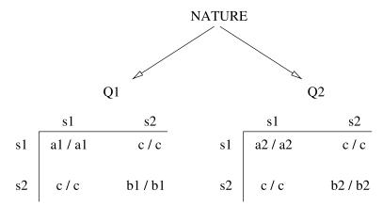
Learning – Formulas 2
Nature selects the payoff matrix for a given payoff-getting period
  Neighboring agents share rewards even if they don’t agree
  This is pareto efficient and leads to Nash Equilibrium

Slide 17

Learning – Formulas 3
System efficiency is measured by
  Summation of all playing agents during every payoff period for the entire time of the system divided by all games times all intersections
  Basically, the average efficiency of intersections over the lifetime of the test.

Slide 18
Results
Six sets of experiments were done
  Agent Experiments
    Emphasis on traffic throughput
    1 - All agents receive a single global reward
    2 - Each agent is rewarded on local choices
    3 - Rewarded locally, but can talk to neighboring agents
  Agent vs Real-World
    Differing flow patterns
    Emphasis on average congestion

Slide 19
Results – Factors 1
λ – Memory Factor
  How important past events are
  0 < λ < 1; higher forgets faster
f_{l} – Frequency of Learning
  0 < f_{l} < ∞
  Higher is slower learning
f_{i} – Frequency of flow change
  0 < f_{i} < ∞
  Higher is less changes locally

Slide 20
Results – Factors 2
p_{w} – Percent chance to pick a reasonable signal plan
  0 < p_{w} < 1; higher is more reasonable
  Arterial changes usually take 90 cycles, so experiments hope to reach p_{w}=0.9 before 50 cycles (about half the time)

Slide 21
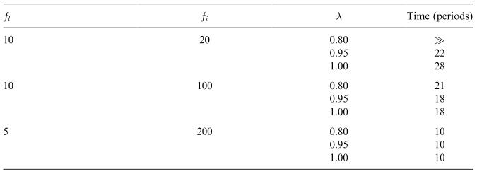
Results – Experiment 1
Agents try to maximize global reward
  This worked reasonably well, only the system with many changes, low learning, and long memory took too long

Slide 22
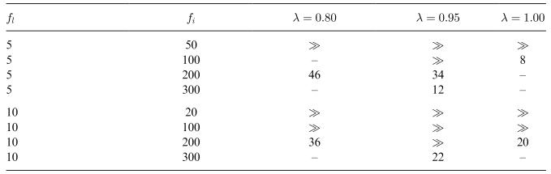
Results – Experiment 2
Agents try to maximize local reward
  This didn’t go so well, which is to be expected
  Learning rates are heavily influential

Slide 23
Results – Experiment 3
Agents notify their neighbors before changing, and are rewarded locally
  This didn’t work at all. There’s not even a noteworthy chart!

Slide 24
Results – Compare with Real Systems
Real systems don’t have arbitrary learning times, so a comparison may better detail efficiency
To keep things simple, two lanes are used, west and east
Different flow densities are tested

Slide 25
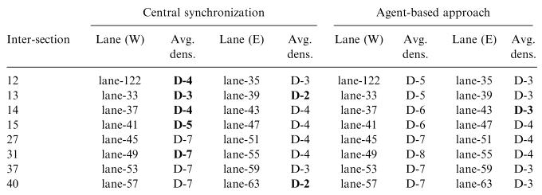
Results – Real Traffic 1
West flow is much higher than East
  Centralized system wins because it doesn’t have to learn, and flow is predictable

Slide 26
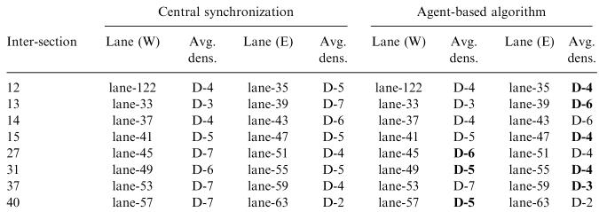
Results – Real Traffic 2
West and East have similar flows
  Agent system wins because it learns to handle both directions, but centralized sometimes halts at the wrong time

Slide 27
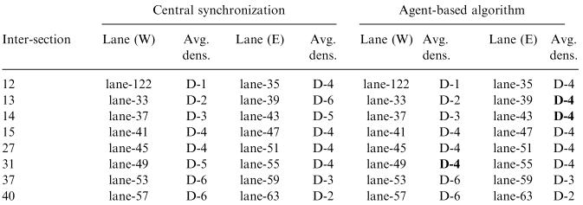
Results – Real Traffic 3
West and East have low/medium flow
  Agent system wins because it is able to self-optimize for bursts in patterns, while centralized simply switches back and forth.

Slide 28
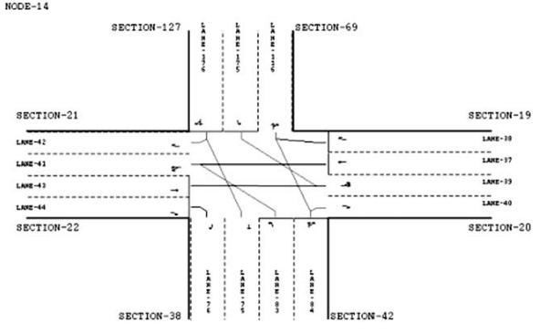
Results – 4
What does an intersection look like?
  This is NODE-14 with lanes and sections marked

Slide 29
Conclusions 1
In predictable situations, current traffic control works better than this agent system. However, gains are made in hard-to-predict areas
Inflexibility in learning harms the agent system
Communication is even more damaging!

Slide 30
Conclusions 2
Nature provides a central control without losing autonomous choice by individual agents
The best results were obtained without communication between agents. Incoming traffic, however, serves as a means of indirect observation!

Slide 31
Questions
Thank you for your time!
Questions?

