Slide 1
Informed search strategies

Slide 2
Informed search - Introduction
Informed search strategy use problem-specific knowledge and can find solutions more efficiently than an uninformed strategy
The general approach is called best-first search
Best-first search is an instance of the general TREE-SEARCH or GRAPH-SEARCH algorithm in which a node is selected for expansion based on an evaluation function, f(n)
The evaluation function is construed as a cost estimate, so the node with the lowest evaluation is expanded first
The implementation of best-first graph search is identical to that for UCS except for
the use of f instead of g to order the priority queue
The choice of f determines the search strategy
Most best-first algorithms include as a component of f a heuristic function, denoted h(n) :
h(n)=estimated cost of the cheapest path from the state at node
n to a goal state
E.g., in Romania, one might estimate the cost of the cheapest path from Arad to Bucharest via the straight-line distance from Arad to Bucharest
Heuristics are arbitrary, nonnegative, problem-specific functions where if n is the goal state, then h(n)=0

Slide 3

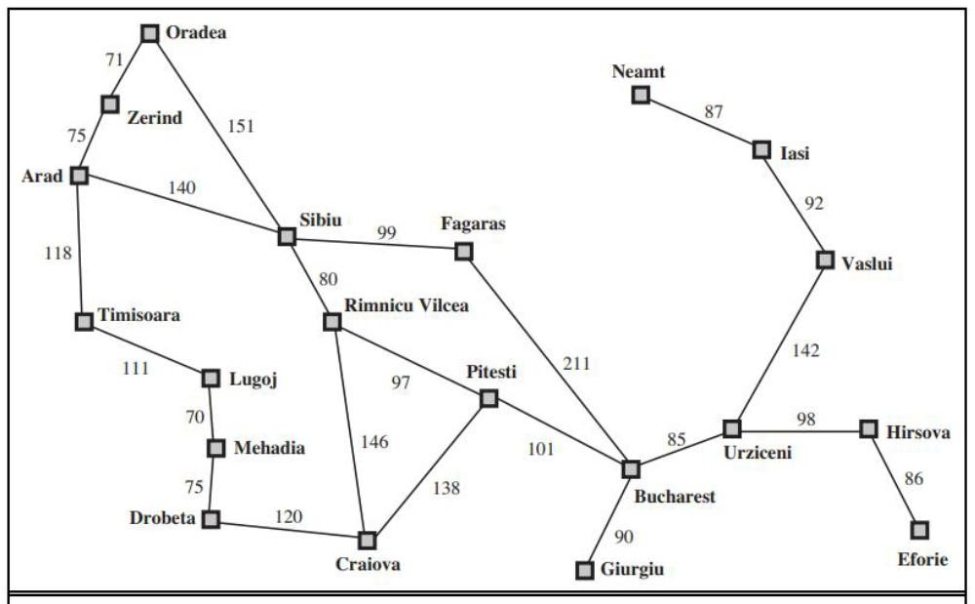
Figure 1 : A simplified roadmap of part of Romania
Figure from Russel and Norvig, Artificial Intelligence : A Modern Approach

Slide 4
Greedy best-first search
Greedy best-first search tries to expand the node that is the closest to the
goal, on the grounds that this is likely to lead to a solution quickly
Thus it evaluates nodes by using just the heuristic function; that is,
f(n)=h(n)
For the route-finding problem in Romania, we use the straight-line
distance heuristic, which we will call ℎ_{𝑆𝐿𝐷}
If the goal is Bucharest, we need to know the straight-line distances to Bucharest (Fig. 2)
E.g. ℎ_{𝑆𝐿𝐷} 𝐼𝑛 𝐴𝑟𝑎𝑑 = 366
Notice that the value of ℎ_{𝑆𝐿𝐷} cannot be computed from the problem
description itself
Moreover, it takes a certain amount of experience to know that ℎ_{𝑆𝐿𝐷} is correlated with actual road distances and is, therefore, a useful heuristic
Fig. 3 shows the progress of a greedy best-first search using ℎ_{𝑆𝐿𝐷} to find a path from Arad to Bucharest

Slide 5

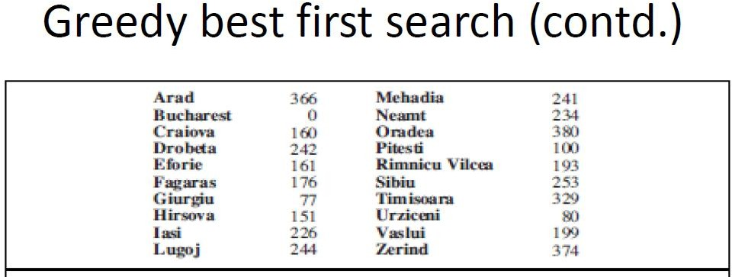
Figure 2: Values of ℎ_{𝑆𝐿𝐷} - straight line distances to Bucharest
Figure from Russel and Norvig, Artificial Intelligence : A Modern Approach

Slide 6
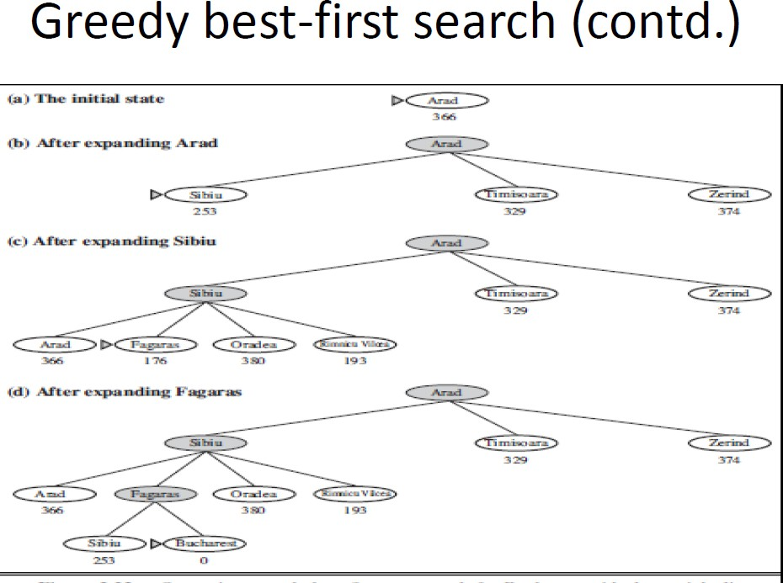
Figure 3 : Stages in a greedy best-first search for Bucharest with the straight line distance heuristic ℎ_{𝑆𝐿𝐷}. Nodes are labeled with their h-values.
Figure from Russel and Norvig, Artificial Intelligence : A Modern Approach

Slide 7
Greedy best-first search (contd.)
The first node to be expanded from Arad will be Sibiu because it is closer to Bucharest than either Zerind or Timisoara
The next node to be expanded will be Fagaras because it is closest to
Bucharest
Fagaras in turn generates Bucharest, which is the goal
For this particular problem, greedy best-first search using ℎ_{𝑆𝐿𝐷} finds a solution without ever expanding a node that is not on the solution path; hence its search cost is minimal
It is not optimal, however; the path via Sibiu and Fagaras to Bucharest is 32 kms longer than the path through Rimnicu Vilcea and Pitesti.
This shows why the algorithm is called “greedy” – at each step it tries to
get as close to the goal as it can
Greedy best-search tree search is also incomplete even in a finite space, much like DFS

Slide 8
Greedy best-first search (contd.)
Consider the problem of getting from Iasi to Fagaras
The heuristics suggests that Neamt be expanded first because it is
closest to Fagaras, but it is a dead end
The solution is to go to Vaslui – a step that is actually farther from the goal according to the heuristic – and then to continue to Urziceni, Bucharest, and Fagaras
The algorithm will never find this solution, however, because expanding Neamt puts Iasi back into the frontier, Iasi is closer to Fagaras than Vaslui is, and so Iasi will be expanded again, leading to an infinite loop
The worst-case time and space complexity for the tree version is
𝑂(𝑏^{𝑚}), where m is the maximum depth of the search space
With a good heuristic function, however, the complexity can be
reduced substantially
The amount of the reduction depends on the particular problem and on the quality of the heuristic

Slide 9
A* algorithm
The most widely known form of best-first search is called A* search
It evaluates nodes by combining g(n), the cost to reach the node, and h(n), the cost to get from the node to the goal:
f(n) = g(n) + h(n)
Since g(n) gives the path cost from the start node to node n, and h(n) is the estimated cost of the cheapest path from n to the goal,we have
f(n) = estimated cost of the cheapest solution through n
Thus, if we are trying to find the cheapest solution, a reasonable
thing to try first is the node with the lowest value of g(n) + h(n)
It turns out that this strategy is more than just reasonable; provided that the heuristic function h(n) satisfies certain conditions, A* search is both complete and optimal
The algorithm is identical to UCS except that A* using g+h instead
of g

Slide 10
A* algorithm (contd.)
Conditions for optimality : Admissibility and consistency
  The first condition we require for optimality is that h(n) be an admissible heuristic
  An admissible heuristic is one that never overestimates the cost to
reach the goal
  Because g(n) is the actual cost to reach n along the current path, and f(n)=g(n)+h(n), we have as an immediate consequence that f(n) never overestimates the true cost of a solution along the current path through n
  Admissible heuristics are by nature optimistic because they think the
cost of solving the problem is less than it actually is
  An obvious example of an admissible heuristic is the straight-line distance ℎ_{𝑆𝐿𝐷} that we used in getting to Bucharest
  Straight-line distance is admissible because the shortest path between any two points is a straight line, so the straight line cannot be an overestimate
  Fig. 4 shows the progress of an A* tree search for Bucharest

Slide 11
A* algorithm (contd.)
The values of g are computed from the step costs in Fig. 1, and the values of ℎ_{𝑆𝐿𝐷}
are given in Fig. 2
Notice in particular that Bucharest first appears on the frontier at step(e), but it is not selected for expansion because its f-cost (450) is higher than that of Pitesti (417)
Another way to say this is that there might be a solution through Pitesti whose cost is as low as 417, so the algorithm will not settle for a solution that costs 450
A second, slightly stronger condition is called consistency (or sometimes monotonicity) is required only for applications of A* to graph search
A heuristic h(n) is consistent if, for every node n and every successor n’ of n generated by any action a, the estimated cost of reaching the goal from n is no greater than the step cost of getting to n’ plus the estimated cost of reaching the goal from n’ :
ℎ 𝑛 ≤ 𝑐 𝑛, 𝑎, 𝑛′ + ℎ(𝑛′)
This is a form of the general triangle inequality, which stipulates that each side of a triangle cannot be longer than the sum of the other two sides
Here, the triangle is formed by n,n’ , and the goal 𝐺_{𝑛} closest to n
For an admissible heuristic, the inequality makes perfect sense; if there were a route from n to 𝐺_{𝑛} via n’ that was cheaper than h(n), that would violate the property that h(n) is a lower bound on the cost to reach 𝐺_{𝑛}

Slide 12
A* algorithm (contd.)
Every consistent heuristic is also admissible
Consistency is therefore a stricter requirement than admissibility, but one has to work quite hard to concoct heuristics that are admissible but not consistent
E.g. For ℎ_{𝑆𝐿𝐷}, the general triangle inequality is satisfied when each side is measured by the straight-line distance, and the straight-line distance between n and n’ is no greater than c(n,a,n’), making it a consistent heuristic
For A*, the tree-search version is optimal if h(n) is admissible, while the graph-search version is optimal if h(n) is consistent
Since f-costs are nondecreasing along any path, we can draw contours in
the state space
Fig 5 shows an example
Inside the contour labelled 400, all nodes have f(n) less than or equal to 400, and so on
Then, because A* expands the frontier node of lowest f-cost, we can see that an A* search fans out from the start node, adding nodes in concentric bands of increasing f-cost

Slide 13
A* algorithm(contd.)
With UCS, the bands will be circular around the start state
With more accurate heuristics, the bands will stretch towards the goal
state and become more narrowly focused around the optimal path
If C* is the cost of the optimal solution path, then :
  A* expands all nodes with f(n)<C*
  A* might then expand some of the nodes right on the goal contour (where f(n)=C*) before selecting a goal node
Completeness requires that there be only finitely many nodes with cost less than or equal to C*, a condition that is true if all step costs exceed some finite 𝜀 and if b is finite
Notice that A* expands no nodes with f(n)>C* e.g. Timisoara is not expanded in Fig. 3.24 even though it is a child of the root
We say that the subtree below Timisoara is pruned; because ℎ_{𝑆𝐿𝐷} is admissible, the algorithm can safely ignore this subtree while still guaranteeing optimality
The concept of pruning – eliminating possibilities from consideration without having to examine them – is important for many areas of AI

Slide 14
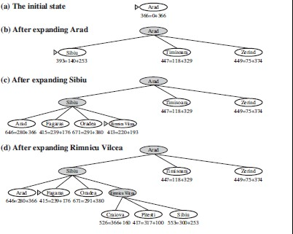
Figure from Russel and Norvig, Artificial Intelligence : A Modern Approach
14

Slide 15
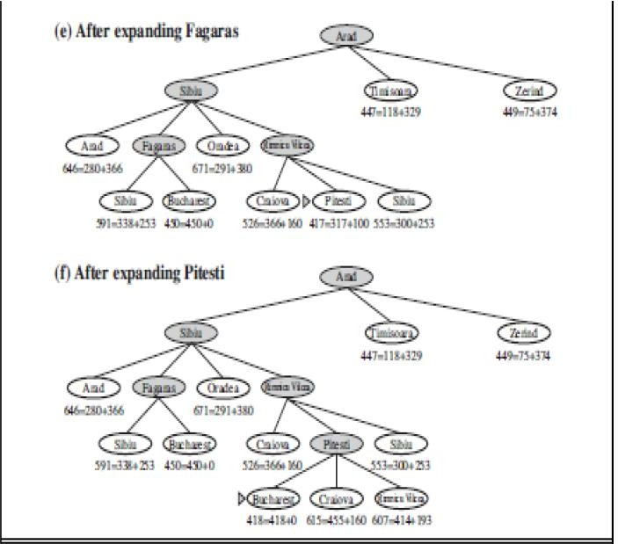
Figure 4 : Stages in A* search for Bucharest. Nodes are labeled with f=g+h. The h values are straight line distance to Bucharest taken from Figure 2
Figure from Russel and Norvig, Artificial Intelligence : A Modern Approach

Slide 16
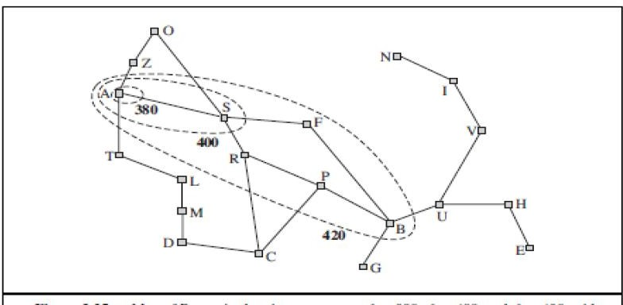
Figure 5 : Map of Romania showing contours at f=380, f=400 and f=420, with Arad as the start state. Nodes inside a give contour have f-costs less than or equal to the contour value
Figure from Russel and Norvig, Artificial Intelligence : A Modern Approach

Slide 17
A* algorithm (contd.)
A* algorithm is optimally efficient for any given consistent heuristic
This means no other optimal algorithm is guaranteed to expand fewer nodes than A*
This is because any algorithm that does not expand all nodes with
f(n)<C* runs the risk of missing the optimal solution
Hence A* search is complete, optimal and optimally efficient
For most problems, the number of states within the goal contour search space is still exponential in the length of the solution
The complexity of A* often makes it impractical to insist on finding an optimal solution
One can use variants of A* that find suboptimal solutions quickly or heuristics that are more accurate but not strictly admissible
Space complexity for A* is more of a problem than time complexity and it runs out of space long before it runs out of time

Slide 18
Memory bounded heuristic search
The simplest way to reduce memory requirements for A* is to adapt the idea of iterative deepening to the heuristic search context, resulting in the iterative-deepening A* (IDA*) algorithm
The main difference between IDA* and standard iterative deepening is that the cutoff used is the f-cost (g+h) rather than the depth; at each iteration, the cutoff value is the smallest f-cost of any node that exceeded the cutoff on the previous iteration
IDA* is practical for many problems with unit step costs and avoids the substantial overhead associated with keeping a sorted queue of nodes
Unfortunately, it suffers from the same difficulties with real-valued costs as does the iterative version of UCS
Two other memory-bounded algorithms are RBFS and MA*

Slide 19
Memory-bounded heuristic search (contd.)
Recursive best-first search (RBFS) is a simple recursive algorithm that attempts to mimic the operation of standard BFS, but using only linear space
The algorithm is shown in Figure 6
Its structure is similar to that of a recursive depth-first search, but rather than continuing indefinitely down the current path, it uses f_limit variable to keep track of the f-value of the best alternative path available from any ancestor of the current node
If the current node exceeds this limit, the recursion unwinds back to the
alternative path
As the recursion unwinds, RBFS replaces the f-value of each node along the path with a backed-up value – the best f-value of its children
In this way, RBFS remembers the f-value of the best leaf in the forgotten subtree and can therefore decide whether it is worth re-expanding the subtree at some later time
Fig. 3.27 shows how RBFS reaches Bucharest

Slide 20
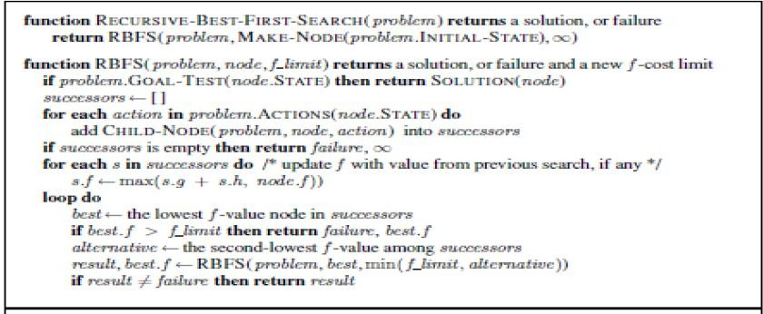
Figure 6 : The algorithm for recursive best-first search (RBFS)
Figure from Russel and Norvig, Artificial Intelligence : A Modern Approach

Slide 21
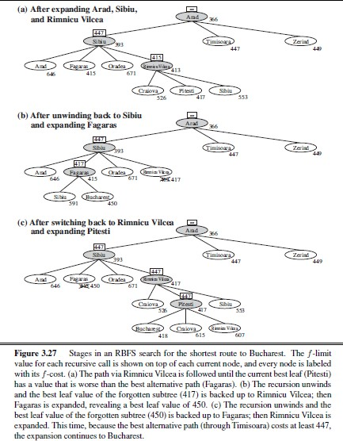
Figure from Russel and Norvig, Artificial Intelligence : A Modern Approach

Slide 22
Memory-bounded heuristic search (contd.)
RBFS is more efficient than IDA*, but still suffers from excessive node re-generation
E.g. in Fig. 3.27, RBFS follows the path via Rimnicu Vilcea, then “changes its mind” and tries Fagaras, and then changes its mind back again
These mind changes occur because every time the current best path is extended, its f-value is likely to increase – h is usually less optimistic for nodes closer to the goal
When this happens, the second-best path might become the best path, so the search has to backtrack to follow it
Each mind change corresponds to an iteration of IDS* and could require many reexpansions of forgotten nodes to recreate the best path and extend it one more node
Like A* tree search, RBFS is an optimal algorithm if the heuristic function h(n) is admissible
Its space complexity is linear in the depth of the deepest optimal solution, but its time complexity is rather difficult to characterize; it depends both on the accuracy of the heuristic function and on how often the best path changes as nodes are expanded

Slide 23
Memory-bounded heuristic search (contd.)
IDA* and RBFS suffer from using too little memory
Between iterations, IDA* retains only a single number; the current f-cost limit
RBFS retains more information in memory, but it uses only linear space
Even if more memory were available, RBFS has no way to make use of it
Because they forget most of what they have done, both algorithms may end up re-expanding the same states many times over
Furthermore, they suffer the potentially exponential increase in complexity associated with redundant paths in the graphs
Two algorithms that use all available memory are MA* (memory-bounded A*) and SMA* (simplified MA*)

Slide 24
Memory-bounded heuristic search (contd.)
SMA* proceeds just like A*, expanding the best leaf until memory is full
At this point, it cannot add a new node to the search tree without dropping an old one
SMA* always drops the worst leaf node – the one with the highest f-values
Like RBFS, SMA* then backs up the value of the forgotten node to its parent
In this way, the ancestor of a forgotten subtree knows the quality of
the best path in that subtree
With this information, SMA* regenerates the subtree only when all other paths have been shown to look worse than the path it has forgotten
Another way of saying this is that, if all the descendants of a node n are forgotten, then we will not know which way to go from n, but we will still have an idea of how worthwhile it is to go anywhere from n

Slide 25
Memory-bounded heuristic search (contd.)
If all the leaf nodes have the same f-value, SMA* expands the newest best leaf and deletes the oldest worst leaf
These coincide when there is only one leaf, but in that case, the current search tree must be a single path from root to leaf that fills all the memory
If the leaf is not a goal node, then even if it is on an optimal solution path, that solution is not reachable with the available memory
Therefore, the node can be discarded exactly as if it had no successor
SMA* is complete if there is any reachable solution – that is, if d, the depth of the shallowest goal node, is less than the memory size (expressed in nodes)
It is optimal if any optimal solution is reachable; otherwise, it returns the best reachable solution

Slide 26
Memory-bounded heuristic search (contd.)
In practical terms, SMA* is a fairly robust choice for finding optimal solutions, particularly when the state space is a graph, step costs are not uniform, and node generation is expensive compared to the overhead of maintaining the frontier and the explored set
On very hard problems, however, it will often be the case that SMA* is forced to switch back and forth continually among many candidate solution paths, only a small subset of which can fit in memory
Then the extra time required for repeated regeneration of the same nodes means that problems that would be practically solvable by A*, given unlimited memory, become intractable for SMA*
This means that memory limitations can make a problem intractable from the point of view of computation time

Slide 27
Hill-Climbing Search
•
Starts with an initial solution and moves towards the best neighboring solution.
Variants:
  Simple Hill Climbing
  Steepest-Ascent Hill Climbing
  Stochastic Hill Climbing
Can get stuck in local maxima, plateaus, and ridges.
•
•
•
•
•

Slide 28
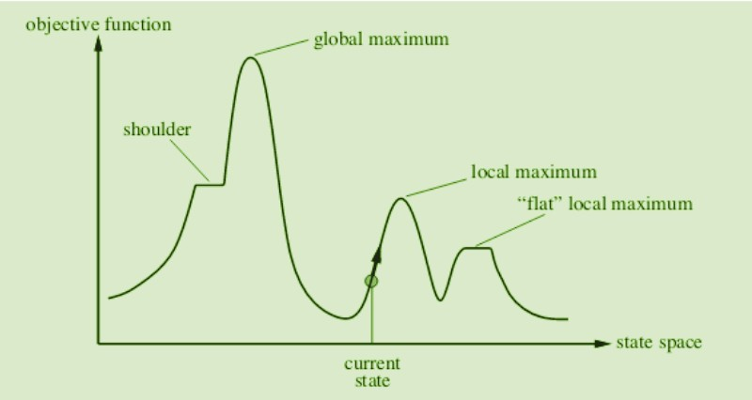
State-Space Diagram in Hill Climbing: Key Concepts and Regions

Slide 29
Local Maximum: A local maximum is a state better than its neighbors but not the best overall. While its objective function value is higher than nearby states, a global maximum may still exist.
Global Maximum: The global maximum is the best state in the state-space diagram, where the objective function achieves its highest value. This is the optimal solution the algorithm seeks.
Plateau/Flat Local Maximum: A plateau is a flat region where neighboring states have the same objective function value, making it difficult for the algorithm to decide on the best direction to move.
Ridge: A ridge is a higher region with a slope, which can look like a peak. This may cause the algorithm to stop prematurely, missing better solutions nearby.
Current State: The current state refers to the algorithm’s position in the state-space diagram during its search for the optimal solution.
Shoulder: A shoulder is a plateau with an uphill edge, allowing the algorithm to move toward better solutions if it continues searching beyond the plateau.

Slide 30
Simple Hill Climbing Algorithm
Simple Hill Climbing is a straightforward variant of hill climbing where the algorithm evaluates each neighboring node one by one and selects the first node that offers an improvement over the current one.
Algorithm for Simple Hill Climbing
Start at random and make it initial state
Evaluate the initial state. If it is a goal state, return success.
Else
Make the initial state the current state
Loop until a solution (global maxima ) is found or no change in current state
  Select a new state that has not yet been applied to the current state.
  Evaluate the new state.
  If the new state is the goal, return success.
  If the new state improves upon the current state, make it the current state and continue.
  If it doesn’t improve, continue searching neighboring states.

Slide 31
2. Steepest-Ascent Hill Climbing
Steepest-Ascent Hill Climbing is an enhanced version of simple hill climbing. Instead of moving to the first neighboring node that improves the state, it evaluates all neighbors and moves to the one offering the highest improvement (steepest ascent).
Algorithm for Steepest-Ascent Hill Climbing
Evaluate the initial state. If it is a goal state, return success.
Make the initial state the current state.
Repeat until the solution is found or the current state remains unchanged:
  Select a new state that hasn’t been applied to the current state.
  Initialize a ‘best state’ variable and evaluate all neighboring states.
  If a better state is found, update the best state.
  If the best state is the goal, return success.
  If the best state improves upon the current state, make it the new current state and repeat.
Exit the function if no better state is found.

Slide 32
Stochastic Hill Climbing
Stochastic Hill Climbing introduces randomness into the search process. Instead of evaluating all neighbors or selecting the first improvement, it selects a random neighboring node and decides whether to move based on its improvement over the current state.
Algorithm for Stochastic Hill Climbing:
  Evaluate the initial state. If it is a goal state, return success.
  Make the initial state the current state.
  Repeat until a solution is found or the current state does not change:
    Apply the successor function to the current state and generate all neighboring states.
    Choose a random neighboring state based on a probability function.
    If the chosen state is better than the current state, make it the new current state.
    If the selected neighbor is the goal state, return success.
  Exit the function if no better state is found.

Slide 33
Simulated Annealing Search
•
•
Inspired by annealing in metallurgy.
Uses a temperature parameter that decreases over time.
Sometimes accepts worse solutions to escape local maxima.
Cooling schedule determines the temperature drop rate.
•
•

Slide 34
Steps to Implement a Simple SA Algorithm
Initialize the solution: Start with a random solution.
Define an objective (cost) function: This function evaluates how good a solution is.
Set initial temperature: A high temperature allows more exploration.
Iterate the process:
  Generate a new neighboring solution.
  Calculate the energy (cost) difference between the current and new solution.
  If the new solution is better, accept it.
  If the new solution is worse, accept it with a probability based on temperature (to allow escaping local optima).
  Gradually decrease the temperature.
Repeat until termination: Stop when the temperature is low or a stopping criterion is met.

Slide 35
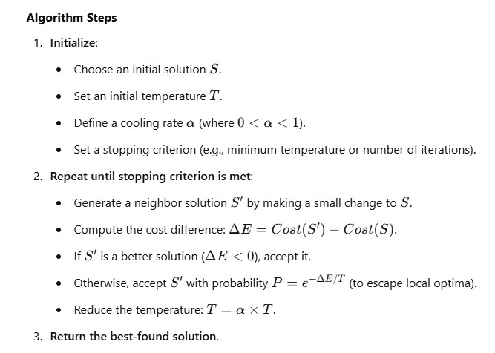

Slide 36
Comparison: Hill-Climbing vs. Simulated
Annealing
Feature | Hill-Climbing | Simulated Annealing
Approach | Greedy, moves towards best solution | Accepts worse solutions occasionally
Exploration | Limited, may get stuck | Can escape local maxima
Speed | Fast | Slower
Best For | Simple optimization problems | Complex search spaces
Real-World Use | Pathfinding, game AI | Traveling Salesman, VLSI design

