Slide 1
Problem Solving agent

Slide 2
Problem solving by search
Problem solving agents move from one state of the world to another till the solution is reached
Actions or operators are used to move from one state to another state
Goal formulation based on the current situation and the agent’s performance measure, is the first step of problem solving
Problem formulation is the process of deciding which actions and states to consider, given the goal
The solution to any problem is a fixed sequence of actions
The process of looking for a sequence of actions that reaches the goal is called search
A search algorithm takes a problem as input and returns a solution in the form of an action sequence

Slide 3
Definition of a problem
A problem can be formally defined by 5 components
  The initial state that the agent starts in
  A description of the possible actions available to the agent. Given a state s,
ACTION(s) returns the set of actions which can be executed in s
  A description of what each action does; which is a transition model specified by the function RESULT(s,a) which returns the state that results by doing action a in state s. Any state reachable from state s is the successor state of s.
  The goal test determines whether the state is a goal or not
  The path cost assigns a numeric cost to each path
  The initial state, actions and transition model define the state space of the problem – the set of all states reachable from the initial state by any sequence of actions. A path in the state space is a sequence of states connected by a sequence of actions
  A solution to the problem is a sequence of actions which leads from the initial state to the goal state
  Solution quality is measured by the path cost function and the optimal solution has the lowest path cost among all the solutions

Slide 4
Example problems
We first consider toy problems
The vacuum world can be formulated as follows :
  State : The state is determined by the agent location and the dirt location. The agent can be in one of two locations which might or might not contain dirt. If there are two locations, there are 2𝑋2² = 8 states. If there are n locations, there are 𝑛. 2^{𝑛} states
  Initial state : Any state can be designated as the initial state
  Actions : Each state has three actions - left, right and suck. Larger environments might also have – up, down
  Goal test : This checks whether all the squares are clean
  Path cost : Each step costs 1, so the path cost is the number of steps in the path

Slide 5
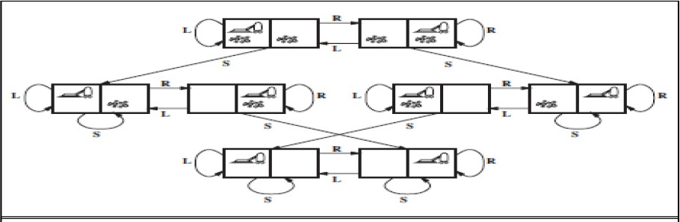
Vacuum World
The state space for the vacuum world ; Links denote actions L : left; R : right; S : suck
From Russel and Norvig, “Artificial Intelligence : A Modern Approach”

Slide 6
8-Puzzle problem
It consists of a 3 X 3 board with 8 numbered tiles and a blank space
A tile adjacent to the blank space can slide into the space
The object is to reach a specified goal state
The standard formulation is as follows :
  States : A state description specifies the location of each of the specified tiles and the blank is one of the nine squares
  Initial State : Any state can be designated as the initial state
  Actions : These are defined as movements of the blank space left, right, up or down. Different subsets of these are possible depending on where the blank is
  Transition model : Given a state and model, it returns the resulting state.
  Goal Test : This checks whether the state matches the goal
configuration
  Path Cost : Each step costs 1, so the path cost is the number of steps in the path

Slide 7
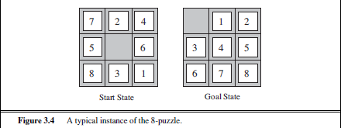
8 puzzle problem (contd.)
The 8 puzzle belongs to the family of sliding-block puzzles
The 8-puzzle has ^{9!} = 181,440 reachable states and is easily solved
2
The 15 puzzle on a 4 X 4 board has around 1.3 trillion states, and random instances
can be solved optimally in a few milliseconds
The 24 puzzle on a 5 X 5 board has around 10²⁵ states and random instances take several hours to solve optimally
Figure From Russel and Norvig, “Artificial Intelligence : A Modern Approach”

Slide 8
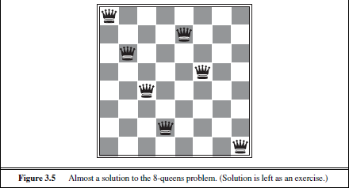
8 queens Problem
The goal of the 8 queens problem is to place 8 queens on a chessboard such that no queen attacks any other
A queen attacks any other queen in the same row, column or diagonal
Figure shows an attempted solution that fails ; the queen in the rightmost column is attacked by the queen in the top left
8

Slide 9
8 queens Problem (contd.)
Although special purpose algorithms exist for this problem, it is a
useful test problem for search algorithms
There are two kinds of formulations :
  An incremental formulation involves operators that augment the state description, starting from an empty state. Each action adds a queen to the state
  A complete state formulation starts with all 8 queens on the board and moves them around.
The path cost is of no interest as only the final state counts. The incremental formulation is the following
States : Any arrangement of 0 to 8 queens on the board is a state
Initial State : No queen on the board
Actions : Add a queen to any empty square
Transition Model : Returns the board with the queen added to the specified square
Goal test : 8 queens on the board, none attacked

Slide 10
8 queens Problem (contd.)
In this formulation, we have 64𝑋63𝑋 … 57 ≈ 1.8𝑋10¹⁴
possible sequences to investigate
A better formulation would prohibit placing a queen in any square that is already attacked
  States : All possible arrangements of n queens (0 ≤ 𝑛 ≤ 8), one per column in the leftmost n columns, with no queen attacking another
  Actions : Add a queen to any square in the leftmost empty column such that it is not attacked by any other queen
This formulation reduces the state space from
1.8X10¹⁴ to just 2057, and solutions are easy to find
For 100 queens the reduction is from roughly 10⁴⁰⁰
states to about 10⁵² states

Slide 11
Cryptarithmetic problem
Constraint Satisfaction Problem
Eg. | FORTY | Solution: 29786 | F=2,O=9,R=7,T=8
+ | TEN | + 850 | Y=6,E=5,N=0,S=3
+ | TEN | + 850 | I=1,X=4
 | SIXTY | 31486

Slide 12
Cryptarithmetic problem (contd.)
The problem formulation is as follows :
  State : Some letters may have numbers assigned
  Initial State : All letters are unassigned to numbers
  Action : Assign a unique unassigned number to a letter so that the rules of arithmetic are followed
  State transition : If k (0 ≤ 𝑘 ≤ 𝑛) letters have been assigned numbers, assign an unused number to the k+1 letter
  Goal State : All letters have been assigned numbers which are unique and the rules of arithmetic are satisfied

Slide 13
Real world problems
Airline travel problem
  States : Each state obviously includes a location (e.g. an airport) and the current time. Because the cost of an action (a flight segment) may depend on previous segments, their fare bases and their status as domestic or international, the state must record extra information about these “historical” aspects
  Initial State : This is specified by the user’s query
  Actions : Take any flight from the current location, in any seat class, leaving after the
current time, leaving enough time for within-airport transfer if needed
  Transition model : The state resulting from taking a flight will have the flight’s destination as the current location and the flight’s arrival time as the current time
  Goal test : Are we at the final destination specified by the user?
  Path cost : This depends on monetary cost, waiting time, flight time, customs and immigration procedures, seat quality, time of day, type of airplane, frequent-flyer mileage awards, and so on
There are additional complications to handle the byzantine fare structures that airlines impose
A really good system should include contingency plans – such as backup reservation on alternate flights – to the extent that these are justified by the cost and likelihood of failure of the original plan

Slide 14
Real world problems (contd.)
Touring problems :
  These are closely related to route-finding problems, but with an important difference
  E.g. “Visit every city in Figure 3.2 at least once, starting and
ending in Bucharest”
  As with route finding, the actions correspond to trips between adjacent cities
  The state space, however, is quite different
  Each state must include not just the current location but also
the set of cities the agent has visited
  So the initial state will be : In(Bucharest),Visited({Bucharest}), a typical intermediate state would be
In(Vaslui),Visited({Bucharest,Urzicene,Vaslui})
  The goal test would check whether the agent is in Bucharest and
all 20 cities have been visited

Slide 15
Real world problems (contd.)
Traveling salesman problem (TSP)
  It is a touring problem in which each city should be visited exactly once
  The aim is to find the shortest route
  The problem is known to be NP-hard, but an enormous amount of effort has been expended to improve the capabilities of TSP algorithms
  In addition to planning trips for traveling salespersons, these algorithms have been used for tasks such as planning movements of automatic circuit-board drills and of stocking machines on shop floors

Slide 16
Real world problems (contd.)
Automatic assembly sequencing
  Automatic assembly sequencing of complex objects by a robot was first demonstrated by FREDDY (Michie 1972)
  At present, the assembly of intricate objects such as electric motors is economically feasible
  In assembly problems, the aim is to find an order in which to assemble the parts of some object
  If the wrong order is chosen, there will be no way to add some part
later in the sequence without undoing some of the work already done
  Checking a step in the sequence for feasibility is a difficult geometrical search problem closely related to robot navigation
  Thus, the generation of legal actions is the expensive part of assembly sequencing
  Any practical algorithm must avoid exploring all but a tiny fraction of
the state space
  Another important assembly problem is protein design, in which the goal is to find a sequence of amino acids that will fold into a three- dimensional protein with the right properties to cure some disease

Slide 17
Searching for solutions
Having formulated some problems, we need to now solve them
A solution is an action sequence, so search algorithms work by considering various possible action sequences
The possible action sequences starting at the initial state form a search tree with the initial state at the root
The branches are actions and the nodes correspond to states in the state
space of the problem
Figure 3.6 shows the first few steps in growing the search tree for finding a route from Arad to Bucharest
The root node of the tree corresponds to the initial state, In(Arad)
The first step is to test whether this is a goal state
Then we need to consider taking various actions
We do this by expanding the current state; i.e. applying each legal action to the current state, thereby generating a new set of states
In this case, we add three branches from the parent node In(Arad) leading to three new child nodes : In(Sibiu), In(Timisoara) and In(Zerind)
Now we must choose which of these three possibilities to consider further

Slide 18
Searching for solutions (contd.)
This is the essence of search – following up one option now and putting the others
aside for later, in case the first choice does not lead to a solution
If we choose Sibiu first, we check to see if it is a goal state (it is not) and then we expand it to get In(Arad),In(Fagaras),and In(RimnicuVilcea)
We can then choose any of these four or go back and choose Timisoara or Zerind
Each of these six nodes is a leaf node, that is, a node with no children in the tree
The set of all leaf nodes available for expansion at any given point is called the
frontier
In Figure 3.6, the frontier of each tree consists of those nodes with bold outlines
The process of expanding nodes on the frontier continues until either a solution is
found or there are no more states to expand
Figure 3.6 gives the general TREE-SEARCH algorithm
All search algorithms share this basic structure; they vary primary according to how they choose which state to expand next which is called the search strategy

Slide 19
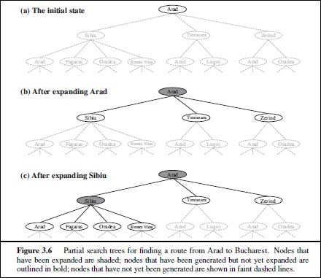
Searching for solutions (contd.)
From Russel and Norvig, “Artificial Intelligence : A Modern Approach”

Slide 20
Searching for solutions (contd.)
If we look at the search tree in Figure 3.6, it includes the path from Arad to Sibiu and back to Arad again
In(Arad) is a repeated state in the search tree, generated in this case by a loopy
path
Considering such loopy paths means that the complete search tree for Romania is infinite because there is no limit to how often one can traverse a loop
On the other hand, the state space has only 20 states
Loops can make certain algorithms to fail, making otherwise solvable problems
unsolvable
So there is no need to consider loopy paths
Since path costs are additive and step costs are nonnegative, a loopy path to any given state is never better than the same path with the loop removed
We can also have redundant paths which exist whenever there is more than one way to get from one state to another
We can have Arad-Sibiu (140km long) and Arad-Zerind-Oradea-Sibiu (297 km long).
The second path is redundant
To reach the goal, there is no reason to keep more than one path to any given state, because any goal state that is reachable by extending one path is also reachable by extending the other

Slide 21
Searching for solutions (contd.)
Redundant paths are unavoidable and include all problems where the
actions are reversible, such as route-finding and sliding block puzzles
Route finding on a rectangular grid (Fig. 3.9) is used a lot in computer games. Each state has four successors, so a search tree of depth d that has repeated states has 4^{𝑑} leaves but only 2𝑑² distinct states within d steps of any given state. For d=20, this means about a trillion nodes but only about 800 distinct states
Following redundant paths can cause a tractable problem to become intractable
This is true even for algorithms that know how to avoid infinite loops
The way to avoid exploring redundant paths is to remember where one has been
To do this, we augment the TREE-SEARCH algorithm with a data structure called the explored set , which remembers every expanded node
Newly generated nodes that match previously generated nodes – ones in the explored set or the frontier – can be discarded instead of being added to the frontier
The new algorithm, called GRAPH-SEARCH, is shown in Figure 3.7

Slide 22
Searching for solutions (contd.)
The search tree constructed by GRAPH-SEARCH algorithm contains at most one copy of each state, so we can think of it as growing a tree directly on the state-space graph, as shown in Figure 3.8
The frontier separates the state-space into the explored region and the unexplored region, so that every path from the initial state to an unexplored state has to pass through a state in the frontier
This property is illustrated in Figure 3.9
As every step moves a state from the frontier into the explored region while moving some states from the unexplored region into the frontier, we see that the algorithm is systematically examining the states in the state space, one by one, until it finds a solution

Slide 23
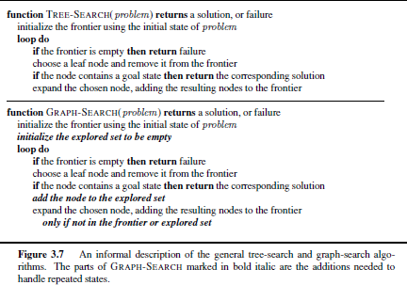
Searching for solutions (contd.)
From Russel and Norvig, “Artificial Intelligence : A Modern Approach”

Slide 24
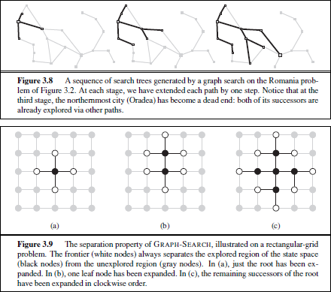
Searching for solutions (contd.)
From Russel and Norvig, “Artificial Intelligence : A Modern Approach”

Slide 25
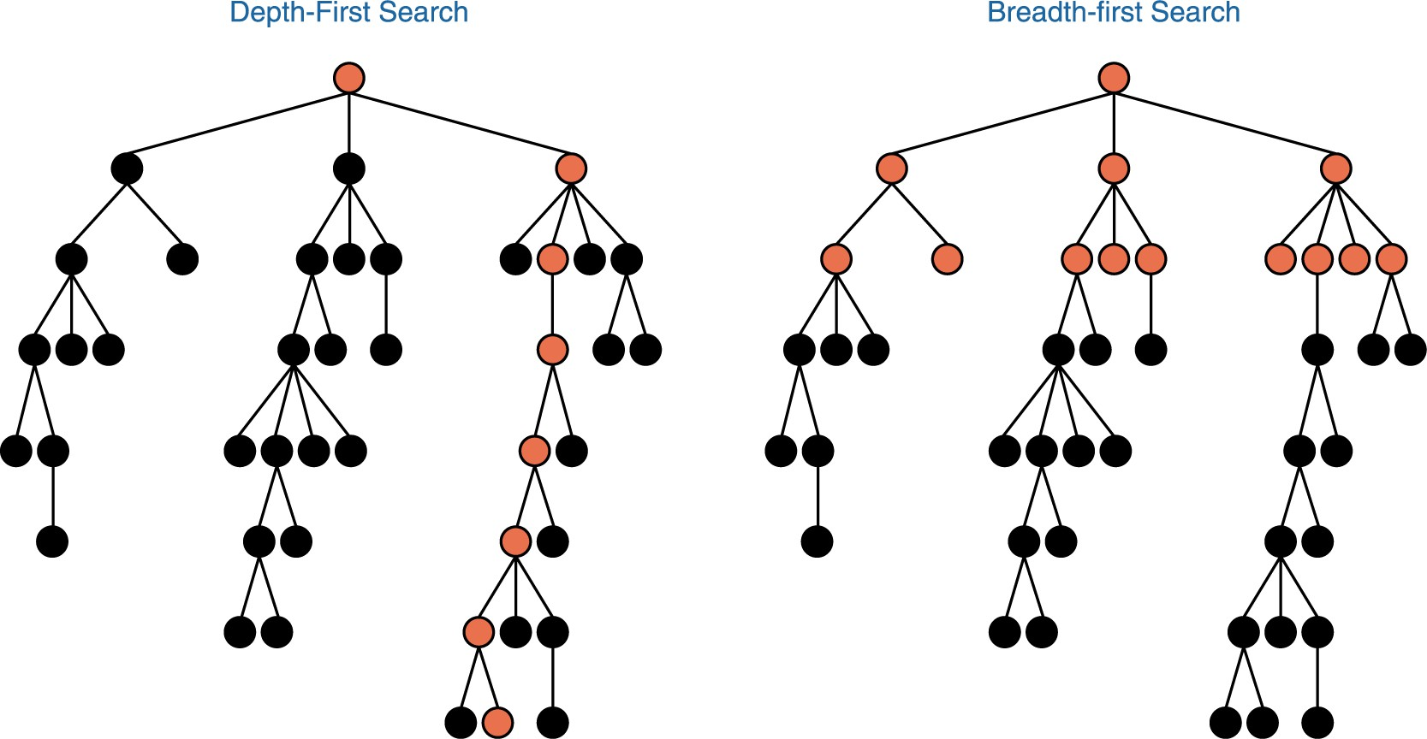
Search Trees

Slide 26
Search Strategies
Uninformed or blind search
Informed or heuristics search
Game playing search
Randomized search algorithms
  Hill climbing
  Stochastic search like genetic algorithms

Slide 27
Performance of problem solving
Four criteria to be used
  Completeness : Is the algorithm guaranteed to find a solution when
there is one?
  Optimality : Does the strategy find the optimal solution?
  Time complexity : How long does it take to find a solution?
  Space complexity : How much memory is needed to perform the search?
Time and space complexity are always considered with respect to
some measure of the problem difficulty
In theoretical CS, the typical measure is the size of the state space graph, |V| + |E|, where V is the set of vertices (nodes) of the graph and E is the set of edges (links)
In AI, the graph is often represented implicitly by the initial state,
actions and transition model and is frequently infinite

Slide 28
Performance (contd.)
Complexity is therefore expressed in terms of b, the branching factor or maximum number of successors of any node; d, the depth of the shallowest goal node (i.e. the number of steps along the path from the root); and m, the maximum length of any path in the state space
Time is measured in terms of the number of nodes generated during
search
Space is measured in terms of the maximum number of nodes stored in memory
To assess the effectiveness of a search algorithm, we can consider the search cost which depends on the time and space complexity
We can also assess effectiveness by using the total cost, which combines search cost and the path cost of the solution found
For the problem of finding a route from Arad to Bucharest, the search cost is the amount of time taken by the search and the solution cost is the total length of the path in kilometers

