Slide 1
Uninformed search strategies

Slide 2
Uninformed search - Introduction
Also called blind search
This means strategies that have no additional information about states beyond that provided in the problem definition
All they can do is generate successors and distinguish a goal from a non-goal state
All search strategies are distinguished by the
order in which nodes are expanded
Strategies that know whether one “non-goal” state is better than another are called informed search or heuristic search strategies

Slide 3
Breadth first search (BFS)
BFS is a simple strategy in which the root node is expanded first,
then all the successors of the root node are expanded, then their
successors, and so on
In general all the nodes are expanded at a given depth in the
search tree before any node at the next level are expanded
BFS is an instance of the general graph-search algorithm in which
the shallowest unexpanded node is chosen for expansion
This is achieved very simply by using a FIFO queue for the frontier
Thus, new nodes (which are always deeper than their parents) go to
the back of the queue, and old nodes which are shallower than the
new nodes, get expanded first
The goal-test is applied to each node when it is generated rather
than when it is selected
The algorithm following the general template for graph search,
discards any new path to a state already in the frontier or the
explored set; it is easy to see that any such path must be atleast as
deep as the one already found
Thus BFS always has the shallowest path to every node on the
frontier
Pseudocode is given in Fig. 3.11 . Fig 3.12 shows the progress of the search on a simple binary tree

Slide 4
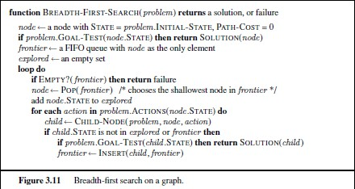
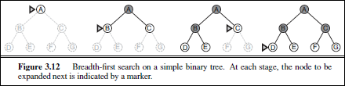
BFS (contd.)
Taken from Russel and Norvig, Artificial Intelligence : A Modern Approach

Slide 5
BFS (contd.)
•
•
•
How does BFS rate according the four criteria?
We can easily see that it is complete – if the shallowest goal is at some
finite depth d, BFS will eventually find it after generating all shallower
nodes (assuming the branching factor b is finite)
As soon as the goal node is generated, we know it is the shallowest goal
node because all shallower nodes must have been generated already
and failed the goal test
Now, the shallowest goal node is not necessarily the optimal one;
technically, BFS is optimal if the path cost is a nondecreasing function of
the depth of the node
The most common such scenario is that all actions have the same cost
Time and space complexity is high
Imagine searching a uniform tree where every state has b successors.
The root of the search tree generates b nodes at the first level, each of
which generates b more nodes, for a total of 𝑏² at the second level.
Each of these generates b more nodes, yielding 𝑏³ nodes at the third
level, and so on
Then the total number of nodes generated is
𝑏 + 𝑏² + 𝑏³ + ⋯ + 𝑏^{𝑑} = 𝑂(𝑏^{𝑑})
•
•
•
•
•
•
•
5

Slide 6
BFS (contd.)
If the algorithm were to apply the goal test to nodes when
selected for expansion, rather than when generated, the
whole layer of nodes at depth d would be expanded before the goal was detected and the time complexity would be 𝑂 𝑏^{𝑑+1}
For any kind of graph search, which stores every
expanded node in the explored set, the space complexity
is always within a factor of b of the time complexity
For breadth-first graph search in particular, every node
generated remains in memory
There will be 𝑂(𝑏^{𝑑−1}) nodes in the explored set and
𝑂(𝑏^{𝑑}) nodes in the frontier so the space complexity is
𝑂(𝑏^{𝑑}), i.e. it is dominated by the size of the frontier
Switching to a tree search would not save much space,
and in a state space with many redundant paths, switching could cost a great deal of time

Slide 7
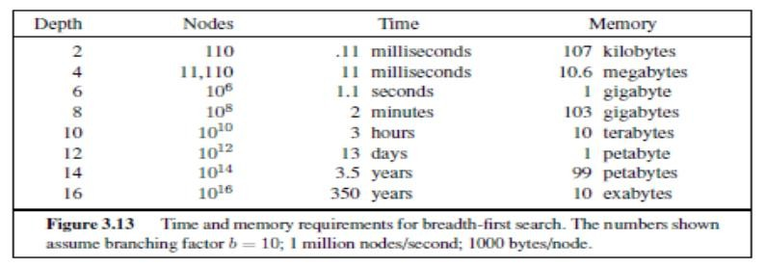
BFS (contd.)
An exponential complexity bound such as 𝑂(𝑏^{𝑑}) is scary
Fig. 3.13 lists, for various values of the solution depth d, the time and
memory required for a BFS with branching factor b=10
The table assumes that 1 million nodes can be generated per second and that a node requires 1000 bytes of storage
Many search problems fit roughly within these assumptions when run
on a modern personal computer
Taken from Russel and Norvig, Artificial Intelligence : A Modern Approach

Slide 8
BFS (contd.)
Two lessons can be learned from Fig. 3.13 .
First, the memory requirements are a bigger problem
for BFS than is the execution time
You might wait 13 days for a solution to an important
problem with search depth12, but no personal computer
has the petabyte of memory it would take
Fortunately, other strategies require less memory
The second lesson is that time is still a major factor
If your problem has a solution at depth 16, then it will
take about 350 years for breadth-first search to find it
In general, exponential-complexity search problems
cannot be solved by uninformed methods for any but the smallest instances.

Slide 9
BFS
Completeness?
Yes
Time complexity?
O(b^{d})
Space complexity?
O(b^{d}) ☹
Optimality?
yes

Slide 10
Uniform cost search (UCS)
When all step costs are equal, BFS is optimal because it always
expands the shallowest unexpanded node
Similarly, we can find an algorithm that is optimal with any step-
cost function
Instead of expanding the shallowest node, uniform-cost search
expands the node n with the lowest path cost g(n)
This is done by storing the frontier as a priority queue ordered by
g
This algorithm is shown in Fig. 3.14
In addition to the ordering of the queue by path cost, there are
two significant differences from BFS
The first is that the goal test is applied to a node when it is
selected for expansion (as in the generic graph-search
algorithm) rather than when it is first generated
The reason is that the first goal node that is generated may be
on a suboptimal path
The second difference is that a rest is added in case a better
path is found to a node currently on the frontier
10

Slide 11
UCS (contd.)
Both of these modifications come into play in the example shown in Fig.
3.15, where the problem is to get from Sibiu to Bucharest
The successors of Sibiu are Rimnicu Vilcea and Fagaras, with costs 80
and 99, respectively
The least-cost node, Rimnicu Vilcea, is expanded next, adding Pitesti with
cost 80+97=177.
The least-cost node is now Fagaras, so it is expanded, adding Bucharest
with cost 99+211=310
Now a goal node has been generated, but UCS keeps going, choosing
Pitesti for expansion and adding a second path to Bucharest with cost
80+97+101=278
Now the algorithm checks to see if this new path is better than the old one;
it is, so the old one is discarded
Bucharest, now with g-cost 278, is selected for expansion and the solution
is returned
It is easy to see that UCS is optimal in general
Whenever UCS selects a node n for expansion, the optimal path to that
node has been found
Were this not so, there would have to be another frontier node n’ on the
optimal path from the start node to n and n’ would have lower g-cost than
n and would have been selected first
Because step costs are nonnegative, paths never get shorter as nodes
are added
This implies that UCS expands nodes in order of their optimal path cost
Hence, the first goal node selected for expansion must be the optimal
solution
•
•
•
•
•
•
•
•

Slide 12
UCS (contd.)
UCS does not care about the number of steps a path has, but only about
their total cost
Therefore, it will get stuck in an infinite loop if there is a path with an
infinite sequence of zero-cost actions, e.g. a sequence of NoOp actions
Completeness is guaranteed provided the cost of every step exceeds
some small positive constant 𝜖
UCS is guided by path costs rather than depths, so its complexity is not
easily characterized in terms of b and d.
Instead, let C* be the cost of the optimal solution, and assume that every
action costs at least 𝜖
Then the algorithm’s worst-cast time and space complexity is
_{𝐶}∗
𝜖
) is just 𝑏^{𝑑+1}
𝑂(𝑏^{𝑙} +
When all step costs are the same, UCS is similar to BFS, except that the
latter stops as soon as it generates a goal, whereas UCS examines all
the nodes at the goal’s depth to see if one has a lower cost; thus UCS
does strictly more work by expanding nodes at depth d unnecessarily

Slide 13
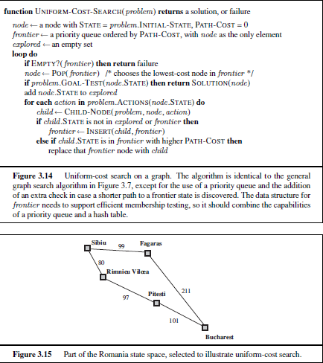
UCS (contd.)
Taken from Russel and Norvig, Artificial Intelligence : A Modern Approach

Slide 14
Depth-first search (DFS)
DFS always expands the deepest node in the current frontier of
the search tree
The progress of the search is shown in Fig. 3.16
The search proceeds immediately to the deepest level of the
search tree, where the nodes have no successors
As those nodes are expanded, they are dropped from the
frontier, so then the search “backs up” to the next deepest node
that still has unexplored successors
DFS algorithm is an instance of the graph-search algorithm
Whereas BFS uses a FIFO queue, DFS uses a LIFO queue
A LIFO queue means that the most recently generated node is
chosen for expansion
This must be the deepest unexpanded node because it is one
deeper than its parent – which, in turn, was the deepest
unexpanded node when it was selected
As an alternative to graph-search, it is common to implement
DFS with a recursive function that calls itself on each of its
children in turn
A recursive depth-first algorithm incorporating a depth limit is shown in Fig 3.17

Slide 15
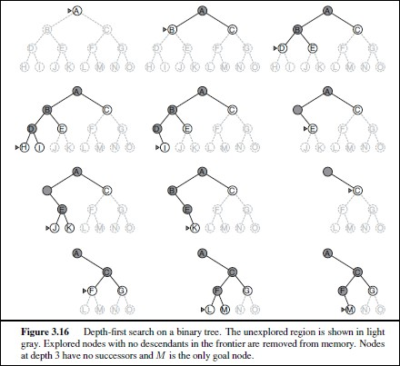
DFS (contd.)
Taken from Russel and Norvig, Artificial Intelligence : A Modern Approach
15

Slide 16
DFS (contd.)
The properties of DFS depend strongly on whether
the graph-search or tree-search version is used
The graph-search version, which avoids repeated
states and redundant paths, is complete in finite
state space because it will eventually expand every
node
The tree-search version, on the other hand, is not
complete – e.g. in Fig. 3.6 the algorithm will follow
the Arad-Sibiu-Arad-Sibiu loop forever
Depth-first tree search can be modified at no extra
memory cost so that it checks new states against
those on the path from the root to the current node;
this avoids infinite loops in finite state space but
does not avoid the proliferation of redundant paths
In infinite state spaces, both versions fail if an infinite non-goal path is encountered

Slide 17
DFS (contd.)
For similar reasons, both versions are nonoptimal
E.g. in Fig. 3.16, DFS will explore the entire left subtree even if node C is a
goal node
If node J were also a goal node, then DFS would return it as a solution
instead of C, which would be a better solution; hence DFS is not optimal
The time complexity of depth-first graph search is bounded by the size of
the state space (which may be infinite, of course)
A depth-first tree search, on the other hand, may generate all of the 𝑂(𝑏^{𝑚})
nodes in the search tree, where m is the maximum depth of any node; this
can be much greater than the size of the state space
Note that m itself can be much larger than d (the depth of the shallowest
solution) and is infinite if the tree is unbounded
A depth-first tree search needs to store only a single path from the root to a
leaf node, along with the remaining unexpanded sibling nodes for each node
on the path
Once a node has been expanded, it can be removed from memory as soon
as all its descendants have been fully explored
For a state space with branching factor b and maximum depth d, DFS requires storage of only O(bm) nodes

Slide 18
DFS (contd.)
Using the same assumptions as earlier, we find that DFS would require 156
kilobytes instead of 10 exabytes at depth d=16, a factor of 7 trillion times
less space
Due to this, DFS is used in many areas of AI, include constraint satisfaction,
propositional satisfiability and logic programming
A variant of DFS called backtracking search uses still less memory
In backtracking, only one successor is generated at a time rather than all the
successors; each partially expanded node remembers which successor to
generate next
In this way, only O(m) memory is needed rather than O(bm)
Backtracking search facilitates yet another memory-saving (and time-saving)
trick : the idea of generating a successor by modifying the current state
description directly rather than copying it first
This reduces the memory requirements to just one state description and
O(m) actions
For this to work, we must be able to undo each modification when we go
back to generate the next successor
For problems with large state space descriptions, such as robotic assembly, these techniques are critical to success
NOTE : 1 Exabyte = 1000 petabytes = 1 billion gigabytes

Slide 19
DFS
Completeness?
Yes, assuming state space finite
Time complexity?
O(|S |), can do well if lots of goals
Space complexity?
O(n), n deepest point of search
Optimality?
No

Slide 20
Depth-limited search
The failure of DFS in infinite spaces can be
alleviated by supplying DFS with a predetermined
limit ℓ
This means that nodes at depth ℓ are treated as if
they have no successor
This approach is called depth-limited search
The depth limit solves the infinite-path problem
Unfortunately, it also introduces an additional source
of incompleteness of if choose ℓ˂d , that is, the
shallowest goal is beyond the depth limit
Depth-limited search will also be nonoptimal if we choose ℓ˃d
Its time complexity is 𝑂 𝑏^{𝓁} and its space complexity
DFS can be viewed as a special case of depth- limited search with ℓ=∞
is 𝑂(𝑏𝓁)
20

Slide 21
Depth-limited search (contd.)
Sometimes, depth limits can be based on knowledge of
the problem
E.g. in the map of Romania since there are 20 cities, if
there is a solution, it must be of length less than 10 so
ℓ=19 is a good choice
But it is possible to reach any city from any other city in
atmost 9 steps
This is the diameter of the state space and gives a better
depth limit
Depth-limited search can be implemented as a simple
modification to the general tree- or graph-search
algorithm
It can also be implemented as a simple recursive
algorithm as shown in Fig. 3.17
Depth-limited search can terminate with two kinds of
failure : the standard failure value indicates so solution; the cutoff indicates no solution within the depth limit

Slide 22
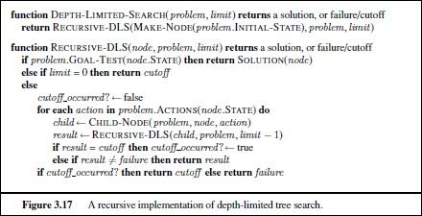
Depth-limited search (contd.)
Taken from Russel and Norvig, Artificial Intelligence : A Modern Approach

Slide 23
Depth-limited Search
DFS, only expand nodes depth ≤ l.
Completeness?
No, if l ≤ d. ☹
Time complexity?
O(b^{l})
Space complexity?
O(l)
Optimality?
No
23

Slide 24
Iterative deepening DFS
Iterative deepening search (or iterative deepening DFS) is a general
strategy, used in combination with depth-first tree search, that finds the best
depth limit
It does this by gradually increasing the limit – first 0, then 1, then 2 and so on
– until a goal is found
This will occur when the depth limit reaches d, the depth of the shallowest
goal node
The algorithm is in the figure
Iterative deepening combines the benefits of DFS and BFS
Like DFS, its memory requirements are modest : O(bd)
Like BFS, it is complete when the branching factor is finite and optimal when
the path is a nondecreasing function of the depth of the node
Figure 3.19 shows four iterations of ITERATIVE-DEEPENING-SEARCH on a
binary tree, where the solution is found on the fourth iteration
Iterative deepening search may seem wasteful because states are
generated multiple times
It turns out this is not too costly
The reason is that in a search tree with the same (or nearly the same)
branching factor at each level, most of the nodes are in the bottom level, so it does not matter much that the upper levels are generated multiple times

Slide 25
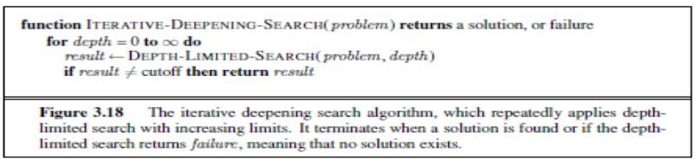
Iterative deepening DFS (contd.)
In an iterative deepening search, the nodes on the bottom level (depth d) are generated once, those on the next-to-bottom level are generated twice, and so on, up to the children of the root, which are generated d times
So the total number of nodes generated in the worst case is
𝑁 𝐼𝐷𝑆 = 𝑑 𝑏 + 𝑑 − 1 𝑏² + ⋯ + (1)𝑏^{𝑑}
which gives a time complexity of 𝑂(𝑏^{𝑑}) – asymptotically same is BFS
There is some extra cost for generating the upper levels multiple times, but it is
not large
Figure taken from Russel and Norvig, Artificial Intelligence : A Modern Approach
25

Slide 26
Iterative deepening DFS (contd.)
E.g., if b=10 and d=5, we get
N(IDS)=50+400+3000+20000+100000=123450 N(BFS)=10+100+1000+10000+100000=111110
In general, iterative deepening is the preferred uninformed search method when the search space is large and the depth of the solution is not known

Slide 27
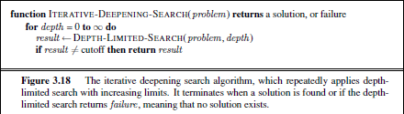
Iterative deepening
Taken from Russel and Norvig, Artificial Intelligence : A Modern Approach

Slide 28
Iterative Deepening
Depth limited, increasing l.
Completeness?
Yes. ☺
Time complexity?
O(b^{d}), even with repeated work! ☺
Space complexity?
O(d) ☺
Optimality?
Yes

