Slide 1
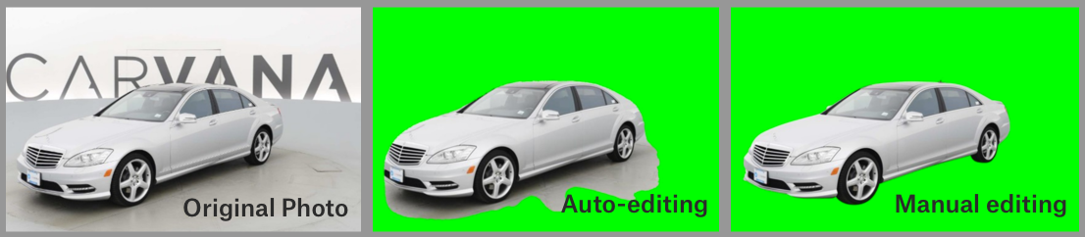
Carvana Mask using CNN
https://www.kaggle.com/c/carvana-image-masking-challenge/overview

Slide 2
Train a mask model which can isolate images of cars from their background
Achieve a high DICE score for the trained mask CNN model
Problem Statement

Slide 3
Car model identifier
Rotation Index – for segmentation
318 Models on the train set
6254 models on the test
EDA on Car, Mask datasets

Slide 4
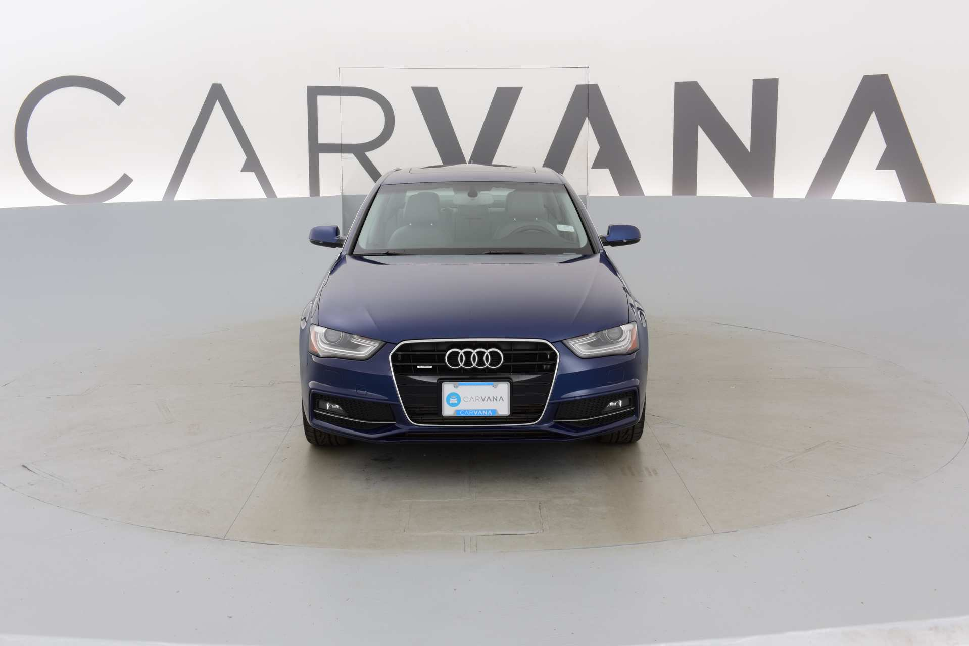
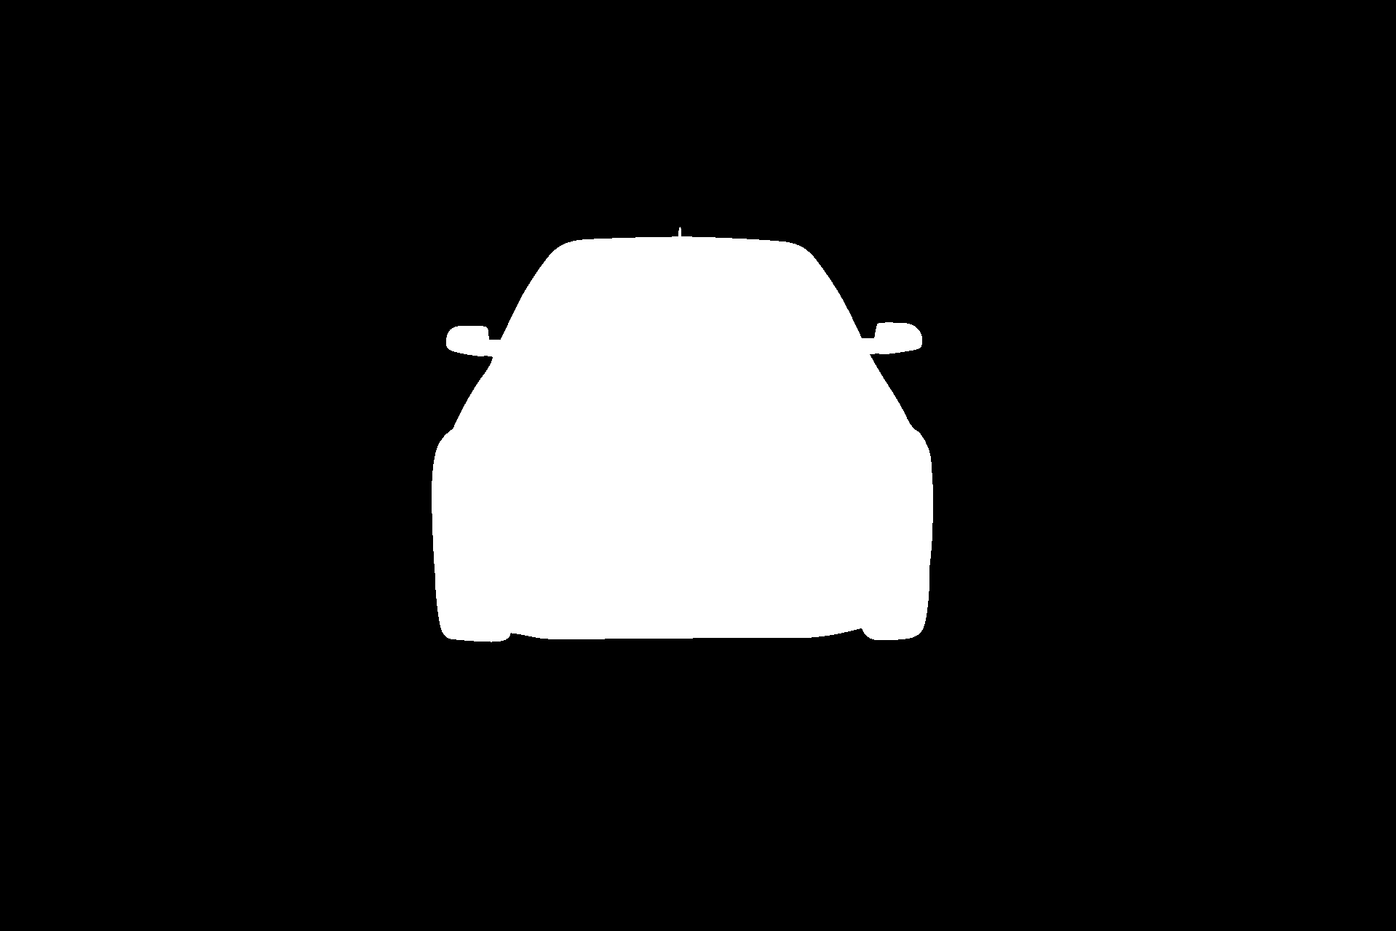
EDA 0cdf5b5d0ce1, Index 1

Slide 5
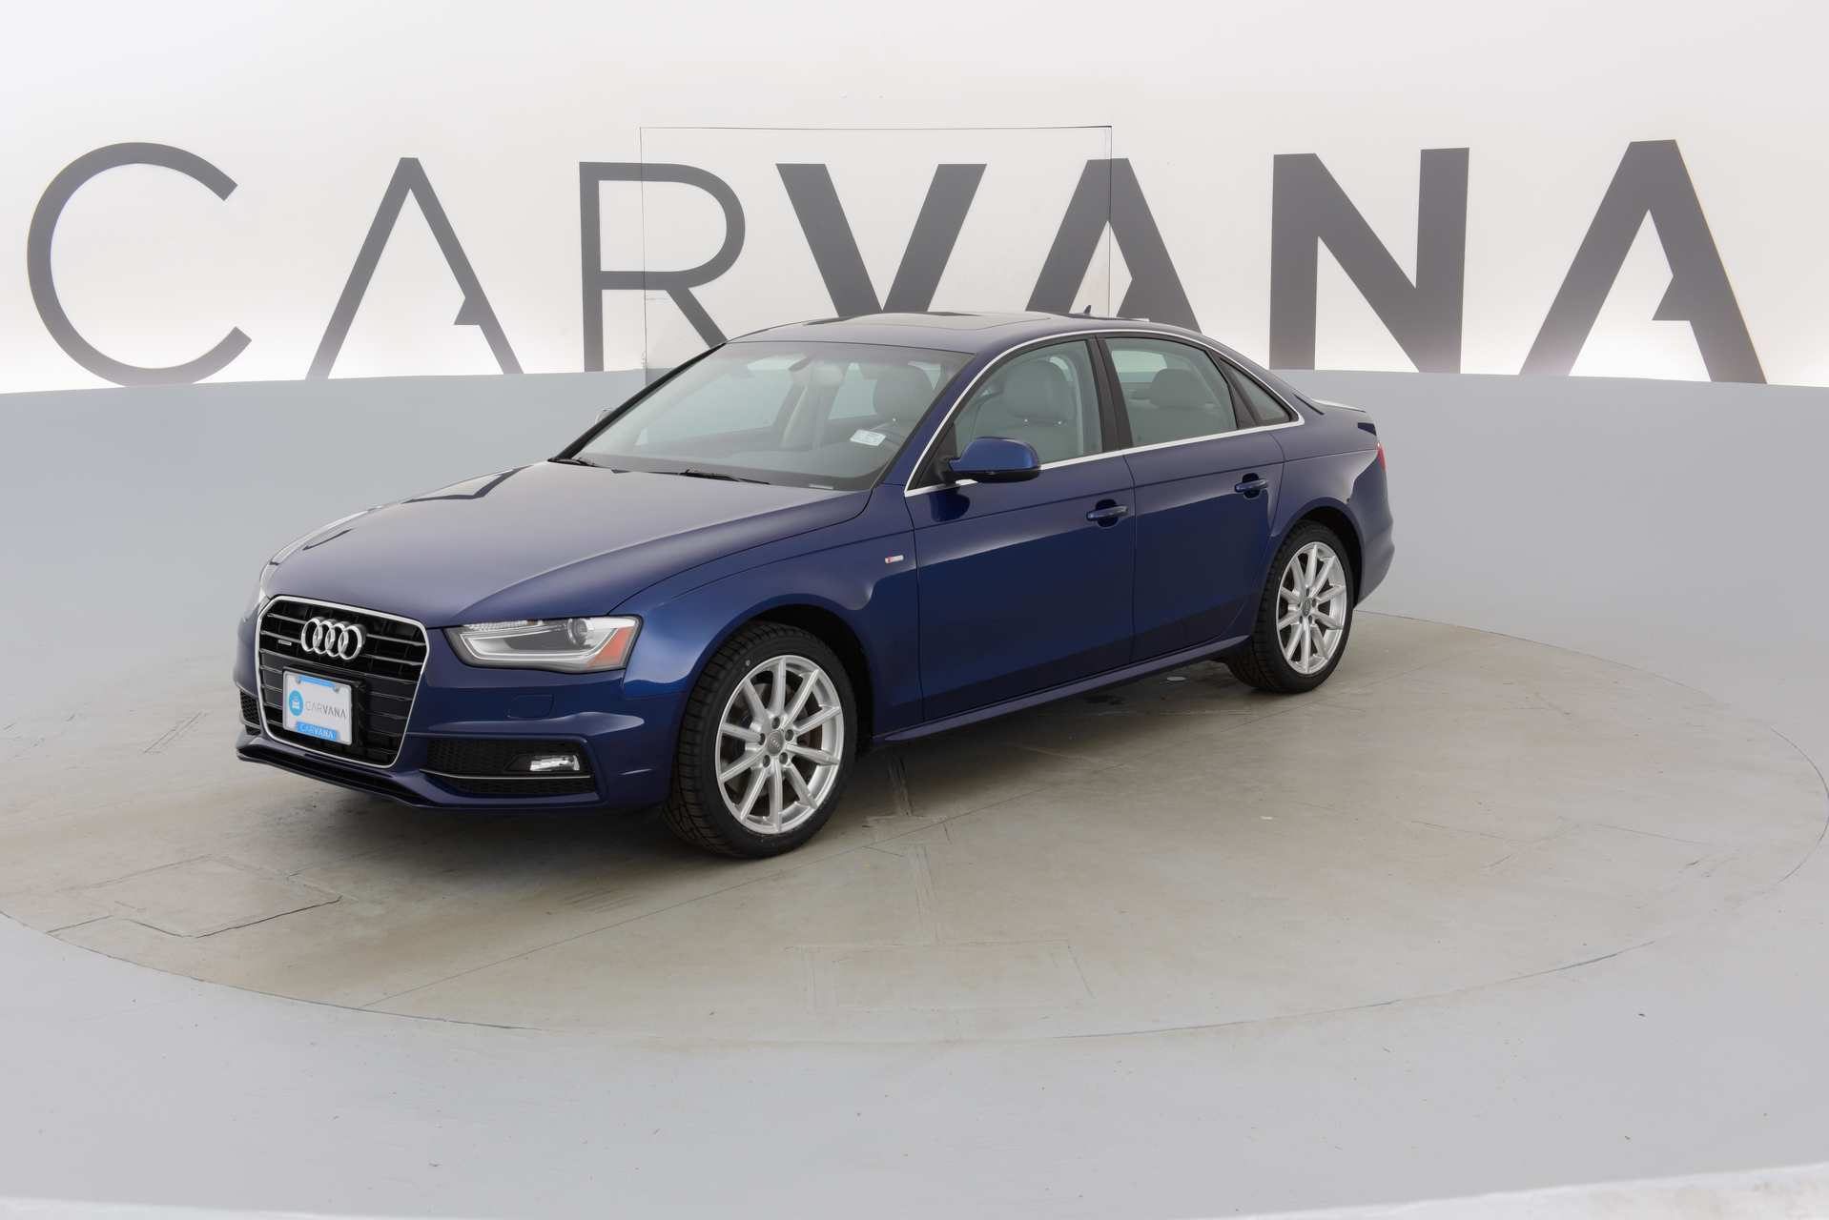
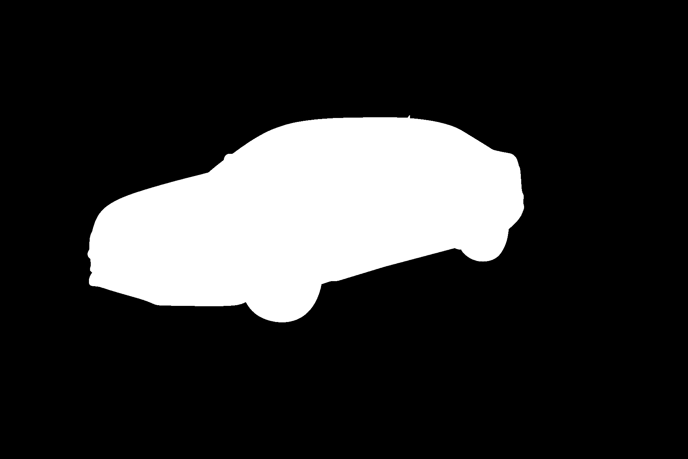
EDA 0cdf5b5d0ce1, Index 3

Slide 6
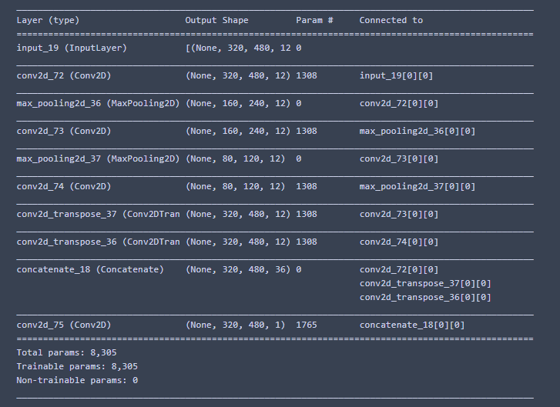
https://cv-tricks.com/cnn/understand-resnet-alexnet-vgg-inception/
Three 3X3 kernel-sized filters one after another.
With pooling layers in between
Simple CNN with Deconv

Slide 7
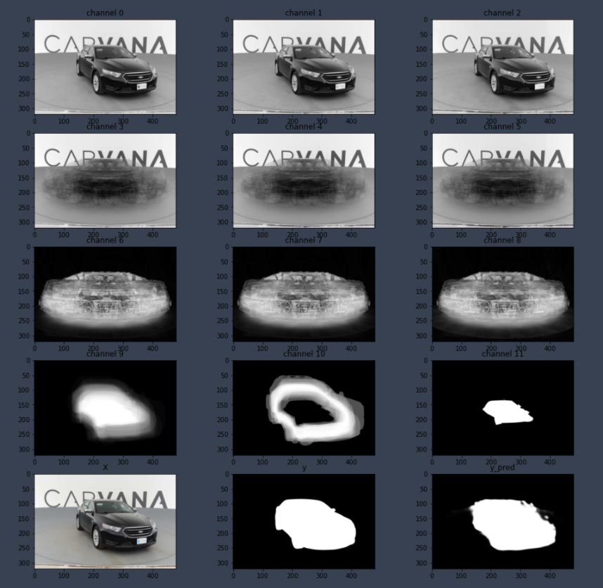
https://www.pyimagesearch.com/2017/03/20/imagenet-vggnet-resnet-inception-xception-keras/
12 Channels:
3 RGB Channels, each with:
the image,
image mean across different rotations
Image standard deviation across rotations
For a total of 9 channels
3 more channels for
Mask mean
Mask standard deviation
Mask Minimum values
For each rotation index
CNN –output layers

Slide 8
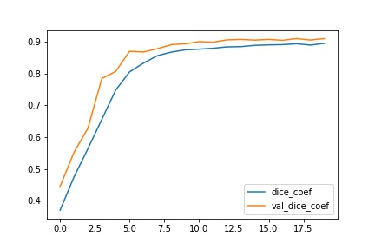
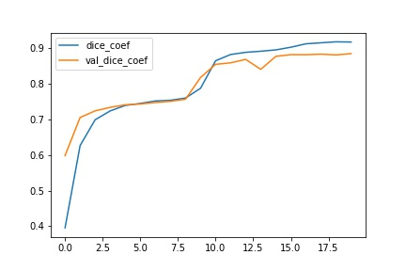
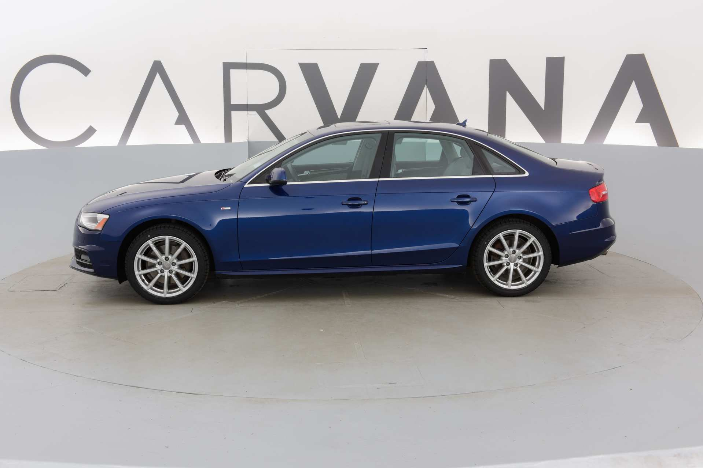
Model Training History -20 Epochs

Slide 9
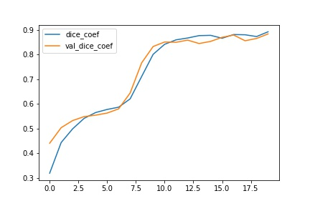
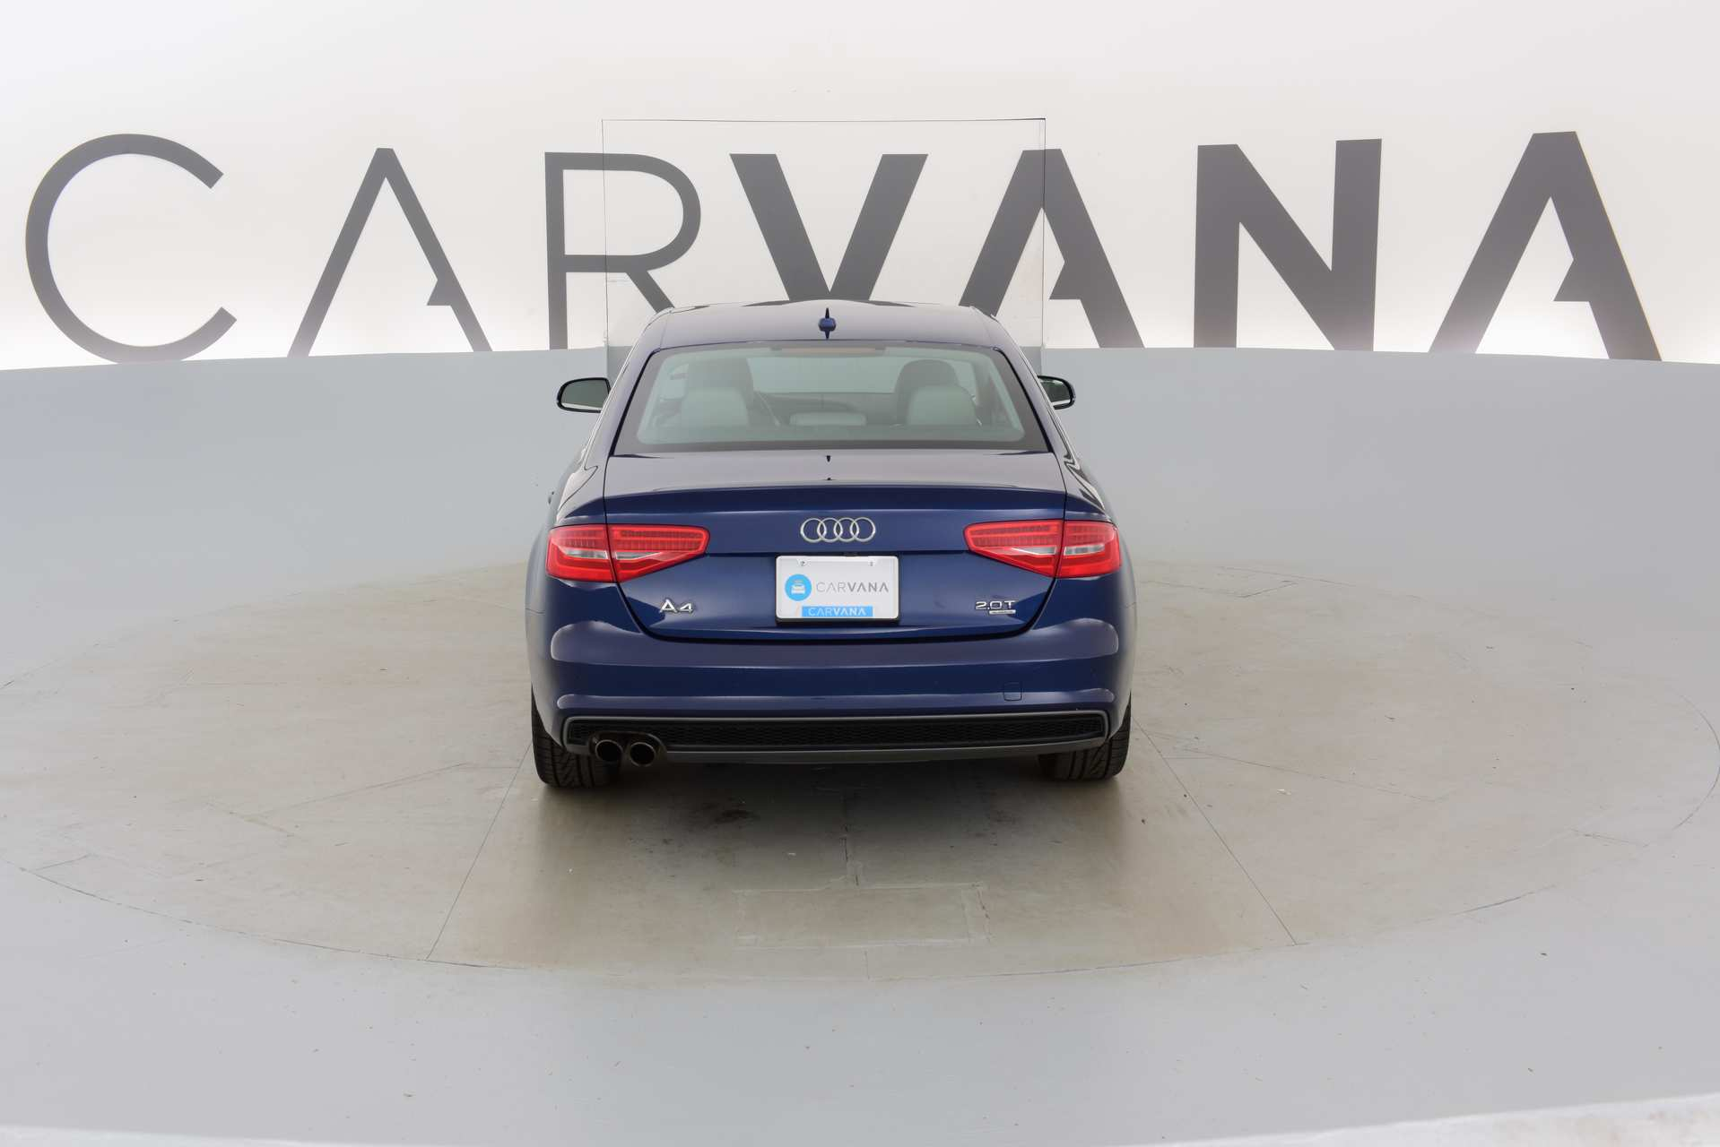
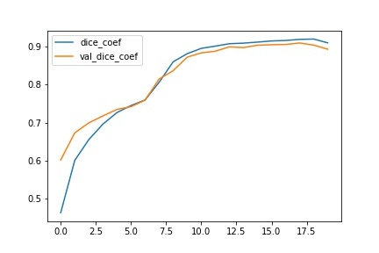
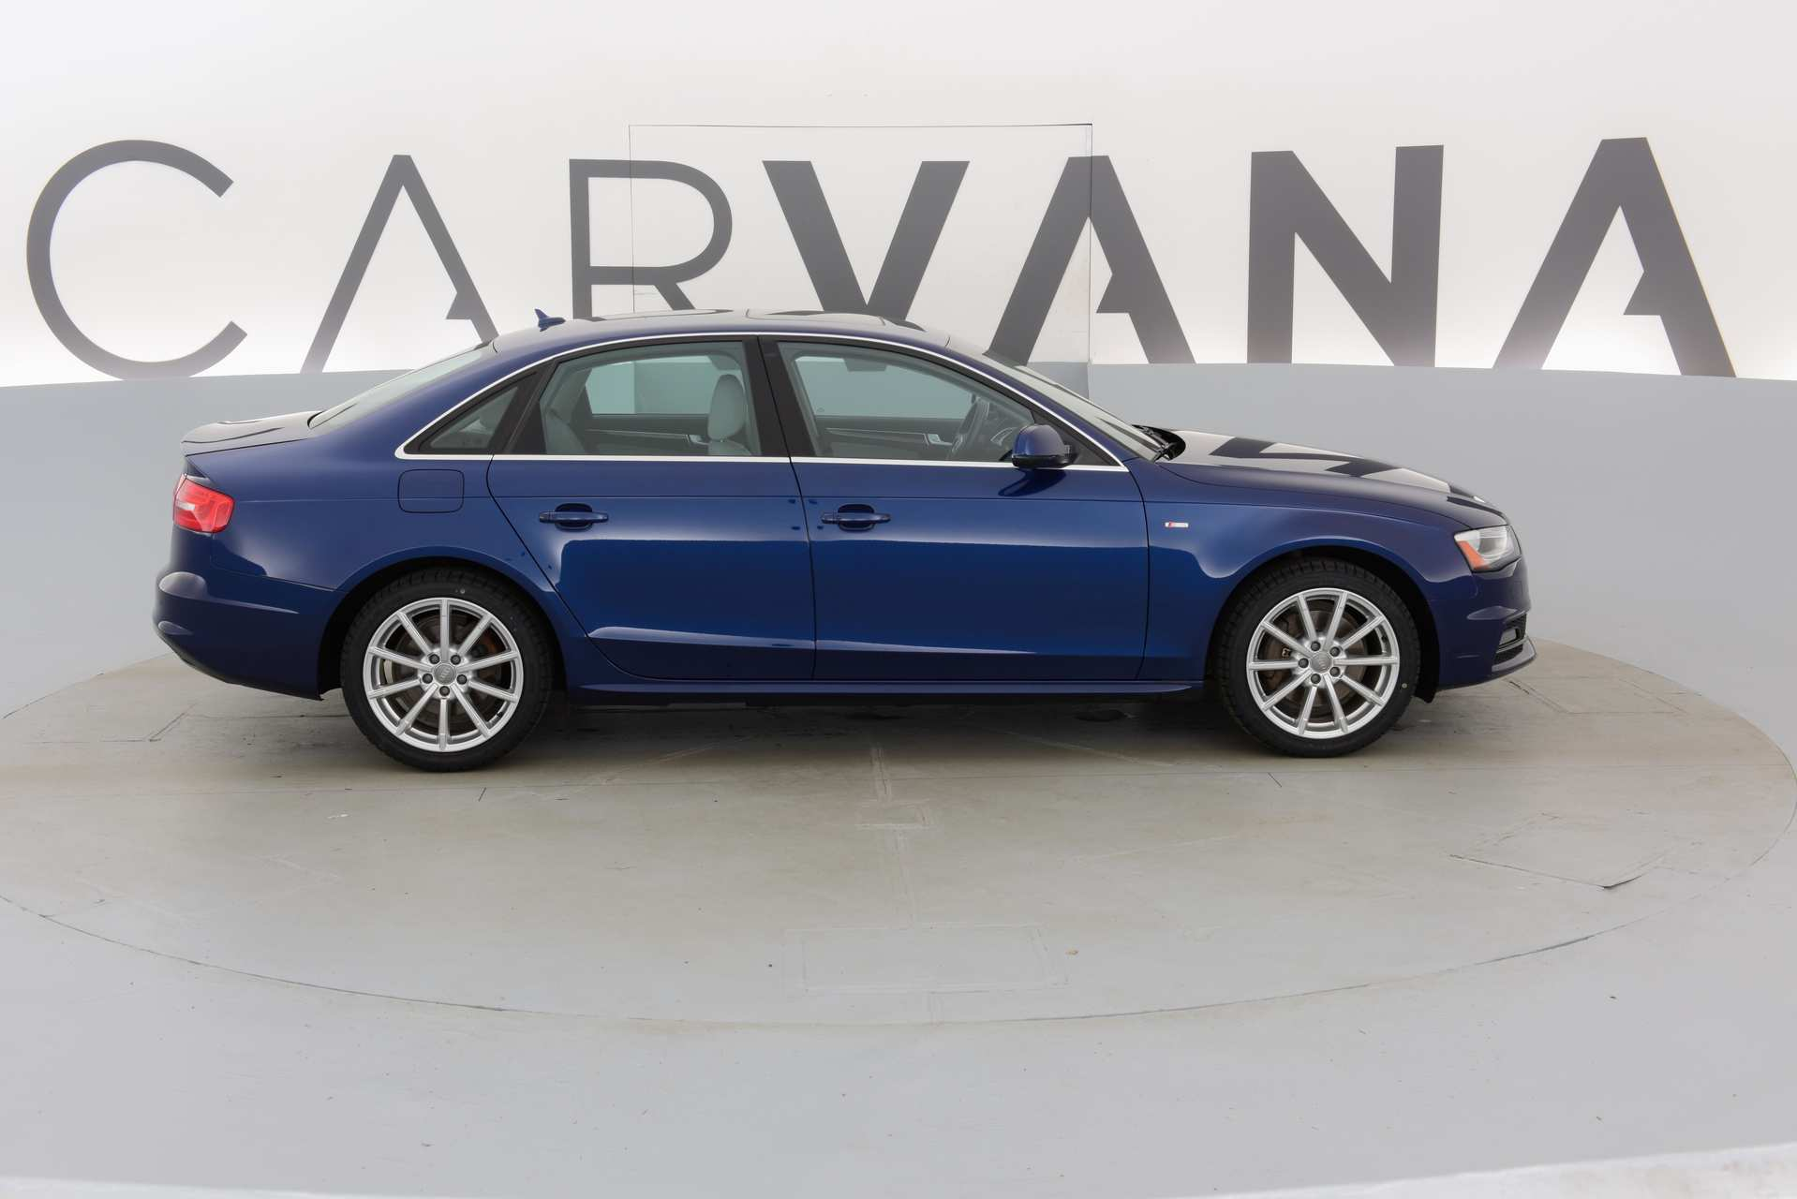
Model Training History -20 Epochs

Slide 10
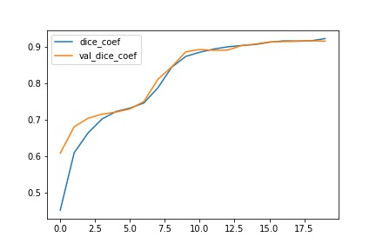
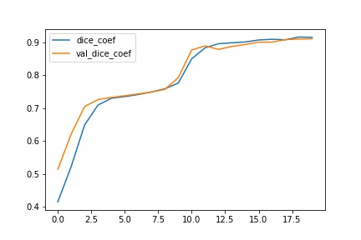
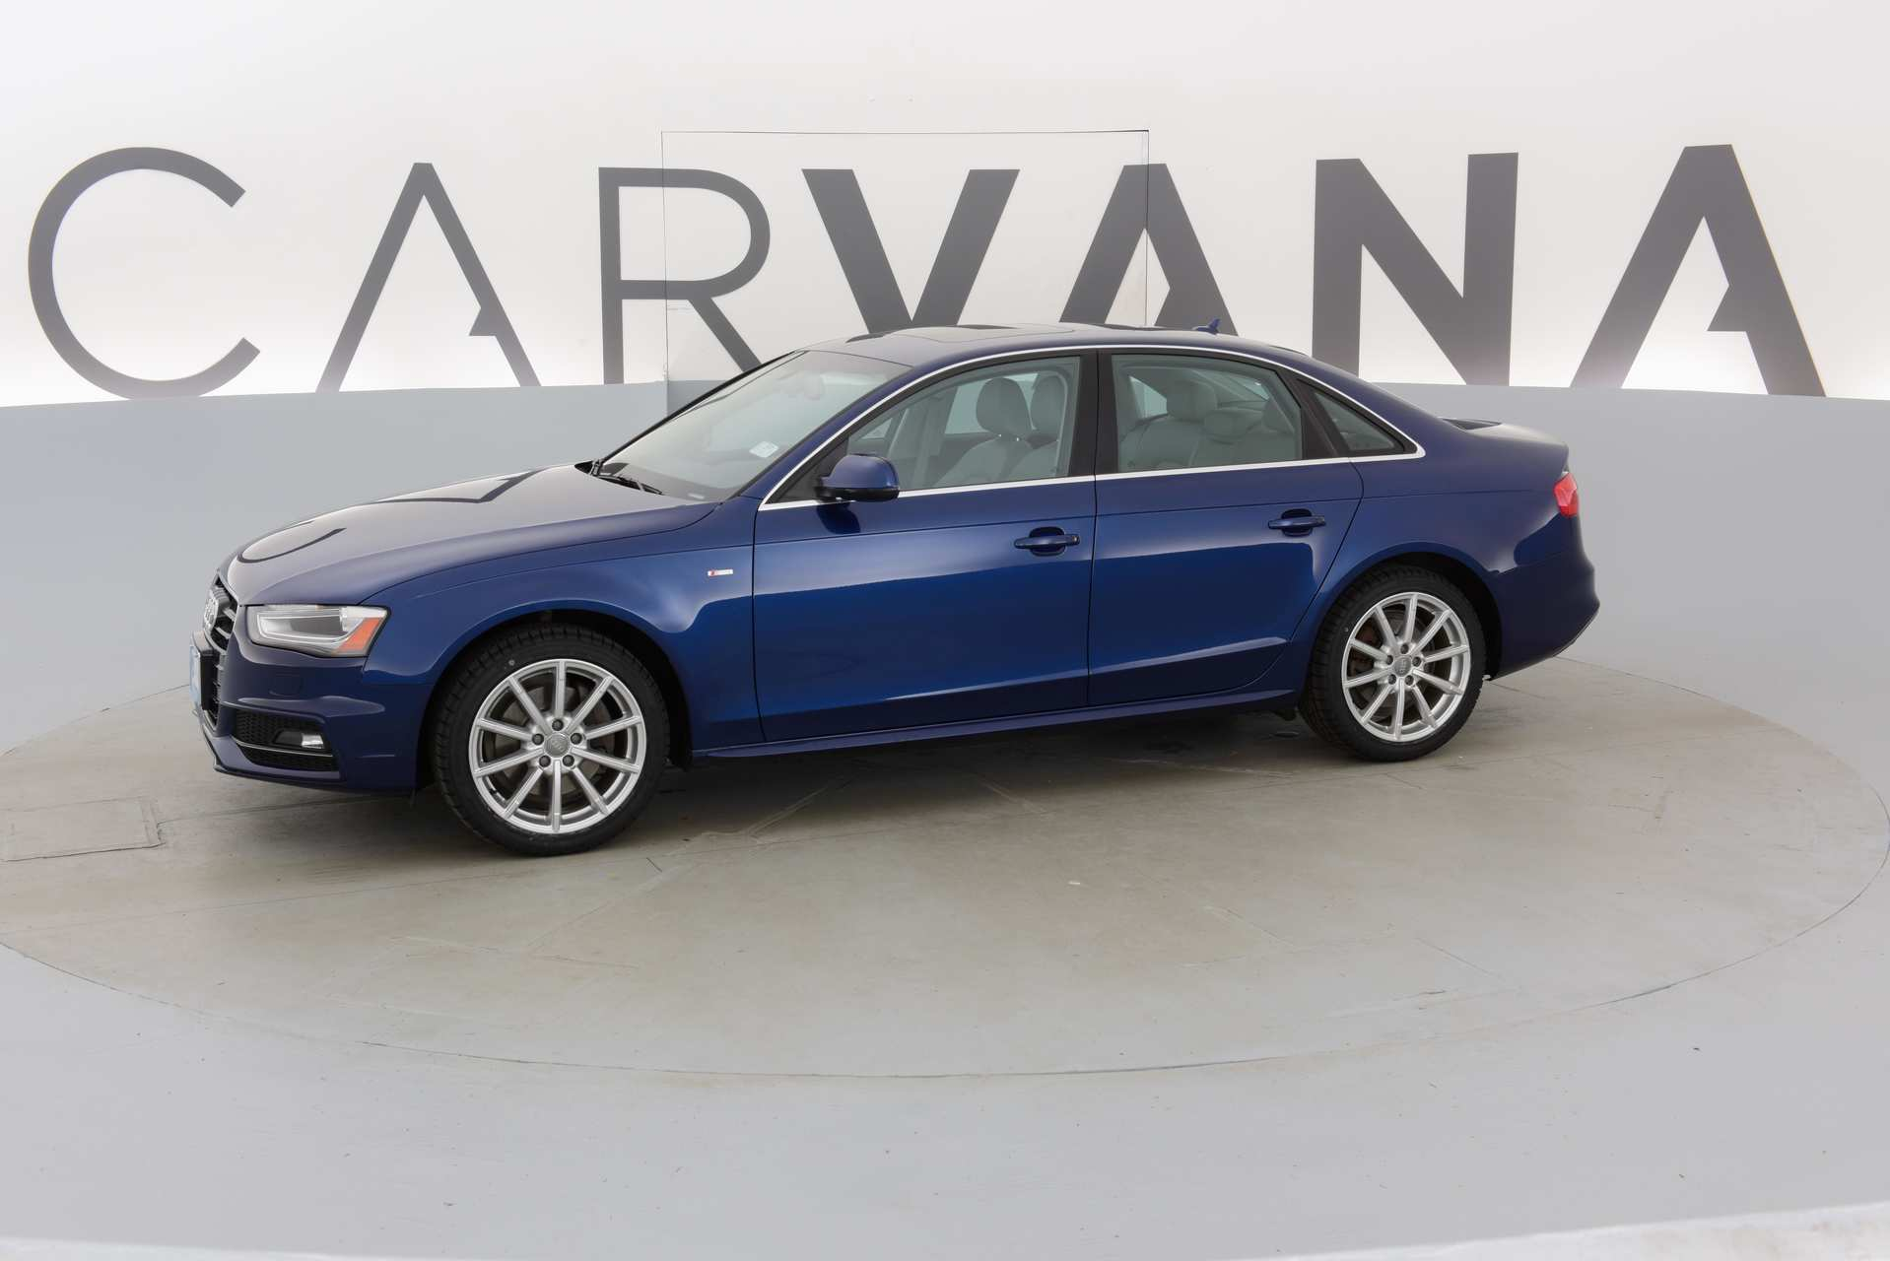
Model Training History -20 Epochs

Slide 11
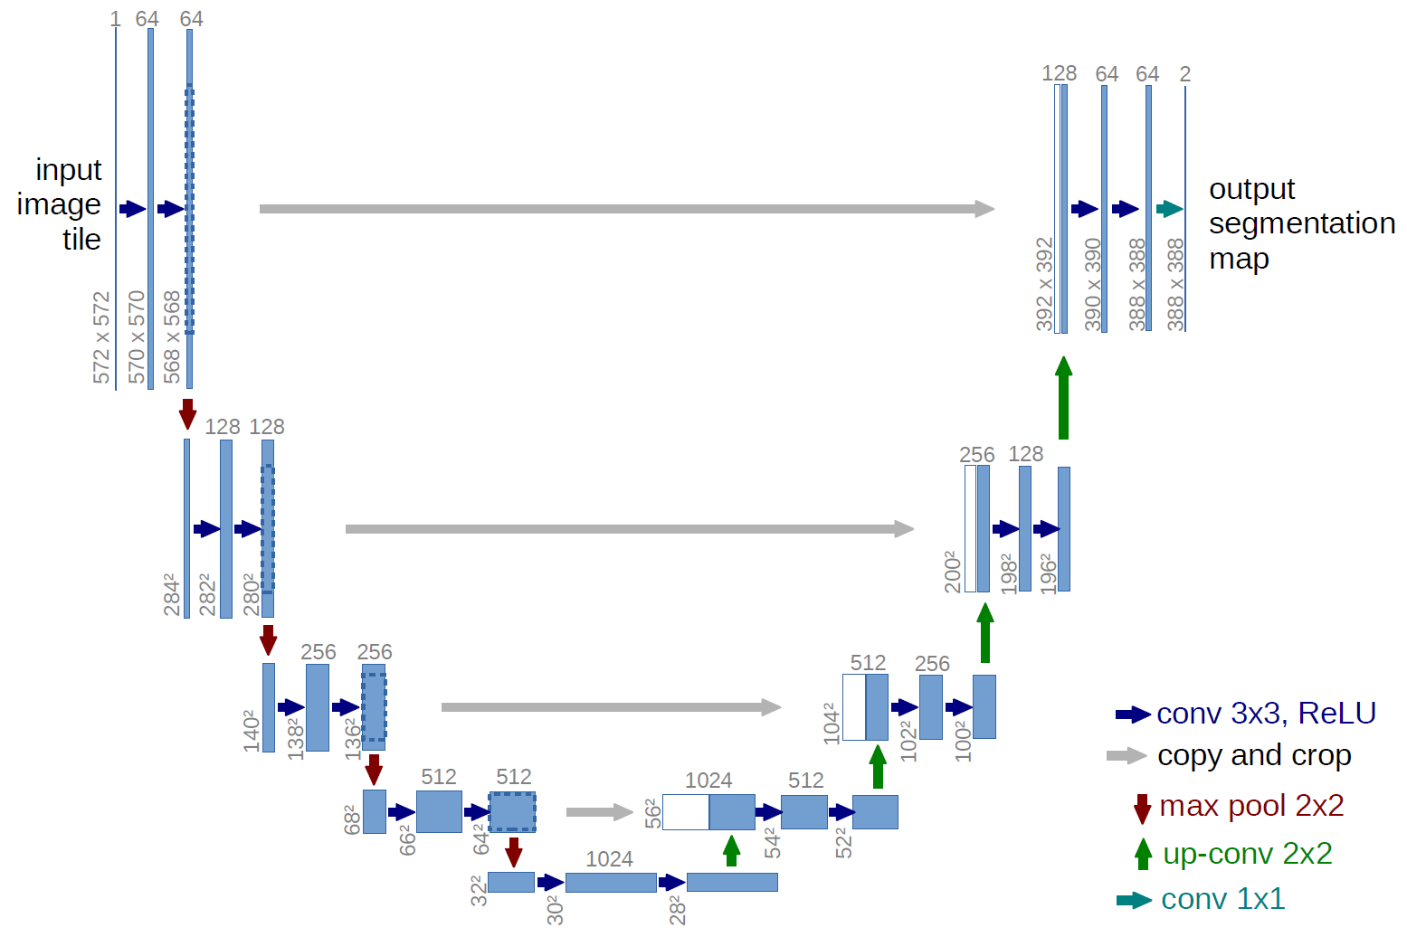
https://lmb.informatik.uni-freiburg.de/people/ronneber/u-net/
U Net

Slide 12
Question Time

